Slide 1
The History of Unions in the US Class 3: Public Sector Unions
Jim Dunphy
dunphyjj@aol.com

Slide 2
Overture
The Union Maid
By Woody Guthrie
Lyrics brought into the 21st Century
https://www.youtube.com/watch?v=Rs5_gB582IM

Slide 3
Organization of class
Federal Labor Unions
State and Local Labor Unions

Slide 4
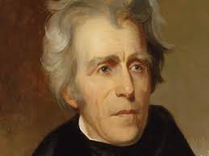
Early Federal Employment
For most of the early years of the Republic, federal employment was under the spoils system
Based on a supposed quote from Andrew Jackson “To the victor goes the spoils”
After each election, the federal workforce was turned over

Slide 5
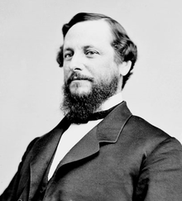
Early Federal Employment
The 1883 Pendleton Act established that federal positions should be filled by merit
Initially, few positions fell under this act, as politicians did not want to give up patronage
It took an early Civil Service Commissioner, Teddy Roosevelt, to expand the reach of the Act

Slide 6
Unionization
Under the spoils system, unionization was inappropriate, as there was no job security.
The first stirrings of unions in the Federal Sector came after the Pendleton Act and were in the Post Office

Slide 7
Unionization – Postal workers
First to organize were the Letter Carriers
There had been a number of unsuccessful attempts beginning in 1870 to organize these workers
In 1889 the Milwaukee Letter Carriers issued a call for a national convention
This time it was successful, with 52 locals by 1890 and 335 by 1892

Slide 8
Non Postal Federal Unions
Prior to the 1930’s there was little union activity in the federal sector outside of the postal service.

Slide 9
Non Postal Federal Unions
In a 1902 Executive Order, Teddy Roosevelt precluded federal workers, individually or collectively, from soliciting:
an increase of pay, or to influence or to attempt to influence in their own interest any legislation whatever, either before Congress or its Committees, or in any way save through the heads of the Departments in or under which they serve
The penalty was dismissal

Slide 10
Non Postal Federal Unions
President Taft revised the Executive Order, to allow workers to contact Congress, but only through their Department heads.
The Congress, more progressive than the President, passed the Lloyd-Lafollette Act in 1912, allowing workers, individually or collectively, to contact Congress

Slide 11
Non Postal Federal Unions
This provided an impetus for the creation of federal labor unions.
The first was the National Federation of Federal Employees (NFFE).
Under the Lloyd-Lafollette Act, NFFE concentrated on legislative action instead of collective bargaining.

Slide 12
Non Postal Federal Unions
NFFE was originally a part of the AFL, but broke with them in 1931 after the AFL continued to support trade unionism
Part of NFFE membership wished to remain in the AFL, and formed the American Federation of Government Employees (AFGE) in 1932
More about both of these unions and many others in the federal service later.

Slide 13
The New Deal
FDR was generally seen as friendly to unions, but not in the federal sector.
In 1937, FDR stated that “All Government employees should realize that the process of collective bargaining, as usually understood, cannot be transplanted into the public service.”

Slide 14
The New Deal
The 1935 Wagner Act, which provided the legal basis for unionization of the private sector, specifically excluded the public sector.
In 1939, the Hatch Act banned federal employees from most political action.

Slide 15
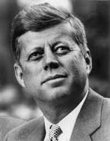
JFK Executive Order
JFK issued Executive Order 10988 in January 1962

Slide 16
JFK Executive Order
This order
Allowed employees to join unions and perform such activities as collective bargaining without having to take leave
Agencies to seek the input of unions with “affirmative willingness”
Workers still not permitted to strike, and only allowed to bargain to impasse, where a 3rd party would decide.

Slide 17
JFK Executive Order
As a result of this order, union membership skyrocketed
As an example, AFGE had 71,000 members in 1961 and 301,000 members in 1970.
The order was revised (and somewhat strengthened) by President Nixon in EO 11491

Slide 18
1978 Civil Service Reform Act
The Act divided the Civil Service Commission into
Office of Personnel Management (OPM)
Federal Labor Relations Authority (FLRA)
Merit Systems Protection Board (MSPB)

Slide 19
Federal Labor Unions

Slide 20
The Big Two
American Federation of Government Employees (AFGE)
National Treasury Employees Union (NTEU)

Slide 21
AFGE
Founded in 1932 by NFFE members who wanted to stay in the AFL
Represents federal and DC workers
Is organized into Districts (geographic) and Councils (by Department)

Slide 22
AFGE
Represents over 700,000 bargaining unit employees (non supervisors)
Federal government is an open shop, so AFGE must represent both dues paying and non dues paying members
AFGE currently has a little over 300,000 dues paying members.

Slide 23
AFGE
Represents employees in grievance procedures
Lobbies on behalf of workers issues with Congress (as union members, not federal employees)
Negotiates both specific agreements and master agreements on behalf of employees

Slide 24
AFGE
These activities are conducted on “official time.”
This is time which the union either negotiates on a case by case basis or in a master agreement for hours when paid by the agency and doing representational work.
Matter of some controversy with the new administration and Congress.

Slide 25
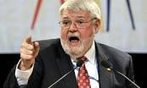
AFGE Leadership
J. David Cox (c) was elected President in 2012 and reelected in 2015 and 2018
Started federal employment as a VA nurse, and also served as the 1st VP of the National VA Council
In 2009, he was elected National Secretary Treasurer of AFGE

Slide 26
AFGE Leadership
Jeremy Lanham was elected VP for Women and Fair Practice at the 2018 convention
He replaced Augusta Thomas, who had a very interesting childhood

Slide 27
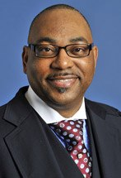
AFGE Leadership
The third constitutional officer is the National Secretary Treasurer
Previously held by Eugene Hudson, who was dismissed in the summer of 2017
Currently, Everett Kelly holds the position, after being elected in 2018

Slide 28
Trump Executive Orders
Not surprisingly, most unions, including AFGE, support Democratic candidates
So when Republicans are in power, they try to curb the power of unions
Perhaps the most far reaching were a series of Executive Orders by the Trump administration in the summer of 2018

Slide 29
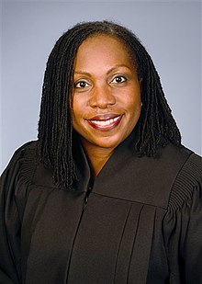
Trump Executive Orders
Thus, it was not a great surprise that portions of the EOs were overturned by Judge Ketanji Jackson of the US District Court for DC in August 2018
In particular, the sections dealing with negotiations, official time and facilities

Slide 30
Trump Executive Orders
At least initially, agencies are complying with the decision
Many agencies had held off taking action, and the few that did appear to be backing off
However, it may be expected that this decision will be appealed
So stay tuned!

Slide 31
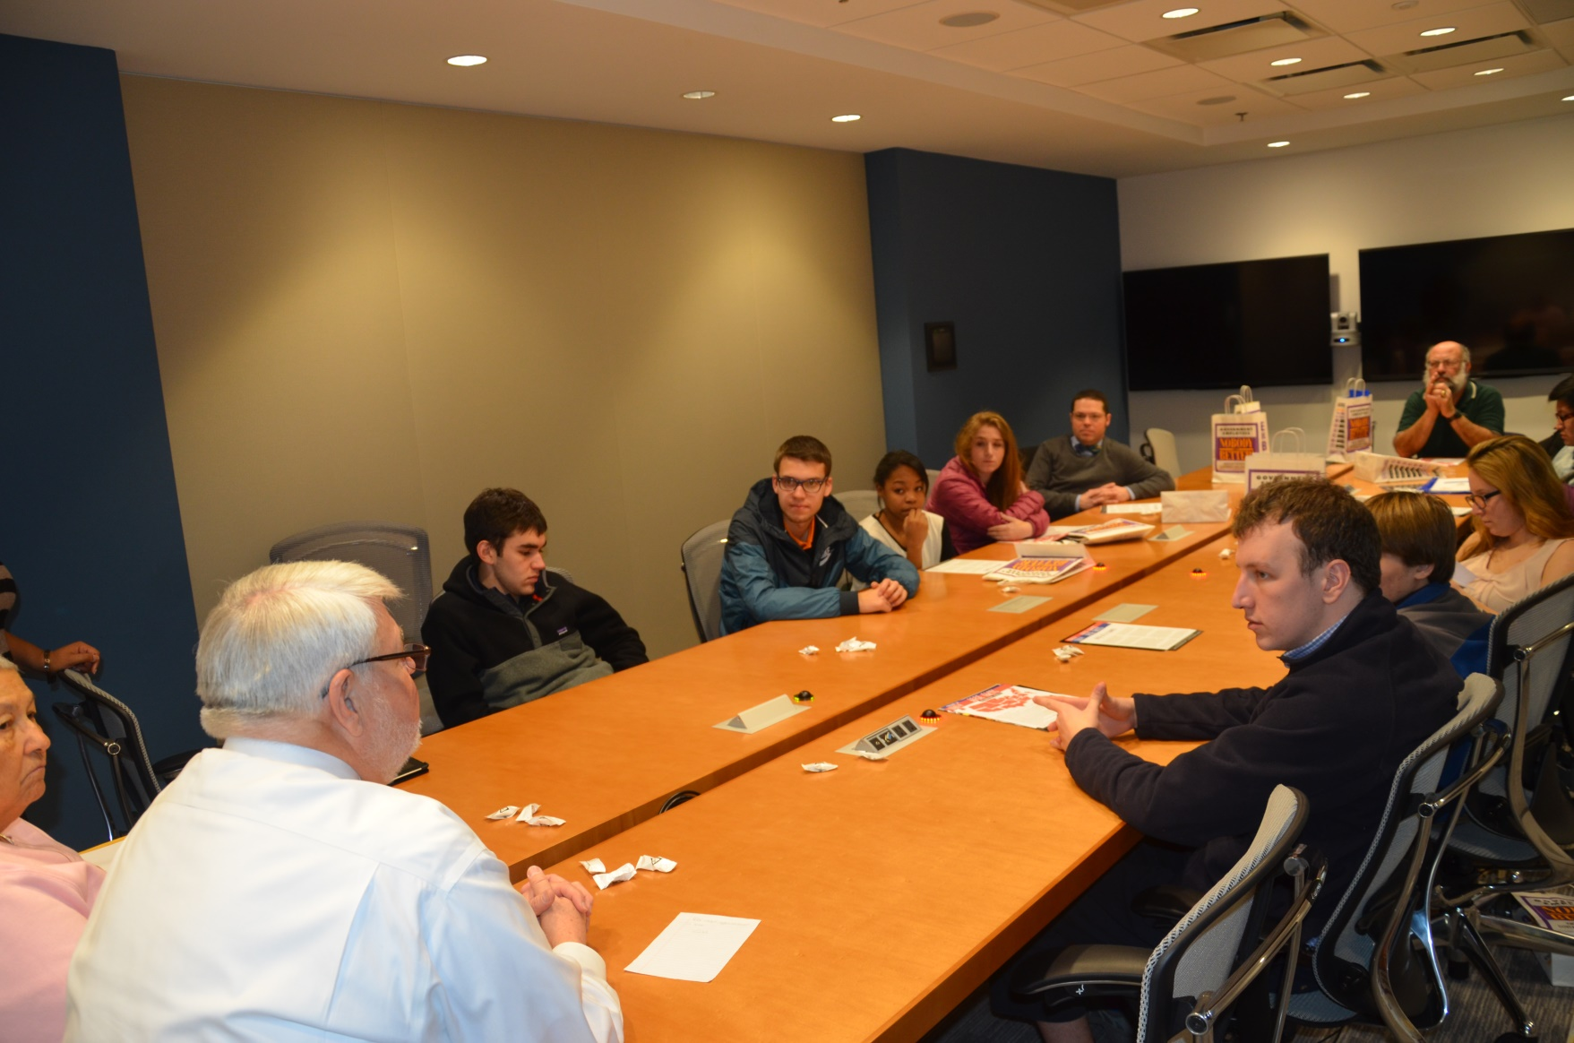
Meeting with my son’s High School AP Government Class Feb 2014

Slide 32
NTEU
Despite the name, represents workers at departments other than Treasury
Started in 1938 representing IRS workers, then Treasury, then all feds

Slide 33
NTEU
Rejected a 1966 merger with AFGE
In 1978, FCC employees became the first non Treasury employees to be represented by NTEU
Like AFGE, negotiates, lobbies and grieves, but also uses the courts
Currently represents about 150,000 bargaining unit employees

Slide 34
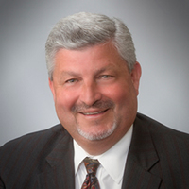
NTEU
Current President is Tony Reardon, elected in 2015.
He succeeded Colleen Kelly, who served from 1999-2015
Presidents have been long serving:
Vincent Connery 1966-1983
Robert Tobias – 1983-1999

Slide 35
Other Federal unions
NFFE – National Federation of Federal Employees
NAGE – National Association of Government Employees

Slide 36
NFFE Reunification
If you remember, AFGE grew out of a split with NFFE
NFFE associated with the IAM, and became part of the AFL-CIO
All AFL-CIO unions agree to a non raiding clause

Slide 37
NFFE Reunification
NFFE ran into financial difficulties in 2000, and did not pay their per capita (dues) to the AFL-CIO
As a result, NFFE was suspended from membership, and the no raiding clause was no longer in effect

Slide 38
NFFE Reunification
AFGE filed representational petitions at a number of locations, principally within the VA, where NFFE represented workers
As a result, a number of VA facilities, in SF, Miami, Austin, Topeka and Gainesville, among others, changed from NFFE representation to AFGE

Slide 39
Other Federal unions
Also internationals with federal members:
NNU – National Nurses United
SEIU – Service Employees International Union
IAFF – International Association of Fire Fighters
FOP – Fraternal Order of Police

Slide 40
State/Local unions

Slide 41
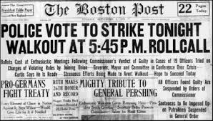
1919 Boston Police Strike
Unlike most municipal police departments, Boston was run by the state and not the city
Pay was extremely low, and the police had to buy their own uniforms and equipment
During WWI, inflation rose much higher than pay increases

Slide 42
1919 Boston Police Strike
Boston Police formed the Boston Social club in 1906 try to solve the issues of low pay and long hours
Boston management was “sympathetic” but did not agree to the requests
In June 1919, Boston was one of many cities where the police organized into a union under the AFL.

Slide 43
1919 Boston Police Strike
Boston leaders proposed a compromise where the city would recognize a non AFL affiliated union that rejected the right to strike, but Governor Coolidge rejected that compromise.
With this, the police voted 1134 to 2 to go on strike, and the strike started on September 9
Without police in the city, violence broke out.

Slide 44
1919 Boston Police Strike
Governor Coolidge first called out the National Guard, then fired all the strikers and then hired replacements
Ironically, the newly hired men got increased pay and benefits.

Slide 45
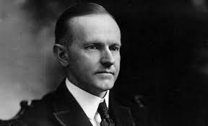
1919 Boston Police Strike
Coolidge became famous for his quote: “There is no right to strike against the public safety by anybody, anywhere, anytime,”
Within 18 months he was Vice President, and within 4 years he was President.
The failure of the Boston strike cast a impediment over future municipal unionization in general and strikes in particular

Slide 46
Current Police Organizations
FOP – Fraternal Order of Police
PBA – Patrolmen’s (sometimes Policemen’s) Benevolent Association
IUPA – International Union of Police Associations (AFL-CIO recognized union)

Slide 47
Current Police Organizations
Most organizations are either legally prohibited from striking or eschew the right to strike
They, along with fire fighters, employ a media campaign that they are “different” from other municipal workers
Often more effective than striking – in Wisconsin, police and fire were exempted from most of the more onerous rules

Slide 48
Current Police Organizations
Unlike most unions, non bargaining unit employees (what are they?) are allowed to form their own organizations.

Slide 49
Current Police Organizations
In New York, for example, there is
Patrolmen’s Benevolent Association
Detectives’ Endowment Association
Sergeants’ Benevolent Association
Lieutenants’ Benevolent Association
Captains’ Endowment Association

Slide 50
Current Police Organizations
Police unions
Bargain for pay and benefits
Provide assistance for officers facing discipline (call my delegate)
Lobby for laws and regulations perceived to be in the interest of police officers

Slide 51
Fire Fighters Unions
Principal union is the International Association of Firefighters (IAFF)
Founded in 1918, represents over 300,000 firefighters in over 3,200 affiliates
Performs in a like manner as the police unions – without the right to strike

Slide 52
Fire Fighters Unions
Like the police, both firefighters and officers can belong to a union
Personal example:
After World War II, my father joined the FDNY and became a member of the UFA (Uniformed Firemen’s Association – well, it was 1947!)
In 1959, he was promoted to Lieutenant and became a member of the UFOA – Uniformed Fire Officers Association.
Remained a member through promotions to Captain and Battalion Chief

Slide 53
Teacher Unions – NEA
There are two major teacher unions – the NEA and the AFT
Currently has about 3 million members, and while thought of a teachers’ union, any school employee can join
Unlike AFT, not a member of the AFL-CIO.

Slide 54
NEA
Current NEA membership is about 2.6 million
While many think of the NEA as a teachers’ union, all school employees can join

Slide 55
NEA
The NEA was founded in 1857 as the National Teachers Association
After a merger with a number of other educational associations, named the NEA in 1886
By the 1920’s had grown so large needed a professional staff, located at NEA headquarters in DC

Slide 56
NEA
A separate organization, the American Teachers Association, consisting of black educators, was associated with the NEA
Such an organization was started because of the segregated nature of Southern schools (the NEA allowed members to join regardless of race)
By the 1960’s, mergers of the two unions began, and the ATA was totally integrated into the NEA by 1969

Slide 57
Teacher unions – AFT
The American Federation of Teachers was founded in 1916, and currently has about 1.5 million members.
It was originally based in Chicago, and differentiated itself from the NEA by only allowing teachers to join
Growth was slow as authorities did not recognize the union

Slide 58
AFT
Like many public sector unions, the AFT struggled with laws prohibiting public sector union membership
It was not until 1932 that such laws were overridden in the Norris-LaGuardia Act
In 1998, talks were initiated between the AFT and the NEA about a merger
While the talks eventually failed, they did agree to a “no raid” clause.

Slide 59
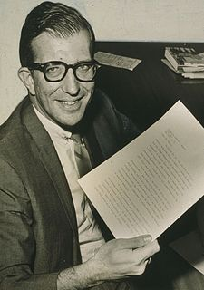
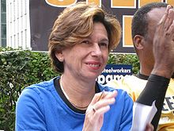
Famous leaders – AFT
Albert Shanker – President NYC AFT 1964-1985; AFT 1974-1997
Randi Weingarten – President NYC AFT 1998-2008, AFT 2009-pres

Slide 60
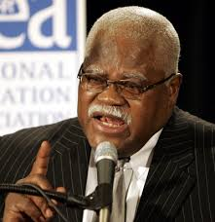
Famous leaders – NEA
Reg Weaver – President, 2002-2008.
Under NEA rules, Presidents cannot serve more than 6 years
Fiery speaker and motivator

Slide 61
Other educational unions
AAUP – American Association of University Professors
CSEA – California School Employee Association
Issue –
Teaching assistants (grad students) and adjutant professors
Number of locals, not yet recognized

Slide 62
Case study – the 1968 NYC Strike
The strike centered on actions in the Brownsville (Brooklyn) district
In the 1940’s, the neighborhood was predominantly Jewish (6% black)
By the 1970 census, it was 77% black and 19% Hispanic

Slide 63
Case study – the 1968 NYC Strike
Teachers in NY were hired through civil service, and at the time of the strike only 8% of teachers and 3% of administrators were black.
Centralized control of the schools was in the Board of Education, a huge and unwieldy bureaucracy
In 1967, NYC Mayor Lindsay created three pilot decentralized school districts, including Ocean Hill Brownsville

Slide 64
Case study – the 1968 NYC Strike
Rhody McCoy, a black educator was named the head of the district
He began replacing principals without following civil service rules, and then on May 6, 1968, moved 13 teachers and 6 administrators without following the union contract

Slide 65
Case study – the 1968 NYC Strike
The initial action was limited to the schools in the Brownsville District
UFT reaction was to send the teachers back to their schools, only to have the teachers blocked by the community
Later, 350 UFT teachers stayed out of school for three days, and they were removed by the Board from their schools and sent back to the central Board

Slide 66
Case study – the 1968 NYC Strike
On September 9, 1968, when the new school year began, the UFT, lead by Albert Shanker, called a strike
93% of the 58,000 teachers walked out over the issue of Brownsville

Slide 67
Case study – the 1968 NYC Strike
After two days, they returned when the central Board agreed to reinstate the transferred teachers
However, on September 13, the teachers went out again when it became apparent the Central Board had no power in Brownsville

Slide 68
Case study – the 1968 NYC Strike
The overwhelming majority of teachers were Jewish, and the parents and students in Brownsville were almost all black and Hispanic
Racism and anti-Semitism played at least a role in the strike and the positions of the adversaries

Slide 69
Case study – the 1968 NYC Strike
In November 1968, the state ended the strike by taking control of the Ocean Hill-Brownsville District
Dismissed and transferred teachers were reinstated
Three principal appoint by the District were transferred
State run trusteeship ran the District for 4 months

Slide 70
Case study – the 1968 NYC Strike and legacy
Shanker became a national figure and was soon President of the national AFT
Mayor Lindsay’s effectiveness was further undermined, along with loss of white support
The traditional liberal alliance of blacks and Jews was splintered if not ended
Teachers learned that they could achieve their goals through forcefulness, and a new militancy was born

Slide 71
Case study – the 1968 NYC Strike and legacy
Shanker became a national figure and was soon President of the national AFT
Mayor Lindsay’s effectiveness was further undermined, along with loss of white support
The traditional liberal alliance of blacks and Jews was splintered if not ended
Teachers learned that they could achieve their goals through forcefulness, and a new militancy was born

Slide 72
And Yes…..
There was an unfortunate consequence to the rise of Albert Shanker:
https://www.youtube.com/watch?v=D2fYguIX17Q
1:45

Slide 73
State and Municipal Unions
Principal Union:
AFSCME – American Federation of State, county and Municipal Employees

Slide 74
AFSCME
It currently represents over 1.2 million workers
In 1932, a group of 50 workers in Wisconsin banded together to form the Wisconsin State Employees Association
In 1934, this organization was granted an AFL charter as AFSCME

Slide 75
AFSCME
In addition to headquarters staff in DC, AFSCME consists of 3400 locals, including health care workers, corrections officers, sanitation workers, police officers, firefighters, and childcare providers
Organized into councils (geographic) and caucuses (occupational)
Example: District Council 37 in NYC, representing 125,000 employees

Slide 76
AFSCME
Issues:
Outsourcing/privatization
Minimum wage increases
Safety and workplace security
Health care
Strong political action, allied with the progressive wing of the Democratic Party

Slide 77
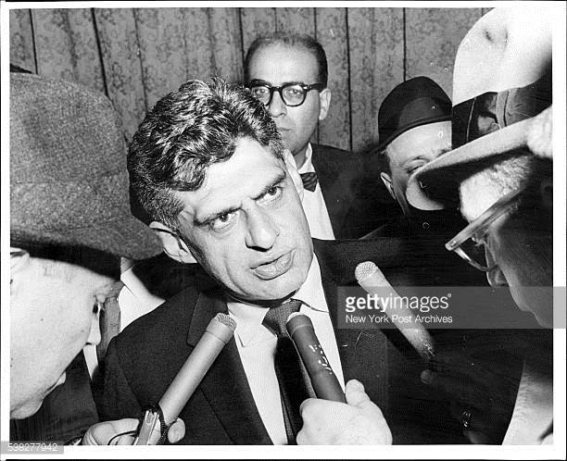
AFSCME
Like many unions, long serving presidents
AFSCME Presidents
Arnold Zander 1936-1964
Jerry Wurf 1964-1981 (right)
Gerald McTenee 1981-2012

Slide 78
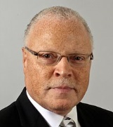
AFSCME
Current President: Lee Saunders
From a union family in Cleveland
Began work in 1974 in Ohio
Became an AFSCME Staffer in 1978
Elected Secretary Treasurer in 2010, then President in 2012

Slide 79
Next week
Labor Relations from the end of World War II
to the Present

