Slide 1
The History of Unions in the US Class 1: Origins
Jim Dunphy
dunphyjj@aol.com

Slide 2
Overture
Solidarity Forever:
https://www.youtube.com/watch?v=Ly5ZKjjxMNM

Slide 3
What is a union?
An organization of workers who have come together to achieve common goals such as:
improving safety standards
achieving higher pay and benefits
securing better working conditions.

Slide 4
What is a union?
Key is the workers coming together to united seek a common goal that will benefit all workers, and not just a specific worker

Slide 5
Terms
Will from time to time revert to “unionese”
Please let me know if I do – will probably not even realize I did!

Slide 6
So How about
I told the EVP to start I & I for a new CBA, but the LMR folks wanted to declare an impasse, so I wanted to check with the NVP before going to FSIP

Slide 7
Or
One of the BUEs came by the office with an issue – not sure if we want to do G & A, file a ULP with the FLRA, or send an EEO

Slide 8
Classes
Class 1 – Origins to 1900
Class 2 – 1900-1945
Class 3 – Public Sector Unions
Class 4 – 1945 to the present

Slide 9
On a personal note
My family have been union members for almost 100 years
Grandfather – TWU
Father – UFA/UFOA
Me – AFGE/NEA

Slide 10
On a personal note
So this class takes the conclusion unions are good – they mess up sometimes, but are good
OLLI would be more than happy to have a class argue the opposite, but that is not this one

Slide 11
Best Single Volume
There have been many books written about unions – some of which I will mention.
Probably the best single volume is There is Power in a Union by Philip Dray

Slide 12
Early American Industry
Most industry in the colonial and Early American time periods was home or small based, with just a few employees
Many employees were actually apprentices, who were in the process of learning the craft
Items were individually made, requiring a high level of individual skill

Slide 13
Industrial Revolution
Started in Great Britain at the end of the 18th Century
Used water and steam power to work machines
Began standardization of parts and procedures
Allowed for much larger scale enterprises

Slide 14
Lowell
First large scale textile factory in US
Used machines and plans smuggled out of England
The workers were young women off the farms in New England

Slide 15
Sarah Bagley
First came to work at Lowell in 1835
After a series of wage cuts due to depressions, Bagley formed the Lowell Female Reform Association and began to publish a newspaper, the Voice of Industry

Slide 16
Sarah Bagley
The Association provided the Massachusetts Legislature with a petition for a 10 hour day.
Forced to respond to the petition, the Legislature formed a committee in 1845, which looked into the issue but found no basis for state action.

Slide 17
Sarah Bagley
A second committee also found that this was an issue between employer and employee, not the state
Faced with political and worker pressure, the mills reduced the work day to by 30 minutes in 1847 and to 11 hours in 1853

Slide 18
Sarah Bagley
A new, male President of the Voice of Industry fired Bagley in 1846.
Discouraged by what she saw as male privilege over a largely female work place, she left Lowell and union activities shortly thereafter.

Slide 19
Sarah Bagley
She moved to Philadelphia and married in 1851 at age 45
She and her husband both practiced homoepathic medicine
Their motto was “To the rich, one dollar, to the poor, free”
She died in 1889, surviving her husband by 18 years.

Slide 20
Legal Basis of Unions
As the Industrial Revolution changed working conditions in Lowell and elsewhere, the legal basis of unions became an issue.
Common law and numerous court cases held that labor unions were an “illegal combination.”

Slide 21
Commonwealth v. Hunt – Facts
In Boston, the Boston Journeymen Bootmaker’s Society agreed on a wage of $2.00 per boots produced
A bootmaker, Jeremiah Horne, agreed to work on boots without fee, and was fined by the Society
When Horne continued to do so, the Society threatened a walk out at Horne’s employer, so the employer fired Horne

Slide 22
Commonwealth v. Hunt – Facts
Horne filed a complaint with the County Attorney, and attempted to reach a settlement with the Society
When the settlement failed, the County Attorney brought in an indictment against the Society and its leaders.
The basis of the indictment was the Society was a criminal conspiracy

Slide 23
Commonwealth v. Hunt – Trial Court
The prosecution argued that the Society was coercive and did not allow for freedom of contract
Defense stressed the benefits of membership and that there were many professional societies of lawyers and doctors who operated in a similar manner

Slide 24
Commonwealth v. Hunt – Trial Court
The trial judge’s charge was that if such a society was allowed, it would
render property insecure, and make it the spoil of the multitude, would annihilate property, and involve society in a common ruin
To no great surprise, the jury held for the prosecution, and the defense appealed to the Massachusetts Supreme Court

Slide 25
Commonwealth v. Hunt – Supreme Court
Decision was written by Chief Justice Lemuel Shaw
Not considered a friend of labor
In a case decided shortly before Hunt, Shaw found that employers were not responsible for workplace injuries if a fellow employee was partially to blame (the fellow servant rule)

Slide 26
Commonwealth v. Hunt – Supreme Court
Shaw concluded that prior English precedents were not appropriate, in a new industrial environment.
In this environment, both workmen’s and business associations would arise
Workers had the right to organize and deny their labor, as long as they did so peacefully.

Slide 27
Commonwealth v. Hunt – Supreme Court
On the issue of criminal conspiracy, Shaw held, that to be a conspiracy, a combination would have to have as it goal:
To accomplish some criminal or unlawful purpose, or to accomplish some purpose, not in itself criminal or unlawful, by criminal or unlawful means
Shaw found nothing unlawful or criminal in fining a bootmaker

Slide 28
Commonwealth v. Hunt – Significance
In general, Hunt held that labor combinations which used legal means to reach legal ends were not unlawful
However, it did allow for prosecution if the means or ends were not lawful
In post Civil War era, this latter teaching was used to criminalize some union behavior.

Slide 29
Civil War and Industrialization
In the spring of 1860, shoemakers in Lynn MA marched and organized after wage cuts and downsizing
Management did not give in to demands, but with the onset the next year of the Civil War, the demand for shoes allowed for full employment and an increase in wages
Like Lowell, Lynn did not win concrete benefits but showed growing militancy among workers.

Slide 30
Lincoln and Lynn
In March 1860, when Presidential Candidate Abraham Lincoln was asked about the Lynn actions, he replied:
I am glad to see that a system of labor prevails in New England under which laborers can strike if they want to….
Where they are not obliged to labor whether you pay them or not. I like a system which lets a man quit when he wants to, and wish it would prevail everywhere.

Slide 31
Civil War and Industrialization
By 1870, for the first time in US history, there were more people working in industry than agriculture
New trade unions were formed, such as the National Typographical Union and the Iron Molders Union
The latter union soon had 7,000 workers in 53 locals

Slide 32
National Labor Union
The first national labor federation, the National Labor Union (NLU) was formed in 1866
Worked towards moving away from the gold standard and workers cooperatives
Principal goal was the 8 hour day

Slide 33
William Sylvis (1828-1869)
First began working as an iron molder in 1846
While working in Philadelphia, became active in the trade union movement and was one of the founders of the Iron Molders Union
While not an early leader, was elected the third president in 1868
He died shortly thereafter in 1869

Slide 34
National Labor Union
The initial union included both women and blacks, under the direction of Sylvis
Rank and file was not happy with this, so by 1869, a Colored National Labor Union was formed, and women were likewise relegated to a secondary status

Slide 35
National Labor Union
After Sylvis’ death, the idea of a National Labor Party was dropped
The NLU became aligned with the Democratic Party, and endorsed Horace Greeley in 1872
The impetus became more political than workers rights, like the 8 hour day, and without Sylvis’ leadership, the organization faltered and eventually disbanded

Slide 36
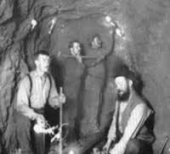
Coal Mines
Always a dangerous profession, a major accident took place at the Avondale Mine in September 1869
179 died
Much of the deaths attributable to limited exits from the mine
Only limited union activity in mines before then

Slide 37
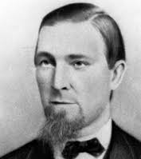
John Siney and the WBA
The Workers Benevolent Association (WBA), founded during the Civil War, was one of the first miners unions
After Avondale, successfully got a law passed to require multiple exits from mines, and increased inspectors
The WBA also founded the first Miners Hospital
Even with improved safety, there were still over 500 deaths in mines between 1870 and 1875.

Slide 38
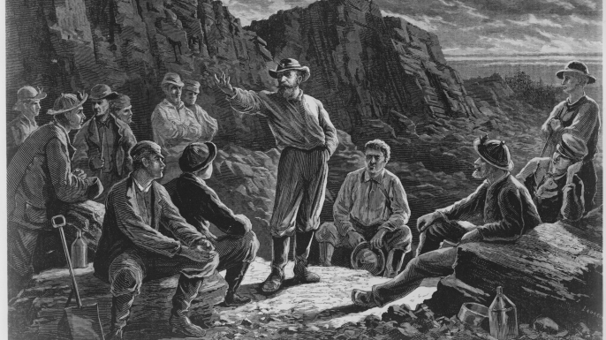
Molly Maguires
Many of the workers were first generation Irish, and members of the Ancient Order of Hibernians .

Slide 39
Molly Maguires
While the AOH was a non violent benevolent society, some members formed the Molly Maguires, a violent gang
Named after a mythical tenant rebel, the Mollies were founded during the Civil War and fought conscription

Slide 40
Molly Maguires
They also assaulted scab workers, and were seen by many Irish workers as the only defenders of their class.
After Siney and the WBA were successful on a number of issues, there was relative stability, particularly after an agreement was signed covering 85% of the workers

Slide 41
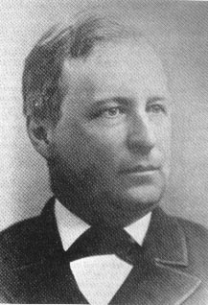
Franklin Gowen and the Coal Operators
Gowen was the President of the Philadelphia and Reading Railroad, and was a key ally of the coal operators.
Subsequent to the Panic of 1873, the WBA went out on strike against lowered wages and worsening working conditions.

Slide 42
Franklin Gowen and the Coal Operators
After a series of murders, Gowen had the Mollies infiltrated by Pinkerton Agents, which led to a series of trials and executions
Because of its proximity to the Mollies, and its failure to win the strike, the WBA was destroyed as a viable representative of the workers.

Slide 43
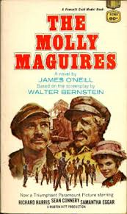
Legacy
Made into a 1970 movie, starring Sean Connery and Richard Harris, with Harris portraying a Pinkerton detective
Emphasizing social conflict rather than action, the movie was a box office failure.

Slide 44
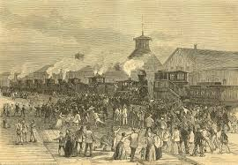
Strike of 1877
As a result of the Panic of 1873, union membership declined greatly.
There was also a series of layoffs, leading to much higher unemployment
A target for anger was the railroads, who were not only powerful but who also had a poor record with their workers.

Slide 45
Strike of 1877
The strike started in Martinsburg WV after the B & O Railroad cut wages for the third time in a year.
The workers refused to let trains through, and local militia refused to attack the strikers
The Governor of WV called for federal troops to put down the strike

Slide 46
Strike of 1877
The strike soon spread to NY, Baltimore, Chicago, Pittsburgh, Philadelphia and other cities in PA
In St Louis, in addition to actions at the rail yard, a general strike was called and shut down the city.

Slide 47
Strike of 1877
The St Louis general strike also had as issues the 8 hour day and a ban on child labor
The strike was broken after 45 days by the use of federal troops

Slide 48
Strike of 1877 - Aftermath
Employers took two tracks – one getting conspiracy statutes passed to block union activity and beefing up the National Guard
The second was to try and offset strikes by increasing benefits

Slide 49
Strike of 1877 - Aftermath
In particular, the B & O provided coverage for workplace injuries and death, and a pension plan
The workers, who generally were not organized in the strike, began to create umbrella unions, such as the Knights of Labor.

Slide 50
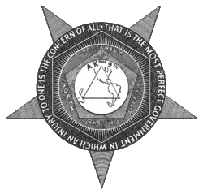
Knights of Labor
Knights were formed out of a tailors’ union in Philadelphia.
First president was Uriah Stephens, and was instituted in December 1869.
By 1880, had 28,000 members, and by 1886, over 800,000 members
This represented 20% of all workers

Slide 51
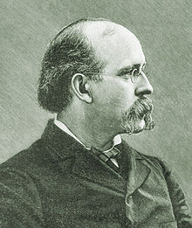
Knights of Labor
With the collapse of the NLU, the Knights became the most important union.
Stephens was replaced by Terrence Powderly, who was greatly influenced by the Workers Benevolent Association.
The Knights represented all types of employees, which was both a strength and weakness

Slide 52
Knights of Labor
The National leadership allowed for blacks, Asians and women to join, but also allowed local organizations (particularly in the South) to preclude blacks
Among the issues the Knights fought for were:
8 hour day
End to child and convict labor
Graduated income tax

Slide 53
Knights of Labor
While many Knights (including Powderly) were Catholic, their secret rituals made Catholic bishops think the Knights were similar to the Masons, and therefore not an organization Catholics should join
Powderly eschewed political action, but many of his members did not.

Slide 54
Knights of Labor – Decline
The Knights were associated with the Haymarket riots
Many workers wanted to be in unions dedicated to their particular craft
Powderly left in 1894, pursuing a political and administrative career.
By the mid 1890’s the Knights were under 100,000

Slide 55
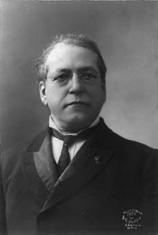
Samuel Gompers and the AFL
Gompers was born in London in 1850, and moved to the US in 1863, settling in New York city.
He began working as a cigar maker at home and then in cigar stores.
At age 14 he became a member of a Cigar Makers Local, and by age 25 elected President of the Local. He later rose to national office in the Cigar Makers union.

Slide 56
Gompers and the AFL
In 1881, Gompers was one of the founders of the Federation of Organized Trades and Labor Unions
This was reorganized in 1886 as the American Federation of Labor (AFL), with Gompers as President
Gompers would essentially remain President of the AFL until his death in 1924

Slide 57
Gompers and the AFL
The AFL was organized around skilled craft unions
Central leadership, but decentralized control to the labor federations.
Emphasis was on fundamental and achievable goals – not looking for a revolution in labor management relations

Slide 58
Gompers and the AFL
Non skilled labor was not welcome in the AFL
Nor were blacks
Gompers and the central leadership fought hard against socialism

Slide 59
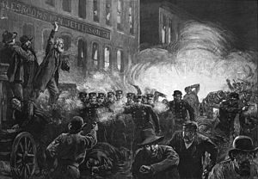
Haymarket
The Federation of Organized Trades (remember them?) set May 1, 1886 as the date for nationwide marches in support of the 8 hour day
Hundreds of thousands marched and struck on that day
On May 3, there was a march on the McCormick Harvester Company, and police killed 4 of the marchers

Slide 60
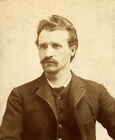
Haymarket
August Spies (left) addressed the crowd and called for a mass meeting in Haymarket Square for the next day
The rally, attended by about 2000, began peacefully and was surrounded by plainclothes police
British socialist Samuel Fielden was the last speaker and finished at about 1030
By then, it was raining and most of the crowd had left

Slide 61
Haymarket
Police Inspector John Bonfield then ordered the crowd to disperse and the police moved forward to do so
At that time, a bomb was thrown, killing one policeman and wounding six others
Gunshots then broke out – never proved who fired first, but most evidence is that the police did
By the time the affair was over, 7 police and 4 workers were dead.

Slide 62
Haymarket
Investigation followed quickly, and police assumed that an anarchist was the bomb thrower.
Eventually, eight men were charged and tried for the conspiracy in the bombing and the deaths of the police officers.
Most were immigrants, predominately from Germany

Slide 63
Haymarket
The trial judge displayed open hostility towards the defense, and all 12 jurors were native born and non laborers.
All eight men were found guilty and seven were sentenced to hanging and one to 15 years
Two of the seven had their terms commuted to life in prison and one committed suicide before being executed.
The remaining 4 defendants, including Spies, were hung on November 11, 1887

Slide 64
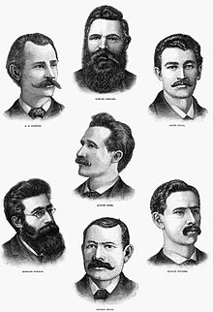
Haymarket Aftermath
Scores of protests occurred after the executions
The actual bomber was never brought to trial, and has never been positively identified
In the short run, Haymarket was a defeat for the eight hour day, but in the long term, increased worker militancy

Slide 65
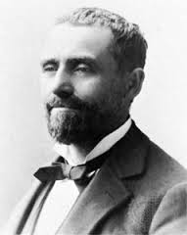
Haymarket Pardons
Continuing protests, particularly among writers and other intellectuals, kept the issue alive.
In June 1893, Governor John Peter Altgeld, himself a German immigrant, signed pardons for the remaining three imprisoned defendants.
As a result of this action, he was defeated for reelection

Slide 66
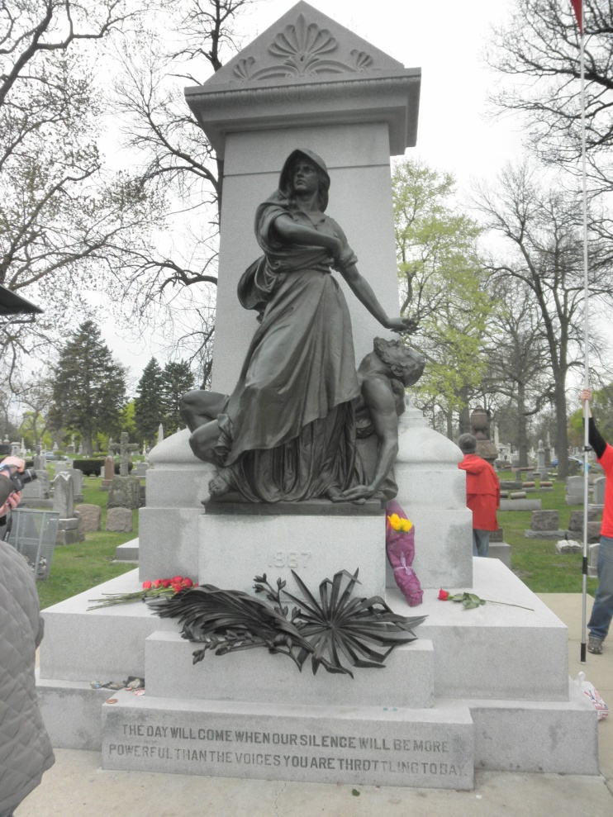
Haymarket Legacy
A monument to the executed men was erected in 1893
In 2011, it was restored and rededicated
Haymarket remains a turning point in union history

Slide 67
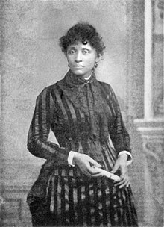
Haymarket Legacy
One of the men executed after Haymarket was Albert Parsons, born in Alabama and a veteran of the Confederate Army.
His wife was Lucy Parsons, who was born a slave and was of black, Native American and Mexican background
She later became a union and socialist activist in her own right

Slide 68
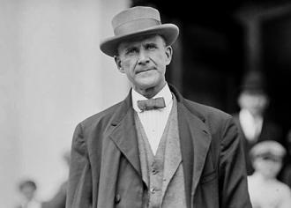
Eugene Debs and the Pullman Strike
Eugene Debs was born in 1855 and started life as a Democrat, being elected to the Indiana House
He joined the Brotherhood of Locomotive Firemen in 1875, rising to General Secretary
He organized the American Railway Union in 1893, and successfully struck the Great Northern Railway in 1894

Slide 69
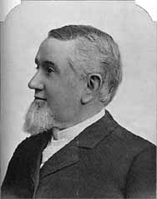
The Pullman Company
The Pullman Company, under the ownership of George Pullman, built luxury railroad cars (hence the workers were part of the American Railway Union)
The workers lived in a company town, paying rent to the company and being under their rules
In 1893, a panic led to 25% lower wages, but not lower costs to the people living in the company town

Slide 70
The Pullman Strike
In May 1894, a delegation of workers met with management to discuss the issues, and management vowed there would be no reprisals
The next day, three of the committee were discharged due to what management called previously ordered staff reductions.
That evening, Pullman workers voted to strike

Slide 71
The Pullman Strike
At a convention of the ARU in June 1894, the delegates voted not to handle any Pullman cars
The boycott spread, and management got an injunction against the strike under the Anti Trust law
Federal troops from Fort Sheridan surrounded the epicenter of the strike in Chicago
Debs and other leaders were arrested and imprisoned

Slide 72
The Pullman Strike
The ARU requested the support of the AFL and were turned down.
With the leaders imprisoned, the strike was broken in August 1894, and the leaders of the strike were not rehired (and therefore thrown out of company housing)
Debs was convicted of violating the federal injunction, and sentenced to six months in prison

Slide 73
The Pullman Strike – Aftermath
The workers realized that the federal government was against them, and that any improvement in their condition would have to come from collective action
Pressured by Governor Altged, President Cleveland created a panel to look into the causes of the strike, and found that Pullman’s paternalism was largely the cause.

Slide 74
The Pullman Strike – Aftermath
In 1898, the Illinois Supreme Court ordered Pullman to divest of his company town, which became part of Chicago
In 1894, in an attempt to conciliate with organized labor, President Cleveland designated Labor Day a federal holiday.

Slide 75
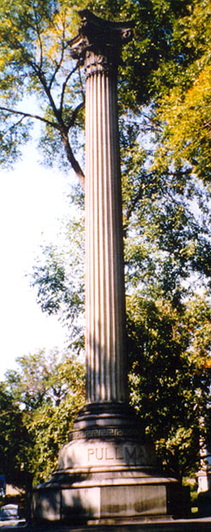
Final Aftermath
Three years after the strike, in 1897, George Pullman died
Before his death, because he feared his remains would be disturbed by angry workers, he designed a special tomb.
His lead-lined coffin was sunk in a concrete block and placed in a tomb made of reinforced concrete covered with asphalt and tarpaper, followed by a layer of steel rails bolted at right angles with another layer of concrete poured on top

Slide 76
Socialism and the lack of a Labor Party
In February 1900, the British Labor Party was founded, as a workers’ alternative to the Liberal Party
The Labor Party was socialist in nature
While there would be a minor socialist party in the US, no labor based party was ever created

Slide 77
Alternates to a workers party
Fighting Bob Lafollette and the Progressive Party
The Democratic-Farmer Labor Party in Minnesota
Vito Marcantonio and the American Labor Party in NY
More about these parties later.

Slide 78
Next week
Labor relations 1900-1945

