Slide 1
PIRATES

Slide 2
Piracy
Piracy is a war-like act committed by non-state actors (private parties not affiliated with any government) against other parties at sea. The term applies especially to acts of robbery and/or criminal violence at sea. People who engage in these acts are called pirates.

Slide 3
Privateer
A Privateer - a private person or ship authorized by a government by Letters of Marque to attack foreign shipping during wartime
Letter of Marque - a government license authorizing a person to attack and capture enemy vessels, and bring them before admiralty courts for condemnation and sale

Slide 4
Early History of Piracy
Piracy existed as long as the oceans were used for commerce
Earliest documentation of piracy are the exploits of the Sea People who threatened the Aegean and Mediterranean in the 13th century BCE
Phoenicians sometimes resorted to piracy, and specialized in kidnapping boys and girls to be sold as slaves

Slide 5
Early History of Piracy (Cont’d)
During the 1st century BC, there were pirate states along the Anatolian coast, threatening the commerce of the Roman Empire in the eastern Mediterranean
On one voyage across the Aegean Sea in 75 BC, Julius Caesar was kidnapped by Cilician pirates and held prisoner

Slide 6
Early History of Piracy (Cont’d)
Piracy continued during the entire rule of the Roman Empire
As early as 258 AD, the Goth fleets ravaged towns on the coasts of the Black Sea
In the Roman province of Britannia, Saint Patrick was captured and enslaved by Irish pirates.
On the other side of the world, early Polynesian warriors attacked seaside and riverside villages

Slide 7
The Middle Ages and the Vikings
In medieval Europe, the Vikings were the most widely known and far reaching pirates, mainly between 793 - 1066
They raided the coasts, rivers and inland cities of all Western Europe as far as Seville in 844
Vikings even attacked coasts of North Africa and Italy.
They also plundered all the coasts of the Baltic Sea, ascending the rivers of Eastern Europe as far as the Black Sea and Persia.
The lack of centralized powers all over Europe during the Middle Ages favoured pirates all over the continent

Slide 8
The Mediterranean Pirates
In the Late Middle Ages, Moor pirates were common in the Mediterranean Sea
Toward the end of the 9th century, Moor pirate havens were established along the coast of southern France and northern Italy
In 846 Moor raiders sacked Rome and damaged the Vatican
From 824 to 961 Arab pirates in the Emirate of Crete raided the entire Mediterranean

Slide 9
The Mediterranean Pirates (Cont’d)
Arab raids on the Adriatic coast in 887–888 caused continuing conflicts with the Italians
The Venetians futilely continued to fight them throughout the 10th and 11th centuries
In the 14th century, raids by Moor pirates forced the Venetian Duke of Crete to ask Venice to keep its fleet on constant guard

Slide 10
British Isles and Piracy
In 937, Irish pirates sided with the Scots, Vikings, Picts, and Welsh in their invasion of England, but they were driven back
King Henry III took an especially severe view of the crime of piracy
An Englishman named William Maurice was convicted of piracy in 1241
He was hanged, drawn and quartered

Slide 11
Piracy in the Indian Ocean
Piracy was also prevalent in the Indian Ocean as early as the 7th century
Constant wars between between various Indian factions demanded frequent resupply of fresh horses
This trade was subject to frequent raids by pirates based in the coastal cities of Western India

Slide 12
Africa and Asian Piracy
Piracy was rampant around Africa, particularly in Madagascar, where the pirate population numbered 1000 in the 17th – 18th century
The southern coast of the Persian Gulf became known as the Pirate Coast
Meanwhile the Japanese were active in piracy from 1200 – 1600
But the most powerful pirate fleets of East Asia were those of the Chinese

Slide 13
The Chinese Pirates
Chinese pirate fleets grew increasingly powerful throughout the early 19th century
The effects large-scale piracy had on the Chinese economy were immense
Chinese pirates formed a coalition that, by 1804, consisted of over ten thousand men
In the 1840s and 1850s, the United States Navy and Royal Navy forces campaigned together against Chinese pirates
It wasn't until the 1860s and 1870s that fleets of pirate junks ceased to exist

Slide 14
The Barbary Pirates
Operated from the North African ("Barbary coast") ports of Algiers, Tunis, Tripoli and ports in Morocco
They preyed on shipping in the western Mediterranean Sea from the time of the Crusades
They also attacked ships on their way to Asia around Africa until the early 19th century
Between 1 and 1.25 million Europeans were captured by Barbary pirates and sold as slaves in North Africa and Ottoman Empire between the 16th and 19th centuries

Slide 15
Ransom for us ships and crews
In July 1785, Algerians captured two American ships
The Dey of Algiers held their crews of twenty-one people for a ransom of nearly $60,000
Thomas Jefferson opposed the payment of tribute - ”Lastly our determination to prefer war in all cases to tribute under any form, and to any people whatever"
However, the United States continued to negotiate for cash settlements

Slide 16
Hugh payments
In 1795 alone the United States was forced to pay nearly a million dollars in cash, naval stores, and a frigate to ransom 115 sailors from the Dey of Algiers
Annual gifts were settled by treaty on Algiers, Morocco, Tunis, and Tripoli
When Jefferson became president in 1801 he refused Tripoli's demands for an immediate payment of $225,000 and an annual payment of $25,000.

Slide 17
The Barbary War
The pasha of Tripoli then declared war on the United States
Jefferson dispatched a squadron of naval vessels to the Mediterranean
The American show of force quickly awed Tunis and Algiers into breaking their alliance with Tripoli
Aggressive action of Commodore Edward Preble forced Morocco out of the fight

Slide 18
- - - - to the shores of Tripoli
American fleet under Commodore John Rogers and a land force threatened to capture Tripoli
The threat to install the brother of Tripoli's pasha on the throne brought an end to the hostilities
A second war with Algiers, in 1815, with naval victories by Commodores William Bainbridge and Stephen Decatur led to treaties ending all tribute payments by the United States
European nations continued annual payments until the 1830s

Slide 19
THE GOLDEN AGE OF PIRACY

Slide 20
View of a Typical Pirate
Peg Leg
Arm Hook
Cutlass
Parrot
Skull and Crossbones
Eye Patch

Slide 21
Your Typical Pirate
Blackbeard - Edward Teach

Slide 22
Your Not So Typical Pirate
Anne Bonny & Mary Read

Slide 23
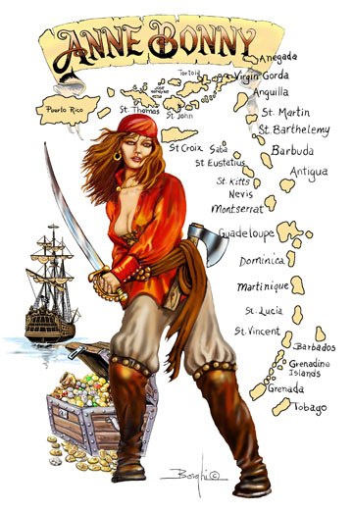
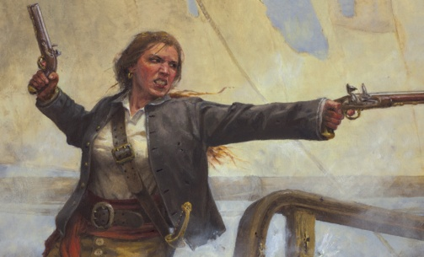
Famous Women Pirates
Anne Bonny
Mary Read
Mary Read

Slide 24
Grace O’Malley
Grace O'Malley was a famous pirate, seafarer, trader and chieftain in Ireland in the 1500's.
Born in 1530 in County Mayo, Ireland, the daughter of a sea captain
As a young child, Grace always knew she wanted to be a sailor
Extremely upset when her father refused to take her on a sailing trip, Grace cut off all her hair and dressed as a boy
Eventually she was allowed to go to sea with her father and his fleet of ships.

Slide 25
Grace O’Malley
She learned the ways of the sea and eventually had her own fleet of ships.
In her later life, Grace took up piracy by taking on Turkish and Spanish pirate ships and even the English fleets.
She grew her estate to include a fleet of ships as well as several islands and castles on the west coast of Ireland.
In her later years, Grace developed her reputation as fearless in battle

Slide 26
Anne Bonny
Anne Bonny was a native of Cork; born to her father’s servant
Her father, a respected attorney eloped with the servant and Anne to America
Anne married a young sailor without a shilling, enraging her father who threw them out of his home
Anne and her husband sailed for the island of Providence, in the hope of gaining employment

Slide 27
Anne Bonny
Anne became estranged from her husband and eloped with the pirate, Captain Jack Rackam (Calico Jack), and went to sea in men's clothes
When the king's offered a pardon to all pirates, Rackam surrendered, and went into privateering
He soon returned to his piratical exploits, joined by Anne Bonny and Mary Read
They were captured by the British
Anne Bonny, Mary Read and a seaman were the last three who remained fighting when the vessel was taken

Slide 28
Anne Bonny
By a special favor, Rackam was permitted to visit her the day before he was executed
Instead of consoling him, she only observed that if he had fought like a man he needed not have been hanged like a dog
Being with child, she remained in prison until her recovery, was reprieved from time to time, and was not executed

Slide 29
Mary Read
Mary Read was a native of England
Her mother married a sailor who, soon after their marriage, went to sea, left her pregnant, and never returned
After the birth of Mary, her mother convinced her husband’s mother that Mary was a boy
The grandmother provided Mary’s mother a crown per week for ‘his’ support

Slide 30
Mary Read
Mary’s mother continued to rear her daughter as a boy
After the grandmother died, the allowance stopped
Mary’s strength and manly disposition increased with her years
She eventually signed on board a man-of-war
She joined a regiment of foot as a cadet and later enlisted into a regiment of horse

Slide 31
Mary Read
She again enlisted into a regiment of foot
She went on board a vessel bound for the West Indies
During the voyage, the vessel was captured by English pirates
Mary joined the pirates and continued with them for some time
She then joined a ship to serve onboard as a privateer

Slide 32
Mary Read
Scarcely had the ships sailed, when the crew mutinied to return to pirating
Among the crew were Mary Read and Anne Bonny
When the vessel was taken, these two heroines, along with another of the pirates, were the last three upon deck
Mary Read was captured and tried, but because she was pregnant her execution was delayed
While she would probably been spared, in the mean time she fell sick and died

Slide 33
Other Famous Women Pirates
Lady Mary Killigrew – vicious pirate from Cornwall
Charlotte de Berry – another woman who went to sea dressed as a man
Rachel Wall – the first American woman pirate
Loi Chai-san- Queen of the Macao pirates during the 1920s

Slide 34
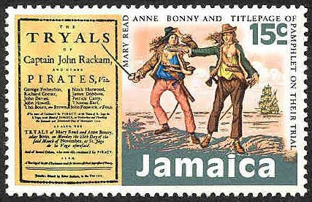
A Final Note On Cross-Dressing
Mary Read maintained her role as a man for many years and no one had discovered her gender
Not until she told Anne Bonny
Anne, supposing Mary to be a handsome fellow,
became greatly enamored of her
Anne disclosed to Mary that she (Anne) was a
woman and was interested in Mary
Now Mary was forced to reveal her secret to Anne

Slide 35
The Spanish Main
The term the 'Spanish Main' is often associated with famous pirates
The “Spanish Main” referred to the coastal region of the Americas surrounding the Caribbean Sea and South America
The Spanish established colonies on the land in the New World and also claimed specific sea routes

Slide 36
The Spanish Main
The territories around the Spanish Main opened up paths to the new wealth which was found in the New World
Ships were loaded with their treasure to send back to Spain
These Spanish treasures fleets were attacked by many of the famous pirates
The Pirates of the Spanish Main used many of the Caribbean Islands as their bases. The traffic in treasure made the Spanish Main a haunt of famous pirates and privateers

Slide 37
The Golden Age of Piracy
The Golden Age of Piracy lasted just over 100 years form the 1500's to the mid 1600’s
The Spanish were continuously harassed in the Caribbean by pirates and buccaneers who attacked the Spanish galleons which were carrying riches back to Spain
There were safe havens for pirates, or pirate enclaves, all over the world but Port Royal and Jamaica were famous examples of places where pirates could gather without fear of attack or arrest

Slide 38
Benefits of being a pirate
Many seamen who had served in merchant or naval ships, turned to the lucrative, but dangerous occupation of being a pirate
Pirate crews were treated much better than the navy crews who were subjected to harsh, rules, treatment and punishment and low wages - many were press-ganged into service
The pirate ships were governed by their own laws, called Articles, which were agreed between the pirate crew and the captain

Slide 39
The Pirate Code of Conduct
Pirate Code of Conduct 1 - Equal Voting Rights
Pirate Code of Conduct 2 - Fair share of the loot and pirates punishments for those who cheated
Pirate Code of Conduct 3 - Gambling was banned
Pirate Code of Conduct 4 - No lights at night - a pirates sleep should not be disturbed
Pirate Code of Conduct 5 - Each pirate was responsible for the upkeep of their weapons
Pirate Code of Conduct 6 - No Boys or women allowed on board
Pirate Code of Conduct 7 - Penalty for Desertion
Pirate Code of Conduct 8 - No fighting between pirates on board the ship
Pirate Code of Conduct 9 - A Pension according to the severity of wounds
Pirate Code of Conduct 10 - Shares of the loot or booty
Pirate Code of Conduct 11 - Musicians available to play when required!

Slide 40
The pirate song
The most famous words are from the first four lines of this pirate song are :
Fifteen men on a dead man's chest Yo ho ho and a bottle of rum Drink and the devil had done for the rest Yo ho ho and a bottle of rum.

Slide 41
The Pirate Song
What does the song mean?
- Dead Man's Chest is a tiny island that forms part of the British Virgin Islands in the Caribbean Sea. Pirate legends of the Caribbean claim that the notorious pirate, Edward Teach ( Blackbeard ), marooned 15 of his pirate crew on 'Dead Man's Chest' as a punishment for their mutiny and desertion

Slide 42
The Pirates of the Golden Age
The celebrated English Explorers Sir John Hawkins and Sir Francis Drake were classed as famous pirates
The pirates who operated in the Caribbean in later years included Blackbeard, Calico Jack (Jack Rackham), Anne Bonny and Henry Morgan
Other famous pirates operating in the Caribbean included Black Bart, Henry Every, and Captain Kidd

Slide 43
Blackbeard – Edward Teach (1680 – 1718)
The best known non-fictional pirate even
though he was not the most successful
He is remembered mainly because of his image
that he himself helped to create
He was said to be a somewhat amiable man and
generous to those that cooperated with him
Teach was also apparently a ladies man. It is said
that he had around 14 wives.

Slide 44
Blackbeard – Edward Teach
Teach captured the Concorde, a large French trader carrying a cargo of slaves
He re-christened it the Queen Anne’s Revenge, and installed 40 guns
He really made his reputation when he engaged and defeated HMS Scarbourough
It was at this time that he created his well-known Blackbeard persona
He knew that if he looked frightening then ships might surrender to him sooner

Slide 45
Blackbeard – Edward Teach
He let his hair grow and started a beard that would almost cover his face
He twisted his long hair and beard in pigtails and he was known to tie colored ribbons on the ends
During battle he put lit slow burning hemp cords under his hat near his ears that would smoke and envelop him in a cloud
To add to his menacing appearance he also wore several pistols (as much as six) along with his knives and cutlass at his waist

Slide 46
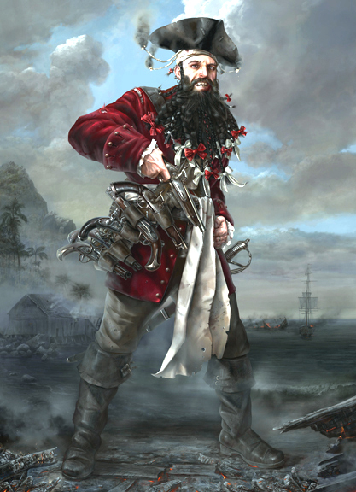
Blackbeard – Edward Teach
After capturing many prizes and valuable cargos, Blackbeard decided to take advantage of the King’s pardon and retire from pirating
However, he could not stay away and eventually was defeated by two sloops manned by Royal Navy crews
It was reported that Blackbeard fell with at least five gun shot wounds and at least 20 sword wounds
His severed head was hung from sloop's bowsprit as a trophy and to prove that the legendary Blackbeard the pirate was indeed dead

Slide 47
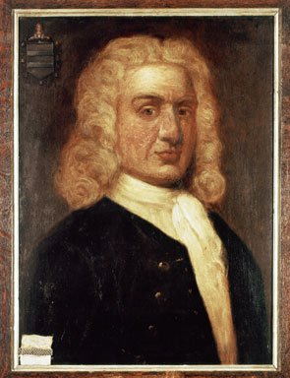
Captain William Kidd (1645 –1701)
Born in Dundee, Scotland
One of the most well known Pirates of all times
He was an English Privateer who found such success in the West Indies
The King’s officers asked Kidd to captain a new powerful ship - the Adventure Galley, equipped with 34 cannons and a crew of 80
Kidd’s mission was to capture all French ships, and the pirates of Madagascar

Slide 48
Captain William Kidd
A good portion of his new crew left Kidd’s ship in order to join the pirates
The remaining portion of pirates on Kidd’s crew, threatened him with mutiny, unless Kidd would attack any and all ships
Kidd refused
After Kidd killed the mutiny leader, the crew did not pursue the revolt further
However, Kidd was a changed man and he now became a pirate

Slide 49
Captain William Kidd
Kidd decided to plunder the Quedagh Merchant, a huge treasure ship
Captain Kidd was in the possession of one of the greatest pirate treasures ever
With this final accomplishment under his belt, he ordered his crew to set sail for New York
He thought he could fool the New Yorkers into believing that all his plunder had been taken only from French and pirate vessels
Unfortunately for him, he was very mistaken - a great deal of the booty belonged to the powerful British East India Company

Slide 50
Captain William Kidd
Kidd was clapped into chains and shipped to England were he was sentenced to death
Kidd experienced a terrible death - the hangman’s rope broke twice, the third time it held
Once Kidd was dead: his body was dipped in tar and hung by chains along the Thames River
There are a number of accounts which state that Kidd was falsely accused and unfairly tried and executed

Slide 51
Modern Piracy
Seaborne piracy against transport vessels remains a significant issue
An estimated worldwide losses of US$13 to $16 billion per year
Concentrated in the waters between the Red Sea and Indian Ocean, off the Somali coast, and in the Strait of Malacca and Singapore
These waters are used by over 50,000 commercial ships a year
Surprisingly, in recent years, vessels have suffer from regular pirate attacks on the Serbian and Romanian stretches of the Danube river

Slide 52
Pirate activity

Slide 53
Why somalia?
Central government collapsed after civil war
Somali Navy disbanded, territorial waters undefended
Foreign fishing trawlers began illegally fishing on the Somali seaboard
Ships from big companies started dumping waste off the coast of Somalia
Led to the erosion of the fish stock

Slide 54
Why somalia?
Local fishermen banded together to protect their resources
Began to see profitability of ransom payments
Financiers and former militiamen began to fund pirate activities
They split the profits evenly with the pirates
In most hijackings, the pirates have not harmed their prisoners

Slide 55
Modern Piracy
In the first six months of 2011 there were 266 pirate attacks - 60% by Somali pirates
As of June 30, 2011, Somali pirates were holding 20 ships and 420 crew hostage
Worldwide in the first six months of 2011, 495 sailors were taken hostage, 7 were killed and 39 wounded
During the period, 99 vessels were boarded, 76 fired upon and there were 62 thwarted attacks
In some cases, the pirates force the crew off the ship and then sail it to a port to be repainted.

Slide 56
Prosecutions for Piracy
Prosecutions are rare for several reasons
Modern laws against piracy are almost non-existent
Warships that capture pirates have no jurisdiction to try them
Prosecutors have a hard time assembling witnesses and finding translators
Countries are reluctant to imprison pirates because they would be saddled with them upon their release

Slide 57
New Self-Protection Steps
Placing armed security guards aboard ship
Weapons training for ships’ crew
Avoiding the pirates (radar, warnings, etc.)
Implementing vessel boarding protection systems (e.g., hot water wall, electricity-charged water wall, slippery foam)
Finally, warships can be called upon. In some areas such as near Somalia, naval vessels from different nations are present
The use of armed drones

Slide 58
Update
Improved anti-piracy measures has lead to dramatic decrease in piracy
By the end of 2011, only four vessels hijacked in the last quarter of the year
During the same quarter in 2010, 17 vessels were hijacked
So what’s a pirate to do? Dramatic increase in hostage taking ashore!

Slide 59
National Laws
The United States has a statute imposing a sentence of life in prison for piracy "as defined by the law of nations" committed anywhere on the high seas, regardless of the nationality of the pirates or the victims
United Kingdom - In 2008 the British Foreign Office advised the Royal Navy not to detain pirates of certain nationalities as they might be able to claim asylum in Britain under British human rights legislation, if their national laws included execution, or mutilation as a judicial punishment for crimes committed as pirates

Slide 60
Summary
Piracy was with us as early as the 13th century BCE
It is still with us
Until there is an internationally agreed upon set of rules for dealing with piracy and pirates, it will continue

Slide 61
Dare me with a question. Just try me!

Slide 62
THE END

