Slide 1

Health Policy 2018: Surveying the Progress and Damage, and Charting New Courses
Len M. Nichols, Director and Professor of Health Policy
OLLI Health Policy Lecture
April 6, 2018

Slide 2
Overview
BRIEF History of Major US Health Policy Efforts
Where We Are Today
Where We MIGHT be going

Slide 3
Early Health Policy Developments
First health policies in US?
  Virginia (1639), Mass (1649), NJ and NY (1665) regulated physician FEES
  1760 NYC banned unlicensed medical practice
  By 1830, all but PA, NC, and VA had licensing boards
  Diploma vs. license
In UK, Chadwick, Snow, and Shattuck established importance of clean water, 1830-1840
AMA formed in 1847
Louisiana created first state Board of Health in 1855
Flexner Report 1910
Johns Hopkins formed first US School of Public Health 1916

Slide 4
More Recent Policy History
Bismarck→TR→FDR→Truman
  Republican Congress blocked Universal Coverage, but passed Hill-Burton (1946)
McCarron-Ferguson (1945)
LBJ and Great Society (Medicare, OAA, Medicaid, War on Poverty)
Nixon and HMO Act, ERISA
Reagan (TEFRA + DRGs); Bush I (RBRVS + Medicaid Expansion)
Clinton (HIPAA, SCHIP, BBA)
W (Medicare Drugs, FQHC Support)

Slide 5
Common Themes in US Health Policy
Before the ACA
Bi-Partisan
Expand Access and Equity but Mindful of Cost
States in charge of licensure, quality* + solvency
Federal purpose financed with $ (strings)

Slide 6
What Was Different About ObamaCare?
At End, was not Bi-Partisan
Why? Tale of Two Narratives
  Ds started where Rs were in 1993-4 (Chafee-Dole-Durenberger)
  BUT by Fall of 2009, R’s were no longer there, had moved to Right
  Rs wanted to compromise, Ds insisted on covering all
Many had too much to gain from “failure” of bi-partisanship

Slide 7
Effects of ACA
Coverage
Cost
Quality
Health
Politics
Future

Slide 8
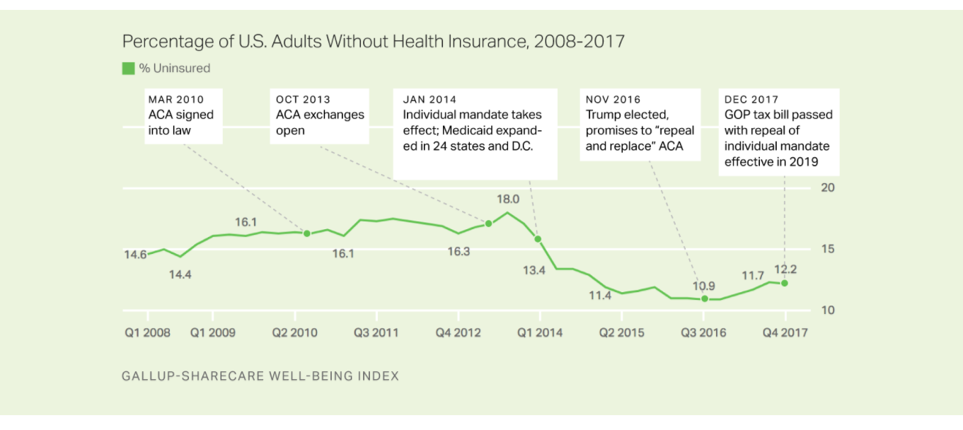

Slide 9
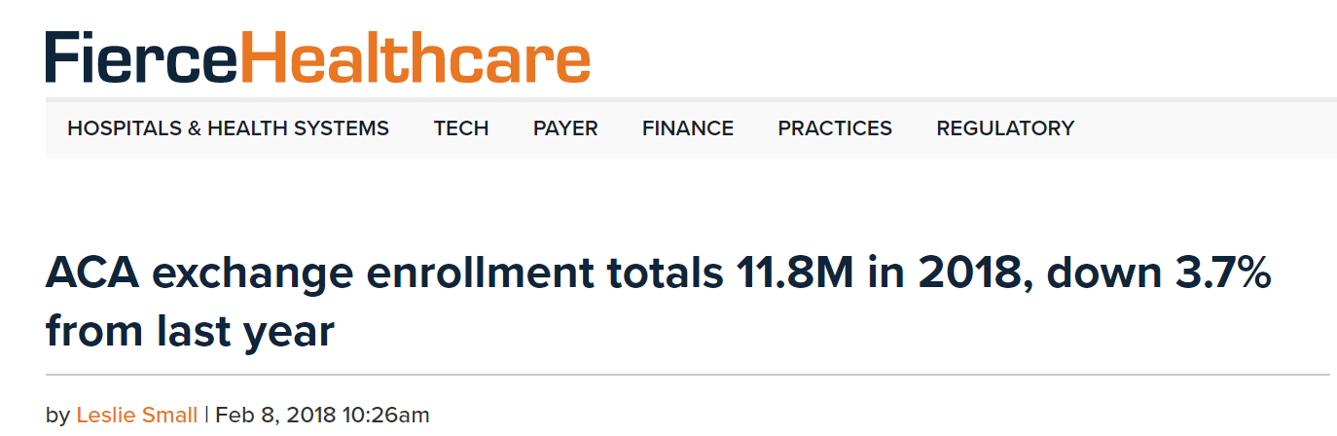

Slide 12
Problems with the “elite” discussion of “cost”
People care mostly about their out-of-pocket payments
  For premiums AND for services
Deductibles in marketplace are high
Premiums went UP for some who were in non-group market pre-ACA

Slide 13
Individual payment models’ performance mixed → disappointing, glass > ½ full?
ACOs
  MSSP
  Pioneer
  Next Generation?
Primary Care
  CPCI
Bundled Payments (Models 2* {acute and post-acute} and 4** {prospective acute})
Private sector initiatives
PTAC

Slide 14


Independent PFPM Technical Advisory Committee
PFPM =
Physician-Focused Payment Model
Goal to encourage new APM options for Medicare clinicians
 
Secretary comments on CMS website, CMS considers testing proposed models

Submission of model proposals by Stakeholders
Technical Advisory Committee
11 appointed care delivery experts that review proposals, submit recommendations to HHS Secretary
For more information on the PTAC, go to: https://aspe.hhs.gov/ptac- physician-focused-payment-model-technical-advisory-committee

Slide 15
What Has PTAC Done So Far?
Reviewed 18 proposals, 6 more in process
April 2017: Recommended 2 of 4 (1 withdrew after PRT report); Sec agreed to reject one, “engage” with others (Project Sonar +, ACS-Brandeis - )
Sept: Recommended 2 of 3 (sent one back for more work) ;
  HAH+ and Oncology BP were suggested limited scale
  C-TAC’s Advanced Care Model judged incomplete…
Dec: Recommended 2 of 7; ESRD bundle + Adv. Primary Care
March 2018: recommended 4 of 4; 2 advanced illness, H at Home, etc
NO SECRETARIAL RESPONSES SINCE APRIL 2016 votes

Slide 16
Lessons Learned → Payment Reform 3.0
ID which patients on which to focus care coordination/integration
MACRA intensifies incentives for MDs to bear risk
Hospitals/systems/MD groups see bearing risk as way to get leverage v. health plans
BUT, many plans reluctant to share data and risk with providers
Information systems in MD offices and hospitals not ready for prime time
Focus on price levels, PROMs, and identifying target patients is coming; win-win reductions in “unnecessary” utilization “not enough”
Notes:
Heart, bypass, hip and femur

Slide 17
Source: MEDPAC, March 2017, Annual Report to Congress

Slide 18
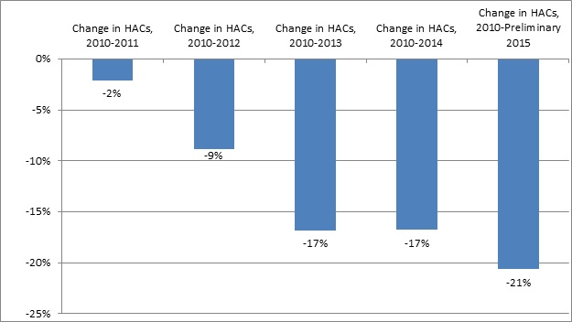

Slide 19
Sommers et al
Annals of Internal Medicine
160(9)

Slide 20
Sommers et al

Slide 21
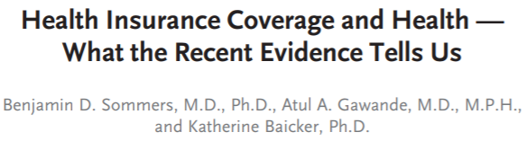
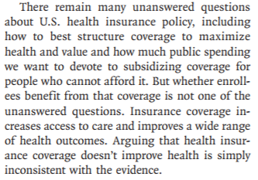

Slide 22
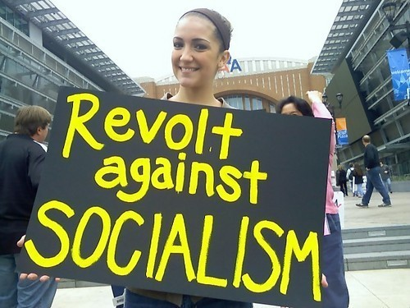

Slide 23
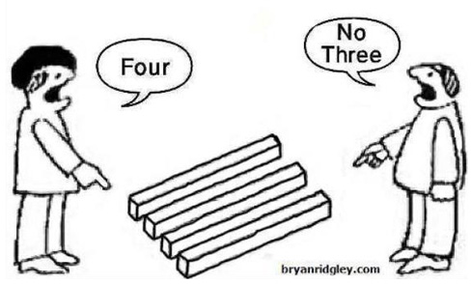

Slide 24


Slide 25
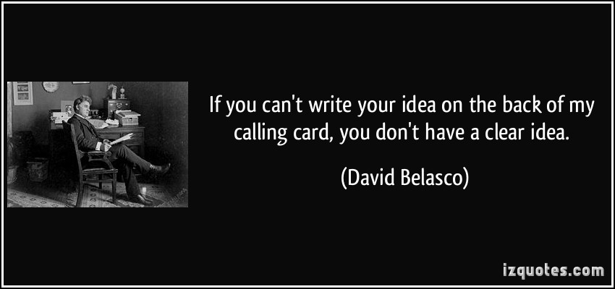

Slide 26
Philosophy of ACA vs. NOT ACA
ALL vs. Some
Rules vs. Liberty
Population health vs. personal health choices
Compensating for disadvantages vs. reducing tax burden

Slide 27
What We All Agree Upon Now
Health Care and Health Insurance Cost Too Much
ACA is a “disaster” (Except for the parts people like)
“Fixing” the ACA is complicated
  20m+ gained coverage, most like/need it; ACA more popular than ever
  Most of coverage gains in Medicaid
  Many insurers pulled or threatened to pull out of marketplaces
  3-4m hurt by benefit mandates and risk pooling*
Governing is harder than campaigning

Slide 28


Slide 29


Slide 30


Slide 31
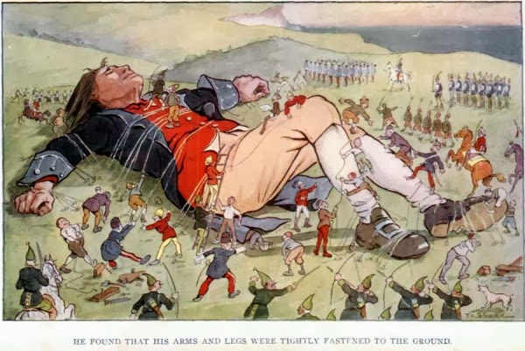

Slide 32
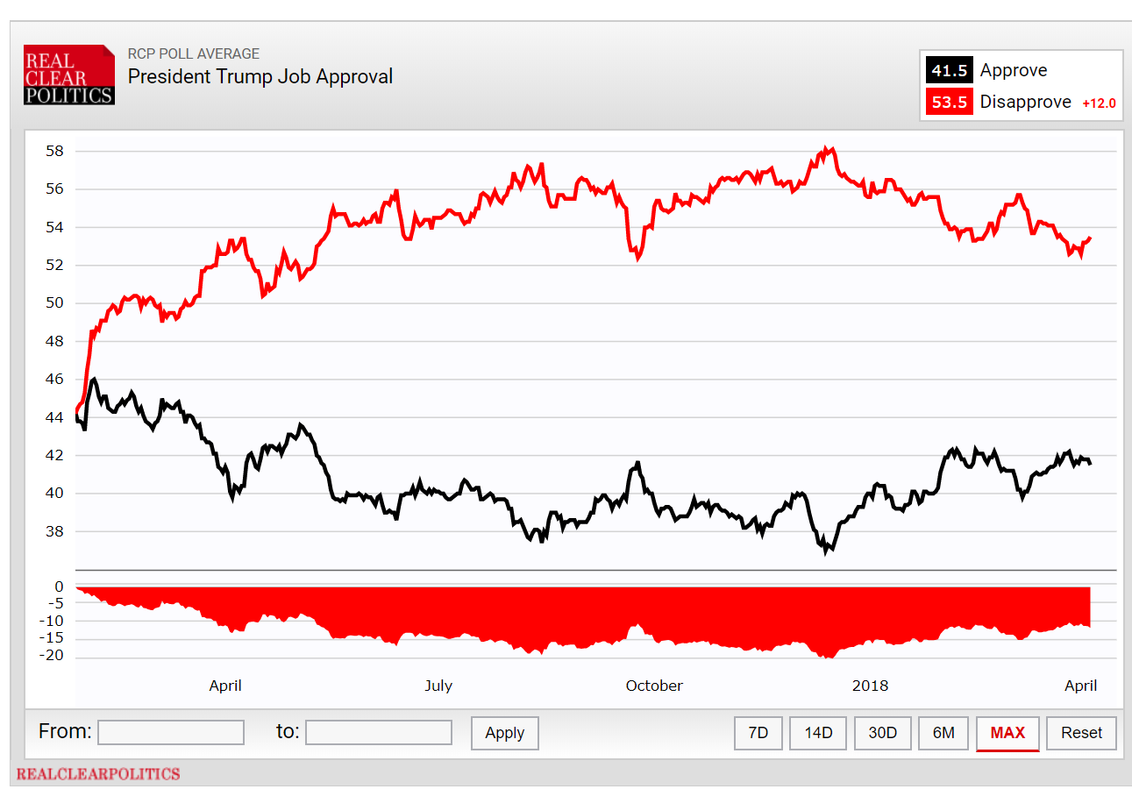

Slide 33
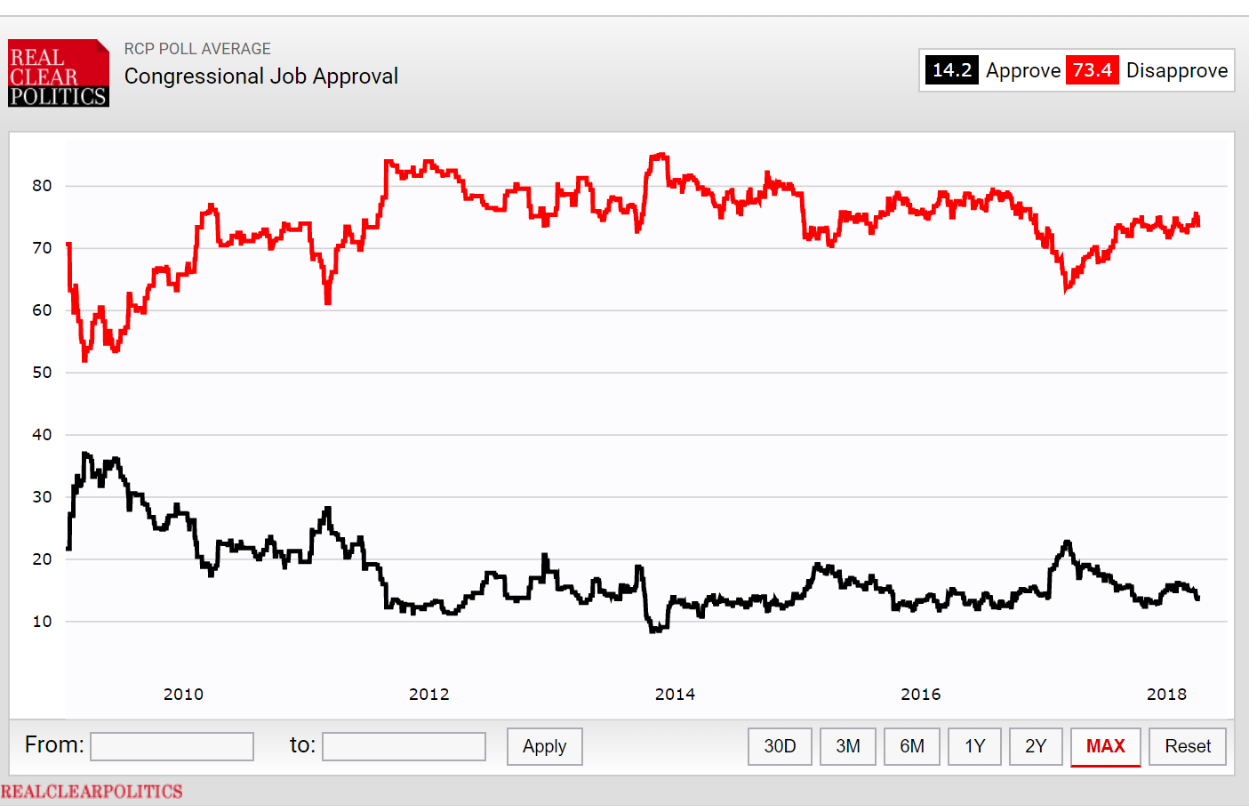
+ 59.2

Slide 34
What Do Trump Republicans Want to do on Coverage?
Reduce public spending
Reduce premiums for those who buy “on their own”
Reduce regulations for those who sell insurance = Increase Freedom for those who buy insurance
Ending mandate, expanding Association Health Plans, waiving benefit mandate requirements, allow “short term” plans for 364 days to use underwriting, limited benefits, risk rating
Ending CSR payments to drive UP premiums and make people flee ACA marketplaces into more free outside market
Allow states to impose work requirements in Medicaid

Slide 35
Where is Health Policy Headed?
Tax cut has intensified pressure to reduce federal health care spending

Slide 36

SPEND LESS
to pay for tax cuts
SPEND LESS to
pay for coverage
expansion

Slide 37
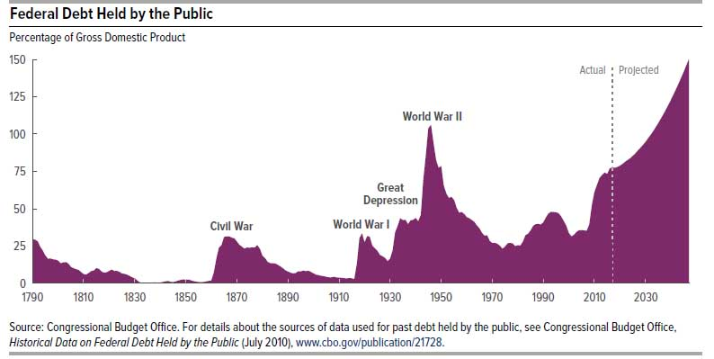
BBA

Slide 38
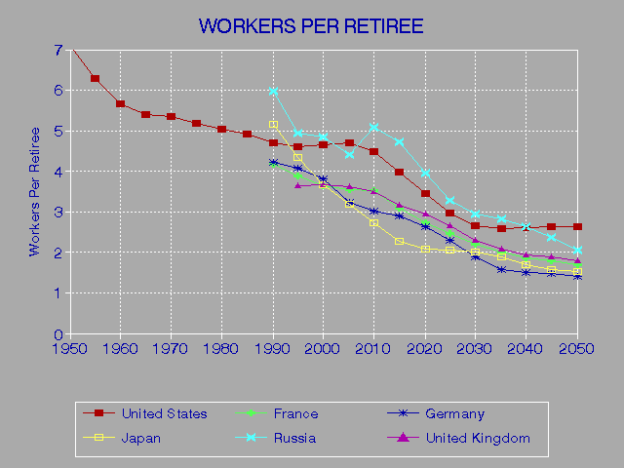
Source: http://www.econdataus.com/workers.html

Slide 39
USA

Slide 40
Where is Health Policy Headed?
Tax cut has intensified pressure to reduce federal health care spending
ACA Fix?
  Alexander-Murray: CSR $, outreach $, 1332 streamline plus catastrophic plans available to all (not just under 30)
States are going to get more discretion for ACA 1332 and Medicaid 1115 waivers, most likely with less federal money
Payment reform probably going to add HSA / high d experiments
Social Determinants of Health and PRICES may get a lot more attention
What Leadership Could Do

Slide 41
Most Pressing Need: Someone with Credibility who will speak Truth
Patients and providers must own actionable data
We need major overhaul of health information systems and data sharing norms
Drug prices are not based on past R&D costs
No health care prices actually make sense
We can’t afford everything for everybody at today’s prices. Your choices are:
  Cut the number of covered
  Cut benefits of the covered
  Reduce payments to providers and plans, through efficiencies or price cuts
  Raise taxes
  All of the above

Slide 42
Here is the Bottom Line
SOMEONE is going to have to pay more IF we are to have access for ALL
There are untoward consequences of inequitable access

Slide 43
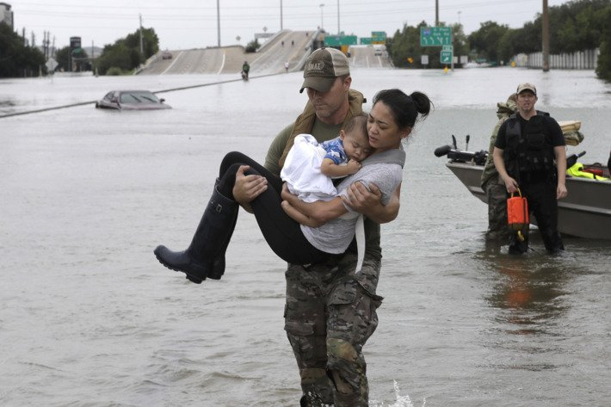

Slide 44
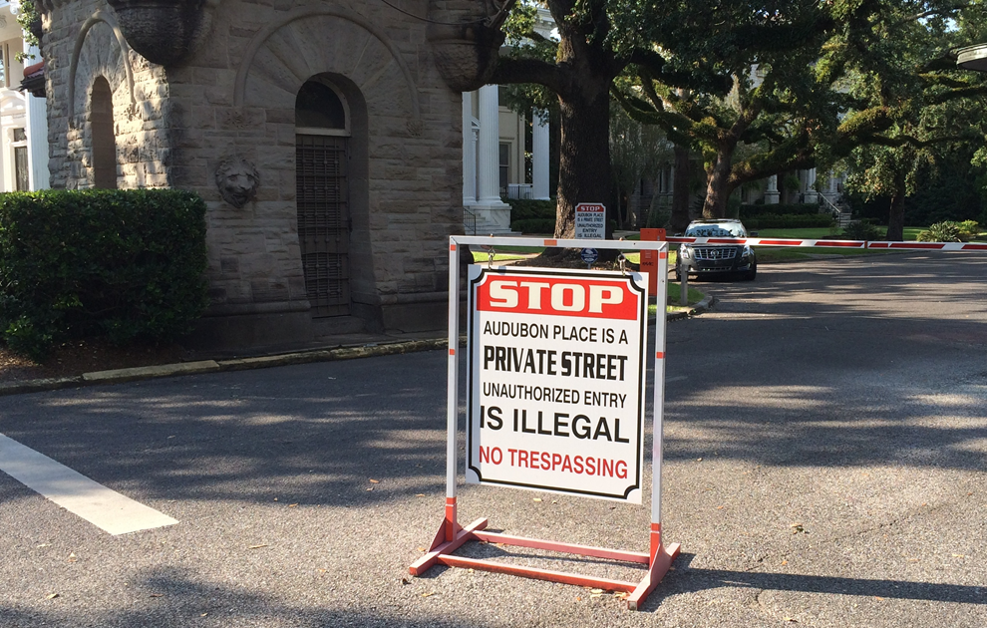

Slide 45
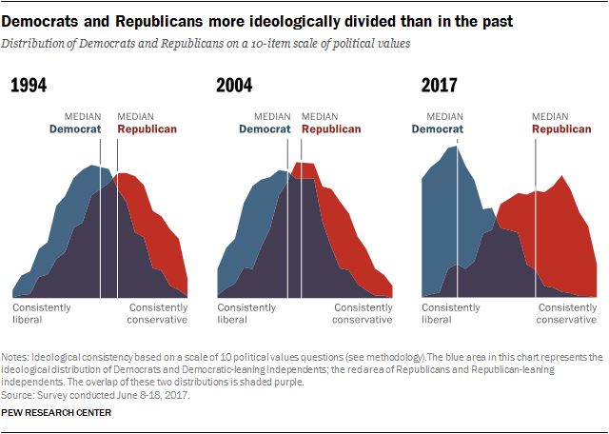

Slide 46
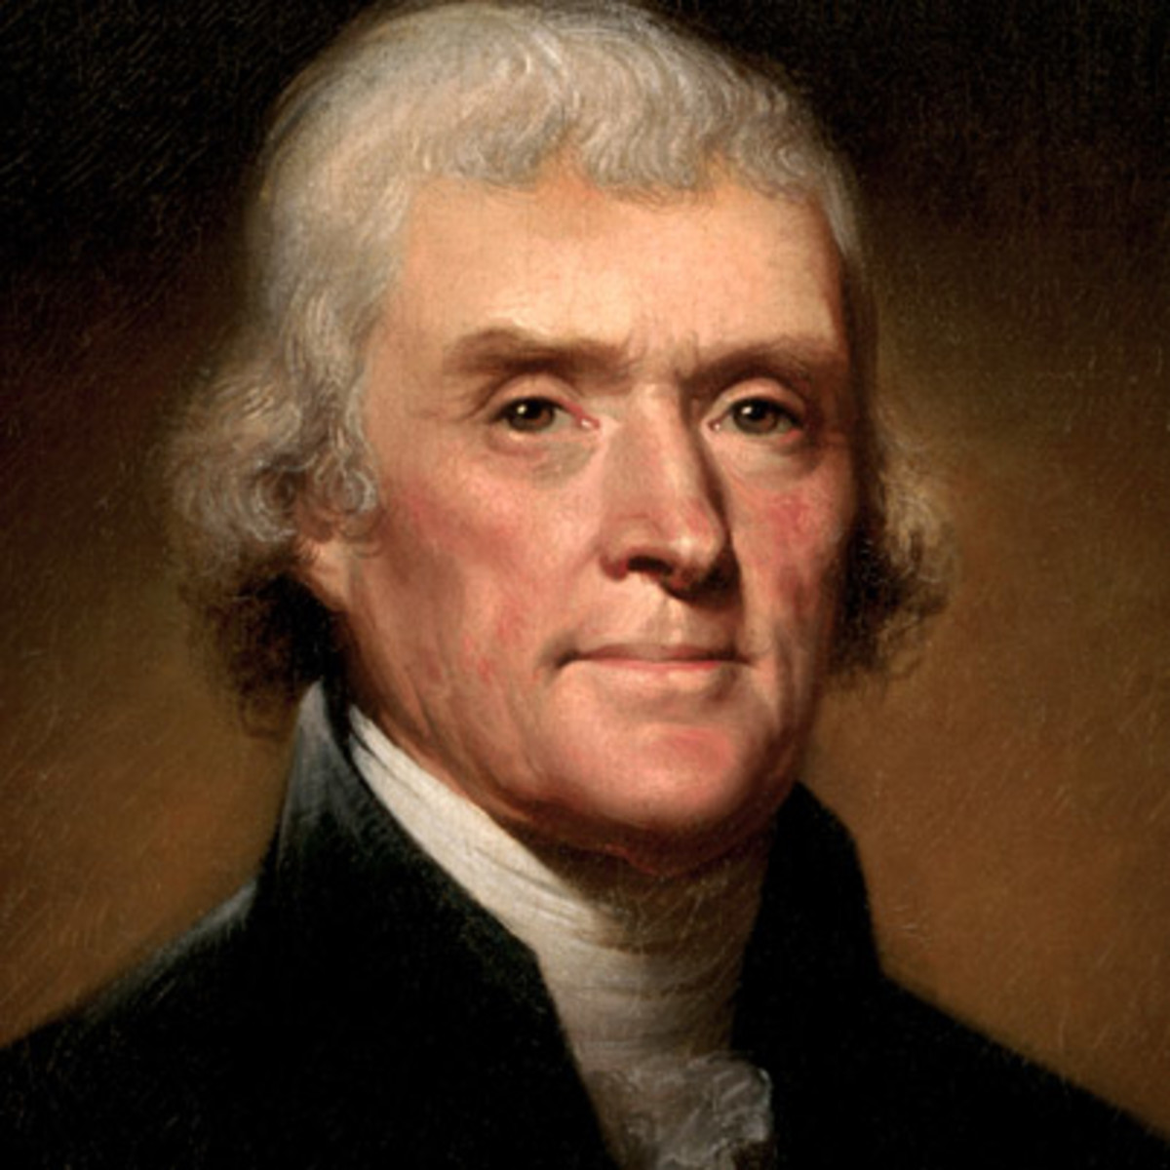
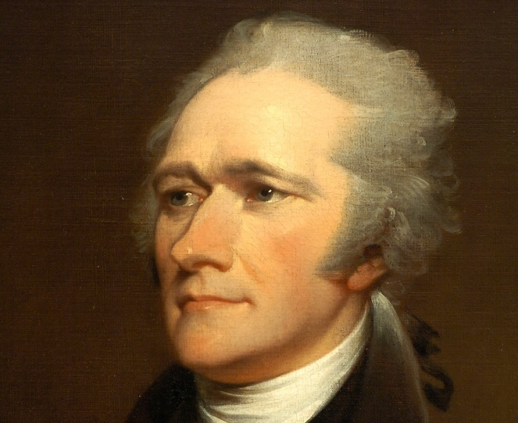
V.

Slide 47

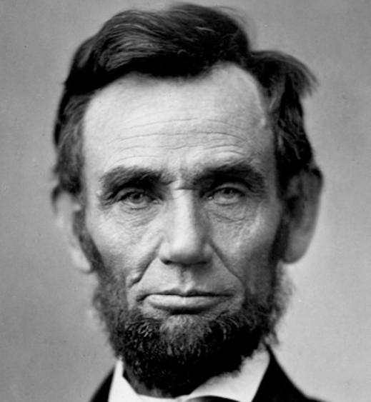


Slide 48
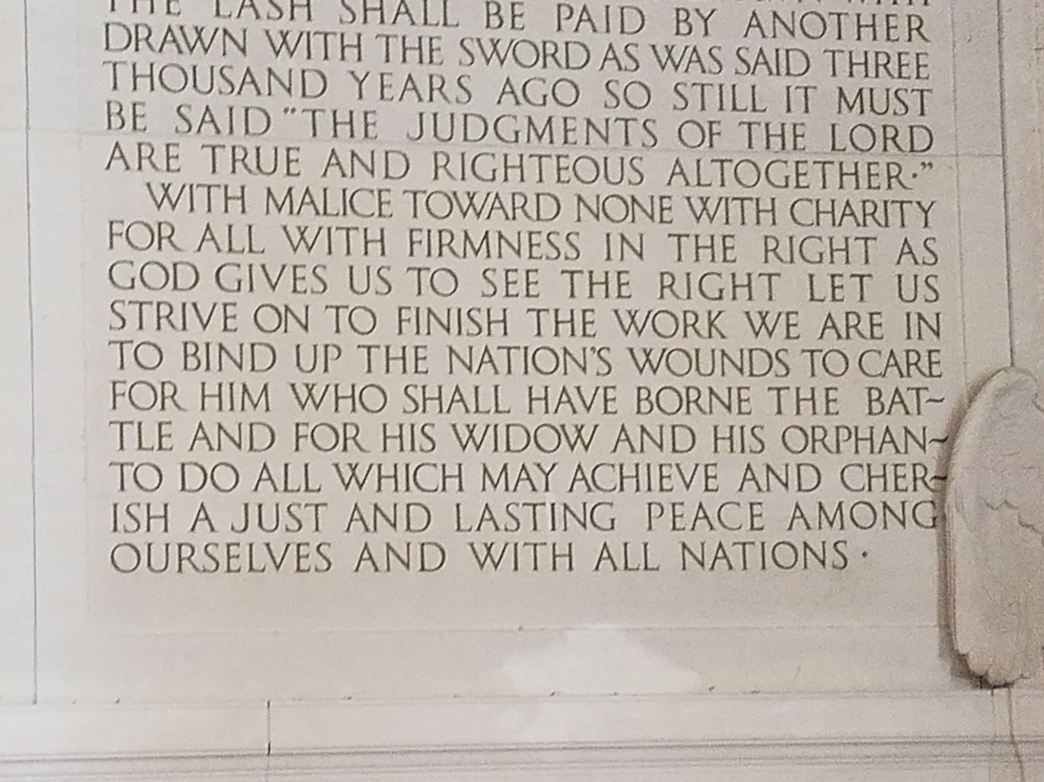
Abraham Lincoln, 2nd Inaugural Address, March, 1865.

Slide 49

Make Peace, Not Love
Focus on Better Virtues than
Brotherhood:
Justice,
Common Sense, and
Imagination

