Slide 1

The ACA’s 6th Birthday:
Is a Party or a Funeral in its Near Future?
Len M. Nichols, Ph.D.
George Mason University
Osher Lifelong Learning Institute
Fairfax, VA
April 27, 2016

Slide 2
Outline
Why the law passed
What Law Did/Does
Scorecard of Performance So Far
Likely debates during and after the 2016 elections

Slide 3
This is Why the ACA Passed in 2009-10!

Slide 4
Cost of Family Coverage / FPL*, Median Family Income , 2014
Premium /
Poverty

Slide 5
Goals of the ACA
Improving Equity
  Increasing subsidized health insurance coverage
    Private insurance and Medicaid
  New rules in all insurance markets
  Prevention and Public Health Trust Fund
Improving Efficiency
  Incentivizing providers to generate more value
    Medicare payment cuts
    Medicare payment reform demos and pilots
      Some of which include Medicaid and Private participation
    Patient Centered Outcomes Research Trust Fund
  Regulations on insurance plans in New Marketplaces

Slide 6
What is the ACA Really About?
Elevating population health and stewardship
Signaling that “business as usual” is over
Changing Obsolete Business Models
Incentive Realignment

Slide 7
Incentive Alignment Is Multi-Dimensional
Community
Patient
Employer/Payer
Clinicians
Coverage $
Community
Decision Support
Wellness &
Cost Sharing
Payment
Reform

Slide 8
Criteria for Judging ACA Performance
Coverage
Cost
  National
  Federal
  Family
Quality
Health
Politics

Slide 9
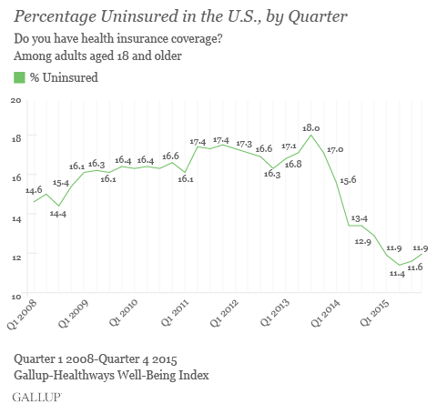

Slide 10
Newly Enrolled by Source, US millions
Source: Kaiser Family Foundation, based on ASPE data.

Slide 11
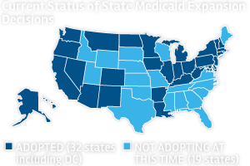

Slide 12
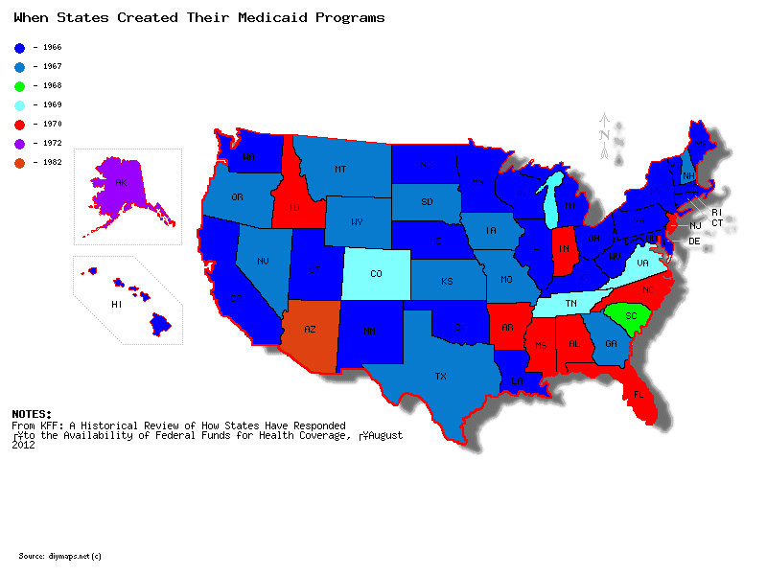

Slide 13
Some Less Fun Facts About ACA and Insurance Rules
“Essential Health Benefits” are more generous than 3-4m people were buying in non-group market in 2013
Insurance market regulations favor unhealthy over the healthy, (some) consumers over insurers and other consumers
Transparency and new business models may increase competition in the long run in many insurance markets

Slide 14
Growth in health spending, share of GDP of health spending

Slide 17
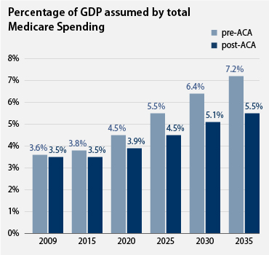

Slide 18
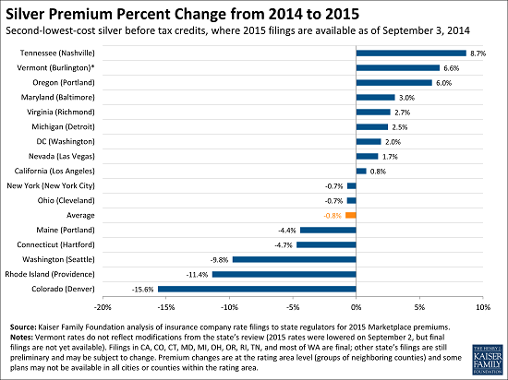

Slide 19
Premium Increases Modest in 2015
“The data, released by the Centers for Medicare and Medicaid Services, indicates that price increases will be modest for many people willing to change plans. In a typical county, the price will rise 5 percent for the cheapest silver plan and 4 percent for the second cheapest.”
New York Times, “Cost of Coverage Under Affordable Care Act to Increase in 2015”
By ROBERT PEAR, REED ABELSON and AGUSTIN ARMENDARIZ
NOV. 14, 2014

Slide 20
Premium Increases in Marketplace, 2015-16
AVG Penalty for NOT buying health insurance, 2016 = $969

Slide 21
MANY Switched Plans to Save $

Slide 23
Average Annual Marketplace Premium
2016 = $4,800 (unsubsidized)
= $1,272 (subsidized)
Average Annual Small Group Premium
2014 = $5,886
= $1,060 (employee share)

Slide 24
Exhibit 4. Change in All-Cause 30-Day Hospital Readmission Rates
Percent
Source of slide:
Commonwealth
Fund
Source: Patrick Conway, Office of Information Products and Data Analytics, Centers for Medicare and Medicaid Services.

Slide 25
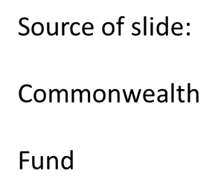
Exhibit 7. Change in Rates for Hospital-Acquired Conditions, 2010–13
Source: Agency for Healthcare Research and Quality, Efforts to Improve Patient Safety Result in 1.3 Million Fewer Patient Harms: Interim Update on 2013 Annual Hospital-Acquired Condition Rate and Estimates of Cost Savings and Deaths Averted from 2010 to 2013, Dec. 2014.

Slide 26
Oregon Medicaid Expansion Experiment
Legislature voted (2008) to expand access for childless adults more than budget allowed
Lottery was rationing device chosen => randomization provided opportunity to test hypotheses about impact of coverage vs. no coverage
Pre-dated but similar to expansions under ACA
1st year’s results (better self reported health status, esp. mental health) often dismissed

Slide 27
Oregon Results
From http://www.nber.org/oregon/3.results.html

Slide 28
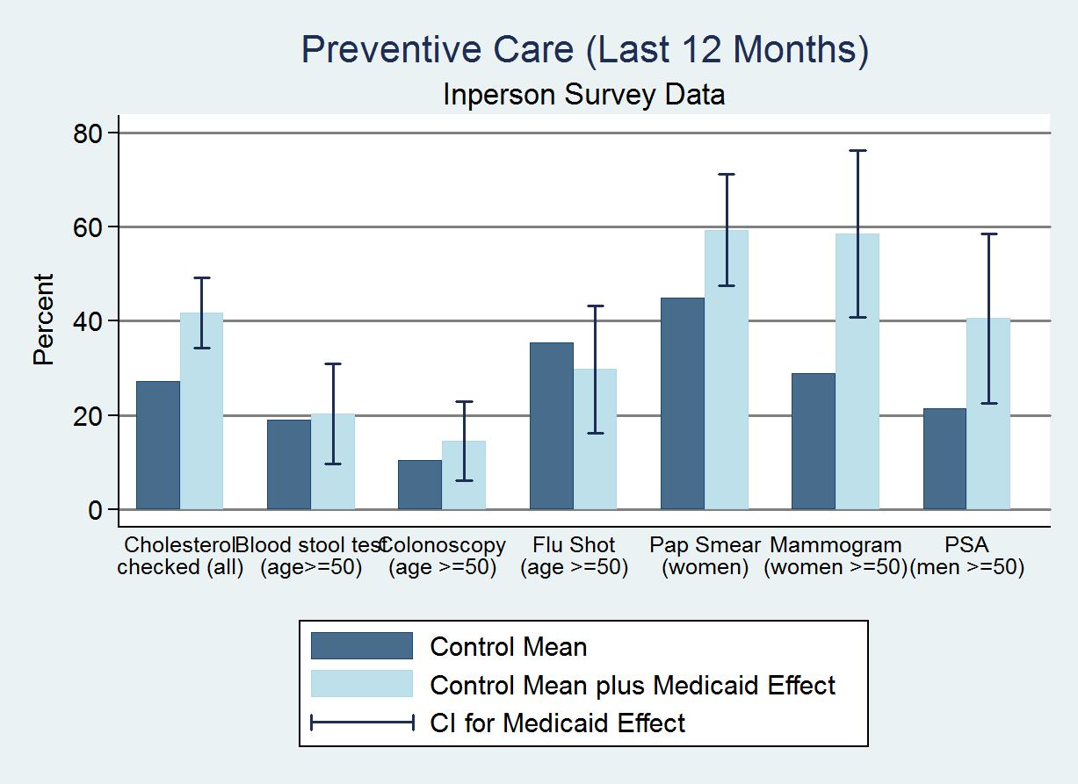

Slide 29
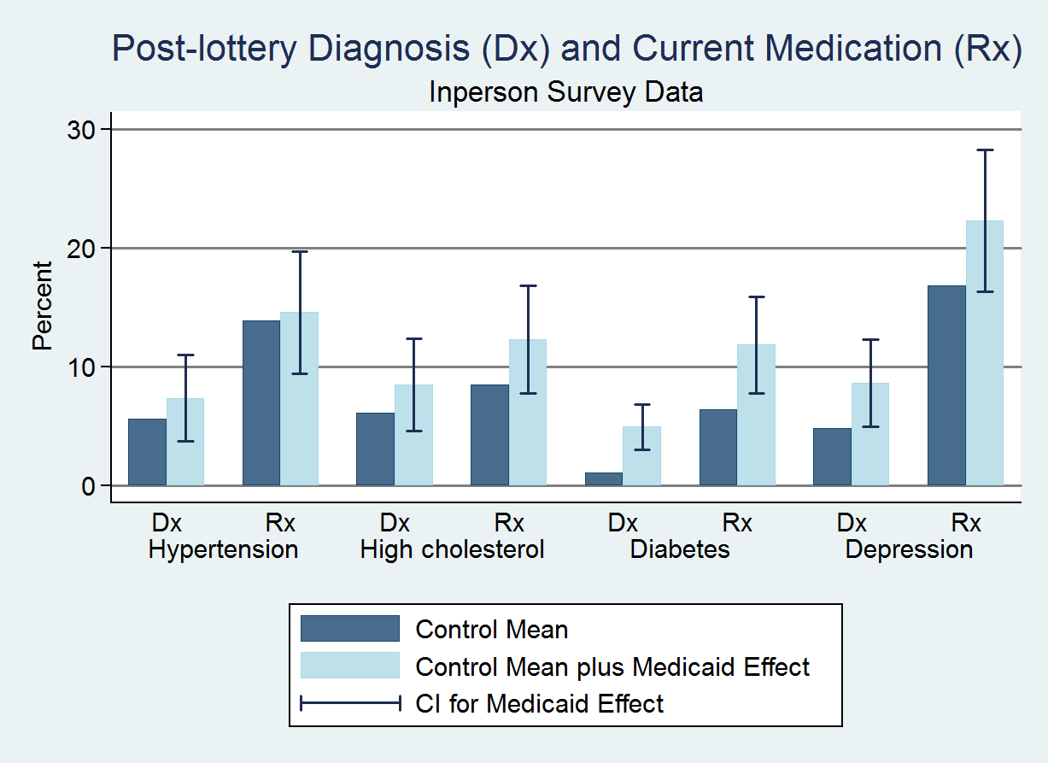

Slide 30

Massachusetts Is a “Natural Experiment”
  Romneycare was started in 2006
  Similar to ACA in structure as well
  Researchers compared Mass’ to surrounding states’ citizens’ mortality

Slide 31
Sommers et al
Annals of Internal Medicine
160(9)

Slide 32
Sommers et al

Slide 33
Mortality Reduction Confirms IOM and CEA projections, $ 130B-180B per year
Longer Life
Healthier Life
Productivity+

Slide 34
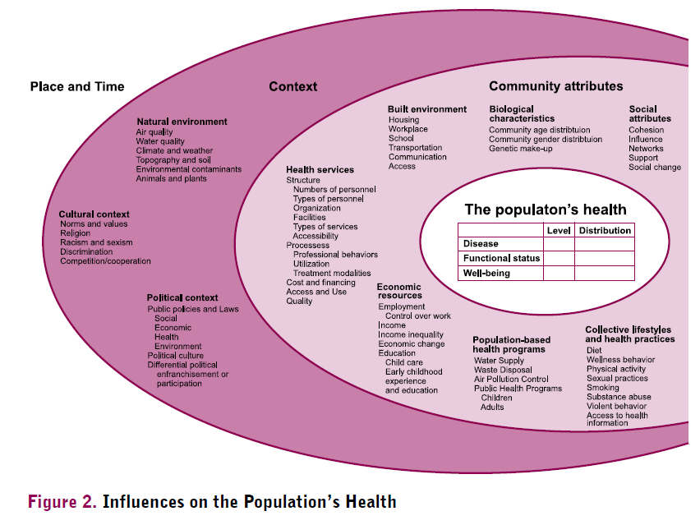
NCVHS, Shaping a Health Statistics Vision for the 21st Century, 2002.

Slide 35
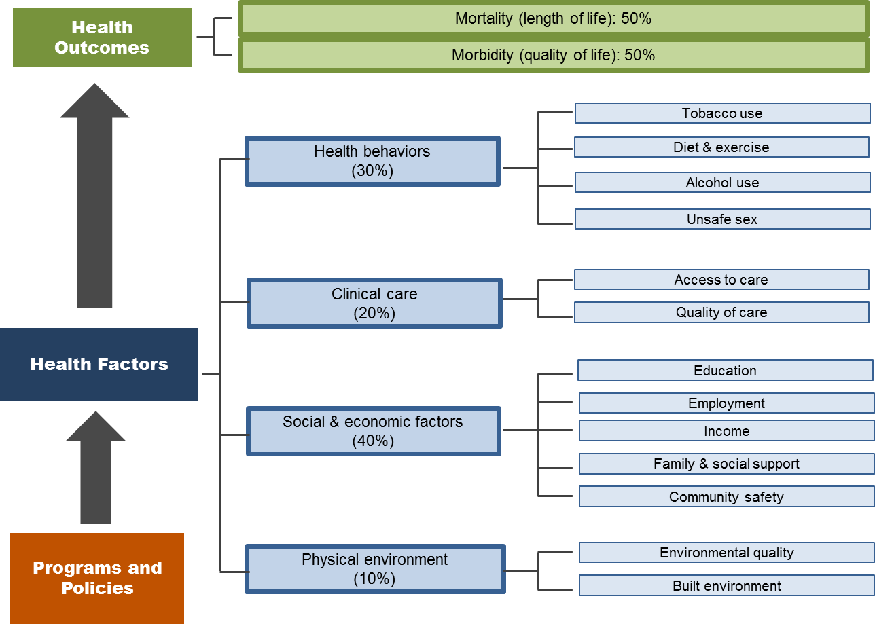
County Health Rankings, Our Approach, http://www.countyhealthrankings.org/our-approach

Slide 36
Breaking News: Important New Study on Income, Geography, and Health

Slide 43
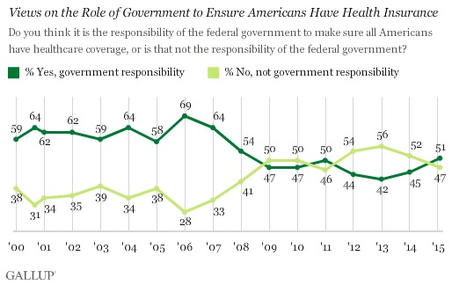

Slide 44


Slide 45


Slide 46


Slide 47


Black Sails

Slide 48
Election Impact on Health Policy
If an R wins WH, they will hold Senate and will repeal ACA as of 2019*, then replace it with something
If a D wins WH, they might take the Senate back and either way will also amend ACA
SO, no matter who wins WH, ACA will be modified
Will we learn of Congressional R alternative to ACA before 2017? Ryan vs. McConnell …

Slide 49
ACA Amendments/Changes on Table
Delay/Repeal unpopular taxes, cost-control (bi-Partisan support for these)
  Cadillac Tax, Device Tax, IPAB
Some Rs want to go further:
  Insurer tax, taxes on higher income people
  Reduce/end insurance market regulations, and purchase mandates
  Reduce generosity of subsidies
  Allow across state lines, larger HSAs, block grant Medicaid
  Bush would have capped ESI exclusion, institute age adj. tax credits
Hillary and Bernie want richer cost-sharing subsides and tougher drug price / out-of-pocket controls; Hillary will likely make a 1332 overture
NOTE: ALL R plans (Ryan, Burr-Hatch-Upton) preserve ACA Medicare payment changes, MACRA is bipartisan also

Slide 50
Conclusions
ACA has covered a lot of people
  But less than ½ of the uninsured
ACA has laid foundation for long term cost control
  But we are not assured of enough success yet
ACA has exacerbated debate/division over roles of government in American society and politics
  But may hold key to beginning of reconciliation, IF wise leadership is exercised…

