Slide 1
Chemistry for Those Who Hate or Flunked Chemistry
Lorrin R. Garson
Osher Lifelong Learning Institute
February 4, 2016
© 2016 Lorrin R. Garson
Notes:
Last edited February 1, 2016 @ 11:26 am
Length of lecture: 1 hr 25 min (85 min)
PowerPoint template from http://www.free-power-point-templates.com

Slide 2
Outline: Topics to Cover
Some historical developments
Relationships between the physical sciences
Blurring between the physical and biological sciences
The impact of chemistry on everyday life
Debunking a few commonly held beliefs
A few recent advances in chemistry

Slide 3
What did you do before you retired?
Response: “I’m a retired chemist”
Reactions…
“Oh”
“I hated chemistry!”
“I got a “D” in high school chemistry”
“I dropped out of pre-med when I took organic [chemistry]”
“You like pesticides, don’t you.”
“Oh, I’m so sorry!”

Slide 4
Why Is Chemistry Unpopular?
Cultural bias against:
science in general
chemistry in particular
Uninspiring teaching:
Unqualified high school teachers
Chem 101 at universities taught by junior staff
First chemistry course quite different from previous courses taken

Slide 5
Why Is Chemistry Unpopular? (cont.)
Student disinterest
Laboratory experience is new
Inadequate math skills
Basic arithmetic and algebra
Calculus
New complex vocabulary ⬅ click here for more information
Anode, enthalpy, entropy, stoichiometry, molarity, enantiomer, half-life, etc.
Naming of substances and reactions (memorization)
Complex and difficult issues—some counter intuitive (absolute zero, quantum chemistry, etc.)

Slide 6
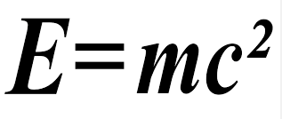
Everything in the Physical Universe…
… consists of
Energy
or
Matter (chemicals); there are 118 known elements
The relationship between matter and energy is:
The languages of science are mathematics and English
P.S. Theoretically two high energy photons colliding can produce an electron and a positron
Notes:
E in joules, m in kg and the speed of light as 299,792,458 meters/second
(86,282.397 miles/second)

Slide 7
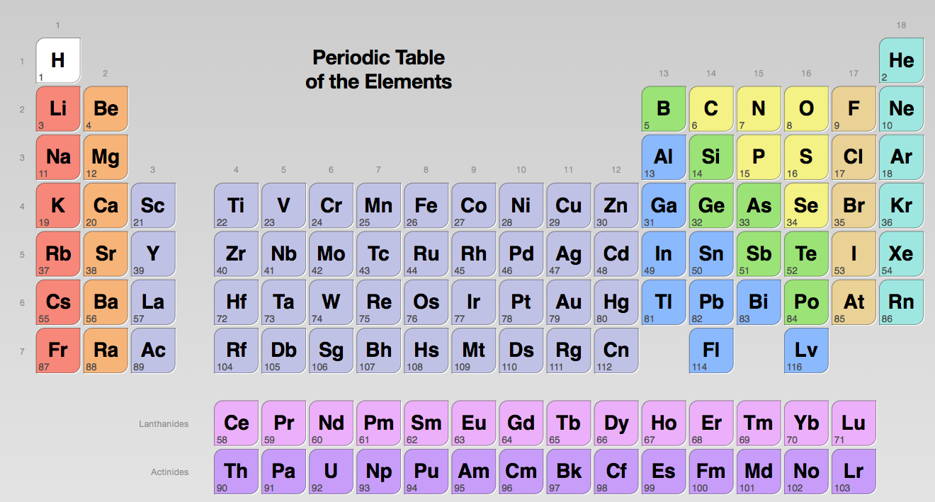
How unchangeable is this information?
Notes:
The element numbers correspond to the number of protons they have

Slide 8
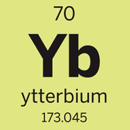
Breaking News! Ytterbium Loses Weight
The standard atomic weight of Yb is now 173.045, down from 173.054 (-0.0052%)
IUPAC evaluates atomic weights every two years, depending on new data available
On average, atomic weights of individual elements get updated about every 14 years
See

Slide 9
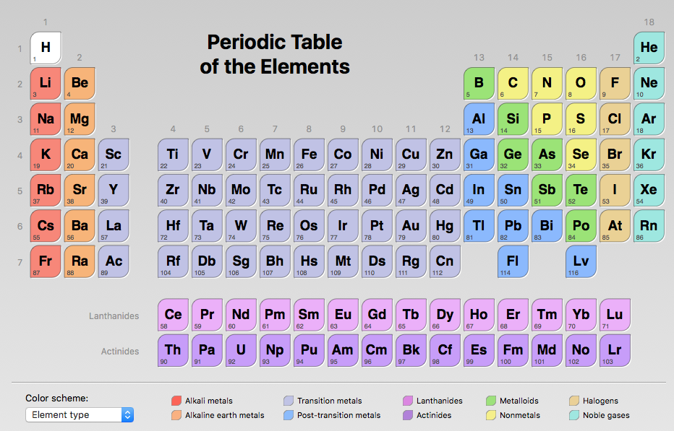
113
115
117
118
News Flash! In December 2015 four new elements were
reported: 113, 115, 117 and 118
Notes:
The element numbers correspond to the number of protons they have

Slide 10
How Many Known Chemicals Are There?
~106+ million organic and inorganic substances in CAS Registry; ~15,000 added daily
Also…
101,467,940 commercially available chemicals
85,952,894 synthetic preparations (reactions)
66,523,823 protein and DNA sequences
1,110,137 searchable chemical structures
345,380 inventoried/regulated substances
As of January 31, 2016 @ 3:32 pm
Notes:
Update these values just before the presentation
Click on right-most URL in slide.

Slide 11
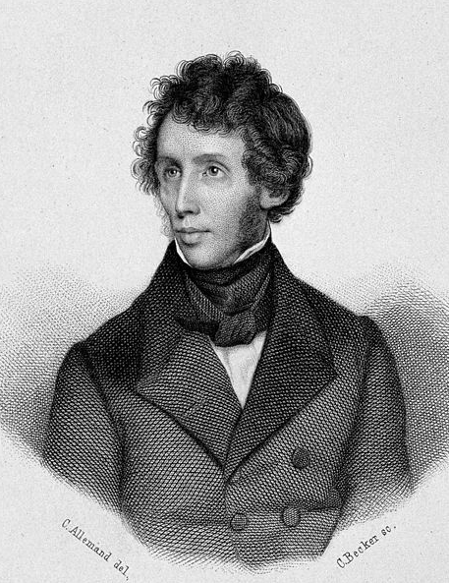
Friedrich Wöhler
1800—1882
http://

Slide 12
Friedrich Wöhler
Pioneer in organic chemistry
1828 synthesized urea from two inorganic compounds
AgOCN + NH₄Cl ➔ AgCl + [NH₄OCN] ➔ H₂N-CO-NH₂
The Vitalist hypothesis: "organic compounds” can only be made by living things
Mammals produce urea in the kidneys which is excreted in urine
Wöhler’s synthesis was revolutionary and controversial for many years
Notes:
Silver cyanate and ammonium chloride

Slide 13
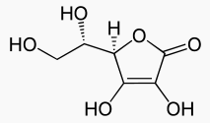
Vitamin C
An essential nutrient for humans
A cofactor in at least eight enzymatic reactions
Found in numerous fresh fruits, vegetables and meats
L-Ascorbic Acid
IUPAC Name: (R)-3,4-dihydroxy-5-((S)-1,2-dihydroxyethyl)furan-2(5H)-one

Slide 14
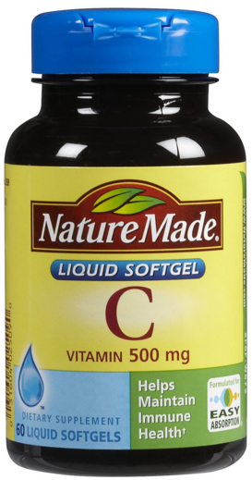
Vitamin C (cont.)
“Most all of our products are manufactured at our own facilities in Southern California”
80% of the world’s vitamin C is produced in China
Large doses of vitamin C have no clinical effect against the common cold
Common belief “natural is better”

Slide 15
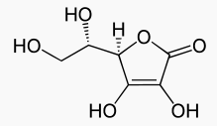
Natural
Vitamin C
Synthetic
Vitamin C
Identical in all respects: physical,
chemical and biological

Slide 16
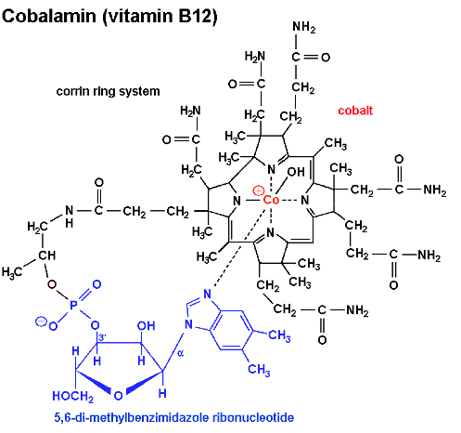
Synthesized by R. B. Woodward in 1972

Slide 17
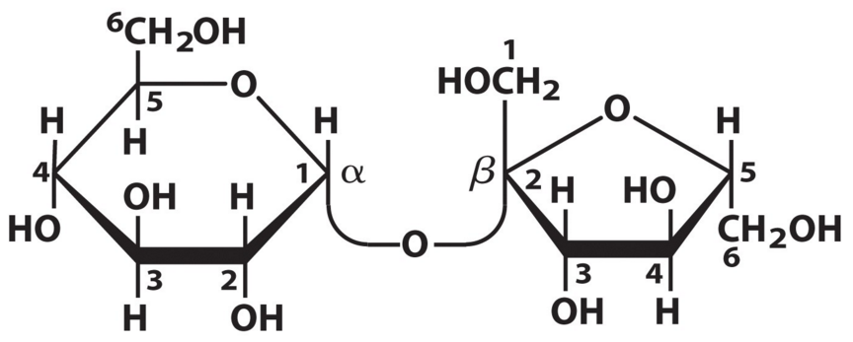
Which Best? Cane or Beet Sugar
There is no difference
Sucrose (table sugar) produced from both plants
A disaccharide of glucose and fructose
C₁₂H₂₂O₁₁

Slide 18
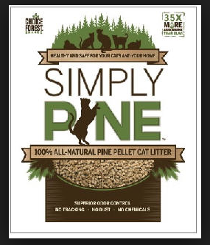
[cat liter] “…contains no chemicals…”

Slide 19
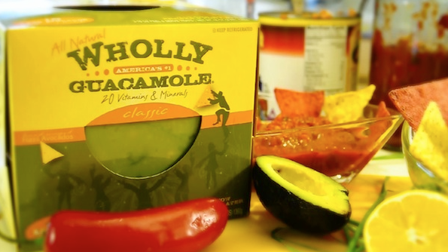
%
“This creamy avocado spread tastes better than
restaurant guac, and contains no chemicals…”

Slide 20
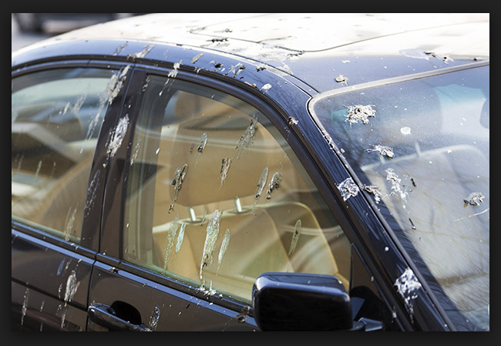

Slide 21
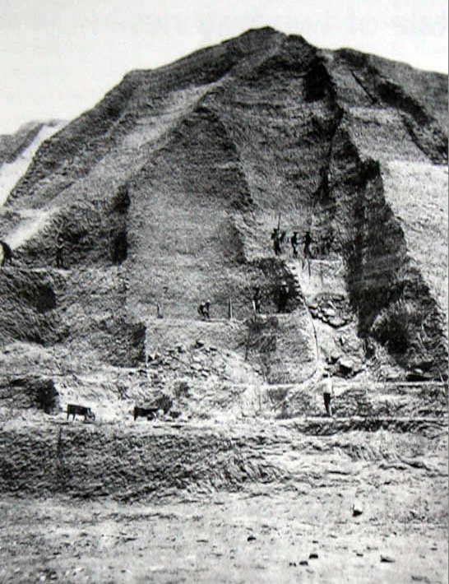
Mining guano in the
Chincha islands off
the coast of Peru
c. 1860
Notes:
Photo from https://en.wikipedia.org/wiki/Guano (edited with Photoshop Elements)

Slide 22
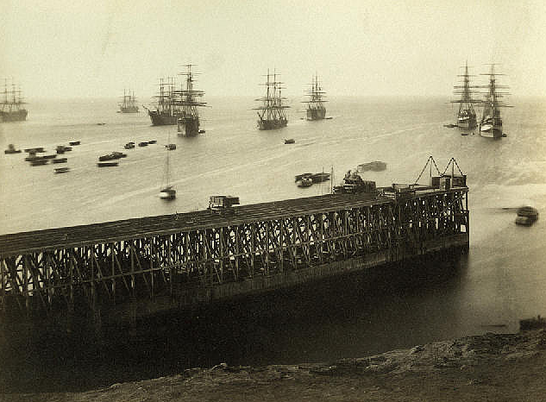
Chincha Island Harbor
Notes:
20% OF TIME 17 MINUTES
Photo from https://www.flickr.com/photos/nbwm/2894983189 Edited with Photoshop Elements

Slide 23
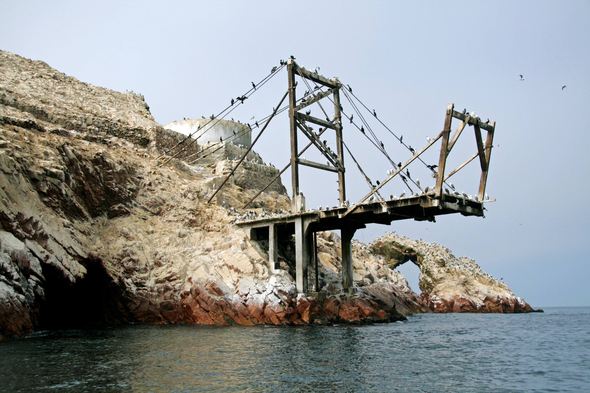
Islas Ballestas, Peru
January 16, 2013
Notes:
Ann and I visited Ballestas Islands off coast of Peru on January 16, 2013

Slide 24
Bird Guano
First used by Carthaginians in ~200 BC
Imported to England from Peru 1840s
Germany was highly dependent on imported fertilizer
World War 1: England imposed naval blockade of Germany
Nitrogen compounds desperately needed in Germany for agriculture and munitions

Slide 25
Where to get nitrogen?
Composition of dry air:
N₂ 78.09%
O₂ 20.95%
Ar 0.93%
CO₂ 0.04%
Traces of: H₂, Kr, Ne, He and CH₄

Slide 26
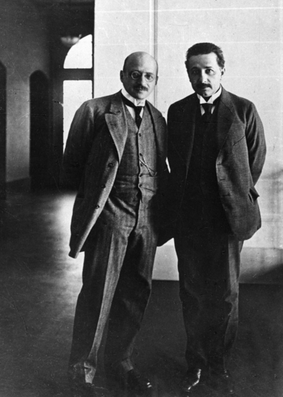
Fritz Haber ➔
Albert
Einstein

Slide 27
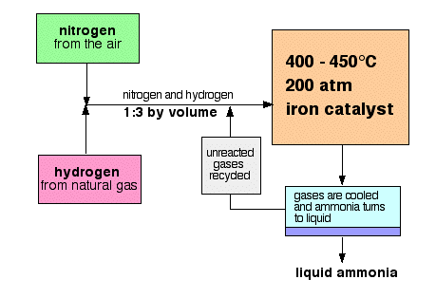
Haber—Bosch Process
⬆ More about this later
Notes:
See http://chemguide.co.uk/physical/equilibria/haber.html
Carl Bosch: Nobel Prize in Chemistry 1931. Managing Director BASF. Chairman of the Board of Directors I.G. Farben in 1935.

Slide 28
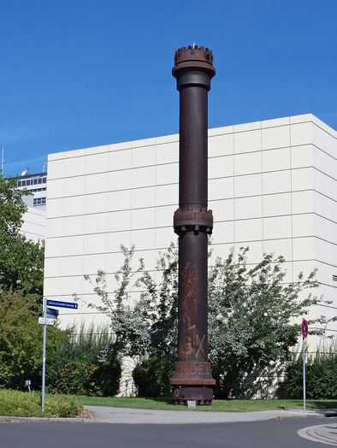
Steel pressure
reactor to produce
NH₃ (1921)
Karlsruher Institut für Technologie
Notes:
Created in 2009 by combining the University of Karlsruhe (Universität Karlsruhe)
with the Karlsruhe Research Center Forschungszentrum Karlsruhe (aka)
The National Nuclear Research Center (Kernforschungszentrum Karlsruhe

Slide 29
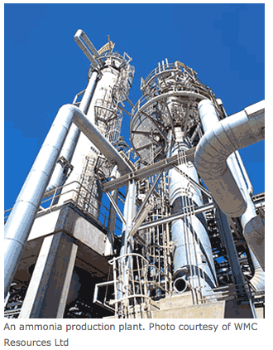

Slide 30
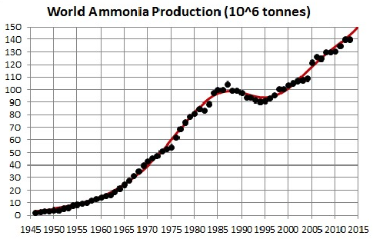
See

Slide 31
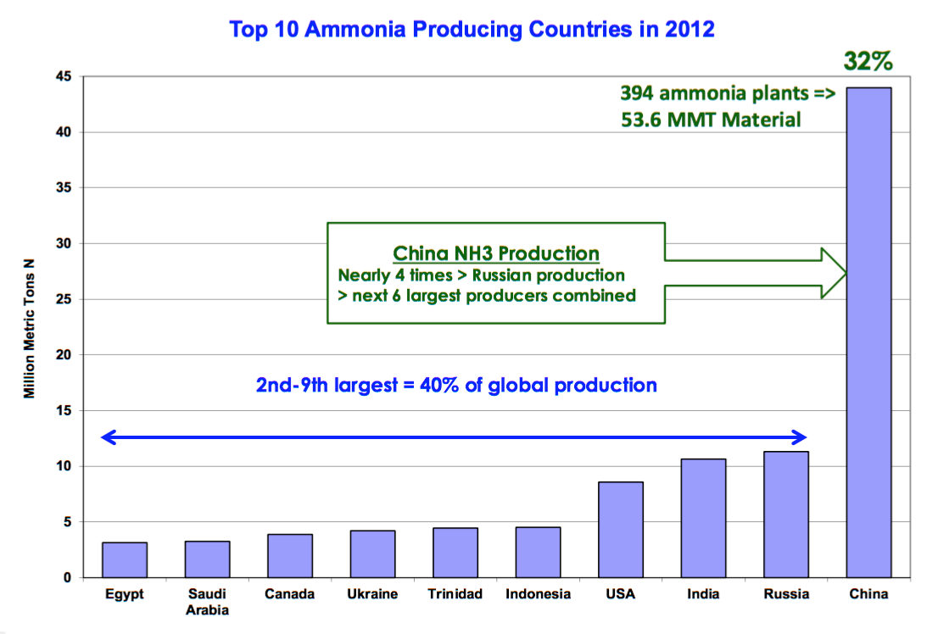
See

Slide 32
Without Synthetic Fertilizers…
1898 William Crookes predicted “millions will starve to death due to lack of nitrogen fertilizer…”
World Population:
1898: ~1.7 billion
2015: ~7.3 billion
Without the Haber-Bosch process, draw your own conclusions…
And then the impact of…
Pesticides & herbicides
Plant breeding & genetic engineering
Farming technology
Notes:
1898-2015 (117 years) world population increased by a factor of 4.3

Slide 33
Uses of Ammonia
Fertilizers
Pharmaceuticals
Dyes
Cosmetics
Explosives (mining, construction, etc.)
Waste water treatment
Rubber production
Pulp and paper production
Household cleaners
Munitions

Slide 34
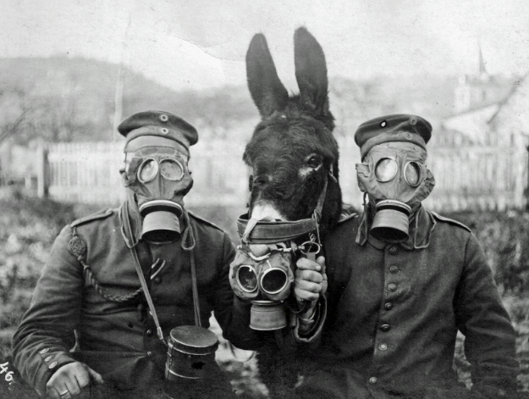
Back to World War 1…

Slide 35
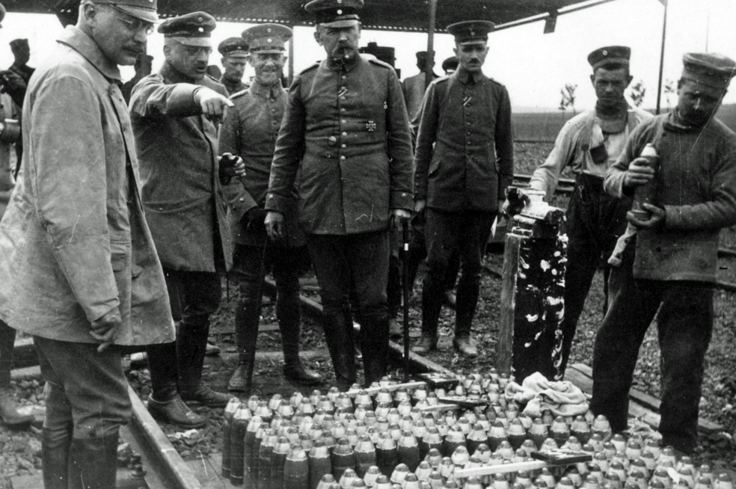
Hauptmann Fritz Haber

Slide 36
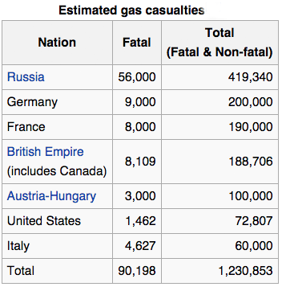
Gas Warfare
Fritz Haber—”father of chemical warfare”
WW-1 Total Casualties
38 million
18 million deaths
20 million wounded
Notes:
See https://en.wikipedia.org/wiki/Chemical_weapons_in_World_War_I
World War 2 deaths are estimated between 50-80 million

Slide 37
Comments on Fritz Haber
1908: Developed Haber—Bosch process
1916: Chief of Germany’s Chemical Warfare Service
1918: Nobel Prize in Chemistry
1918+: Ostracized and vilified by scientific community
1918-1932 Important contributions in electrochemistry and thermodynamics
1933: Dismissed from all positions by Nazis—went into exile
1934: Died in Basel, Switzerland
Notes:
Einstein was visiting in the U.S. in 1933 when Nazis came to power.
He did not return to Germany becoming a U.S. citizen in 1940.

Slide 38
Fritz Haber One more thing…
Treaty of Versailles required Germany to pay 50 billion gold marks in reparations ($12.5 billion USD)*
Where to get this money?
*$171.5 billion in 2016 money

Slide 39
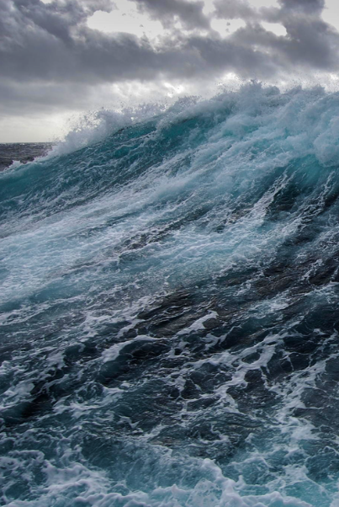
What’s of value
in the oceans?
Fish
Oil
Minerals
Gold

Slide 40
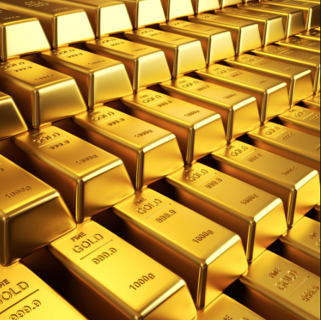
X
Gold?
Each cubic mile of seawater contains 42-125 g Au worth $1,400 to $4,300
The oceans contain ~20,000,000 tons of gold!
Notes:
Each liter only holds 13 billionths of a gram.
You would have to process 25 million gallons of seawater to get 1 Troy oz. of gold.
Price of gold $1,122 per Troy oz. or $36.07 per gram (January 28, 2016)
1 Troy oz. = 31.1035 g

Slide 41
Notes:
Ciara with 15 carat diamond ring. Real name: Ciara Princess Harris

Slide 42
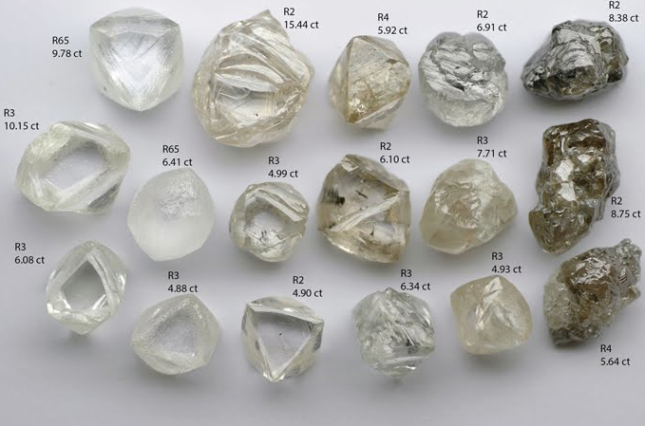
Uncut Diamonds

Slide 43
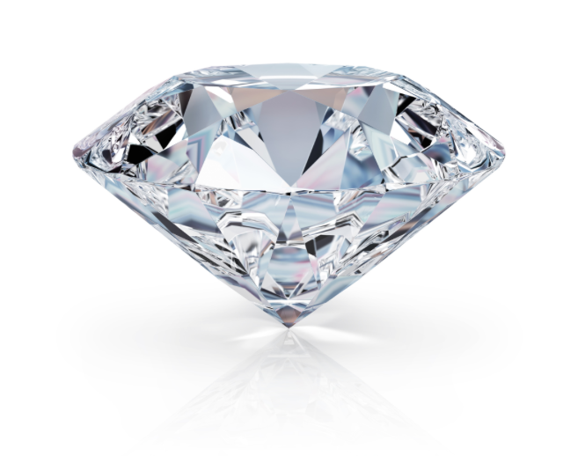
Notes:
40% OF TIME 34 MINUTES

Slide 44
Properties of Diamond
An allotrope of carbon (other types: graphite, amorphous carbon, carbon fiber)
Colors: white, brown, yellow, gray, black, blue, green, orange, purple, pink & red
Mined (natural) diamonds are formed deep within the earth under high temperature and extreme pressure
High thermal conductivity (5X copper)
A good electrical insulator
Very hard (Mohs scale 10)
1 Carat = 200 mg = 0.00705479239 oz
Notes:
Diamonds are found in volcanic pipes in Kimberlite or Lamproite

Slide 45
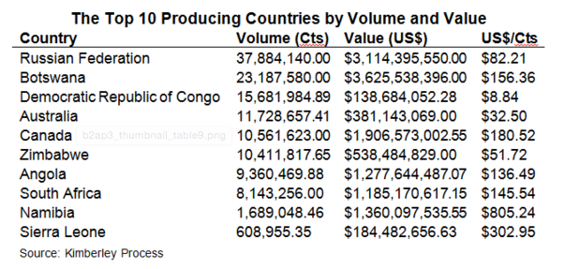
Source of Mined Diamonds
Reported July 8, 2015
From:
Total production: 129,257,532 Ct = 25,851.5 kg = 56,992.8 lbs.

Slide 46
From:
Volume in millions of carats

Slide 47
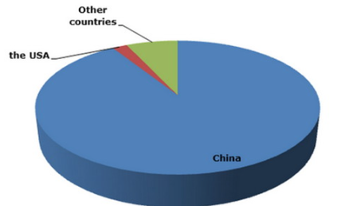
Which country produces the most industrial diamond?
90%

Slide 48
Common Perspective Mined vs. Manufactured
Mined:
Genuine
Real
Natural
Manufactured:
Fake
Synthetic
Simulated
Unnatural

Slide 49
Differences Between Mined & Manufactured Diamond
Both have same chemical and physical properties (refractive index, density, hardness, light dispersion, crystalline structure, spectral characteristics, chemical composition (C), etc.
Generally mined diamonds have more impurities and crystal irregularities
Generally manufactured diamonds are larger
Usually a mined diamond cannot be distinguished from a manufactured diamond
Jewel grade manufactured diamonds are 20-30% less expensive than mined diamonds

Slide 50
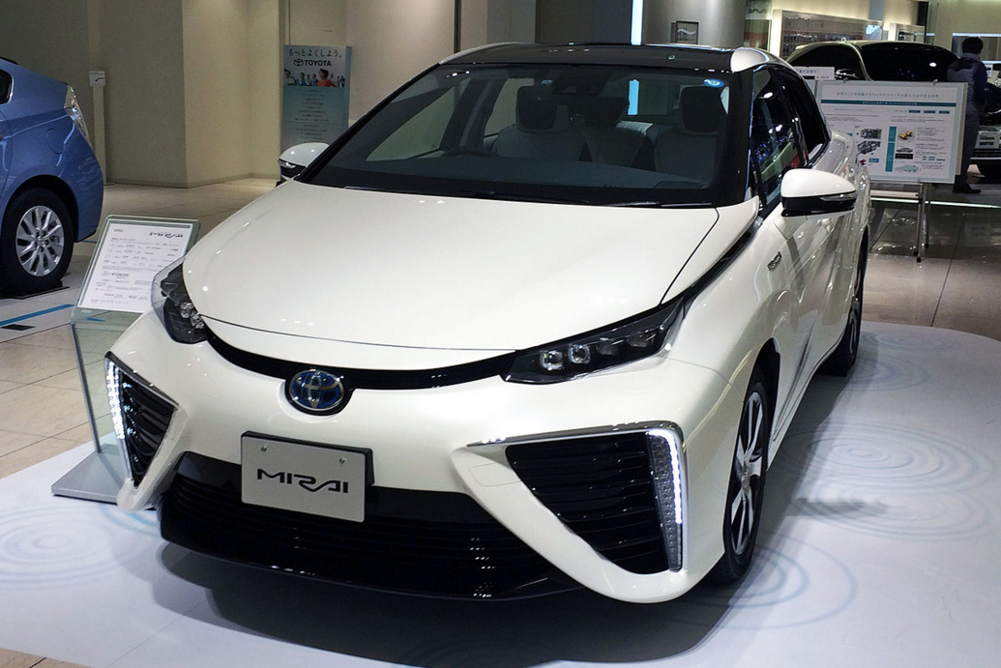
Toyota Mirai Fuel Cell Sedan
First hydrogen fuel cell vehicle sold commercially
$58,335

Slide 51
What is a Fuel Cell?
A device that generates electricity by a chemical reaction between a continuous source of fuel and oxidant

Slide 52
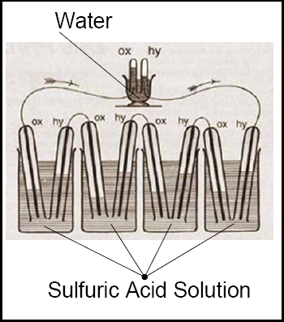
Sketch William Grove’s Fuel Cell 1839

Slide 53
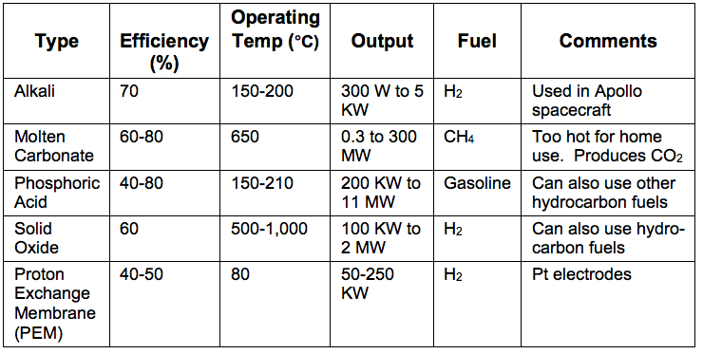
Types of Fuel Cells
1 KW = 1.341 HP
Modern gasoline engines have an efficiency of 25-30%
Modern diesel engines have an efficiency up to 50%

Slide 54
PEM Hydrogen Fuel Cell
How a H₂ fuel cell works:
⬅ Go Ahead—
Click Here!

Slide 55
Hydrogen Powered Vehicles
Powered by:
Fuel cell
Combustion 2H₂ + O₂ ➔ 2H₂O
“Zero emissions out the tail pipe”
BUT…
95⁺% of H₂ produced in U.S. comes from natural gas
CH₄ + 2H₂0 ➔ 4H₂ + CO₂

Slide 56
Challenges with Hydrogen Powered Vehicles
Need environmental friendly source of H₂
Distribution channels for H₂ not in place
Transportation and storage of H₂ is energy demanding ($$)
H₂ powered vehicles more expensive to produce
But… 2NH₃ ➔ 3H₂ + N₂ (?)
Ammonia can be used as a fuel in internal combustion engines
Notes:
BP Hydrogen is -259.34 C or 20.20 K
Ammonia could be used directly as a fuel in internal combustion engines

Slide 57
Challenges with Hydrogen Powered Vehicles (cont.)
And… CH₄ ➔ 2H₂ + C (?) (in molten tin)*
Fuel cells not as robust as internal combustion engines
Education of public needed concerning: safety, benefits, dependability, advantages and disadvantages
*The Economist, Dec 15, 2015, p. 77

Slide 58
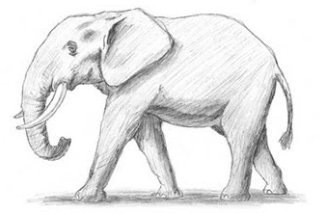
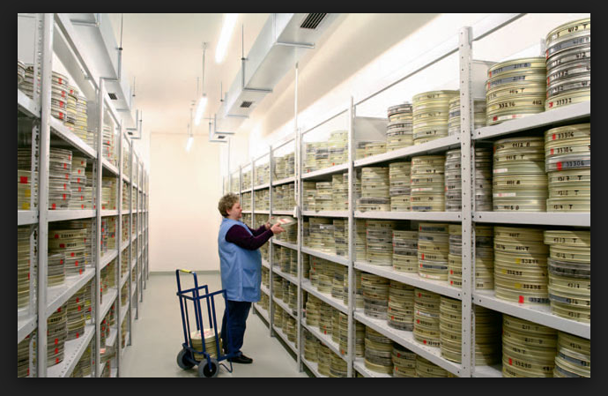
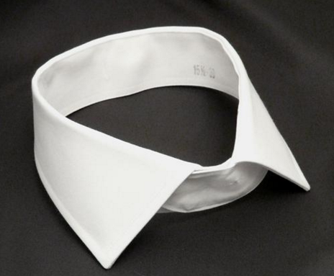
http://
Notes:
Elephant, billiard ball, nitrocellulose film
Celluloid collar

Slide 59
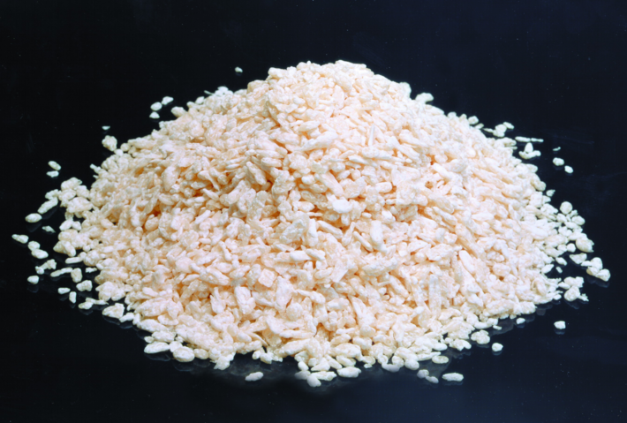
Nitrocellulose
Henri Braconnot 1832
http://

Slide 60
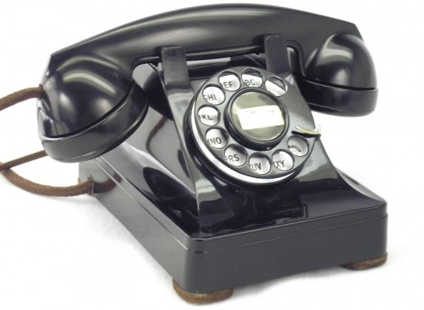
Types of Plastics (Polymers)
Bakelite (1907): electrical and mechanical parts
Polyvinyl Chloride (1930s): plumbing, gutters, house siding
Polystyrene (1930s [1839]): toys, dinnerware, plates and cups (Styrofoam)
Nylon (1930s): clothing, rope, cookware, machine parts
Polyesters: clothing, pillows, upholstery, rope

Slide 61
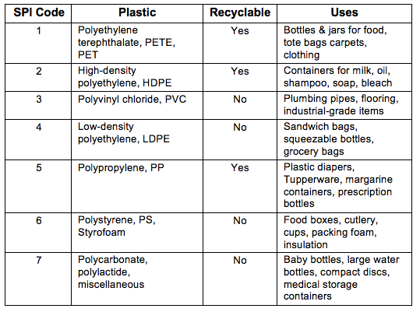
Society of the Plastics Industry

Slide 62
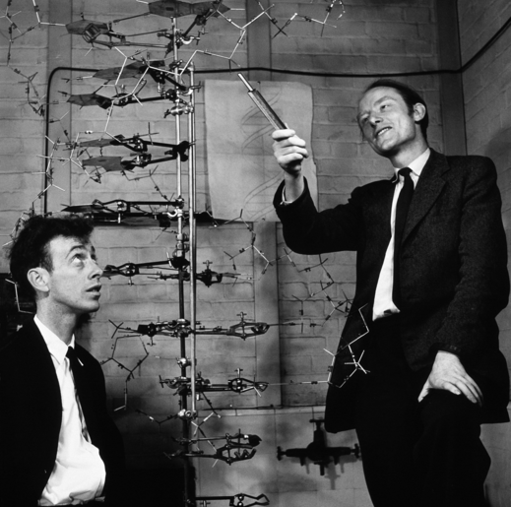
1953
http://
James Watson
Francis Crick
Notes:
1962 Nobel Prize in Physiology or Medicine,
also with Maurice Hugh Frederick Wilkins
James Watson 1928-
Francis Crick 1916-2004
Maurice Hugh Frederick Wilkins 1916-2004

Slide 63
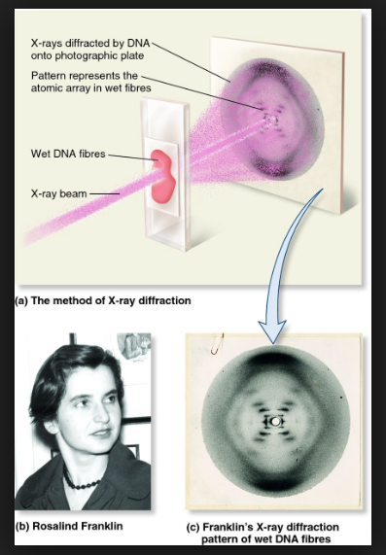
Notes:
Rosalind Franklin: 1920-1958 (ovarian cancer)

Slide 64
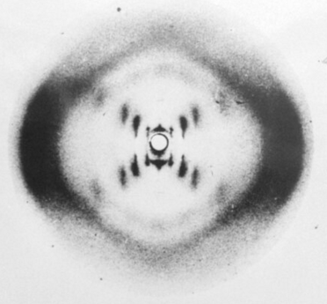
The “X” shape of the image indicates a helical structure
Notes:
60% OF TIME 51 MINUTES

Slide 65
Functions Deoxyribonucleic Acid (DNA)
“The blueprint of life”—for all living things
Controls day-to-day function of cells
Contains directions (blueprint) to construct other cell components such as proteins and RNA
Self-repairing in cells—correcting damage to DNA
1962 Nobel Prize for Watson, Crick and Wilkins*
Potential for long term storage of digital information
And the chemistry of DNA…
*Rosalind Franklin almost certainly would have been included had she lived
Notes:
Researchers at Harvard stored 700 TB of digital data in1 g DNA.
DNA is decoded though normal sequencing processes to retrieve digital data
In RNA uracil replaces thymine and ribose replaces deoxribose.
RNA is a single strand helix
Some viruses use RNA in their genetic material

Slide 66
Composition Deoxyribonucleic Acid (DNA)
Made of five elements: C, H, N, O, P
Consists of six chemical substances
Ribose
Phosphoric acid
Adenine
Thymine
Cytosine
Guanine

Slide 67
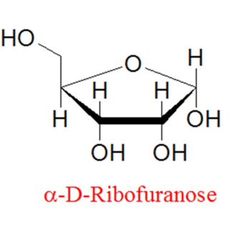
Ribose & Phosphoric Acid
H₃PO₄
Notes:
Sucrose is a disaccharide of glucose and fructose

Slide 68
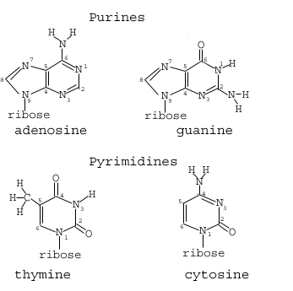
DNA’s Four Bases

Slide 69
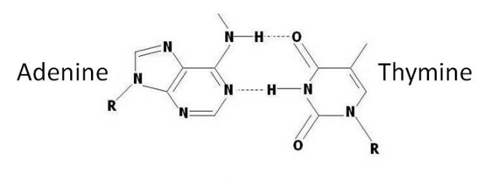
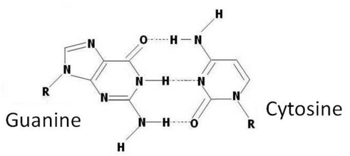
DNA Nucleotide Pairing
A + T = 1
G + C = 0

Slide 70
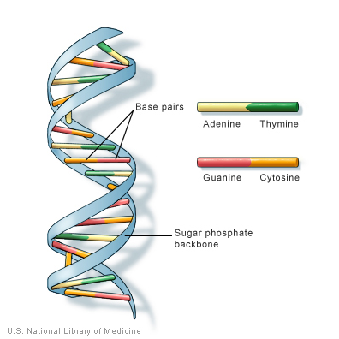
DNA Double Helix
⬅ Go Ahead—
Click Here!

Slide 71
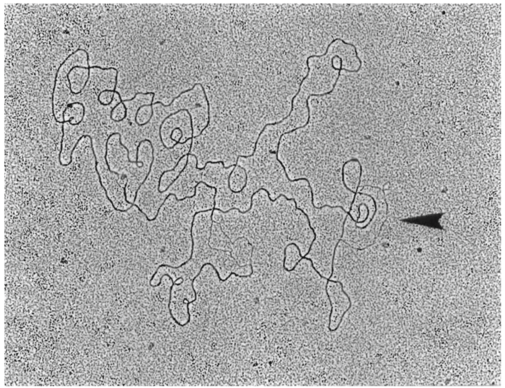
Electron micrograph of a representative λ
circular DNA containing a D-loop structure

Slide 72
Tobacco Mosaic Virus (TMV)
A virus that infects tobacco and other Solanaceae
Structure studied by Rosalind Franklin with Wendell Stanley*
First virus identified (1892)
The first virus to be crystallized
Franklin also worked on trying to determine the structure of the polio virus
Arguably the beginning of molecular biology
*Nobel Prize in Chemistry 1946
Notes:
*Nobel Prize in Chemistry in 1946

Slide 73
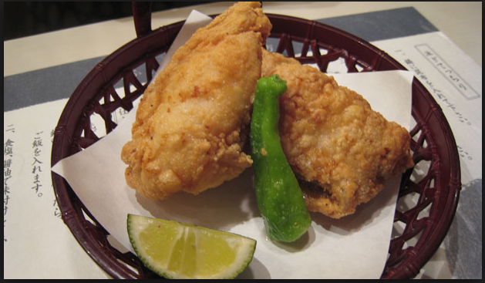
Do you like seafood?
http://

Slide 74
Fugu, Japanese Blowfish or Puffer Fish

Slide 75
Tetrodotoxin (TTX)
Present in the liver, ovaries and skin of fugu fish
Toxicity
LD₅₀ (mice) 334 μg per kg (334 μg = 0.0000117 oz.)
1000 to 10,000 times more toxic than KCN
50-100 people a year die in Japan from TTX
Notes:
0.0000117 is 11.7 millionths of an ounce

Slide 76
Tetrodotoxin (TTX) (cont.)
IUPAC Name: (4R,4aR,5R,6S,7S,8S,8aR,10S,12S)-2-azaniumylidene-4,6,8,12-tetrahydroxy-6-(hydroxymethyl)-2,3,4,4a,5,6,7,8-octahydro-1H-8a,10-methano-5,7-(epoxymethanooxy)quinazolin-10-olate
CAS Number: 4368-28-9

Slide 77
Donald J. Cram
1919-2001
Ph.D. Harvard (Louis Fieser)
Professor at UCLA (“The Bruins”)
Taught Chemistry 101 (freshmen) for many years
1987 Nobel Prize in Chemistry (Jean-Marie Lehn & Charles Pedersen)
The Tonight Show, Oct 15, 1987
“Now I do a good job on carpets, but this seemed a little excessive”
The party…
Notes:
The Donald Cram on the Tonight Show on October 15, 1987 was Donald O. Cram, who had a carpet cleaning business and had been a chemistry student at USC and knew of Donald J. Cram. Donald O. Cram was contacted by the Royal Swedish Academy of Sciences in Stockholm and told he had won the Nobel Prize in Chemistry.
15-crown-5
Nobel prize for work on the synthesis of macrocyclic polyethers, aka crown ethers.

Slide 78
UCLA Bruin—Morning After

Slide 80
Louis
Fieser
1899—
1977
http://

Slide 81
Louis Fieser
Professor at Harvard University
World War 2
Project X-ray (drop bats with incendiary charges on Japan)
Invent napalm—produced by Dow Chemical
1962 Served on U.S. Surgeon General’s Advisory Committee that issued landmark report on relationship between smoking and health
Was a chain smoker—had lung cancer
Notes:
Napalm is a mixture of gasoline and Al salts of naphthenic acid and palmitic acid

Slide 82
Robert
Burns
Woodward
1917—1979
http://

Slide 83
R. B. Woodward
1936 B.S. (MIT)
1937 Ph.D. (MIT)
Professor at Harvard 1937—1979
1965 Nobel Prize in Chemistry (Nobel lecture* )
20+ honorary degrees
Preeminent organic chemist of the 20th century
Trained 200+ Ph.D. students and postdocs
Published ~200 scientific papers
Many papers published after his death
*Synthesis of cephalosporin C, 121 pp.
Notes:
Woodward completed BS in 3 years He started inn 1933, not admitted in 1934, graduated in 1936.
Roald Hoffman (Cornell) and Kenichi Fukui received 1981 Nobel Prize in chemistry for Woodward-Hoffman rules

Slide 84
Substances Synthesized by R. B. Woodward
Estrone
53-16-7
Cholesterol
57-88-5
Notes:
Awarded Ph.D. for synthesis of Estrone
Estrone is an estrogen, a female sex hormone
Estrone is carcinogenic

Slide 85
Substances Synthesized by R. B. Woodward (cont.)
Quinine
130-95-0
Notes:
Quinine an antimalarial from cinchona tree

Slide 86
Substances Synthesized by R. B. Woodward (cont.)
Cortisone
53-06-5
Strychnine
57-24-9
Notes:
80% OF TIME 68 MINUTES
Cortisone produced in adrenal cortex
An anti-inflammatory anti-allergic drug
Strychnine (toxic alkaloid) from Strychnos nux-vomica tree

Slide 87
Substances Synthesized by R. B. Woodward (cont.)
Reserpine
50-55-5
Lysergic Acid
82-58-6
Notes:
Lysergic acid (LSD is diethylamide) a psychedelic drug
Reserpine is n antipsychotic and antihypertensive drug; an indole alkaloid

Slide 88
Substances Synthesized by R. B. Woodward (cont.)
*Cephalosporin C
61-24-5
Chlorophyll c1
18901-56-9
*Structure taken from R. B Woodward’s
Nobel Prize lecture
Notes:
There are 6 chlorophylls: a, b, c1, c2, d and f
Found in chloroplasts in plants; critical in photosynthesis
Cephalosporin is a beta-lactam antibiotic

Slide 89
The Ig Nobel Prizes
Awarded annually in October for ten unusual or trivial achievements in scientific research
2015 Ig Nobel Prize in Chemistry: for inventing a chemical recipe to partially un-boil an egg

Slide 90
2000 Ig Nobel
Prize in Physics
To Andre Geim &
Michael Berry
Magnetically Levitating a live frog

Slide 91
2010
Nobel
Prize
in
Physics
To Andre Geim for
Work on graphene

Slide 92
Some Recent Advances
in Chemistry
http://

Slide 93
Solar Energy
2008 to 2015: 1.2 GW to 20 GW (4 million homes)
Cost of solar panels dropped 50% from 2011 to 2014
Solar energy now competitive with conventional energy sources in California, Hawaii, Texas & Minnesota
Net-metering (utilities must buy power from customers)
Who pays for the grid?
Numerous regulatory and political issues
For more information see

Slide 94
Detecting Ovarian Cancer
In U.S. ~22,000 new cases/year; ~14,000 deaths
A flexible film with gold nanoparticles
Electrical properties changed by organic compounds associated with ovarian cancer
The sensor detects ppb of these volatile organic compounds with 82% accuracy. From Nano Letters 2015
Notes:
A nanoparticle is 1 to 100 nanometers in size
25 nm = 1 millionth of an inch
100 nm = 4 millionths of an inch

Slide 95
Compounds Associated with Ovarian Cancer
Styrene
Nonanol
2-Ethylhexanol
Decanal
3-Heptanone
Hexadecane
Notes:
styrene, nonanol, 2-ethylhexanol, 3-heptanone, decanal, and hexadecane

Slide 96
Treating Parkinson’s Disease
Parkinson’s disease impacts ~1 million Americans
A 0.8 μm gold wire mesh, encapsulated in biocompatible epoxy based polymer, is injected into the brain [schematic picture to come]
Mesh hooked up to external electronics via printable conductive ink
Method approved by FDA to generate electric impulses for treating Parkinson’s disease
Technique can also be used for monitoring brain activity
Notes:
0.8 micrometer = ~3 100,000th of an inch
Taken from Chemical & Engineering News, December 21, 2015, p. 21

Slide 97
Needle injected in
brain to desired depth—
mesh introduced
Needle withdrawn
allowing mesh to
unfold
A piece of the mesh
outside tissue ready to
connect to external
electronics
Work done at Harvard University, Department of Chemistry
and Chemical Biology

Slide 98
Ah, the good old days…

Slide 99
The Darwin Awards
To recognize individuals who improve the human gene pool by death or sterilization by their own actions
A 28-year-old demolition worker attempted to commit suicide by washing down nitroglycerine pills with vodka. After swallowing the pills, he tried to explode the nitroglycerine by repeatedly ramming himself into a wall. He was treated for bruises and released from the hospital… with counselling.
A Honorable Mention (February 2001):

Slide 100
Back on track…

Slide 101
The Cyborgesque Synthesizer

Slide 102
Cyborgesque Synthesizer
Automated synthesis and purification of organic compounds for drug discovery
Employing 14 classes of small molecules
Successful in making complex macrocyclic and polycyclic natural products
An extension of automatic peptide synthesis techniques
Work done at University of Illinois at Urbana-Champaign, Department of Chemistry
Notes:
Taken from Chemical & Engineering News, December 21, 2015, p. 21

Slide 103
The Nanocar
A single molecule vehicle—a “vehicule”
A phenylene ethynylene chassis and axle—covalently mounted to four fullerene wheels [picture to come]
Wheelbase of < 5nm (0.0000002 inches)
So what?
Capture the minds on non-chemists (whimsical)
To study how atoms in molecules interact with surfaces
Important for catalysts and enzyme interactions
Work done at Rice University (2005)
Notes:
0.0000002 in = 0.2 millionths of an inch
Taken from Chemical & Engineering News, December 21, 2015, p. 21

Slide 104
The Nanocar
The Nanocar scooting along a gold surface

Slide 105
The Nanosubmarine
A single molecule “ship” of 244 atoms
Whizzes around in solution
Work done at Rice University and North Carolina State University (2015)

Slide 106
A Molecular Submarine

Slide 107
You may be a chemist, If
…all your shirts have holes
…a mole isn't something on your face or in your yard
…you think chemistry is
…you put your coat on after you get to work
…you pronounce "unionized"
…someone writes, “I love U”
…you make your own eye glasses cleaner
…you understand and can pronounce words on food labels
pHun
un-ionized
you think Uranium

Slide 108
Thanks for…
Listening!
Notes:
100% OF TIME 85 MINUTES

