Slide 1
Sustainable Living
31 Years Of “Pocket Change” For Utility Bills

Slide 2
Who we are. Those Two Ancient Middle Age Teenagers Rich & Marian Taschler

Slide 4
Our Journey
What we did
What we learned
Results
What others did

Slide 5
Cause & Effect
The Energy crunch in the home 1970’s- 80’s.
Electric heaters of multiple types became all the rage. Sales skyrocketed.
But that approach went after the EFFECT of heat loss, NOT the CAUSE.
We went after the CAUSE of heat loss in the house via insulation.

Slide 6
15” Of Insulation

Slide 7
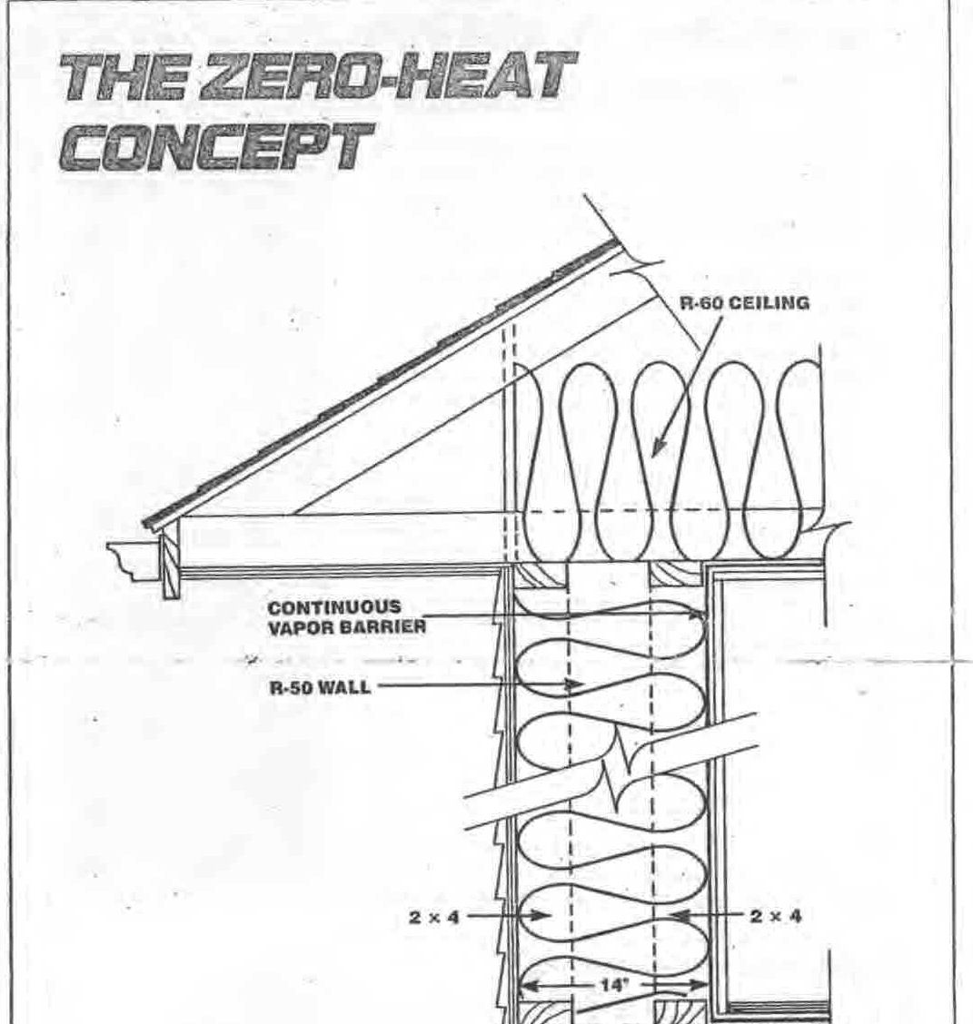

Slide 8
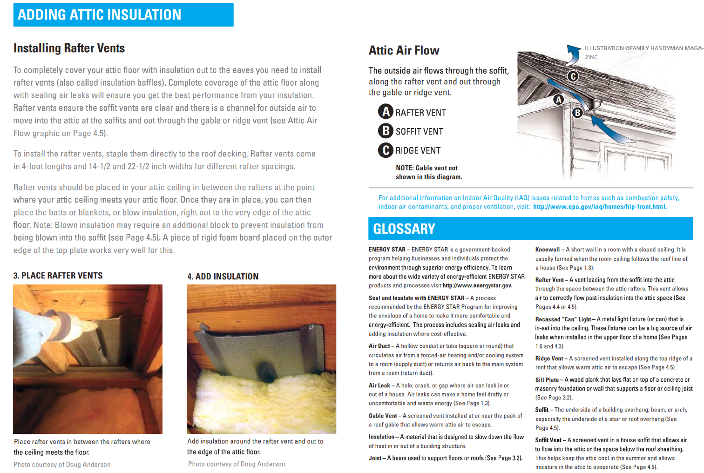

Slide 9
2x6” Studs vs Double Wall with staggered studs
Why, over the years, have I had so many people whose homes were built using 2x6 studs come to me with their tales of woe seeking a solution to their high energy costs.
2 Sources of the problem.
1.) Wood conducts heat
2.) Micro channels
The double wall eliminates both problems.

Slide 10
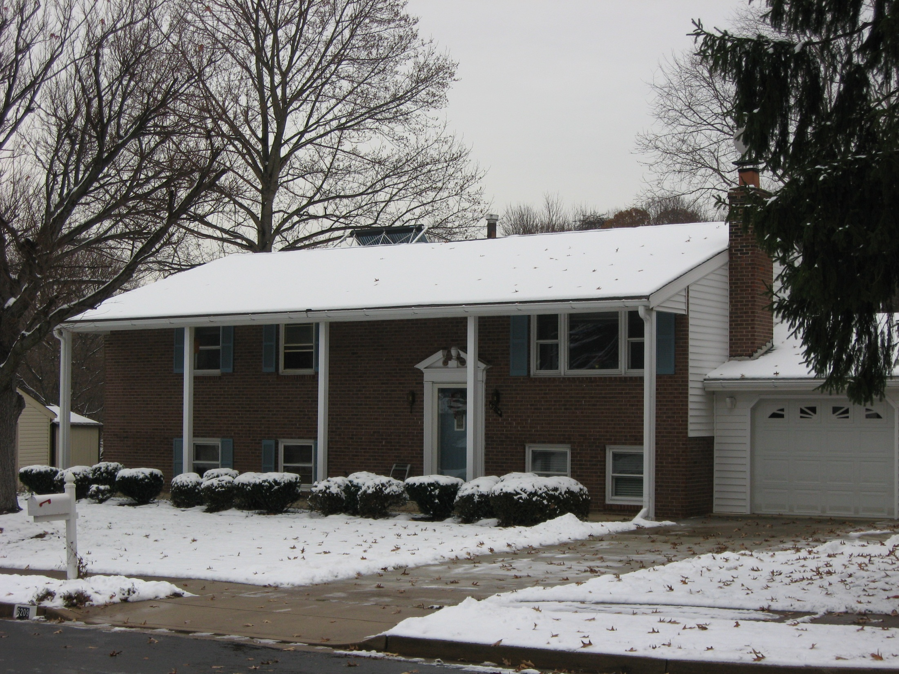

Slide 11
Our Super Insulation Retrofit
Begun in 1976 doing 1 or 2 rooms each year.
Completed 1983 at which time we turned our furnace OFF. Washington Gas DESCENDED upon our house. (They have to get money [2.5 million] to pay for their fraud against the federal gov’t.).
Costs: $2300 for materials -$2000 Federal rebate
$300
23 Single Pane Windows BUT we had 3 children and their stereos, TVs, a gazillion hot showers, cooking, etc., etc., compensated for no furnace.

Slide 12
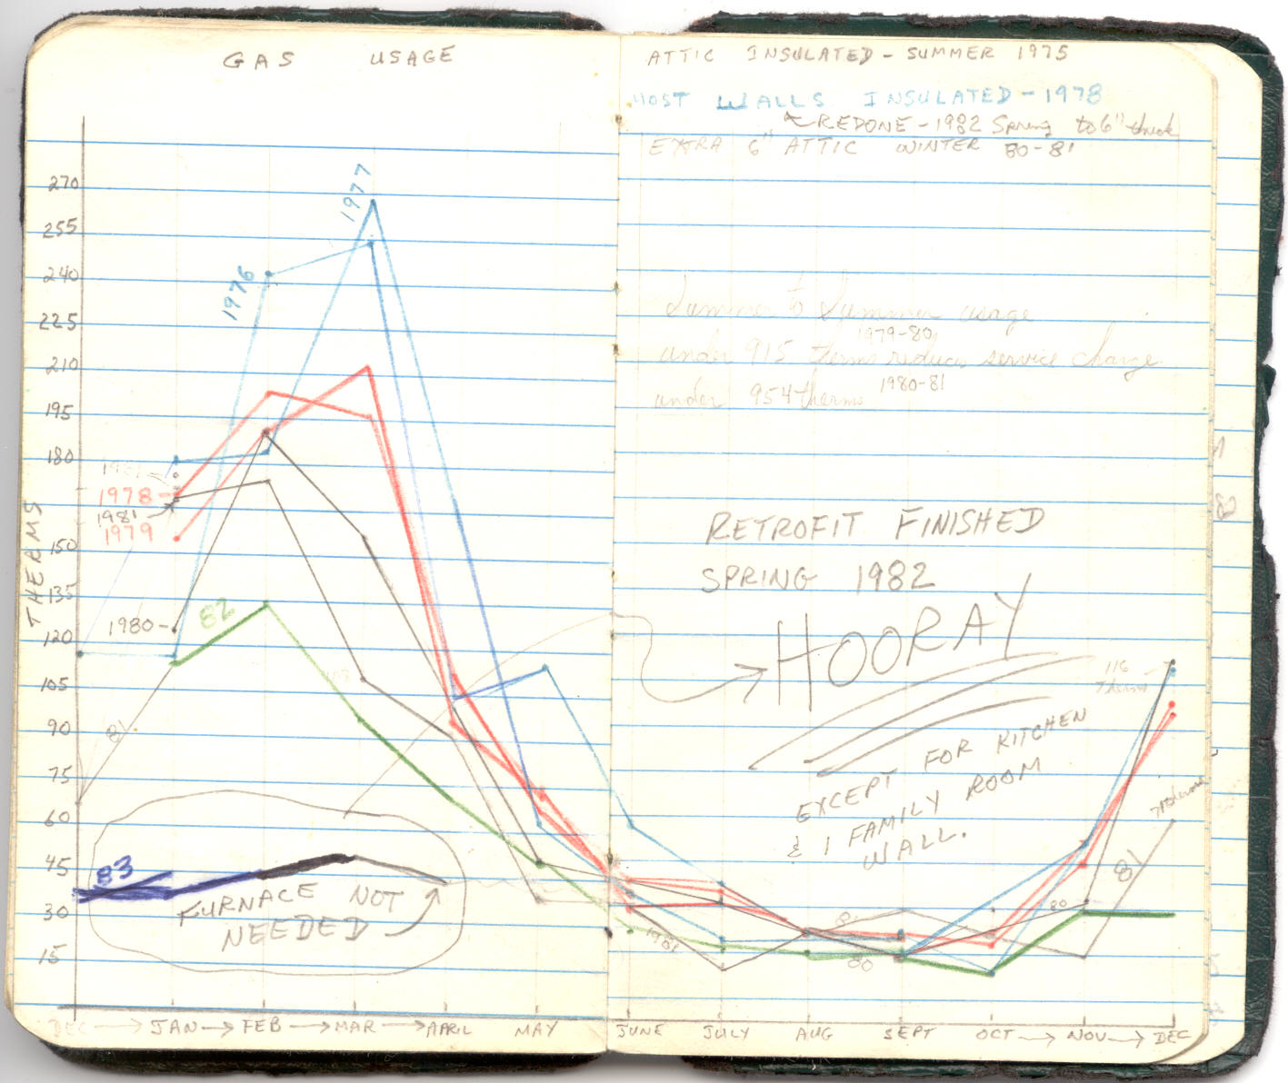

Slide 14
Our House 25 years Later
Do we have mold or otherwise damage the house from what we did?
We removed the sheet rock from 2 walls.
No! It looked like the day we insulated.

Slide 15
Benefits of Super Insulation
Sound Proofing from outside noise.
A comfort factor that makes you never again want to live in a ‘regular’ house.
Reduce or eliminate heating bills
No furnace or smaller less expensive furnace
Reduce electric usage (heating/cooling).
Smaller less expensive central air conditioner
Solar Hot Water & Solar Electric are Icing On The Cake

Slide 16
1990 we became Empty Nesters
Do we need a Furnace?
House evaluated resulting in 2 alternatives.
1. A small space heater at each end of house.
2. Smallest apartment furnace available on the market, but there are none small enough.
And no central air conditioner unit available is small enough.
2014 - STILL no central units small enough.

Slide 17
Our Home’s (3000 sq. ft.) Energy Costs (Gas + Electric)
2012 $545.41
2013 $522.63
2014 $614.88
And YES, we heat/cool the entire house.
Our Energy Star Rating (Out of 10 Possible)
2011 9.8 (Before Solar Electric)
2012 9.9 (After Solar Electric)
2013 9.9
2014 9.9

Slide 18
The First Solar Subdivision In The USA
Where - Just a few miles outside Chicago
When – 1940
Actually, half the subdivision homes were solar and properly insulated. They sold out fast.
BUT – WWII came, the Depression ended, fossil fuels were cheap so no need to properly insulate homes.
BUT we are beginning to catch up to where we were despite the chicanery of the fossil fuel moguls.

Slide 19
Did you know that since 1980, homes have been built in Alaska, Canada and across the Northern USA that are so well insulated that furnaces are
NOT installed OR needed?

Slide 20
Saskatchewan
Insulation
Walls R40
Ceiling R60

Slide 21
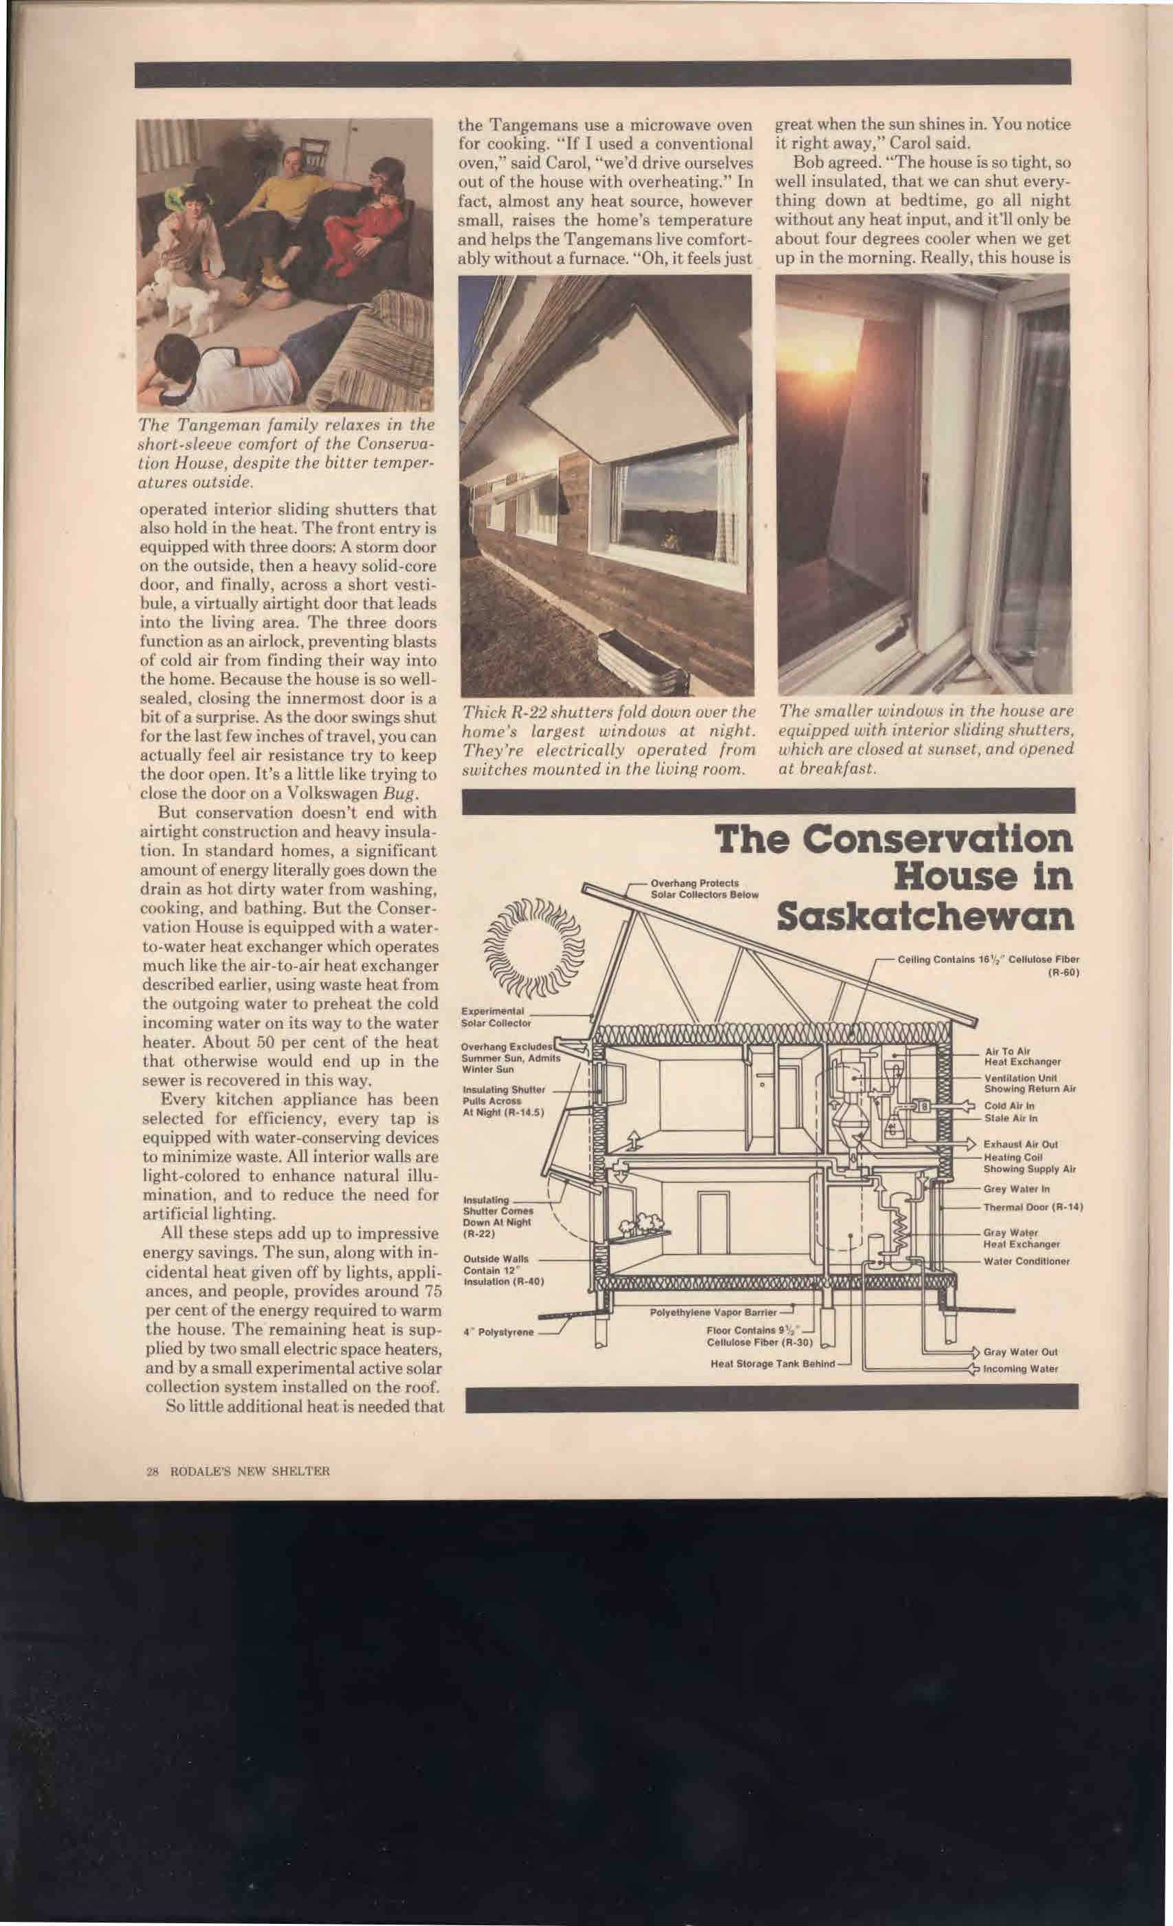

Slide 22
Upstate New York
Walls 14” R value of 50
Attic R 60

Slide 23
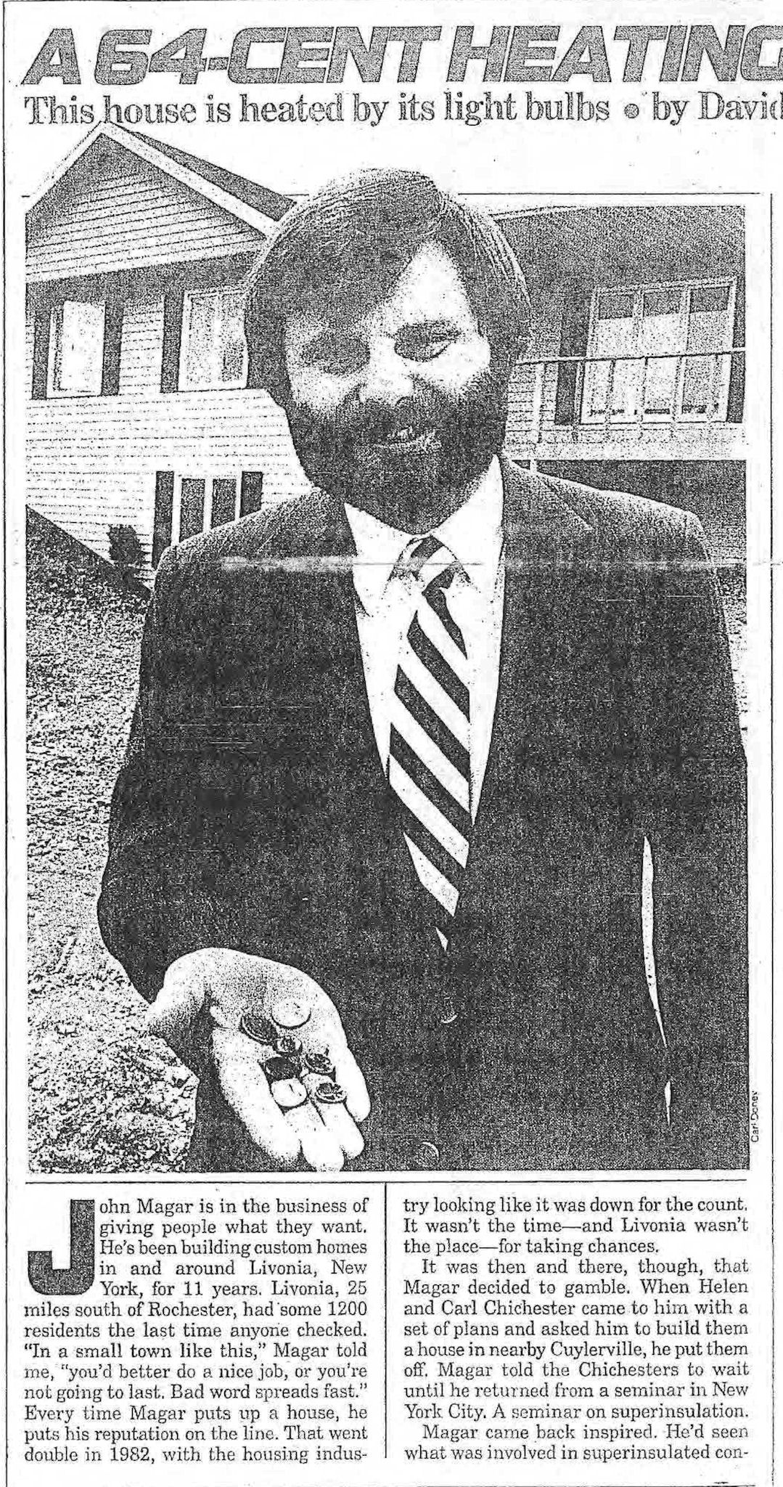

Slide 24
Massachusetts
Walls
9” Thick giving R Value of 35

Slide 25
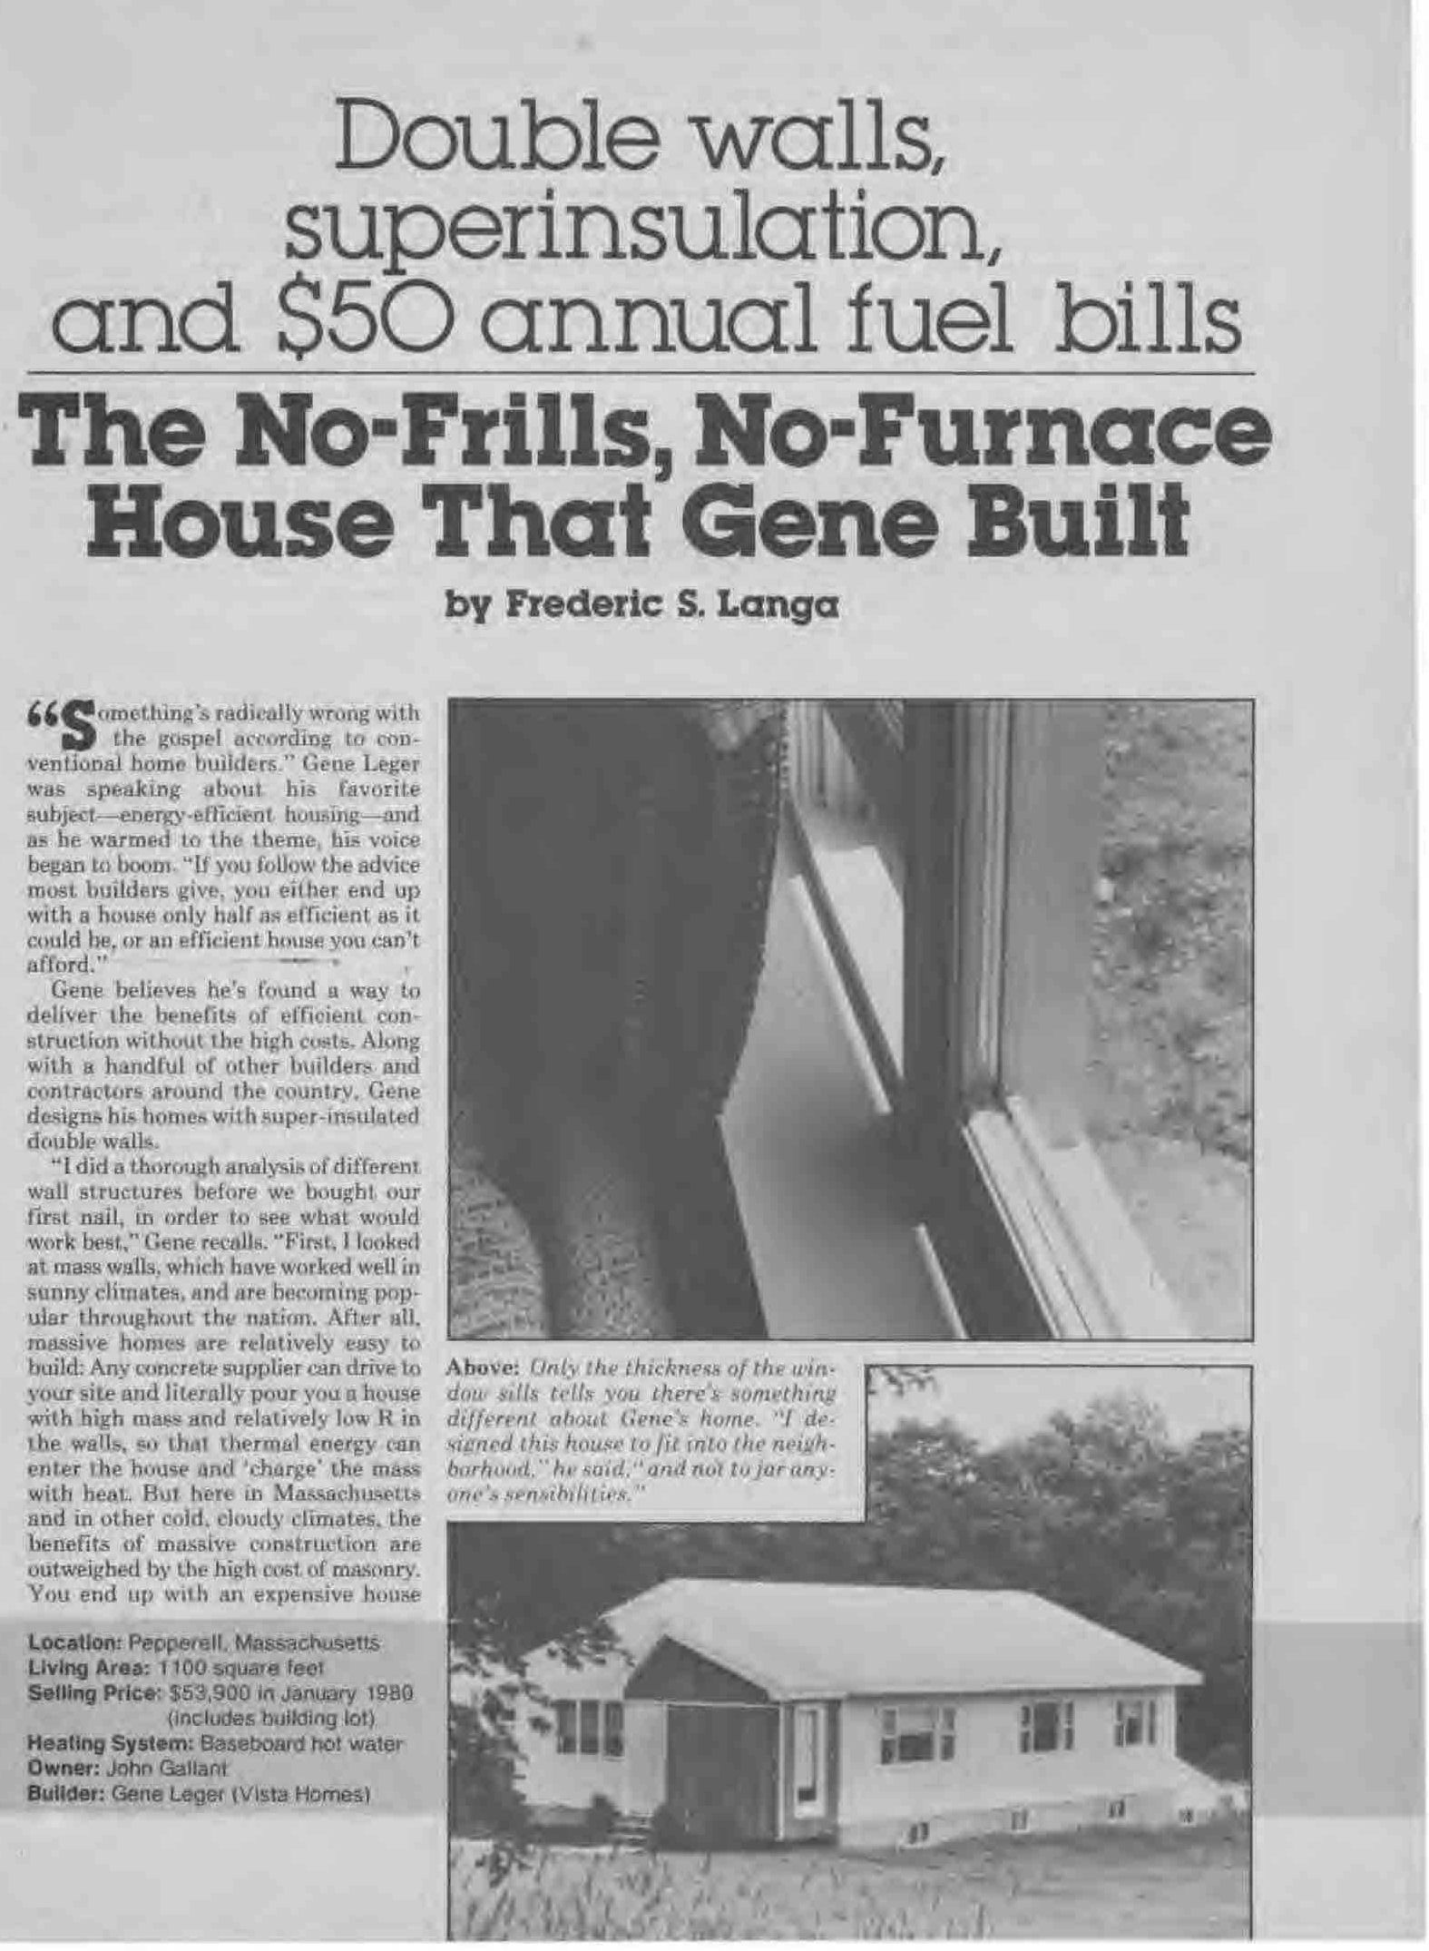

Slide 26
Belgium
New Law of the country
ALL NEW CONSTRUCTION MUST BE
SUPER INSULATED

Slide 27
New “Energy Star” homes by local builders in 2012
Energy Star Rating of 3 out of a possible 10.
They use the super efficient (90+%) large furnaces. (And just as expensive to replace).
Just think, they make more money off of expensive furnaces/air conditioners. The fossil fuel (oil/gas/electric) moguls (I refer to them as mongrels) love it and the building trade loves it.
And the consumer gets to pay and pay and pay them!
Compare that to our Energy Star Rating of 9.9
And our oversized 80% efficient Apartment furnace with its inefficient oversized ductwork.

Slide 28
Fast forward 30+ years to 2014
A new “Net Zero” DREAM HOME, which is:
A passive solar home in Falls Church, Va.
And uses the same basic concepts.
The materials and equipment have improved.
Note the large and numerous windows which the owners love.

Slide 29
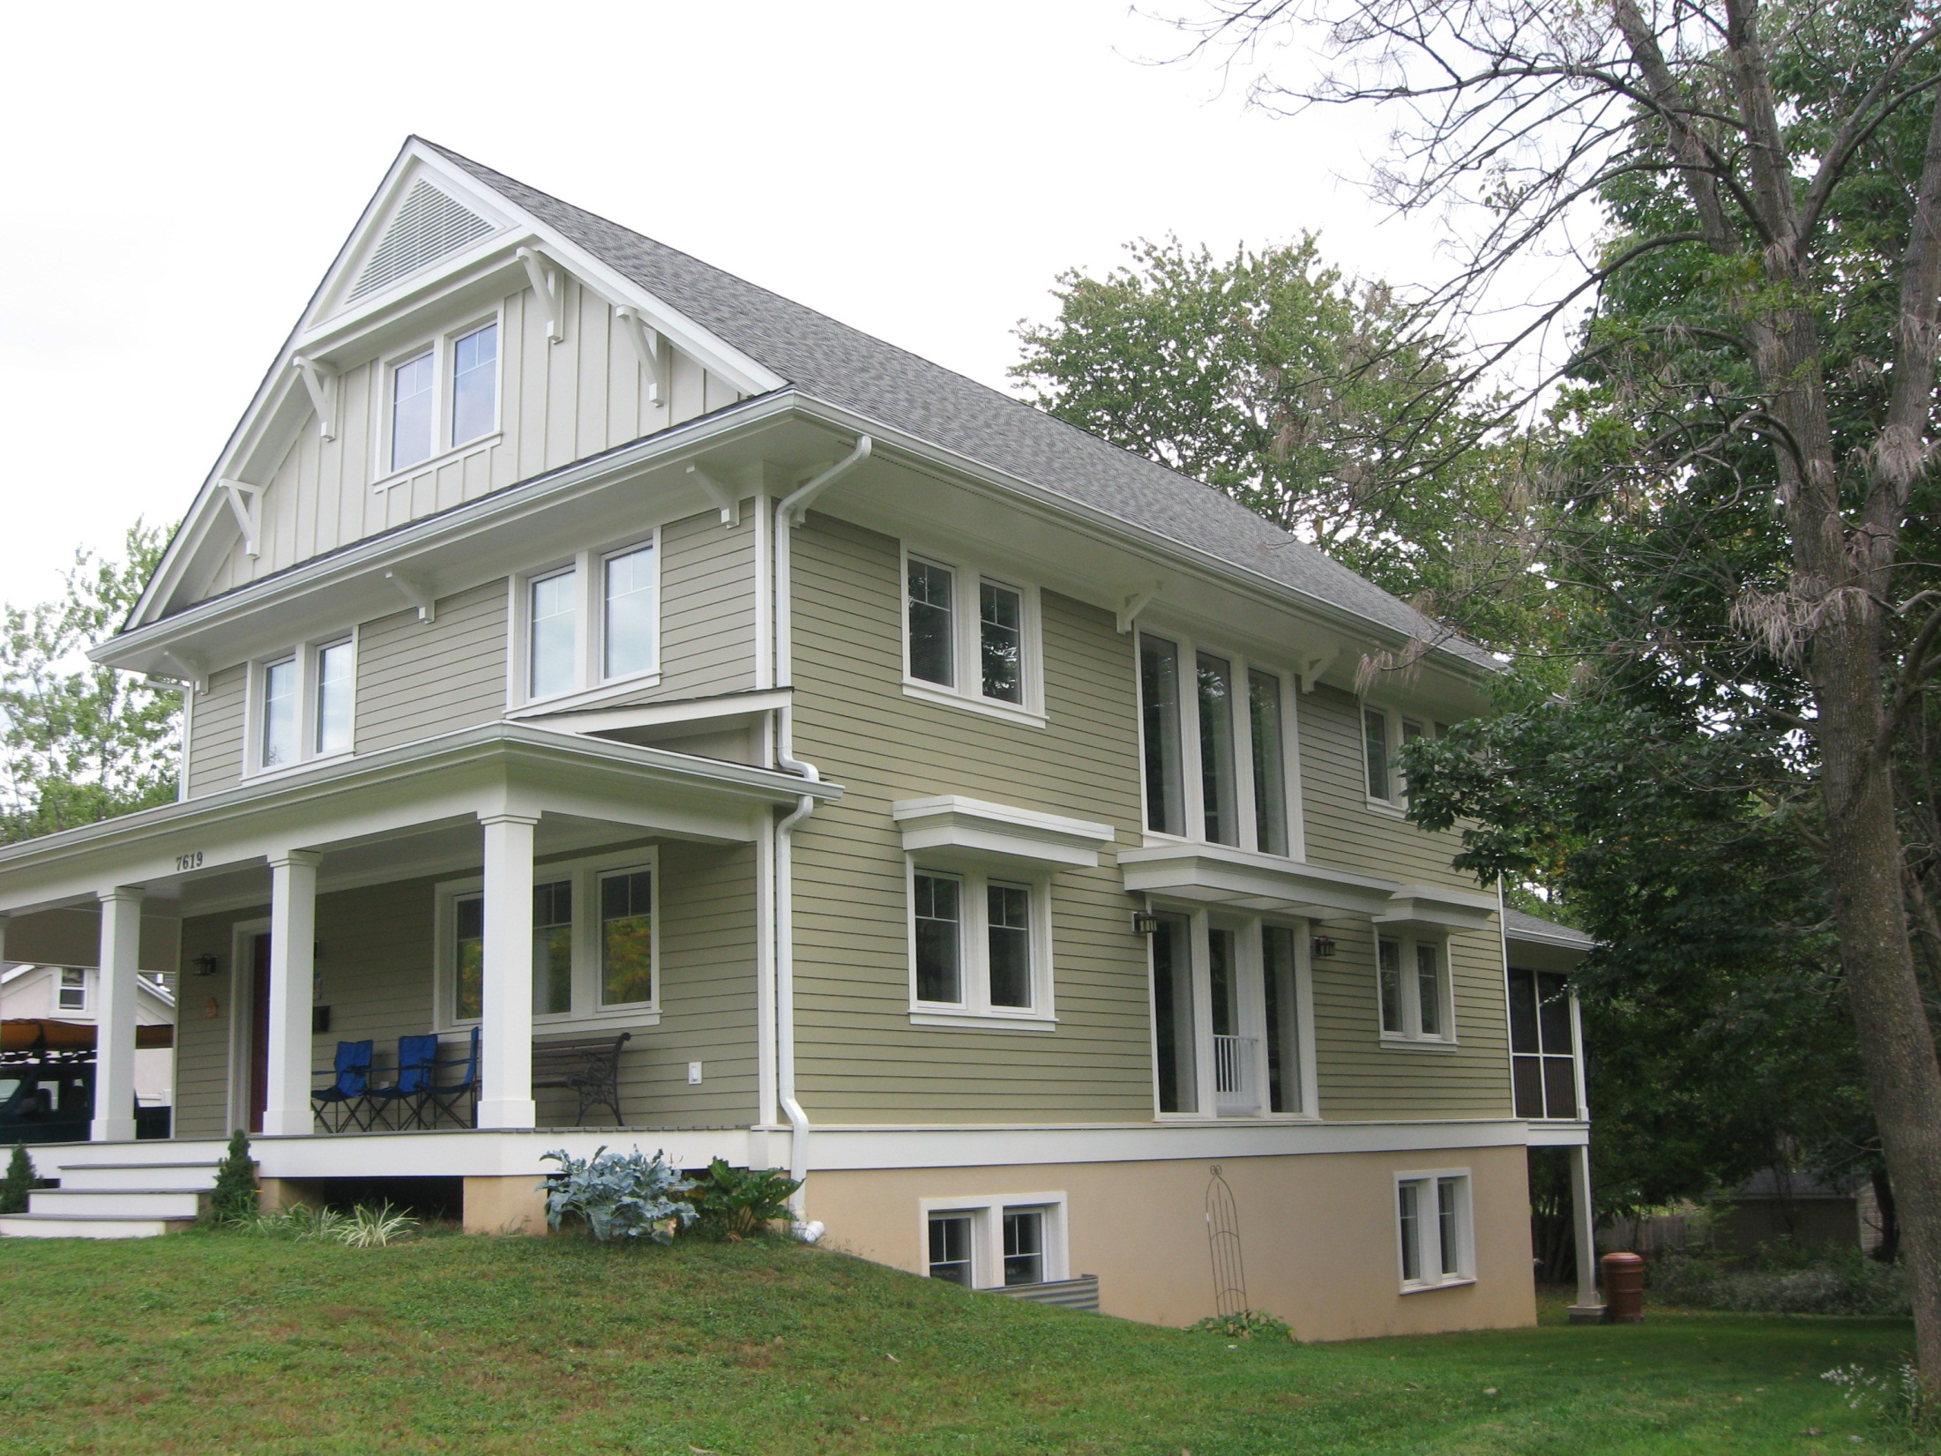

Slide 32
Solar Hot Water System Diagram

