Slide 1
Legalizing Marijuana Pros and Cons OLLI October 2013
Notes:
None

Slide 2
DRUG
A drug may have medicinal, intoxicating, performance enhancing, or other effects when taken or put into a human body and is not considered a food..
Coffee is the most widely used psychoactive drug beverage in the world. In 1999, the average consumption of coffee was 3.5 cups per day per U.S. citizen.
Notes:
Wine is a common alcoholic beverage.
What is considered a drug varies between cultures, and distinctions between drugs and foods and between kinds of drug are enshrined in laws which vary between jurisdictions and aim to restrict or prevent drug use. Even within a jurisdiction, however, the status of a substance may be uncertain or contested with respect to both whether it is a drug and how it should be classified if at all. There is no single, precise definition, as there are different meanings in drug control law, government regulations, medicine, and colloquial usage.

Slide 3
Marijuana
Marijuana is the most commonly used recreational drug around the world, only behind alcohol, caffeine, and tobacco.
It is a dry, shredded green and brown mix of flowers, stems, seeds, and leaves derived from the plant Cannabis sativa and indica.
Notes:
There are 483 identifiable chemical constituents known to exist in the cannabis plant, and at least 85 different cannabinoids have been isolated from the plant. The two cannabinoids usually produced in greatest abundance are cannabidiol (CBD) and/or Δ⁹-tetrahydrocannabinol (THC), but only THC is psychoactive. Cannabinoids are a class of diverse chemical compounds that activate cannabinoid receptors on cells that repress neurotransmitter release in the brain. These receptor proteins include the endocannabinoids (produced naturally in the body by humans and animals), the phytocannabinoids (found in cannabis and some other plants), and synthetic cannabinoids (produced chemically by humans).
Time Magazine June 2012 Marijuana boasts somewhere between 119 million and 224 million users in the adult population of the world (18 or older). And there are no signs to indicate the popularity of marijuana will fall anytime soon. Cannabis is consumed in some fashion in all countries, the report says, and it is grown in most. Though the use of the drug is stabilizing in North America, and Oceania, smoking pot is on the rise in West and Central Africa, Southern Africa, South Asia and Central Asia.
In 2010, marijuana use was most prevalent in Australia and New Zealand. The U.S. and Canada came in second, followed by Spain, France, Italy, and the Czech Republic. Nigeria, Zambia, and Madagascar were tied for fourth place.

Slide 4
Colorado Marijuana Laws
Recreational: Legal to possess under 1 oz. age 21 and older. Legal to consume in private residence, not in public. Legal to sell, provided store has obtained permit to do so. Retail sales start early in 2014. Private non-commercial cultivation of cannabis is legal up to six plants per person.
Medical: Legal since 11/2000. Use with written medical consent. No more than six plants, only three flowering. May get supply from dispensary.
Notes:
Consumption is permitted in a manner similar to alcohol, with equivalent offenses for driving.
Dispensaries offer a range of cannabis strains with different qualities, as well as various “edible” or food products that contain cannabis. Certain dispensaries also offer patients seeds and “clones” for those who want to grow their own medicine.

Slide 5
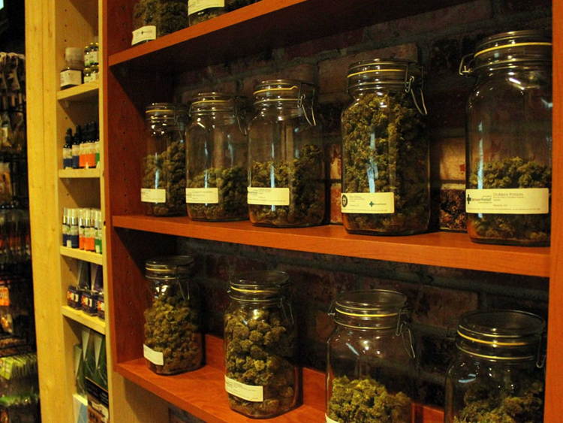
Notes:
Marijuana Dispensary

Slide 6
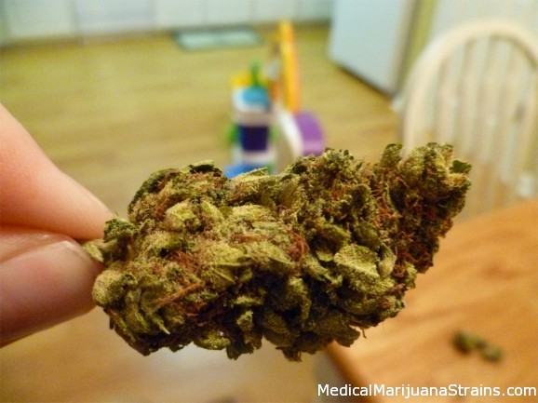
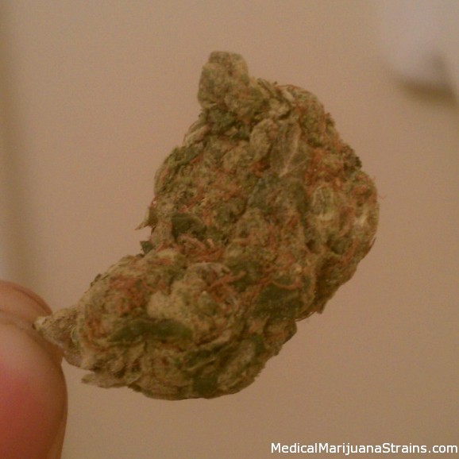
Notes:
Skywalker OG Kush
Traits: dank smell, Good For Insomnia, Pain Relief, Relaxing, and Stress. Indica, kush smell, kush taste, light green, lots of crystals, Night Time Use, orange hairs, strong smell, taste great, Very Potent. Has a higher cannabinoid (CBD) content than sativa hence is milder or more mellow. Produces more of a “stoned” feeling or a “body buzz” and good for pain relief, insomnia, and tends to mitigate the anxiogenic effect of THC. Due to the relaxing nature of indicas, they are best used for non-active times of the day and before bed.

Slide 7
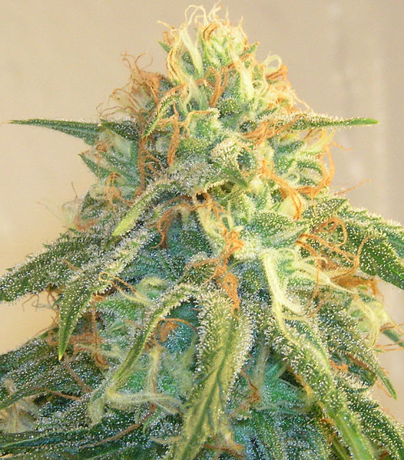
Notes:
Marijuana (Cannibis sp.) is an example of a plant that has unisexual flowers and is dioecious (Greek for two households). Marijuana plants with female flowers are far more valuable than those with male flowers. Male flowers have to be present but if female Cannabis flowers are sex starved they put out extra large growth. Photo is Cannabis flower with visible trichomes. These are the resinous growths or glistening translucent glands protruding from the buds, leaves and just about everywhere else on on the plant. The sticky coating of trichomes is the home to the active ingredients in cannibis – the stuff that gets you high and has all the medical benefits – tetraydrocannabinol (THC), cannabidol (CBD) and other cannabinoids. Trichomes (Greek “growth of hair”) protects the plant from its environment. It protects against offensive insects, makes the plant less palatable to hungry animals, inhibit the growth of some types of fungus, insulates from high wind and low humidity and acts as a sunscreen.
Marijuana has a distinctive smell that is similar to that of the plant of origin, Cannabis plants parts have a strong sweet and fruity odor, particularly the flowers, but the smoke is mild.

Slide 8
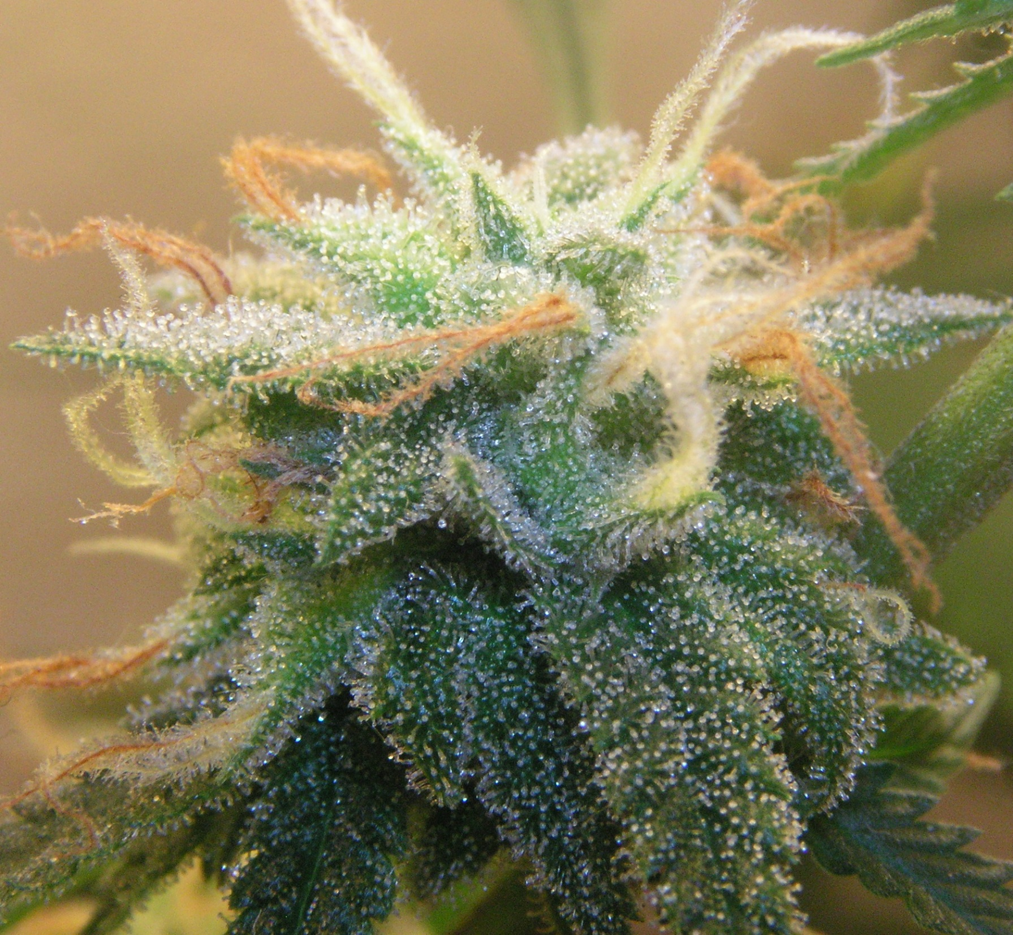
Notes:
Close-up of flower with trichomes. Preparations of flowers (marijuana) and leaves and preparations derived from resinous extract (hashish) are consumed by smoking, vaporizing and oral ingestion. Historically, tinctures, teas, and ointments have also been common preparations. Some therapeutic uses: Reduces depression, elevates mood; Relieves headaches and migraines; Relieves menstrual cramps; Energizes and stimulates; Increases focus and creativity; Reduces nausea; and Stimulates appetite.
The primary effects of sativa are on the mind and emotions. These benefits can be particularly helpful for the psychological aspects of many illnesses, giving people an increased sense of well-being. Due to the stimulating nature of sativa, they are generally better for daytime use.
The flowers of the female plant can produce hundreds of seeds. All known strains of cannabis are wind pollinated.

Slide 9
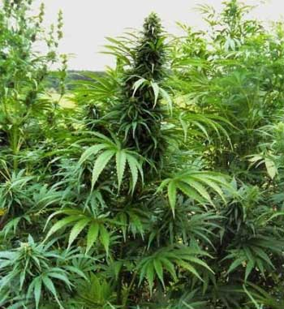
Notes:
Cannabis Indicia plant. Cultivation Broad-leafed Cannabis indicia plants originating in India, Afghanistan, Bangladesh and Pakistan. Traditionally were cultivated for the production of hashish. Because of the often harsh and variable (extremely cold winters, and warm summers) climate of those parts, C. indicia is well-suited for cultivation in temperate climates. Indicia plants are normally shorter and stockier than sativa. They have wide, deeply serrated leaves and a compact and dense flower cluster. Generally better for indoor growing because they don’t grow as tall.

Slide 10
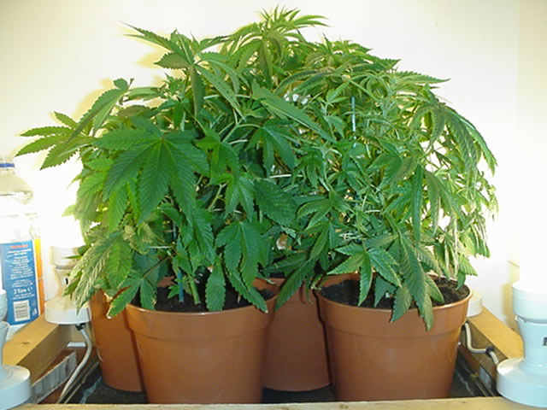
Notes:
Indoor marijuana plants. Indica is short, conical, densely branched. Origins in the Hindu Kush mountain range of Afghanistan and Pakistan. Well suited to temperate climates. Short dense plants, with broad leaves. After flowering starts they will be mature in 6 to 8 weeks. Users report more of a “stoned” feeling and less of a “high” compared to Sativa. Induces less anxiety then sativa so produces a sedative effects and preferred for night time use as medical cannabis and are best used at relaxing non-active times of day and before bed. Higher rate of CBD to THC. Yield two to five ounces or more dried marijuana per plant indoors.
Real prize is outdoor plants that will yield two pounds with some reports of up to five pounds per plant.
Price a few years ago would have been higher. Retail value of product much higher.

Slide 11
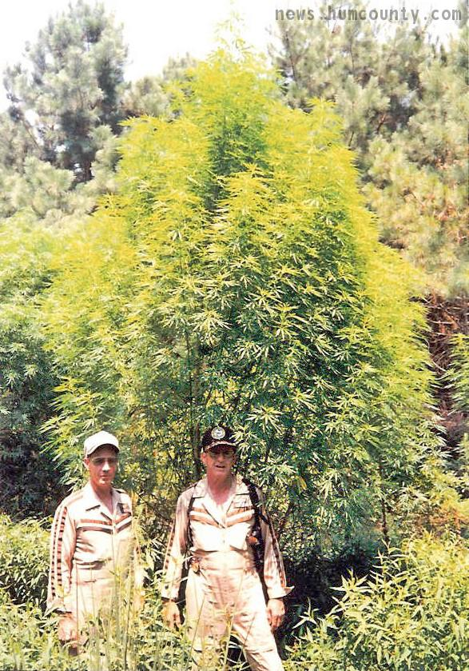
Notes:
Outdoor giant sativa marijuana plant. People have cultivated this herb throughout recorded history as a source of industrial fiber (hemp), seed oil, food, recreation, religious and spiritual enlightenment, and medicine. Used most commonly for hempseed oil which can be used for cooking, lamps, lacquers, or paints. Also as caged bird seed oil.
Hemp is a commonly used term for varieties of the Cannabis plant and its products, which include fiber, oil, and seed. In many countries regulatory limits for concentrations of psychoactive drug compounds (THC) in hemp encourage the use of strains of the plant which are bred for low tetrahydrocannabinol (THC) content or otherwise have the THC removed.^{[1]} Hemp is refined into products like hemp seed foods, hemp oil, wax, resin, rope, cloth, pulp, paper, and fuel.

Slide 12
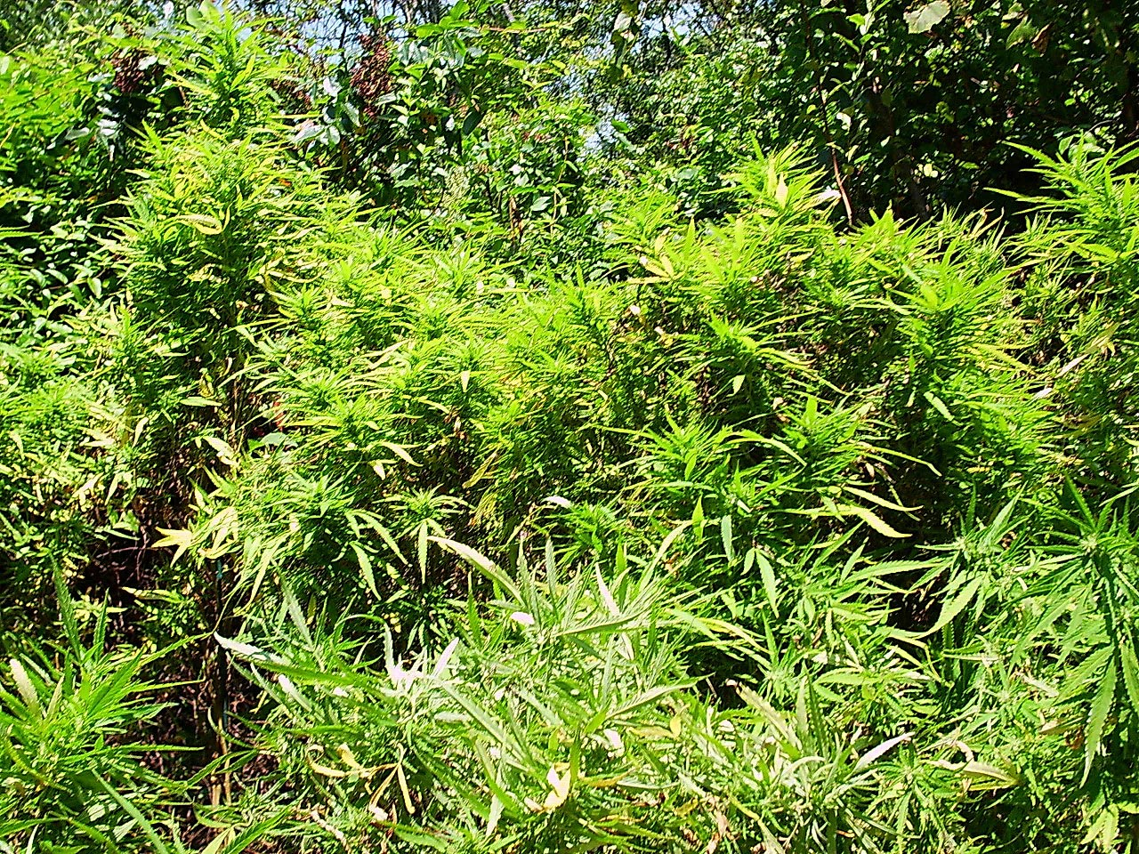
Notes:
Sativa is the most common and potent Cannibis. Due to the stimulating nature of sativas, they are generally better for daytime use. The primary effects of sativas are on the mind and emotions. These benefits can be particularly helpful for the psychological aspects of many illnesses, giving people an increased sense of well-being. Weed Farmer indicates sativa....higher THC than CBD equals cerebral, soaring type of high, more energetic Yield is usually lower than Indica, but is very potent. eg: Sativa grow taller, laxly branched and have a longer flowering period, so they are better suited for outdoors and do well in warm lowland areas. Flowers for outdoor plants bloom from late summer to mid-fall.
Other sources: A Cannabis plant requires more than 12–13 hours of light per day to stay vegetative. Flowering usually occurs when darkness equals at least 12 hours per day.
The flowering cycle for sativa’s can last anywhere between 10 and 16 depending on the strain and environmental conditions

Slide 13
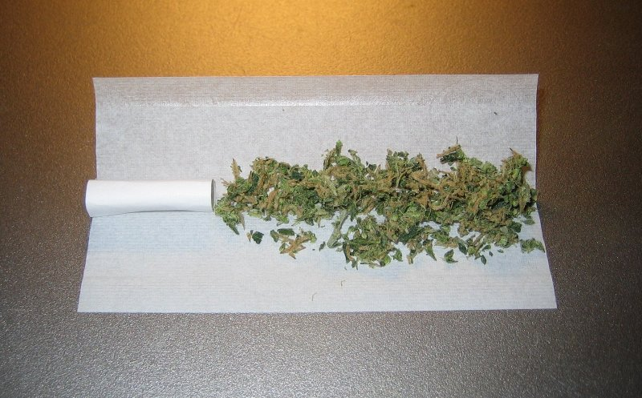
Notes:
Marijuana (i.e. weed and many other variations) consists of the flowers (and to a lessor extent the leaves, stems, and seeds) of cannabis sativa and indica.
A joint prior to rolling with a paper "roach" at left.
Joint is a slang term for a cigarette rolled using cannabis . Rolling papers are the most common rolling medium among industrialized countries. There are all sorts of variations over the world on joints.
The perfect joint website suggests:
A joint consists of weed and tobacco
Mixture is 1/3 weed and 2/3 tobacco
You do not put weed in a cigar!!!
You do not make a weed only cigarette and smoke it till the end!

Slide 14
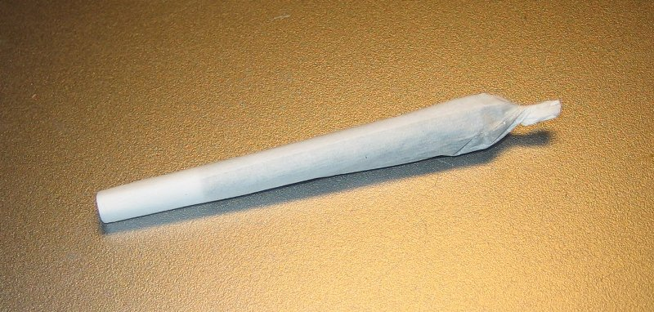
Notes:
500-mg. joint with European-style "roach“.
A joint can range in size, typically containing between 0.25 to 1 gram net weight of cannabis (depending on whether tobacco is used in the rolling process. There are all sorts of variations on the rolling paper on colors and types of paper, use of a filter, etc.

Slide 15
Weed Prices $ Per Ounce Street High and Medium Quality 9/2013
CALIFORNIA 251 193
Texas 346 232
Colorado 239 199
Washington 239 194
New York 356 271
Illinois 364 287
Virginia 379 285
Florida 309 220
Canada 226 184
Alexandria M 220 oz. 27th
Fairfax H 60 eighth 28th
Fairfax H 300 oz. M 28th
Fredericksburg H 80 quarter
Charlottesville M 200 half
Manassas M 100 quarter
Blacksburg H 50 eighth 28
Reston H 50 eighth 27th
Notes:
Source www.priceofweed.com.
The right column: Marijuana Prices in the USA compiled by Clint is more general but of interest. Mids (ok weed/regular) dime $10, dub bag $20, eighth $30, quarter $50, half ounce $100, ounce $150, quarter pound $550, half pound $1,000, pound $1,500.
High Quality (good weed/exotic) easily can run 50% higher.

Slide 16
Wholesale Marijuana Prices
Implications: Current retail street prices imply weed per pound is worth $3,824 to $6,064. More realistically $3,000 to $5,000. Medium quality roughly $2,000 to $3,500.
Wholesale prices vary widely depending on quality and location. Columbia S.A. $180 per pound, US market can vary widely depending on quality by a factor of 10. Retail prices seem to be the best indicator.
Notes:
Domestic production US all states with CA, OR, WA, TN, KY, WVA larger production. Imports Mexico (two crops per year some areas, Columbia, Peru, Jamaica significant income for small farmers. Canada has very high quality B.C. Bud, Quebec Gold, etc.
Trafficking involves bulk movements from suppliers i.e. through Central America and Mexico, shifting to a micro process of breaking wholesale shipments into smaller parcels as a hedge against interdiction, breaking packages into small units for distributors.
Smuggling using tunnels; traversing borders on foot, dirt bikes, ATV’s, and pack mules; fording the Rio Grande and cutting fences, using dense vegetation as dead drops, flying or helicoptering across borders, concealing in private vehicles, bribing border officials, hiding on cross border trains, tractor trailers, boats on coasts, human mules in luggage and shipping by mail.
Use networks of safe houses for distribution or local gangs in Hub cities as middlemen and retail distributors and massive numbers of expendable, low skilled dealers for retailing. Effective dealer might load 50 baggies daily and make $3,000 of deliveries.
All steps in system minimize face-to-face and electronic communications.
Money flows in reverse up front with payoffs due to margin or flat fee based on successful movement.

Slide 17
Cost of a Joint of Marijuana
An ounce equals 28.349 grams. This will provide enough marijuana for 28 to 57 joints of 1 gram to 500 mg.
With high quality weed ranging from $239 (CO & WA) to $379 (VA) an ounce, a high quality joint should cost at least $4.19 to $13.54. .
Adding on 21 cents for filters and paper the per joint cost will range from $4.40 to 13.75 assuming you roll your own. Tobacco may be used in the rolling process. Joints fully ready to smoke are often $20.00.
Currently one firm is advertising Colorado medical marijuana indica joints (Grand Daddy Purple) in a pack of five for $59.95 or $12.00 each per joint.
Notes:
Marijuana prices are declining with the increase in the number of states approving the use of medical marijuana and with Washington and Colorado legalizing marijuana at the state level. Implicitly this should also mean less emphasis on marijuana by local law enforcement. Lower returns for growers or smugglers.

Slide 18
Get High for Free If pot were truly legal, joints would cost only a few cents
Legal Pot would be amazingly cheap. Growth, distribution and marketing would be entirely different.
You have a nonperishable crop like wheat or lentils. America’s farmlands are some of the most productive in the world, thanks to large scale production technology.
For hemp, a non-drug form of sativa, production costs in Canada are now $500 per acre. So mid-grade commercial weed (cannabis that is 80 percent of the US market) could be as low as 20 cents per pound of smokeable material or joints could cost 25 cents. Joints could be given away for advertising like small packs of pretzels or peanuts.
Notes:
Matthew Yglesias. Slate. Published by the Slate Group, a Division of the Washington Post Company. January 2013.

Slide 19
Get High for Free 2
In practice recreational marijuana plants would likely be grown from transplanted clones like cherry tomatoes or asparagus. So costs would be $5,000 to $20,000 per acre. Costs of legal marijuana would be more like tea or tobacco or a few cents per joint.
Radically lowering the price to say $1.00 per joint plus imposing a 20% tax would make pot the cheapest intoxicant on the market, absolutely blowing beer and liquor out of the water.
Notes:
Ibid.

Slide 20
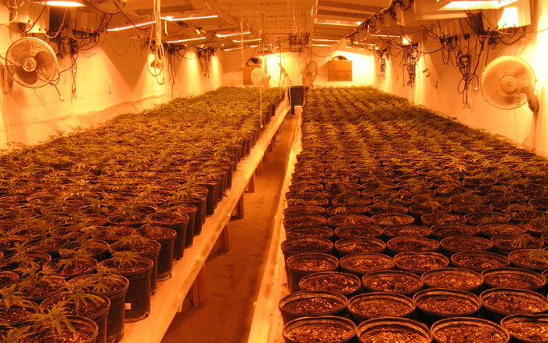
Notes:
Marijuana seedlings. Before growing marijuana think about growing medium, warmth, light, water, nutrients, germinating, seeding phase, sexing, training (sizing), topping, pinching or cropping, low stress training or manipulation, pre-flowering, flowering, quality, camouflaging, housing, house damage, harvesting, drying, curing, pests, and preparing product.
Research by Caulkins published by the Rand Policy Research Center WR-764-RC, July 2010 estimates production costs per pound of $200-$400 per pound in a 1500 square foot residential house and $70 to $215 per pound for 1 acre 50% covered with greenhouses. Drying and processing costs were estimated at $80 to $200 per pound to as low as $20 to $35 pound. In summary legal production and processing costs per pound would be slightly less or equal to current prices per ounce of marijuana in California of $251. The imposition of excise taxes of 15% to 20% of sales are not included.

Slide 21
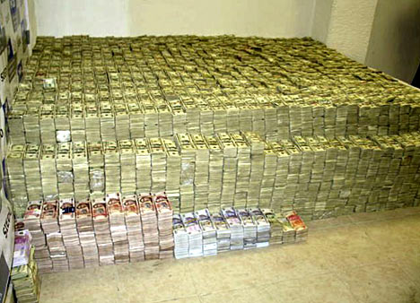
Notes:
Drug Money(?) in home of Zhenli YeGon 207 million dollars, 18 million Mexican pesos, Euros, Hong Kong dollars, gold coins, jewels, photo 2007
Drug distribution: Basically a black market system.
World estimates are 1 to 1.5 percent of world trade?

Slide 22
Potential Earnings and Savings with Legalizing Marijuana
Nationally $26 billion federal and state taxes. Also several billion savings from prohibition and substantially lowering incarceration of users and dealers.
Lowering incarceration results in income taxes and reductions in transfer payments to marijuana users and their families. Reductions in costs of support for disruption of families and support of an average of 1.1 children per marijuana offender. Increased stability for communities.
Colorado taxes $90 to $210 million excise and sales taxes.
Washington $564 million taxes.
Canada $6.2 billion plus savings for foregoing the costs of enforcement.
New York City estimate $400 million plus $31 million thru eliminating misdemeanor arrests (stop and frisk, etc.).
Notes:
Various studies, plenty of assumptions, and lots of unknowns in estimates.

Slide 23
IS MARIJUANA DANGEROUS?
Notes:
Marijuana Laws Virginia
Cultivation Any amount felony 5 - 30 years $10,000
Sale 1/2 oz or less misdemeanor 1 year $2,500
1/2 oz to 5 lbs felony1 - 10 years $2,500
5 lbs to 100 kg felony 5 - 30 years $2,500
To a minor felony 10 - 50 years $100,000
Within 1,000 feet of a school or other specified areas felony 1 - 5 years $100,000 Transport 5 lbs or more into state with intent to sell felony 3 years MMS* - 40 years $1,000,000

Slide 24
Substances
The Drug Enforcement Agency (DEA) website provides information on a list of 311 drugs The Controlled Substances Act (CSA) of 1970 regulates five classes of drugs: Narcotics, depressants, stimulants, hallucinogens, and antibiotic steroids but excludes alcohol and tobacco.
Marijuana is a Schedule I Drug. A Schedule I Drug has high potential for abuse and no currently accepted medical use.
Notes:
DEA Drugs of Abuse

Slide 25
Schafer Commission
National Commission on Marihuana and Drug Abuse ("the Shafer Commission"), appointed by President Nixon (1970?).
Report recommended decriminalization, ending prohibition and utilizing other methods to discourage use, 1972 and 1973, reports.
Ultimately, nothing became of the report, as neither the Nixon Administration nor Congress took any further action. As a result, marijuana remains a Class I substance under the Controlled Substances Act.
President Nixon needed a campaign at the time and “The War on Drugs” evolved..
Notes:
While the Controlled Substances Act was being drafted in a House committee in 1970, Assistant Secretary of Health Roger O. Egeberg had recommended that marijuana temporarily be placed in Schedule I, the most restrictive category of drugs, pending the Commission's report. The Act created a “Presidential Commission” to report on the effects of marijuana and other drugs and recommend appropriate drug policies. The Commission was headed by Governor Raymond Schafer of Pennslyvania, a former prosecutor know as a “law and order” governor to head the commission.
Nixon linked marijuana to the counter culture wars of the times.
Nixon made clear several times that he wanted a report which supported his views and 'tough on crime' policies, no matter what the facts might be. “I want a Goddamm strong statement about marijuana. Can I get that out of this sonfabitching, uh Domestic Council? …I mean one on marijuana that just tears the ass out of them” (Conversation with Bob Haldeman May 26, 1972.
Highlights of Nixon comments on marijuana:
Jews and marijuana: That's a funny thing, every one of the bastards that are out for legalizing marijuana are Jewish. I suppose it's because most of them are psychiatrists.
"You see, homosexuality, dope, immorality in general. These are the enemies of strong societies. That's why the Communists and the left-wingers are pushing the stuff, they're trying to destroy us."
Marijuana compared to alcohol: marijuana consumers smoke "to get high" while "a person drinks to have fun." "At least with liquor I don't lose motivation.“
Marijuana and political dissent: ". . . radical demonstrators that were here . . . two weeks ago . . . They're all on drugs, virtually all."
Drug education: "Enforce the law, you’ve got to scare them."
After the Schafer Commission's widespread study and analysis, it concluded that "Looking only at the effects on the individual, there, is little proven danger of physical or psychological harm from the experimental or intermittent use of the natural preparations of cannabis.“
“Marijuana’s relative potential for harm to the vast majority of individual users and it’s actual impact on society does not justify a social policy designed to seek out and firmly punish those who use it. (p130)
The Commission also found that "the use of drugs for pleasure or other non-medical purposes is not inherently irresponsible; alcohol is widely used as an acceptable part of social activities.

Slide 26
Is Marijuana Dangerous?
Development of a Rational Scale to Assess the Harm of Drugs of Potential Misuse: Article in The Lancet 2007 United Kingdom.
An article by Blakemore and Nutt, et. al., presents a scale of harms based on three scales – physical harm, dependence and social harm – which were independently assessed by two groups of experts from the fields of chemistry, pharmacology, forensic science, psychiatry and other medical specialties 2007.
Substances with high physical harm scores include heroin, cocaine, barbiturates, ketamine, street methadone and amphetamines.
Substances with a high dependence or addictiveness include heroin, cocaine, tobacco, street methadone, barbiturates, alcohol and bendiaozepines (benzo).
Notes:
British Study

Slide 27
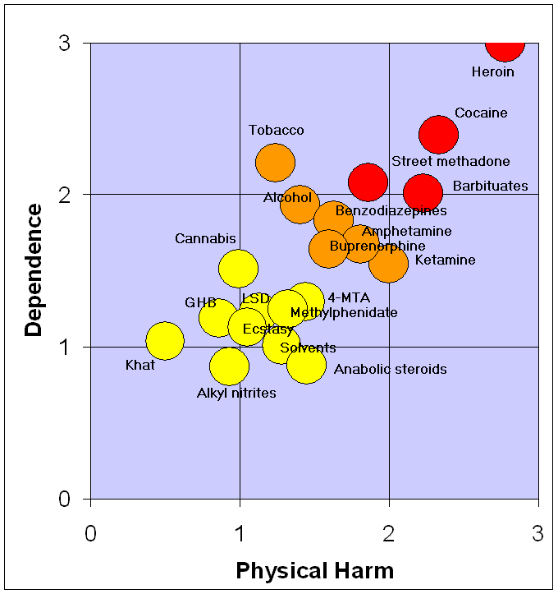
Notes:
A rational scale to assess the harm of drugs. Data source is the March 24, 2007 article: Nutt, David, Leslie A King, William Saulsbury, Colin Blakemore. "Development of a rational scale to assess the harm of drugs of potential misuse" The Lancet 2007; 369:1047-1053. (PMID 17382831;).
The data in the paper is obtained solely from questionnaire results obtained from two groups of people: the first comprised people from the UK national group of consultant psychiatrists who were on the Royal College of Psychiatrists’ register as specialists in addiction, while the second comprised of people with experience in one of the many areas of addiction, ranging from chemistry, pharmacology, and forensic science, through psychiatry and other medical specialties, including epidemiology, as well as the legal and police services; the experts are not named and were chosen by the authors. This is a tertiary source (see Wikipedia policy on primary, secondary, tertiary sources) as it summarizes experts' opinions on the matter (which are secondary sources) without any direct references to primary sources. The data was first reported in appendix 14 of "Drug classification: making a hash of it?

Slide 28
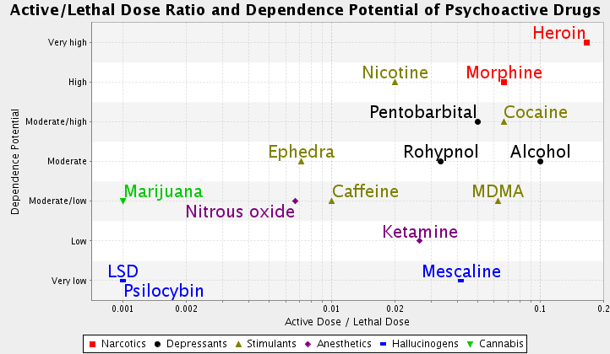
Notes:
Wikimedia Commons. Drug danger and dependence. File April 2010 based on article by R.S. Gable (2006) Acute toxicity of drugs versus regulatory status.
Class I Heroin (poppy), LSD, Psilocybin, Mescaline and Marijuana (Cannabis). Class II (some medical use) Cocaine (coca leaves), Methanphemine, Metnadone, Oxhycodone, and Opium. Class III Ketamine, Class IV Rohyonol (benzodiazepine).

Slide 29
The Truth About Marijuana
Short-term effects: sensory distortion, panic, anxiety, poor coordination of movement, lowered reaction time, after an initial “up” the user feels sleepy or depressed, increased heartbeat (and the risk of heart attack).
Notes:
Source: Drug Free World

Slide 30
The Truth About Marijuana 2
Long-term effects: Reduced resistance to common illnesses (colds, bronchitis, etc.); suppression of the immune system; growth disorders; increase of abnormally structured cells in the body; reduction of male sex hormones; rapid destruction of lung fibers and lesions (injuries) to the brain could be permanent; reduced sexual capacity; study difficulties: reduced ability to learn and retain information and apathy.
Notes:
Source: Drug Free World

Slide 31
Marijuana Overview
Cannabis is a popular recreational drug around the world, only behind alcohol, caffeine and tobacco. In the United States alone, it is believed that over 100 million Americans have tried Cannabis, with 25 million Americans having used it within the past year.
Notes:
Virginia roughly 2.6 percent of US population. Implies 65,000 users in the past year or 8,000 plus in Fairfax County.

Slide 32
The War on Drugs
Most parents who support the war on drugs are mainly concerned about their children becoming addicted to drugs rather than simply becoming occasional or modest drug users.
Yet ironically the war on drugs may increase addiction rates, and it may even increase the number of addicts.
Notes:
Have We Lost the War on Drugs? Gary S. Becker and Kevin M Murphy. The Saturday Essay. The Wall Street Journal. January 4, 2013.

Slide 33
US Marijuana Use: Adults 18 and Older
Survey results suggest 100 million adults have used marijuana. Half of those under age 50.
Whites make up 68 percent of the population. 76 percent of those adults that have used.
Hispanics or African-Americans 26 percent of the population. 20 percent of those adults that have used.
Of the 26 million American adults (NSDUH) that have used marijuana this year, past studies suggest 37 percent use marijuana more than 100 times per year.
This would imply there are an estimated 9.6 million chronic users, with almost half of these aged 18-25.
Notes:
Sources: NSDUH (National Survey on Drug Use and Health); Russ Belville, CC Cannabis Culture Magazine, April 2009, based on US Government Substance Abuse and Mental Health Data Archive (SAMHDA).

Slide 34
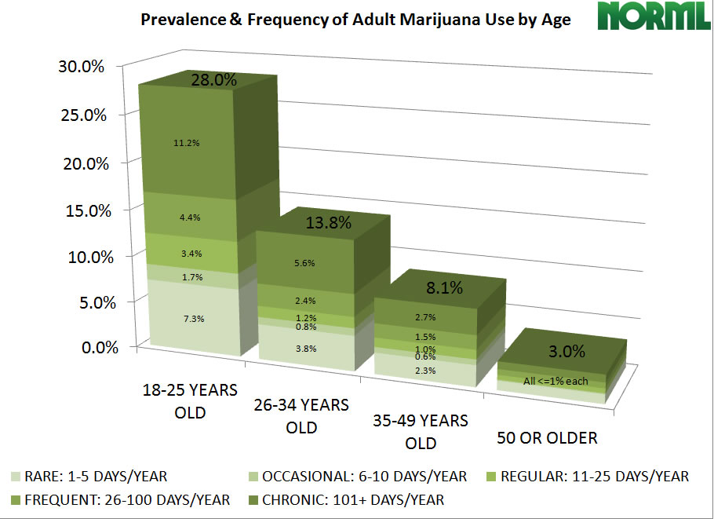
Notes:
Facts About Marijuana
US Adults Who Use Marijuana Annually by Age
Most marijuana users never use any other illicit drug today. For the large majority, it is a terminus rather than a so-called gateway drug. Alcohol is the gateway.
Most people who use marijuana do so occasionally. Fewer than 10 percent of those who try marijuana ever meet the clinical criteria for dependence, while 32 percent of tobacco users and 15 percent of alcohol users do.

Slide 35
Marijuana
Claims about increases in marijuana potency are vastly overstated and not related to risk of dependence or health impacts. THC in domestically grown marijuana is less than 5%. In the 1980’s was 3%. Doctors may legally prescribe Marinol, an FDA-approved pill that contains high levels of THC effective for treatment of nausea, vomiting, and wasting disease. Sativex in Canada has roughly 50% THC.
Marijuana has not been shown to cause mental illness. Ingestion may cause panic, anxiety, and paranoia but effects are temporary. Distress may lead to use but not the reverse.
Marijuana use has not been shown to increase risk of cancer.
Notes:
Drug Policy Alliance. May reduce head and neck cancer. Five year long study has found heavy use marijuana was not associated with lung cancer or upper aerodigestive tract cancers.

Slide 36
Marijuana
Marijuana has been proven helpful for treating the symptoms of a variety of medical conditions.
Marijuana use rates in the Netherlands are roughly one-half those in the U.S. despite very different policies of quasi-legalization versus prohibition.
Marijuana has not been shown to cause long-term cognitive impairment. Short term memory yes depending on strength and amount of use., long term permanent - lack of evidence.
Notes:
Drug Policy Alliance 6. Reducing cancer chemotherapy nausea, stimulating appetite in HIV or AIDS patients including cachexia (wasting and malnutrition), reducing intraocular pressure in people with glaucoma, and reducing muscle spasticity in patients with neurological disorders (epilepsy and seizures). Critics argue that one of the most pervasive drug scandals in the United States is the epidemic of under-treatment of pain. “Addiction” to (i.e., dependence on) opiates among the terminally ill is the appropriate course of medical treatment.
Smoking marijuana to ease the nausea of chemotherapy, to reduce the pain of multiple sclerosis and other disorders characterized by muscle spascity, to alleviate the symptoms of glaucoma and to improve appetite dangerously reduced from AIDS are effective medicine.
Users currently are regarded as criminals. Prohibition also prevents research on the medical use of marijuana.
Chemotherapy patients, especially those being treated for mucositis, nausea and anorexia.
Postoperative pain patients (using cannabinoids as an opioid adjunct to determine whether nausea and vomiting from opioids are reduced).
Patients with spinal cord injury, peripheral neuropathic pain or central post-stroke pain.
Patients with chronic pain and insomnia.
AIDS patients with cachexia (wasting and malnutrition), AIDS neuropathy or any significant pain problem.
7. Netherland’s drug policy is one of the most nonpunitive in Europe. For more than 20 years, Dutch citizens over age eighteen have been permitted to buy and use cannabis (marijuana and hashish) in government-regulated coffee shops. The policy has not resulted in dramatically escalating marijuana use.

Slide 37
Marijuana
There is no compelling evidence that marijuana contributes substantially to traffic accidents and fatalities.
More than 750,000 people are arrested for marijuana each year, the vast majority for simple possession. This is far more than the total number of arrestees for all violent crimes combined, including murder, rape, robbery, and aggravated assault.
Notes:
Drug Policy Alliance 9. At some doses, marijuana affects perception and psychomotor performance – changes which could impair driving ability. However consistently less than produced by low to moderate doses of alcohol and many legal medications. Marijuana tends to make subjects more cautious. In cases where THC is detected in the blood, alcohol is almost always detected as well.
10. Of those charged with marijuana violations, approximated 86 percent , 663,032 Americans were charged with possession only. The remaining 94,937 were charged with “sale/manufacture” which includes cultivation offenses even if for personal or medical use. In past years, roughly 30 percent of those arrested were age 19 or younger.

Slide 38
Is Marijuana Dangerous?
What are Americans telling us?
Should marijuana be legalized?
Are the residents of one half of our states irrational?
Why are they approving medical marijuana? Why have Washington and Colorado legalized marijuana?
Notes:
Policy Questions

Slide 39
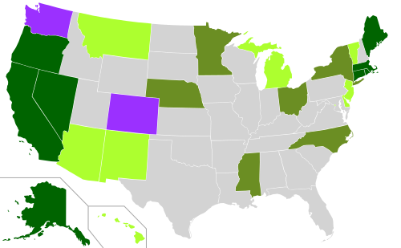
Notes:
Map of the US showing US cannabis laws.
Light Green Medical 18 states and D.C., add New Hampshire and Illinois in 2013
Medium green decriminalized cannabis possession laws. Alabama and New York with pending medical marijuana laws.
Dark green State with both medical and decriminalized possession laws.
Purple State with legalized cannabis.
Nevada has laws decriminalizing cannabis possession for adults age 21 and over; non-medicinal cannabis possession remains a felony with a minimum one-year and a maximum four-year prison sentence for adults under age 21. Thus, Nevada is not considered to have fully decriminalized marijuana.^{[1]}
Maryland has an active medical marijuana program, but this is really an affirmative defense law rather than an active program. Therefore it is not included above.
Other states with pending legislation to Legalize Medical Marijuana include Iowa, Kansas, Kentucky, and Oklahoma.
Currently: Five states are considering legislation to legalize adult consumption and sale of marijuana.
Nine states are considering legislation to decriminalize minor marijuana possession offenses.
Eight states are considering legislation to legalize the use of marijuana for therapeutic purposes. NORML Feb 14, 2013
Portland, Maine and Lansing Michigan will be considering legalization laws this fall.
Canadian Association of Chiefs of Police have come out in favor if citing but not arresting citizens found with marijuana for personal use.

Slide 40
Telling the Truth to Teens
As compared to most drugs, Pot is the least dangerous. Pot is less addictive than coffee.
Beer causes the same memory loss as Pot. Marijuana enhances certain mental abilities, helps you think “outside the box”.
Don’t take Pot before a test!
Its your life! Be responsible! Learn how to say no and mean it.
One reason Pot isn’t legal is because a lot of people are making money on it because it’s not legal. Drug abuse is a bad idea.
Notes:
Telling Teenagers the Truth about Smoking Pot. Cannabis Web Directory. A Ring of Cannabis, Marijuana and Hemp Related Sites.

Slide 41
Who Opposes Legalizing Marijuana and Why
The uninformed. The government, politicians afraid to act. Religion – fun is sin. Moralizers. People who do no drugs.
The alcohol lobby. The tobacco Lobby.
Law enforcement. Government agencies.
Pot dealers. Wood Industry. Private prisons. Trial lawyers. Mental hospitals. Some conservatives(?), Some therapists(?).
I’d add international cartels, domestic producers.
Notes:
Pew Research Council 2010 study: 64 percent of religiously unaffiliated support legalization, 33 percent of Christians. Two largest lobbying groups: The U.S. Conference of Catholic Bishops and the Family Research Council (Christian moral interests.
Dominant among the opponents of change who testify before legislative panels are the recipients of public funds - police chiefs, prosecutors, and drug abuse experts funded by government contracts and grants.

Slide 42
Drug War Argument
Most people can use most drugs without doing much harm to themselves or anyone else. Only a tiny few of the millions world wide that have tried marijuana have gone on to have problems.
The same is true for cocaine and hallucinogens. That a few million people have serious problems is no reason to demonize these drugs and the people that use them.
Notes:
Yes and no. As a health problem heroin, cocaine and hallucinogens can result in medical repercussions and costs.

Slide 43
Health
Most illegal drugs are not especially harmful (tobacco is more addictive than virtually all drugs). Most users of illegal drugs, including cocaine and heroin, take them only occasionally. They do so because they enjoy them (as they do whisky or a Marlboro light).
Addiction – impacts on families. Legalization offers the opportunity to deal and treat addiction properly.
Notes:
Drug War Facts

Slide 44
United States Drug Use 2011 Past month, age 12 & over
Substance Users (Millions) % Population*
Drugs 22.5 8.7
Marijuana 18.1 7.0
Cocaine 1.4 .5
Heroin .3 .1
Hallucinogens 1.0 .4
Prescription-type 2.4 2.5
Alcohol 133.4 51.8
Tobacco 68.2 26.5
*Age 12 and over population
Source: Results from the 2011 National Survey on Drug Use and Health: National Findings.
Notes:
2011 current population data were down from 2010 by .5% of the population for alcohol and for binge drinking (5 days past month heavy drinking), cocaine down .1%, hallucinogens down .1% and prescription type psychotherapeutic drugs down .3%.
According to the National Survey on Drug Use and Health, in 2010, about
22.6 million Americans aged 12 and older were current (in the past month) illegal
drug users, representing 8.9 percent of the population. This represents the largest
proportion in the past decade of people aged 12 and older identified as current
illegal drug users.

Slide 45
Annual Causes of Death in the United States
Source: Journal of the American Medical Association. March 2004
Tobacco 435,000
Alcohol 85,000
Adverse reaction to prescription drugs 32,000
Incidents involving firearms 31,347*
Motor vehicle crashes 34,485 *
An illicit drug use, direct and indirect 17,000
Non-steroidal anti-inflammatory drugs such as Aspirin 7,600
Marijuana 0
*2009 data
Notes:
Drug War Facts. Causes of Death. Data from 2009 unless otherwise noted. Basic Data item 19. (Marijuana Safety - DEA Administrative Law Judge's Ruling) "3. The most obvious concern when dealing with drug safety is the possibility of lethal effects. Can the drug cause death? "4. Nearly all medicines have toxic, potentially lethal effects. But marijuana is not such a substance. There is no record in the extensive medical literature describing a proven, documented cannabis-induced fatality. "5. This is a remarkable statement. First, the record on marijuana encompasses 5,000 years of human experience. Second, marijuana is now used daily by enormous numbers of people throughout the world. Estimates suggest that from twenty million to fifty million Americans routinely, albeit illegally, smoke marijuana without the benefit of direct medical supervision. Yet, despite this long history of use and the extraordinarily high numbers of social smokers, there are simply no credible medical reports to suggest that consuming marijuana has caused a single death. "6. By contrast aspirin, a commonly used, over-the-counter medicine, causes hundreds of deaths each year. "7. Drugs used in medicine are routinely given what is called an LD-50. The LD-50 rating indicates at what dosage fifty percent of test animals receiving a drug will die as a result of drug induced toxicity. A number of researchers have attempted to determine marijuana's LD-50 rating in test animals, without success. Simply stated, researchers have been unable to give animals enough marijuana to induce death. "8. At present it is estimated that marijuana's LD-50 is around 1:20,000 or 1:40,000. In layman terms this means that in order to induce death a marijuana smoker would have to consume 20,000 to 40,000 times as much marijuana as is contained in one marijuana cigarette. NIDA-supplied marijuana cigarettes weigh approximately .9 grams. A smoker would theoretically have to consume nearly 1,500 pounds of marijuana within about fifteen minutes to induce a lethal response. "9. In practical terms, marijuana cannot induce a lethal response as a result of drug-related toxicity."
Source:
US Department of Justice, Drug Enforcement Administration, "In the Matter of Marijuana Rescheduling Petition" (Docket #86-22), September 6, 1988, p. 56-57. http://druglibrary.net/olsen/MEDICAL/YOUNG/young4.html
The second most common form of drug abuse in the United States is the
misuse of prescription drugs. The Office of National Drug Control Policy views
prescription drug abuse as “the Nation’s fastest-growing drug problem.” An
even more striking demonstration of this trend is the fact that overdose deaths
from prescription painkillers now outnumber deaths involving heroin and
cocaine combined, accounting for 20,044 of 36,450 overdose deaths in the U.S.
in 2008.24 In contrast, only 4,000 people died of overdoses related to these types
of drugs in 1999.25
Researchers found a sharp increase in deaths tied to cocaine and to opioid analgesics, a class of drugs used medically for pain treatment that includes fentanyl, methadone, morphine and popular pain relievers like Vicodin and Oxycontin.
2006 estimates:
Cocaine-related 7,000.
Methadone-related 5,000.
Other opioids 6,000, including brand names such as Buprenex, Stadol, Tylenol with codeine, Duragesic, Vicodin, Dilaudid, Dolophine, Astramorph, OxyContin and Darvon.

Slide 46
Alcohol-Related Mortality
Alcohol-related deaths are now 1 in 25 around the world (3.8%) and close to tobacco in overall impact. Alcohol-related causes of death include accidents, violence, poisoning, mouth and throat cancer, breast cancer, suicide and many others.
In the US, the Center for Disease Control estimates alcohol causes 25,000 deaths a year. Overall, 100,000 deaths occur each year because of alcohol consumption. Alcohol can be blamed for deaths from: 5% of circulatory system diseases, 15% of respiratory system diseases, 30% of accidents by fire and flames, 30% from accidental drowning, 30% of suicides, 40% of accidental falls, 45% of automobile accidents and 60% of homicides.
Notes:
For some time I have felt that marijuana would reduce or be a substitute for consumption of alcohol, especially for younger persons. Marijuana makes one mellow and sleepy if used at a party, a person is apt to have one or two alcoholic drinks and smoke a roach of marijuana and then go to sleep. The alternative without marijuana is to “binge” drink several alcoholic drinks which can be very detrimental and dangerous. Two recent studies address the issue. A Danish study indicates “Among psychoactive substances alcohol still poses the largest problem in terms of driver risk of getting injured.” Alcohol alone or combined with other psychoactive substances was the highest risk. Various drug-drug combinations, amphetamines and medical opioids was second most risky. The least risky drug seemed to be cannabis and benzodiazepines and Z-drugs (sleep enhancers like benzo).
Montana: The passage of the medical cannabis laws is associated with a reduction in the public’s overall consumption of alcohol and with fewer incidences of traffic facilities. In the period 1990-2010, we find that traffic fatalities fall by 8-11 percent the first full year after (marijuana) legalization. …marijuana users are less likely to drive while impaired.

Slide 47
Public Health Care Cost
(2009) “The public health burden of cannabis use is modest compared with that of alcohol, tobacco, and other illicit drugs.
A recent Australian study estimated that cannabis use caused 0.2% of total disease burden in Australia—a country with one of the highest reported rates of cannabis use.
Cannabis accounted for 10% of the burden attributable to all illicit drugs (including heroin, cocaine and amphetamines). It also accounted for around 10% of the proportion of disease burden attributed to alcohol (2-3%), but only 2.5% of that attributable to tobacco (7-8%).”
Notes:
Research Study

Slide 48
Results of the War on Drugs
Nixon elected 1971. Expectation drug trafficking could be reduced. Cost is now over $2.5 trillion, tallied up 45 million arrests and insurmountable damages to society. America is not now nor will ever be drug free.
Total direct monetary cost includes spending on police, court personnel, guards and other resources spent on imprisoning and punishing those convicted is now estimated at $40 billion per year.
Notes:
FedCure numbers

Slide 49
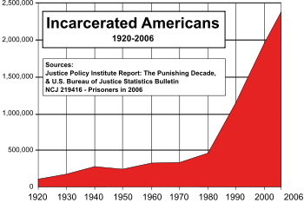
Notes:
High school drop outs have remained large at 25%. . Important factor for the poor and in inner-city neighborhoods is the temptation to drop out in order to profit from the drug trade.
Persons incarcerated in state and federal prisons has grown from 330,000 in 1980 to about 1.6 million today. Much of this increase is directly due to the war on drugs and severe punishments for persons convicted of drug trafficking. Total prisoners and jail inmates totaled 2,239,800 at the end of 2011. Becker and Murphy. Also Bureau of Justice Statistics Prisoners in 2011

Slide 50
Drug Issues
High school drop out rate has remained large at 25%. Important factor for the poor and in inner-city neighborhoods is the temptation to drop out in order to profit from the drug trade.
The number of persons incarcerated in state and federal prisons has grown from 330,000 in 1980 to about 1.6 million today. Much of this increase is directly due to the war on drugs and severe punishments for persons convicted of drug trafficking. Total prisoners and jail inmates totaled 2,239,800 at the end of 2011.
Notes:
Becker and Murphy. Also Bureau of Justice Statistics Prisoners in 2011

Slide 51
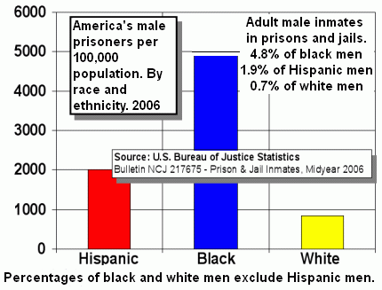
Notes:
Highest in the world. U.S. incarcerates nearly one-quarter the worlds inmates and prisoners. Of this number 21.5% are pretrial detainees, 8.7% are females, 0.4% are juveniles, and 5.9% are foreign prisoners.
Racism in Criminal Justice
Nationally African Americans are 13 percent of drug users but 35 percent of arrests for possession, 55 percent of convictions, and 74 percent of convictions for drugs.
Easier to make arrests in open air inner city drug markets (blacks) then in suburban basements (whites).
Fewer criminal zones in Europe. Violent offenders, terrorists, certain sex offenders and drug dealers. Drug users do not find themselves in prison.

Slide 52
Drug Prices
Prices of illegal drugs are pushed up whenever many drug traffickers are caught and punished harshly. Higher prices help compensate traffickers for the risks of being apprehended.
The paradox is the harder governments push the fight especially if they target small-fry dealers the larger the profits. More aggressive war on drugs lead to higher levels of violence and corruption and the higher the costs imposed on society.
Notes:
Becker and Murphy

Slide 53
Notes:
The larger the profits the more the encouragement to bribe and intimidate police, politicians, the military and anyone else involved in the war against drugs. Anyone who resists begins to fear for their lives and those of their families.
Probably 60,000 people have died since Mexico’s antidrug campaign started in 2006, maybe 100,000 given numbers of missing persons, magnitudes greater than American losses in Iraq and Afghanistan combined and proportionally three times as many as Vietnam. Many killed were innocent civilians and the army personnel, police officers and local government officials involved in the antidrug effort.

Slide 54
INTERNATIONAL AGREEMENTS
The United States was a major force behind The Single Convention on Narcotic Drugs of 1961 and its amendment by the 1972 Protocol. The Convention on Psychotropic Substances of 1971 added cannabis to the list of controlled drugs.
The U.S and Sweden are proponents of zero tolerance policies on cannabis and other drugs which has the effect of preventing the UN from promoting harm reduction policies like needle exchange and Heroin-assisted treatment.
Notes:
Summary note of report

Slide 55
Drug Policy Alliance
Everyone has a stake in ending the war on drugs.
Whether you are a parent concerned about protecting children from perceived drug related “harm”, a social justice advocate worried about racially disproportionate incarceration rates or a fiscally conservative taxpayer you have a concern.
U.S. federal, state and local governments have spent hundreds of billions of dollars trying to make American “drug free”. Yet heroin, cocaine, methamphetamine and other illicit drugs including marijuana are cheaper, purer and easier to get than ever before.
Notes:
Overview

Slide 57
Impacts of Legalizing Pot
Marijuana: not clear if there will more or less consumption. Likely some increase with lower prices. But thrill of use may wane and if access is limited to age 21 could have a reduction in use.
Prices should fall fewer barriers to marketing and distribution. Competition and lower prices will likely reduce profits for many growers, dealers, traffickers, and international cartels.
Reduction in the number of inmates in federal and state prisons and local jails by 20% to 40%.
Opportunity for extensive research on use of cannabis for medical problems.
Opportunity to expand trade and develop strong relationships with Central and South American countries.

Slide 58
Side Effects of the War on Drugs
Advocates claim the war reduces drug use and addiction. However this may well lead drug users to lower priced but more dangerous alcohol as drugs become more expensive.
It may be harder to break an addiction to an illegal drug. Addicts may be leery of going to clinics or to nonprofit “drugs anonymous” groups for help for fear they will be reported.
The illegality of drugs stunts development of ways to help addicts. It leads them to associate more with addicts and less with those who might help them quit.
Notes:
Becker and Murphy

Slide 59
Other Considerations
Joseph McNamara, an active member of Law Enforcement Against Prohibition (LEAP) describes marijuana laws as much worse than ineffective: “they waste valuable police resources .”
These officers, judges and prosecutors support legalizing marijuana because it:
Stops wasting police officers on non-violent marijuana offenders and enables them to focus on preventing violent crime.
Cuts off funding to violent gangs and drug cartels.
Reduces marijuana access to children by instituting strict age-limits and public safety controls.
Protects the lives of police officers now at risk in the “drug war,”
Restores mutual respect and good relations between law enforcement and communities bearing the brunt of current marijuana laws.

Slide 60
Marijuana Laws Virginia
Possession Any amount (first offense) misdemeanor 30 days $500
Any amount (subsequent offense) misdemeanor1 year $2,500
Cultivation Any amount felony 5 - 30 years $10,000
Sale 1/2 oz. or less misdemeanor 1 year $2,500
1/2 oz. to 5 lbs. felony1 - 10 years $2,500
5 lbs. to 100 kg felony 5 - 30 years $2,500
More than 100 kg felony 20 years MMS* $1,000,000
To a minor felony 10 - 50 years $100,000
Within 1,000 feet of a school or other specified areas felony 1 - 5 years $100,000 Transport 5 lbs. or more into state with intent to sell felony 3 years MMS* - 40 years $1,000,000
*Mandatory minimum sentence.
Miscellaneous (paraphernalia, license suspensions, drug tax stamps, etc...) Paraphernalia sale misdemeanor 1 year $2,500
Paraphernalia sale to a minor felony1 - 5 years $2,500
Probation with deferred proceedings is possible for first offenders. Any marijuana conviction results in the suspension of one’s drivers license for a period of six months.

Slide 61
DRUGS Virginia State Police 2008 Arrests and Offenses Reported
“Crack Cocaine” 3,646, Cocaine 2,577,
Heroin 771,
Marijuana 19,911,
Morphine 71, Opium 28, Other Narcotic 1,139, LSD 7, PCP 45, Other Hallucinogens 58,
Amphetamines/Methamphetamines 312,
Other Stimulants 81, Barbiturates 23, Other Depressants 112, Other Drugs 622, Unknown Drug Type 3,508.
Total Drug Arrests 32,929. Drug Offenses Reported 46,115.
Age Range Under 10 one, 65 and over 91, peak age 19 = 2,530.

Slide 62
Reform Legalize Drugs
Steadily eliminate the “War on Drugs” to one of taxation of drug sales and treatment of addicts along the same lines currently in place for tobacco and alcohol.
Decriminalize possession and use of marijuana and harder drugs including cocaine and heroin.
Utilize educational programs and counseling of youth regarding the medical aspects of drugs. Provide appropriate medical and additional support programs, community based treatment and access to approved quality controlled distributors for those that wish to use drugs. Make drugs available for medical use and treatment of pain.
Minimize incarceration as a punishment for possession of drugs. Legalize distribution of drugs through private sector outlets under government regulation and control.
Notes:
Reform Ideas

Slide 63
Legalizing
Issue- fear that more people would take drugs under a legal regime. Not clear this would be the case but a cheaper, safer product, and more widely available product might result in some increase in consumption.
In Portugal, where use of drugs is considered a health problem, drug use is less than half what it is in the United States. In Holland, where drugs are legal, teen drug use is half of what it is in the U.S.
One researcher points out that roughly 30 percent of the U.S. drug market has been decriminalized in recent years and drug use has not increased in those states. Legalizing might result in drugs being substituted for alcohol consumption.
Providing honest information about health risks of different drugs and pricing them accordingly by governments can steer people toward the least harmful ones. It might encourage legitimate drug companies to improve designer drugs.

Slide 64
Drug Legalization Various Views
Legalization of drugs need not be viewed as a single giant step in which all restrictions are abruptly removed, resulting in a chaotic free market.
With alcohol the federal government retained some oversight and a remarkable degree of discretion was given to individual states.
Alcohol remains one of the most regulated products available, in terms of licensing, location, time, pricing, advertising and other respects. Similar liberalization—with taxation and other regulation—could be tried for other drugs….

Slide 65
Drugs and Politics
Promise politicians love to make to assuage the sense of moral panic that has been the hand maiden of prohibition for a century. Intended to reassure parents of teenagers across the world. It is a highly irresponsible promise because it cannot be fulfilled. The war terrorizes the parents of teenagers that try a mild controlled substance that should be legal.
The war on drugs has been a disaster, creating failed states in the developing world as addiction has flourished in the rich world.

Slide 66
Drug Policy
The “least bad” policy is to legalize drugs. “Least bad” does not mean good. Many vulnerable drug-takers would suffer. But in the view of the Economist, more would , gain.
Governments would tax and regulate the drug trade, and use the funds (billions) saved on law enforcement to educate and treat. Sales to minors would be banned. Different drugs would command different levels of taxation and regulation.

Slide 67
In Summary
Half a million people are behind bars on drug charges – more then western Europe (with a larger population) incarcerates for all offenses. The war on drugs has become a war on families, a war on public health and a war on constitutional rights. Drug Policy Alliance.
Public health problems like HIV and Hepatitis C are all exacerbated by zero tolerance laws that restrict access to clean needles. Children of inmates are at risk of educational failure, joblessness, addiction and delinquency.
People suffering from cancer, AIDS and other debilitating illnesses are regularly denied access to their medicine or even arrested and prosecuted for using medical marijuana.
We can do better.
Notes:
Insummary

Slide 68
U.S. Justice versus Europe
Fewer criminal zones in Europe. Violent offenders, terrorists, certain sex offenders and drug dealers.
Very limited use of prison on property offenses.
Increased use of fines, probation, and community service.
Use of “day fine” system tailored to ability to pay and to degree of integration into society.
Drug users do not find themselves in prison.
Prostitution legalized in Northern Europe, procuring is not.
Deviancy has been defined down.
Special class of judges. Presupposes inmates will be released early, provide treatment toward re-socialization.
Continental courts have grown stronger.

Slide 69
Inmate Population
It is estimated that three-fourths of the persons that are incarcerated have a history of drug/alcohol abuse.
One out of six have mental illness.
One-half the women have suffered sexual or physical abuse.
Prisoners predominately come from poor/working class communities.
Two-thirds are racial and/or ethnic minorities.

