Slide 1
World Goals in Context Emerging and Re-Emerging Infectious Diseases
Felice M Apter, PhD
OLLI 2018

Slide 2
Part I Global Goals MDGs and SDGs

Slide 3
Precursor to Sustainable Development Goals The MDGs 2000-2015
Notes:
MDG 1: The number of people living on less than $1.25 a day has been reduced from 1.9 billion in 1990 to 836 million in 2015, although the target of halving the proportion of people suffering from hunger was narrowly missed.
MDG 2: Primary school enrolment figures have shown an impressive rise, but the goal of achieving universal primary education has just been missed,
MDG 3: About two-thirds of developing countries have achieved gender parity in primary education.with the net enrolment rate increasing from 83% in 2000 to 91% this year.
MDG 4: The child mortality rate has reduced by more than half over the past 25 years – falling from 90 to 43 deaths per 1,000 live births – but it has failed to meet the MDG target of a drop of two-thirds.
MDG 5: The global maternal mortality ratio has fallen by nearly half – short of the two-thirds reduction the MDGs aimed for.
MDG 6: The target of halting and beginning to reverse the spread of HIV/Aids by 2015 has not been met, although the number of new HIV infections fell by around 40% between 2000 and 2013.
MDG 7: Some 2.6 billion people have gained access to improved drinking water since 1990, so the target of halving the proportion of people without access to improved sources of water was achieved in 2010 – five years ahead of schedule. However, 663 million people across the world still do not have access to improved drinking water.
MDG 8: Between 2000 and 2014, overseas development assistance from rich nations to developing countries increased by 66% in real terms, and in 2013 reached the record figure of $134.8bn.

Slide 4
Lives Saved are Primarily from HIV/AIDS, TB and Vaccine-Preventable Diseases Reduction of Maternal Mortality through FP
Brookings Institute
2015

Slide 5
2015 MDG Lessons Learned From Developing Countries to a Global Approach Measurement and Focus

Slide 6
Part II Emerging Infectious Disease in Global Health

Slide 7
Emerging Infectious Diseases: Multisectoral Everything is Inter-related

Slide 8
Basic Definitions
Emerging Infectious Disease- disease recognized in a human host for the first time
Re-emerging Infectious Disease- disease that have historically occurred in human hosts, but are now:
New geographical area
New resistance to medical countermeasures (AMR)
Reappear after apparent control or elimination (VPD)

Slide 9
Soft Introduction – Some Short Films

Slide 10
One Health – Public health as part of the “ecosystem”
Human Cases Wild Animal Domestic Animal
Animal Amplification
C A S E S
Wildlife Surveillance/ Forecasting
Early Detection and Control Opportunities
TIME
Emerging Threats Program

Slide 11
Key risk factors for important EIDs
Human
Animal
Environment
Their interactions
Human
Environment
Animal

Slide 12
Part III Definition of an Epidemic The Historical Context

Slide 13
“There will come yet other new and unusual ailments in the course of time. And this disease will pass away, but it later will be born again and be seen by our descendants.”
GIROLAMO FRASCATORO
Speaking About Syphilis
>450 years ago.

Slide 14
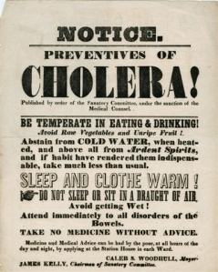
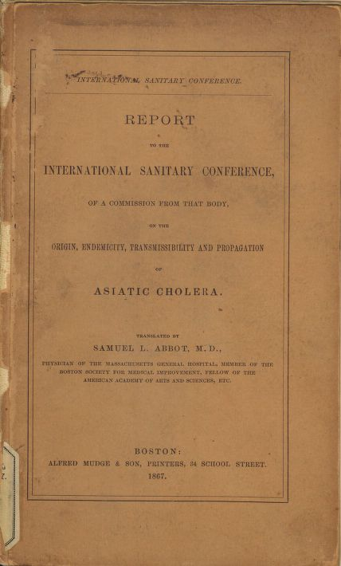
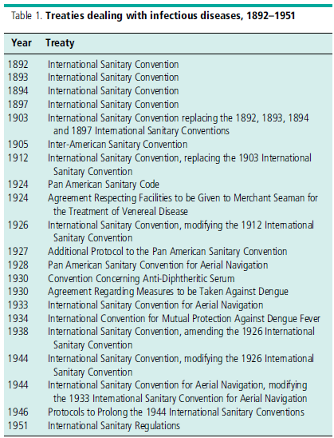
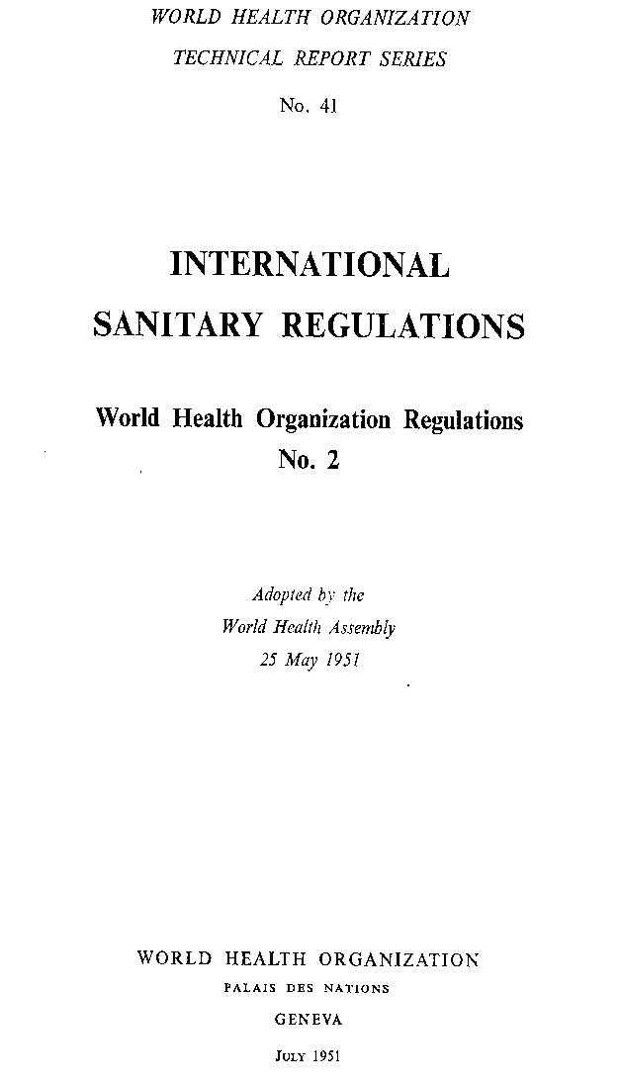
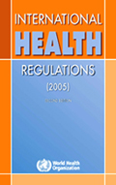
Evolution of International Sanitary Regulations
Table by Fidler
Notes:
Note that there have been international agreements around infectious diseases for several hundred years.
Up to International Sanitary Regulations in 1951, renamed International Health Regulations in 1969, which remained basically unchanged.

Slide 15
Re-Emerging Diseases Today The World’s Largest Outbreak Ever of Cholera

Slide 16
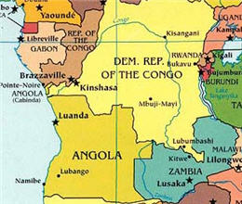
Democratic Republic of Congo
WASHINGTON — Torrential downpours and subsequent mudslides in the crowded capital of the Democratic Republic of the Congo, Kinshasa, earlier this week are expected to worsen the cholera outbreak that has held the country in its grasp since January 2017.
The national health emergency — which, to date, has caused more than 1,000 deaths among the 53,000 confirmed cases — is the country’s worst cholera outbreak in more than two decades. Some 21 of the country’s 26 provinces are affected, and since October 2017, cases have appeared in typically unaffected regions such as the southwest region of Kasai province. There, 3.5 million lack water, sanitation, and many have been displaced by local conflict.

Slide 17
Zambia Cholera Outbreak Response Behavior Change Communication
https://youtu.be/heA6yEWbmvk
https://www.facebook.com/mohzambia/videos/944572569050734

Slide 18
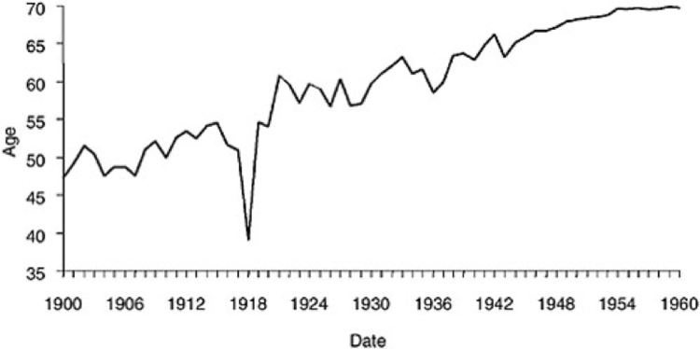
A Central Theme in 2018 - 100 Years 1918 Influenza Global Pandemic
The Influenza Pandemic of 1918 was the greatest death event of the 20th Century. It impacted the rise in life expectancy and took the lives of 567,254 Americans and between 21 and 50 million people worldwide.
https://www.prosperoanalyticsllc.com/1918-onedayatatime/
This website is an annual calendar covering influenza daily news coverage in 1918

Slide 19
Early Detection and Mitigation is Crucial
Source: WHO, The World Health Report 2007.
A Safer Future: global public health security in the 21st century

Slide 20
Modern History
The start of the twentieth century, tuberculosis, pneumonia, and
diarrheal diseases caused 30 percent of all deaths in the United States.
Improvements in hygiene, sanitation, water, food, housing,
nutrition and vector control led to major declines in infectious disease mortality in the US.
Antibiotics. Deaths from infectious disease- particularly TB and pneumonia- declined more than 8% each year from 1938-1952
By the mid-1960s, effective pertussis, polio, smallpox, tetanus, and diphtheria vaccines
Unprecedented outlay of government resources, a vast network
of field epidemiologists and research scientists, and extensive cooperation from private industry (Garrett, 1995)
From 1900 to 1980, annual deaths from infectious disease had
dropped from 797 to 36 per 100,000 persons (Armstrong et al.,
1999). By the turn of the 21st century, the average life expectancy in the United States had increased to over 76 years.

Slide 21
ONE OF SCIENCE'S MOST FAMOUS QUOTES IS FALSE
ELEMENTS
‘It’s time to close the books on infectious diseases, declare the war against pestilence won, and shift national resources to such chronic problems as cancer and heart disease’
William H. Stewart, US Surgeon General 1967
By Michael Specter, The New Yorker, January 5,2015

Slide 22
Part IV Defining the Challenge

Slide 23
JITMM, Bangkok, 12-14 December 2012

Slide 24
What did these Epidemic Infectious Diseases have in Common?
All were caused by zoonotic pathogens
All spread by modern transportation
Laboratory and clinical diagnoses were problematic
Poor communication among countries
Major economic impact

Slide 25
JOSHUA LEDERBERG ROBERT E. SHOPE BARRY R. BLOOM, ROBERT L. BUCHANAN, JOHN R. DAVID,
CIRO A. DE QUADROS,. PATRICIA N. FULTZ JOHN J. HOLLAND DEAN T. JAMISON EDWIN D. KILBOURNE ADEL A. F. MAHMOUD, GERALD L. MANDELL, STEPHEN S. MORSE JUNE E. OSBORN WILLIAM C. REEVES, PHILIP K. RUSSELL ALEXIS SHELOKOV
P. FREDERICK SPARLING, ANDREW SPIELMAN
Notes:
https://www.nap.edu/read/2008/chapter/1 -- 1992

Slide 26
NAS-1992 Factors of Emergence
Microbial adaptation and change
Economic development and land use
Human demographics and behavior
International travel and commerce
Technology and industry
Breakdown of public health measures

Slide 27
Factors of Emergence 2003
Microbial adaptation and change
Human susceptibility to infection
Climate and weather
Changing ecosystems
Human demographics and behavior
Economic development and land use
International travel and commerce
Technology and industry
Breakdown of public health measures
Poverty and social inequality
War and famine
Lack of political will
Intent to harm

Slide 28
Drivers of Disease Emergence in Humans
E. Loh et al. 2015. Vector-borne and Zoonotic Diseases 15(7)

Slide 29
World Population
Major area, region, country or area | Total population in 2010 (thousand)
World | 6,895,889
China | 1,341,335
India | 1,224,614
Indonesia | 239,871
Japan | 126,536
Republic of Korea | 48,184
Singapore | 5,086
Source : United Nations, Department of Economic and Social Affairs, Population Division (2011). World Population Prospects: The 2010 Revision, CD-ROM Edition.

Slide 30
Most Populous Cities in The World (November 2010)
In thousand
35000
30000
25000
20000
15000
10000
5000
0
Rosenberg, Matt (2011). Largest Cities in the World – List One. www.geography.about.com

Slide 31
Global Examples of Emerging and
Re-Emerging Infectious Diseases
Antimicrobial- r: ;:nt threats
-MRSA
Enterovirus D68 Cryptosporidiosis Ebola virus disease West Nile E.coli O104:H4
MERS-CoV
Akhmeta virus
Rift Valley fever
Typhoid fever
SFTSV
bunyavirus
E.coli
O157:H7
C. difficile
N. gonorrhoeae
H3N2v influenza Cyclosporiasis
E. coliO 15 7: H_ 7- _,l. -_-_-_-_-_:.:-::$5
Human monkeypox
Listeriosis Bourbon
virus
2009 H1N1
influenza
Adenovirus 14
Anthrax bioterrorism
Qii :
- - -==- -
- - - ---+--
H10N8
influenza
H7N9
influenza
https://youtu.be/xOFH57Do2EM
https://youtu.be/xOFH57Do2EM
Hendra virus
Enterovirus 71 Human monkeypox
Ebola virus disease
Zika virus Plague
Hantavirus pulmonary syndrome
Marburg hemorrhagic fever
MDR / XDR tuberculosis
Human African trypanosomiasis
Newly emerging
Re-emerging/resurging
"Deliberately emerging"
December 2016
CJj •
Georgetown University Medical Ccntct
J 7
8.9

Slide 32
Global Distribution of relative risk of EID events
a) Zoonotic pathogens from wildlife
c) Drug resistance pathogens
b) Zoonotic pathogens from domestic animals
d) Vector-borne pathogens
Jones et al. Nature 2008

Slide 33
Examples: Vector-borne Disease Dynamics
Susceptible population
Migration (forced)
•Vector environment
Vector
•Survival, lifespan
•Reproduction/breeding patterns
•Biting behavior
Pathogen
•Survival
•Transmission
•Replication in host

Slide 34
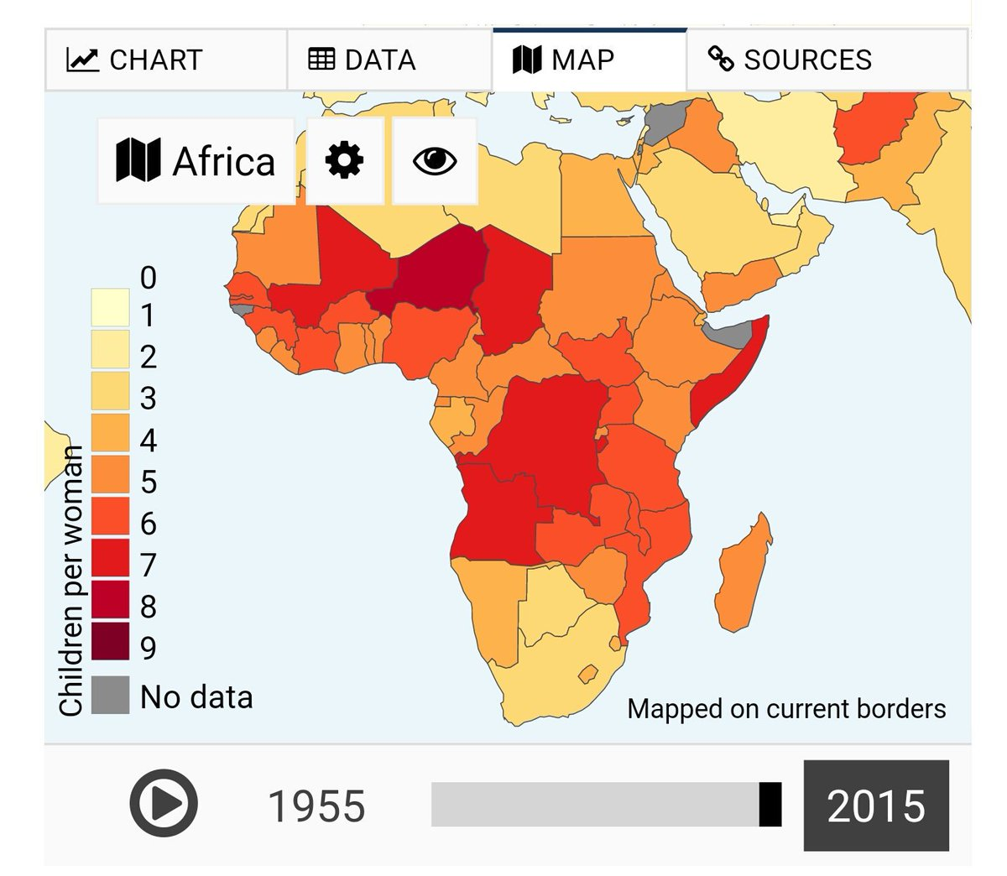

Slide 35
Vector-borne Disease Mortality Distribution
WHO, 2005
Majority of Vector-borne Disease (VBD) burden borne by developing countries
Disproportionate amount in Africa

Slide 36
Case Study: Malaria (cont.)
Estimated incidence of clinical malaria episodes (WHO)
40% world population at risk
500 million severely ill
Climate sensitive disease¹
No transmission where mosquitoes cannot survive
Anopheles: optimal adult development 28-32ºC
P falciparum transmission: 16-33ºC
McDonald et al., 1957
Highland malaria²
Areas on the edges of endemic regions
Global warming → El Niño³
Outbreaks
¹ Khasnis and Nettleman 2005; ² Patz and Olson 2006; ³ Haines and Patz,
2004

Slide 37
Drivers of Disease Emergence

Slide 38
Human
Notes:
The 2003 IOM study also presented what is called the Convergence Model:
FIGURE 3-1
The Convergence Model. At the center of the model is a box representing the convergence of factors leading to the emergence of an infectious disease. The interior of the box is a gradient flowing from white to black; the white outer edges represent what is known about the factors in emergence, and the black center represents the unknown (similar to the theoretical construct of the “black box” with its unknown constituents and means of operation). Interlocking with the center box are the two focal players in a microbial threat to health—the human and the microbe. The microbe–host interaction is influenced by the interlocking domains of the determinants of the emergence of infection: genetic and biological factors; physical environmental factors; ecological factors; and social, political, and economic factors.

Slide 39
Part V Our Modern World

Slide 40
“I rate the chance of a widespread epidemic, far worse than Ebola, in my lifetime, as well over 50 percent”
- Bill Gates, May 2015
“I rate the chance of a widespread epidemic,
far worse than Ebola, in my lifetime, as well over 50 percent”

Slide 41
Response and Solutions
At the start of an EID Outbreak:
WHO
WHAT WHERE WHEN WHY
Who is infected (index case) with What?
Where did it come from?
How is it spread? (epi curve, epi map, R0, finding cases)
Case definition, Incubation Period and CFR

Slide 42
,,-....
,
'' I
II
,I
,
(
_{-t} •_{I, ,}'-"'
1!1
I t
I:;I
I
'-, - -#
.I
,
,

Slide 43
Global Examples of Emerging and
Re-Emerging Infectious Diseases
Antimicrobial- r: ;:nt threats
-MRSA
Enterovirus D68 Cryptosporidiosis Ebola virus disease West Nile E.coli O104:H4
MERS-CoV
Akhmeta virus
Rift Valley fever
Typhoid fever
SFTSV
bunyavirus
E.coli
O157:H7
C. difficile
N. gonorrhoeae
H3N2v influenza Cyclosporiasis
E. coliO 15 7: H_ 7- _,l. -_-_-_-_-_:.:-::$5
Human monkeypox
Listeriosis Bourbon
virus
2009 H1N1
influenza
Adenovirus 14
Anthrax bioterrorism
Qii :
- - -==- -
- - - ---+--
H10N8
influenza
H7N9
influenza
https://youtu.be/xOFH57Do2EM
https://youtu.be/xOFH57Do2EM
Hendra virus
Enterovirus 71 Human monkeypox
Ebola virus disease
Zika virus Plague
Hantavirus pulmonary syndrome
Marburg hemorrhagic fever
MDR / XDR tuberculosis
Human African trypanosomiasis
Newly emerging
Re-emerging/resurging
"Deliberately emerging"
December 2016
CJj •
Georgetown University Medical Ccntct
J 7
8.9

Slide 44
A health threat anywhere is a health threat everywhere
Nature Reviews Microbiology 2013;11:
133-141.
The Lancet 380:9857, 1-7 Dec
2012, pp. 1946-
55.

Slide 45
EID risk per airport
Hosseini et al. (in review)

Slide 46
Direct economic impact of selected infectious disease outbreaks, 1990-2003
Heymann DL. Emerging and re-emerging infections. In Oxford Textbook of Public Health, 5th
ed, 2009, p1267.

Slide 47
Pandemic Risks and Comparative Costs
A severe flu pandemic could result in over
$3 trillion (to as high as $5.8 trillion) in global economic losses.
Cost of prevention: $3.4 b every year in 139 developing countries.
Economic rate of return to investment in public health: 50-123%

Slide 48
Part VI – USG Leadership

Slide 49
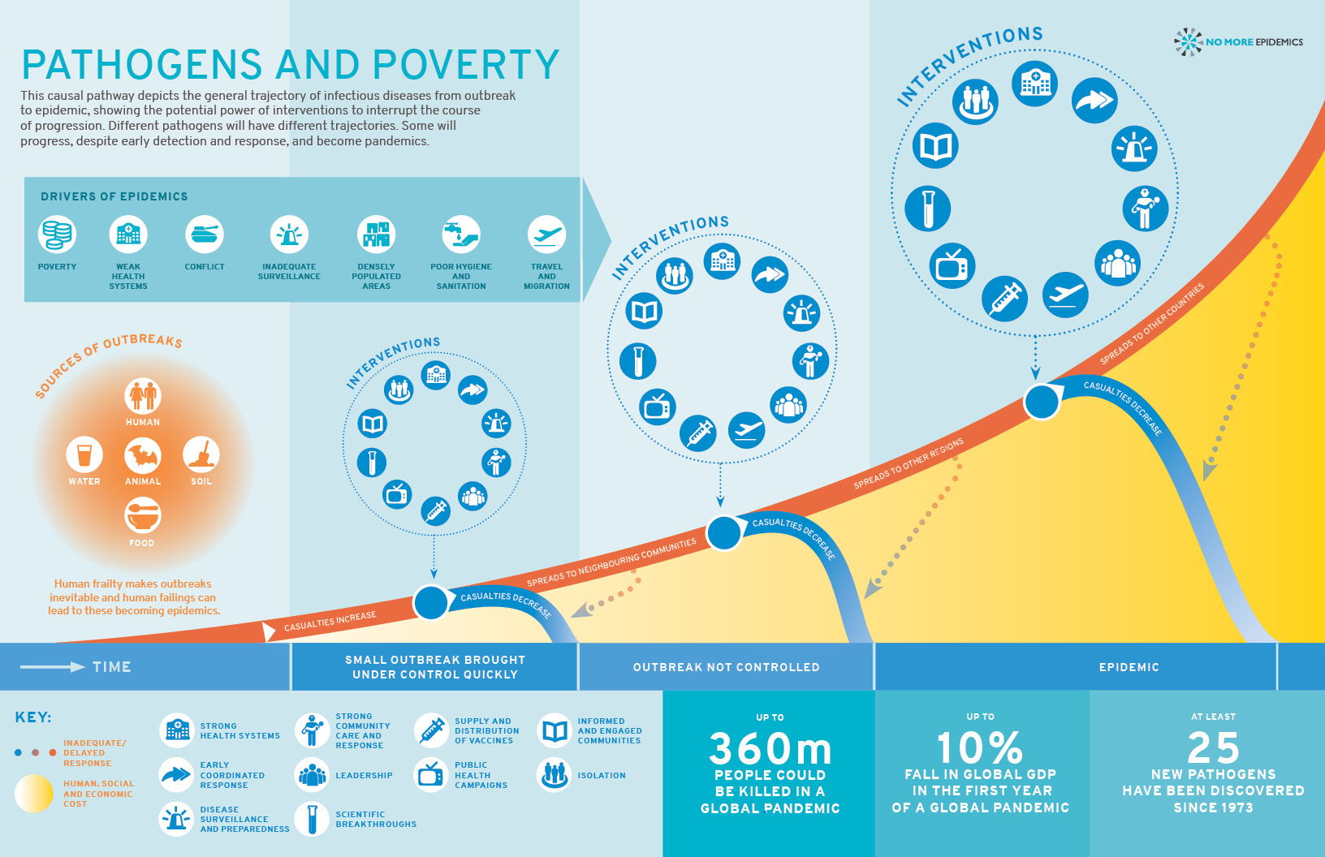
Notes:
And here NME tries to put it all on one slide

Slide 50
Early Detection and Mitigation is Crucial
Source: WHO, The World Health Report 2007.
A Safer Future: global public health security in the 21st century

Slide 51
Ebolavirus Ecology
Enzootic Cycle
Epizootic Cycle
Newevidence stron gly implicates t:atsas the reservoirhostsfor ebolavirus,es though themeansof local enzootlc malntalnanceand
t·ansmission of the virus wi thin bat
i:opulatlons remain unknown.
Ebolavlruses:
£bola viru s(formerly Zairevirus)
Sudan virus
Ta'iForest virus
Bundibugyo viru s
Epizooticscaused byebolavirusesappear sporadically, producing highmortalityamong non -humanprimatesandduikersandmay precede human outbreaks.Epidemicscaused by ebolavlruses produce acutediseaseamong
humans, with the exception ofRestonviruswhich does not producedetectable dis.easein humans. Litt le is .no wn abouthow the virusfirst passes to humans.triggerni g waves of human -to -human transmission,and an epidemic.
Restonvirus(non-human) ,_ ....,_ ,
Human-to-humantransmission is a
predominant feature of epidemics.
Following initial humaninfecti through contacwt ithaninfe<:ted bat o r other wikl animal, human·t o-human transmission
oftenoccurs.
,d( | ,,•..•.₋.

Slide 52
Response and Solutions
At the start of an EID Outbreak:
WHO
WHAT WHERE WHEN WHY
Who is infected (index case) with What?
Where did it come from?
How is it spread? (epi curve, epi map, R0, finding cases)
Case definition, Incubation Period and CFR

Slide 53
Public Health and Individual Rights

Slide 55
USG Response: Ebola and Zika

Slide 56
Next Week From Panic and Neglect to Investing in Health Security: Pandemic Preparedness at the International National Level

Slide 57
Early Detection Of Outbreaks Saves Lives
Source: WHO (2007)
Notes:
Have some fun! Generate your own epidemic curve. https://www.cdc.gov/training/QuickLearns/CreateEpi/

Slide 58
Readings
Introduction/Overview
Morens D., Fauci A, Emerging Infectious Diseases: Threats to Human Health and Global Stability July 4 2014 PLOS http://journals.plos.org/plospathogens/article?id=10.1371/journal.ppat.1003467
Smolinksi MS, Hamburg MA, Lederberg J Microbial threats to health: emergence, detection and response NAS – review the Executive Summary https://www.ncbi.nlm.nih.gov/pubmed/25057653

Slide 59
Readings
One Health Climate Change
Spillover http://www.pbs.org/spillover-zika-ebola-beyond/home (video)
WHO Preventing disease through healthy environments: a global assessment of the burden of disease from environmental risks http://www.who.int/quantifying_ehimpacts/publications/preventing-disease/en/
Martinez PP et. Al. http://www.pnas.org/content/113/15/4092.full
Contagion - Film; various outlets

