Slide 1
UNDERSTANDING ALZHEIMER’S DISEASE
JANE FLINN
GEORGE MASON UNIVERSITY

Slide 2
ALOIS ALZHEIMER
The disease was brought to modern attention by Dr Alois Alzheimer, with his description of his patient, Auguste Dieter.
She had the symptoms now associated with Alzheimer’s disease:
Profound loss of memory (everyone)
Impaired sleep wake cycle (common)
Accusations of infidelity (less common)

Slide 3
BRAIN PATHOLOGY
Alzheimer also examined Auguste’s brain and published his findings in 1906.
He identified plaques and tangles in the brain. The plaques are extracellular and the tangles intracellular. We now know that the plaques contain a protein called amyloid. The tangles are caused by another protein, tau.
It was Kraepelin, who believed that mental illness had a biological basis, who coined the term “Alzheimer’s disease”.

Slide 4
EARLY AND LATE ONSET AD
There are two forms of the disease, early onset and late onset. The underlying genetics are very different but the brain pathology is the same.
Early onset AD before ~age 60, about 5% of all cases.
Late onset AD, after age 65, these are the majority of the cases. Here age is a risk factor.
Common figures are that 10% of those over 65 and 20-40% of those over 80 have AD.

Slide 5
AN ANCIENT DISEASE
Not a new condition.
Worse still than all decay of limbs is memory’s decay, which recalls neither his slaves’ names nor the friend’s features, with whom he supped but yesternight, nor those whom he begot and bred. Juvenalis 60-140 AD
In Shakespeare’s King Lear, Lear did not recognize his daughter Cordelia.

Slide 6
GOOD NEWS
The good news is that the rates of AD are going down. This was first observed last year in men in England and is now true for both sexes in the US.
Presumably due to changes in behavior that have been going on for some time.
EXERCISE, EXERCISE, EXERCISE!

Slide 7
PRESENTATION
Types of memory.
Structure of the brain.
Brain regions and memory.
Spread of plaques and tangles in AD.
Consequent memory losses.
Damage to the Ach system.
Drugs.
Reasons for failure (?).
Helpful life style changes.

Slide 8
TYPES OF MEMORY
Episodic memory; memory for events, a wedding, a child’s birth, a party, a holiday.
Nine/ eleven.
Semantic memory; memory for facts, Paris is the capital of France. The names of things and people.
You have to store and then retrieve these memories. Sometimes just keep them in mind.

Slide 9
TYPES OF MEMORY, 2
Habit memory; riding a bicycle, using a computer keyboard.
Spatial memory; remembering where to go, where things were placed.
Fear memories, remembering something is dangerous, not smoking in bed.
The different types of memory depend on different regions of the brain.

Slide 10
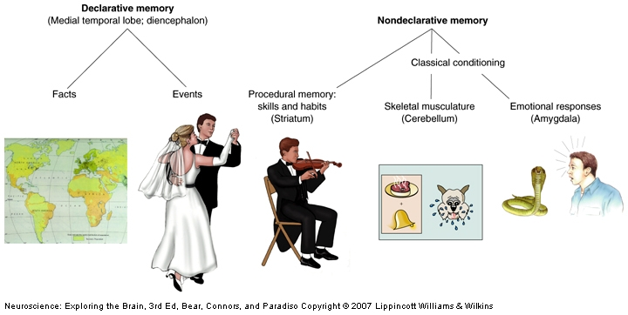
THERE ARE TWO MAIN TYPES OF LONG-TERM MEMORY,

Slide 11
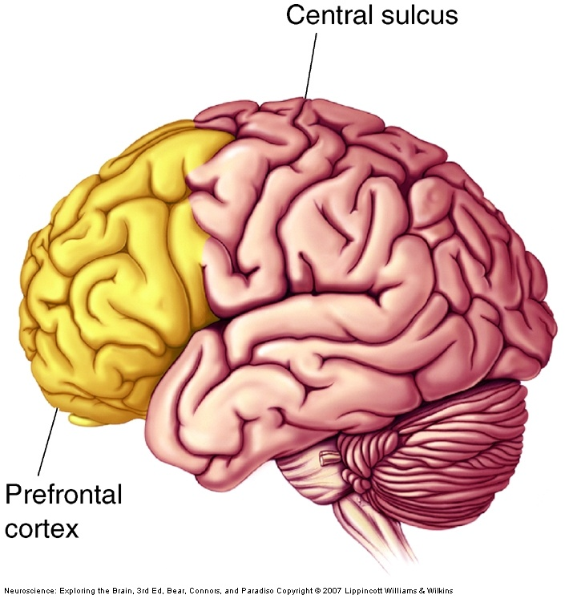
LATERAL VIEW OF THE CORTEX

Slide 12
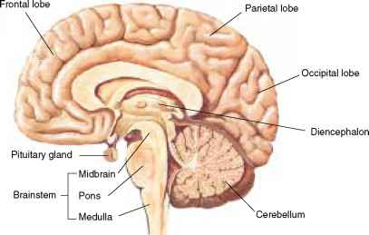
MEDIAL, INNER, VIEW OF THE BRAIN

Slide 13
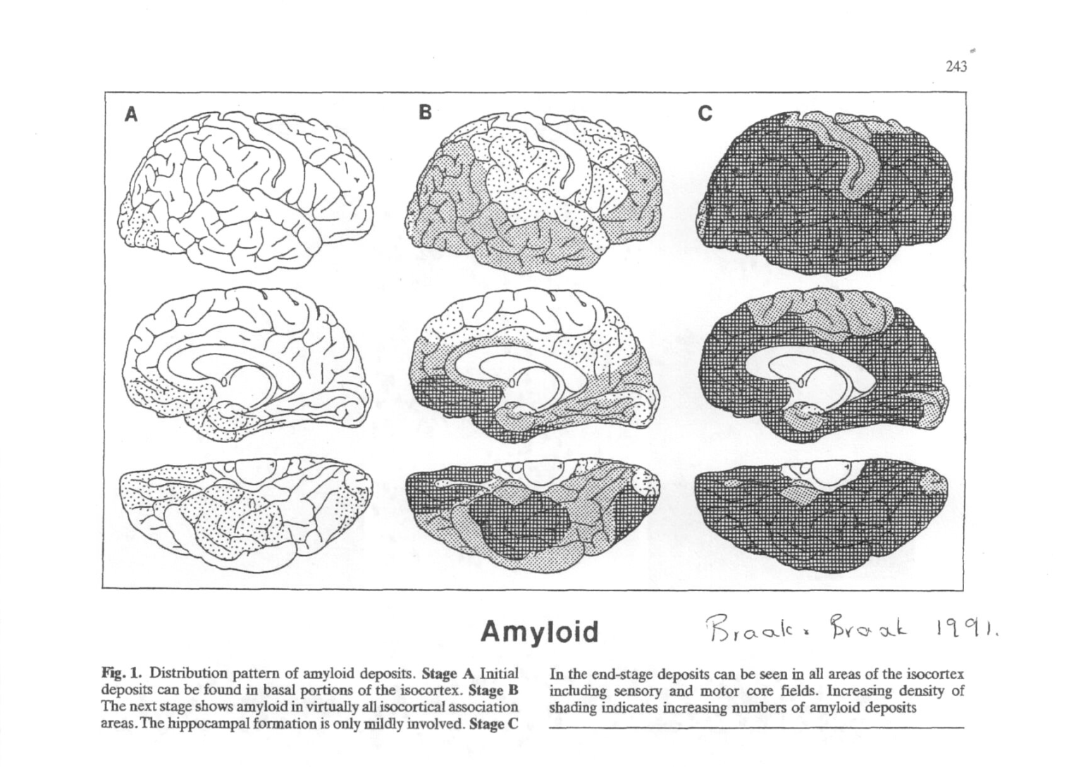
AMYLOID STAGES IN AD

Slide 14
TYPES OF CORTEX
Primary sensory cortex: receives sensory input, visual, auditory and somatosensory.
Primary motor cortex; sends signals down the spinal chord and thence to the muscles.
Association cortex; modifications of initial sensory and motor information.

Slide 15
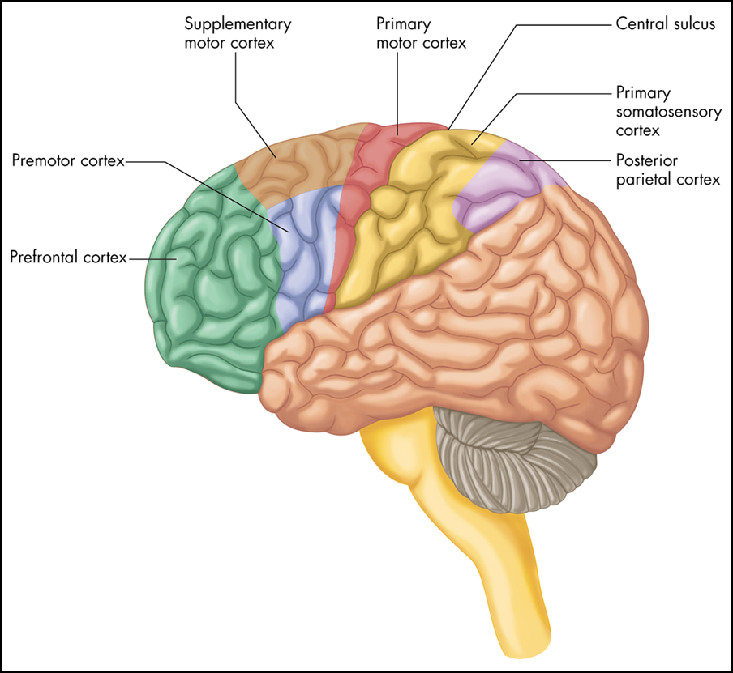
motor cortex regions
15

Slide 16
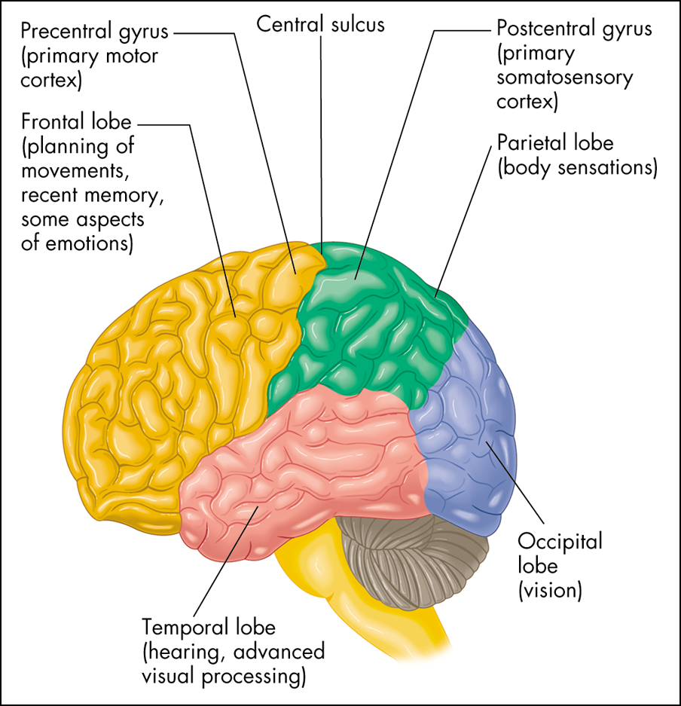
THE CORTEX AND THE LOBES OF THE BRAIN.

Slide 17
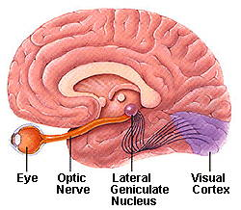
Visual signals travel to the cortex via the thalamus, the lateral geniculate nucleus is part of the thalamus.

Slide 18
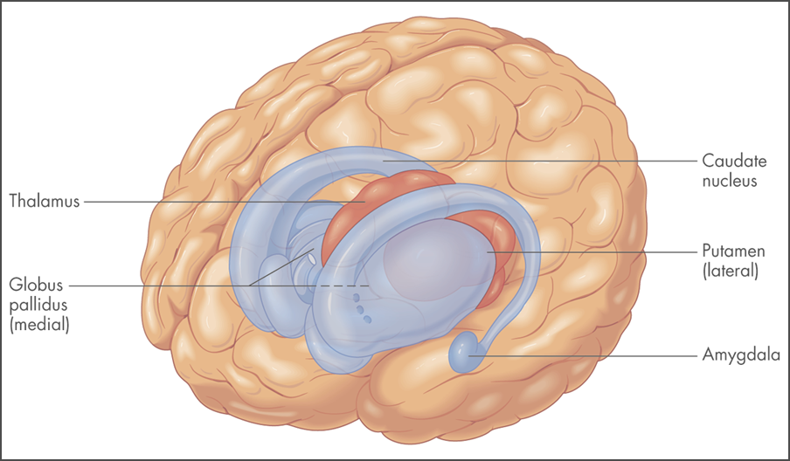
THE THALAMUS AND THE BASAL GANGLIA,

Slide 19
SUBCORTICAL STRUCTURES
The thalamus receives sensory information and sends it to the apprpriate cortex.
The basal ganglia are part of the motor system. They connect with the cortex via the thalamus.
May provide back up for words and facts, maybe involved in memory for music (goes very late).
The amygdala is involved with emotions. We remember an emotional event better. It helps us learn and remember what is dangerous.

Slide 20
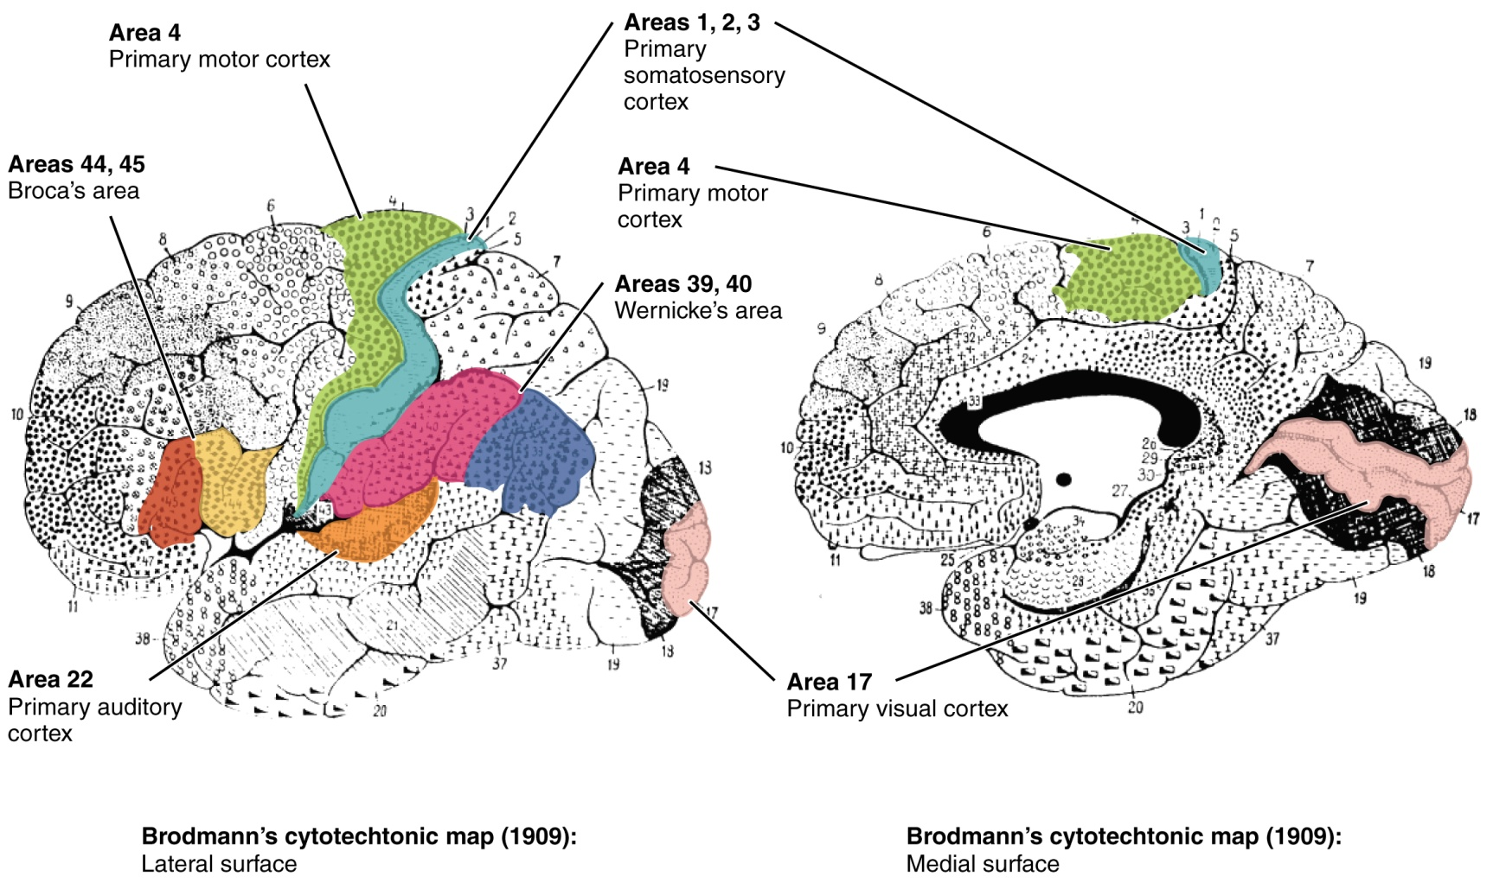
BRODMANN’S AREAS, ANOTHER VIEW OF THE BRAIN, note auditory cortex

Slide 21
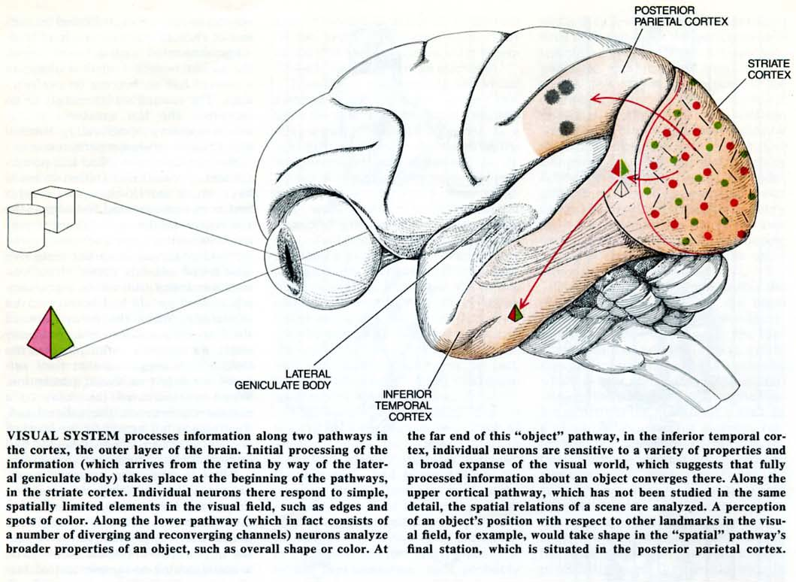
2 VISUAL PATHWAYS, WHAT AND WHERE, (ATTENTION), note the temporal lobe.

Slide 22
TWO MORE REGIONS
The entorhinal cortex connects the association cortex to the hippocampus.
It is also contains “grid cells” which map space, so is important in spatial memory.
The hippocampus is essential for storing episodic memory, memory for events.
It contains “place cells” and is essential for spatial memory.

Slide 23
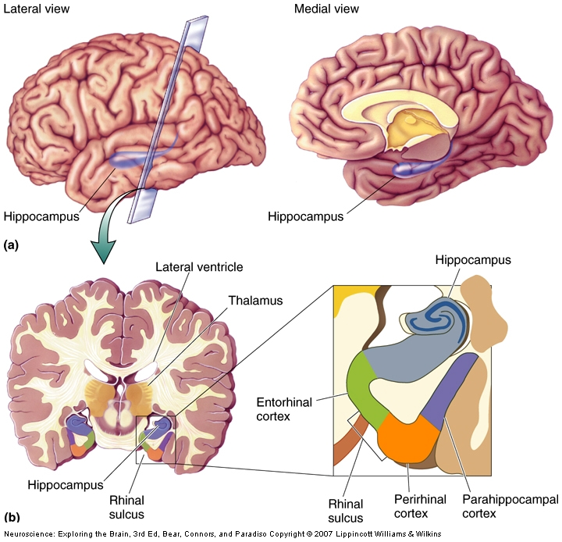

Slide 24
PREFRONTAL CORTEX
Very large in humans;
Retrieves memories for events and for facts.
Keeps things in mind.
Inhibits the amygdala. The “brakes of the brain”.

Slide 25
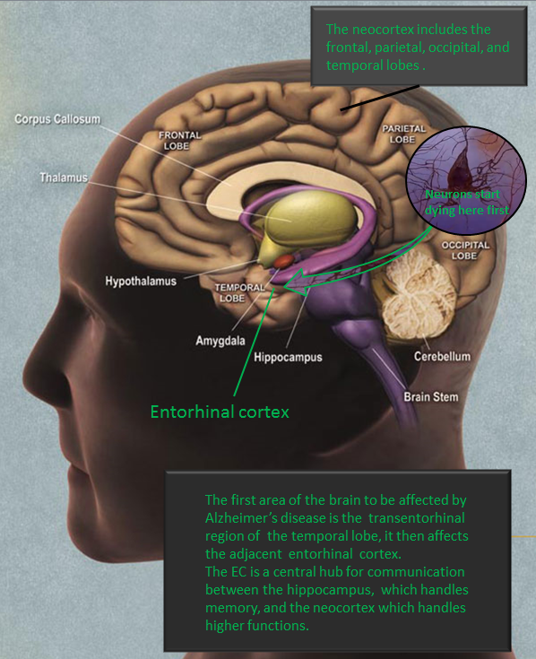

Slide 26
AMYLOID STAGES

Slide 27
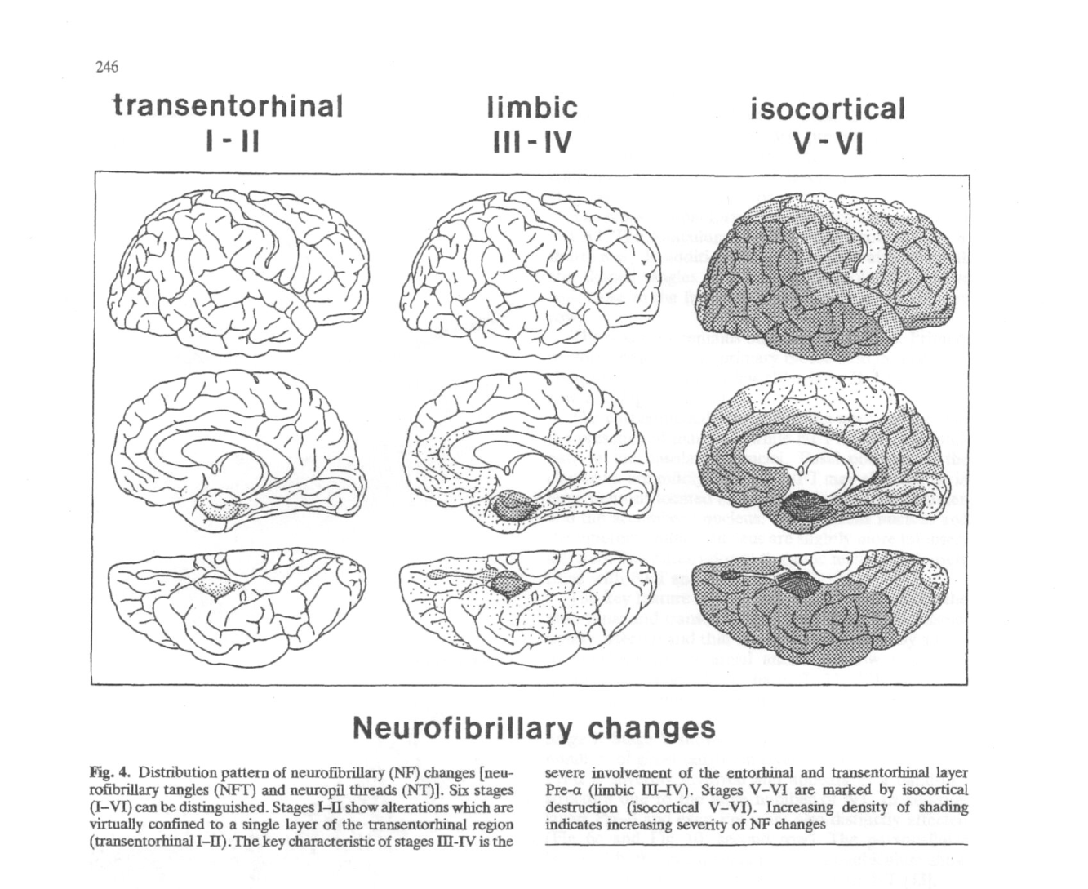
NFT CHANGES,(tangles made of tau), Braak and Braak

Slide 28
MEMORY OVERVIEW
Sensory information arrives in primary sensory cortex.
It is transferred and processed in association cortex. It passes through the entorhinal cortex to the hippocampus.
It is processed in the hippocampus and returned to the association cortex for storage. It is retrieved by the prefrontal cortex when a memory is called up.

Slide 29
SPREAD OF AMYLOID AND TAU
Damage begins in the medial temporal lobe. The entorhinal and hippocampus are damaged early on. Then the damage spreads to adjacent cortex, including the prefrontal region.
The primary motor and sensory cortices are damaged last.
The basal ganglia are damaged later.

Slide 30
ROLES OF THE LATERAL TEMPORAL LOBE CORTEX
Damage here leads to an inability to recognize, or name, familiar objects that are seen.
Regions of the cortex, e.g. the fusiform gyrus, are needed for facial recognition. Damage in this region of the temporal lobe may lead to prosopagnosia, the inability to recognise faces, including your own.

Slide 31
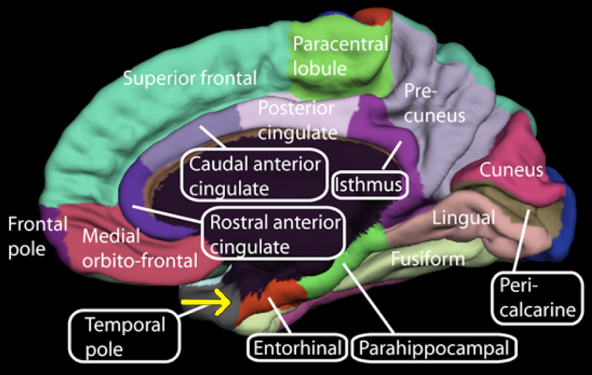
Entorhinal cortex and fusiform gyrus. (wikipedia)

Slide 32
LOSSES IN AD AFTER DAMAGE TO SPECIFIC REGIONS
EC, damaged early, get lost, begin to be unable to recall words.
Hippocampus, get lost, forget recent events, e.g. visits by family. Annoying, as patient can recall old memories but cannot form new memories for events. Keeps asking the same question.
Fusiform gyrus, forget faces e.g. of family.
Temporal lobe cortex, initially have difficulty recalling a word (pre-frontal retrieval needed). But when the outer/lateral temporal cortex is damaged, the words stored there are gone.

Slide 33
BRODMANN’S AREAS, note Broca’s area, involved in speech production

Slide 34
OTHER LOSSES
Amygdala, become angry, damage to the amygdala, or to the pre frontal cortex which can no longer inhibit the amygdala.
Do dangerous things, put paper plate on stove.
Prefrontal cortex, Inability to recall old events or facts.
Impulsive behavior, paranoia.
Inability to plan and to see consequences.
Basal ganglia, inability to type on computer.

Slide 35
WHAT IS NOT IMPAIRED
Motor cortex.
Not necessarily good.
People try to drive when they should not.
Parietal lobe damage, do not orient self correctly in space. Pre motor damage, do not plan series of actions.
Can hit accelerator not brake.
Spatial losses too.

Slide 36
OTHER BRAIN DAMAGE
The basal nucleus, where the neurotransmitter acetylcholine, ACh is produced, is damaged in AD.
ACh is used in the hippocampus and is involved in memory.
Loss of ACh leads to impaired memory. Four of the five approved drugs increase the amount of ACh.
But there are two ACh systems and the drugs increase the ACh in both systems, causing side effects.

Slide 37
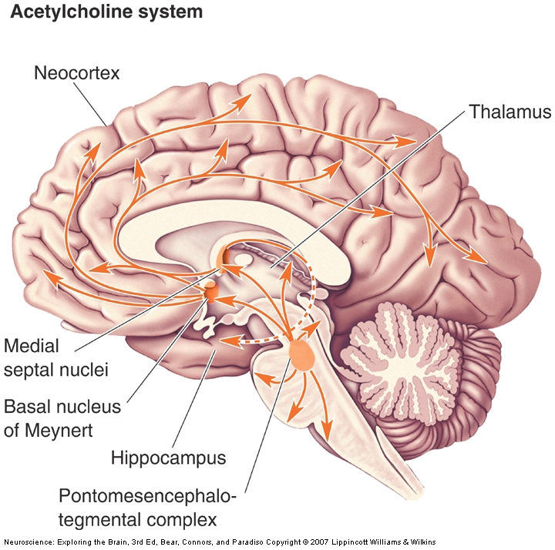
ACETYLCHOLINE SYSTEMS

Slide 38
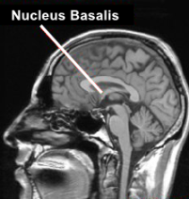
Nucelus Basalis

Slide 39
DRUGS
Acetylcholinesterase, AChE, breaks down ACh, therefore the drugs attack AChE. (They may also enhance the response to the ACh there is.)
They are AChE inhibitors, often called cholinesterase inhibitors.

Slide 40
DRUGS, 2
But there are side effects.
ACh is also involved in the motor systems.
It slows down the heart, this can be dangerous.
It moves food through the gut. Thus increased levels of ACh here can lead to diarrhea. Also causes increased urination.

Slide 41
MEMANTINE/NEMANDA
Memantine, also called Nemanda, the 5th drug approved, operates quite differently.
It works with the glutamate system. One of the glutamate receptors, the NMDA receptor, is often overactive in AD. Memantine is an NMDA antagonist.
A combination of an AChE inhibitor and memantine is often given as the disease progresses and can be helpful.

Slide 42
DRUG FAILURES
Namenda was the last drug to be approved in the US. In 2006.
The last 23 drugs have failed.
Possibly this is because it is now realised that the brain changes begin many years before behavioral changes are seen.
We can now see amyloid in the brain of a living person. (Klunk at Pittsburg)

Slide 43
IMAGING AMYLOID IN THE BRAIN, PITTSBURG COMPOUND

Slide 44
BIOMARKERS
Video “can Alzheimer’s be Stopped?”
Columbian family has had early onset since the Spanish invasion. Can test descendants for the gene, follow them, scan their brains as they age. See amyloid deposits years before see behavioral changes.
Researchers are now looking for bio markers that will let them detect AD earlier.

Slide 45
GENETICS OF AD
Early onset has different genes than late onset. If you have a mutation in a gene called pre senilin1 , you will get AD.
Late onset has a genetic risk factor. The gene APOE has 3 normal forms, E2, E3, E4.
Those with a copy of E4 ( ~20% of the population) are more likely to get AD and here the environmental effects can be stronger.

Slide 46
ENVIRONMENTAL EFFECTS
Because drug development is lagging, life style changes are attracting more interest.
Head injury is a risk for dementia.
Stroke is a risk for dementia, particularly sub- cortical strokes.
Smoking is a risk, because it is a risk factor for stroke.
Reduce blood pressure, also a risk for stroke.
Control diabetes, stroke risk.

Slide 47
STROKE AND AD
There are those with heavy amyloid and plaques in the brain who do NOT have dementia.
Study with nuns* showed that Stroke-free brains can compensate for AD lesions.
Among Sisters with an AD brain, 93% had dementia if they had stroke damage in deep white matter, thalamus or basal ganglia.
Only 57% were demented if they had an AD brain but no stroke damage. i.e. 43% did not have dementia.
* “Aging with Grace” Snowdon

Slide 48
POSITIVE ENVIRONMENTAL FACTORS
Anti-inflammatories are helpful, aspirin OR ibuprofin. (Baby or coated aspirin).
Statins may be helpful. (Zocor/simvastin)
Anti-oxidants in the food; blueberries, strawberries, curcumin.
Nuts (walnuts), leafy green vegetables, red wine,
Fish.
Green tea.
Folic acid, B12, cooked tomatoes.

Slide 49
OTHER FACTORS
Education beyond HS, then an undergraduate degree, reduces the risk of AD. Theory of Cognitive reserve.
Education can also delay onset of AD.
Social support. (also for caregivers.)

Slide 50
MORE POSITIVE BEHAVIORS
A strong day/night schedule.
Get enough sleep (helps clear amyloid).
Mental activity.
EXERCISE. EXERCISE, EXERCISE.
(Ballroom dancing.)
Singing is a way to interact with those with AD.
Build up strength, balance, so you do not fall.
All these factors are important in healthy aging too.

Slide 51
SUMMARY
Understanding how these brain changes affect behavior may be helpful.
Very prevalent. Ronald Reagan helped publicize.
Nobody chooses to get Alzheimer’s, nobody normally chooses to forget.

