Slide 1

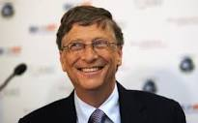
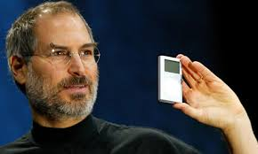


“The Innovators”
The Age of the Digital Revolution
“How a Group of Hackers, Geniuses and Geeks Created the Digital Revolution.”
Session 3

Slide 2


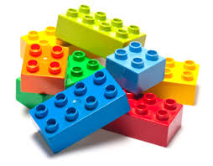
Ada
1935
1990
Now
The Legos
Of the
Computer
Age
The Computer, Programming
The Transistor, The Microchip
The course’s
eight
sessions
Video Games, The Internet
Software, On-Line
The Personal Computer
It gets
Complex
Here.
The Web
The book’s chapters are silo’ed.
In the narrative of the later sections
the systems begin to be integrated to reflect
what we have today.
------------------------------------
Ada Forever

Slide 3
Session 3
Concluding the Computer discussion with some thoughts on Artificial Intelligence
The Building Blocks of the Digital Revolution imply solid state devices:
The Transistor
The Microchip

Slide 4

Artificial Intelligence?
Can a Machine Think, more so feel emotion?
Turing vs. Ada
Turing began to contemplate a thinking machine in 1937.
In 1943 he goes to Bell Labs, meets Claude Shannon, of Boolean fame. They believed that since computers with simple instruction can do math problems, which are logic — then they could do all logic. Since logic was the basis of how human brains reasoned, then a machine, in theory, could replicate human intelligence.
Turing started with chess; he wanted the computer to know the situation and refine its instructions and then identify the next moves.
In 1950 he devised the Turing Test: He defined a narrow test: If the output of the machine is indistinguishable from that of a human, then we have no meaningful reason to insist that the machine is not thinking.
Ada felt that the machines:
  [1] had to both modify its program based on the sensory inputs it received,
  [2] modify its response and
  [3] then understand the emotion from the sensor and the reason for the change.
Turing never had the chance to pursue this.

Slide 5
Artificial Intelligence — Now
Can a Machine Think; More So, Feel Emotion?
US Robotics' Nestor-5 with a Positronic brain
Thursday Jan 15, 2015 Bill Gates has followed Stephen Hawking and Elon Musk in issuing a warning about super-intelligent robots.
Gates is one of hundreds of computer scientists and technology experts to have signed an open letter, which calls for research into the problems of artificial intelligence.
Gates said that he was ‘in the camp that is concerned about super intelligence’ when asked whether he thought artificial intelligence would become an existential threat.
  ‘First the machines will do a lot of jobs for us and not be super intelligent,’ he wrote.
But, while robots would be useful, Gates is concerned about ‘super-intelligent’ AI. OK; if we manage it well.
But, ‘A few decades from now, if the intelligence is strong enough, it could to be a concern. I agree with Elon Musk and others on this and don’t understand why some people are not concerned.’
Gates added that he was actively working on projects that involved ‘intelligent’ digital personal assistants.

Slide 6

Tim Berners-Lee on Thinking Computers
We will discuss his major contributions in the Web section.
He posed an interesting point on thinking computers vs a human.
How the human brain makes random associations.
Example: The fresh smell of coffee in the morning conjures up the red dress a friend wore, when you last had coffee with her. Remembering the woman was important, not the coffee.
A human would make the association, whereas a machine would only know to make that associations that is has been programmed to make.
HAL might have known — or…

Slide 7
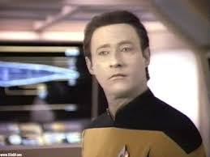
Commander Data
Would Make the Inference,
But He Was
One-of-a Kind
Data is a Soong-type android with an ultimate storage capacity of eight hundred
quadrillion [one thousand million million] bits and a total linear computational
speed rated at sixty trillion operations per second.
Data has a positronic net.
Cmdr. Data asserts that he not only perceives data and facts, but also the
"substance" and“ flavor" and other ineffable qualities of the experience,
which would be lost when downloaded to a conventional computer.
From: en.memory-alpha.org/wiki/Data

Slide 8
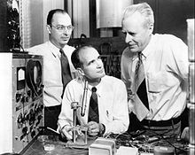
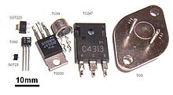

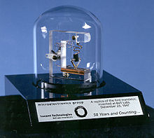


Semiconductors — More Commonly Transistors
John Bardeen, William Shockley and
Walter Brattain at Bell Labs, 1948.
$0.00/$69.00
monthly service
A replica of the first working transistor.
$349.00

Slide 9
Repeat: Bell Labs Innovation and collaboration
In 1907 AT&T’s patents were running out and in order to keep its telephone near monopoly it had to demonstrate that it could keep up an expanding, complex and ultra reliable ubiquitous system.
It hired the best and the brightest to research all aspects of communications engineering and physics to extract new designs and then productize them and deploy them through Western Electric.
It was the place to be. Considering the times it paid well and had the resources and the encouragement to tinker. It drove the leap from electro-mechanical to electronic tubes to solid state (and with it the computer).
In part, it kept the regulated monopoly till the 1980s and was able to obtain a continuous flow of investment $$s.

Slide 10
The Search for Transistor Was Driven by Telephone System Operations Cost
Bell Labs established a Solid state Physics Department in 1936 to do basic research and find an improved vacuum tube.
In 1939, William Shockley noted that it would be more economical for the telephone system to develop solid state device and replace the tubes.
He started experimenting.
It took nine more years, with four years off for WW II!

Slide 11
Transistor Breakthrough
The search for a tube replacement continued with vengeance after WWII. A team of the best of the best was assembled.
The digital revolution was spawned in Murray Hill NJ shortly after lunchtime on Tuesday Dec 16,1948.
Initially two, John Bardeen and Walter Brattain scientists at Bell Labs succeeded that day in putting together a tiny contraption that had been concocted from a strip of gold foil, a chip of semiconducting material and a bent paper clip.
When wiggled just right it could amplify an electric current and switch it on and off.

Slide 12
Transistor incubator
Shockley who was on the team and did earlier work was not part of this breakthrough and was bitter and believed that there was a better method.
He worked separately for several months and did produce a more consistent and producible design.
The transistor, as it was oft-handily named, by team member John Pierce and ultimately with the ability to etch millions of them into a single microchip― became to the Digital Age what the Steam Engine had been to the Industrial Revolution.
Bell politically listed the three colleagues as collaborators and the joint inventors, but the incubator was the support and resources of Bell Labs.

Slide 13
Bell Labs Careful Business Ventures
Bell Labs performed extensive research.
They developed many technical breakthroughs.
They were careful to focus developments toward Telephone Business requirements.
They were careful to not engage in non telephone enterprises so as to not jeopardize their “monopoly” telephone franchises.
They licensed many items for minimal sums.
Transistors manufacture license: $25,000/year.

Slide 14
A little Technology Here

Slide 15
More than you want to know
A semiconductor is a material which has electrical conductivity between that of a conductor such as copper and that of an insulator such as glass.
Semiconductors are the physical foundation of modern electronics and the digital world, including transistors, solar cells, light-emitting diodes (LEDs), quantum dots and digital and analog integrated circuits.
The modern understanding of the properties of a semiconductor relies on quantum physics to explain the movement of electrons inside a lattice of atoms.
The increasing understanding of semiconductor materials and fabrication processes has made possible continuing increases in the complexity and speed of individual semiconductor devices,
an effect known as Moore's Law.

Slide 16

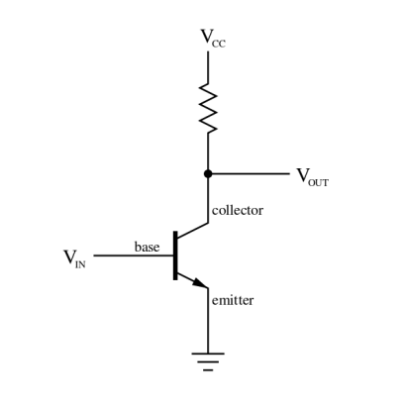
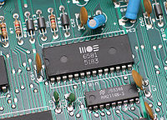

Classic Technological Impact
From 1950 on it changed our lives in uncountable ways!
What did the semiconductor/transistor bring?
Dramatic reduction in size and power requirements (think a power cord
plugging into wall socket vs batteries) 1000’s of time smaller.
Profound increase in the speed of operations that can be done. This is
what makes computers and smart phones possible. The vast array of medical
devices, GPS, modern aviation, controls of every sort and more.

Slide 17
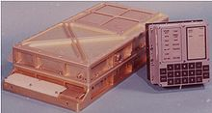

Size Reduction/Capacity Growth
50 years
Apollo Guidance Computer with display and keyboard Apple iPhone 6
Designed by MIT Instrumentation Laboratory 10s of 1000s of times
Manufacturer Raytheon faster, vast increase in memory capacity, active
Weight 70 pounds displays, capabilities plus
a camera, GPS a radio and a phone.
Size 24x13x7 inches 5.5x2.75x0.375 inches
Number used 2 with some common software Millions
- Command Module
- LEM

Slide 18
What do you do with a $25K Investment? Build Products that People Don’t Know They Need
In 1952, Texas Instruments, with a $25K license and some Bell Labs veterans and visionary TI management pushed the development of less expensive and more reliable silicon based transistors.
Military transistors were selling for $15.00. TI drove the price down to $3.00.
Then, Steve Jobs like, TI VP Pat Haggerty pushed the introduction of the portable pocket transistor radio— that you just had to have.
The Regency TR-I [4 transistor] 22.5V battery powered radio, introduced in Nov 1954, sold for $49.95.
Within a year 100,000 were sold.

Slide 19
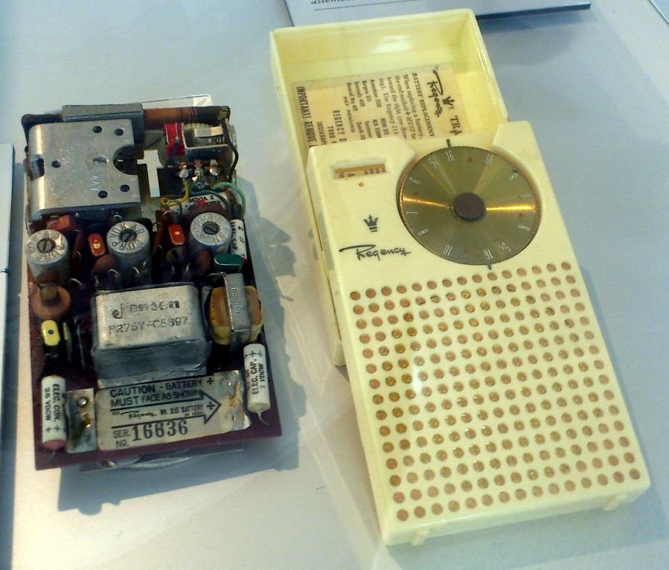
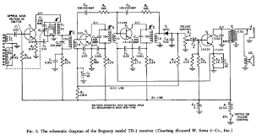
The transistor radio became a defining
item of the digital age — it made
electronics personal.
Some also say that it brought Rock and Roll
TI built the 4 Transistors, they
bought everything else.

Slide 20

Shockley Goes out on His Own
Shockley is difficult to work with, to say the least. He leaves Bell Labs in 1955 seeking to establish his own Transistor Company.
After about a year he is convinced to join Arnold Beckman’s Beckman Instruments [BI] leading a new BI division that will be located in Palo Alto CA, not LA where most high tech had been located.
He joined many new start-ups in PA including David Packard and William Hewlett, who actually started in a garage in 1938.
With Stanford as a hub, and offering hundreds of acres of university land for factories and research labs, technology gravitated to PA― now Silicon Valley.

Slide 21
Shockley Recruits some of the Best
To say that he is a lousy manager is an understatement; he is brilliant but a tyrant.
He sets up the division and attempts to build a four layer device, pushing the state-of-the-art. If it works; it would be the first micro chip.
He fails and blames everyone but himself.
Concurrently he wins the Nobel Prize with John Bardeen and Walter Brattain for the transistor.
He becomes more difficult to work for.
Eight of his key recruits, fed up, believe that they can go on their own

Slide 22
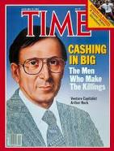
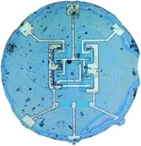
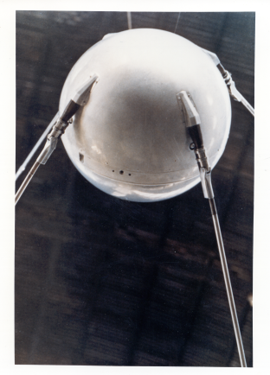
Venture Capitalism and New Start-Ups
The 1950s business culture was that you joined a company and stayed till retirement.
Leaving was risky, eight Ph.D. rebels, including Robert Noyce, the nominal #2 under Shockley, looked for an other company to go to or possibly $$ to start a separate company.
No takers! Until they met Arthur Rock from Wall St.
Rock serendipitously contacts Sherman Fairchild, sole owner of Fairchild Camera and Instruments, largest IBM shareholder, a risk taker, an entrepreneur who meets alone with the “Traitorous Eight” and he underwrites the new company with $1.5M.
This is 3 days before Sputnik in October 1957.
Technological developments takes off and the business model is changed possibly forever.

Slide 23
Shockley Falls off a Cliff
He is enraged at the “betrayal.”
He becomes more paranoid.
He gets into eugenics and believes that the “Black Race” is inferior. He is heckled everywhere he goes!
Beckman drops out of semiconductors and Shockley retreats to a professorship at Stanford. In spite of his failings he is a Ph.D., an inventor and a Nobel winner.
The “traitorous eight” were at the right place, at the right time, with the right technology and $$ backing.
  Uncle Sam needed tiny complex electronics to fit into missile nose cones and myriad other military needs. These inventions flowed into the commercial world.

Slide 24



The Microchip
Half inch

Slide 25
The Microchip
Why is there a separate chapter on the Microchip?
It is a semiconductor, but…
Scale and a profoundly more complex technology from the logic to the manufacturing.

Slide 26
Prologue
In 1957 in a paper to celebrate 10th anniversary of the transistor, when Fairchild was formed and Sputnik went up, a Bell Labs executive identified a problem dubbed “the Tyranny of Numbers.”
If the number of components in a circuit increase the number of connections grow exponentially. 10,000 components would require >100,000 connections, most soldered by hand―Not good for reliability.
It was recipe for innovation. Hundreds of small advances occurred independently and simultaneously at both TI and Fairchild. Connections and components were constructed in single small slabs of silicon: The integrated circuit, also know as the microchip.

Slide 27
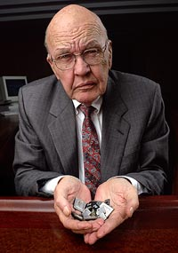
Jack Kirby at TI
Jack Kirby was an electronic tinker and Ham Radio operator in the 1930s. He was studying for a BSEE at U of Illinois when WWII broke out.
He spent 4 years in the Navy keeping radio stations operating in the Pacific and in India. He completed his degree in 1950 and went to work for Centralab, an electronic parts maker.
Centralab bought a Bell license and sent him to school at the labs. Eventually he looked for a job with direct Semiconductor involvement; was hired by TI in 1958.
He arrived at the plant during summer shutdown and spent time in a lab just tinkering. There he devised a way to build all various components from items of silicon that were treated differently.
He was given several months and constructed an oscillator on a single chip. From his underlying approach to chemically treat various parts of the silicon slab differently thereby having a “solid state chip design
TI leaped on the invention and filed a patent.

Slide 28
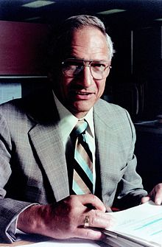
Robert Noyce at Fairchild
Robert Noyce was at Fairchild and his team was working to perfect a microchip and came at the project from a different approach.
Using multiple layers of silicon with chemically exposed holes and to chemically etch electrical pathway so the components could be connected in the manufacturing process as they were too small to solder [called the Planar process]
He came up with a working model two months after Kirby.
Fairchild also filed a patent.
There then ensued a 10 year legal battle over who invented the microchip. Both companies continued development on new products and sold them. There were many other competitors who were building microchips and were threatened with suits. But business just continued to explode. In 1966, the adults in the room meet and agreed to cross-license and obtain royalties from others.
That was an other set of legal sparing.

Slide 29
One of the First Major Uses of the “Miniaturized” Microchips―1967
50 years
iphone6
Apollo Guidance Computer with display and keyboard
Designed by MIT Instrumentation Laboratory
Manufacturer Raytheon
Size 24x13x7 inches
Microchips used: 5000 identical Fairchild chips. Software organized and manipulated
the chips to do different functions
Microchip Cost: First prototype [each]: $1000.00, Production: $20.00
Number 2 with some common software
Computers - Command Module
used - LEM

Slide 30
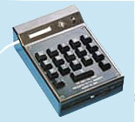
Commercial use of the Microchip
The first use was in hearing aids. Small but expensive with a limited market.
Once again in 1967 TI’s Haggerty came up with a new product idea: a hand held calculator that could do everything the large desk bound units could do; but run on batteries and fit into a shirt pocket.
First unit, 2 pounds, only four functions and cost $150.00. It was a run-away success; people bought a product that they didn’t know they needed.
It kept getting smaller, lighter, more capable and cheaper. Sales were doubling every year. One low end 2014 TI model sells for $3.95.

Slide 31
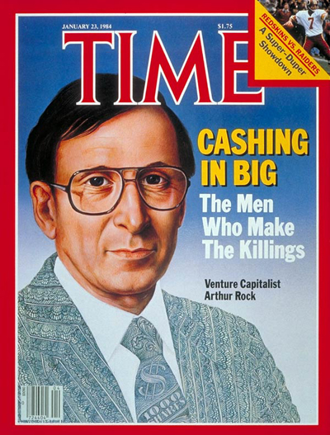
Arthur Rock
Venture Capital
Arthur Rock built something that was almost as important to the Digital Revolution as the Microchip: Venture Capital.
Prior to the 1950s investments were controlled by a small number of Wall St. Investment Banks.
Rock went to Silicon Valley and began finding opportunities and funding sources. It was the right time.
The financing was convertible debentures. They were not loans. Banks would not make loans on an idea. CDs were a piece of the company, maybe. If the company was successful they were converted to stock. If not, they were worthless.
Sometimes Rock had more $$ available than opportunities but he was prudent.
He wanted to know the company Principals more than the product.

Slide 32
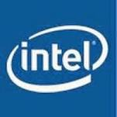
Fairchild Gets Too Big for Noyce
By 1968 Fairchild grew and was too large; he wanted to be an inventor more than a manager.
He convinces Gordon Moore to go with him.
He called Arthur Rock and asked if it was possible to get funding for a new Company?
“What took you so long?” he asked
In two days Rock had the $$ commitments. He wrote a three page sketch, in case an investor wanted one. Units of 500,000 shares at $5/share. A company dealing with Transistor Technologies.
They worked through several possible names. One stuck: Integrated Electronics Corporation. Not too thrilling, but it could be abridged to Intel.

Slide 33
Intel― A culture of Meritocracy
Noyce and Moore did not like controversy. They liked meeting where all sides were aired. Decisions were hard to come by.
Intel allowed each of its units to operate as if they were separate companies. If there was a cross unit issue ― work it out at the unit level.
Intel was devoid of the trappings of Hierarchy
  No reserved parking places.
  Every one, including Noyce and Moore, worked in the same cubicale in the middle of the Prairie Dog warren of cubicles.
  Everyone had the same metal desk.
  It was a culture of innovation.
  But someone had to be able to make decisions and as needed say No!
  Andy Grove steps into middle of the company

Slide 34
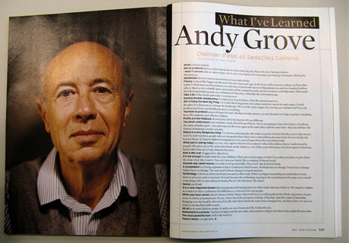
Andy Grove
Andy Grove is the quintessential immigrant. He arrives penniless in the US in 1956 at age 20 from Hungary.
He doesn't speak English, he goes to CCNY, gets a degree in Chemical Engineering and goes to work at Fairchild and goes to the newly formed Intel, its 3rd employee.
He quickly bubbles up to Director of Engineering. Noyce is the outside man with customers; Moore is the inside man with the engineers. Grove is the manager.
He is a good manager; he pushes and forces decisions and is groovy in the hair and clothing style of the day. He is the boss, but people like him.

Slide 35
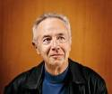
Andy Grove - the Yogi
Berra of Silicon Valley
Success breeds complacency. Complacency breeds failure. Only the paranoid survive.
Just as we could have rode into the sunset, along came the Internet, and it tripled the significance of the PC.
There is at least one point in the history of any company when you have to change dramatically to rise to the next level of performance. Miss that moment - and you start to decline.
You have to pretend you're 100 percent sure. You have to take action; you can't hesitate or hedge your bets. Anything less will condemn your efforts to failure.
Profits are the lifeblood of enterprise. Don't let anyone tell you different.

Slide 36
Ted Hoff and the Microprocessor
Intel is making memory chips. They get a contract from a Japanese company that wants to make pocket calculators.
They need 12 different chips. They are complex and the development will not be recouped in the selling price.
Ted Hoff, Intel’s 12th employee, as a Stanford professor, began to realize the microchips were not efficient. Why not make one chip that can be controlled to do the 12 functions.
This was the Intel 4004 in 1971.
The birth of the microprocessor and as we shall see the underpinning of the home computer and thousands of other items.
Intel’s coup is when they get IBM to only use Intel microprocessors.

Slide 37
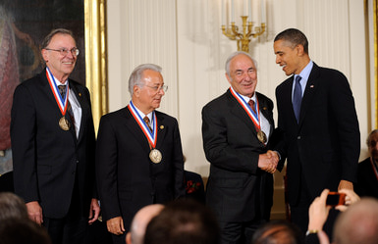
In November, 1971, a company called Intel publicly introduced the world's first single chip microprocessor, the Intel 4004 (U.S. Patent #3,821,715), invented by Intel engineers Federico Faggin, Ted Hoff, and Stanley Mazor.
Ted Hoff
President Barack Obama presents a National Medal of Technology and Innovation to (L-R) Federico Faggin, Ted Hoff, and Stanley Mazor from Intel Corporation in the East Room of the White House November 17, 2010 in Washington, DC.
Olivier Douliery-Pool/Getty Images
Ted Hoff

Slide 38
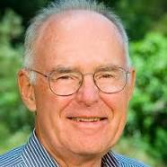
Moore’s Law -1
Now 50 Years
Gordon Moore described a trend in his 1965 paper that over the history of computing hardware, the number of transistors in a dense integrated circuit doubles approximately every 2 years.
His prediction has proven to be accurate, in part because the law now is used in the semiconductor industry to guide long-term planning and to set targets for R&D.
The capabilities of many digital electronic devices are strongly linked to Moore's law: quality-adjusted microprocessor prices, memory capacity, sensors and even the number and size of pixels in digital cameras. All of these are improving at roughly exponential rates as well.
This exponential improvement has dramatically enhanced the effect of digital electronics in nearly every segment of the world economy.

Slide 39
Moore’s Law 2 - It Is Really a Rule of Thumb
Moore's law describes a driving force of technological and social change, productivity, and economic growth in the late twentieth and early twenty-first centuries.
The period is often quoted as 18 months because of Intel executive David House, who predicted that chip performance would double every 18 months (being a combination of the effect of more transistors and the clock rate being faster).
Although this trend has continued for more than half a century, "Moore's law" should be considered an observation.
And, it reached a zenith in 2006 with silicon.
While more logic can be added, silicon clock rate increases hit a wall. Gallium nitride next candidate.

Slide 41
The Semiconductor Revolutionary
Alex Lidow and Gallium Nitride
Alex Lidow has spent much of his career developing a superefficient replacement for silicon. Earlier he developed the MOSFET.
Silicon has been at heart of semiconductors for over 60 years. A valley is named for it!
Clock speed wall, physically can’t get smaller
GaN after nearly 20 years of experimentation and productization, GaN units have come on line in the last year and a half.
  Faster clock speeds
  Withstands higher voltages

Slide 42
Gallium Nitride components
on a “pluggable “chip
From Bloomberg Business Week, Feb 22, 2015

Slide 43
Hardware as a Commodity
Computer hardware and architectures evolved over the decades and the product began to take on a certain commonality as the microchip building block continued to expand capability and reduce cost.
The cost of memory now almost trivial.
Eventually computers were a commodity, but the real genius resided in the software which explodes to this day.
What is today’s App?

Slide 44
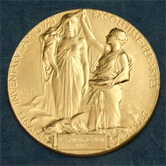
Kirby is awarded the Nobel for the Microchip
Kirby and Noyce are friends and while are at different companies they meet often. Noyce dies in 1992.
Kirby is awarded the Nobel for the Microchip in 2000 and graciously recognizes Noyce as the co-inventor at the award ceremony.
Kirby is modest for his efforts and mentions the beaver and rabbit at the base of the Hoover dam story .
  “I didn’t build it, but it is based on my ideas.”

