Slide 1
Discovering the Problem
The Response to Climate Change
Osher Lifelong Learning Insttute
Fall 2014

Slide 2
1. Basic Principles
Temperature measures kinetic energy of system’s molecules or atoms: thermal energy
Energy gain = energy loss: equilibrium temperature
Energy gain ≠ energy loss: temperature change

Slide 3
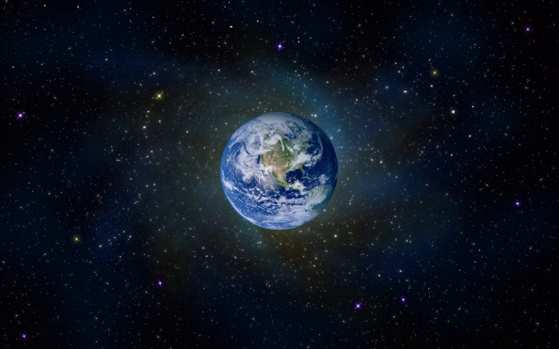
Applying the Principles to Earth
Gaining and losing thermal energy on Earth
  Conduction
  Convection
  Radiation
Only radiation for Earth system
Unequal incoming and outgoing radiation (radiative forcing) → temperature change

Slide 4
Long ago in a galaxy far away
Planet Keeling ejected from its system
Heat from home star lost during journey
Insignificant internal source of heat
Dull black – reflects nothing
No atmosphere

Slide 5
Keeling Arrives
Captured by Sun-like star in near-circular orbit of 150 million kilometer radius
Incoming solar radiation:
  Cross-section: 1366 watts/meter²
  Average for Keeling’s surface: 342 watts/meter²
Initial outgoing radiation: ~none
Radiative forcing: 342 watts/meter²

Slide 6
Now What?
The Path to Equilibrium
Radiative forcing adds energy → Planet’s temperature rises
Higher temperature → more outgoing radiation
More outgoing radiation → less radiative forcing
No radiative forcing when incoming and outgoing radiation are equal: 279º K = 6º C

Slide 7
The Path to Equilibrium
6º C

Slide 8
Equilibrium for Planet Keeling I
Incoming
Solar
Outgoing
Thermal
=

Slide 9
Where did 6º come from?
Radiation = σT⁴
    Radiation is in w/m²
    Temperature is in degrees Kelvin (centigrade + 273)
    σ = 5.67 x 10⁻⁸ watts
Task: Solve for T for σT⁴ = 342
Some algebra: T⁴ = 342/(5.67 x 10⁻⁸)
And more : T = (342/5.67)^{1/4} x (10⁸)^{1/4} = 2.79 x 100 = 279º K = 6º C

Slide 10
Morals of the Story
Adding energy at constant rate creates feedback that, absent other factors, produces equilibrium
Determination of quantitative relationship comes from 19th century science

Slide 11
Good (19th century) Physics
But Wrong Answer:
Earth is Warmer than 6º C

Slide 12
Planet Keeling Mark II: Add Albedo
Reflects 30% of solar radiation (0.3 albedo)
Solar radiation now balanced by:
  Keeling’s own thermal radiation plus
  Reflected solar radiation
Equilibrium requires less thermal radiation → reached at lower temperature

Slide 13
The New Path to Equilibrium
-18 C

Slide 14
Equilibrium for Planet Keeling II
Incoming
Solar
Outgoing
Thermal
Outgoing
Reflected
=
+

Slide 15
The Model is More Realistic
But the Answer is More Wrong:
Earth Isn’t a Snowball

Slide 16
The Greenhouse Effect

Slide 17
The Start of an Explanation
Fourier (1827)
  Earth’s temperature is limited by its thermal radiation
  But why doesn’t that produce a frozen Earth?
  Atmosphere must trap heat
But
  What part of atmosphere does this?
  And how does it do it?

Slide 18
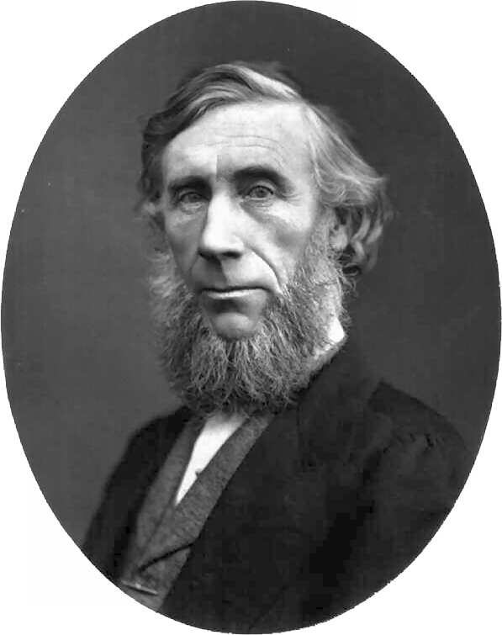
Tyndall Answers the First Question

Slide 19
1859 Experiment: What caused the ice age?
Fourier’s blanket? Shares assumption that atmosphere is transparent to all radiation
But experiments: confirm for nitrogen and oxygen (99% of atmosphere)
Then tries coal gas (methane): opaque to infrared
Continues: H₂O and CO₂ also block infrared

Slide 20
Tyndall’s Experiment:
Modern Version
CO₂
Infrared Camera
Glass tube
Person
Reduced infrared component
Full-spectrum radiation

Slide 21
Infrared Image of Face with Normal Atmosphere
Notes:
Source: Nova/Frontline Film: What’s Up with the Weather

Slide 22
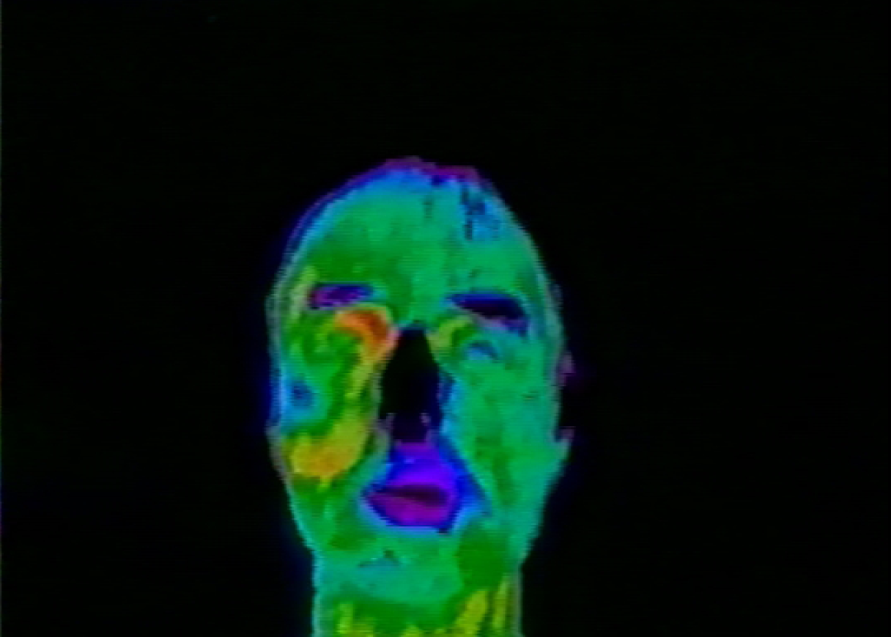
Add CO₂ to Tube
– And More and More

Slide 23
About that Ice Age
Tyndall’s conclusions
  CO₂ could not have been driving force: not enough of it (0.028%)
  Water vapor is much more important
  Perhaps something dried out the atmosphere
Missing pieces
  Water vapor is a feedback
  Measure of CO₂’s impact

Slide 24

Svante Arrhenius advances the analysis

Slide 25
Arrhenius and Tyndall
Both concerned with cause of past glaciations
Both were very good scientists
Arrhenius had two advantages
  Had measure of effect of CO₂
  Knew that water vapor is a feedback

Slide 26
Arrhenius speculates
Perhaps fewer volcanic eruptions: Less CO₂ → cooler → less water vapor → still cooler
Side note: Basically correct.
  Volcanoes vs. carbon burial determines amount in atmosphere-biosphere-ocean system
  Change in volcanism-burial balance created condition for glaciation
To be complete, looks at the reverse: more eruptions → more CO₂ → more water vapor → warmer world

Slide 27
Arrhenius calculates
Science: CO₂ and water vapor feedback
Data: atmospheric absorption of thermal radiation from Langley experiments
Tools: pen and paper
Result of doubling: 5º-6º C warming – just above range of modern calculations
Moral: Basic idea of global warming isn’t complicated

Slide 28
But why?
An empirical result for Tyndall and Arrhenius
Explanation requires early 20th century physics
  Electromagnetic radiation
  Interaction of radiation and gas molecules

Slide 29
1. Electromagnetic Radiation
Includes X-rays, visible light, thermal radiation, radio waves
Behaves as particles (photons) and waves
High/low-energy photons = short/long wavelength

Slide 30
Sun and Earth
Source temperature determines photon energy/ wavelength
Incoming solar radiation: high energy photons/short wavelength
Outgoing radiation:
  Reflected solar radiation: unchanged
  Earth’s thermal radiation: low energy photons/long wavelength

Slide 31
Solar Radiation
And Earth’s Thermal Radiation
Notes:
Lyndon State College (Vermont), Survey of Meteorology, Dr. Nolan Atkins, downloaded August 30, 2008. © 2007 Thomason Higher Education

Slide 32
2. Molecules and Greenhouse Gases
Molecules can only occupy certain energy states
Absorb photons if energy matches interval between available states
Greenhouse gases: Gases with intervals matching energy of Earth’s thermal radiation
Absorb photons with that energy

Slide 33
The Process Continues
Molecules quickly drop back to original energy level
Emit photons in random direction
Further collisions repeat process
Ends when photon escapes into space OR strikes Earth’s surface

Slide 34
Molecular Bumper Cars
Space
Earth

Slide 35
The New Equilibrium
Surface is warmed by thermal radiation as well as solar radiation
Warmer surface → increased thermal radiation from surface
Radiation escaping into space also increases
Warming continues until escaping thermal radiation plus reflected solar radiation equals incoming solar radiation

Slide 36
Planet Keeling III
Incoming
Solar
Escaping
Thermal
Outgoing
Reflected
+
=
Atmospheric
GHGs

Slide 37
Equilibrium
Equilibrium reached in all cases: Keeling I, II, III (preliminary) and III (final)
Difference: temperature needed to reach it
Lower if part of incoming solar is reflected
Higher if only part of surface thermal radiation escapes into space

Slide 38
But is there a problem?

Slide 39
Implications and assumptions
For any surface temperature, more CO₂ reduces the amount of radiation escaping into space
Equilibrium therefore requires a higher surface temperature
Much higher for doubling CO₂
But when (if ever) will it double?

Slide 40
Not to worry
Large emissions far in the future
  Economic implication: discount rate
  Political implication: will not affect present voters, or their children, or their grandchildren, or . . . .
Anyway, oceans would absorb most CO₂
  Problem not just distant – it doesn’t exist
  No consideration, or perhaps awareness, of ocean acidification issue

Slide 41
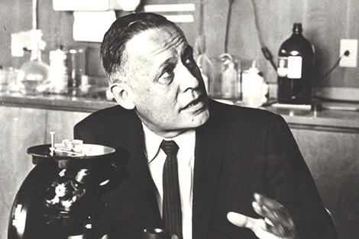
Roger Revelle Eliminates One Reason

Slide 42
His 1957 Experiment
Grant to study ocean chemistry
  Expects to find that ocean absorbs CO₂
  It does but (surprise) most pops back out again
But not a call to immediate action – still a matter of centuries

Slide 43
“Thus human beings are now carrying out a large scale geophysical experiment of a kind that could not have happened in the past nor be reproduced in the future. Within a few centuries we are returning to the atmosphere and oceans the concentrated organic carbon stored in sedimentary rocks over hundreds of millions of years. This experiment, if adequately documented, may yield a far-reaching insight into the processes determining weather and climate. It therefore becomes of prime importance to attempt to determine the way in which carbon dioxide is partitioned between the atmosphere, the oceans, the biosphere and the lithosphere.”
--
Revelle and Hans E. Suess, “Carbon Dioxide Exchange Between Atmosphere and Ocean and the Question of an Increase of Atmospheric CO2 during the Past Decades,” Tellus IX (1957)pp. 19-20.

Slide 44
We Need Measurements
Policy issue now does not concern the science but the facts
Is atmospheric concentration of CO₂ rising?
Are global temperatures rising?
What is the quantitative relationship between CO₂ concentration and global temperature?

Slide 45
CO₂ Concentration
Changed by difference between flows into/out of atmosphere
Early 1950s: No consensus on size (or even sign) of difference
  No reliable direct measurements
  No systematic data for bottom-up calculations
The problems
  Lack of continuous measurements
  Measurements affected by local sources and sinks

Slide 46
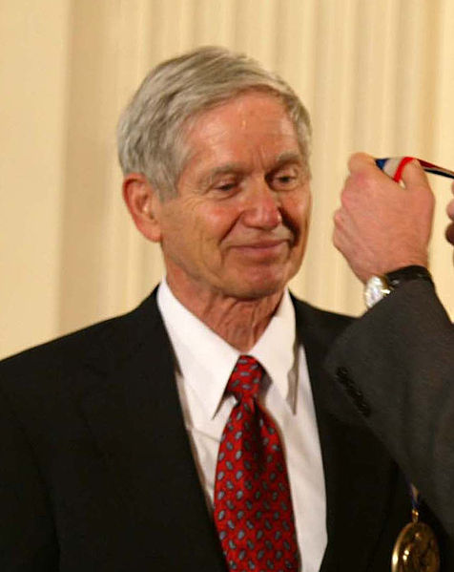
David Keeling Solves the Problem
Notes:
Source: Charles David Keeling Wikipedia entry

Slide 47
His Solution
Monitor at isolated location: Mauna Loa
  Observatory at 3,397 meters
  No nearby industry or motorized vehicle traffic
  In barren lava field
Monitor continuously

Slide 48
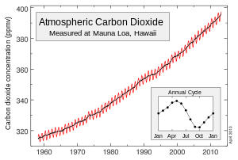
The Keeling Curve
2013: 396 ppm CO₂ and 478 ppm CO_{2eq}
2005: Keeling dies
NSF stops supporting “routine” research – Revelle to the rescue

Slide 49
The Keeling Carbon Cycles
Biological:
  Dominates intra-annual cycle
  Little interannual impact
Fossil fuels dominate interannual changes

Slide 50
http://www.esrl.noaa.gov/gmd/ccgg/trends/history.html

Slide 51
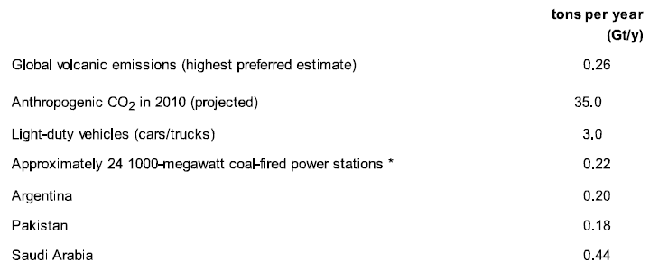
CO₂ Emissions: Man vs. Volcanoes
Notes:
USGS, Volcanic gases and climate change overview

Slide 52
1960s: Non-empirical concerns
CO₂ emissions → increase atmospheric concentration
  Revelle (1957)
CO₂ concentration in fact rising
  Keeling (from mid-1950s)
Rising atmospheric concentration → rising temperature
  Arrhenius (1896), Plassy (1956)
But best (not very good) estimates indicated falling temperature since 1940
Concerns had to rest on(also not very good) computer models
Notes:
Note three paths: science, empirical, computer models – based on science but can deal with multi-factors

Slide 53
Temperature

Slide 54
A contemporary parallel

Slide 55
Contemporary parallel
Very little temperature increase since 1998
Justification for “pause” and “hiatus” description: science and (much improved) models
One leading explanation: multi-decade cycle in transfer of thermal energy between surface and deep ocean
Implication 1: pause will end (but maybe not soon)
Implication 2: 1970-1998 increase may overstate long-term trend

Slide 56
Explanations, explanations
Reduced radiative forcing
  Reduced solar output
  Volcanoes and/or Asian factories
It’s a measurement problem I: failure to measure Arctic temperatures
It’s a measurement problem II: using surface temperatures as the metric

Slide 57
The Oceans’ Role:
Distribution of Additional Thermal Energy

Slide 58
Oceanic explanations
El Nino-La Nina cycle
  Around seven years
  Pause should have been over by now
Longer term cycle
  20-30 years
  Possible implications
    Pause could last another decade or more
    1970-1998 experience overstates long-term warming

Slide 59
Temperature Milestones Since 1980
~1980: NASA, NOAA and Hadley Center develop estimates of global temperature from 1880
1998-99: Mann and co-authors estimate temperatures from 1000 AD primarily from tree rings
2011-2012: Berkeley Earth Project reanalysis largely confirms NOAA/NASA/Hadley estimates
~1999 to present: NASA/NOAA/Hadley data show warming “pause”, “hiatus”

Slide 60
1970s: Shift in scientific views
1970: Charney report finds no major missing factors in models
1972 meeting: some recognition of risk of warming but principal concern was global cooling – end of interglacial hastened by pollution
1977 NAS report warns of possible near-catastrophic temperature rise over next centuries based on improved (but crude) models
July 1977 NYT front page: “Scientists fear heavy use of coal may bring adverse shift in climate” -- Carter isn’t pleased

Slide 61
1970s-Early 1980s Policy
Prompted by Arab oil embargo and 1975-1976 natural gas shortages
1975 legislation: CAFÉ standards
1978 legislation
  Promotes renewables through tax credits and favorable regulatory regime
  Promotes use of coal and discourages use of natural gas in electricity generation
1983 EPA report
  Expresses foresees a large rise in temperatures with potentially catastrophic consequences
  But sees no practical way to prevent it
  Administration dismisses report as alarmist

Slide 62
The end of the non-empirical phase
[G]lobal warming is now large enough that we can ascribe, with a high degree of confidence, a cause-and-effect relationship to the greenhouse effect.”
James Hansen 1988 testimony before Senate Committee

Slide 63
On the international front
http://www.esrl.noaa.gov/gmd/ccgg/trends/history.html
1988
  Margaret Thatcher (a chemist) becomes first world leader to recognize global warming as a problem
  WMO and other UN agencies create Intergovernmental Panel on Climate Change
IPCC first assessment report (1990): Based on current models, we predict: under [BAU] increase of global mean temperature during the [21st] century of about 0.3 ºC per decade (with an uncertainty range of 0.2 to 0.5º C per decade); this is greater than that seen over the past 10,000 years; . . . .

Slide 64
A global negative externality
Negative externality: costs imposed on non-parties to transaction
Results
  Affected parties cannot avoid the impact through their own decisions
  Inadequate incentive to reduce output of product responsible for the externality or change the mode of production
Most externalities fall within jurisdiction of an existing governmental body
  Levy a tax equal to the externality (Pigovian tax) and let people and companies proceed to make money
  Regulate or prohibit the activity
Do we create an international legal structure, and what kind?

Slide 66
Achievements (if assumptions hold)
If
Individuals’ willingness to pay measures benefit to society
Suppliers’ costs equal cost to society
Then
Cost to society of goods supplied is minimized
Net benefit to society is maximized

Slide 67
Failure of an assumption

