Slide 1
Conics
OLLI Summer 2014

Slide 2
Menaechmus
Born: about 380 BC in Alopeconnesus, Asia Minor (now Turkey), Died: about 320 BC
Pappus (290 –350 CE) and Proclus (412–485 CE)
A student of Eudoxus and a contemporary of Plato
Discover of the conic sections
Solved the problem of the two mean proportionals (Hippocrates - duplication of the cube) by means of conic sections.
Is credited with the discovery of the parabola, rectangular hyperbola, and ellipse
Notes:
Hippocrates showed that the doubling the cube problem could be solved by finding the two mean proportions.
Menaechmus's solution is described by Eutocius in his commentary to Archimedes' On the sphere and cylinder.

Slide 3
Two Mean Proportionals
Assume that a, b are two given unequal straight lines and x, y the two required mean proportionals, the discovery of Hippocrates amounted to the fact that from the relation
(a/x) = (x/y) = (y/b)
If follows that x² = ay, y² = bx, and xy = ab
And (a/x)³ = (a/b)
If b = 2a, 2a³ = x³
The solutions of Menaechmus amount to a solution of any two of the equations.
Notes:
x is the side of a cube with twice the volume as a cube with side a.
x² = ay,
x⁴ = a²y², but y² = bx hence x⁴ = a²bx or x³ = a²b
x³/a² = b, x³/a³ = b/a and (a/x)³ = a/b
We now see that the values of x and y are found from the intersection of the parabola x²= ay and the rectangular hyperbola xy = ab. Of course we must emphasis that this in no way indicates the way that Menaechmus solved the problem but it does show in modern terms how the parabola and hyperbola enter into the solution to the problem.

Slide 4
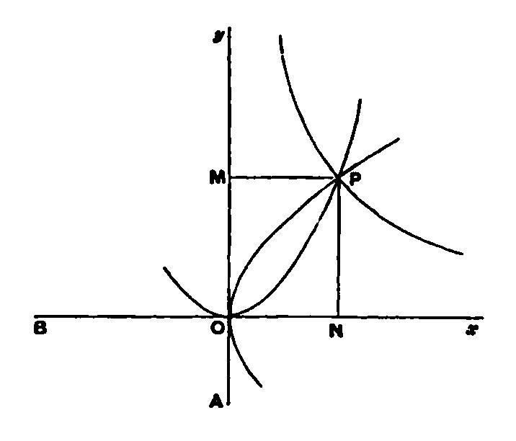
One Solution
hyperbola
It is believed that the discovery by “M” was not the result of a systematic study of the sections of a cone. More likely he looked for ways to generate these figures and found he could get them from a right cone.
parabola
Apollonius gave the conic sections the names we know them by.
Menaechmus called a parabola a section of a right-angled cone , an hyperbola
a section of an obtuse-angle cone, and an ellipse a section of an acute angled cone.
Only cones with vertex above the center of the circular base.
Notes:
Draw figures of three types of cones on board and show how conics originally generated.
Rotate three types of right triangles about a side and generate cones with acute, right and obtuse cone angles.
Draw a plane at right angles to a cone generating element for each cone.
The acute cone produces an ellipse, the right cone a parabola, and the obtuse cone an hyperbola

Slide 5
Conics After Menaechmus
Treatises by Aristaeus the elder (active 370 BCE-300 BCE)
Euclid – Four books on conics which were lost. Probably a compilation of earlier works. Believe they are the first four books of Apollonius’s eight books on conics.
Archimedes
Heracleides, the biographer of Archimedes, is quoted as saying that Archimedes was the first to invent certain theorems in conics, and that Apollonius, having found that they had not been published by Archimedes, took credit for them.
Eutocius responded that the allegation is in his opinion not true, “for on one hand Archimedes appears in many passages to have referred to the elements of conics as an older treatise, and on the other hand Apollonius does not profess to be giving his own discovers.”

Slide 6
Archimedes and Conics
Basic results from Euclid and others used without proof.
The straight line drawn from the center of an ellipse, or point of intersection of the asymptotes of a hyperbola, through the point of contact of any tangent, bisects all chords parallel to the tangent.
In the ellipse the tangents at the extremities of either of the two conjugate diameters are both parallel to the other diameter
If a line between the asymptotes meets a hyperbola and is bisected at the point of concourse, it will touch the hyperbola.
In a hyperbola, if P be any point on the curve and PK, PL are straight lines drawn parallel to the asymptotes and meeting the other, the rectangle PK.PL is a constant.
Notes:
Remember that a diameter is an line that goes through the center of the ellipse, a line that goes through the intersection of the asymptotes for a hyperbola, or a line parallel to the axis of symmetry for a parabola.

Slide 7
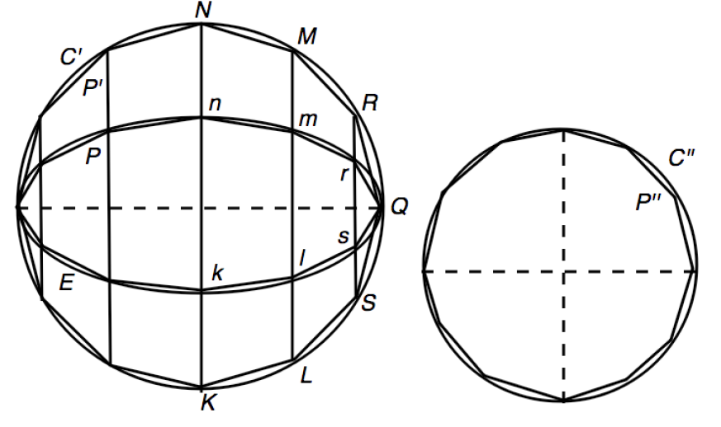
Area of an Ellipse
E is an ellipse with major axis “a” and minor axis “b”.
C’ is a circle with radius “a” circumscribed about E.
C” is a circle with radius √ab.
Archimedes proved that the area of E equals the area of C” using the method of exhaustion.
The area of C” = πab.
Note there is no simple rule for the length of the circumference of an ellipse.
This is proposition 4 in On Conoids and Spheroids

Slide 8
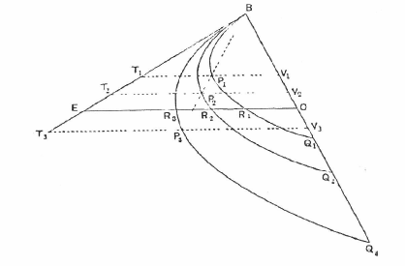
Archimedes Example
If any three similarly situated parabolic segments have one extremity (B) of their bases common and their bases BQ₁, BQ₂, BQ₃ lying along the same straight line, and if EO be drawn parallel to the axis of any of the segments meeting the tangent at B to one of them in E, the common base in O, and each of the three segments in R₁, R₂, R₃ then
Notes:
This is stated in “On Floating Bodies” (book 2 prop 10) without proof. It may follow from another proposition.
Used in Archimedes’ study on the positions of rest of a paraboloid of revolution in water.

Slide 9
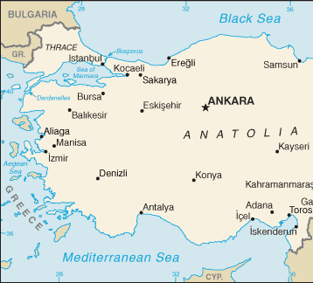
Bio Apollonous Devoted to Apollo
Born about 262 BCE in Perga, Pamphylia, Greek Ionia
Now Murtina, Antalya, Turkey
As a young man he went to Alexandria where he studied under the followers of Euclid and he later taught there.
In the preface to one of his books he notes that he has a son also named Apollonous.
His famous work is his 8 books on Conics. Only the first 4 survive in Greek. Books 5 - 7 survive in Arabic.
In 1710 Halley provided a Latin translation of books 1 – 7.
Notes:
Antalya is right above the “ean” in Mediterranean.
Ancestors probably priests of Apollo.
While in Alexandria, Apollonous got the nickname Epsilon.
Euclid Alpha
Eratosthenes Beta
Archimedes Gamma
Conon of Samos Delta

Slide 10
Bio continued
Most of the results in Books 1 -4 were known to Euclid and others
Books 5 – 7 were highly original
Remnants of Book 8 were used to partially reconstruct it
Pappus (290 – 350 CE) identifies six other works
Cutting-off of a ratio, Cutting an area, On determinate section, Tangencies, Plane loci, and On verging constructions
Cutting of a ratio survives in Arabic
We know from other commentaries of other lost works
Regular solids, Theory of irrationals, on a number system, on properties of burning mirrors
In his work on burning mirrors Apollonius showed that light from the sun is not focused by a spherical mirror but a parabolic mirror
Apollonius died at the age of ~ 72 in Alexandria (190 BCE)
Notes:
Tangencies on follow on slide
A geometric construction, also called a verging construction, which allows the classical geometric construction rules to be bent in order to permit sliding of a marked ruler. Using these rules cube duplication, angle trisection and construction of a regular heptagon (seven sides) are soluble.

Slide 11
Some of the Lost Works
Tangencies
Contains the famous Apollonian problems: Given any three points, lines, or circles, or any combination of three of these, to construct a circle passing through the points and tangent to the given lines or circles.
Early mathematicians including Newton were under the impression that Apollonius had not solved the 3 circle case and took it as a challenge.
Simple cases of Apollonian problems
3 points and 3 lines
Slightly more complicated 2 lines and 1 point & 2 points and a line
Notes:
Solve these problems on white board
Two points and a line.

Slide 12
Apollonius’ Conics
The contents of the eight books of the Conics are described in the prefaces to books and are contained in the letter that Apollonius sent with each book.
Book 1: Apollonius to Eudemus, greetings. If you are in good health and things are in other respects as you wish, it is well; with me too things are moderately well. During the time I spent with you at Pergamum I observed your eagerness to become acquainted with my work on conics; I am therefore sending you the first book, which I have corrected, and will forward the remaining books when I have finished them to my satisfaction. …

Slide 13
Apollonius’ Conics – Book 1 Preface Cont.
Now of the eight books the first four form an elementary introduction. The first contains the modes of producing the three sections and the opposite branches (of the hyperbola) and the fundamental properties subsisting in them, worked out more fully and generally than in the writings of others.
The second book contains the properties of the diameters and axes of the sections as well as the asymptotes ….
The third book contains many remarkable theorems useful for the syntheses of solid loci and for diorismi; the most and prettiest of theses theorems are new, and it was their discovery which made me aware that Euclid did not work out … .
Notes:
Diorismi [a statement in advance as to when, how, and in how many ways the problem will be capable of solution]

Slide 14
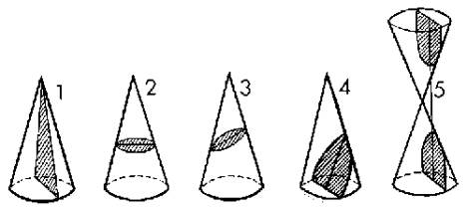
Conics 1
Conics have a long history that started with Menaechmus (ca 380 - 320 BCE), continued with Euclid and Archimedes, and reached its peak with Apollonius.
Really complicated because it is 3-D
straight lines circle ellipse parabola hyperbola

Slide 15
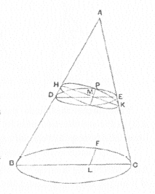
An Unusual Circle
Conic DPE is a circle
Conic HPK is also a circle if
< AHK = <BCA
When this is true the section of the cone is called a subcontrary section
For any point P on the section HPK, it can be shown that
HM * MK = PM²
It follows from this that the section HPK is a circle
Except for this special case, no other sections are circles. So what are they?

Slide 16
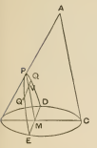
Definition of a Diameter (Book 1)
If a cone be cut by a plane which intersects the circular base in a straight line (DE) perpendicular to the base of any axial triangle (ABC), the intersection of the cutting plane and the plane of the axial triangle (PM) will be a diameter of the resulting section of the cone.
B

Slide 17
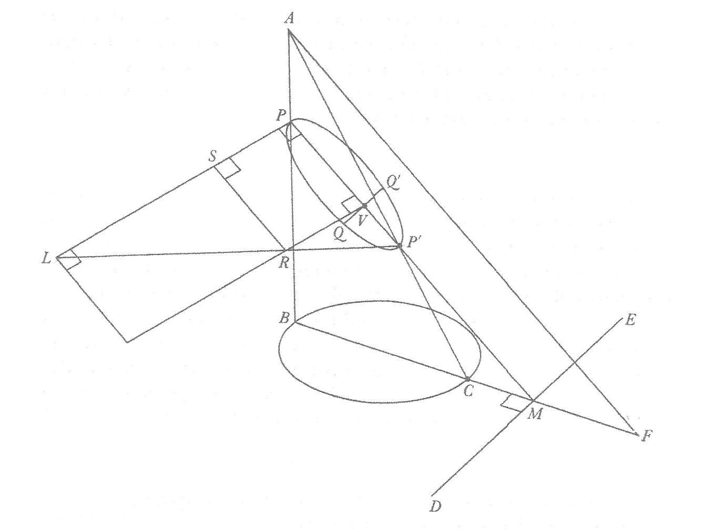
Given circle BC and vertex A
ABC is axial triangle
Cut the cone with plane PDE
such that DE is perpendicular
to BC extended
ABC cuts the conic in PP’
Q’Q is chord parallel to DE
PP’ bisects Q’Q
Apollonius shows that QV² = PVwVR. QV is our “y”. PV is our x. Length PL is 2p and
PP’ is d. Using the fact that rt LR is similar to rt LP’, it can be shown that
y² = 2px – 2px²/d (ellipse)
With this construction, d = ∞ for the parabola and if the minus sign is changed
to a plus sign an hyperbola is obtained.

Slide 18
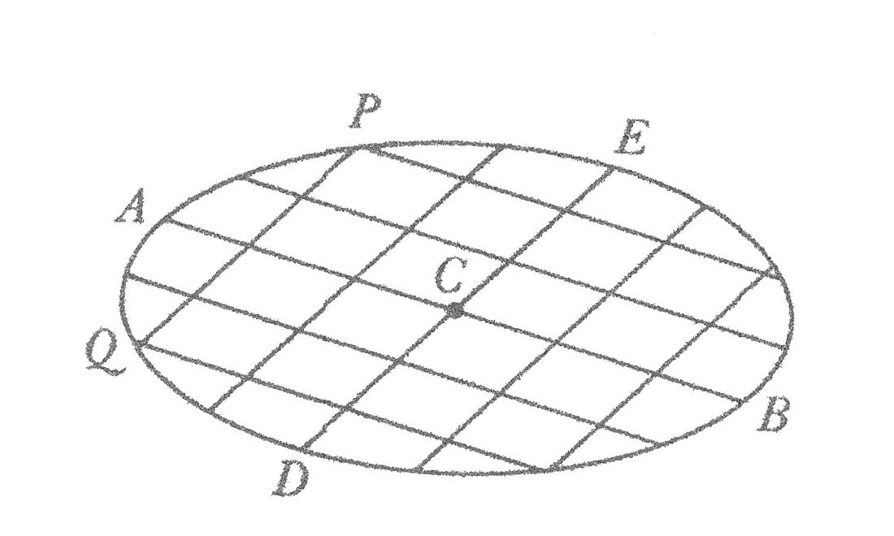
Concepts, Book 2
Many diameters – largest is major axis and smallest is minor axis
Definition of conjugate diameter
Construction of tangent
Notes:
Consider the set of chords parallel to PQ. Apollonius proved that the midpoint of the chords lie on a straight line (AB) which is a diameter. The line drawn at the end of the diameter parallel to the chords is tangent to the ellipse.
Also, if through C, the midpoint of AB, a line DE is drawn parallel to PQ then DE will bisect all lines drawn parallel to AB. DE is called the conjugate diameter.

Slide 19
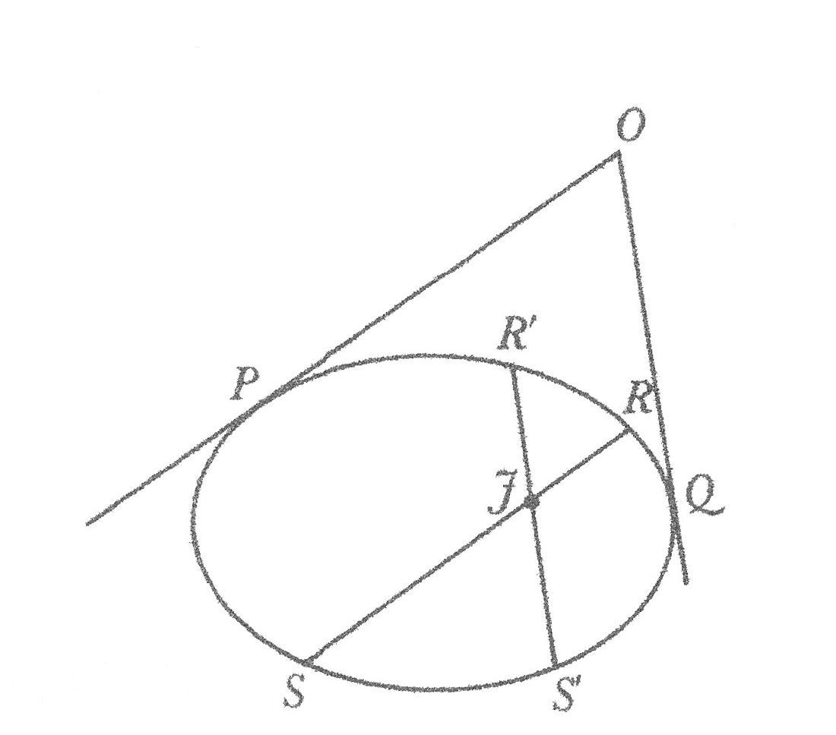
Interesting properties
OP and OQ are tangents
RS any chord || OP
R’S’ any chord || OQ
RS and R’S’ intersect in J
(RJ.JS)/(R’J.JS’) = OP²/OQ²
This is a generalization of the theorem for a circle.

Slide 20
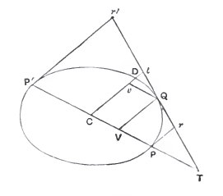
Book III, Proposition 42
If the tangents at the extremities of a diameter PP’ of a central conic be drawn, and any other tangent meet them in r, r’ respectively, then
Pr x P’r’ = CD²

Slide 21
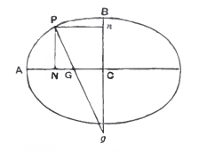
Book V, Proposition 91
If g be on the minor axis of a ellipse, and gP is a maximum straight line from g to the curve, and if gP meets the major axis in G, GP is a minimum straight line from G to the curve.
The concept of minimum and maximum distances is pretty sophisticated.

Slide 22
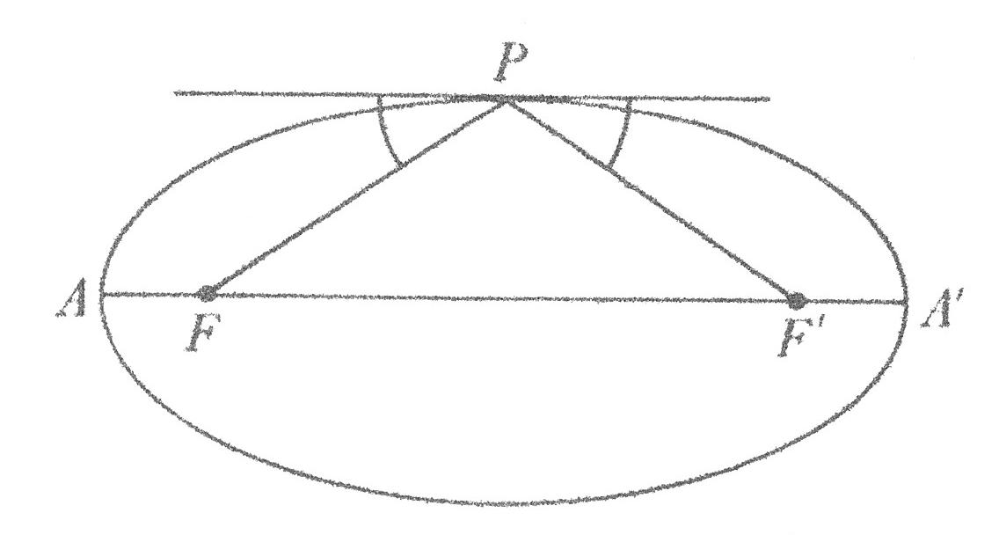
Foci of Ellipse
The foci, points F and F’ are determined by PF’ = OA’ and PO
FO = OF’ = sqrt(AO² – PO²)
PF + PF’ = 2 AO for P anywhere on the ellipse.
For P anywhere on the ellipse, the angles between the tangent at P and PF and PF’ are equal
Properties of an ellipsoidal dome
O
The principle was used in the construction of "whispering galleries" such as
in St. Paul's Cathedral in London. If a person whispers near one focus, he can be
heard at the other focus, although he cannot be heard at many places in between.

Slide 23
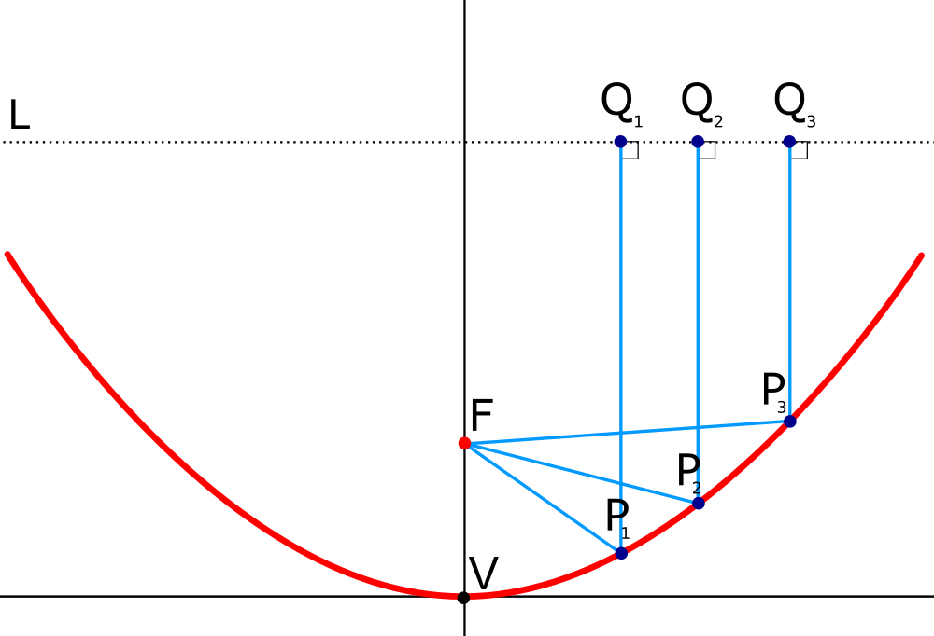
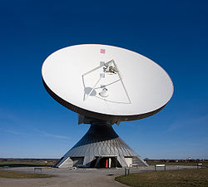
Parabolic Mirror
Before Apollonius it was believed that a spherical mirror focused light to a point. Apollonius proved that only a parabolic mirror focused light at a point

Slide 24
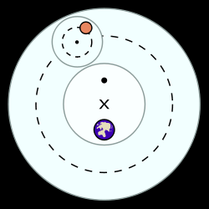
Apollonius the Astronomy
Ptolemy :
Earth (center), Moon, Mercury, Venus, Sun, Mars, Jupiter, and Saturn.
The inequalities in the motions of these heavenly bodies necessitated either a system of deferents and epicycles or one of movable eccentrics (both systems devised by Apollonius of Perga, the Greek geometer of the 3rd century BC) in order to account for their movements in terms of uniform circular motion.
The basic elements of Ptolemaic astronomy, showing a planet on an epicycle (smaller dotted circle) , a deferent (larger dotted circle), and an equant (larger black dot).
http://www.windows2universe.org/mars/mars_orbit.html
Notes:
In the Ptolemaic system, each planet is moved by a system of two or more spheres: one called its deferent, the others, its epicycles. The deferent is a circle whose center point exists halfway between the equant and the earth, marked by the X in the picture to the right where the equant is the solid point opposite the earth. Another sphere, the epicycle, is embedded inside the deferent and is represented by the smaller dotted line to the right. A given planet then moves along the epicycle at the same time the epicycle moves along the path marked by the deferent. These combined movements cause the given planet to move closer to and further away from the Earth at different points in its orbit, and caused observers to believe that the planet even slowed down, stopped, and moved backward (in retrograde motion).
Equant (or punctum aequans) is a mathematical concept developed by Claudius Ptolemy in the 2nd century AD to account for the observed motion of heavenly bodies. The equant is used to explain the observed speed change in planetary orbit during different stages of the zodiac. This planetary concept allowed Ptolemy to keep the theory of uniform circular motion alive by stating that the path of heavily bodies was uniform around one point and circular around another point.

Slide 25
Think Kepler (1571 – 1630 CE)
Kepler’s First Law
The orbits of the planets are ellipses, with the Sun at one focus of the ellipse.
Kepler’s Second Law
The line joining the planet to the Sun sweeps out equal areas in equal times as the planet travels around the ellipse.
Kepler’s Third Law
The ratio of the squares of the revolutionary periods for two planets is equal to the ratio of the cubes of their semimajor axes:
Anyone who ... points the way will be for me the great Apollonius," Kepler wrote. Here Kepler is seeking help in verifying the 2nd law.
Notes:
Copernicus (1473 – 1543) had placed the sun at the center of the solar system but thought the orbits were circles. Kepler (1571 – 1630) was Tycho Brahe (1546 – 1601) assistant. He set Kepler the task of understanding the orbit of the planet Mars, which was particularly troublesome. It is believed that part of the motivation for giving the Mars problem to Kepler was that it was difficult, and Brahe hoped it would occupy Kepler while Brahe worked on his theory of the Solar System. In a supreme irony, it was precisely the Martian data that allowed Kepler to formulate the correct laws of planetary motion, thus eventually achieving a place in the development of astronomy far surpassing that of Brahe.

Slide 26
Planetary Orbits
Planet | a | e | i
Mercury | 0.387 | 0.206 | 7° 00'
Venus | 0.723 | 0.007 | 5° 24'
Earth | 1.000 | 0.017 | 0° 00'
Mars | 1.881 | 0.093 | 1° 51'
Jupiter | 11.857 | 0.048 | 1° 18'
Saturn | 29.42 | 0.056 | 2° 29'
Uranus | 83.75 | 0.046 | 7° 00'
Neptune | 163.72 | 0.009 | 1° 46'
Pluto | 248.0 | 0.249 | 17° 09
Notes:
‘a’ is the semi major axis
‘e’ is the eccentricity
‘b’ is the semi minor axis
b/a = sqrt(1 – e^2)^.5
I is the inclinition of the plane of orbitof the planet to that of earth.

Slide 27
Apollonius the Great Geometer
Apollonius's contributions to the development of mathematics are countless. Apollonius showed how to construct the circle, which is tangent, to three given circles. He extended Euclid's theory of irrationals and improved Archimedes's approximation of ‘pi.' Apollonius showed that parallel rays of light are not brought to a focus by a spherical mirror and discussed the focal properties of a parabolic mirror. In his mathematical astronomy studies he found the point where a planet appears stationary, namely the points where the forward motion change to a retrograde motion or the converse. To top everything off, Apollonius developed the hemicyclium, a sundial which has the hour lines drawn on the surface of a conic section.

Slide 28
References
http://www-history.mcs.st-andrews.ac.uk/Biographies/Apollonius.html
The Treasury of Mathematics by Henrietta O. Midonick
Mathematical Thought from Ancient to Modern Times by Morris Kline
Many of my figures are from here
Treatise on Conic Sections by Apollonius of Perga, edited by T. L. Heath
A History of Greek mathematics – volume II, Sir Thomas Heath

