Slide 1
Class 4 Inertia and Responding To Climate Change
Climate Change
OLLI Summer 2013

Slide 2
Increase in Equilibrium Temperature Due to Increase in CO₂ Concentration from 280 ppm
ΔT = ΔT_{2X} * Ln(new CO₂ concentration/280 ppm concentration)/Ln(2.0)
Ln(2.0) = 0.69
Current sensitivity estimate:
1.5º to 4.5º

Slide 3
Notes:
OLLI summer 2013 class 3 workpaper

Slide 4
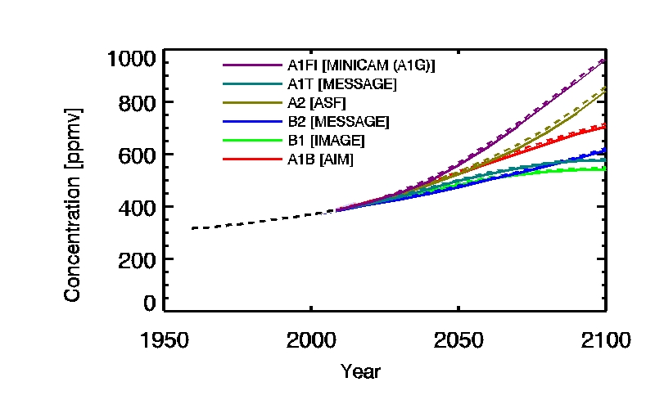
2007 IPCC CO₂ Scenario Projections

Slide 5
Notes:
OLLI summer 13 Class 3 workpaper, downloaded from http://www.ipcc-data.org/observ/ddc_co2.html (last updated June 20, 2013)

Slide 6
What equilibrium temperature means: 740 ppm example
Transient temperature
Temperature when concentration reaches 740 ppm
Equilibrium temperature
Temperature when radiative forcing is zero at 740 ppm
Thermal radiation plus reflected solar radiation equals incoming solar radiation

Slide 7
Why the lag? Near-term answer: Feedbacks
Water vapor: near-instantaneous
Longer: years to decades
Vegetation
Snow and ice cover
Carbon pools:
Soils and permafrost
Methane hydrates???

Slide 8
Long-Term Answer
Time needed to achieve equilibrium between surface and deep ocean
Necessary for both CO₂ and temperature

Slide 9
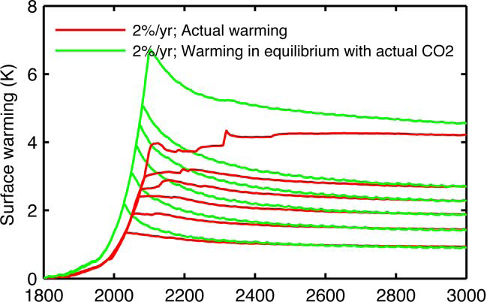
Curves represent peak CO₂ of 450, 550, 650, 750, 850 and 1200 ppm
Notes:
Solomon, et al., Irreversible climate change due to carbon dioxide emissions, PNAS (February 2009)

Slide 10
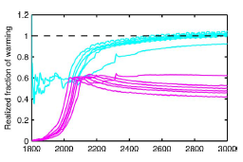
Transient T/equilibrium T ratio
Ratio of temperature to equilibrium temperature for peak CO₂
Notes:
Solomon, et al., Irreversible climate change due to carbon dioxide emissions, PNAS (February 2009)

Slide 11
What’s Happening?
At millennial time scale, CO₂ largely equilibrates between ocean (~80%) and atmosphere (~20%)
Result: Radiative forcing reduced from peak
But oceans gradually warm
Result: reduced transfer of heat to ocean
Net result: near-constant temperature over millennium

Slide 12
What does 1000 years mean?
1000 years ago
William the Conqueror not yet born
Spanish Reconquista just beginning
Irreversibility
Not technically irreversible: geological cycle
Irreversible in human terms
Possible escapes
Net removal of CO₂ from atmosphere
Radiation management

Slide 13
Doing something

Slide 14
The Basic Alternatives
Reduce harm
Mitigation
Adaptation

Slide 15
Mitigation Alternatives: Planet Keeling
Stabilize temperatures
Stabilize atmospheric CO₂:
Emissions must not exceed absorption
Natural and anthropogenic on both sides of balance
Offset increasing greenhouse effect with increasing albedo: geoengineering
Undo warming
Same tools
Must achieve negative radiative forcing

Slide 16
What Actions?
Mitigation
Reduce net CO_{2eq} emissions
Radiation management

Slide 17
What Actions?
Radiation management
Small scale: white roofs
Large scale: geoengineering

Slide 18
Geoengineering
Leading candidate: inject sulfate aerosols into stratosphere
Like continuous volcanic eruptions
Advantages
Relatively cheap
Only known alternative to:
Reduce global temperatures on human time scale
Quickly stabilize global temperature
Problems
Stabilizes global average temperate
Sole reliance creates growing temperature overhang
Unknowns

Slide 19
What Actions?
Reduce net CO_{2eq} emissions
Capture and store emissions
Reduce energy-related CO₂ emissions
Reduce non-energy CO₂ emissions
Reduce other GHG emissions

Slide 20
What Actions?
Reduce energy-related CO₂ emissions
Reduce carbon intensity
Reduce energy intensity

Slide 21
Classifying Determinants of Energy-Related CO₂ Emissions
Energy intensity: (Energy consumed)/(value of output), e.g., Gigajoules/$$
Carbon intensity: (Carbon emissions)/(energy consumed), e.g., (Kg of CO₂)/GJ

Slide 22
Example: Plug-In Electric Vehicles
Energy intensity
Energy consumed in generating electricity to move vehicle one mile
Reduced by more efficient generation or vehicle
Carbon intensity
How is the electricity generated
Reduced by replacing fossil fuels with nuclear or renewables or replacing coal with natural gas

Slide 23
What Actions?
Reduce carbon intensity
Expand renewables
Replace coal with natural gas
Expand nuclear power

Slide 24
Jim Hansen and Nuclear Power
“Can renewable energies provide all of society’s energy needs in the foreseeable future? It is conceivable in a few places, such as New Zealand and Norway. But suggesting that renewables will let us phase rapidly off fossil fuels in the United States, China, India, or the world as a whole is almost the equivalent of believing in the Easter Bunny and Tooth Fairy.”
http://www.youtube.com/watch?v=CZExWtXAZ7M

Slide 25
Expanding Renewables
The easy part: massive increase in electricity generated by solar and wind
The hard part: providing
Round-the-clock electricity
Energy for mobile sources

Slide 26
Providing 24/7 Electricity
“Solar (or wind) is cheaper than nuclear” – doesn’t address the issue
Alternatives
Wind and solar plus energy storage
Fossil fuels plus carbon capture and storage
Nuclear power
Issues:
Technical feasibility within the chosen time frame
Comparative economic cost
Environmental impacts

Slide 27
The International Dimension
OECD: most atmospheric CO₂ inventory
Non-OECD: largest and growing share of current emissions
Standard of living – energy – CO₂ link

Slide 28
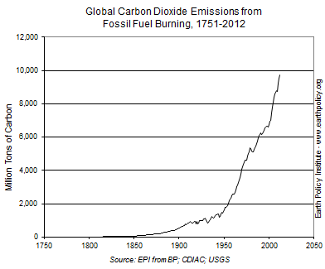
Notes:
Earth Policy Institute, July 23, 2013

Slide 29
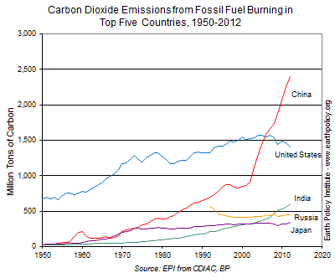
Notes:
Earth Policy Institute, July 23, 2013

Slide 30
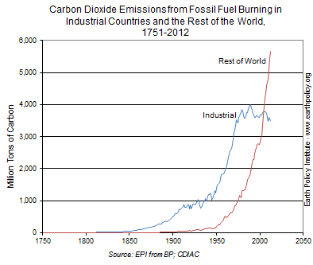
Notes:
Earth Policy Institute, July 23, 2013

Slide 31
United states

Slide 32
U.S. Compared with. World
CO₂
More important: 85% vs. 77%
Larger share from fossil fuels
Land use changes not a net source
Cement production less important
Methane (CH₄) and nitrous oxide
Less important – linked to agriculture’s smaller role
The moral: For US, primary focus on fossil fuels

Slide 33
2011 Share of Primary Energy

Slide 34
2011 Share of Generating Capacity

Slide 35
2011 Share of Generation

Slide 36
Points To Note
Renewable sources’ importance in economy and in electricity
Technologies’ shares of capacity and generation
Petroleum’s tiny role: price determined by superiority as transportation fuel

Slide 37
Capacity Share vs. Generation Share

Slide 38
2006-2011 Growth
 | Billions of kWh | Annual growth rate
Total generation | 42.00 | 0.2%
RN generation | 150.16 | 7.0%
Hydro | 39.26 | 2.6%
Wind | 94.02 | 35.9%
PV | 5.24 | 66.8%

Slide 39
Notes:
Class 1 workpaper

Slide 40
Notes:
Source: 2010 AER

Slide 41
Electricity Generation vs. Emissions

Slide 42
Energy carrier: electricity
Primary Energy: coal, natural gas, petroleum

Slide 43
electricity as a solution

Slide 44
Climate Policy Goal
Stable temperature needs stable GHG concentration
Stable concentration needs zero net emissions
Problem: Reconcile goal with modern energy services
Zero/near-zero net emission alternatives
Renewables
Nuclear
Fossil fuels with CCS

Slide 45
The Electrification Imperative
Alternatives ill-suited for directly supplying energy services
Require an intermediate energy carrier
Electricity
Hydrogen
Implication: Near-zero net emissions requires delivery of most energy in form of electricity

Slide 46
Direct Use of Non-Carbon Energy
Primary Energy | Electricity Generation | Transportation | Thermal
Hydro | X
Wind | X
Biomass | X |  | X
Biofuels | X | X | X
Solar thermal | X |  | X
Solar PV | X
Geothermal | X |  | X
Nuclear | X
Carbon capture & storage | X

Slide 47
Electricity: The Universal Energy Carrier
Fossil fuels
End use function
Nuclear
Electricity
End use function
Renewables
End use function

Slide 48
How We Receive Energy Today
The Big Three
Notes:
From AEO 2008

Slide 49
Two Changes to Stabilize Temperatures
Notes:
From AEO 2008

Slide 50
Biomass
Often efficient for space heating
Limited alternative for electricity generation
Alternative for transportation
Biofuels vs. EVs/fuel cells with non-CO₂ electricity
Liquid fuel vs. batteries or on-board hydrogen
Need biofuels that don’t compete with food: cellulosic ethanol and algae-based fuel

