Slide 1
Photo Album
by Susan M Jampoler

Slide 2
Zoom In
Cropped in
Photoshop Elements
before adding
image to PowerPoint

Slide 3
Comparison
Color corrected in
PhotoShop Elements
before adding to PowerPoint
Original

Slide 4
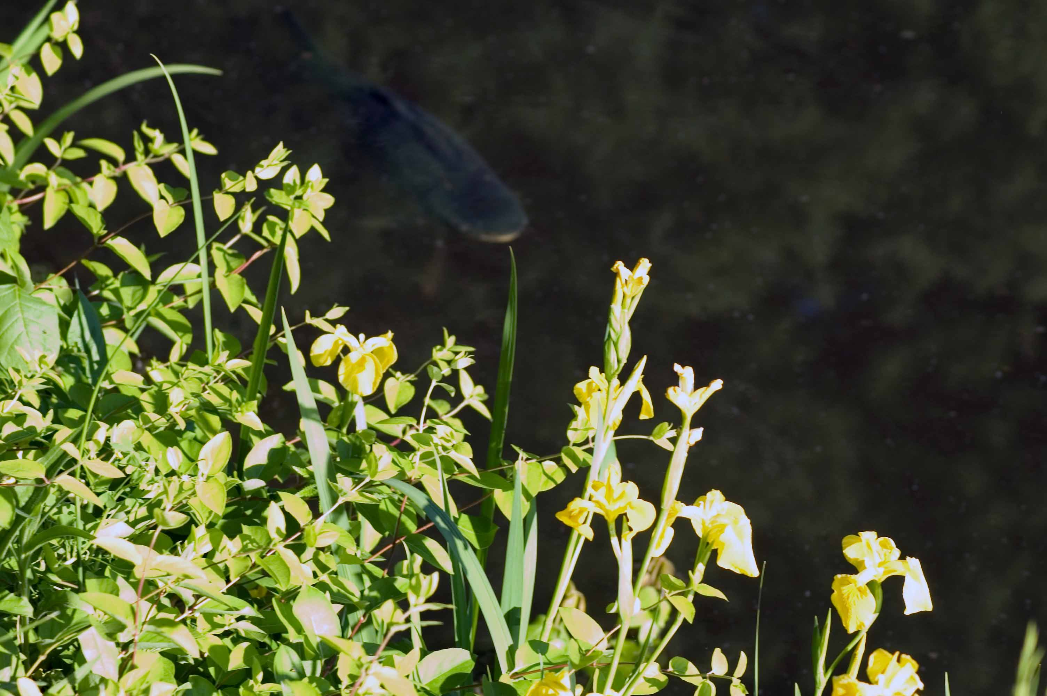
DSC7826
Brightness changed
In PowerPoint
(+20%)
DSC7826

Slide 5
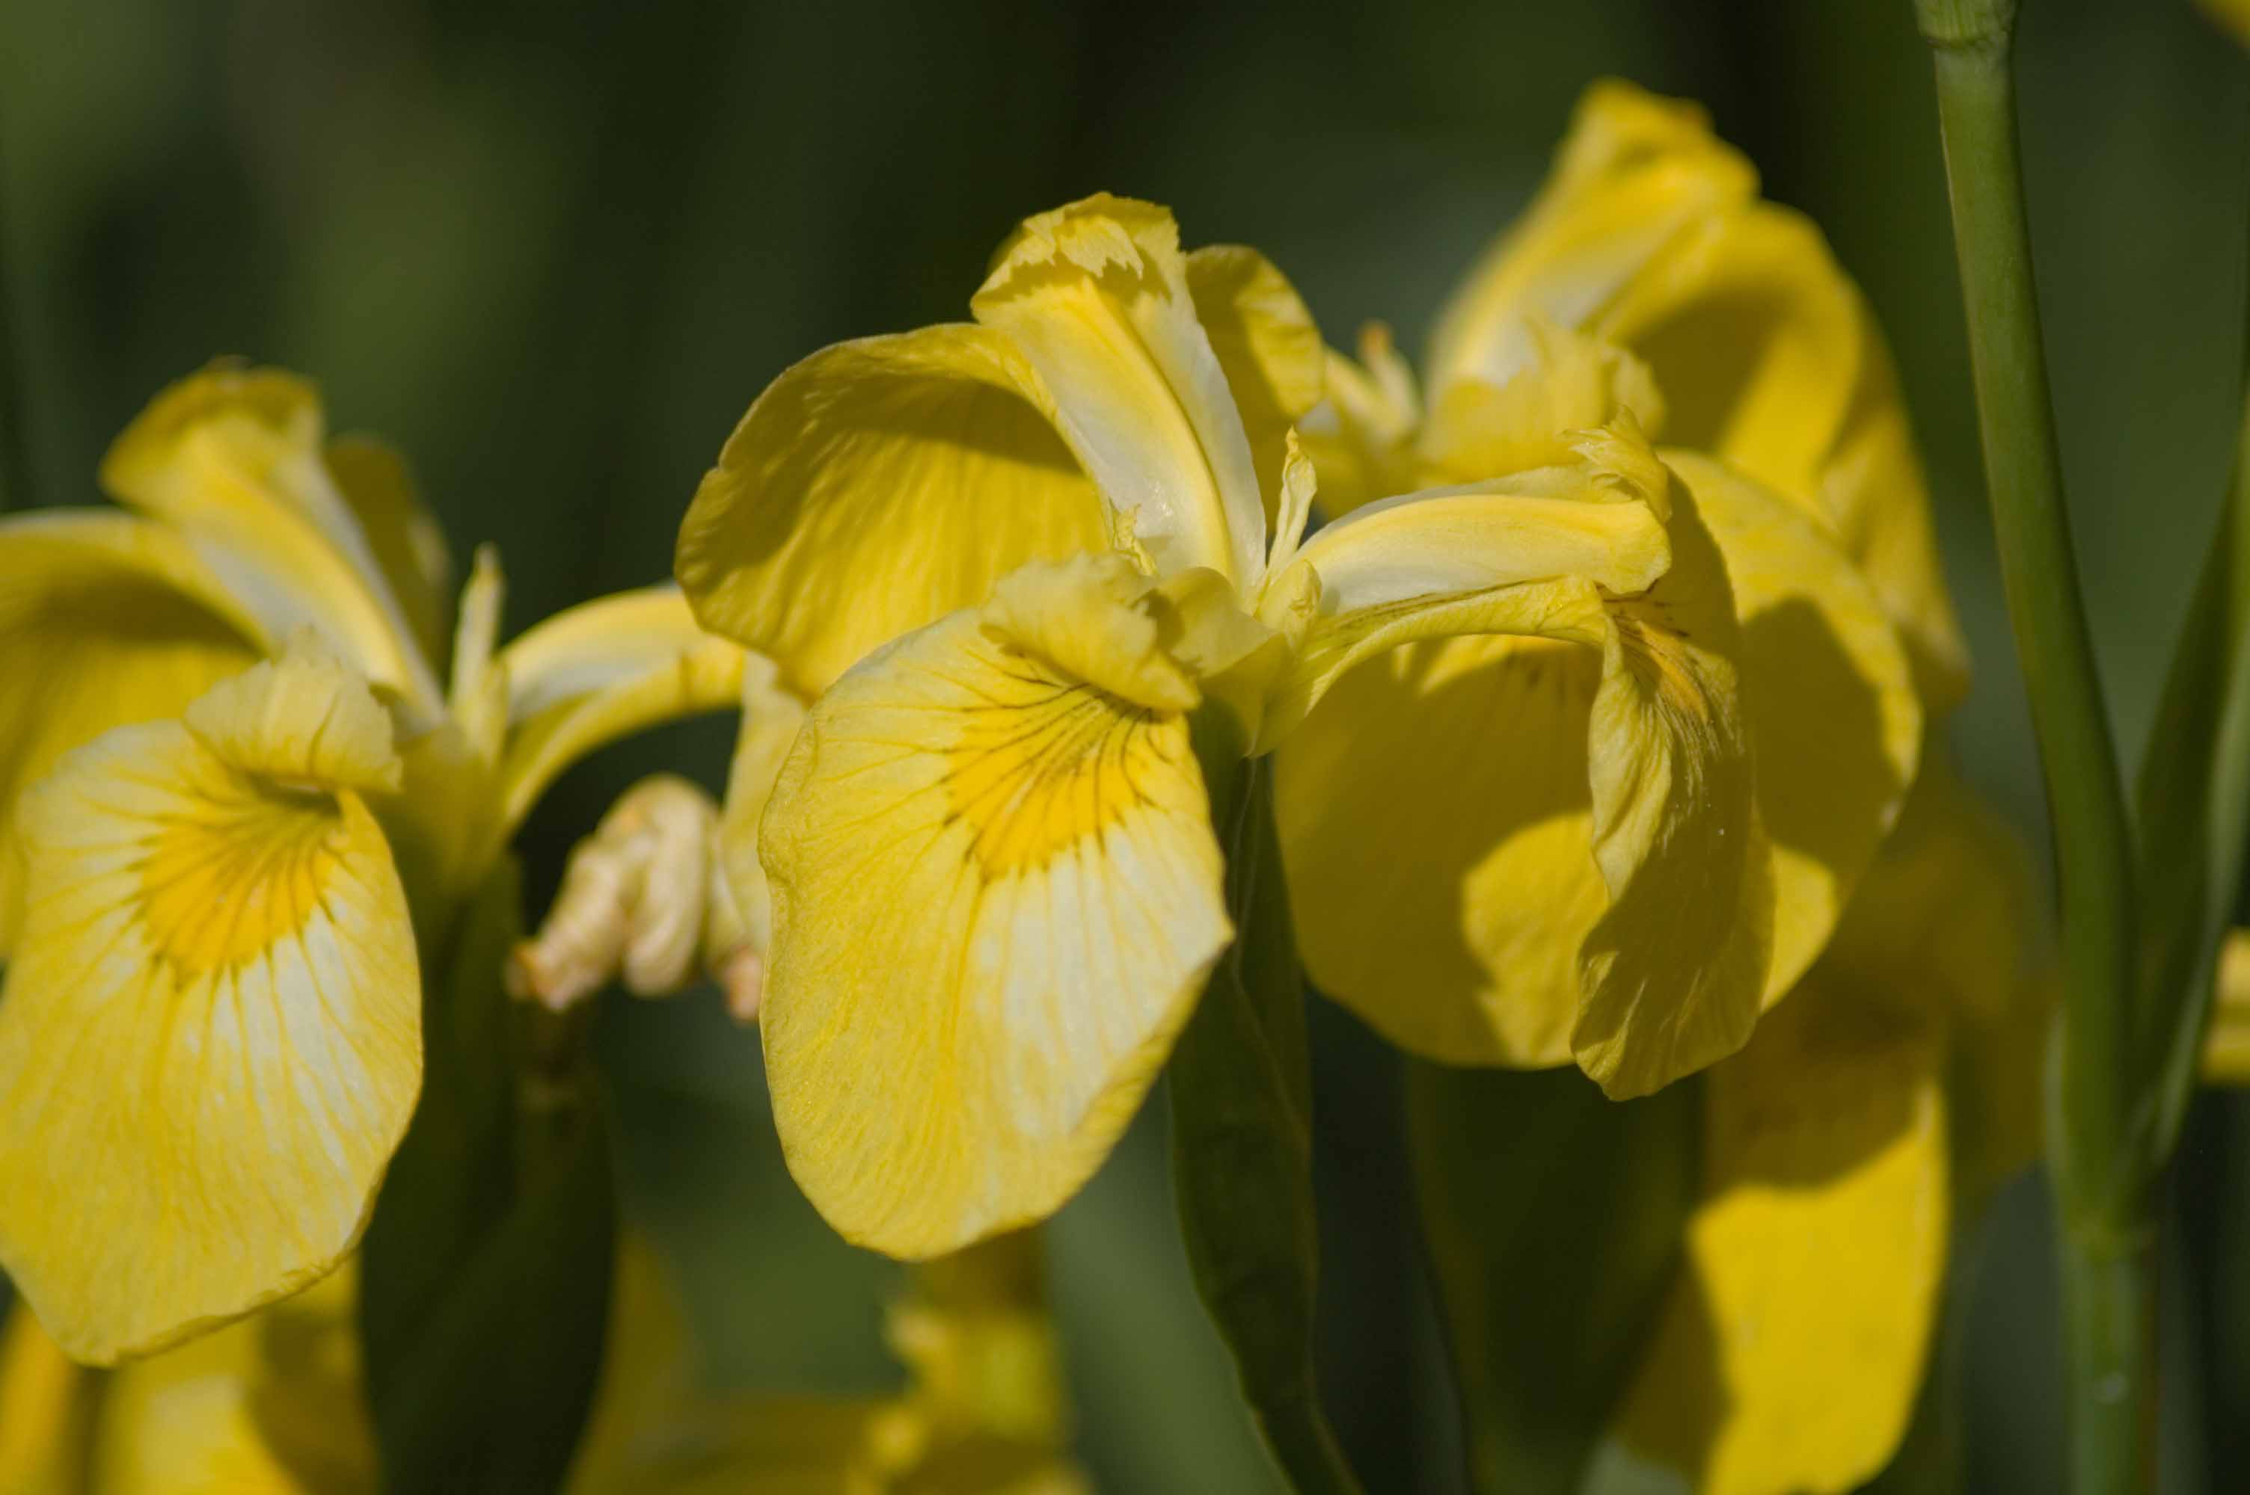
Cropped in PowerPoint
DSC7799
Cropped in Picture Tools -> Format -> Crop
Cropped , then Picture Styles

Slide 6
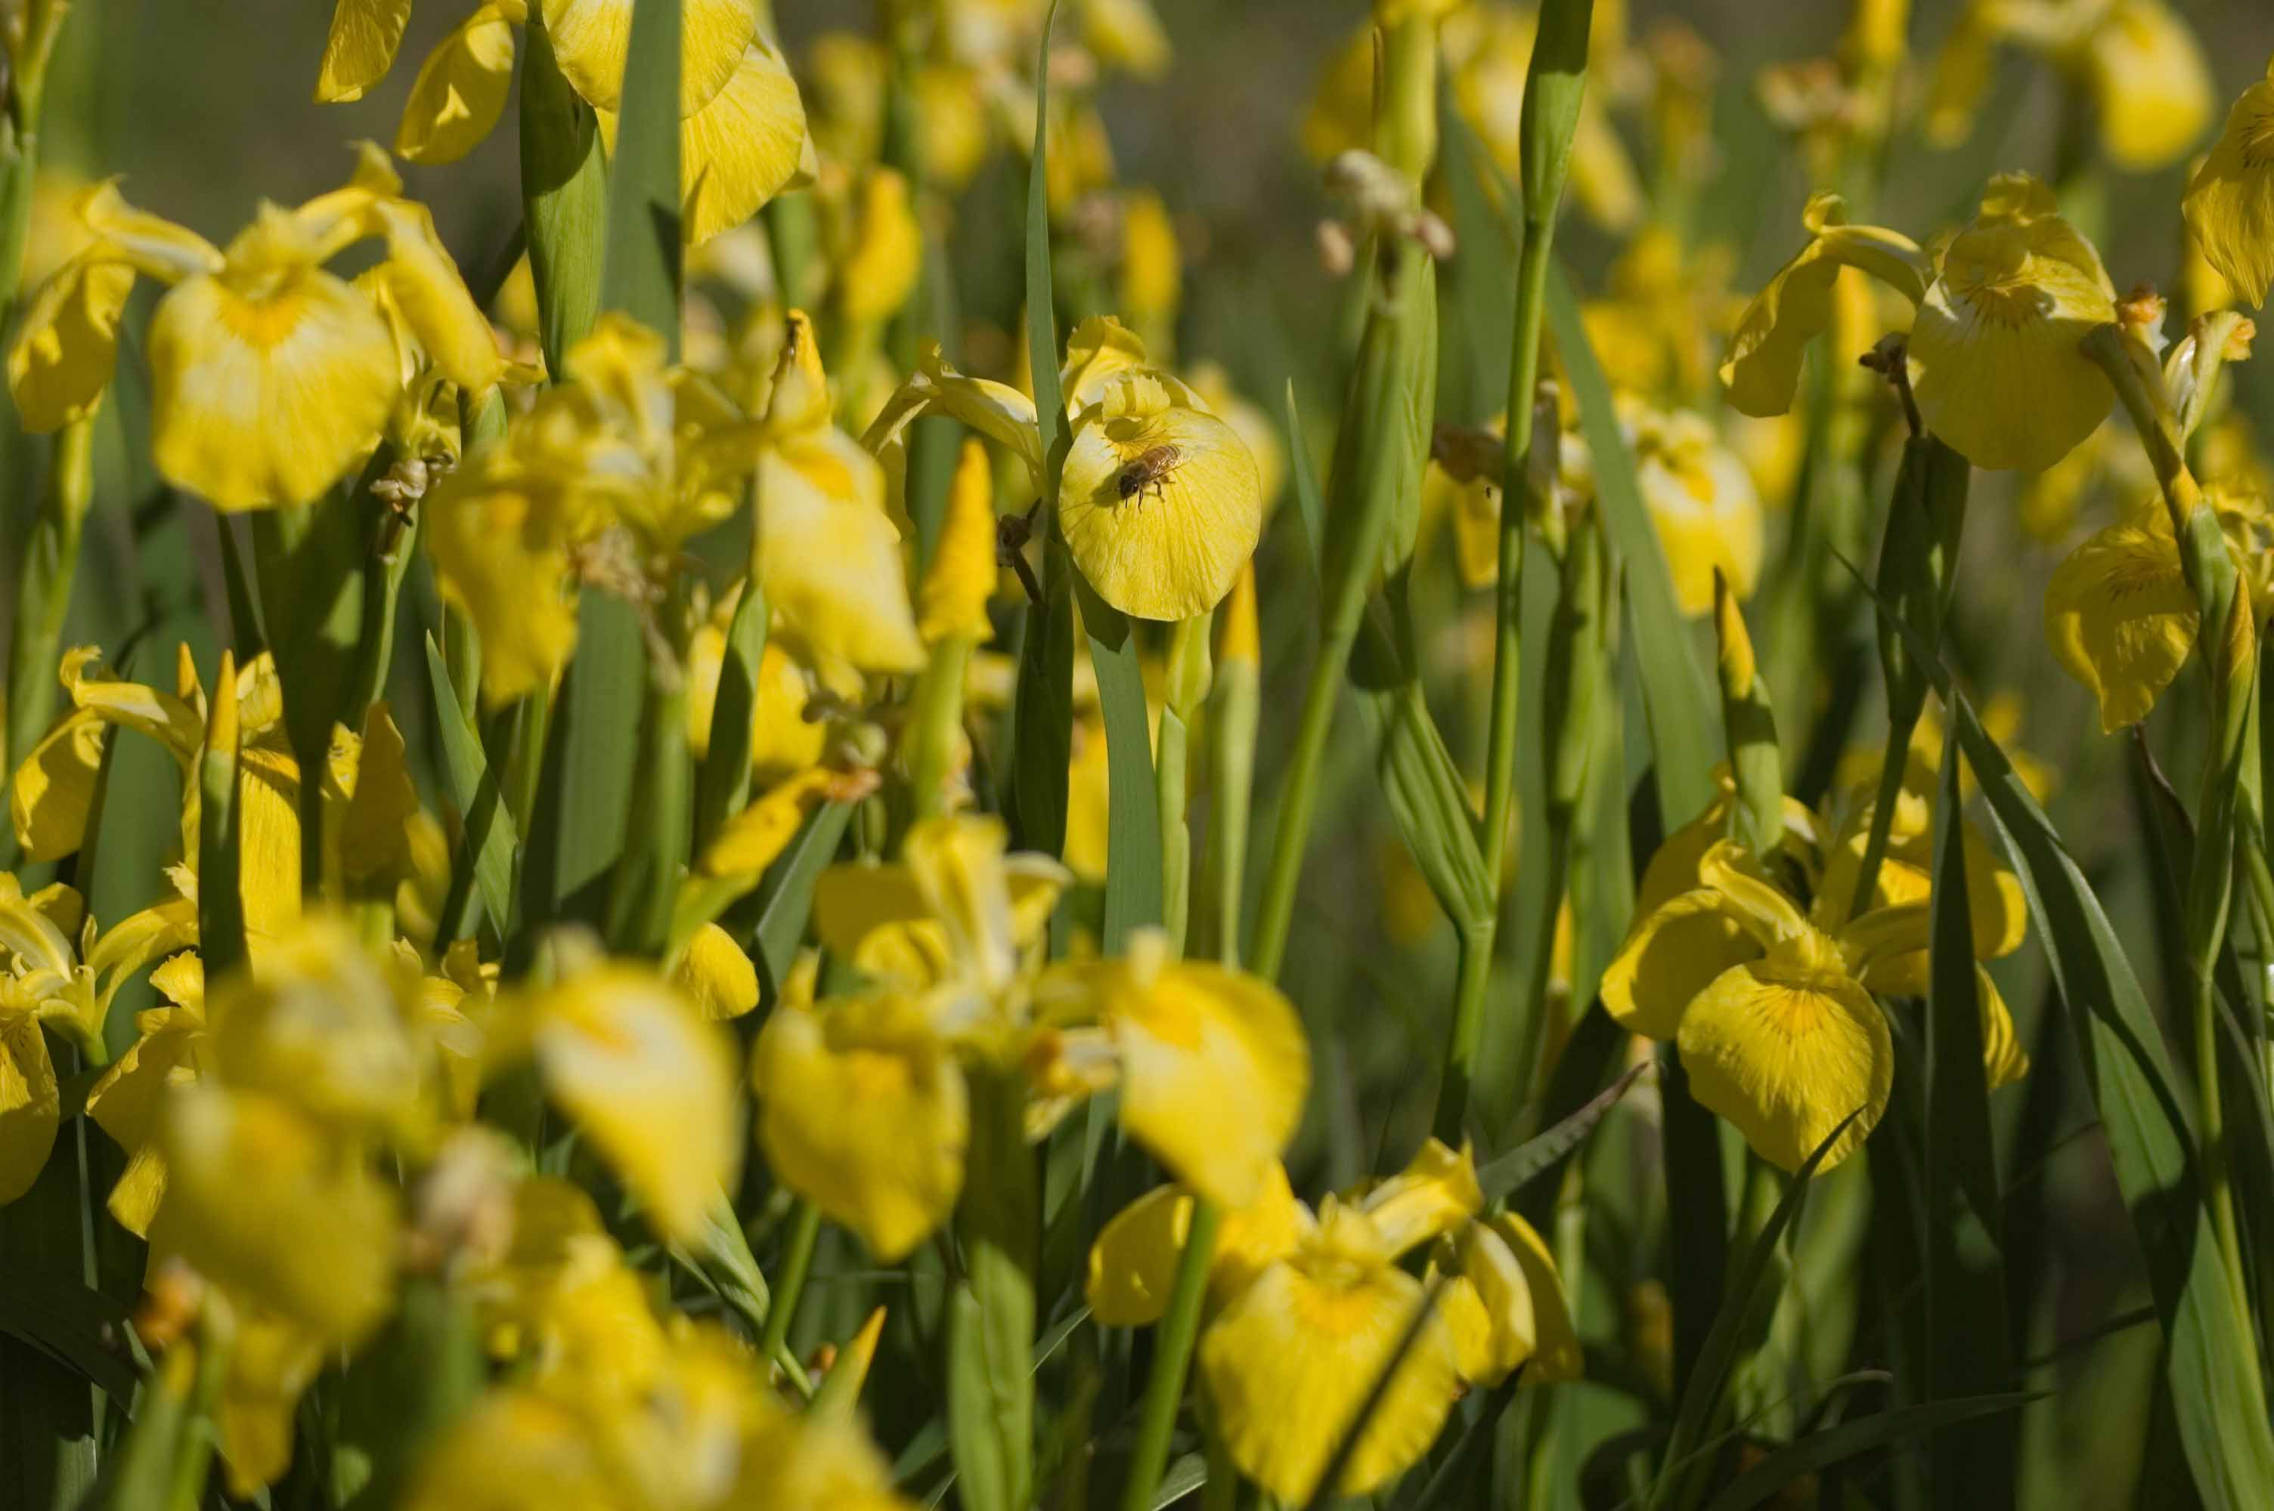
DSC7784

Slide 7
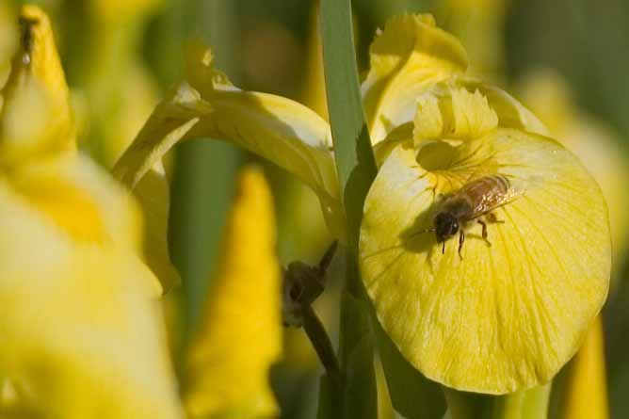
DSC7784_crop

Slide 8
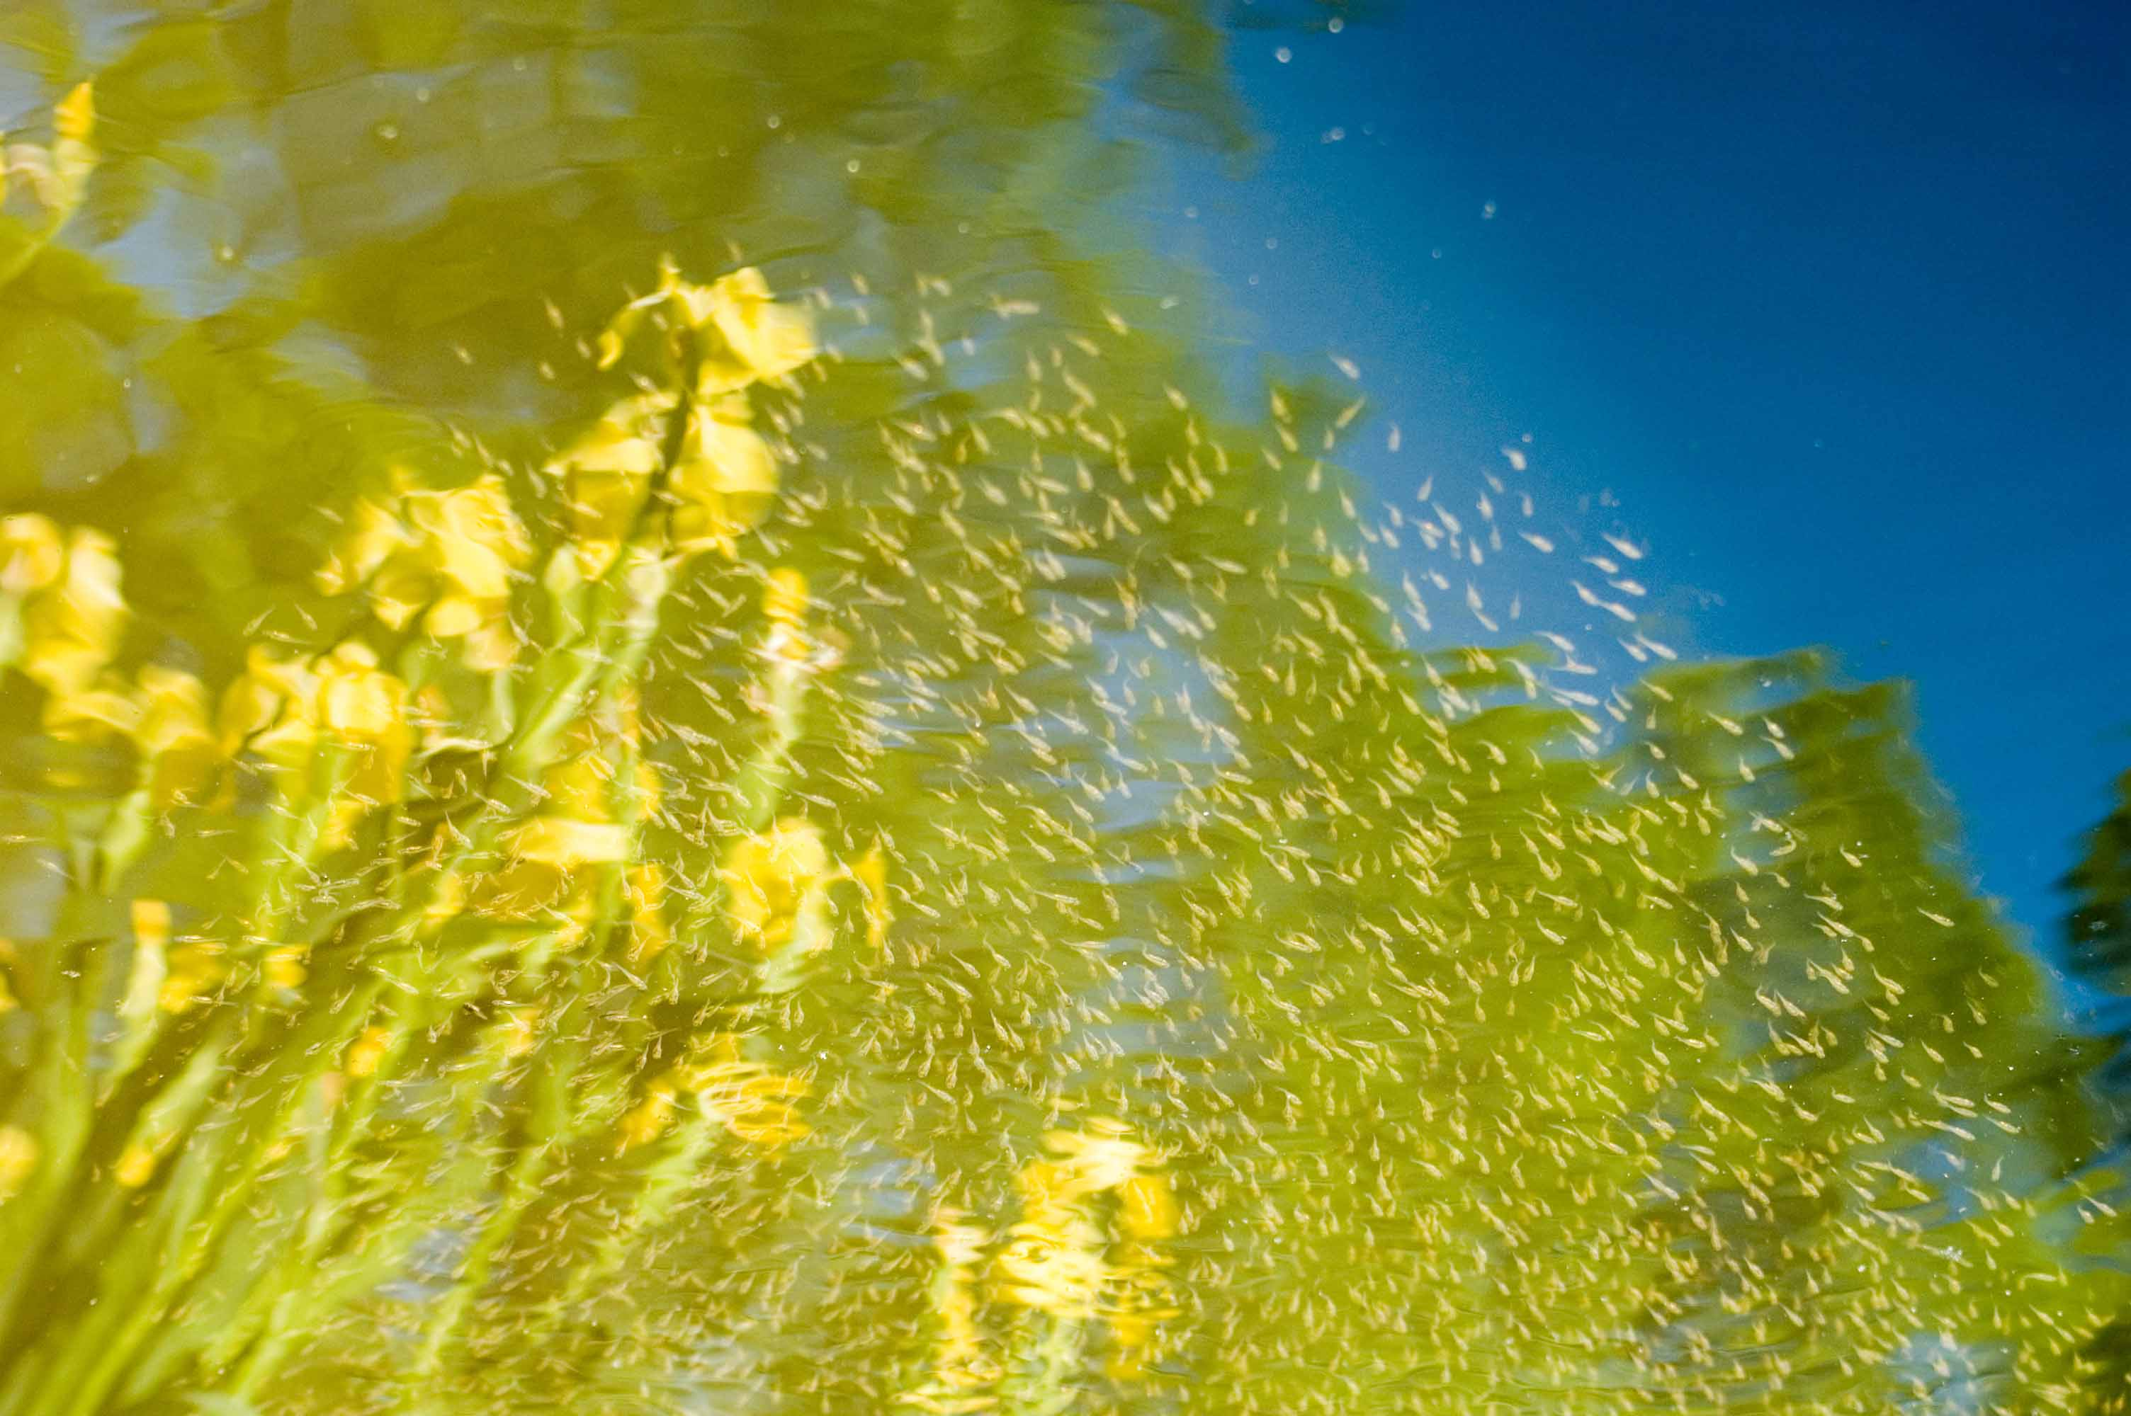
DSC7803

Slide 9
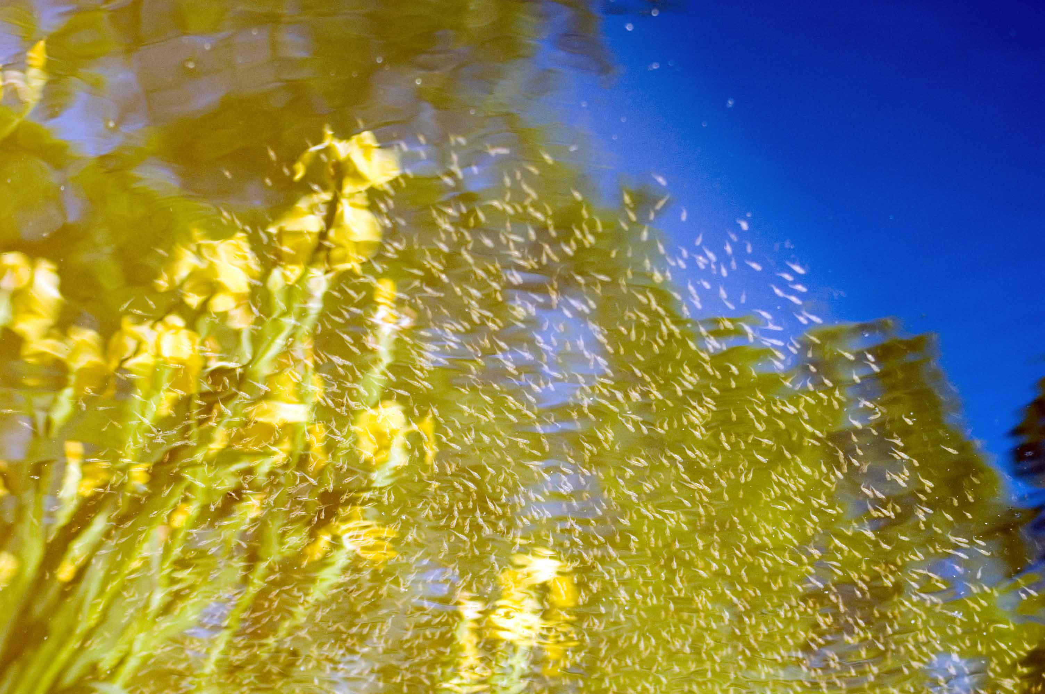
DSC7803__color_corrected

Slide 10
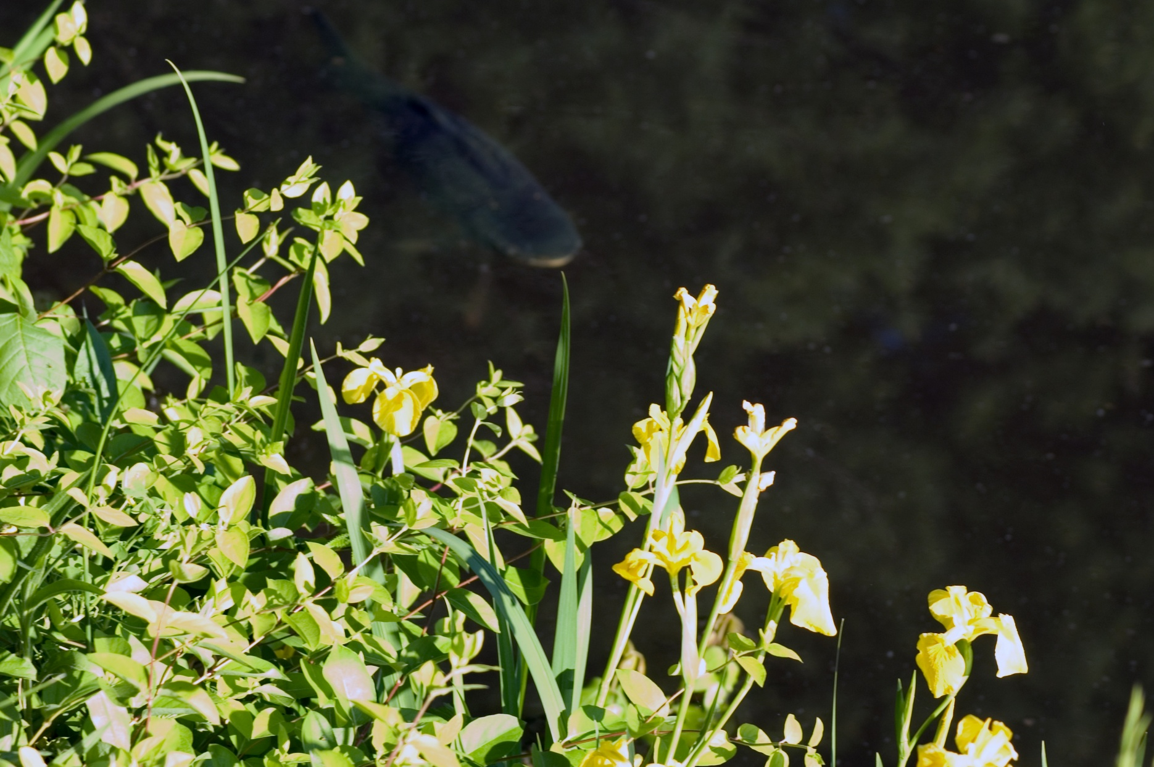

Slide 11
Crop in PowerPoint
DSC7799

Slide 12
My first photo album presentation

