Slide 1
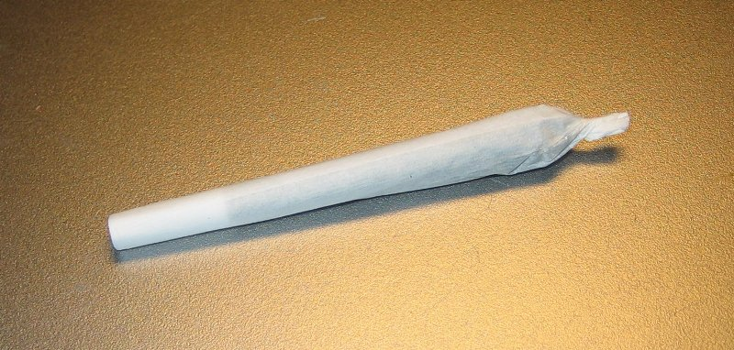
Notes:
500-mg. joint with European-style "roach"
Depending on your preferences you can get 56 joints per ounce of ‘weed” or as few as 28 1000 mg joints.
Cost of weed in Woodbridge, VA was $80 per ounce or so joints can run as low as $1.43 each for the cost of the weed. Perhaps double or triple this for retail made up joints. So joints should run $5.00 to $10.00 each.

Slide 2
LEGALIZING MARIJUANA
PROS AND CONS
Notes:
Should we legalize Marijuana?

Slide 3
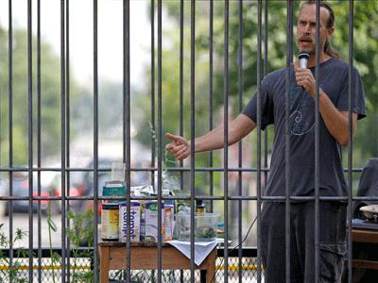
Notes:
David Bronner, CEO Dr. Bronner’s Magic Soaps. Number one selling organic soap brand in the U.S.
Wants to legalize multi-purpose industrial hemp. Protest in Lafayette Park Sq., Mon. June 11, 2012 One of their soaps key ingredients.
Bronner imports several tons or several hundreds of thousand of dollars of Canadian hemp oil annually for his soaps. Argues industrial plants have no drug value for recreational or medical use, less than 0.3% THC No more drug value than a poppy seed bagel.
Argues U.S ban on production is not science based or good for the U.S. economy.
U.S. is the biggest market on the planet for healthy hemp seed and fiber products with retail sales in 2011 of over $400 million.
Drug Enforcement Agency (DEA) has placed industrial hemp on its proscribed list next to marijuana but it can be imported.
History of ban goes back to the alleged “yellow journalism” of newspaper mogul William Randolf Hearst, whose papers in the 1930’s demonized in the cannabis plant and put emphasis on connections between cannabis and criminalization. Hearst felt that hemp might be a threat to his extensive timber holdings, source of paper pulp. He joined forces with Andrew Mellon and the Du Pont family that had invested heavily in nylon as a substitute for hemp in the production of fiber. DuPont in 1937 had just patented nylon and “a new sulfate/sulfite process for making paper from wood pulp” — so presumably “if hemp had not been made illegal, 80 percent of DuPont’s business would never have materialized.”
So it is with Dow today. Industrial uses of hemp include plastics, water purification and weed control that could compete with Dow products and perhaps cause its business to decline.
DuPont, Monsanto, Dow Chemical and Standard Oil are protected from competition by the marijuana laws...as are the cotton, coal, timber, chlorine, polyester, latex paint and vinyl plastic industries. The major considerations blocking hemp's utilization are not agricultural or botanical, but political.
Hemp producers sell hemp seeds as a health food, as they are rich in sought-after essential fatty acids and have a good amino acid balance, together with various vitamins and minerals. Hemp "milk" is a milk substitute made from hemp seeds; it is both dairy- and gluten-free.^{[82]}
Hemp is valuable in tens of thousands of commercial products, especially as fibre^{[81]} ranging from paper, cordage, construction material and textiles in general, to clothing, in which hemp is stronger and longer-lasting than cotton. It also is a useful source of biofuels (from the oils found in the seeds) and medical products. Hemp has been used by many civilizations, from China to Europe (and later North America) during the last 12,000 years or so

Slide 4
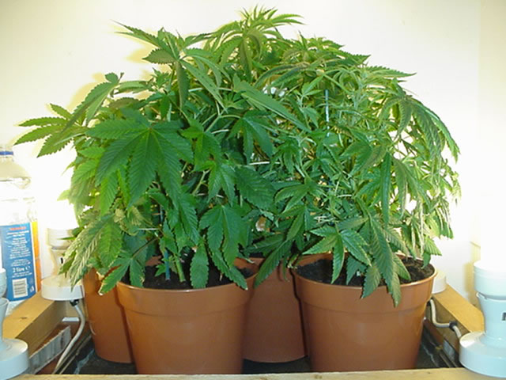
Notes:
Marijuana Plant: Cannabis Sativa
Yield two to five ounces or more dried marijuana per plant indoors. Value $160 to $400 or for the four pots shown $540 to $1600.
Real prize is outdoor plants that will yield two pounds with some reports of up to five pounds per plant. So 32 ounces would have a value of $2560.
Price a few years ago would have been higher. Retail value of product much higher.

Slide 5
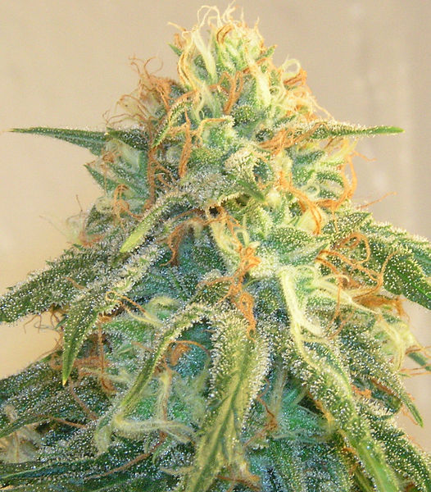
Notes:
Cannabis Sativa bud. Annual herbaceous plant. People have cultivated this herb throughout recorded history as a source of industrial fibre, seed oil, food, recreation, religious and spiritual enlightenment, and medicine.
Its seed, chiefly used as caged-bird feed, is a valuable source of protein. The flowers (and to a lesser extent the leaves, stems, and seeds) contain psychoactive and physiologically active chemical compounds known as cannabinoids that are consumed for recreational, medicinal, and spiritual purposes. When so used, preparations of flowers (marijuana) and leaves and preparations derived from resinous extract (hashish) are consumed by smoking, vaporizing and oral ingestion. Historically, tinctures, teas, and ointments have also been common preparations.
The flowers of the female plant can produce hundreds of seeds.
A Cannabis plant requires more than 12–13 hours of light per day to stay vegetative.
Flowering usually occurs when darkness equals at least 12 hours per day.
The flowering cycle can last anywhere between nine to fifteen weeks, depending on the strain and environmental conditions.
The main psychoactive chemical compound in Cannabis is Δ⁹-tetrahydrocannabinol (THC).

Slide 6
Is Marijuana Dangerous?
Cannabis is a popular recreational drug around the world, only behind alcohol, caffeine and tobacco. In the United States alone, it is believed that over 100 million Americans have tried Cannabis, with 25 million Americans having used it within the past year.
Notes:
Virginia roughly 2.6 percent of US population. Implies 65,000 users in the past year.

Slide 7
Effects
Psychoactive effects - biphasic nature (two phases)
A state of relaxation, and to a lesser degree, euphoria from tetrahydrocannabinol.
Secondary effects, such as a facility for philosophical thinking, introspection and metacognition.
Cases of anxiety and paranoia.
Finally use can include an increase in heart rate and hunger.
Notes:
The psychoactive effects of Cannabis are known to have a biphasic nature. Primary psychoactive effects include a state of relaxation, and to a lesser degree, euphoria from its main psychoactive compound, tetrahydrocannabinol. Secondary psychoactive effects, such as a facility for philosophical thinking, introspection and metacognition have been reported amongst cases of anxiety and paranoia. Finally, the tertiary psychoactive effects of the drug cannabis, can include an increase in heart rate and hunger, believed to be caused by 11-Hydroxy-THC, a psychoactive metabolite of THC produced in the liver.

Slide 8
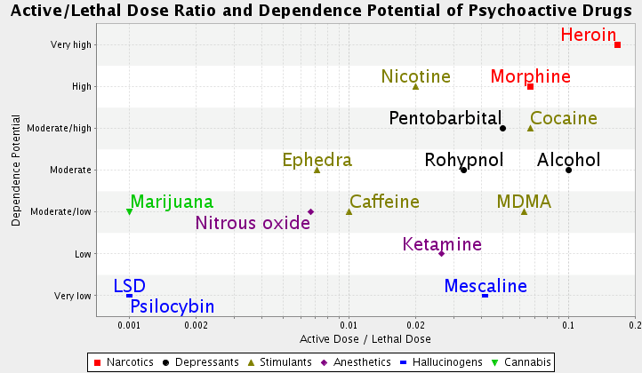
Notes:
Comparison of physical harm and dependence regarding various drugs. Source: The above table appeared in: Gable, R. S. (2006). Acute toxicity of drugs versus regulatory status. In J. M. Fish (Ed.), Drugs and Society: U.S. Public Policy, pp.149-162, Lanham, MD: Rowman & Littlefield Publishers. Also see Vol. 94 2006 the American Scientist, page 208.

Slide 9
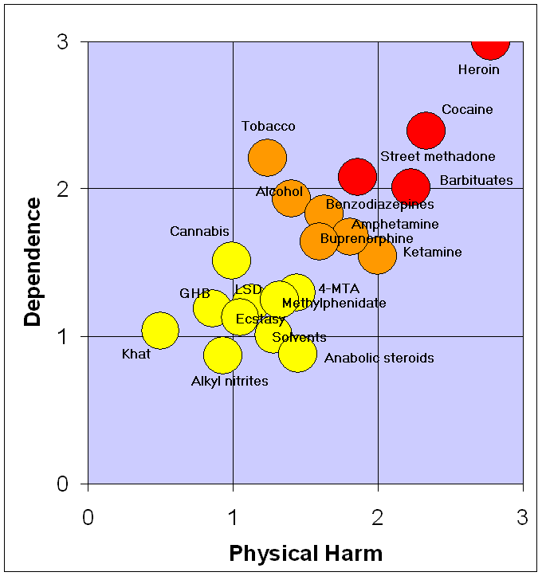
Notes:
A rational scale to assess the harm of drugs. Data source is the March 24, 2007 article: Nutt, David, Leslie A King, William Saulsbury, Colin Blakemore. "Development of a rational scale to assess the harm of drugs of potential misuse" The Lancet 2007; 369:1047-1053. (PMID 17382831; doi:10.1016/S0140-6736(07)60464-4) The data in the paper is obtained solely from questionnaire results obtained from two groups of people: the first comprised people from the UK national group of consultant psychiatrists who were on the Royal College of Psychiatrists’ register as specialists in addiction, while the second comprised of people with experience in one of the many areas of addiction, ranging from chemistry, pharmacology, and forensic science, through psychiatry and other medical specialties, including epidemiology, as well as the legal and police services; the experts are not named and were chosen by the authors. This is a tertiary source as it summarizes experts' opinions on the matter (which are secondary sources) without any direct references to primary sources. The data was first reported in appendix 14 of "Drug classification: making a hash of it?.“
Amphetamine: Stimulant
Benzodiazepine: sedative, relaxant
Buprenorphine: semi-synthetic opioid used to treat opioid addiction, pain

Slide 10
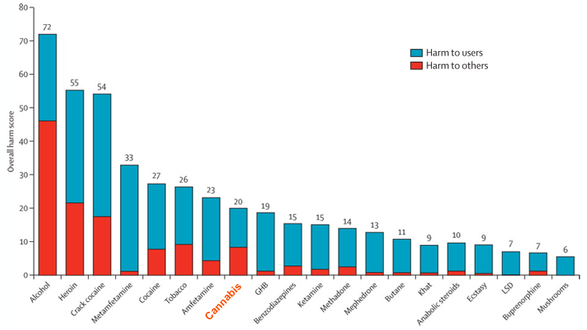
Notes:
The British peer-reviewed journal Lancet published a study titled "Drug Harms in the UK: A Multicriteria Decision Analysis" on Nov. 1, 2010 which ranked 20 drugs from alcohol to marijuana to tobacco based on harm factors.
The red area for Cannabis was very controversial and political. Items included community, economic cost (very large), international damage, family adversities (medium), and environmental damage. Without the economic cost item and a lower family adversity score it would rank five or six points lower.

Slide 11
Substance Abuse Deaths
There are an estimated 79,000 alcohol-related deaths each year. An additional estimated 25,000 additional Alcohol related deaths were due to accidents.
Cigarette smoking and exposure to second-hand tobacco smoke kills an estimated 443,000 people each year.

Slide 12
2008 or 2009 Causes of Death - Annual
Poisonings 41,592
Unintended 76.4 % or 31,775*
15.4% Suicides or 6,400*
Drug Poisonings: Misuse of prescription drugs 36,500
Opioid analgesic pain relievers 40% or 14,800
MORPHINE, CODEINE, HYDROCODONE, OXYCODONE 9,100
METHADONE (SYNTHETIC OPIOID ANALGESIC) 4,900
SYNTHETIC OAP’S OTHER THAN METHADONE - I.E. FENTNYL, PROPOXYPHEND and other 2,300
Other drugs not OAP’s 33.5%* or 12,400
Unknown or combinations 25% or 9,200
* Estimated based on % or absolute data available.
Notes:
Source:
Kochanek KD, Xu JQ, Murphy SL, et al. "Deaths: Preliminary data for 2009." National vital statistics reports; vol 59 no 4. Hyattsville, MD: National Center for Health Statistics. 2011. pp. 17-20.
Highest rate of deaths were males, were people in the 45-54 year old age group, were non-Hispanic white.
In 2007-2008 48% of Americans used at least one prescription drug in the past month and 11% used at least five or more prescription in the past month.
Source: Drug poisoning deaths in the United States, 1980-2008. National Center for Health Statistics, Centers for Disease Control and Prevention, US Dept. of Health and Human Services.

Slide 13
Deaths from Drugs Illegal and Legal
Year 2009
Cocaine 5,100
Heroin 3,000
Cannabis (Marijuana) 0
Four and one-half years Jan. 1997 to Jun. 2005
Marijuana primary 0, secondary 279 total 279
17 FDA approved primary 10,008 total 11,687
Viagra primary 2,254, secondary 40 total 2294
Notes:
FOIA request to Food and Drug Administration from ProCon.org of June 24, 2005. Drugs chosen included 12 commonly prescribed in place of medical marijuana, seven were randomly selected because they are widely used and recognized.

Slide 14
2009 Deaths
All Causes 2,436,652
Lack of Health Insurance 44,789
Motor Vehicle Traffic Deaths 2008 were over 38,000 (less than for poisoning deaths)
Firearms 31,224
HIV (Human Immunodeficiency Virus) 9,424
Notes:
Lack of health insurance calculated in the Journal of Public Health

Slide 15
Illicit Drug Use USA
22.9 million in the past month (2010) NSDUH age 12 years and older, 8.9 percent of population.
Marijuana 17.4 million, 1.5 cocaine, 1.2 hallucinogens, 7.0 prescription-type psychotherapeutic drugs nonmedically, .4 methamphetamine and .2 heroin users.
Youth 12 to 17, 10.0 percent including marijuana at 8.2% of the population.
Notes:
National Survey on Drug Use and Health sponsored by the Substance Abuse and Mental Health Services Administration (SAMHSA) Primary source of data based on survey of approximately 67,000 persons.
Nonmedical drugs include pain relievers 2.0%, tranquilizers 0.9%, stimulants 0.4% and sedatives 0.1 percent. Highest rate of use 18-24 years old 23.1%. Ecstasy use by 12-17 year olds 0.5%.

Slide 16
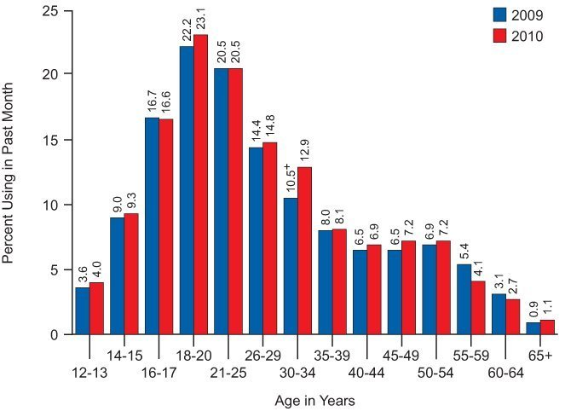
Notes:
Percent using illicit drugs in the past Month

Slide 17
Alcohol and Tobacco
Alcohol: Current (past month 2010) 51.8 percent or 131.3 million aged 12 and older.
Binge 23.1 percent or 58.6 million and heavy drinking 6.7 percent or 16.9 million.
Driving under the influence past year 11.4%.
Tobacco use (past month 2010) 27.4 percent or 69.6 million; Age 16-17 15.4%.
Cigarette smokers 23.0%, young adults not enrolled in college full time 39.9%.
Notes:
Current (past month use) – at least one drink; Binge use – five or more drinks at the same occasion on at least one day in the past month; Heavy use – five or more drinks on each of 5 or more days in the past month.
Alcohol causes as much as half of America’s criminal violence and vehicular fatalities.

Slide 18
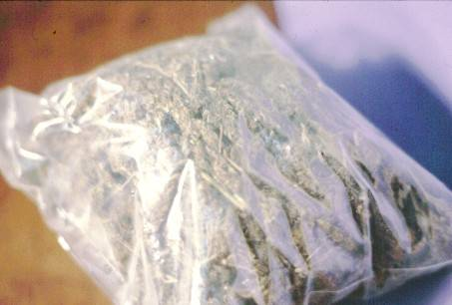
LEGAL? PRO AND CON
Bag of Marijuana
Notes:
Also what of other drugs? Pro and Con arguments are often about harder drugs including heroin and cocaine.

Slide 19
Efficacy
Prohibition: Alcohol use rates were 80 to 90 percent, tobacco 60 percent in the past. Now lower.
Drug use in Sweden one-third European average with aggressive controls.
Legalize: August Vollmer 1936. Drug addiction, like prostitution, and like liquor, is not a police problem. It is first and last a medical problem.
Stephen Rolles 2010: Prohibition on production, supply and use has not only failed but is counterproductive. HIV, secondary criminal markets and networks, endemic violence.
Notes:
Supporters of prohibition claim that prohibitive drug laws have a successful track record suppressing illicit drug use since they were introduced 100 years ago.^{[1][2]} The licit drug alcohol has current (last 12 months) user rates as high as 80-90% in populations over 14 years of age,^{[3]} and tobacco has historically had current use rates up to 60% of adult populations,^{[4]} yet the percentages currently using illicit drugs in OECD countries are generally below 1% of the population excepting cannabis where most are between 3% and 10%, with six countries between 11% and 17%.
Sweden is an excellent example. Drug use is just a third of the European average while spending on drug control is three times the EU average. For three decades,^{[nb 1]} Sweden has had consistent and coherent drug-control policies, regardless of which party is in power. There is a strong emphasis on prevention, drug laws have been progressively tightened, and extensive treatment and rehabilitation opportunities are available to users.
Legalize: August Vollmer, founder of the School of Criminology at University of California, Irvine and former president of the International Association of Chiefs of Police. In his 1936 book The Police and Modern Society, he stated his opinion that:
Stringent laws, spectacular police drives, vigorous prosecution, and imprisonment of addicts and peddlers have proved not only useless and enormously expensive as means of correcting this evil, but they are also unjustifiably and unbelievably cruel in their application to the unfortunate drug victims. Repression has driven this vice underground and produced the narcotic smugglers and supply agents, who have grown wealthy out of this evil practice and who, by devious methods, have stimulated traffic in drugs. Finally, and not the least of the evils associated with repression, the helpless addict has been forced to resort to crime in order to get money for the drug which is absolutely indispensable for his comfortable existence.
Drug addiction, like prostitution, and like liquor, is not a police problem; it never has been, and never can be solved by policemen. It is first and last a medical problem.
Stephen Rolles, writing in the British Medical Journal, 2010(?), argues:
Consensus is growing within the drugs field and beyond that the prohibition on production, supply, and use of certain drugs has not only failed to deliver its intended goals but has been counterproductive. Evidence is mounting that this policy has not only exacerbated many public health problems, such as adulterated drugs and the spread of HIV and hepatitis B and C infection among injecting drug users, but has created a much larger set of secondary harms associated with the criminal market. These now include vast networks of organised crime, endemic violence related to the drug market, corruption of law enforcement and governments.
A report sponsored by the New York County Lawyers' Association, one of the largest local bar associations in the United States, argues on the subject of US drug policy:
Notwithstanding the vast public resources expended on the enforcement of penal statutes against users and distributors of controlled substances, contemporary drug policy appears to have failed, even on its own terms, in a number of notable respects. These include: minimal reduction in the consumption of controlled substances; failure to reduce violent crime; failure to markedly reduce drug importation, distribution and street-level drug sales; failure to reduce the widespread availability of drugs to potential users; failure to deter individuals from becoming involved in the drug trade; failure to impact upon the huge profits and financial opportunity available to individual "entrepreneurs" and organized underworld organizations through engaging in the illicit drug trade; the expenditure of great amounts of increasingly limited public resources in pursuit of a cost-intensive "penal" or "law-enforcement" based policy; failure to provide meaningful treatment and other assistance to substance abusers and their families; and failure to provide meaningful alternative economic opportunities to those attracted to the drug trade for lack of other available avenues for financial advancement. Moreover, a growing body of evidence and opinion suggests that contemporary drug policy, as pursued in recent decades, may be counterproductive and even harmful to the society whose public safety it seeks to protect. This conclusion becomes more readily apparent when one distinguishes the harms suffered by society and its members directly attributable to the pharmacological effects of drug use upon human behavior, from those harms resulting from policies attempting to eradicate drug use.^{[19]}
With aid of these distinctions, we see that present drug policy appears to contribute to the increase of violence in our communities. It does so by permitting and indeed, causing the drug trade to remain a lucrative source of economic opportunity for street dealers, drug kingpins and all those willing to engage in the often violent, illicit, black market trade. Meanwhile, the effect of present policy serves to stigmatize and marginalize drug users, thereby inhibiting and undermining the efforts of many such individuals to remain or become productive, gainfully employed members of society. Furthermore, current policy has not only failed to provide adequate access to treatment for substance abuse, it has, in many ways, rendered the obtaining of such treatment, and of other medical services, more difficult and even dangerous to pursue.^{[20]}
The Economist fear [of legalisation] is based in large part on the presumption that more people would take drugs under a legal regime. There is no correlation between the harshness of drug laws and the incidence of drug-taking: citizens living under tough regimes take more drugs, not fewer.
The use of drugs by minors is much more difficult to control with drugs prohibited. To effectively regulate the sellers of drugs so as to ensure that they only sell drugs to adults, drugs must be legalized, and the sellers licensed. With drugs prohibited, sellers are "underground" and therefore nearly impossible to control

Slide 20
Deterrance
Prohibition: US ONDCP. Controls and prohibitions help to keep prices higher, and higher prices help keep use rates relatively low.
Legalize: The use of drugs by minors is much more difficult to control with drugs prohibited.
Dutch are among the lowest users of marijuana or cannabis in Europe, despite the Netherlands' policy on soft drugs being one of the most liberal in Europe.
Notes:
Prohibition: A 2001 Australian study of 18-29 year olds by the NSW Bureau of Crime Statistics and Research suggests that prohibition deters illicit drug use. 29% of those who had never used cannabis cited the illegality of the substance as their reason for never using the drug, while 19% of those who had ceased use of cannabis cited its illegality as their reason.
Gil Kerlikowske, Director of the US Office National Drug Control Policy (ONDCP) argues,
Controls and prohibitions help to keep prices higher, and higher prices help keep use rates relatively low, since drug use, especially among young people, is known to be sensitive to price. The relationship between pricing and rates of youth substance use is well-established with respect to alcohol and cigarette taxes. There is literature showing that increases in the price of cigarettes triggers declines in use.“
Legalize: The use of drugs by minors is much more difficult to control with drugs prohibited. To effectively regulate the sellers of drugs so as to ensure that they only sell drugs to adults, drugs must be legalized, and the sellers licensed. With drugs prohibited, sellers are "underground" and therefore nearly impossible to control
According to a 2009 annual report by the European Monitoring Centre for Drugs and Drug Addiction, the Dutch are among the lowest users of marijuana or cannabis in Europe, despite the Netherlands' policy on soft drugs being one of the most liberal in Europe, allowing for the sale of marijuana at "coffee shops", which the Dutch have allowed to operate for decades, and possession of less than 5 grams (0.18 oz).
British Crime Survey statistics indicated that the proportion of 16 to 24 year-olds using cannabis decreased from 28% a decade ago to 21%, with its declining popularity accelerating after the decision to downgrade the drug to class C was announced in January 2004. The BCS figures, published in October 2007, showed that the proportion of frequent users in the 16-24 age group (i.e. who were using cannabis more than once a month), fell from 12% to 8% in the past four years.

Slide 21
Gateway Drug Theory
Prohibition: The US Drug Enforcement Agency’s "2008 Marijuana Sourcebook" argues that recent research supports the gateway hypothesis …search for a better high.
Legalize: Both alcohol and tobacco tend to precede cannabis use, and it is rare for those who use hard drugs to not have used alcohol or tobacco first.
Notes:
Prohibition: The US Drug Enforcement Agency’s (DEA) "2008 Marijuana Sourcebook" argues that recent research supports the gateway hypothesis that certain drugs (such as cannabis) act as gateways to use of harder drugs such as heroin, either because of social contact or because of an increasing search for a better high.^{[41]} Proponents cite studies such as that of 311 same sex twins, where only one twin smoked cannabis before age 17, and where such early cannabis smokers were five times more likely than their twin to move on to harder drugs.^{[42]}
Legalize: A study of drug users in Amsterdam over a 10-year period conducted by Jan van Ours of Tilburg University in the Netherlands concluded that cannabis is not a stepping stone to using cocaine or heroin.
In the US, such substances as prescription painkillers appear to be more common than cannabis as the first "illicit" drug tried, and are relatively easy to obtain by adolescents. Due to the similarity between narcotics, those who become addicted to prescription painkillers sometimes move on to heroin since the latter can actually be a cheaper habit to support.
For teenagers, credibility of adults is eroded when the dangers of the "gateway" drugs are exaggerated or made up, leading them to think all anti-drug messages are nonsense.
The US Institute of Medicine found no conclusive evidence that the drug effects of marijuana are causally linked to the subsequent abuse of other illicit drugs. Several other studies National Development and Research Institute in New York and the Rand Drug Policy Research Center in Santa Monica, California
Some individuals are, for whatever reason, willing to try any substance, and the "gateway" drugs are merely the ones that are (usually) available at an earlier age than the harder drugs.

Slide 22
Health
Prohibition: Marijuana is far more powerful than it used to be.
Illegal drugs already cost $180 billion a year in health care. …addictions curb individual freedom.
Legalize: many illicit drugs pose comparatively fewer health dangers than certain legal drugs.
The risks from cannabis use.. overstated. Cannot enforce quality control on products sold and manufactured illegally.
Illegality may be dissuading research. Medical uses later discussion.
Notes:
Very messy and controversial issues. Often mix in discussions of drugs in general versus drugs such as marijuana. DEA role and responsibilities versus public views and results of non-government studies are often at opposite poles.
Prohibition: The DEA has said marijuana is far more powerful than it used to be. Note: US marijuana was very poor quality relative to Europe in the 1960’s and 1970’s. Product caught up to competition in past three decades. According to the National Institute on Drug Abuse, "Studies show that someone who smokes five joints per week may be taking in as many cancer-causing chemicals as someone who smokes a full pack of cigarettes every day." Marijuana contains more than 400 chemicals, including the most harmful substances found in tobacco smoke. For example, smoking one marijuana cigarette deposits about four times more tar into the lungs than a filtered tobacco cigarette. [...] The short-term effects are also harmful. They include: memory loss, distorted perception, trouble with thinking and problem solving, loss of motor skills, decrease in muscle strength, increased heart rate, and anxiety. Marijuana impacts young people’s mental development, their ability to concentrate in school, and their motivation and initiative to reach goals. Note: Can likely make comparative statements about tobacco and alcohol.
Gil Kerlikowske, director of the US Office of National Drug Control Policy (ONDCP) argues that in the United States, illegal drugs already cost $180 billion a year in health care, lost productivity, crime, and other expenditures, and that number would only increase under legalization because of increased use.
As is the case with alcohol addiction, illicit drug addictions likewise serve to keep many such users functionally in poverty and often as a continued burden on friends, family and society.
Legalize: There is evidence that many illicit drugs pose comparatively fewer health dangers than certain legal drugs. The health risks of MDMA (Ecstasy) have been exaggerated for instance, the risks from cannabis use also overstated, and health problems from the use of legal substances, particularly alcohol and tobacco, are greater, even than from cocaine use for example. Occasional cocaine use does not typically lead to severe or even minor physical or social problems.
More on health benefit arguments later.
World Health Organization report: "As cannabis is an illegal drug its cultivation, harvesting and distribution are not subject to quality control mechanisms to ensure the reliability and safety of the product used by consumers. …The government cannot enforce quality control on products sold and manufactured illegally.
The illegality of many recreational drugs may be dissuading research into new, more effective and perhaps safer recreational drugs.
Taking into account deaths from non-illegal drugs leaves only 21 percent of CDC "drug-induced death" figures actually due to the use of "illegal" drugs.

Slide 23
Economics
Prohibition: DEA-- "compared to the social costs of drug abuse and addiction—whether in taxpayer dollars or in pain and suffering—government spending on drug control is minimal.
Legalize: US drug prohibition $350 million budget in 1971, by 2006 was a US$ 30 billion. Only direct prohibition enforcement expenditures.
Total cost of prohibition much higher. Cost of incarcerating 500,000 prisoners as a starter. Impacts on Mexico, Columbia, Afghanistan.
Notes:
Prohibition: The tax revenue collected from alcohol pales in comparison to the costs associated with it. Federal excise taxes collected on alcohol in 2007 totaled around $9 billion; states collected around $5.5 billion. Taken together, this is less than 10 percent of the over $185 billion in alcohol-related costs from health care, lost productivity, and criminal justice. Tobacco also does not carry its economic weight when we tax it; each year we spend more than $200 billion on its social costs and collect only about $25 billion in taxes.
— Gil Kerlikowske, current director of the US ONDCP (April 2010). Why Marijuana Legalization Would Compromise Public Health and Public Safety.
Legalize: The United States efforts at drug prohibition started out with a US$ 350 million budget in 1971, and was in 2006 a US$ 30 billion campaign. These numbers only include direct prohibition enforcement expenditures, and as such only represent part of the total cost of prohibition. Economic impact of holding 500,000 prisoners on prohibition violations for one.
The war on drugs is extremely costly to such societies that outlaw drugs in terms of taxpayer money, lives, productivity, the inability of law enforcement to pursue mala in se crimes, and social inequality. ….financial and social costs of drug law enforcement far exceed the damages that the drugs themselves cause.
It has been argued that if the US government legalized marijuana it would save $7.7 billion per year in expenditure on enforcement of prohibition. Also, that marijuana legalization would yield tax revenue of $2.4 billion annually if it were taxed like all other goods and $6.2 billion annually if it were taxed at rates comparable to those on alcohol and tobacco.
if you look at the drug war from a purely economic point of view, the role of the government is to protect the drug cartel. That's literally true.
—Milton Friedman^{[95]}
The United States' "War on Drugs" has added considerably to the political instability in South America. has allowed criminal, paramilitary and guerrilla groups to reap huge profits. Afghanistan went from producing practically no illegal drugs in 2000 (following banning by the Taliban), to cultivating what is now as much as 90% of the world's opium.
Rural farmers in the poor regions. crops are frequently destroyed by U.S.-sponsored eradication treatments (usually sprayed from the air with varying degrees of discrimination), whether or not the farmers directly supply the cocaine trade.

Slide 24
Crime, Terrorism and Social Order
Prohibition: Arguments, but mostly outdated and geared toward harder drugs other than marijuana. Also similar as those regarding alcohol use.
Legalize: Will lower smuggling and drug cartel profits. Lower profits means less violence and fewer homicides. Less police and other corruption.
Less stigma of convictions will help employment and educational attainment. Fewer adolescents in drug trade. Social order benefits.
Notes:
Prohibition: The US Drug Enforcement Administration claims: Crime, violence and drug use go hand in hand. Six times as many homicides are committed by people under the influence of drugs, as by those who are looking for money to buy drugs. ; they’re committed by people on drugs.
—US Drug Enforcement Administration (2003). "Speaking Out Against Drug Legalization“
Late 1990’s Drug Use Forecasts statements
Frequent use of hard drugs is one of the strongest indicators of a criminal career.
Offenders who use drugs are among the most serious and active criminals, engaging in both property and violent crime.
Early and persistent use of cocaine or heroin in the juvenile years is an indicator of serious, persistent criminal behavior in adulthood.
Those arrested who are drug users are more likely than those not using drugs to be rearrested on pretrial release or fail to appear at trial. Late 1990’s statements.
Legalize: Violence and profits of drugs traffickers:
Prohibition protects the drug cartel insofar as it keeps the distribution in the black market and creates the risk that makes smuggling profitable. We are loved by the drug cartels.
Drug money has been called a major source of income for terrorist organizations. Note unclear how important this is. US government agencies and government officials have been caught trafficking drugs to finance US-supported terrorist actions in events such as the Iran-Contra Affair, and Manuel Noriega.
Corruption :Human rights organizations and legal scholars have claimed that drug prohibition inevitably leads to police corruption.
Stigma of conviction: Despite the fact that most drug offenders are non-violent, the stigma attached to a conviction can prevent employment and education.
Children being lured into the illegal drug trade: The lack of government regulation and control over the lucrative illegal drug market has created a large population of unregulated drug dealers who lure many children into the illegal drug trade. The U.S. government's most recent 2009 National Survey on Drug Use and Health (NSDUH) reported that nationwide over 800,000 adolescents ages 12–17 sold illegal drugs during the previous 12 months preceding the survey.

Slide 25
Civil Rights
Prohibition: no point in having criminal laws unless those caught breaking them will at least face prosecution.
Legalize: Cognitive liberty. What persons do in private should not be regulated by the government as long as they do not harm others.
Drug use is a victimless crime. The government does not forbid overeating. Compares with freedom of thought.
Notes:
The Christian Institute argues that there is no point in having criminal laws unless those caught breaking them will at least face prosecution.
Drug Free Australia argues "The notion that illicit drug use is a victimless crime and that everyone should be free to do what they want with their body disregards the web of social interactions that constitute human existence. Affected by an individual’s illicit drug use are children, parents, grandparents, friends, colleagues, work, victims of drugged drivers, crime victims, elder abuse, sexual victims, patients made sicker by medical marijuana etc. Illicit drug use is no less victimless than alcoholism.
Legalize: Cognitive liberty: Authors such as Aldous Huxley, and Terence McKenna believed what persons do in private should not be regulated by the government. It is argued that persons should be able to do whatever they want with their bodies, including the recreational use of drugs, as long as they do not harm others. Such arguments often cite the harm principle of philosopher John Stuart Mill who urged that the state had no right to intervene to prevent individuals from doing something that harmed them, if no harm was thereby done to the rest of society: 'Over himself, over his own body and mind, the individual is sovereign' and 'The only purpose for which power can be rightfully exercised over any member of a civilized community, against his will, is to prevent harm to others. His own good, either physical or moral, is not sufficient warrant.' The argument is that drug use is a victimless crime and as such the government has no right to prohibit it or punish drug consumers, much like the government does not forbid overeating, which causes significantly more deaths per year. This can be equated with the quest for freedom of thought.

Slide 26
Politics
Prohibition: sending out signals should be a consideration of drug policy.
Reality "Talking sense about drug policy in today's climate of opinion can be political suicide.“
Legalize: "Criminal law is supposed to prevent crime, not 'send out' public health messages".
Notes:
Prohibition: Previous UK Home Office Minister Vernon Coaker 2006: Argues that sending out signals should be a consideration of drug policy.
John Donnelly, writing for the Boston Globe on the presidential race of 2000, suggested that the candidates' silence on drug policy may stem from a widely shared belief that any position even hinting at reducing penalties for drug use would be political suicide. Charles R. Schuster, director of the National Institute on Drug Abuse under Presidents Reagan and Bush (Snr.), was reported as saying in 1997, "Talking sense about drug policy in today's climate of opinion can be political suicide.“
Legalize: The Science and Technology Committee appointed by the House of Commons to inquire into the Government's handling of scientific advice, risk and evidence in policy making agreed with Transform Drug Policy Foundation's view that "Criminal law is supposed to prevent crime, not 'send out' public health messages". Transform warned that sending out signals could backfire by "fostering distrust of police and public health messages amongst young people".

Slide 27
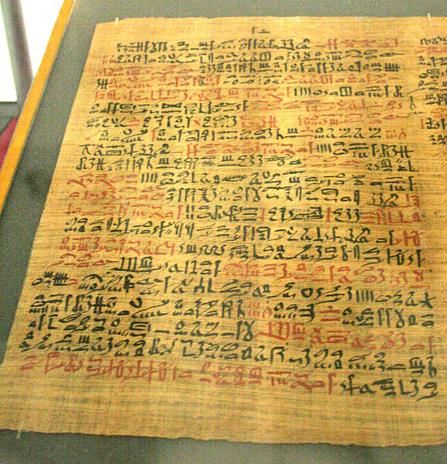
Medical Marijuana
The Ebers Papyrus (ca. 1550 BCE) from Ancient Egypt has a prescription for medical marijuana applied directly for inflammation
Notes:
The Cannabis plant has a long history of use as medicine, with historical evidence dating back to 2737 BCE.^{[1]} Cannabis is one of the 50 "fundamental" herbs of traditional Chinese medicine,^{[2]} and is prescribed to for a broad range of indications.
Supporters of medical cannabis argue that cannabis does have several well-documented beneficial effects. Among these are: the amelioration of nausea and vomiting, stimulation of hunger in chemotherapy and AIDS patients, lowered intraocular eye pressure (shown to be effective for treating glaucoma), as well as gastrointestinal illness. Its effectiveness as an analgesic (pain reliever) has been suggested—and disputed—as well.
There are several methods for administration of dosage, including vaporizing or smoking dried buds, drinking, or eating extracts, and taking capsules. The comparable efficiency of these methods was the subject of an investigative study^{[6]} conducted by the National Institutes of Health.
Synthetic cannabinoids are available as prescription drugs in some countries. Examples are Marinol (The United States and Canada) and Cesamet (Canada, Mexico, the United Kingdom, and the United States).
Many countries are beginning to entertain varying levels of decriminalization for medical usage, including Canada, Austria, Germany, Switzerland, the Netherlands, Czech Republic, Spain, Israel, Italy, Finland, and Portugal. In the United States, federal law outlaws all use of herb parts from Cannabis, while some states have approved use of herb parts from Cannabis as medical cannabis in conflict with federal law. The United States Supreme Court has ruled in United States v. Oakland Cannabis Buyers' Coop and Gonzales v. Raich that the federal government has a right to regulate and criminalize cannabis, even for medical purposes.
A 2002 review of medical literature by Franjo Grotenhermen states that medical cannabis has established effects in the treatment of nausea, vomiting, premenstrual syndrome, unintentional weight loss, insomnia, and lack of appetite. Other "relatively well-confirmed" effects were in the treatment of "spasticity, painful conditions, especially neurogenic pain, movement disorders, asthma, [and] glaucoma".^{[7]}
Preliminary findings indicate that cannabis-based drugs could prove useful in treating inflammatory bowel disease, migraines, fibromyalgia, and related conditions.^{[8]}
Medical cannabis has also been found to relieve certain symptoms of multiple sclerosis^{[9]} and spinal cord injuries^{[10][11][12]} by exhibiting antispasmodic and muscle-relaxant properties as well as stimulating appetite.
Other studies state that cannabis or cannabinoids may be useful in treating alcohol abuse,^{[13]} amyotrophic lateral sclerosis,^{[14][15]} collagen-induced arthritis,^{[16]} asthma,^{[17]} atherosclerosis,^{[18]} bipolar disorder,^{[19][20]} colorectal cancer,^{[21]} HIV-Associated Sensory Neuropathy^{[22]} depression,^{[23][24][25][26]} dystonia,^{[27]} epilepsy,^{[28][29][30]} digestive diseases,^{[31]} gliomas,^{[32][33]} hepatitis C,^{[34]} Huntington's disease,^{[35]} leukemia,^{[36]} skin tumors,^{[37]} methicillin-resistant Staphylococcus aureus (MRSA),^{[38]} Parkinson's disease,^{[39]} pruritus,^{[40][41]} posttraumatic stress disorder (PTSD),^{[42]} psoriasis,^{[43]} sickle-cell disease,^{[44]} sleep apnea,^{[45]} and anorexia nervosa.^{[46]}

Slide 28
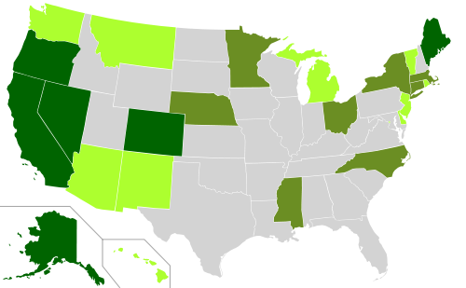
Notes:
Twenty three states have made changes
Dark green: 7 States with both medical and decriminalization laws. Alaska, California, Colorado, Maine, Nevada, and Oregon. *Note: Connecticut bill signed into law June 1, 2012.
Light green: 9 States with legal medical cannabis. Arizona, Delaware, Hawaii, Montana, New Jersey, Rhode Island, New Mexico, Vermont, and Washington.
Medium green: 7 States with decriminalized cannabis possession laws. Connecticut*, Massachusetts, Michigan, Mississippi, Nebraska, New York, North Carolina, and Ohio.
States whose medical marijuana bills failed in 2012. Alabama, Idaho, Indiana, Iowa, Kansas, Maryland, Mississippi, New Hampshire, Tennessee, and Wisconsin..
Six states have pending legislation to legalize medical marijuana. Illinois, Massachusetts, Missouri, New York, Ohio, and Pennsylvania.
State with pending legislation that is favorable towards medical marijuana but would not legalize its use. Kentucky

Slide 29
The War on Drugs – The Result
The US has 760 incarcerated persons per 100,000 citizens. Japan 63, Germany 90, Britain 153, Mexico 208, Brazil 242. In 1980 the US rate was 150.
The US makes up 5 percent of the worlds population but we make up 25 percent of the worlds incarcerated persons.
In 2009 alone, 1.66 million Americans were arrested on drug charges. And 4 out of 5 of those arrests were simply for possession including 750,000 for marijuana).
Notes:
Approximately half a million people are in prison or jail for a drug offense today, compared to an estimated 41,000 in 1980. An increase of 1100 percent. In 2005 four out of five drug arrests were for possession, and only one out of five was for sales. Moreover, most people in state prison for drug offenses have no history of violence or significant selling activity.
By the end of 2007 more than 7 million Americans—or one in every 31 adults—were behind bars, on probation or on parole.

Slide 30
The War on Drugs the Result 2
Over the past four decades, the US has spent more than $1 trillion fighting the war on drugs
The money spent on prisons has risen at six times the rate spent on higher education in the past 20 years.
In California it costs $8,667 per college student per year; a prisoners costs $45,006 a year.
The result is gruesome at every level.
Source: Time Magazine March 25, 2012 Fareed Zakaria, Editor-at-Large, CNN Host, etc.
Notes:
The WSJ in April suggests major increases in alcohol taxes for revenue for programs and to discourage use, and moderate but firm punishments with rehabilitative opportunities to break offenders of habits. A lot of details and options to be considered.

Slide 31
Criminal Justice Today
The United States has the highest documented incarceration rate in the world. At the end of 2009 it was 743 adults incarcerated per 100,000 population or more than 1 percent of the adult population.
In total 7,225,800 adults were under correctional supervision (probation, parole, jail, or in prison—about 3.1% of adults in the U.S. Resident population.
70% of prisoners(not jail inmates) are non-whites.
61.5% of Virginia prisoners are African-American.
Over 20 percent or 243,000 African-Americans in Virginia are disenfranchised and cannot vote.
Notes:
In 2008 the breakdown for adults under correctional control was as follows: one out of 18 men, one in 89 women, one in 11 African-Americans (9.2 percent), one in 27 Latinos (3.7 percent), and one in 45 Caucasians (2.2 percent).
In recent decades the U.S. has experienced a surge in its prison population, quadrupling since 1980, partially as a result of mandatory sentencing that came about during the "war on drugs." Violent crime and property crime have declined since the early 1990s
The state prison population increased from 2000 through 2008, the expected length of stays for these offenders declined slightly during this period.
Violent crime was not responsible for the quadrupling of the incarcerated population in the United States from 1980 to 2003. Violent crime rates had been relatively constant or declining over those decades. The prison population was increased primarily by public policy changes causing more prison sentences and lengthening time served, e.g. through mandatory minimum sentencing, "three strikes" laws, and reductions in the availability of parole or early release. These policies were championed as protecting the public from serious and violent offenders, but instead yielded high rates of confinement for nonviolent offenders. Nearly three quarters of new admissions to state prison were convicted of nonviolent crimes. Only 49 percent of sentenced state inmates were held for violent offenses. Perhaps the single greatest force behind the growth of the prison population has been the national "war on drugs." The number of incarcerated drug offenders has increased twelvefold since 1980. In 2000, 22 percent of those in federal and state prisons were convicted on drug charges.

Slide 32
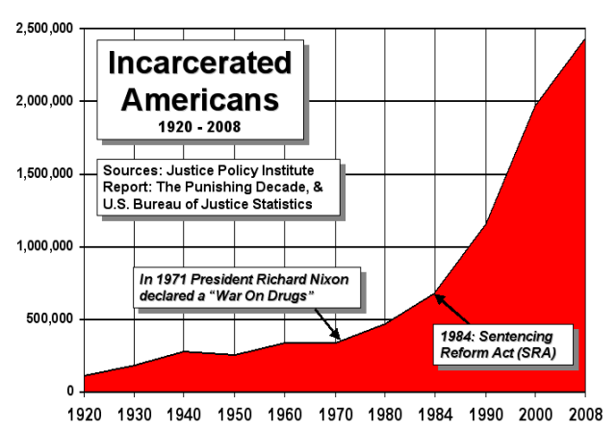
Notes:
A Sick Society

Slide 33
The New Jim Crow
A “War on Drugs”, a perfect outgrowth of the 1964 Civil Rights Act. 1968 election Richard Nixon and George Wallace “law and order” theme. Nixon called for a “war on drugs—public enemy number one.”
Reagan 1980 condemned “welfare queens” and “criminal predators” (presumably race neutral); formally launched “War on Drugs”.
Notes:
In the 1968, race a powerful wedge breaking up what had become a solid liberal coalition based on economic interests of the poor and the working and lower-middle classes. As Nixon remarked it’s all about those damn Negro-Puerto Rican groups out there. Busing, Viet-Nam War, Watergate.
Between 1980 and 1984 FBI antidrug funding increased from $8 million to $95 million. DOD antidrug funds grew from 33 million in 1981 to $1,042 million in 1991, and in same period DEA antidrug spending grew from $86 million to $1,042 million. The budget for the National Institute on Drug Abuse was reduced from $274 million to $57 million and drug prevention Education from $14 to $3 million.
1986 “crack” named “issue of the year” by time magazine. Len Bias case summer 1986 erroneously reported due to “crack”. Media frenzy.

Slide 34
The New Jim Crow 2
1988 George Bush, Sr. decimated Dukakis with Willie Horton ad (escaped on work furlough, committed rape White Woman!). “1989 drugs most pressing problem facing nation.”
Bill Clinton 1992 “I can be nicked a lot, but no one can say I am soft on crime.” “Three strikes, you’re out”, “tough on crime polices” resulted in the largest increases in federal and state prison inmates of any president in American history. 90% admitted to prison for drug offenses were black or Latino. The New Jim Crow was born
Notes:
How the criminal justice system really works to cage blacks and browns:
Roundup. Police conduct drug operations primarily in poor communities of color. Police departments are rewarded in cash—through forfeiture laws and federal grant programs—for rounding up as many people as possible. Operate unconstrained by constitutional rules of procedures. Can stop, interrogate, and search anyone they choose for drug investigations once they get “consent”. No meaningful check on police discretion, racial bias are given free rein. Can rely on race as a factor in selecting whom to stop and search (even thought people of color are no more likely to be guilty of drug crimes than whites.
Conviction: Once arrested defendants are generally denied meaningful legal representation and pressured to plead guilty whether they are or not. Prosecutors are free to “load up” defendants with extra charges, and their decisions cannot be challenged for racial bias. Once convicted, due to the drug war’s harsh sentencing laws, drug offenders in the U.S. spend more time in the justice system’s formal control—in jail or prison, on probation or parole—then anywhere else in the world. The control may last a lifetime but the vast majority are released from their cells to a much larger, invisible cage.
Invisible punishment. Criminal sanctions imposed on individuals after they are released, a system that operates outside of the public view and takes effect outside the traditional sentencing framework. Sanctions are imposed by operation of the law rather then decision of a sentencing judge. They often have more impact on one’s life course than does the months behind bars. Laws operate collectively to ensure vast majority of convicted offenders will never integrate into mainstream, white society. They will be discriminated against, legally for the rest of their lives—denied employment (most employers use the box have you ever been convicted of a crime, professional licensing restrictions abound), housing (public Section 8 housing, at least for five years and a lifetime of public and private discrimination), education (Pew grants and federal assistance) and public benefits (welfare five year ban, TANF food stamps lifetime ban for drug offenders,. Initially they may be sentenced to a term of probation, community service and court costs. Even if working they may face “debtor’s prison” as a result of not being able to pay their fines. Most states have voting restrictions or disenfranchisement (Virginia is one of the most punitive in the country) and you will be excluded from serving on juries.
The difficulties of basic existence, day-to-day living, carrying for family members, avoiding any violations that would violate probation rules, surviving without going to public shelters and hosts of other problems coupled with recovery from substance abuse, paying off fines and court fees are frequently overwhelming even for ex-offenders that do not have mental problems. For racial (black and brown) and ethnic minorities where discrimination can be a serious issue the task is even more difficult.

Slide 35
International Unintended Consequences
Impacts on producer, transit and consumer countries:
Growth of a ‘huge criminal black market’.
Policy displacement to fund vast law enforcement effort.
Geographical displacement, production shifts location to avoid attention of law enforcement.
Notes:
UNINTENDED CONSEQUENCES
The implementation of the war on drugs has generated widespread negative consequences for societies in producer, transit and consumer countries. These negative consequences were well summarized by the former Executive Director of the United Nations Office on Drugs and Crime, Antonio Maria Costa, as falling into five broad categories:
The growth of a ‘huge criminal black market’, financed by the risk-escalated profits of supplying international demand for illicit drugs.
2. Extensive policy displacement, the result of using scarce resources to fund a vast law enforcement effort intended to address this criminal market.
3. Geographical displacement, often known as ‘the balloon effect’, whereby drug production shifts location to avoid the attentions of law enforcement.

Slide 36
International Unintended Consequences 2
4. Substance displacement when previous choice of drug is difficult to obtain due to law enforcement.
5. The perception and treatment of drug users, who are stigmatized, marginalized and excluded.
Notes:
UNINTENDED CONSEQUENCES
The implementation of the war on drugs has generated widespread negative consequences for societies in producer, transit and consumer countries. These negative consequences were well summarized by the former Executive Director of the United Nations Office on Drugs and Crime, Antonio Maria Costa, as falling into five broad categories:
4. Substance displacement, or the movement of consumers to new substances when their previous drug of choice becomes difficult to obtain, for instance through law enforcement pressure.
5. The perception and treatment of drug users, who are stigmatized, marginalized and excluded.

Slide 37
What to Do?
U.S. taxpayers have spent an estimated $2.5 trillion on the "war on drugs" since former President Richard Nixon first declared it in 1971. With the U.S. federal government so far in debt, it is well overdue that this type of expenditure come under greater scrutiny. CNN June 2011.
The United States needs to get whole heartedly behind the recommendations of the Global Commission on Drug Policy.
Notes:
Blank

Slide 38
WAR ON DRUGS
Report of the Global Commission on Drug Policy. June 2011 www.globalcommissionondrugs.org
19 Commissioners including George P Schultz, former Secretary of State, US (honorary chair), Paul Volcker, for Chairman of the United States Federal Reserve and the Economic Recovery Board and Kofi Annan, former Secretary General of the United Nations.
Notes:
The global war on drugs has failed, with devastating consequences for individuals and societies around the world. Fifty years after the initiation of the UN Single Convention on Narcotic Drugs, and 40 years after President Nixon launched the US government’s war on drugs, fundamental reforms in national and global drug control policies are urgently needed.
Vast expenditures on criminalization and repressive measures directed at producers, traffickers and consumers of illegal drugs have clearly failed to effectively curtail supply or consumption. Apparent victories in eliminating one source or trafficking organization are negated almost instantly by the emergence of other sources and traffickers. Repressive efforts directed at consumers impede public health measures to reduce HIV/AIDS, overdose fatalities and other harmful consequences of drug use. Government expenditures on futile supply reduction strategies and incarceration displace more cost-effective and evidence-based investments in demand and harm reduction.

Slide 39
Global Report Principles
1. Drug policies must be based on solid empirical and scientific evidence. The primary measure of success should be the reduction of harm to the health, security and welfare of individuals and society.
2. Drug policies must be based on human rights and public health principles. We should end the stigmatization and marginalization of people who use certain drugs and those involved in the lower levels of cultivation, production and distribution, and treat people dependent on drugs as patients, not criminals
Notes:
Drug policies were initially developed and implemented in the hope of achieving outcomes in terms of a reduction in harms to individuals and society – less crime, better health, and more economic and social development. However, we have primarily been measuring our success in the war on drugs by entirely different measures – those that report on processes, such as the number of arrests, the amounts seized, or the harshness of punishments. These indicators may tell us how tough we are being, but they do not tell us how successful we are in improving the ‘health and welfare of mankind’.
2 Of particular relevance to drug policy are the rights to life, to health, to due process and a fair trial, to be free from torture or cruel, inhuman or degrading treatment, from slavery, and from discrimination. These rights are inalienable.
A number of well-established and proven public health measures (generally referred to as harm reduction, an approach that includes syringe access and treatment using the proven medications methadone or buprenorphine) can minimize the risk of drug overdose deaths and the transmission of HIV and other blood-borne infections. However, governments often do not fully implement these interventions, concerned that by improving the health of people who use drugs, they are undermining a ‘tough on drugs’ message. This is illogical – sacrificing the health and welfare of one group of citizens when effective health protection measures are available is unacceptable, and increases the risks faced by the wider community.

Slide 40
Global Report Principles Continued
3. The development and implementation of drug policies should be a global shared responsibility, but also needs to take into consideration diverse political, social and cultural realities.
4. Drug policies must be pursued in a comprehensive manner, involving families, schools, public health specialists, development practitioners and civil society leaders, in partnership with law enforcement agencies and other relevant governmental bodies.
Notes:
3. Policies should respect the rights and needs of people affected by production, trafficking and consumption, as explicitly acknowledged in the 1988 Convention on Drug Trafficking.
The UN drug control system is built on the idea that all governments should work together to tackle drug markets and related problems.
However, the idea of shared responsibility has too often become a straitjacket that inhibits policy development and experimentation. The UN (through the International Narcotics Control Board), and in particular the US (notably through its ‘certification’ process), have worked strenuously over the last 50 years to ensure that all countries adopt the same rigid approach to drug policy – the same laws, and the same tough approach to their enforcement.
As national governments have become more aware of the complexities of the problems, and options for policy responses in their own territories, many have opted to use the flexibilities within the Conventions to try new strategies and programs, such as decriminalization initiatives or harm reduction programs. When these involve a more tolerant approach to drug use, governments have faced international diplomatic pressure to ‘protect the integrity of the Conventions’, even when the policy is legal, successful and supported in the country.
Despite the fact that successive studies have shown19 that the indigenous practice of coca leaf chewing is associated with none of the harms of international cocaine markets, and that a clear majority of the Bolivian population (and neighboring countries) support this change, many of the rich ‘cocaine consumer’ countries (led by the US) have formally objected to the amendment.
The idea that the international drug control system is immutable, and that any amendment – however reasonable or slight – is a threat to the integrity of the entire system, is short-sighted.
4. With their strong focus on law enforcement and punishment, it is not surprising that the leading institutions in the implementation of the drug control system have been the police, border control and military authorities directed by Ministries of Justice, Security or Interior. At the multilateral level, regional or United Nations structures are also dominated by these interests.
Although governments have increasingly recognized that law enforcement strategies for drug control need to be integrated into a broader approach with social and public health programs, the structures for policymaking, budget allocation, and implementation have not modernized at the same pace.
These institutional dynamics obstruct objective and evidence-based policymaking. Repeated studies have demonstrated that governments achieve much greater financial and social benefit for their communities by investing in health and social programs, rather than investing in supply reduction and law enforcement activities. However, in most countries, the vast majority of available resources are spent on the enforcement of drug laws and the punishment of people who use drugs.
Global drug policy should be created from the shared strategies of all interested multilateral agencies – UNODC of course, but also UNAIDS, WHO, UNDP, UNICEF, UN Women, the World Bank, and the Office of the High Commissioner on Human Rights.

Slide 41
RECOMMENDATION 1
Break the taboo. Pursue an open debate and promote policies that effectively reduce consumption, and that prevent and reduce harms related to drug use and drug control policies. Increase investment in research and analysis into the impact of different policies and programs.
repressive strategies will not solve the drug problem, and the war on drugs has not, and cannot, be won.

Slide 42
RECOMMENDATIONS 2,3
Replace the criminalization and punishment of people who use drugs with the offer of health and treatment services to those who need them.
Encourage experimentation by governments with models of legal regulation of drugs (with cannabis, for example) that are designed to undermine the power of organized crime and safeguard the health and security of their citizens.
Notes:
Countries that have introduced decriminalization, or other forms of reduction in arrest or punishment, have not seen the rises in drug use or dependence rates that had been feared. Examples cited include Portugal, Netherlands, and Western Australia.
National authorities and the UN need to review the scheduling of different substances. The current schedules, designed to represent the relative risks and harms of various drugs, were set in place 50 years ago when there was little scientific evidence on which to base these decisions. This has resulted in some obvious anomalies – cannabis and coca leaf, in particular, now seem to be incorrectly scheduled and this needs to be addressed.

Slide 43
Recommendations 4,5,6
Establish better metrics, indicators and goals to measure progress.
Challenge, rather than reinforce, common misconceptions about drug markets, drug use and drug dependence.
Countries that continue to invest mostly in a law enforcement approach (despite the evidence) should focus their repressive actions on violent organized crime and drug traffickers, in order to reduce the harms associated with the illicit drug market.
Notes:
4. The impact of most drug strategies are currently assessed by the level of crops eradicated, arrests, seizures and punishments applied to users, growers and dealers.
A new set of indicators is needed to truly show the outcomes of drug policies, according to their harms or benefits for individuals and communities – for example, the number of victims of drug market-related violence and intimidation; the level of corruption generated by drug markets; the level of petty crime committed by dependent users; levels of social and economic development in communities where drug production, selling or consumption are concentrated; the level of drug dependence in communities; the level of overdose deaths; and the level of HIV or hepatitis C infection among drug users. Policymakers can and should articulate and measure the outcome of these objectives.
5. “people who use drugs are ‘amoral addicts’, and all those involved in drug markets are ruthless criminal masterminds.” The reality is much more complex. The United Nations makes a conservative estimate that there are currently 250 million illicit drug users in the world, and that there are millions more involved in cultivation, production and distribution. We simply cannot treat them all as criminals.
Of the estimated 250 million drug users worldwide, the United Nations estimates that less than 10 percent can be classified as dependent, or ‘problem drug users’.
• Most people involved in the illicit cultivation of coca, opium poppy, or cannabis are small farmers struggling to make a living for their families. Alternative livelihood opportunities are better investments than destroying their only available means of survival.
• The factors that influence an individual’s decision to start using drugs have more to do with fashion, peer influence, and social and economic context, than with the drug’s legal status, risk of detection, or government prevention messages.
• The factors that contribute to the development of problematic or dependent patterns of use have more to do with childhood trauma or neglect, harsh living conditions, social marginalization, and emotional problems, rather than moral weakness or hedonism.
Most people involved in drug trafficking are petty dealers and not the stereotyped gangsters from the movies – the vast majority of people imprisoned for drug dealing or trafficking are ‘small fish’ in the operation (often coerced into carrying or selling drugs), who can easily be replaced without disruption to the supply.
6. On the other hand, where drug markets are diverse and well-established, preventing drug use by stopping supply is not a realistic objective. Note: The United States is a good example. Easy to catch fish, which we do with over enthusiasm. Very difficult to catch “major” cartel operators.
Poorly designed drug law enforcement practices can actually increase the level of violence, intimidation and corruption associated with drug markets. Law enforcement agencies and drug trafficking organizations can become embroiled in a kind of ‘arms race’, in which greater enforcement efforts lead to a similar increase in the strength and violence of the traffickers. In this scenario, the conditions are created in which the most ruthless and violent trafficking organizations thrive. Unfortunately, this seems to be what we are currently witnessing in Mexico and many other parts of the world.

Slide 44
RECOMMENDATIIONS 7,8,9
Promote alternative sentences for small-scale and first-time drug dealers.
Invest more resources in evidence-based prevention, with a special focus on youth.
Offer a wide and easily accessible range of options for treatment and care for drug dependence with special attention to those most at risk, including those in prisons and other custodial settings.
Notes:
7. The majority of people arrested for small-scale drug selling are not gangsters or organized criminals. They are young people who are exploited to do the risky work of street selling, dependent drug users trying to raise money for their own supply, or couriers coerced or intimidated into taking drugs across borders.
These people are generally prosecuted under the same legal provisions as the violent and organized criminals who control the market, resulting in the indiscriminate application of severe penalties.
8. Clearly, the most valuable investment would be in activities that stop young people from using drugs in the first place, and that prevent experimental users from becoming problematic or dependent users. Prevention of initiation or escalation is clearly preferable to responding to the problems after they occur.
Simplistic ‘just say no’ messages do not seem to have a significant impact.
Successful models of prevention have tended to target particular groups at risk – gang members, children in care, or in trouble at school or with the police – with mixed programs of education and social support that prevent a proportion of them from developing into regular or dependent drug users. Implemented to a sufficient scale, these programs have the potential to reduce the overall numbers of young people who become drug dependent or who get involved in petty dealing.
9. Including substitution and heroin-assisted treatment.
In all societies and cultures, a proportion of individuals will develop problematic or dependent patterns of drug use, regardless of the preferred substances in that society or their legal status.
Preventing and treating drug dependence is therefore a key responsibility of governments – and a valuable investment, since effective treatment can deliver significant savings in terms of reductions in crime and improvements in health and social functioning.
Abusive practices carried out in the name of treatment – such as forced detention, forced labor, physical or psychological abuse – that contravene human rights standards by subjecting people to cruel, inhuman and degrading treatment, or by removing the right to self-determination, should be abolished. Governments should ensure that their drug dependence treatment facilities are evidence-based and comply with international human rights standards.

Slide 45
RECOMMENDATIONS 10,11
The United Nations system must provide leadership in the reform of global drug policy.
Act urgently: the war on drugs has failed, and policies need to change now.
Getting drug policy right is not a matter for theoretical or intellectual debate – it is one of the key policy challenges of our time.
Notes:
10, While national governments have considerable discretion to move away from repressive policies, the UN drug control system continues to act largely as a straitjacket, limiting the proper review and modernization of policy. For most of the last century, it has been the US government that has led calls for the development and maintenance of repressive drug policies.
It will be necessary, though, for the US to follow up new rhetoric (President Obama himself acknowledging the futility of a ‘war on drugs’ and the validity of a debate on alternatives with real reform), by reducing its reliance on incarceration and punishment of drug users, and by using its considerable diplomatic influence to foster reform in other countries.
There are a number of ways to make progress on this objective. For a start, the UN could initiate a wide-ranging commission to develop a new approach; UN agencies could create new and stronger structures for policy coordination; and the UNODC could foster more meaningful program coordination with other UN agencies such as the WHO, UNAIDS, UNDP, or the Office of the UN High Commissioner for Human Rights.
11. There are approaches that have been proven to tackle these problems that countries can pursue now. Getting drug policy right is not a matter for theoretical or intellectual debate – it is one of the key policy challenges of our time.

