Slide 1
The Changing Faces of US Media Today
Dr. Richard T. Craig

Slide 2
What is the purpose of the media: to educate and inform or to prod people into specific action?

Slide 3
Culture and the Evolution of Mass Communication
Mass media are the cultural industries that produce and distribute:
Songs
Novels
TV shows
Newspapers
Movies
Video games
Internet Services

Slide 4
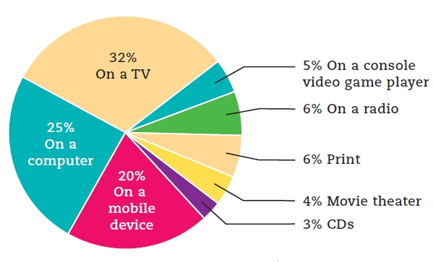
Figure 1.1: Daily Media Consumption by Platform, 2010 (8- to 18-Year-Olds)

Slide 5
Cultural Model for Mass Communication
Recognizes that individuals bring diverse meanings to messages
Audiences actively affirm, interpret, refashion, or reject the messages and stories that flow through various media channels

Slide 6
Eras in Communication
Oral communication
Written communication
Printed communication
Electronic communication
Digital communication

Slide 7
The Digital Era
Digital communication redefined news and social interaction.
Bloggers have become an important part of the news industry.
E-mail has assumed some of the functions of the postal service.
Social media like Twitter and Facebook connect people in a new way.

Slide 8
Media Convergence
Dual roles
Technological merging of content across different media channels
Cross platform, the consolidation of media holdings under one corporate umbrella

Slide 9
Media Convergence and Cultural Change
Changes in how we consume and engage with media culture
Watch TV shows on Hulu and Netflix or DVR/On-Demand options
Make media choices based on social media recommendations
Upload our own media
Discuss programs as we watch them through “live-tweeting”

Slide 10
The Impact of Media Convergence and Mobile Media
Media consumption is mobile and flexible.
Merging of media onto one device blurs distinctions between what used to be separate media
Formats are morphing
We can experience media in multiple manners simultaneously

Slide 11
Stories: The Foundation of Media
Stories we seek and tell are changing in the digital era.
Reality TV and social media dominate.
Ordinary citizens are able to participate in, and have an effect on, stories told in the media.
Media institutions and outlets are in the narrative business.

Slide 12
Contemporary Culture
Cultural critics are concerned about:
The quality of contemporary culture
The overwhelming amount of information now available
How much the media shape society is still unknown.

Slide 13
NEWS

Slide 14
The Penny Press Era: Newspapers Become Mass Media
Penny papers
Made possible by technology
Sold on the street
New York Sun
Favored human-interest stories
New York Morning Herald
Independent paper for middle- and working-class readers

Slide 15
The Penny Press Era: Newspapers Become Mass Media (cont.)
Penny papers were innovative.
Reported local news and crime
Separated news and editorial
Neutral toward advertisers
Associated Press
Founded by six New York newspapers in 1848
First major news wire service

Slide 16
The Age of Yellow Journalism: Sensationalism and Investigation
Yellow journalism
Overly dramatic stories and investigative journalism
New York World
Pulitzer encouraged plain writing and the inclusion of illustrations.
New York Journal
Hearst was unscrupulous, but a champion of the underdog.

Slide 17
Social Reform and the Muckrakers
Magazines allowed journalists to write in depth about issues.
Muckrackers
Investigative journalists
Raised awareness, leading to the Pure Food and Drug Act, the Meat Inspection Act, and antitrust laws

Slide 18
TV Information: Our Daily News Culture
Network news
NBC’s Meet the Press (1947)
CBS-TV News (1948)
First news show to be videotaped for rebroadcast on affiliate stations (1956)
ABC World News Tonight (1978)
Cable news
First cable news channel was CNN
Created a 24/7 news cycle

Slide 19
How do we feel about journalism today?
Is there a focus on investigative journalism?
How would you describe the content of mainstream news delivered to audiences?
Are the news media performing as the “fourth estate”, the watchdog branch of democracy?

Slide 20
The Digital Era

Slide 21
Readership Declines in the United States
Decline began during the Great Depression with the rise of radio.
Dropped in the 1960s and 1970s
Competition from TV and weeklies
Dropped again in the 2000s
Online readership increased
Other nations have experienced increases in readership.

Slide 22
The World Begins to Browse
World Wide Web
Developed in the late 1980s
HTML (hypertext markup language)
Allows computers to communicate
Web browsers
Allow users to navigate the Web

Slide 23
Users Link in through Telephone and Cable Wires
Internet Service Providers (ISP)
Connect users to their proprietary Web system
Broadband connections have largely replaced dial-up ISP services.
Major ISPs
Verizon, Time Warner Cable, CenturyLink, Charter, and Cox

Slide 24
People Embrace Digital Communication
Digital communication
Image, text, or sound is converted into electronic symbols, which are transported and reassembled as a precise reproduction.
Includes e-mail and instant messaging

Slide 25
Search Engines Organize the Web
Search engines
Automated route to finding content on the Internet
Built on mathematic algorithms rather than manually entered data
Google became a major success largely due to its new algorithm based on a page’s popularity.

Slide 26
What Are Social Media?
Venues for social interaction
Virtual communities that are multiplatform, participatory, and digital… truly democratic
Platforms that enable the interactive Web by engaging users to participate in, comment on, and create content as a means of communicating

Slide 27
Types of Social Media
Blogs
Collaborative projects
Wiki Web sites
Content communities
Social networking sites
Virtual game worlds and virtual social worlds

Slide 28
Social Media and Democracy
Tools for democracy and for undermining repressive regimes
Arab Spring protests
Occupy Wall Street movement
Increasing mass communication and exposure to the outside world in China

Slide 29
What’s Next

Slide 30
New Models for Journalism
New business model ideas
Developing new ventures
Support from wealthy universities and/or Internet companies
Newspapers as nonprofit entities
Public radio and TV focusing on local news
Universities becoming sources of news reporting
National Fund for Local News

Slide 31
The Next Era: The Semantic Web
Semantic Web
Will place the basic information of the Web into meaningful categories
Apple iPhone’s Siri
Uses conversational voice recognition to answer questions, find locations, and interact with various iPhone functionalities

Slide 32
The Internet and Democracy
Commercialism
May be the biggest threat to the Internet’s democratic potential
Internet’s potential for widespread use by all could be partially preempted by narrower commercial interests.
Net Neutrality

Slide 33
Where Does Media Go From Here?!?!
What is the remaining life span for newspapers?
How does radio maintain relevance in the digital world?
Will Television continue to rein supreme as the preferred source of information/entertainment?
How will the digital platform continue to revolutionize how we experience information/entertainment?

