Slide 2
The Strange Case of John Ruggles

Slide 3
New York State Constitution
The free exercise and enjoyment of religious profession and worship, without discrimination or preference, shall forever be allowed in this state to all mankind

Slide 4
New York State Constitution
Every citizen may freely speak, write and publish his sentiments on all subjects …and no law shall be passed to restrain or abridge the liberty of speech or of the press.

Slide 5
Judge James Kent

Slide 6
Recap: American Religion as of 1800
1. End of church establishments.

Slide 7
Recap: American Religion as of 1800
2. Large majority of white Americans Christian; minority church members.

Slide 8
19th-Century Protestant America
Second Great Awakening / waves of evangelicalism.
The place of religious minorities in nineteenth-century America. Mormons as a case study.

Slide 9
The Second Great Awakening

Slide 10
Methodist Circuit Riders

Slide 12
Lorenzo Dow

Slide 14
2nd Great Awakening: Impact
“Churching of America,” including African Americans
Evangelical, revivalist Protestantism becomes the dominant strain of American religiosity

Slide 15
Counterpoints
1. Catholic immigration.

Slide 16
Joseph Smith -- History
Some time in the second year after our removal to Manchester, there was in the place where we lived an unusual excitement on the subject of religion. It commenced with the Methodists, but soon became general among all the sects in that region of country. Indeed, the whole district of country seemed affected by it, and great multitudes united themselves to the different religious parties, which created no small stir and division amongst the people, some crying, “Lo, here!” and others, “Lo, there!” Some were contending for the Methodist faith, some for the Presbyterian, and some for the Baptist.

Slide 17
In the midst of this war of words and tumult of opinions, I often said to myself: What is to be done? Who of all these parties are right; or, are they all wrong together? If any one of them be right, which is it, and how shall I know it?

Slide 18
I saw a pillar of lightexactly over my head, above the brightness of thesun, which descended gradually until it fell upon me.
It no sooner appeared than I found myselfdelivered from the enemy which held me bound. When the light rested upon me I saw twoPersonages, whose brightness and glory defy all description, standing above me in the air. One of them spake unto me, calling me by name and said, pointing to the other—This is My Beloved Son. Hear Him!

Slide 19
I was answered that I must join none of them, for they were all wrong; and the Personage who addressed me said that all their creeds were an abomination in his sight

Slide 20
First Vision

Slide 21
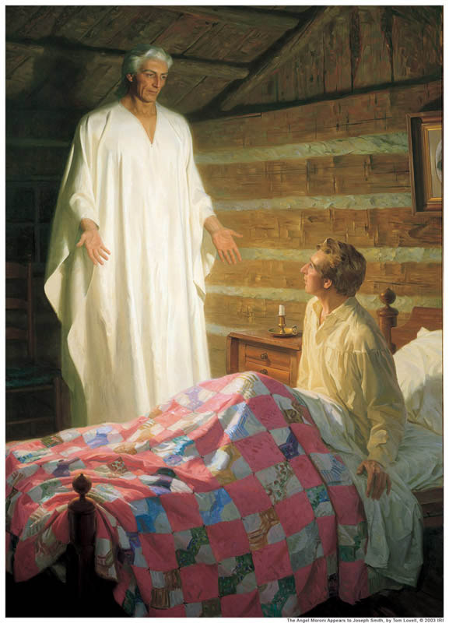
Moroni / Golden Plates

Slide 22
The Book of Mormon

Slide 23
The Book of Mormon
Family of Israelites migrated to the New World.
Split into two factions, the righteous Nephites and the sinful Lamanites.
Appearance of Jesus Christ to these people after his resurrection.
Nephites wiped out by the Lamanites. Last remaining Nephites: Mormon and his son Moroni.

Slide 24
“The Restoration”
1829: restoration of “priesthood”
March 1830: publication of the Book of Mormon
April 1830: founding of the Church of Christ

Slide 25
“Joseph the Seer”

Slide 26
LDS (Latter-day Saint) Scripture
The Bible.
The Book of Mormon.
Doctrine & Covenants [D&C].
Pearl of Great Price (includes Joseph Smith History).

Slide 27
Revelations in Doctrine & Covenants
D&C 76, “The Vision,” 1832. Three degrees of heaven glory: celestial (sun), terrestrial (moon), telestial (stars).
D&C 89, “Word of Wisdom,” 1833. No “hot drinks,” “wine or strong drink,” or tobacco.
Gather to Zion. Build a temple. Prepare for Second Coming.

Slide 28
The Church of Jesus Christ of Latter-day Saints

Slide 29
Jackson County, Missouri
Zion
Millennialism
Gathering

Slide 30
Missouri
Salt Sermon / 4th of July Oration (“war of extermination”).
Oct. 1838 Extermination Order – said Mormons were in “open and avowed defiance of the laws, and of having made war upon the people of this State ... the Mormons must be treated as enemies, and must be exterminated or driven from the State if necessary for the public peace—their outrages are beyond all description."
Haun’s Mill Massacre.
Smith arrested on charges of treason.

Slide 31
The Church of Jesus Christ of Latter-day Saints

Slide 32
Nauvoo, Illinois
Development of distinctive Mormon doctrines and rituals:
Baptism for the dead.
Endowment.
Sealing in marriage .
Polygamy.
These ordinances (save polygamy, probably) understood as requirements for exaltation.

Slide 33
Carthage, Illinois, jail, 27 June 1844

Slide 34
Brigham Young – The “American Moses”

Slide 37
Proposed State of Deseret

Slide 38
Mormon Handcart Pioneers

Slide 39
Utah Territory
1857 Utah War

Slide 40
Mountain Meadows Massacre

Slide 41
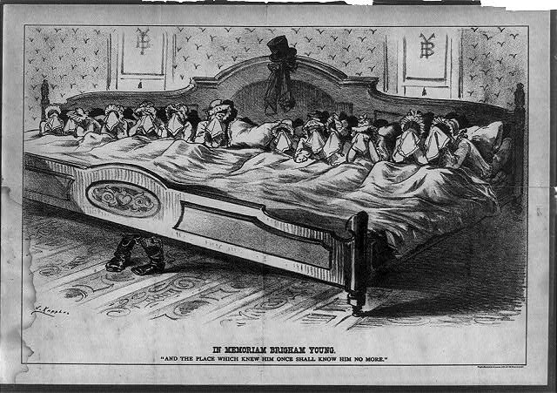
Joseph Keppler, 1877, Library of Congress

Slide 42
“Cohabs” (lascivious cohabitation)

Slide 43
Wilford Woodruff
1890. “The Manifesto.” Church members encouraged to follow the law of the land on marriage.

Slide 44
Utah Statehood

Slide 45
Religious Freedom: Limits
Polygamy = Barbarism (Reynolds v. U.S., 1879), not protected by First Amendment.
Supreme Court held that territories could strip Mormons of the right to vote (Davis v. Beason, 1890).

Slide 46
A Protestant Nation?

