Slide 1
The Eighth and Ninth Circles
OLLI Spring 2017
Dante’s Inferno

Slide 2
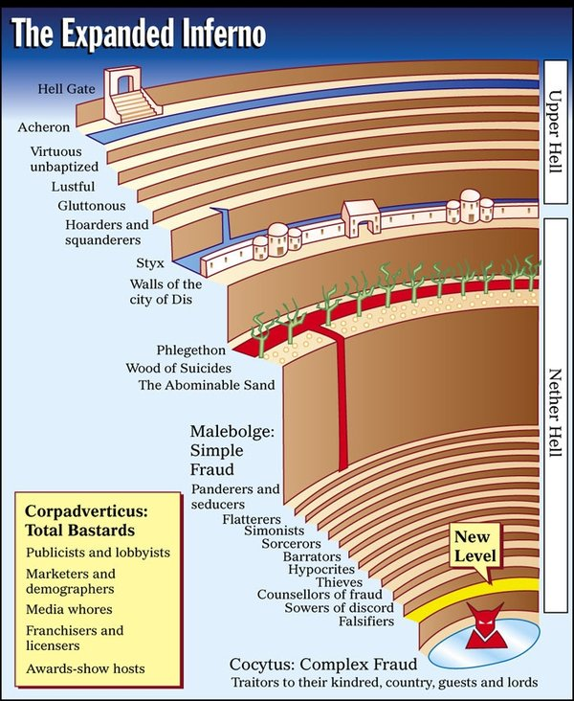

Slide 3
Geryon: Reading the beast allegorically

Slide 4
Amongst the monstruous: hybridity

Slide 5
“Here pity lives only when it is truly dead.”
Inf. 20.28

Slide 6
Descent to Malebolge (“Evil Pouches”) Inf.18.1-18

Slide 7
Malebolge: Inf.18-30

Slide 9
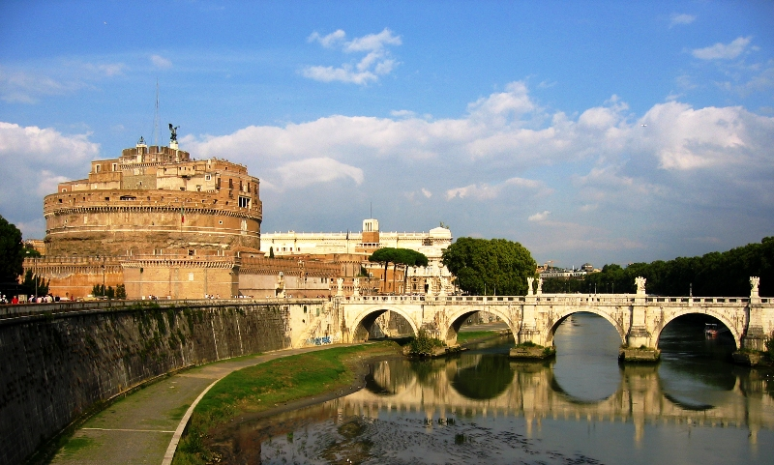

Slide 10
First Pouch: Panderers and Seducers (Inf.18)

Slide 11
Second Pouch: Flatterers (Inf. 18)

Slide 12
First Pouch: Structure
panderers and seducers | flatterers
disposition of both (22-39) | disposition (100-114)
modern exemplar (52-66) : Venedico Caccianemico of Bologna, 1228-1302, panderer who procured his own sister, Ghisolabella, to the Marquis of Este | modern exemplar (115-126): Alessio Interminei, of Lucca
classical exemplar (82-99): Jason of the Argonauts, Expedition to Colchis to get the golden fleece. Stopped at Lemnos, seduced Hypsipyle, then seduced Medea, daughter of the King of Colchis | classical exemplar (127-136): Thaïs, courtesan in the Eunuchus by Terence (comedy)

Slide 13
Third Pouch: Simonists (Inf. 19)

Slide 14
Simony
Simon Magus allegedly tried to purchase the power to execute ecclesiastical offices (specifically baptism) from Peter and John (Acts of the Apostles 8:9-24). Peter rejected him for thinking that a gift of God could be purchased.
Simony: corruption in the Church (Barratry/Graft: corruption in the State)
The buying and selling of ecclesiastical offices.
Based upon the idea of the Donation of Constantine (Inf.19.115-17). Ultimately proven to be a forgery by Lorenzo Valla in the 15th century, this refers to when Emperor Constantine invested the Church with his temporal power in Rome, thereby moving the empire to Constantinople. Pope Sylvester I was in power at this time.

Slide 15
Popes in the Comedy
Of the 14 popes that served between 1265 and 1316, Dante only places ONE pope in Heaven: Giovanni XXII (1316-1334)
Pope Nicholas III: Giovanni Orsini (1277-1280)
Pope Boniface VIII: Benedetto Caetani (1294-1303)
Pope Clement V: Raymond Betrand de Got (1305-1313) – beginning of the “Avignon Captivity” (1309-1378)

Slide 16
The “two suns” of Rome
In Purgatory 16, Marco Lombardo advances a theory that in the past, there were two suns of Rome, one temporal and the other ecclesiastical, but now these two lights have extinguished each other. (Purg. 16.106-111).
This stood in opposition to the idea that the Pope is the sun and the emperor is the moon.
He also argued this point in his political treatise, On Monarchy.

Slide 17
De Monarchia 3.16
“One is the Supreme Pontiff, to lead humankind to eternal life, according to the things revealed to us; and the other is the Emperor, to guide humankind to happiness in this world, in accordance with the teaching of philosophy.”
Boniface VIII wrote that both “swords” of the spiritual and temporal authorities reside with the church in his papal bull, Unam sanctam (1302).
The De Monarchia was ordered to be burned in 1329 and in the 16th century it was placed on the papal index of banned books, only to be removed from the index in 1881.

Slide 18
Fourth Pouch: Soothsayers (Inf. 20)

Slide 19
Fourth Pouch: Soothsayers (Inf. 20)

Slide 20
Soothsaying
“who can be more impious than he who links God’s judgment to passivity”
What does Dante “learn” in this pouch?

Slide 21
Soothsayers
Tiresias (Ovid’s Metamorphosis, III, 324-331). Famous soothsayer of Theves
Amphiarus: One of the seven kinds against Thebes who forsaw his death
Aruns: An Etruscan soothsayer
Manto (Mantua): Vergil’s history of Mantua is false (founded by Ocnus, son of Mantua). Dante uses Statius’s account in the Thebaid, even though Vergil here asserts himself to be true (v.97)

Slide 22
Soothsayers
Eurypulus: Soothsayer from the Aeneid whom Dante knows well. Gave advice to the Greeks for when to return home from Troy.
Michael Scot (1175-1235): Scientist, philosopher, occultist and astrologer from Scotland who spent many years at the court of Frederick II in Palermo, Sicily.
Guido Bonatti: Astrologer at the court of guida da Montefeltro. Helped Guido Novello during the war at Montaperti.
Asdente: Shoemaker from Parma who was famous for his prophecies.

Slide 23
Fifth Pouch: Barrators (Inf.21-23)

Slide 24
Malacoda and his crew

Slide 25
Barratry
Graft, or corruption in the state. The civil version of simony.
Dante accused of barratry (Inf.6.).
Here, Dante features many of the inhabitants of Lucca as guilty of barratry (Saint Zita, Inf. 21.38).
Longest single episode of the Inferno, from canto 21 to 23.
“Exception” of Bonturo Dati is ironic, as he was one of the most corrupt of the leading political party (Inf.21.41).
Ciampolo is the Navarrese who we witness being tortured. He is together with Fra Gomita and Michele Zanche, both Sardinians who were accused of accepting bribes in their lifetimes.

Slide 26
Venetian Arsenal (Inf.21.7-18)

Slide 27
On the Arsenal

Slide 28
The Venetian Arsenal

Slide 29
Jousting in Arezzo (Inf.22.4-9)

Slide 30
Dolphins breaching (Inf.22.19-21)

Slide 31
Frogs crouching (Inf.22.25-27)

Slide 32
Ducks and falcons (Inf.22.130-132)

Slide 33
Aesop’s Fable (Inf.23.4-6)
http://www.youtube.com/watch?v=1-E4QEOr_aw
Aesop: between 620 and 530 BC.

Slide 34
Just like a mother : Vergil
(Inf.23.37-51)

