Slide 1
Literary job Part 2
OLLI Spring Term 2016
- Tom Manteuffel

Slide 2
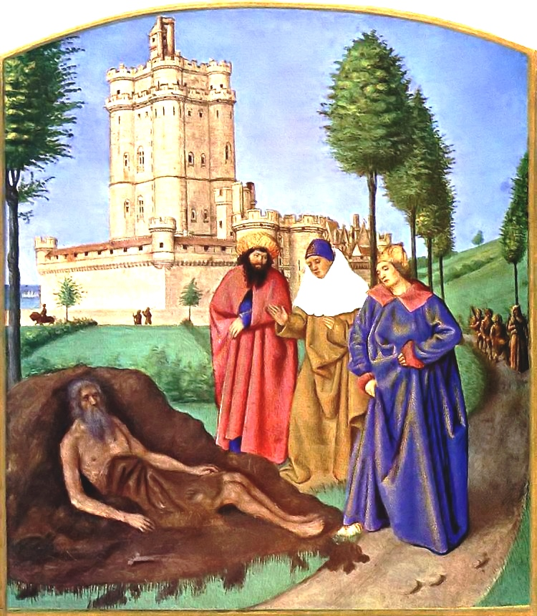
Job and His False Comforters
Jean Fouquet, c 1460

Slide 3
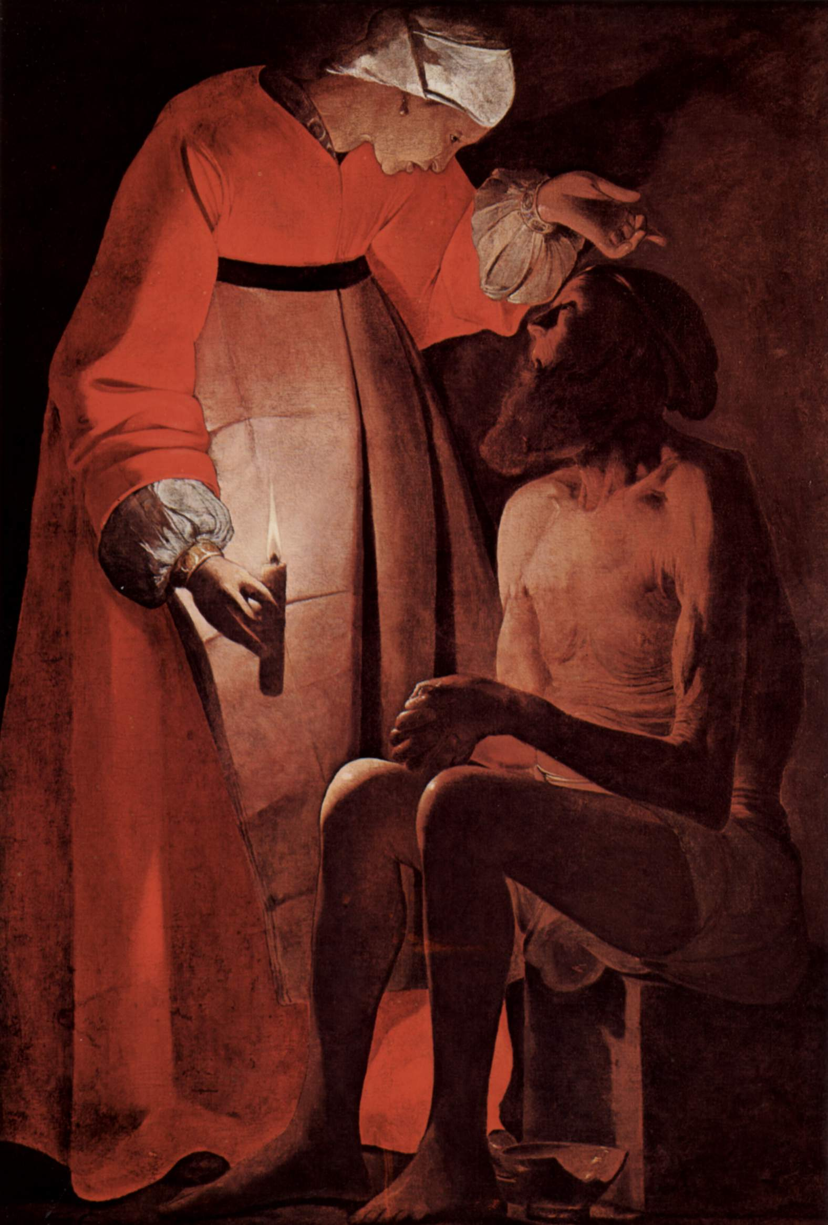
Job Mocked by His Wife
Georges de la Tour, 1630s

Slide 4
Structure of Job
Prologue (1,2)
Prose
FIRST CYCLE
Job (3)
Eliphaz (4)
Job (6, 7)
Bildad (8)
Job (9,10)
Zophar (11)
SECOND CYCLE
Job (12-14)
Eliphaz (15)
Job (16,17)
Bildad (18)
Job (19)
Zophar (20)
THIRD CYCLE
Job (21)
Eliphaz (22)
Job (23,24)
Bildad (25-26:14?)
Job (26:1-4?)
[Zophar ??]
Job (27)
Poetry
Wisdom Hymn (28)
Job (29-31)
Elihu (32-37)
Yahweh Speaks (38-41)
Job (42:1-6)
Epilogue (42:7-17)
Prose

Slide 5
Biblical Poetry
Most important element
Parallelism
Semantics
Syntax
Rhythm (stress)
All is in couplets (or ‘hemistichs’, ‘colons’, ‘versets’)
- or occasionally triplets
But the effect is just as often an asymmetry as pure balance…
Biblical poetry is not repetitive so much as intensifying.

Slide 6
Biblical Poetry
Subsidiary elements
Stress (not meter)
“By rule no two stresses are permitted to follow each other… [therefore] each stress dominates a group of two three or four syllables; there are two, three or four such groups in a verset; and two, three or four parallel versets in a sentence.”
- Benjamin Hrushovski (Harshav)
Mitchell uses three stresses per line

Slide 7
Biblical Poetry
Subsidiary elements
Intensification
Often of degree, or quantity or ‘sophistication’
An implied “How much more so…”
An invariable rule is that if you introduce a number in the first couplet, you have to go up in the second.
Six things are there that the Lord hates,
and seven He utterly loathes.
- Proverbs 6:16

Slide 8
Biblical Poetry
Subsidiary elements
Intensification via ‘sophistication’
“The predominant pattern of biblical poetry is to move from a standard term in the first verset to a more literary or highfalutin term in the second verset.”
- Robert Alter, The Art of Biblical Poetry, 1985
Look, Wisdom calls out,
and Discernment lifts her voice.
- Proverbs 8:1

Slide 9
Biblical Poetry
Subsidiary elements
Intensification via concretization
Your granaries will be filled with abundance,
With new wine your vats will burst.
- Proverbs 3:10
She weeps on through the night,
And her tears are on her cheek.
- Lamentations 1:2

Slide 10
Biblical Poetry
Subsidiary elements
Chiasm
Parallelism either of ‘syntax’ or ‘semantics’
Simplest form is A, B, Bʼ, Aʼ

Slide 11
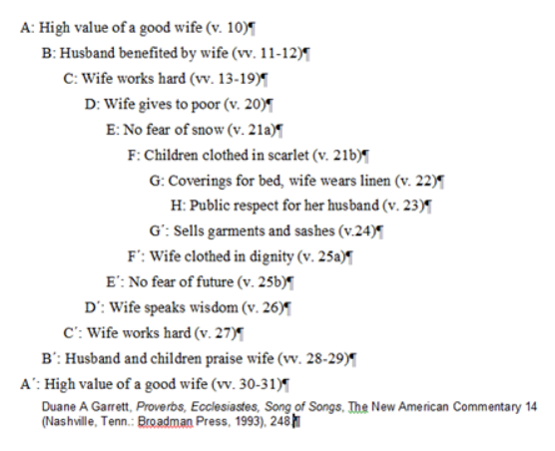
Biblical Poetry
Subsidiary elements
Chiasm
Can be quite complex
Chiastic analysis of Proverbs 31

Slide 12
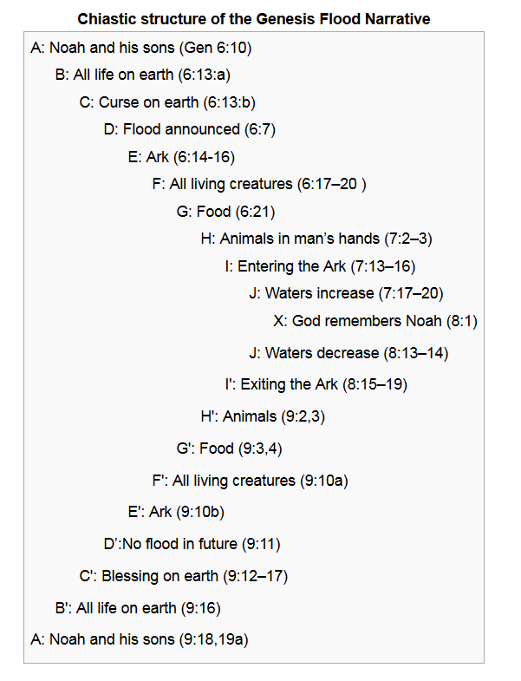
Biblical Poetry
Gordon Wenham’s Chiastic Analysis of Genesis Ch 6-9

Slide 13
Biblical Poetry
Subsidiary elements
Shared verbs between versets (a form of ellipsis)
He found him in a desert land,
in an empty, howling waste.
- from Moses Valedictory Song, Deut 32:10
The ellipsis frees the poet to elaborate and sharpen meaning.

Slide 14
Biblical Poetry
Other elements
Use of concrete imagery to indicate general concepts
Quoting of another’s words
Extreme conciseness (usually)
Rhetorical questions
Many subtypes:
Victory songs
Laments (individual, communal)
Hymns of praise
Love poetry or wedding songs

Slide 15
Biblical Poetry
And flexibility!

Slide 16
Biblical Poetry
Then he said to her, “Please give me a little water to drink; for I am thirsty.” So she opened a skin of milk and gave him a drink and covered him. - Judges 4:19 (NRSV)
He asked water and she gave him milk,
she brought him curds in a lordly bowl.
- Judges 5:25 (NRSV)

Slide 17
Biblical Poetry
On to Job…
“When we move from the prose frame story of chapters 1 and 2 to the beginning of the poetic argument in chapter 3 we are plunged precipitously into a world of what must be called abysmal intensities.”
- Robert Alter, The Art of Biblical Poetry

Slide 18
Job 3: His Malediction
Cursed be the day when I was born;
Let the day when my mother bore me not be blessed.
Cursed be the one who brought my father news saying
‘A son, a male, has been born to you,’
Bringing him such joy.
May this man be like the towns
That YHVH overthrew without mercy;
May he hear alarms in the morning,
The war cry in broad daylight,
since he did not kill me in the womb;
My mother would have been my tomb
while her womb was swollen with me.
Why ever did I come out of the womb
to live in toil and sorrow
and to end my days in shame!
- Jeremiah 20:14-18

