Slide 1
“Liberty’s Exiles” Maya Jasanoff

Slide 2
Schedule By Week
October 19
The “Englishness” of the Colonists, and
The First Test of Colonial Loyalty: The English Civil War
October 26
1760-1776: Colonists in England and England in the Colonies.
November 2
The Center Does Not Hold: Loyalists vs. Patriots
November 9
The Caribbean: “Nothing but England can we relish or fancy.”

Slide 3
Timeline Course Will Cover
1607 Founding of Jamestown
1642-51 English Civil War & the Colonies
1649 England becomes a Commonwealth
1653-58 Oliver Cromwell becomes Lord Protector
1660 Restoration of the Monarchy
1660-1776 The Center Becomes Fragmented
1776-1814 Loyalism Becomes History

Slide 4
We will explore the following:
Did the distance between the Mother country and the colonies leave the American colonists impervious to political events in England?
In terms of numbers—exactly how many Loyalist colonists are we talking about, and how do we know the numbers?
Exactly who were the “loyalists”? Were they just white upper and middle-upper class colonists?
What, specifically, were the ties that bound them to the British Empire?
How were the Loyalists treated in the colonies?
How did the Mother Country treat the Loyalists?

Slide 5
English Colonization
Was different from that of France, Portugal and Spain

Slide 6
Significant Differences
SPAIN: (Florida—the majority were Indian)
A Catholic country sent conquistadores (conquerors)
Mostly male and came for “Gold, God, and Glory”
The Mestizos: people of Spanish and Indian mix who blended into society.
FRANCE: (Louisiana and Canada)
It too was a Catholic country, and settlers were mostly male traders who sought fur and fish.
The Metis: people of French and Indian mix who blended into society.
ENGLISH:
Initially men came but within a short time, families arrived.
Theirs was a cult of commerce.
There was a rigid racial classification system; intermarriage was not common or supported.

Slide 7
1606: Joint Stock Companies Were Formed
They were established by royal charter by King James I on April 10, 1606 with the purpose of establishing colonial settlements in North America.
Given several names: Plymouth Company, Virginia Company of Plymouth, or Virginia Bay Company.
Plymouth Company: establish a colony between Chesapeake Bay and the current US-Canada border.
The London Company: establish a colony between Cape Fear and Long Island Sound.
The Massachusetts Bay Company was established in 1628.

Slide 8
Plantation/Colony
“Plantation”=settlers were planted abroad in order to establish a permanent colonial base.
Seventeenth-century English documents refer to the “Atlantic Plantations,” a term that took in land claimed by England from Newfoundland to Trinidad.

Slide 9
“Seas roll and months pass between the order and the execution” Edmund Burke
Sailing Times FROM
England
Sailing Times TO
England
Boston: 5-7 weeks
Chesapeake: 9 weeks
Barbados: 9 weeks
Hudson Bay: 12 weeks
Boston: 4-5 weeks
Chesapeake: 6 weeks
Barbados: 8 weeks
Hudson Bay: 6 weeks

Slide 10
Nor did you start out at any time of the year.
One exception: ships going to West Indies could go at almost any time of the year.
Because of prevailing winds and currents, the fastest sailing route passed around the north of Ireland.
Ships traveling to the colonies from England sailed midsummer to late September.
By the end of the 17th century the standard practice was to travel in convoys.
THIS HELD TRUE DURING THE TIME OF THE REVOLUTION.

Slide 11
British Colonies in the Americas 1700
North America
West Indies
Connecticut Rhode Island
Delaware South Carolina
Georgia Virginia
Maryland Pennsylvania
Massachusetts
New Hampshire
New Jersey
New York
North Carolina
Antigua Tortola
Barbados Tobago
Dominica
Grenada
Jamaica
Nevis
Montserrat
St. Kitts
St. Vincent

Slide 12
By 1776 the following had been added:
Canada
Newfoundland
Prince Edward Island
Nova Scotia
The Bahamas
Bermuda
East and West Florida

Slide 13
The Colonies were Largely ethnically English
What did that mean?

Slide 14
The Rule of Law
“The people of the colonies are descendants of Englishmen…They are therefore not only devoted to liberty, but to liberty according to English ideas and on English principles.”Edmund Burke: Speech on Conciliation with the Colonies (22 March 1775)
English ideas? English principles?

Slide 15
Two Basic Principles of the English Constitution
The Rule of Law
Defined as: “ The rule of law is a legal maxim whereby governmental decisions be made by applying known legal principles.”
Rule of law implies that every citizen is subject to the law. It stands in contrast to the idea that the ruler is above the law.
The Supremacy of Parliament
Began in In 1215 when the tenants-in-chief secured the Magna Carta from King John. The Great Charter established the rule that the King could not levy or collect taxes without the consent of his royal counsel.
1376—under King Edward III: no law could be made or any tax levied without the consent of both houses and the Sovereign. What became the House of Commons had been established in 1272.

Slide 16
English Bill of Rights 1689 Formalizes Rule by Law
Royal interference with the law is prohibited. The monarch cannot unilaterally establish new courts or act as a judge.
The monarch cannot impose taxes without the consent of Parliament.
The monarch cannot interfere in the election of members of Parliament.
Freedom of speech and debates is guaranteed.
No excessive bail or “cruel and unusual” punishments may be imposed.

Slide 17
Definitions
Loyalist: one who adheres to his sovereign or constituted authority esp. in times of revolt.
Patriot: applied to a person who supported the rights of a country against King and Court.

Slide 18
There were 2 kinds of Loyalism: Before and After 1776
Beginning in 1607:
A long-held form of allegiance to the empire shared by the North American colonists.
The form which emerged in 1774:
That emerged during the traumatic moments before and during the military years when colonists felt compelled to make political choices.

Slide 19
1642: The First Test of Colonial Loyalty:
The English Civil War
And the effect on the American colonies

Slide 20
What was the English Civil War?
The English Civil War, fought from 1642 to 1651, consisted of a series of armed conflicts and political maneuverings between the Royalists lead by King Charles I, and Parliamentarians. The fighting took place in England, Scotland, and Ireland.
The War led to :
the trial and execution of King Charles I;
the exile of his son, Charles II;
The replacement of the English monarchy with
FIRST, the Commonwealth of England and
THEN with a Protectorate under Oliver Cromwell’s personal rule.
Notes:
Jamestown 1607; Massachusetts Bay 1620

Slide 21
The Sides: Roundheads and Cavaliers (Parliamentarians and Royalists)

Slide 22
MAJOR PLAYERS
KING CHARLES I
(1600-1649)
OLIVER CROMWELL
(1599-1658)

Slide 23
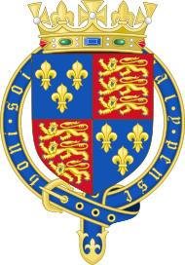
And the Parliament of ENGLAND
UNICAMERAL
1215-1341
BICAMERAL : House of Lords and House of Commons
1341-1649
Unicameral
1649-1657 (Cromwell abolished the House of Lords)
BICAMERAL
1657-1707 (Restoration of the Monarchy restored the House of Lords)
In 1707 with the Union of Scotland and England, the Parliament became the Parliament of Great Britain.

Slide 24
With Respect to the Causes of the Civil War
“No man understands the true grounds of our unnatural wars.”
Sir John Oglander
HOWEVER: ALL DISCUSSION OF CAUSES LEADS TO TWO:
Religion
Parliament

Slide 25
The Religious Traditions Involved in the Issues
Roman Catholics
Church of England—Anglican.
Reform groups:
Puritans wanted to maintain the Established Church but to purge it of the “remnants of popery.”
Separatists split off from the Puritans and advocated separation from all other Christians.
Church of Scotland—Presbyterian
Traces its roots to John Calvin, French Catholic who converted to the Reformation Movement. His follower in Scotland was John Knox, who led the Reformation in Scotland against the Catholic Mary, Queen of Scots.

Slide 26
Of Particular Significance
The Puritan Movement
The cry for “more reform” in the 1560s was the basis of the Puritan Movement with the works of John Calvin being the most widely disseminated publications in England.

Slide 27
King Charles I precipitates military action in two ways:
FIRST:
While the monarch and parliament had become separate institutions, and no law could be made or any tax levied without the consent of Parliament, monarchs could call Parliament and dismiss it at will.
For eleven years (1629-1640) the King did not call Parliament.
When he did, in 1640, Parliament passed the Militia Ordinance denying the King control of any military force that could be used against it.

Slide 28
Second: The Religion Factor
The King planned to replace the Scottish Presbyterian system of church government with the High Anglican system in order to harmonize the churches of England and Scotland.
Opponents of reforms united around the Scottish National Covenant of February 1638; the Covenanters became the leading political and religious force in Scotland.
When the King decided to impose his will by force and moved to invade Scotland, the Scots invaded England.

Slide 29
Regicide
Nov. 1647: King Charles escapes and flees to the Isle of Wight;
December 1748: recaptured and sent to Windsor Castle;
January 1749: Tried for treason;
January 1749: Executed outside Whitehall Palace.

Slide 30
England Becomes a Commonwealth The Interregnum
In May 1649 Parliament passed An Act Declaring England to be a Commonwealth. It was created “for the People of England and all of the Dominions and Territories thereunto belonging.”
Commonwealth defined: an association of self-governing autonomous states more or less loosely associated in a common allegiance
It was governed by a Council of State. The Council's duties were to act as the executive of the country's government in place of the King and the Privy Council.
It was to direct domestic and foreign policy and to ensure the security of the Commonwealth.
The Council was dominated by the Army, with Cromwell in the Chair at its first meeting.

Slide 31
January 1655
“After a hundred procedural delays and prevarications”
Cromwell dismisses Parliament and rules alone for a year. During that time:
Severe crackdown on public debate;
Strict control over the press;
Sanctioned unofficial return of Jewish people to England;
Charged appointees with enforcing the ideals and standards of Puritanism and to eliminate drinking and dressing immodestly.

Slide 32
Effect on the American Colonies
“The worst and most dangerous tymes.”
George Fenwick of New England to Phillip Bell, Governor of Barbados. 1643

Slide 33
Oliver Cromwell becomes “Oliver P.” The Protectorate 1653-58
Cromwell’s Western Design
Objective: to ouster Spain from the Western Hemisphere by military conquest. The colonies were involved in two specific ways:
Enlist colonists to settle in the islands, particularly Jamaica;
Recruit colonists to fight.
Both objectives failed. Distance and logistical problems caused by it enabled the colonies to stay at arm’s length from the project.

Slide 34
Cromwell Focuses on the American Colonies
With This Result:
Commonwealth Coat of Arms: 1649-1660
The Commonwealth Parliament felt it had to put down opposition in Britain, Ireland, and its plantations.
The Council of State announced its authority to cancel all existing colonial charters and replace them with new foundations for government.
It instituted a more systemized form of colonial oversight; thereby implementing an imperial approach to the Atlantic plantations.

Slide 35
The Colonies Had to Decide
At First Neutrality
King Charles’ Execution Changed that
Prevented the colonists from acting on outdated information
They feared full-scale assault by either Royalist or Parliamentarians if they chose sides.
Colonial traders culd not afford to turn away trading ships from “the other side” of the conflict.
They feared Indian attacks if they realized the colonies could not expect aid from the Mother Country.
Six colonies declared open allegiance to the dead monarch’s son, Charles II.
A sixth of the male colonists from New England returned to England to fight for Parliament.
There was fighting in Maryland instigated by Parliamentary privateers. It was called “The Plundering Time.”

Slide 36
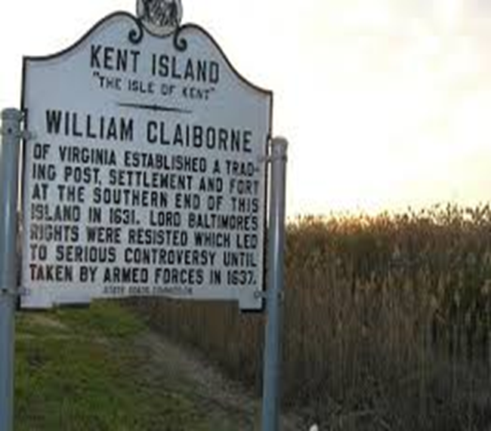
The Curious History of Kent Island

Slide 37
The Plundering Time
1638: Maryland governor, the Catholic Leonard Calvert, sized a trading post on Kent island.
1644: Kent Island retaken by Protestants. When they also seized St. Mary City, Catholic Governor Calvert escaped to the Virginia colony.
Protestants begin plundering the property of anyone who did not swear allegiance to the English Parliament.
1654: Puritans in Maryland disenfranchise Catholics and high-church Anglicans.
1655: Maryland Puritans defeat Anglican-Catholic forces at the Battle of the Severn, but a settlement is reached 2 years later.
1660: Restoration brings back the Calverts in Maryland, but the New England Puritans retain their charters.

Slide 38
Virginia Fights the War Under Governor William Berkeley
1643: Virginia’s General Assembly legislates: “all nonconformists . . . Shall be compelled to depart the collony with all conveniencie.”
1646: Informs Parliament that its location in America necessitates neutrality in relation to the upheaval in England.
1649:. Governor Berkeley proclaims Charles II king.
1649: House of Burgesses enacts legislation to punish those who publicly support the regicide or refuse to acknowledge Charles II as king.
Royalist exiles fled to Virginia: “the only city of refuge left in his Majesty’s dominions.”

Slide 39
The Commonwealth Parliament fights back
1650: embargo against colonies who assert support for Charles II—Barbados, Bermuda, and Virginia.
1651: Navigation Act: all goods shipped to and from American colonies must travel in English ships; Virginia’s best trading partners, the Dutch, are excluded from colonial ports. (This figured predominately into the American Revolution)
1652: Bermuda surrenders to the Commonwealth government after a two-month blockade of its ports.
Virginia stands alone.

Slide 40
The Jamestown Settlement
On March 12, 1652, in order to avoid bloodshed, Virginia governor Berkeley and his council agreed to a negotiated settlement to the forces sent out by the Commonwealth. By the settlement, Virginia relinquished its status as a Royal colony and its formal support of King Charles II. Berkeley was forced to step down as governor.

Slide 41
Meanwhile
Back in England

Slide 42
Sequence of events— “The Royal Miracle”
As Parliamentarians gained ground, and King Charles I faced the possibility of capture, he became more and more insistent that his son leave the country. He wrote to Prince Charles: charging him “never to yield to any conditions that are dishonourable, unsafe for your person, or derogatory to regal authority, upon any considerations whatsoever, though it were for the saving of my life.”
In March 1646 Charles sailed to the Isles of Sicily, and in April to Jersey. In late June, however, as the king surrendered to the Scots, Prince Charles agreed to go to France. He was reunited with his mother at St Germain, near Paris, where he settled at the expense of the French court.

Slide 43
The Biggest Difficulty in Escaping: Charles Could Not Hide in a Crowd
Complexion: he was dark and swarthy, the only one of the royal children who favored his Italian Grandmother, Marie deMedici .
Charles was also 6’ 3” tall in an age where the average height of a man was a little over 5’.

Slide 44
Cromwell Issues a Wanted Proclamation
The poster calls upon “all Officers, as well Civil as Military, and all other good people of this nation” to make a “diligent search” for the king.
It warns if anyone “knowingly Conceal the lad Charls Stuart” they will be held as "partakers and Abbettors of their Trayterous and wicked practices.”
A £1,000 reward is offered for the King’s capture.

Slide 45
On the Run from September 3 to October 15—a 600 mile journey
Charles was aided and sheltered by dozens of people, from the Earl of Derby to a country woman by the name of Jane Lane.
People who helped him could have earned the £1,000 reward for his capture, but they also risked their lives for aiding the escape of one who had been proclaimed a traitor.
At one point he cut his hair, and at Boscobel a Catholic family hid him underground where they had hidden priests.

Slide 46
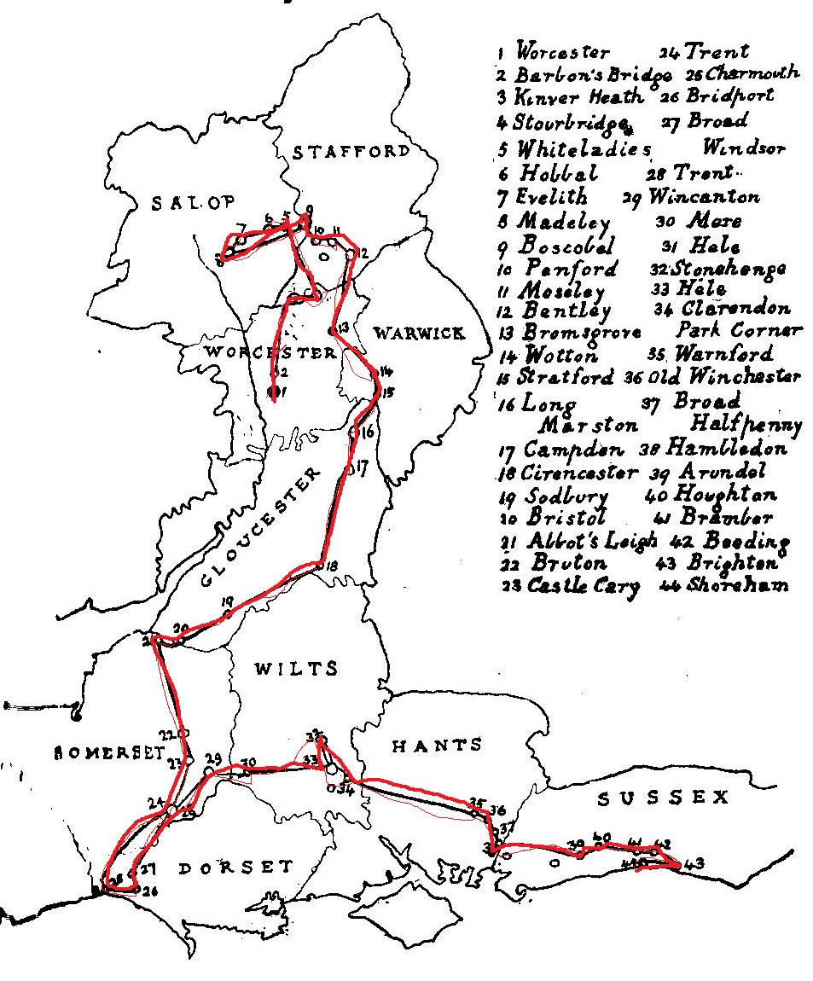

Slide 47
From All Contemporary Reports:
“The combination of resource, intelligence and sheer courage which he showed fully justifies the verdict of John Oldmixon in his early eighteenth-century history of the Stuarts: ‘King Charles the Second in the Oak near Boscobel, makes as Heroical Figure as in any Part of his Reign.’ “
Antonia Fraser, Royal Charles

Slide 48
Restoration of the Monarchy

Slide 49
Bringing Back the Monarchy
Convention parliament
Declaration of Breda
A parliament which, owing to the abeyance of the Crown, assembled without formal summons by the Sovereign.
Assembled for the first time on 25 April 1660 it was predominantly Royalist in its membership.
8 May 1660: Proclaims that King Charles II had been the lawful monarch since the death of Charles I in January 1649.
4 April 1660: Charles II issued a proclamation which promised the following:
A general pardon for crimes committed during the War and Interregnum for those who recognized him as the lawful king.
Retention by current owners of property purchased during the same period;
Religious toleration;
Payment of monies owed to members of the army;
Stipulates that the army would be recommissioned into service under the crown.

Slide 50
Why Restore the Monarchy?
The restoration was an internal process; it was not brought about by war.
Stability and order were needed and desired.
The character of the King was significant:
He made strenuous efforts to retain his protestant reputation;
Even at his lowest moments, he would not make sacrifices, such as a change of religion, to get the support of France, Spain, or the Dutch.
He was known as a decent, serious man—at lest as much so as any monarch.

Slide 51
Once Upon a Time There was a colony of New Haven
But then it gave refuge to three men who signed the death warrant of King Charles II’s father.
And that is why the colony of New Haven lost its charter and was absorbed into the royal colony of Connecticut.

Slide 52
Thus ends the story
Of how Governor Berkeley once again became “his Majesties Governor”
And
How King Charles II gave Virginia the title of “Old Dominion” and restored its status as a crown colony.

Slide 53
King Charlies Spaniel: The breed was brought to England by Charles II
But it seems as though people were stealing the King’s dogs, and he advertised for their return.

