Slide 1
The Course of World War II
Class 4
William A. Reader
williamreader40@gmail.com

Slide 2
The Invasion of Poland

Slide 3
Why Poland Lost the War
Poland chose to disperse its forces so that all avenues of attack and all population and industrial centers were covered
  This guaranteed defeat at those points that the Germans chose to attack in force
Poland mobilized at the last minute so that Polish forces suffered attack before they were fully mobilized
Neither the British nor French launched any offensive in the West to divert German troops from Poland
  Without Belgium willing to allow British & French troops to attack Germany thorough Belgium, the only avenue of attack was against the Siegfried Line
    The French believed the Siegfried Line, like the Maginot Line, was impenetrable
Notes:
French unwillingness to attack - Even though France and England had committed themselves to the defense of Poland, they both assumed that Poland, like Serbia in World War I, would be overrun, but that its independence would be restored with Allied victory. There was no evidence that an immediate offensive into Germany while she was attacking Poland was ever considered although this would have been dangerous to Germany. Without the willingness of Belgium to participate in such an operation, any Allied offensive would have to be launched at that portion of the German border covered by the Siegfried Line or Westwall. Though nowhere nearly as strong as the French military leadership believed, it looked to the French at the time as an insurmountable obstacle – an obstacle which could be overcome only at the cost of casualties the French could not afford. To a large extent, the French overestimation of the Westwall reflected their overestimation of the defensive strength of the Maginot Line. Thus, the French planned for a successful defense, followed only then by lengthy preparation for an offense of their own against a German army worn down by successful French defenses

Slide 4
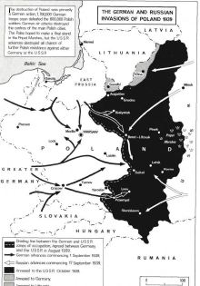
Map – Partition of Poland

Slide 5
Soviet Occupation of Eastern Poland
The Soviets delayed their entry into Poland until 17 September for several reasons
  There was a need to mobilize Soviet forces for the attack and move many of them from sites in the interior of the USSR to the Polish border
  Stalin wanted to time the invasion so that it appeared to be merely a recovery of lands that were once Russian at a time when the Polish state had effectively ceased to exist rather than as an act of aggression
  The fighting at Nomonhan between Russian and Japanese troops was still going on
The Soviet invasion eliminated any possibility that Polish forces could organize continued resistance in the dense forests and swamps of eastern Poland
It forced the Polish government and some 200,000 Polish troops to cross the borders into Lithuania and Romania
Notes:
By the time the war ended, a million Polish soldiers had been captured by the Germans and Russians; over 100,000 had been KIA; something over 200,000 had fled across the borders.

Slide 6
War in the West

Slide 7
Hitler’s Initial Plan
Hitler’s initial plans to attack in the West had a target date of early November
  Bad weather, however, forced successive postponements since the Luftwaffe needed clear weather for its operations
  Initially the plan was to invade Holland and Belgium and then head into northern France to defeat the British and seize coastal sea and air bases
    It differed from both the Schlieffen Plan of World War I and the von Manstein Plan that was eventually adopted
His plans, however, provoked a lot of opposition from many of the German military leaders
  A few opposed attacking neutral countries
  Many believed it made more sense to await a French offensive
  Most were not especially confident that the Wehrmacht could defeat the French
Notes:
Initial plans – Initially, the German offensive in the West was to invade Holland and Belgium and then head into northern France to defeat the enemy forces there and seize naval and air bases for further operations against England. It was not a repetition of the von Schlieffen Plan of World War I. Instead it was directed against English forces; the defeat of the French forces likely to be met in the operation would be an essential byproduct of the campaign, but not its main objective.
November 1939 attack date – Initially, plans and orders had a target attack date in early November. It was in connection with the necessary reviewing of these orders that Hitler left the annual celebration of the Munich Beer Hall putch of 1923 early on the evening of November 9th, thus narrowly escaping an assassination attempt.
Military opposition – Some felt that rather than go along with a descent into a long war of attrition, it would be preferable to overthrow the Nazi regime. Nothing came of the potential coup attempts because key figures were unwilling to act. Field Marshal Walther von Brauchitsch, CIC of the Army, lacked both moral courage and had been literally bought by Hitler in 1938. Neither was General Franz Halder, the Army Chief of Staff, willing to act. Of the three Army Group Commanders, only one, Ritter von Leeb, was willing to move; but the others, von Bock and von Rundstedt, were unwilling to do so

Slide 8
Hitler’s Initial Plan - 2
The postponements of the invasion date from November 1939 to May 1940 had a whole series of repercussions:
  They gave the Wehrmacht additional time to assimilate the lessons of the Polish Campaign
    This led to increasing the number of Panzer divisions from 6 to 10
  The repeated successive warnings of impending German attack and related alerts obscured the significance of the final warnings in May 1940
  They allowed German military planners to shift the main thrust of the offensive from the Low Countries to the Ardennes followed by a drive from there to the English Channel
  They turned the focus of German attacks from the Low Countries and France to Denmark and Norway
Notes:
Bad weather – Successive postponements pushed the operation back 6 months from the original date in November 1939 to May 1940. These postponements, however, had a whole series of repercussions.
First, they gave the German military additional time to assimilate the lessons of the Polish campaign, especially in regard to troop training.
Second, the German intention to attack repeatedly leaked out. But the repeated warnings and alerts followed by new warnings and alerts, however, had the effect of obscuring the significance of the final warnings in May 1940; it was hard to credit the fact that the warnings had been accurate when each – until the last one – had been followed by postponement.
Third, it allowed German military planning to shift the main thrust of the offensive from the Low Countries to the Ardennes which would be followed by a drive from there to the coast, cutting off the French and British forces that had moved northward into Belgium to meet the German invasion. The destruction of these forces would open all of France to German conquest, giving the Germans air and naval bases on the Atlantic as well as the Channel coast.
Polish campaign lessons – The Wehrmacht saw what Panzer divisions could do in Poland and thus decided to expand the number of such divisions from 6 to 10. Here, the German conquest of Czechoslovakia had a crucial impact since 4 of the Panzer divisions were equipped with either former Czech army tanks or those produced by the Skoda works in Czechoslovakia. The Polish campaign also validated the Panzer concept – that tanks should be concentrated in special tank divisions which could break through the enemy line and then cut off the enemy forces’ communications and supplies and eventually encircle them In contrast, the British and French saw the tank as an infantry support weapon and scattered them throughout their infantry divisions.
Learning German attack plans - The very fact that the Allies had learned some details of the earlier German plan made them vulnerable to the later one since the earlier plan suggested that the best counter was an Allied advance into Belgium when in fact such a push would (and did) draw the Allied armies into a trap, leaving them unable to adequately counter the German thrust from the Ardennes to the English Channel.
Von Manstein – His plan involved shifting the thrusht of the Panzer attack to a breakthrough in the Ardennes. This would be followed by a drive from there to the English Channel coast, cutting off the French and British forces that had moved northeastward into Belgium to meet the German invasion. This would trap the British army in Belgium and the destruction of those forces would open all of France to German conquest, giving the Germans air and naval bases on the Atlantic as well as the Channel coast.

Slide 9
The Invasion of Denmark & Norway

Slide 10
Norway - 1
Norway had a coastline of a thousand miles, punctuated by islands and fjords.
  Norway’s coast could provide valuable bases for either a British blockade of Germany or for a German offensive against Allied shipping in the Atlantic
  The Swedish iron ore fields were near the Norwegian port of Narvik which is ice-free in the Winter
German Grand Admiral Raeder pressed Hitler to invade Norway in order to ensure continued German access to Swedish iron ore
On 9 April 1940, Hitler invaded Denmark and Norway

Slide 11
Norway - 2
The Germans caught the Royal Navy and the Norwegians by surprise
  German naval forces seized key ports such as Oslo, Stavanger, Bergen, and Trondheim
  German airborne troops seized key airfields which permitted the Germans to bring land-based aircraft to Norway
Although the British and French landed in Norway, the land-based airpower of the Germans was dominant over the sea power and landing forces of the Allies
  By the end of May, the Allies had been forced out of southern and central Norway. On 8 June, the British were forced out of their last foothold at Narvik in northern Norway

Slide 12
Consequences of the Conquest of Norway
Although the Germans conquered Norway, they lost a good chunk of their surface navy
Control of Denmark and Norway allowed the Germans to extort from Sweden anything they wanted
Allied defeat in Norway led to the fall of the Neville Chamberlain government in Britain and his replacement by Winston Churchill
Control of Norway meant that German submarines and surface ships could use Norwegian ports to attack British shipping and later to attack Allied ships supplying the Soviets via the Murmansk run
Notes:
German naval losses – The Germans lost 10 destroyers in the Narvik operation and a heavy cruiser. They also suffered heavy damage to two of their battleships – the Scharnhorst and the Gneisnau. By 1 July, the Germans could deploy only 1 heavy cruiser, 2 light cruisers, and 4 destroyers.
Sweden - This meant delivery of iron (and high-quality iron ore) in vast quantities as well as other materials needed by German war industries. The German navy could order warships built in Swedish shipyards, and allow German soldiers to travel on Swedish trains.
Fall of Chamberlain – This reflected both anger over a failed military operation and the now felt need, now that the Germans were attacking in the West (as of 10 May 1940 for a coalition government. Knowing that the Labor and Liberal parties would not serve under him, Chamberlain resigned after losing 101 Conservative MPs who demanded he step down, with the expectation that Lord Halifax would succeed him. Both Chamberlain and the King wanted Halifax and Labor was willing to serve under Halifax; but Halifax demurred, saying that leading a government from the House of Lords would be too difficult. As a result, Churchill became Prime Minister. On the day Churchill became Prime Minister, Hitler attacked Holland, Belgium, Luxembourg, and France

Slide 13
The Fall of France

Slide 14
Allied Weaknesses - 1
The combined Dutch, Belgian, French, and British armies outnumbered the Germans in manpower, tanks, and artillery BUT
  The Germans had a much better military doctrine for employing tanks than did the Allies
    The Germans put their tanks in Panzer divisions and gave them close air support from Stuka dive bombers
    The Allies saw the tank as an infantry support vehicle and scattered their tanks among all of their infantry divisions
  Allied war planning was deficient and made assumptions that proved to be false

Slide 15
Allied Weaknesses - 2
Given their commitment to neutrality, the Belgians and the Dutch had not coordinated their war plans with the British and French
  The Dutch withdrawal plan isolated the Dutch army from any contact with, or assistance from, the other Allied forces
British and French war plans sent the best French units and virtually the whole British force into Belgium to counter what they thought would be the main thrust of the German attack
  With half the French army committed to the Maginot Line, the area of the Front facing the Ardennes was lightly defended with no reserve force available if the Germans broke through

Slide 16
The Main German Attack
The main German attack went through Luxembourg, southeastern Belgium, and the Ardennes forest
  The line of French forces holding this sector was quickly pierced
  On 13 May, the Germans crossed the Meuse River
  BY 20-21 May, they reached the Channel coast near Abbeville
The Allies had no substantial reserve force to either plug the gap or attack the flanks of the German spearhead
  Efforts of the French to cut off the armored spearhead before the German infantry could catch up failed
Notes:
Unsuccessful flank attack – The French under General Charles De Gaulle and later the British tried to cut off the armored spearhead but their forces were not strong enough to do so and the attempts were not coordinated with each other.

Slide 17
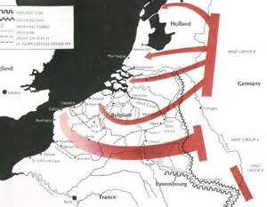
Map – German Invasion of France, Belgium & Holland

Slide 18
The Road to Dunkirk
With the Allied forces in Belgium cut off from those in France and unable to break through the tier of German forces separating them
  The Allied forces in Belgium (which included most of the British Expeditionary Force) decided to retreat to the Coast where they could be evacuated by sea
  Thanks to stubborn fighting (which kept Dunkirk in Allied hands), a German decision to halt their advance up the coast, and the Royal Air Force, the bulk of the British and some of the French armies were evacuated
With the Allied forces in Belgium no longer in play, the Germans attacked the weakened French defensive line in the South on 5 June
  After tough fighting, the Germans broke through, entering Paris on 14 June and attacking the Maginot Line from the rear on the same day
Notes:
Retreat to Dunkirk – Whether the Allied forces in Belgium could actually get to one of the channel ports was very problematical since German panzer armies were advancing north along the French coast from Abbeville, seizing Boulogne and Calais, but stubborn fighting by French and British troops helped slow the German advance, allowing the Allied armies to reach Dunkirk. The Allies were unwittingly aided by a German decision to halt the advance on 24 May so that German tanks could be repaired and German troops resupplied. The Germans also believed that the soggy, canal-crossed terrain of Flanders would hamper tank movements. Also, Goering persuaded Hitler that with the Allied troops congregated on the docks and beaches awaiting evacuation, their destruction could easily be accomplished by the Luftwaffe. Fortunately for the Allies, poor weather delayed Luftwaffe employment and, once the weather cleared, the Royal Air Force was able to effectively defend the air space above the beaches, permitting British naval, merchant, and private ships to evacuate the vast majority of the British – about 220,000 troops – and a substantial number of French – about 120,000 – from Dunkirk, but without their equipment and most of their weapons

Slide 19
The French Surrender
With the French army now disintegrating, Italy decided to enter the war on 10 June
17 June, the new French premier, Marshal Henri-Philippe Petain asked for an armistice
22 June, an armistice was signed at Compiegne in the same railroad car in which the 11 November 1918 armistice was signed
23 June, Hitler visits Paris
3 July – the Battle of Oran
Notes:
De Gaulle - On 23 June, General Charles De Gaulle, head of a French National Committee in London, pledged continued war against Germany. The British government supported De Gaulle and severed relations with the Petain government. After the fall of France, GEN Charles de Gaulle tried to rally Frenchmen in the French colonial empire to the continuation of the war. He was hindered by three factors not under his control.
First, unlike Marshal Petain who was a World War I hero with an established reputation, de Gaulle was an unknown.
Second, the defeatist attitude of most Frenchmen was reinforced by the British sinking of the French fleet to prevent it from being handed over to, or seized by, the Germans.
Third, most French colonial authorities were not only traditionally anti-British, but that had acquired the idee fixe that the British only hoped to seize parts of the French colonial empire for themselves.
Before World War I, a major German colonial possession had been Cameroons in West Africa. This had been given to France in the Treaty of Versailles. In addition, other German territory had been given to the French colonies of Gabon, Chad, and the French Congo. In these colonies, a fear of return to Germany inspired the officials in these colonies to support de Gaulle.
But except for the above colonies, the Free French had little support among the French forces in Africa, and that in obedience to Petain, most French officers were prepared to fight the British and the Free Frenchmen, but not the Germans.
Free French control of French Equatorial Africa had a practical impact on World War II. Symbolically, it provided de Gaulle with a substantial territorial base and thus a sign of status. It made the whole concept of a continuing fight of some kind alongside but independent of England plausible. Practically, Ndjamena (then known as Fort Lamy), the capital of Chad, also became a refueling stop on the Takoradi route for air reinforcements to the Middle East. Finally, the possibility that other portions of French Africa might follow the example of the equatorial colonies and join de Gaulle restrained Germany in its dealings with Spain and Italy – any promises of French territory to either might leak out and inspire further defections to de Gaulle.
Battle of Oran – When the French crews refused to surrender their ships to the British, the Royal Navy sank a major portion of the French fleet based at Oran, Algeria. The next day, July 4th, the British seized all French ships in ports under British control. This caused the Vichy government to sever its relations with the British.

Slide 20
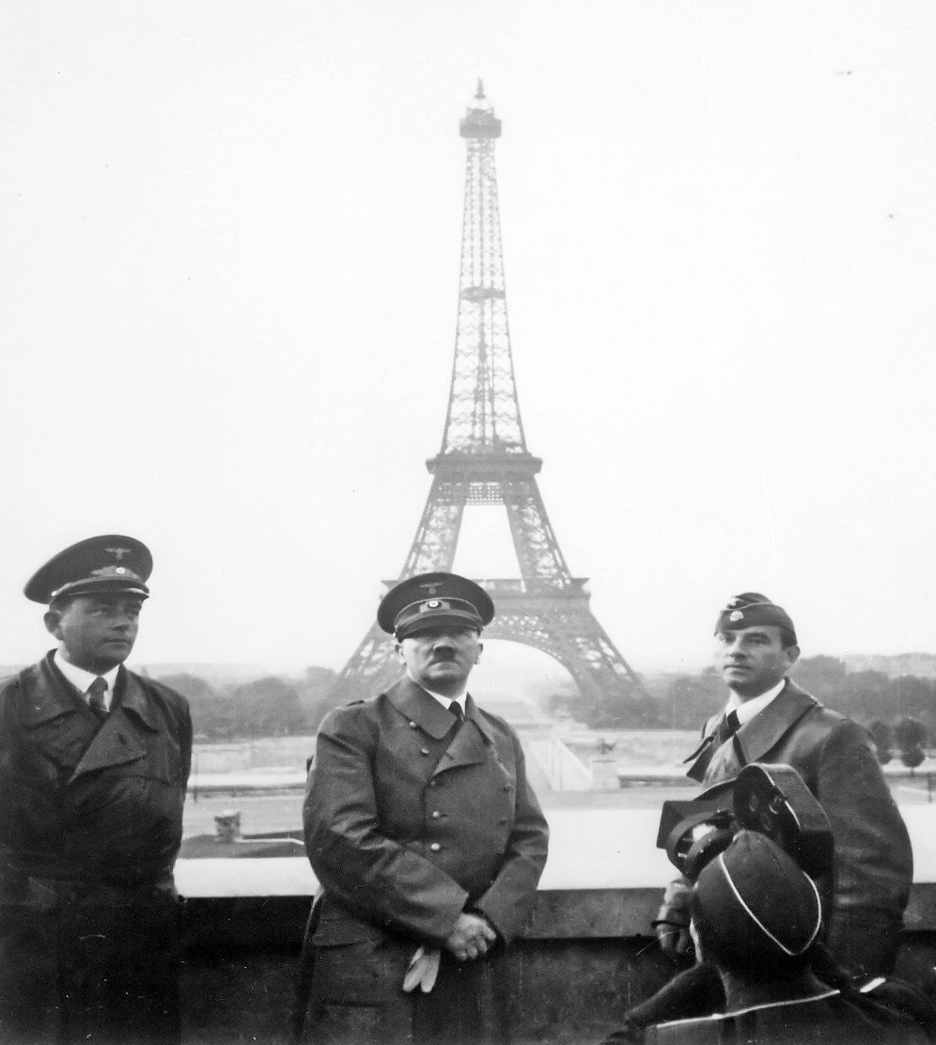
Hitler in Paris
Notes:
Hitler with Albert Speer and Arno Breker with the Eiffel Tower in the background

Slide 21
Consequences
The Fall of France alarmed the United States, leading to an expansion of the Army (by means of the first peacetime draft) and the authorization for the building of a two-ocean Navy
It changed the strategic equation for Japan in East Asia by
  It suggested that Japan might get control of French Indo-China
    Japanese control of northern Vietnam and Laos would help the Japanese cut China off from the outside world
    Japanese bases in southern Vietnam and Cambodia could be used as jumping off points for the seizure of British and Dutch possessions in southeast Asia
  Raising the question of the future of the Dutch East Indies
  It opened the door to the British possessions in South and Southeast Asia

Slide 22
The Battle of Britain

Slide 23
German Strategy
After the fall of France, Hitler hoped that Britain would make peace
  On 19 July, he made a peace feeler to Britain which Churchill rejected
Hitler saw two possible ways for Germany to defeat Britain
  One was a naval blockade involving submarines, mines, and surface ships
  The other was an air offensive that would either pound Britain into submission or clear the way for invasion by destroying the Royal Air Force
In mid-1940, however, neither way could work
  Germany had too few submarines and while she began constructing large numbers of subs after the war began, and especially after fall of France , it would be a while before they could play a role
Notes:
Peace feelers – Having failed to destroy the British army in Belgium, Hitler had hoped that with the defeat of France, Britain would make peace. In this he was disappointed. He was not so much interested in conquering Britain as in ensuring that Britain would let him have his way on the Continent. Since Britain was not only an island fortress but also a Mediterranean power, a continuing war would oblige Hitler to campaign against British sea routes and bases in the Mediterranean, to occupy or least control the whole of France and Spain, and to put German forces in North Africa. Such a war would delay Hitler’s project to obtain lebensraum in the Soviet Union and would not be the short Blitzkrieg war that Hitler liked to fight. On the other hand, an unconquered Great Britain would be a thorn in Germany’s side and also a possible American base in any war between Germany and the United States.
Plans for War with Britain – There were two possible ways for Germany to defeat Britain. One was to have the German Navy blockade and starve the British. A naval strategy entailed submarine warfare supplemented by commerce raiding by surface vessels and the mining of British coastal waters. Hitler, however, had neglected the navy, preferring to devote his stretched resources to the Wehrmacht and the Luftwaffe. At the outbreak of war, Germany had 2 obsolete battleships, 3 “pocket” battleships, 2 battle cruisers, 8 cruisers, 22 destroyers, and only 57 ocean-going submarines. Two battleships and a battle cruiser were commissioned in 1941. The alternative to a naval blockade was an air offensive designed either to make Britain capitulate under the sheer weight and terror bombing or to clear the way for invasion by destroying the Royal Air Force.

Slide 24
Notes on the Battle of Britain
Initially, the Luftwaffe confined its bombing operations to daylight bombing of military-related targets – especially those related to the Royal Air Force
In June through August 1940, this involved extensive aerial combat with heavy losses of fighters on both sides and heavy losses of bombers on the German side
At the end of August 1940, the Germans switched to night bombing of cities
  While this caused great damage and many civilian casualties, it had virtually no effect on either British war production or on the Royal Air Force’s ability to maintain air superiority over Britain
Notes:
The German switch in tactics - When a large number of German airplanes accidentally bombed London on August 24th, the RAF replied with an attack on Berlin. This led Hitler to order mass bombings of London. The attacks on London and other British cities, while causing great damage and numerous casualties, exposed the Luftwaffe to heavy losses whild enabling the RAF to rebuild its support system. When, in response to the heavy losses in daylight raids, the Germans shifted to !! night bombing, their losses dropped but so did their effectiveness. It meant that the British fighter defenses had held in daylight, and this meant that any German invasion would be a highly risky endeavor indeed.
End of the Battle of Britain - The Battle of Britain petered out as the Germans began to shift Luftwaffe assets to eastern Europe in preparation for the coming invasion of Russia. Over all, the Battle of Britain cost the British 60,000 civilian casualties.

Slide 25
Why Germany Lost
The German attempt to bomb Britain into submission and destroy the Royal Air Force failed for the following reasons:
  The Luftwaffe lacked both heavy bombers and long-range fighters
    This meant light bomb loads and no fighter protection beyond southeast England
  By mid-1940, British fighter production was beginning to exceed that of Germany
  Since aerial combat took place over England, it meant that British pilots who were shot down could fight again while German pilots who were shot down became POWs
  British radar alerted the Royal Air Force to German bombing raids so that the Germans could not catch British fighters on the ground
Notes:
The Luftwaffe – The Luftwaffe had been built and trained with the dual functions of winning local air superiority and of providing close air support of the German panzers and infantry. It had neither the doctrine nor the aircraft needed for strategic long-range bombing. The Junkers Ju-87 Stuka dive bomber, with its shark-painted nose and screeching sirens, was good at strafing soldiers and refugees and dive bombing battlefield targets, but it was slow, had a low ceiling, and was not designed to do strategic bombing. The Heinkel He-177 and Dornier Do-217 were fast, lightly-protected medium bombers that had only a limited bomb load and were very vulnerable in daylight unless protected by fighters. The Germans had an excellent fighter, the Messerschmidt Me-109E which was highly-maneuverable and well-armed with cannon and machine guns, but it only had a range of 100-125 miles and remain in the air for only 1½ hours. This meant that it could escort German bombers only to the southeast of England and could not linger long in the air over England.

Slide 26
The War Moves East and South

Slide 27
Romania
On 28 June, the Russians demanded that Romania cede Bessarabia and Northern Bukovina
These cessions led to a coup which overthrew King Carol and made pro-Nazi General Ion Antonescu dictator on 5 September
On 8 October, German troops entered Romania to “protect” the oil fields
On 22 November, Romania joined the Berlin-Rome-Tokyo Pact
Notes:
Bessarabia & Northern Bukovina – This area had been promised in the secret protocol of the Nazi-Soviet Pact to the Soviet Union, These territories consisted of 19,300 square miles with a population of 3,500,000.
German troops in Romania - An implication of the decision to attack the Soviet Union was a desire to make allies of Finland and Romania. In the Nazi-Soviet Pact of 1939, Finland had been allocated to the Soviet sphere and Germany respected this agreement. But after Hitler decided to go east, Germany began to send weapons to Finland, at first secretly and later openly. Romania was important to Germany because it was the principal source of Germany’s oil.
Romania’s accession to the Tripartite Pact – This meant that Romania would be an ally of Germany in the invasion of the Soviet Union. It also meant that German troops could transit through Romania in their subsequent invasions of Yugoslavia and Greece.

Slide 28
Italian Offensives
Germany, while involved in the Battle of Britain, encouraged Italy to attack British positions in the Mediterranean
This led to Italian invasions of British Somaliland in August, Egypt in September, and Greece in October 1940
  If the Italians had succeeded, they would have greatly aided Hitler by:
    Sealing off the Balkans from the South,
    Ousting the British from the Mediterranean
    Placing Axis forces close to Palestine, Iraq, Saudi Arabia, and the Russian oil fields of the Caucasus
Notes:
Italian invasions – The Italians launched their invasion of British Somaliland from Italian Somaliland (present-day Somalia), their invasion of Egypt from Libya (which was then an Italian colony and had been so since before World War I), and their invasion of Greece from Albania (which Mussolini had invaded in April 1939)
If the Italians had succeeded - If the Italians had succeeded in their endeavors, it would have helped the Germans considerably. Italian control of Greece would have sealed off the Balkans from the south during the invasion of the Soviet Union. An Italian conquest of Egypt would have dealt a serious blow to Britain (virtually ousting her from the Mediterranean); allowed Axis forces to threaten Palestine and Saudi Arabia and support pro-Axis forces in Iraq; and placed Axis forces within striking distance of Russian oil in the Caucasus

Slide 29
Italian Debacles
The Italians, however, did not succeed in any of their endeavors
  British forces from Kenya and the sea invaded and captured all of Italian-occupied East Africa in November
  After initially advancing into Egypt, a British attack in December destroyed the Italian 10th Army (taking 115,000 prisoners in the process) and captured Cyrenaica (the area around Benghazi)
  The Greeks halted the Italian invasion from Albania and in their counter-attack captured about a quarter of Albania.
This had several major consequences
  It ended Mussolini’s dream of creating a new Roman Empire
  It forced Hitler to come to the aid of his Italian ally
Notes:
Italian debacles – East Africa -- In November 1941, British forces from Kenya and the sea invaded and occupied all of Mussolini’s East African empire – which consisted of present-day Ethiopia, Eritrea, and Somalia. The British capture of Italian East Africa had two major consequences for the war. First, the U.S. government could now claim that the Red Sea was no longer a war zone and thus open under the Neutrality Act to American shipping as of April 11, 1941, when President Roosevelt so announced. U.S. ships could now carry Lend-Lease supplies directly to Suez, aiding British forces in Egypt and relieving the pressure on British shipping. Second, the removal of Italy from Northeast Africa cleared the Axis from the western shore of the Indian Ocean, a matter of major significance when Japan later entered the war and there were Axis hopes of cutting Allied lifelines through the Indian Ocean.
Italian invasion of Egypt & British counter-attack -– On 13 September 1940, the Italians invaded Egypt, advancing as far as Sidi Barrani. Despite the danger of invasion of the home islands, the British sent significant reinforcements to Egypt. The extra planes, tanks, and troops – the last mostly from India and Australia – added to the units defending Egypt enabled British GEN Sir Archibald Wavell to launch an offensive on December 9th against the Italians who had halted their initial advance into Egypt at Sidi Barrani. Surprising and overwhelming the Italians, the attacking forces destroyed three Italian divisions and pushed the Italians back 60 miles to the Egyptian-Libyan border. After a two-week pause to bring up supplies, the British struck again on January 3, 1941. In a series of alternating infantry assaults and armored thrusts, the British in the following four weeks destroyed the Italian 10th Army, taking 115,000 prisoners and capturing the whole of Cyrenaica, including the coastal fortress towns of Bardia, Tobruk, and Derna
Dreams of Empire – In the words of historian Gerhard Weinberg A World at Arms, “The Italian debacles in Greece, Egypt, and East Africa ended Mussolini’s dreams of great power status, and made him dependent upon rescue in Greece and Libya by Germany. The price of German rescue was the end of Italian independence.”
Coming to Italy’s aid - As a result, Hitler was determined to take action to save his friend. He sent transport planes to assist the Italian air force in ferrying troops and supplies to Albania; sent the 10th Air Corps to Sicily and southern Italy to bomb Malta, attack British naval and merchant shipping in the Mediterranean, and bomb and mine the Suez Canal; and sent the Africa Korps under GEN Erwin Rommel in February 1941 to Tripoli. Finally, the Germans invaded Greece going through Romania and then Bulgaria and Yugoslavia

Slide 30
Why Hitler Went to Mussolini’s Aid
From Hitler’s perspective, Italian defeats opened up a series of dangers to Germany
  Defeat in Greece could open up a second front in Germany’s rear once Germany had invaded Russia
  British bombers in Greece could attack the Romanian oil fields from which Germany got the bulk of its oil
  The loss of Libya would open Italy to attack from the South and possibly lead to the defection of the Vichy-controlled French colonies in North and West Africa to De Gaulle
  Italian defeats, if allowed to stand, could bring down the Mussolini regime
Notes:
The reality of Italian defeats, by contrast with the possibility of Italian victories, opened up a series of dangers from the perspective of Berlin. The defeat in Greece could lead to the opening of a real Balkan front in the war – an intolerable situation for a Germany which wanted to concentrate its land and air forces for an attack on Russia – and, possibly even more dangerous, might result in the stationing of British planes on Greek air bases from which they could attack the Romanian oil fields.” Meanwhile, a British occupation of the whole of Libya would open the Mediterranean to British shipping, Italy itself to attack from the south, and quite possibly the defection of the Vichy-controlled French colonies in North and West Africa to de Gaulle and the Allies. It could, combined with the unavoidable loss of Italian East Africa, bring down the Mussolini regime.

Slide 31
Yugoslavia
Yugoslavia joined the Tripartite Pact on 25 March 1941 in the hope of getting the Aegean port of Salonika
This precipitated a coup on 26-28 March with the new government disavowing the pact and proclaiming neutrality
As a result, Hitler decided to invade Yugoslavia as well as Greece
The conquered Yugoslavia was partitioned into an Italian-controlled area, a German-occupied area, a Croatian puppet state ruled by a genocidal Croatian nationalist, and a Serbian puppet state administered by the Germans, with portions ceded to Bulgaria and Hungary
Notes:
Hitler’s decision to invade - When the Yugoslav government that had adhered to the Tripartite Pact on March 25, 1941 in the hopes of getting the Aegean port of Salonika was overthrown in a coup two days later, Hitler decided to invade and conquer Yugoslavia as well as Greece
Partition of Yugoslavia - Upon the German invasion in 1941, large portions in the north were directly annexed to Germany. There the people sup­posed to be of Germanic ancestry were to be re-Germanized and most of die rest driven out. Some of the expelled Slovenes were settled in Croatia or other parts of occupied Yugoslavia; many perished as a result.¹⁷⁰ Italy annexed large portions of Yugoslav territory both in the north and along the Adriatic coast, while Hungary was awarded a sub­stantial piece of land in the north and Bulgaria in die south. Further­more, the pre-World War I state of Montenegro was revived, now under Italian control, and Italian-dominated Albania was substantially expanded as well. The rest of the country was divided between a nomin­ally independent state of Croatia and a Serbia under German military administration with a puppet government of its own.
Croatia – In Croatia, the extreme Croatian nationalists, the Ustasha of Ante Pavelic, were put in charge. A small and violent group of fanatics, they were determined to expel or exterminate all Serbs, Muslims, and Jews in the area under their control. With no discernible administrative skills, the new masters of Croatia quickly plunged the area into bloody chaos, tried to play off the Germans and Italians against each other, and enormously heightened the already bitter feuds between all segments of the population.
Serbia - In German-occupied Serbia, the major economic aim of the Germans, the exploitation of the Bor copper mines, was attained, but all else quickly sank into an administrative chaos of German civilian, military, and police agencies and plenipotentiaries which rivalled the confusion in Croatia. Led by an unusually fanatic group of military officials of various sorts, and encouraged by the OKW, which complained that far too few prisoners and others were being shot,¹⁷¹ the German forces stationed in Serbia soon strove to set new records of brutality. Those shot were usually the innocent bystanders,¹⁷² and also Jews who were systematically killed off by die military. It did not take long for the population to realize that, in a situation of indiscriminate slaughter, the resisters had a better chance of survival than the acquiescent.

Slide 32
Greece
The Italian setback in Greece offered the British an opportunity to create a Balkan front from which the Romanian oil fields could be bombed
When the Greeks saw that the Germans would attack through Bulgaria and Yugoslavia, the Greeks requested British aid
Unfortunately, the Germans could bring much more military power to Greece than could the British. As a result:
  Greece was conquered by the Germans and the British were forced to evacuate, losing many soldiers and all their equipment in the process
  Enabled the Germans under Rommel to halt the British advance and drive them out of Libya
    This made Rommel a hero and catapulted him into the public limelight
Notes:
British support to Greece - The Italian attack on Greece with its obvious setbacks appeared to offer the British an opportunity as well as an obligation – the guarantee that Britain had given to Greece in 1939 when Italy occupied Albania. The opportunity was the possibility of creating on the continent of Europe a Balkan front based in Greece and supplied from North Africa, from which the Romanian oil fields could be attacked. As it became clear that the Germans would attack Greece through Bulgaria, the Greeks sought British land forces to aid in defense along the Bulgarian frontier. This led to the diversion of British troops from North Africa, leaving Tripolitania as a base for the newly-arrived Africa Corps to attack the British in Cyrenaica. While it was done to honor the political promises made to the Greeks, it disregarded military realities. First, the Germans could bring massive power to invade Greece over their land supply routes while the British lacked the ability to bring a remotely equivalent force to Greece. Second, while the Royal Navy could transport troops to Greece, the British simply did not have the land and air forces in the Mediterranean sufficient to both defend Greece and push the Italians and Germans out of Libya. Thus, the successful transport of troops and equipment to Greece only assured the loss of all the equipment and many of the soldiers
Implications for North Africa - The combination of a British deliberate halt in order to send forces to Greece and the beginnings of German intervention temporarily stabilized a front near El Agheila. As soon as Rommel had his first detachments [the 5th Light Infantry Division] in place, he decided to attack on March 31st (rather than waiting for the armored division that was to arrive in May). In less than two weeks, with the aid of the Italian armored divisions, he drove the British out of Cyrenaica. Rommel’s spectacular advance catapulted him into the public limelight and Hitler’s favor; but the quick drive with limited resources made it impossible for Rommel to accomplish any greater purpose. As his forces advanced, the British fortified Tobruk and held it against the Germans. Unable to advance into Egypt without taking Tobruk (so that he had an unobstructed land route along the coast, could use that port to receive supplies, and concentrate his forces without having to divert forces to defend the perimeter around Tobruk), he could only ward off British attacks.

Slide 33
Fighting in the Desert
In North Africa, fighting took place in a 1,200 mile long coastal strip between Alexandria and Tripoli that was mostly 40-miles wide, bounded by the Mediterranean and either high ground or marshy depression
  In this strip, the chain of small ports was the only but essential points of military value
  The goal of each side was to seize the ports and thereby deprive the enemy of water, fuel, ammunition, food, and reinforcements
As the Axis moved into Egypt or the British into Libya, supply lines became stretched and subject to both supply difficulties and aerial bombardment
  The Axis got their supplies via ships sailing from Sicily to Tripoli while the British got their supplies via ships coming through the Red Sea and the Suez Canal
Notes:
In the North African desert, air and sea power assume major importance. Tanks and trucks cannot hide in a desert and thus are subject to bombing and strafing, Both the British and the Axis were dependent on supplies, equipment, water, fuel, and reinforcements shipped via sea to their respective main supply ports of Alexandria and Tripoli.

Slide 34
Temporary Stalemate in North Africa
By May 1941, a temporary stalemate had been reached in North Africa
  Rommel could not advance because of the impending attack on the Soviet Union
  The British 8th Army could not advance because of the need to send forces to Crete, Syria, and Iraq
The German conquests of Yugoslavia and Greece, and the reconquest of Cyrenaica, seriously altered the military situation and saved Mussolini’s regime in Italy
However, the German decision to invade Russia in June 1941 prevented the Axis from securing victory in the Mediterranean theater
Notes:
Why Rommel could not advance - Major reinforcements could not be sent to Rommel because German planning assumed that the main German effort would directed against the Soviet Union in 1941 – a push into the Middle East would follow, not precede the expected victory over Russia.
Why the British could not advance - One reason was the need for the British to divert forces evacuated from Greece to campaigns first in Iraq and then in Syria, reducing the strength available for operations in the North African desert. A British offensive in May 1941 failed to either dislodge Rommel from the Egyptian-Libyan border or to relieve the siege of Tobruk.
Choosing between victory in the Mediterranean or invasion of Russia -The rapid reconquest of Cyrenaica along with the successful German invasions of Yugoslavia and Greece dramatically altered the military situation in the Mediterranean and also saved the Fascist regime in Italy.!! But what looked like an opportunity for Germany to strike into the Middle East was in fact a process of closing down operations in that area so that German attention and resources could be assigned to the invasion of Russia.

Slide 35
A Note on Iraq
On 2 April 1941, pro-Axis members of the Iraq Army staged a coup which brought to power Rashid Ail al-Gaylani
  This led the British to move troops into Iraq
  The Germans sent a Luftwaffe squadron, but it was not enough to turn back the British invasion
On 30 May 1941, the British captured Baghdad and restored the rule of the Iraqi regent
One of the officers participating in the coup was Khairallah Talfah who was dismissed from the Iraqi officer corps and spent 6 years in prison
  After prison, his nephew (who had lived with him prior to prison) moved in with him. Khairallah imbued his nephew with his hatred of the British, his Nazi views, and his hatred of Jews
Notes:
Pro-Axis coup - On 2 April 1941, just before the German moves into Yugoslavia and Greece, pro-Axis elements in Iraq staged a coup which brought to power Rashid Ali al-Gaylani, who hated the British, and hoped for a German victory. The British moved troops from India to Basra the airfield at Habbaniya, some 55 miles west of Baghdad. The government of Rashid Ali protested, sought help from Germany and Italy, surrounded the airfield, and on May 2nd, attacked it. Receiving reinforcements from Palestine, the British cleared the area around Habbaniya, and advanced on Baghdad, which they reached on May 30th. Key Iraqi leaders either surrendered or fled to Iran. While the Luftwaffe was able to send a fighter squadron to Iraq in May, but they had little effect upon the outcome. In the planning of German strategy, Iraq, like Egypt, came after, not before, the campaign in the East
The nephew’s name – Saddam Hussein

Slide 36
Crete
After conquering Greece, the Germans debated whether to invade Crete or Malta
  Crete won out because its possession would protect Italian tanker traffic between Italy and Romania
The Germans used parachute troops to seize a major airfield at which they could fly in reinforcements and base aircraft
The Germans underestimated the Allied defenses and suffered casualties so heavy that they wrecked the German airborne forces and put an end to Hitler’s willingness to use them
The Allies lost 4,000 KIA and had 12,000 taken prisoner
The attempt of the Royal Navy to supply and then later evacuate troops led to heavy ship losses
  Crete demonstrated that warships could not operate in waters controlled by enemy land-based aircraft
Notes:
Crete or Malta – While fighting too place in Iraq, the Germans won a spectacular airborne invasion victory in Crete. The Germans invaded Crete in order to prevent the British use of the naval base at Suda Bay to interrupt tanker traffic between Romania and Italy which provided much of Italy’s oil supply. Competing with the German desire to capture Crete was the desire to seize Malta. As a British naval and air base, Malta lay across German and Italian supply routes to North Africa. It also provided an excellent base for attacks on Sicily and the Italian mainland. In Axis hands, Malta would protect the route to North Africa and the coast of Sicily while blocking the Central Mediterranean to the British navy. While the high command of the German armed forces (OKH) favored an attack on Malta, the Navy, Goring, and GEN Kurt Student, the German airborne forces expert, all favored Crete. The Germans planned to have parachutists seize two airports followed by transport planes to bring in reinforcements. Codebreaking gave the British an excellent knowledge of German plans, and the Germans greatly underestimated the strength of British defenses on the island. While New Zealand, British, and Greek troops inflicted heavy casualties on the invaders (who attacked on May 20th), the Germans were able to seize a major airport on May 21st and that, along with German control of the air, sealed the outcome since the Germans could use the airport to land reinforcements and supplies in Crete. On May 26th, the British began evacuating troops and completed the evacuation on June 1st. The British were able to evacuate 16,000 troops, but lost 4,000 KIA and had 12,000 taken prisoner. The attempt of the Royal Navy to supply, assist, and eventually evacuate the forces on Crete cost dearly. Three battle cruisers and 6 destroyers were sunk, while an aircraft carrier, 2 battleships, and several other warships were severely damaged. The Crete operation showed again that warships could not operate in waters controlled by an enemy’s land-based planes. Meanwhile, German losses had been extremely heavy. Several hundred planes were destroyed or damaged while the 4,000 KIA and 2,500 wounded vastly outnumbered the casualties of the whole Yugoslav and Greek campaigns. The Crete operation wrecked the German airborne forces and put an end to Hitler’s willingness to use them in an airborne operation capacity forever after

Slide 37
The Invasion of Russia
June 1941- December 1941

Slide 38
The Problem of Britain Still in the War
By late-1940, Hitler realized that Great Britain would not make peace
In his eyes, Britain stayed in the war in the expectation that the Soviet Union and the United States would eventually ally with Britain
There were two ways to deal with the British problem
  Get the Soviet Union to invade India and the Persian Gulf OR
  Invade the Soviet Union
When Molotov in his visit of 12-13 November 1940 ruled out the first, Hitler decided on the second
Notes:
By the end of July 1940, German leaders realized that Britain was not willing to make peace.
Russia vs Britain - Hitler, while definitely leaning toward an attack on Russia, was willing to leave Russia alone provided that it accepted German control of Europe and joined in helping dismember the British empire by striking into India. What made Barbarossa inevitable was the outcome of Molotov’s visit to Berlin on November 12-13, 1940.

Slide 39
12-13 November 1940
On 12 November 1940, Molotov visited Berlin to talk with Hitler and other German leaders
  Hitler while never abandoning his goal of conquering land in Russia nevertheless was willing to allow the Soviets to join the Tripartite Pact provided the Soviet Union attack towards the Persian Gulf and India
  Molotov, in principle, was willing to join the Tripartite Pact, provided that the Germans agree to the Soviet annexation of Finland and Soviet seizure of the straits linking the Black Sea and the Mediterranean
  The Germans, however, would not agree to either the Soviet annexation of Finland or Soviet seizure of the Straits & the Russians were unwilling to invade Iran or India.
On the same days, British carrier aircraft staged a surprise night-time raid on the Italian naval base at Taranto with carrier-launched torpedo planes, damaging 3 battleships and other vessels as well
Notes:
Russia & the Tripartite Pact - If Russia attacked toward the Persian Gulf and India, it would involve the Soviet Union in a war with Great Britain since both Iran (with its Anglo-Iranian oil resources – oil that the British Navy relied on ) and India (the jewel of the British Empire) were vital to Britain. From the German perspective, if Russia helped knock Britain out of the war, so much to the good; even better if Russia also got roughed up in the process, making a subsequent German invasion of Russia that much easier.
Taranto – The attack took place at night with carrier-based planes carrying torpedoes. The attack damaged 3 battleships, one beyond repair. The Japanese were very interested in what had happened at Taranto. It might be noted that the harbor of Taranto shared some features similar to that of Pearl Harbor.

Slide 40
German War Plans - 1
Hitler issued a general directive concerning the invasion of Russia on 18 December 1940
  The idea was to trap and destroy the Red Army close to the border via panzer pincer movements to prevent trading of space for time
  The goal of the operation was a line running from Archangel on the Arctic Ocean to Astrakhan on the Caspian Sea
  It was expected that the Wehrmacht would complete the operation in two or three months
    This was to prove a disastrous assumption given the weakness of German logistics
Notes:
Invasion Thrusts - The main attacks were made by three German Army Groups – North, Center, & South. Army Group North with three field armies headed into the Baltic states toward Leningrad. Army Group Center with four field armies headed into the area of Byelorussia north of the Pripet Marches and thereafter towards Moscow. Army Group South with three field armies headed into the Ukraine. These advances were supplemented in the North by Finnish army attacks directed at the Murmansk railway, the Kola Peninsula, and on both sides of Lake Ladoga toward both Leningrad and its connections to the rest of the country. They were supplemented in the South by two Romanian field armies and the German 11th Army which invaded Bessarabia and headed towards Odessa.
Rationales – The rationale for heading to Moscow was that under Stalin all authority was concentrated on Moscow and that Moscow was also the central hub of the Russian railroad system. Leningrad was a major center of war production, and the Ukraine was both a resource rich area and the breadbasket of the Soviet Union.
Length of the campaign - Since it was assumed that the whole operation would be over in two to three months, no preparations were made for winter fighting – a lack that was the cost the Germans dearly in the winter of 1941-42 .

Slide 41
German War Plans - 2
The decision to invade Russia led to the following:
  Timing – The invasion would take place in late spring after the Spring thaws
  The decision to make allies of Romania and Finland
  The decision to avoid U-boat attacks on American shipping while also promising Japan support if it got involved in a war with the U.S.
Notes:
Timing - Russia has a twice-yearly wet season (called the rasputitsa) caused by the autumn rains and the spring thaw, which turns dirt roads to quagmires and surrounding steppe to swamp – a major hindrance to Panzer tank operations
Finland and Romania as allies - Another implication of the decision to attack the Soviet Union was a desire to make allies of Finland and Romania. In the Nazi-Soviet Pact of 1939, Finland had been allocated to the Soviet sphere and Germany respected this agreement. But after Hitler decided to go east, Germany began to send weapons to Finland, at first secretly and later openly. Romania was important to Germany because it was the principal source of Germany’s oil
Hitler and the U.S. – The decision led Hitler to instruct German submarines to avoid incidents at sea with the U.S. despite the German Navy’s eagerness to strike at American shipping. It also made the position and role of Japan with its large navy more important in German eyes. It made Hitler eager to get Japan to invade Southeast Asia so that it would tie up the U.S. in the Pacific while Germany was still building its own blue water navy. Hence, the Tripartite Pact of September 27, 1940 between Germany, Japan, and Italy.

Slide 42
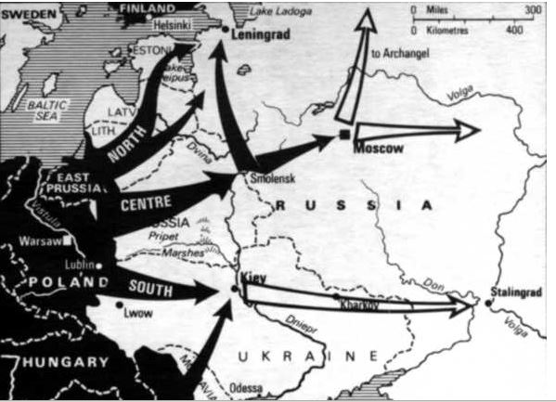
Plan for the Invasion of Russia

Slide 43
Warnings Disregarded
Stalin had many prior warnings that Hitler was about to attack the Soviet Union
  From Roosevelt & Churchill
  From Russian spies in Germany (including the Rote Kappel)
  From German Communist defectors from the Wehrmacht
  From Richard Sorge, a Russian spy in Tokyo who was privy to the dispatches of the German Ambassador
  From the large number of reconnaissance overflights by German aircraft
The Russians had excellent intelligence but because it was not believed and acted upon, it was useless
Notes:
Stalin’s paranoia – Here, Stalin’s paranoia may have come into play. Paranoids have problems with trusting the bearers of unpleasant information that contradicts their assumptions. Stalin had many reasons to be fearful of what might happen if the Soviet Union got into a war. Many people had been alienated and came to hate the regime due to the purges, the forced collectivization of the farms, and the consequent famines that collectivization produced. Consequently, bearers of bad news that invasion was imminent were unwelcome. He could not know that German barbarism and atrocities in Russia would solve his problem of a disaffected populace

Slide 44
Early German Successes
The attack on the Soviet Union was launched in the early hours of 22 June and achieved total surprise
  Over 4,000 Soviet planes were destroyed in the first week, giving the Luftwaffe total air superiority for the next few months
  In the first two weeks, Army Group Center completed two major encirclements of Soviet forces, capturing over 300,000 soldiers in each encirclement, and also capturing Smolensk
  Army Group North reached Estonia and the outer defenses of Leningrad
  Army Group South captured Kiev
This led to early German overconfidence
Notes:
Early German victories - The Germans wanted to encircle as much of the Red Army as possible and destroy it as close to the border as possible, hoping that such terrible initial blows would cause the whole Soviet structure to crumble. In the center, the German concept worked as two major encirclement battles resulted in the capture of over 300,000 Russian soldiers; but in both the north and the south, the Russians were pushed back rather than cut off. Soviet losses in KIA, WIA, equipment, and transport were huge.
German overconfidence - The initial German victories and advances gave the German leaders the impression that they had won the war and that all that was left was the mopping up. On July 3rd, GEN Franz Halder wrote in his diary “It is probably not too much to say when I assert that the campaign against Russia has been won in two weeks.”

Slide 45
Things Were Not What They Seem
Despite the impressive German victories, the Russians were maintaining a continuous front
A steady stream of new units were appearing in the Russian order of battle
Instead of surrendering, the Russians were fighting hard
The Red Air Force was beginning to revive
The Germans began running into logistic problems
  Consequently, they had to pause in late-July and early-August for refurbishing of their tanks and resupply of their units
Notes:
Effect of German war policies on Russian morale – Initially, many Russians, Ukrainians, Byelorussians, Lithuanians, and Latvians greeted the Germans as liberators and many encircled Russian troops surrendered without putting up too much of a fight because they believed that the Germans would treat POWs and enemy civilians decently as they did in World War I. The German policy of killing certain categories of Soviet POWs such as political commissars and Jews and of allowing the rest to die of disease and starvation backfired on the Germans. Nothing enrages a soldier more than seeing his fellow soldiers become the victim of enemy atrocities. As word leaked out of German atrocities and POW mistreatment from civilian witnesses and POW escapees, Russian attitudes towards Germans turned to hatred.
Realizations - By August, it became evident to the Germans that they would not reach either the Caucasus or Murmansk in 1941 and that the campaign would continue at least into 1942
Logistics problems – The Germans depended partly on trucks and mostly on horses to supply their units at the Front. As they moved further into Russia, the German ability to supply their troops declined as their supply lines lengthened. Before they could renew the advance, they had to repair and modify the Soviet rail system so that it could accommodate European-gauge locomotives and rail cars.

Slide 46
Success Then Stalemate
With Army Group Center pausing to refurbish and resupply, Hitler diverted major units from that Group to Army Group North and Army Group South
  This allowed Army Group North to reach Lake Ladoga and cut off land communications to Leningrad, putting the city under siege
  It allowed Army Group South to encircle and capture over 600,000 prisoners and thousands of artillery pieces, and also capture Kharkov and Rostov-on-the-Don
  But it delayed the German thrust toward Moscow until the end of October
The renewed offensive of Army Group Center envelope two Soviet armies which led to the capture of another 600,000 prisoners and brought Army Group Center to within 50 miles of Moscow, where it was finally halted
Notes:
Army Group North -- In October and November, the German Army Group North which had cut off Leningrad (and also a smaller Red Army-held enclave to the West) made one last effort to strike eastward to Tikhvin and beyond in the hope of joining up with Finnish forces east of Lake !! Ladoga. This final gasp of German offensive strength sputtered out in the December snows as the Russians held fast after initial retreats. The Germans were incapable of pushing beyond Tikhvin, and the resulting salient almost invited attack
Army Group South -The major German -operation on the southern part of the main front in the East involved the use of armored formations of which one, previ­ously with Army Group Center, drove southward to meet another arm­ored assault northward across the Dnepr river at Kremenchug. Meeting about 150 miles east of Kiev, these operations in September 1941 led to the destruction of huge Soviet forces; the Germans took over 600,000 prisoners and captured thousands of guns; but once again the Soviet leadership was able to build up a new front.ª Like the German Army Group North, that in the south could and did win more local victories, taking most of the Crimea and occupying much of the central and eastern Ukraine, including the great city of Kharkov, and also advancing along the north shore of the Sea of Azov. This advance culminated in the seizure of Rostov at the mouth of the Don river on November 21, but here, as in the north, German offensive strength was at an end. In the following days, the Red Army's counter-attacks not only stopped the invaders but drove them out of Rostov, and thus doomed all German hopes of cutting off the Soviet Union's ability to transport oil from the Caucasus oil fields to her armies and factories—to say nothing of seizing these oil fields for the Third Reich
Army Group Center - The units sent to assist the German Army Groups in their September offensives in the north and south returned to the Central front for a renewed attack in October. The supplies needed for a renewal of the attack in the center had now been brought forward. In two great armored breakthrough and envelopment operations, the Germans tore up the major Soviet forces on that front, capturing another 600,000 prisoners and moving within 50 miles of Moscow. As German announcers pro­claimed final victory,²⁸ and the Soviet government evacuated most agen­cies from the capital to Kuibyshev, there was a temporary panic in Moscow.²⁹ But once again Red Army reserves, reformed units, and scratch formations held a new front with grim determination, even as German offensive strength waned because of lost or worn out equip­ment, heavy casualties, and a degree of exhaustion among the soldiers still fighting—which many at the highest levels of the German command !! structure did not comprehend. They had now to decide whether to make one more bid for Moscow or to halt and try again the following year.

Slide 47
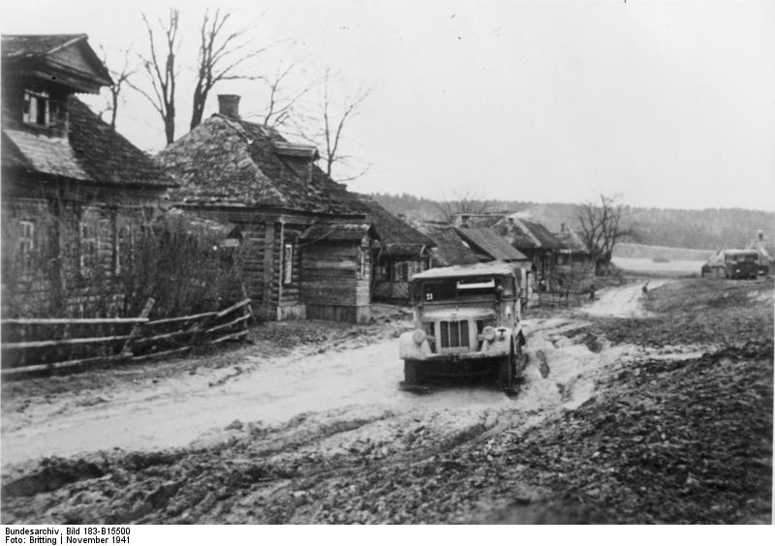
The Russian Rasputitsa
Notes:
Rasputitsa - Rasputitsa is the Rmussian term for the twice yearly muddy weather season – in Autumn from the heavy rains and in Spring from the winter thaws.

Slide 48
The Failure to Capture Moscow
Although Army Group Center was only 50 miles from Moscow, the situation now called for a major decision, especially since winter was now fast approaching
  Try to capture Moscow OR Halt and go on the defensive until next summer
The Germans tried to capture Moscow; but they were hampered first by the heavy November rains and then by the late-November and early-December snows and freezing temperatures
  It was now that the chickens of German overconfidence and inadequate logistics came home to roost
  The combination of inadequate supplies and Russian resistance halted the Germans 20 miles from Moscow and the attempt to capture Moscow was abandoned
Notes:
Halt & Wait until 1942 - There was some sentiment among the German military leadership that it would be best to hold the positions attained in late October and early November, straighten out the lines some, and try to use a defensive posture to remedy the very strained supply situation and provide some rest to the exhausted troops.
Try to capture Moscow - Others, including Hitler himself as well as the Commander-in-Chief of the army, Field Marshal von Brauchitsch and Chief of Staff General Haider, thought that one last push might win them Moscow, and with it better winter quarters for the German forces. Such a local victory would also disrupt the Soviet railway and command system, would mean that the Russians would lose Moscow's industrial facilities, and strike a major psychological blow. The now available evidence makes it clear that General Haider was the most influential and extreme advocate of a renewed offensive.
Chickens coming home to roost – Given Nazi misconceptions about Russia – misconceptions reinforced by the Soviet military purges and the poor performance of the Red Army in the Russo-Finnish War – the Germans had expected the war to be over long before winter set in. But when the Germans finally realized that the Campaign would run into 1942, the overstretched German logistics could not get winter supplies (such as winter boots and winter clothing) to the troops fast enough or in the quantity needed. As a result, many German soldiers suffered from exposure and frostbite. By Christmas, the Germans had suffered 100,000 cases of frostbite. The Germans also suffered from a lack of anti-freeze for their tanks and food for the men.

Slide 49
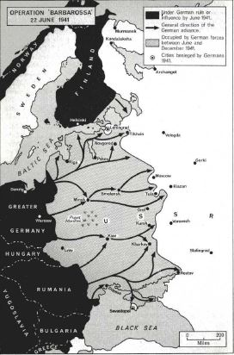
Map – Operation Barbarossa
Black – Area controlled by Germany and its allies prior to the invasion of Russia
Gray – Area occupied by Germany between 22 June and 6 December 1941
Arrow Lines – encircling movements of German armies

Slide 50
The Soviet Counter-attack
The Russian counter-offensive not only surprised the Germans but also the Western Allies
The Soviet offensive of 6-15 December 1941 forced the German lines back, inflicted great losses of men and equipment, and created panic among many German soldiers
Concurrent Soviet counterattacks elsewhere meant that the stretched out German forces in Army Group Center could not count on reinforcements from the other Army Groups.
The presence of a large number of T-34 tanks against which German tanks were overmatched and anti-tank weapons ineffective induced panic among German troops
Notes:
Concurrent attacks - The prior and concurrent limited but successful Soviet attacks at Tikhvin in the north and Rostov in the south meant that the stretched out German forces on the Central Front, exhausted and at the end of their own unsuccessful and already halted attacks toward Moscow, could not count on any substantial reinforcements from other segments of the front. Both north and south of the capital, Soviet reserve formations struck at the German pincers reaching for Moscow; and, immediately afterward, the Red Army also drove westward between the pincers. This carefully prepared and shrewdly timed offensive, planned and directed by Marshal Georgi Zhukov, totally surprised the Germans. Although the balance of forces only slightly favored the Russians, their superior equipment for the weather, the fact that many of the attacking units were rested, and the exhaustion and surprise of the Germans gave the Red Army a substantial advantage. The Russians smashed the German advance units and quickly threatened to cut off and destroy large portions of the German forces which had come closest to the city.
Notes about the fighting - The bitter fighting which marked December 1941 had several significant characteristics,
First, the Red Army was able to drive into the German lines and force them back, inflicting great losses on the whole central section of the front.
Second, in the process, the Germans not only suffered heavy casualties from both the combat and frostbite, but also lost vast quantities of equipment – not only to Red artillery, but also to the inability of the weakened surviving horses to haul it back, forcing the Germans to destroy it.
Third, there were clear signs of panic in many German units as poorly clad soldiers in the most wretched weather (for which they had not been equipped on the assumption that the fighting would have ended long before) faced an attacking foe who seemed likely to overwhelm them.
Fourth, despite a great Soviet victory, the Red Army was not able to trap any large German units. Sometimes with and sometimes against the orders of Hitler, the German generals on the spot were able to extricate their forces from encirclement.

Slide 51
The Soviet Counter-attack - 2
Several factors made possible the major Soviet counter-offensive which began on 6 December 1941
  The Soviets still had a major war production capability which had begun turning out large number of T-34 tanks and Katyusha multiple rocket launchers.
  Japan’s decision to go South allowed Stalin to move the Siberian divisions that had defeated the Japanese at Nomonhan to the Moscow Front.
  German intelligence had NOT picked up that the Siberian reserves were now available for a counterattack. This made the Germans extremely vulnerable.
  The facts that
    The Germans were operating in an environment in which their men lacked proper winter boots and clothing
    The cold froze their tanks and mechanical equipment
Notes:
Soviet industrial capability - The Soviets had built up in the Urals a major industrial and armaments base (to which they move industrial machinery and workers from area now under German control) which could keep the Soviet Army equipped and which had begun turning out in quantity the new T-34 tanks and Katyusha multiple rocket launchers
Japan Going South - The decision of Japan to strike south against Britain, the Netherlands, and the United States, rather than north against the Soviet Union which was discussed in the Preceding chapter, came to be known in Moscow. Much credit for this has been accorded to Richard Sorge, a Soviet spy in Japan whose inform­ants had apprised him of the Japanese choice long before the police !! arrest of October 18, 1941, ended his career in Soviet intelligence. While Stalin was unwilling to believe agent reports about the imminence of a German invasion, the fact that Sorge had predicted the German attack probably gave his analysis of Japanese intentions and his predictions of Japanese actions some credibility. Whether it was Sorge’s information or the desperate desire of Stalin to prevent the fall of Moscow, or a combination of the two, the decision was made in Moscow in early October to begin to move Soviet troops in the Far East along the Manchurian and Mongolian borders to Moscow. Although the Wehrmacht's offensive had been stopped, German intelligence estimated that Soviet forces had no more reserves left and thus would be unable to stage a counteroffensive. This estimate proved wrong, as Stalin transferred over 18 divisions, 1,700 tanks, and over 1,500 aircraft from Siberia and the Far East.
Cold - General Erhard Raus, commander of the 6th Panzer Division, kept track of the daily mean temperature in his war diary. It shows a suddenly much colder period during 4–7 December: from –36 to –38 °C (–32 to –36 °F). Official Soviet Meteorological Service records show the lowest December temperature reached –28.8 °C (–20 °F). The absolute numbers did not matter to the German troops who were freezing with no winter clothing, and whose equipment was not designed for such severe weather. More than 130,000 cases of frostbite were reported among German soldiers. Frozen grease had to be removed from every loaded shell[ and vehicles had to be heated for hours before use.

Slide 52
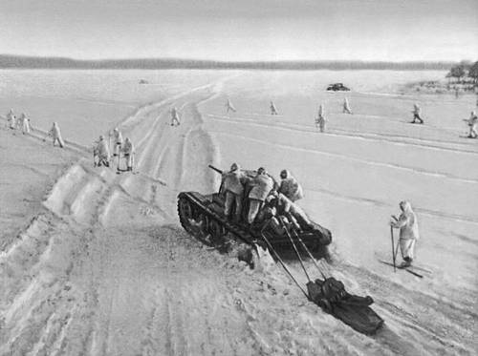
Russian Counter-offensive
Notes:
Notice that the Russians are wearing white winter uniforms which provide concealment against the snowy landscape

Slide 53
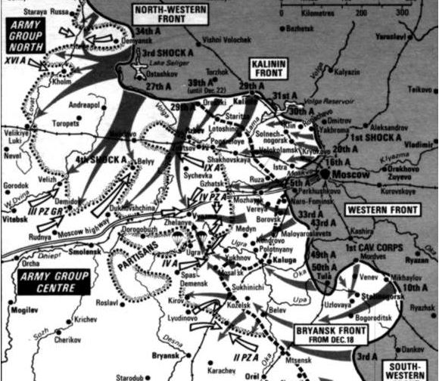
Russian Counteroffensive – December 1941

Slide 54
Effects of the Soviet Counterattack
On the German side, the prospect of Army Group Center being routed and driven into a Napoleonic-style retreat led Hitler to order Army Group Center to hold
  Army Group Center held but at a very heavy cost
The attack led Hitler to institute a whole series of changes in the Army Command
It ended German hopes for a quick victory over Russia and signaled the beginning of a war of attrition – a war Germany could not win
It revealed in the newly-liberated areas the brutality of Nazi rule
It led Stalin to order a January offensive on all fronts that was largely unsuccessful but which led Hitler to draw some fateful conclusions
Notes:
Changes in German command - Hitler instituted a whole series of changes at the top of his military command. This included the CIC of the German Army, the three Army Group commanders, and several field army commanders.
Germany and a war of attrition – As historian John Keegan The Second World War put it, “The worm in the apple of Hitler’s spectacular campaigns of 1939-41 was that they had been fought on an economic base too fragile to sustain a long war, but with effects on the will of his enemies which ensured that the war would inevitably lengthen into a do-or-die struggle unless he could quickly crown it with a swift and decisive victory. Hitler’s Germany … was a hollow vessel. As a producer of capital goods in 1939, she stood equal to Britain, with about 14 percent of world output, compared to 5 percent for France and 42 percent for the United States.
January offensive - On the northern front, the Russian attack was able to tear open the junction between Army Group North and Army Group Center, isolating a small German force in Cholm and a larger one with almost 100,000 soldiers around Demyansk. But the Germans were able to hold both “islands” in bitter fighting and with supplies brought in by the Luftwaffe were able to hold out until relieved in the Spring by advances from the remaining German front. This success may have inclined Hitler to over-estimate the possibility of air supply for an isolated force, disregarding that both ‘islands’ held fewer troops and were much closer to German air bases than the Stalingrad pocket later in 1942.

Slide 55
Total War
The failure of Germany to knock Russia out of the war and American entry into the war had two major effects:
  It led Hitler to finally order total mobilization of the German economy and systematic exploitation of Nazi-ruled Europe
    Hundreds of thousands of Germans were released from war industries and inducted into the Army
    Civilians from conquered territories and Russian POWs were brought into the Reich to perform industrial and agricultural labor
  It led Hitler to apply the “Final Solution” of the “Jewish problem” to the Jews in that part of Europe outside the Soviet Union

Slide 56
America Before Pearl Harbor

Slide 57
Nye Committee
Officially known as the Special Committee on Investigation of the Munitions Industry
  Headed by Senator Gerald Nye of ND
  Set up in 1934 to investigate the causes of U.S. involvement in World War I
The report concluded that wartime loans and sales to the Allies was a major factor in getting the U.S. into World War I
Documented the huge profits that arms factories had made during World War I & implied that the “merchants of death” not only profited from the war but got us into it
Led to the various Neutrality Acts
Notes:
Nye Committee -- Officially known as the Special Committee on Investigation of the Munitions Industry, it was a committee in the United States Senate which studied the causes of United States involvement in World War I. There were seven members of the committee, which met between 1934 and 1936. Led by Senator Gerald Nye of North Dakota, the Nye Committee conducted 93 hearings and questioned more than 200 witnesses.
The committee reported that between 1915 and January 1917, the United States loaned Germany $27 million dollars. In the same period, the US loaned the United Kingdom and its allies $2.3 billion dollars, or about 85 times as much. From this data, some have concluded that the US entered the war because it was in American commercial interest for the United Kingdom not to lose.
Merchants of Death got us into the war - During the 1920s and 1930s, dozens of books and articles appeared which argued that arms manufacturers had tricked the United States into entering World War I. In 1934, Senator Gerald P. Nye of North Dakota held hearings to investigate the country's involvement in World War I. The Nye Committee documented the huge profits that arms factories had made during the war. The investigation created the impression that these businesses influenced the United States' decision to go to war.

Slide 58
America Isolationism & Pacifism
In 1935, historian Walter Millis published his best-selling Road to War: America, 1914-1917
  Gave rise to a demonology that “merchants of death,” aided by false Allied propaganda, had tricked America into war in order to make money
On 6 April 1935, 50,000 WWI veterans held a peace march on Washington
On 12 April 1935, some 175,000 college students staged a 1-hour anti-war strike
A 1935 Gallop Poll found that 70 percent of the respondents agreed that intervention in the Great War had been a mistake
Notes:
Millis – He believed that America got into the war because it was not truly neutral. It had sold arms and made loans to the Allies, thus tilting strongly to the Allies.
Peace March – 6 April 1935 was the 18th anniversary of America’s entry into World War I.
Poll results – A “war to end all war” inevitably gave rise to disillusionment, particularly when it left an unstable world and was ended by a peace treaty that many felt was too harsh and a source of future troubles. Add to this the fact that many American pacifists, radicals, German-Americans, and Irish-Americans had opposed American entry in the first place, and had never become reconciled to it.

Slide 59
Neutrality Act of 1935
Imposed an embargo on arms and war materials to all parties in a war
Declared that American citizens traveling on ships of warring nations do so at their own risk
Set to expire after 6 months
Invoked in the Italy-Ethiopia War
Notes:
1935 Act - The 1935 act, signed on August 31, 1935, imposed a general embargo on trading in arms and war materials with all parties in a war. It also declared that American citizens traveling on warring ships traveled at their own risk. The act was set to expire after six months.

Slide 60
Neutrality Act of 1936
Renewed the provisions of the Neutrality Act of 1935
Forbade all loans or credits to belligerents
Did not cover civil wars, such as the one in Spain from 1936 to 1939
Did not cover oil or dual-use civilian-military items like trucks
Loophole enabled U.S. companies to sell more than $100 million to Franco
Notes:
The Neutrality Act of 1936, passed in February of that year, renewed the provisions of the 1935 act for another 14 months. It also forbade all loans or credits to belligerents.
However, this act did not cover "civil wars," such as that in Spain (1936-1939), nor did it cover materials such as trucks and oil. U.S. companies such as Texaco, Standard Oil, Ford, General Motors, and Studebaker used this loophole to sell such items to Franco on credit. By 1939, Franco owed these and other companies more than $100,000,000.

Slide 61
Neutrality Act of 1937
Reiterated the provisions of the earlier acts
Extended them to include civil wars as well
Had no expiration date
Forbade U.S. ships from transporting any passengers or goods to belligerent nations
Forbade U.S. citizens from traveling on the ships of belligerent nations
Allowed the President to permit on a ‘cash and carry’ basis the sale of materials and supplies to belligerents in Europe as long as the recipients paid in cash and transported the goods themselves
Notes:
The Neutrality Act of 1937, passed in May, included the provisions of the earlier acts, this time without expiration date, and extended them to cover civil wars as well. Further, U.S. ships were prohibited from transporting any passengers or articles to belligerents, and U.S. citizens were forbidden from traveling on ships of belligerent nations.
In a concession to Roosevelt, a "cash and carry" provision that had been devised by his advisor Bernard Baruch was added: the President could permit the sale of materials and supplies to belligerents in Europe as long as the recipients arranged for the transport and paid immediately in cash, with the argument that this would not draw the U.S. into the conflict. Roosevelt believed that cash and carry would aid France and Great Britain in the event of a war with Germany, since they were the only countries that controlled the seas and were able to take advantage of the provision.
Japan invaded China in July 1937, starting the Sino-Japanese War (1937-1945). President Roosevelt, who supported the Chinese side, chose not to invoke the Neutrality Acts since the parties had not formally declared war. In so doing, he ensured that China's efforts to defend itself would not be hindered by the legislation: China was dependent on arms imports and only Japan would have been able to take advantage of cash and carry. This outraged the isolationists in Congress who claimed that the spirit of the law was being undermined. Roosevelt stated that he would prohibit American ships from transporting arms to the belligerents, but he allowed British ships to transport American arms to China

Slide 62
Neutrality Act of 1939
Allowed the sales of arms to belligerents on a ‘cash and carry’ basis
Repealed the Neutrality Acts of 1935 and 1937
Barred American citizens and ships from entering war zones designated by the President as such
Charged the National Munitions Control Board with issuing licenses for all arms imports and exports
Notes:
Early in 1939, after Nazi Germany had invaded Czechoslovakia, Roosevelt lobbied Congress to have the cash and carry provision renewed. He was rebuffed, the provision lapsed, and the mandatory arms embargo remained in place. In September, after Germany had invaded Poland and Great Britain and France had subsequently declared war on Germany, Roosevelt invoked the provisions of the Neutrality Act but came before Congress and lamented that the Neutrality Acts may give passive aid to an aggressor.^{[6]}
He prevailed over the isolationists and on November 4th the Neutrality Act of 1939 was passed, allowing for arms trade with belligerent nations on a cash and carry basis, thus in effect ending the arms embargo. Furthermore, the Neutrality Acts of 1935 and 1937 were repealed, American citizens and ships were barred from entering war zones designated by the President, and the National Munitions Control Board (which had been created by the 1935 Neutrality Act) was charged with issuing licenses for all arms imports and exports. Arms trade without a license carries a penalty of up to two years in prison.

Slide 63
Reactions to World War II
Americans greeted the outbreak of war in Europe with the following emotions”
  A strong desire for the U.S. to stay out of the war
    90% opposed U.S. entry into the war
  A desire that the Allies would win the war
    80% expressed a wish that the Allies win the war
    Only 1% expressed a desire for a German victory
  A fear that that neither desire would be fulfilled
The War led to two distinct lobbies which advocated opposite policies concerning the conflict
Notes:
Keeping out of war – Almost all Americans wanted U.S. to stay out of the war but differed on what policy should be followed to achieve this end
Supporters of Aid to the Allies – Felt that the only way to keep the U.S. out of the war was to keep Britain and its allies in it and prevent a Hitler victory
Committee to Defend America by Aiding the Allies
Isolationists – U.S. should devote all of its resources to self-defense; rejected both Intervention and Aid to the Allies
America First Committee

Slide 64
Fall of France
The Fall of France in June 1940 came as a great shock to the American people
  Provoked a fear that the U.S. was now vulnerable to attack
  Led to U.S. rearmament
    The Two-Ocean Navy
    50,000 planes
    Large-scale expansion of the Army
      First peacetime draft
  Led Roosevelt to seek a third term
  Led the Republicans to nominate Wendell Willkie over Robert Taft for President
  Led Roosevelt to propose Lend-Lease
Notes:
Effect of the Fall of France – After the fall of France, there was a strong belief that Britain would lose the war, either by being invaded by Germany or suing for peace. The prospect of British defeat led to the not unrealistic fear that if the Germans defeated Britain, and captured intact the British and French fleets, then the combined German-Italian-British-French fleets, now under German command and control, would dominate the Atlantic, opening the U.S. East Coast to German invasion.
Naval rearmament – Among the items authorized in the 1940 Naval appropriations were the Iowa class battleships and the Essex class aircraft carriers – both of which started coming into service in 1943.
Destroyers for Bases - On September 2, Secretary of State Cordell Hull and British ambassador Lord Lothian signed papers to transfer fifty World War I destroyers to Britain. In order to avoid a bitter congressional debate, the president arranged for the transfer by executive order. In return, the United States acquired the right to make ninety-nine-year leases for American bases at such diverse British locales as Newfoundland, Bermuda, the Bahamas, Jamaica, and British Guiana.
Peacetime Draft - On September 16, the president signed a bill instituting the first peacetime draft in American history.
Third Term – Given the war situation with a Germany victorious in Western Europe and Roosevelt’s fear that an isolationist would win the presidency if he didn’t run, Roosevelt decided to run for a third term.
Willkie – Unlike Robert Taft who was an isolationist, Willkie, who had the support of the Eastern internationalist Republicans, favored policies very similar to those of Roosevelt.
Lend-Lease. On December 17, 1940, Roosevelt in an address to the American peoples stated, “best defense of Great Britain is the best defense of the United States, and therefore that these materials would be more useful to the defense of the United States if they were used in Great Britain than if they were kept in storage here. Now, what I am trying to do is to eliminate the dollar sign. That is something brand new in the thoughts of practically everybody in this room, I think - get rid of the silly, foolish old dollar sign. Well, let me give you an illustration: Suppose my neighbor's home catches fire, and I have a length of garden hose 400 or 500 feet away. If he can take my garden hose and connect it up with his hydrant, I may help him to put out his fire. Now, what do I do? I don't say to him before that operation, "Neighbor, my garden hose cost me $15; you have to pay me $15 for it." What is the transaction that goes on? I don't want $15 - I want my garden hose back after the fire is over. All right. If it goes through the fire all right, intact, without any damage to it, he gives it back to me and thanks me very much for the use of it. But suppose it gets smashed up - holes in it - during the fire; we don't have to have too much formality about it, but I say to him, "I was glad to lend you that hose; I see I can't use it any more, it's all smashed up." He says, "How many feet of it were there?" I tell him, "There were 150 feet of it." He says, "All right, I will replace it." Now, if I get a nice garden hose back, I am in pretty good shape.”

Slide 65
Committee to Defend America by Aiding the Allies
Organizational Notes
  Formed in May 1940
  Included 125 local chapters with regional offices in Chicago, Chapel Hill, San Francisco, and Boston
  Held numerous rallies and distributed 2 million copies of printed matter
  Included a whole host of eminent Americans
Policy positions:
  Advocated U.S. military materiel support for Britain as the best way to keep the U.S. out of the war
  Opposed the Neutrality Acts
  Supported the destroyer deal & the draft
  Supported Lend-Lease
Notes:
Prominent members - Members included Thomas K. Finletter (prominent Wall Street lawyer and later Secretary of the Air Force), Lewis Douglas (President of the Mutual Life Insurance Company), Adlai E. Stevenson, 5 state governors, Henry L. Stimson, Frank Knox, Retired RADM Harry Yarnell (former commander of the Asiatic Fleet), Philip Dunne (Hollywood screenwriter), Lewis Mumford, Henry Luce (publisher of Time and Life), Dean Acheson, and Reinhold Niebuhr.

Slide 66
America First Committee
Organizational Notes
  Established in September 1940 by Yale Law student R. Douglas Stuart & Yale undergraduate Kingman Brewster
  Had 800,000 at its peak in 650 chapters
    Was a collection of pacifists, anti-Semites, German-Americans, Communists, and Roosevelt-haters
  Headquartered in Chicago
  Headed by Sears executive Robert E. Wood
  Had many celebrity members, including several U.S. senators
Notes:
America First members - Prominent members included Jane Adams (Hull House), Bruce Barton (BBD&O), Sen Theodore Bilbo, Fr Charles Coughlin, Charles Lindbergh, Henry Ford, William Randolph Hearst, Joseph P. Kennedy, Sen Robert M. LaFollette, Sen Robert Taft, Sen Arthur Vandenburg, actress Lillian Gish, Walt Disney, and socialist Norman Thomas. Among the Yale student members were Potter Stewart (future Supreme Court Justice), R. Sargent Shriver (future head of the Peace Corps), and Gerald Ford future President).
Naivete – Senator Robert A. Taft, son of President William Howard Taft, was a consistent isolationist. He condemned Roosevelt “for trying to stir up prejudice against Nazi Germany” in order to “take the minds of the people off their troubles ast home>” Taft later opposed the creation of NATO as an unnecessary provocation of the Soviet Union.

Slide 67
America First Committee - 2
Policy positions:
  Supported the Neutrality Acts
  Opposed Lend Lease on grounds that it weakened U.S. defenses at home and threatened to involve the U.S. in war abroad
  Believed the U.S. Navy and two oceans could protect the U.S. from invasion
  Believed that a large scale military buildup and intervention in World War II would create a garrison state that would be destructive of American liberty and lead to future subsequent wars
Notes:
The persistence of isolationist ideas in new contexts - It might be noted that many ideas espoused by the isolationist Right in the late-1930s were to be espoused again in the 1960s by the New Left and other opponents of the Vietnam War. Congressman Howard Buffett, who was midwestern campaign manager for Robert A. Taft, Mr. Conservative, said: “Our Christian ideals cannot be exported to foreign lands by dollars and guns. We cannot practice might and force abroad and retain our freedom at home.” This statement was quoted very approvingly by Carl Oglesby, an early president of the Students for a Democratic Society (SDS) in his Containment and Change. E.J. Dionne in his Why Americans Hate Politics states, “As opposition to the Vietnam War became ever more central to New Left politics, the warnings of the isolationists that a globally interventionist United States would become less democratic seemed nothing short of prophetic. “ It is interesting that the ideas of the isolationist right in the 1930s and the new left in the 1960s have been picked up by pacifist-inclined Democrats and libertarian Republicans in the 2010s

Slide 68
The End of Neutrality
The Lend-Lease Act of March 11, 1941
  Allowed the U.S. to sell, lend, or give war materials to allied nations fighting the Axis
  Was considered by Hitler an act of war
  Led to German submarine attacks on U.S. merchant ships in war zones
  Eventually led to an undeclared naval war between U.S. destroyers and German submarines
Notes:
Lend Lease - Approval of Lend-Lease - The bill was passed by the Senate on March 8, by a vote of 60-31, and by the House on March 11, by a tally of 317-71. The polls indicated public support for the legislation. The Act allowed the United States to sell, lend, or give military supplies to any nation whose defense the president deemed vital to U.S. security. In the words of Newsweek magazine, Roosevelt was being given permission to lend "anything from a trench shovel to a battle ship.“ The German Navy saw this as an act of war and consequently had submarines attack US merchant ships such as the SS Robin More, an unarmed merchant steamship destroyed by a German U-boat on 21 May, 1941.
Undeclared Naval War - In the fall of 1941, German U-boats attacked American destroyers: the Greer on September 4, the Kearny on October 17, and the Reuben James on October 30. U.S. destroyers, in turn, began attacking German U-boats.

Slide 69
The End of Neutrality - 2
April 1941 – U.S. forces occupy Greenland
April 1941 – U.S. Navy begins patrolling the Western Atlantic
July 1941 – U.S. forces occupy Iceland
July 24, 1941 – In response to the Japanese occupation of Indochina, Roosevelt:
  Freezes all Japanese assets and credits
  Embargoes the sale of scrap iron and petroleum to Japan
Notes:
Throughout the spring and summer of 1941, further presidential moves swiftly followed. On April 9, Roosevelt announced an agreement with the Danish government-in-exile that gave the United States permission to occupy Greenland; on April 18, he proclaimed the establishment of a "Western Hemisphere Neutrality Patrol" in the western Atlantic, an area Germany had pronounced as a combat zone; on June 24, he ruled that the Soviet Union, which had been invaded by Germany four days earlier, qualified for lend-lease aid; on July 7, U.S. forces occupied Iceland. On July 24, Japan began its occupation of Indochina. The president immediately retaliated by freezing all Japanese credits, thereby bringing all trade to a halt and cutting Japan off from much-needed petroleum.

Slide 70
The End of Neutrality - 3
Following the attack on the USS Greer on September 4, 1941, Roosevelt:
  Sought virtual repeal of the Neutrality Acts
  Declared that U.S. naval forces would “shoot-on-sight” any German submarines
On October 17, 1941, the USS Kearny was hit by a German torpedo with 11 KIA and 22 wounded
Following the sinking USS Reuben James on October 31, 1941, most of the provisions of the Neutrality Acts were repealed in November 1941
  U.S. merchant ships were armed and allowed to enter belligerent ports
Notes:
Repeal of the Neutrality Acts - After the attack on the U.S. destroyer Greer on September 4, 1941, Roosevelt, on September 11th, announced that U.S. naval forces would "shoot-on-sight" hostile craft and would escort British convoys three quarters of the way across the Atlantic. Within the month, the president sought modification of the Neutrality Act of 1939 in order to arm American merchantmen crossing the Atlantic and permit them to enter belligerent ports. On November 7, the Senate approved the revised act by a vote of 50-27, as did the House six days later by a vote of 212-94. Fifty-nine
percent of poll respondents approved Congress's action
USS Kearny – With the attack on the Kearny, came the first American military KIAs of World War II
USS Reuben James – In the sinking of that US destroyer, 115 lives were lost.

Slide 71
The Road to Pearl Harbor

Slide 72
On to Pearl Harbor
After the American response to the Japanese occupation of southern Vietnam and Cambodia, the Japanese saw war as inevitable
On 17 October, Hideki Tojo became Prime Minister while simultaneously serving as Army Minister and Home Minister
  After that, war preparations went forward at a fast pace
On 5 November at an Imperial Conference, the proposed war plans for the Pearl Harbor, Southern, and perimeter island operations were approved
It was decided that unless a diplomatic settlement was reached by 25 November, the war would begin on 7 December.
Notes:
War is inevitable - Although it had already begun preparing for such an event, not until the summer of 1941 did Japan come to regard war with the United States as unavoidable. This determination resulted from America's response to Japan's occupation of southern Indochina, which began on July 24.
Tojo – Tojo was a hard-working, determined individual with a sharp mind (he was known as the “razor”) but ignorant of the outside world and contemptuous of it. i.e He was bright but narrow-minded, ignorant, and bigoted. He was determined to establish Japanese primacy in its chosen sphere of influence, to defeat the Western nations (eventually and if necessary Russia, the traditional enemy) which would not accept it, to subdue and incorporate China within the Japanese empire, but to offer other Asian states (Indo-China, Thailand, Malaya, Burma, the East Indies) a place within Japan's Asian 'Co-Prosperity Sphere' under Japanese leadership. His vision was of an Asia liberated from the Western presence, in which Japan stood first among peoples who would recognize the extraordinary effort it had made to modernize itself.
5 November Conference – On 5 November an Imperial conference placed its imprimatur on the gen­eral war plan. At the same time, its participants agreed to have Nomura make one last effort to secure an agreement with Washington. On the same day, Foreign Minister Togo Shigenori cabled Nomura that an agreement with Washing­ton must be secured no later than the twenty-fifth of that month.
Why December 7th - The Southern Operation had to be mounted no later than December, before the north­east monsoon roiled the South China Sea. Effective occupation of the British and Dutch possessions had to be completed during the Manchurian winter, when traditional enemy Russia would find it difficult, though not impossible, to menace Japans exposed northern flank. And Yamamoto's transpacific raid on Pearl Harbor would have to be launched no later than December, before the onset of winter gales and worsened visibility in the northern route, or Vacant Sea, which was chosen in preference to the calmer southern or central routes because it was distant from normal ship­ping tracks.

Slide 73
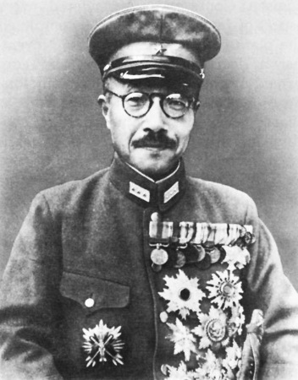
Hideki Tojo

Slide 74
Why War with the U.S.
Inability to resolve the conflict over China
  The U.S. sought to preserve China’s territorial integrity and independence while Japan sought to conquer China
The decision of the Japanese to take advantage of WWII to seize the possessions of France, Britain, and the Netherlands
  To create a base for operations further south
  To cut China’s link to the outside world in order to force an end to the war
This led to the U.S. embargoes which put Japan in the position of either submitting to US demands or going to war
The Japanese belief that they needed to seize the Philippines and to neutralize the U.S. Pacific fleet
Notes:
Conflict over China -During the fateful years 1937-1941, the "China Incident," as the war was called in Japan, created conflict between the U.S. and Japan. Throughout the four years since 7 July 1937, when Japanese Army troops marched across the Marco Polo Bridge west of Peking, every major diplomatic note exchanged between Washington and Tokyo had the assault on China as its text or subtext. In unmistakable language, the U.S. State Department condemned the Japanese incursion and called the world’s attention to its violation of the first paragraph of Article I of the Nine-Power Treaty of Washington, signed by Japan on 6 February 1922, which read: "The Contracting Powers, other than China, agree: (I) to respect the sovereignty, the in
dependence, and the territorial and administrate integrity of China.“
U.S. Embargoes and Economic Pressure – As Japan saw it, America’s threat to deny her oil and metals, against a guarantee of good behavior as Washington should judge it, was therefore tantamount to strangulation. The ‘southern offensive’was an almost predictable outcome.
Seizure of the Philippines - The decision to include war with the United States as a part of the move south was related to the belief that it simply was not safe to by-pass the Philippines, so the islands had to be invaded. The problem was that the Philippines would sit astride Japanese lines of communication to Malaya, Singapore, the British East indies, and the Dutch East Indies. Hence, they had to be seized.

Slide 75
Japanese Strategy for War with the U.S.
Japanese Military leaders believed that America was incapable of fighting a long, protracted war of attrition and that a decisive Japanese victory early in the war would cause America to settle for a negotiated peace that left Japan in control of the areas she conquered
  This implied quick seizure of Southeast Asia and an island perimeter from which the Japanese could hold off the Americans
  It also implied a decisive sea battle in the western Pacific in which the U.S. fleet would be destroyed as it came to the rescue of Guam and the Philippines
Notes:
Strategic premise - The Japanese assumed that the war would end when it had reached the perimeter of their newly-won empire. But there was never any prospect of that happening, had there ever been one, once they attacked Pearl Harbor, because the calculation that the Americans would never expend the blood and treasure to reconquer for others a whole host of islands and other places most Americans had never heard of, and did not care about if they had, was invalidated by the way in which they started the war. The Japanese did not realize this since, even when the tide of battle turned against them, they never abandoned the fundamentally erroneous strategic concept that it was possible for them to raise the cost for the Americans to a level they would not pay
Strategic template - The Emperor and his military chiefs all assimilated information within a framework that took the Russo-Japanese War of 1904-1905 as its his­toric template. In that conflict, the Imperial Navy victory at Tsushima proved the "decisive battle" that determined the outcome of the war. Japa­nese leaders assumed, as a matter of course, that the war with the United States would be decided ultimately in a similarly great "decisive battle."
Decisive battle – The idea was to lure the American fleet into a decisive battle near either Guam or the Philippines. When the U.S. fleet left its West Coast bases (Pearl Harbor after 1940), it would be shadowed by Japanese long-range I-class subs with a range of 10,000 miles and a top surface speed of 23.5 knots and attacked with Type 93 torpedoes fueled by compressed oxygen and kerosene and capable of 49-knot speed at a range of 12 miles (or 39-knot speed at a range of 24 miles. (US torpedoes had only a 2 ½ mile range). When it got near the Japanese-mandated islands, it would be attacked by land-based bombers with torpedoes. After this, the U.S. fleet would be attacked and sunk by the Japanese Navy.

Slide 76
Japanese Strategy - 2
On 7 January 1941, ADM Isoroku Yamamoto argued that this ambush strategy had three major defects:
  It left the initiative to the Americans at a time when the American fleet was growing in power over time as new ships came on line
  Any operation against Malaya and the Dutch East Indies would divert major components of the fleet away from a Western Pacific battle
  The strategy assumed that Japan would have a fleet superior to, or at least equal to, the American Pacific fleet.
Notes:
American initiative – The Japanese “attrit and ambush” plan assumed that the Americans would take the bait and actual sail to the western Pacific. In 1941, the Pacific fleet didn’t have the oilers and support vessels necessary for the battleships, carriers, and cruisers to actual sail to the western Pacific and return. Second of all, from an American perspective, why not wait until the Two Ocean Navy Act of 1940 actually bore fruit in the large number of new carriers, battleships, cruisers, destroyers, and submarines that would give the Americans a numerical superiority over the Japanese Navy.

Slide 77
Japanese Strategy - 3
Instead, Yamamoto proposed a different plan
  Destroy the American fleet on the very first day at Pearl Harbor
  Seize Malaya, Singapore, the East Indies, and the Philippines
  Construct a chain of fortified bases along a perimeter of Pacific islands
  Allow the Americans to suffer a war of attrition trying to take these islands
Notes:
Destroy the American Fleet at Pearl Harbor - Since Japan could not keep up with America's industrial productivity, and since the longer Japan's naval power waited to engage the American fleet the smaller the chance of victory, Japan had to make a preemptive strike against the Americans as soon as practicable. "We should do our best," he wrote, ". . . to decide the fate of the war on the very first day." If the enemy's main body was in Pearl Har­bor, Japanese carrier aircraft and submarines should sink the principal ships (carriers and battleships) at their moorings and blockade the harbor entrance. If the U.S. fleet was at sea, it should be located and sunk off soundings. For the United States the result would be that "the morale of the U.S. Navy and her people" would "sink to the extent that it could not be recovered."³ The entire air strength of the First and Second Carrier Divisions must be committed to the operation, and the strike itself should be made on a moonlit night or at dawn. One thing that convinced Yamamoto that such an attack could succeed was the success of the British carrier air attack on the Italian fleet at Taranto.
Seize Malaya, Singapore, the East Indies, and the Philippines – This would provide the Japanese economy and military with the resources needed to support the Japanese civilian population and the Japanese war machine
Fortified bases - Here, the army and navy would set up a defensive perimeter in Japan's larger islands and archipelagos in the western Pacific, which would deny America and its allies the opportunity to strike back into Japan's area of strategic dominance. The logic of the Japanese plan rested on the perception that, while the eastern Pacific between California and Hawaii is empty ocean, offering no bases or points of replenishment to a fleet or amphibious force based in the continental United States, the western Pacific is a constellation of islands, whose forward edge might be fortified to make the whole complex impenetrable to an outsider. This involved constructing fortified bases along a chain running from the Kurile Islands, off Russian Siberia, through Wake (an American possession), the Marshall Islands (ex-German possessions allocated, with the Carolines and Marianas, to Japan at Versailles), the Gilberts (British), the Bismarcks (ex-German, now Australian), northern New Guinea (Australian), the Dutch East Indies and British Malaya.

Slide 78
Defects of Japanese Strategy
Yamamoto’s Plan (which is what the Japanese adopted) had several conceptual and strategic defects
  Achieving the total surprise necessary for success was a very iffy proposition
  Even if the attack was successful, it would lead to a long war that Japan could not hope to win
  It erroneously assumed that the Pacific Fleet was a threat to the flank of the Japanese attack to the South
  It ignored the implications of attacking a shallow port on a Sunday
Notes:
The psychological consequences of a sneak attack - As RADM Onishi Takijiro pointed out, a war which began with an attack in the South might be ended by a compromise peace, but a surprise attack on Pearl Harbor would destroy any hope for a compromise settlement.
Flank attack on the Japanese drive south – If the Japanese attacked on the British and Dutch possessions in Southeast Asia, but left Pearl Harbor and the Philippines alone, would America have been willing to go to war? Sanctions and a total embargo was one thing, war was another. American military leaders wanted to postpone war with Japan since they felt that America was not ready for war and were more concerned about Nazi Germany. Isolationist sentiment was still strong and a Roosevelt decision to go to war to defend British and Dutch colonialism in the absence of a Japanese attack would not have been popular. In addition, the Pacific Fleet would have been unable to threaten the flank of the Japanese attack because it lacked the necessary oilers and supply ships necessary to operate in the Western Pacific and Southeast Asia
Attacking a shallow port - Yamamoto’s plan involved an attack in a shallow port on a Sunday. This had two major implications for any long war: in a shallow harbor, the ships would be grounded, not sunk, so that they could be raised, repaired, and returned to service; in addition, most of the American naval crew members were likely to survive, either by being on shore leave at the time of the raid or rescued as the ships were grounded in port. In contrast, ships lost in a battle on the open sea would have been permanently lost and so would most, if not all, of their crews.

Slide 79
Two Other Strategic Considerations
As an island nation dependent on the movement of strategic resources from a newly-conquered empire via ship over a distance of many miles
  Japan went to war with a merchant marine barely equal to the peacetime requirements of the Japanese economy; it was not adequate to the task of wartime
  Both the Japanese Navy “attrit and attack” and the Yamamoto “sneak attack” strategies left the Japanese Navy with a force structure incapable of protecting Japanese merchant shipping from attacks by American submarines
Notes:
Merchant Shipping For Japan to realize the economic advantages of its empire, a vast flexible merchant marine was necessary. Japan began the war without a realistic or adequate appreciation of the demands of war on its merchant shipping. In 1941, it possessed 5,300,000 tons of merchant shipping, About 35% of Japanese trade was carried in foreign vessels. The Japanese, unlike the British, did not really comprehend how important merchant shipping was and how their con­quest of Southeast Asia, far from freeing them from dependence on others, in fact made them as vulnerable to blockade by the sinking of merchant ships as Great Britain. The Americans, on the other hand, recognized this early. They soon acted on their comprehension of the obvious fact that Japan's seizing oil wells, tin mines, and rubber planta­tions did not move the wells, mines, and plantations by one inch; it merely meant that their products had to be moved by ships in war rather than in peacetime.
Destroyer escorts - It was not until 1943 that the Japanese Navy finally finished construction of its first destroyer escorts to protect merchant shipping. Since Japanese Naval doctrine called for using submarines to attrit the enemy Naval fleet, it apparently never occurred to Japanese Naval officials before the war that the Americans might do to the Japanese merchant fleet what the German U-boats were doing to the British merchant fleet. As a result, American submarines eventually destroyed the Japanese merchant fleet thus crippling the Japanese economy and greatly limiting the training of Japanese naval and aviation personnel. The only thing that saved the Japanese for a time was the gross inadequacy of American torpedoes (which often failed to explode) and the unwillingness of the American submariners to adopt German “wolfpack” tactics.

Slide 80
War in the Pacific
From Pearl Harbor to Midway

Slide 81
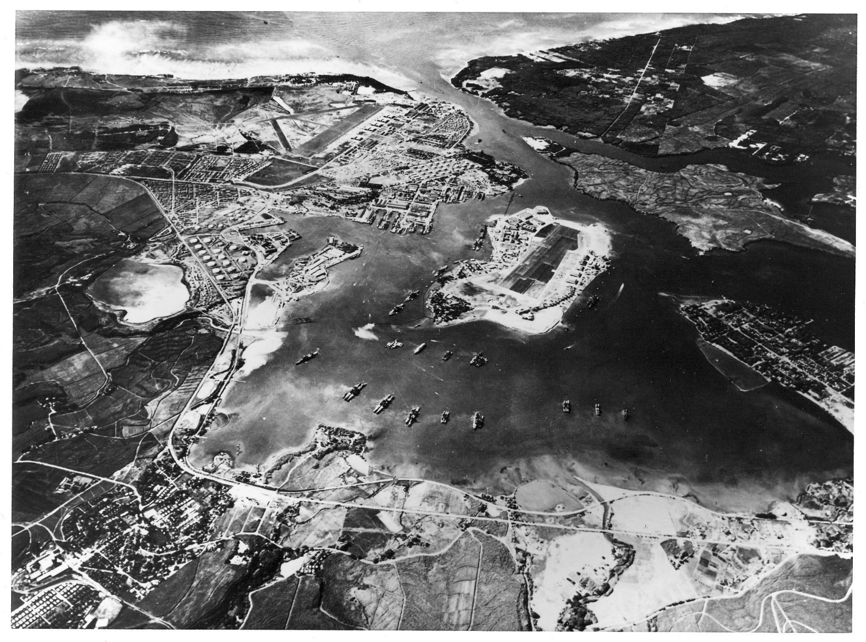
Pearl Harbor – October 1941

Slide 82
Attack on Pearl Harbor - 1
On 7 December 1941, planes from the Japanese First Air Fleet (Kido Butai) attacked Pearl Harbor
  The Japanese force consisted of 6 aircraft carriers with 414 airplanes, 2 battleships, 3 cruisers, 9 destroyers, 8 tankers, 23 submarines and 5 midget submarines
The Japanese Fleet (Kido Butai) avoided detection by sailing through the Northern Pacific area not traveled by commercial shipping because of the storms brought about by the prevailing Westerlies
Notes:
Avoiding detection - “The course chosen took the fleet through the "Vacant Sea," which was practically devoid of commercial shipping, Maintaining surprise was the overriding key to a successful operation so that was the reason this route was chosen. The choice of Sunday, 7 December (Hawaii time) for the attack was owed primarily to the fact that, as the Honolulu consulate had reported, the U.S. Pacific Fleet followed the habit of entering harbor on Friday or Saturday after exercises and of departing on Monday or Tuesday. Also the Sunday date coordinated well with attacks scheduled in the Southern Operation

Slide 83
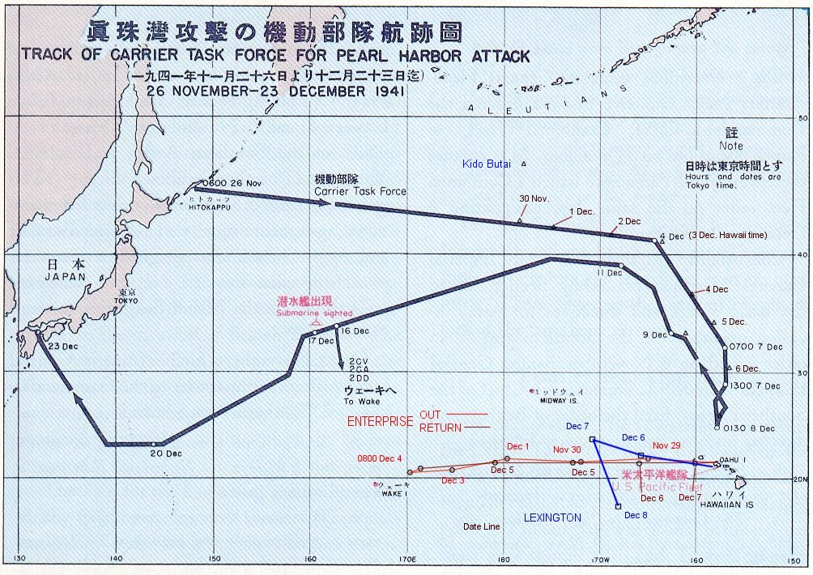
Route of the Kido Butai

Slide 84
Attack on Pearl Harbor - 2
The first attack wave of Japanese planes were picked up on radar but were assumed to be incoming B-17s
  The first wave consisted primarily of dive bombers, fighters, and torpedo bombers – one to attack the airfields and the other to attack the battleships
  The second wave consisted mostly of bombers which bombed both the subsidiary airfields and the ships not accessible to the torpedo bombers
U.S. aircraft were parked wingtip-to-wingtip in the middle of the main airfields because GEN Walter Short feared sabotage rather than a possible Japanese air attack
Notes:
Radar detection - As the first wave approached Oahu, it was detected by the U.S. Army SCR-270 radar at Opana Point near the island's northern tip. This post had been in training mode for months, but was not yet operational.^{[68]} Although the operators, Privates George Elliot Jr. and Joseph Lockard,^{[69]} reported a target, a newly assigned officer at the thinly manned Intercept Center, Lieutenant Kermit A. Tyler, presumed it was the scheduled arrival of six B-17 bombers. The direction from which the aircraft were coming was close (only a few degrees separated the two inbound courses), while the operators had never seen a formation as large on radar; they neglected to tell Tyler of its size, while Tyler, for security reasons, could not tell them the B-17s were due (even though it was widely known).

Slide 85
Attack on Pearl Harbor - 3
The Japanese attack in two waves did the following damage
  4 battleships sunk
  4 battleships heavily damaged
  3 cruisers damaged
  3 destroyers damaged
  2 other ships sunk
  3 other ships damaged
  188 aircraft destroyed
  159 aircraft damaged
  2,402 KIA
  1,247 wounded

Slide 86
Attack on Pearl Harbor - 4
The attack cost the Japanese relatively little
  4 midget submarines sunk
  1 midget submarine beached
  29 aircraft destroyed
  64 KIA
  1 POW

Slide 87
Attack on Pearl Harbor - 5
After the return of the first two waves, there was a big debate on whether to launch a third strike
  The attack planner, Minoru Genda, and the attack leader, Mitsuo Fuchida, wanted to go after the oil tanks, docks, and support facilities
  But ADM Chuichi Nagumo decided different for several reasons
    He was worried about being attacked by the American carriers
    He was worried about possible heavy aircraft losses
    The planes would have had to be refueled and rearmed and the resulting turn-around time would have meant they would be coming back to the carriers at night
    The task force lacked the fuel to remain in Hawaiian waters much longer
    He believed he had completed his mission
Notes:
Why Nagumo decided to withdraw –
American anti-aircraft performance had improved considerably during the second strike, and two thirds of Japan's losses were incurred during the second wave.^{[87]} Nagumo felt if he launched a third strike, he would be risking three quarters of the Combined Fleet's strength to wipe out the remaining targets (which included the facilities) while suffering higher aircraft losses.^{[87]}
The location of the American carriers remained unknown. In addition, the admiral was concerned his force was now within range of American land-based bombers.^{[87]} Nagumo was uncertain whether the U.S. had enough surviving planes remaining on Hawaii to launch an attack against his carriers.^{[88]}
A third wave would have required substantial preparation and turnaround time, and would have meant returning planes would have had to land at night. At the time, only the (British) Royal Navy had developed night carrier techniques, so this was a substantial risk.
Weather had deteriorated notably since the first and second wave launching, and rough seas complicated takeoff and landing for a third wave attack.
The task force's fuel situation did not permit him to remain in waters north of Pearl Harbor much longer, since he was at the very limit of logistical support. To do so risked running unacceptably low on fuel, perhaps even having to abandon destroyers en route home.^{[90]}
He believed the second strike had essentially satisfied the main objective of his mission—the neutralization of the Pacific Fleet—and did not wish to risk further losses.^{[91]} Moreover, it was Japanese Navy practice to prefer the conservation of strength over the total destruction of the enemy.

Slide 88
Attack on Pearl Harbor - 6
For the Japanese, it was a great tactical victory but a strategic disaster in several ways
  First, Pearl Harbor meant that the U.S. would enter the war as a nation united and determined to fight on to victory
    This was a type of war Japan could not win
  Second, the Japanese ignored the tank farms, dry docks, and ship support facilities vital to both naval operations and ship repair
    This enabled the U.S. Navy to both recuperate from the Pearl Harbor attack and conduct the carrier operations that led to victories in the Battle of the Coral Sea and Midway
Notes:
Tactical victory – The Japanese sunk or heavily damaged 8 battleships, 3 cruisers, 3 destroyers, and 3 other ships. But only the Oklahoma and Arizona were total losses. The three heavily damaged battleships would be quickly repaired and returned to service – Maryland by February 1942, Nevada by December 1942, Pennsylvania by January 1943, Tennessee by May 1943— and to refloat, repair, and modernize California by May 1944 and West Vir­ginia by July 1944. California and West Virginia could be raised readily because the harbor water was shallow and their hulls had settled on even keels in the muck. In a way, the U.S. was fortunate the ships were in port. If they had been attacked at sea (and these ships were very vulnerable to the Japanese “long lance” torpedoes, it is very likely they would have been lost and many more sailors would have died. It was this fact that led ADM Nimitz to later remark, “It was God’s mercy that our fleet was in Pearl Harbor on December 7, 1941” As historian and admiral Samuel Eliot Morison noted, Öne can search military history in vain for an operation more fatal to the attacker.”
Political consequences – The attack silenced isolationists and united Americans. Polls showed that a large majority supported the fullest possible effort, including a national service plan similar to that of Great Britain—a level of mobilization beyond what even the government wanted. Opposition to the draft collapsed. Despite complaints about rationing and shortages on the home front, civilians were prepared to assume heavy burdens.
Tank farms and support facilities - As Michael Gannon noted in Pearl Harbor Betrayed, The true story of a man and a nation under attack, “What, then, should the Japanese have targeted at Pearl? The navy yard. First, the two above-ground tank farms east and west, with their several million barrels of oil. That reserve had been barely sufficient to fuel the fleet on a training basis; oil was depleted faster than the supply line could haul it from the West Coast. Even the reduced fleet after 7 December expended 750,000 barrels of fuel oil in the first nine days after the attack, when the most that all the available Navy and commercial tankers could transport to Pearl at a time was 760,000 barrels.²¹ Incineration of the tank farms would have totally immobilized the fleet. Second, the maintenance and repair shops, together with the drydocks, that kept the fleet ready for sea and, after 7 December, returned to the fleet two sunken and four dam­aged battleships, three damaged cruisers, three damaged destroyers, and the damaged Curtiss, Oglala, and Vestal.”

Slide 89
Attack on Pearl Harbor - 7
Third, it ended the sway that the battleship admirals had over the U.S. Navy
  Before Pearl Harbor, the admirals saw the battleship as the queen of the fleet and aircraft as useful primarily for scouting
  After Pearl Harbor, even the traditionalists had to concede that the Aircraft Carrier was now the queen of the fleet
Finally, even if left alone, the U.S. Pacific Fleet would have been unable to interdict the Southern Operation because of the lack of the necessary oilers and support ships
Notes:
Battleship admirals - The Army-Navy Football Game program for the game played on 30 November 1941 had on page 180 a picture of the USS Arizona with the caption ““A bow on view of the U.S.S. Arizona as she plows into a hugh swell. It is significant that despite the claims of air enthusiasts no battleship has yet been sunk by bombs.”
In 1939, a Naval War College pamphlet rejected “the idea that aviation alone can achieve decisive results against well-organized military or naval forces”
The Army-Navy Football Game program for the game played on 30 November 1941 had on page 180 a picture of a battleship with the caption “A bow on view of the U.S.S. Arizona as she plows into a huge swell. It is significant that despite the claims of air enthusiasts no battleship has yet been sunk by bombs.”
In a naval battle, the destruction of enemy carriers would gave our fleet the ability to conceal its movements and by scouting show where the enemy fleet is, but would not in itself be decisive

Slide 90
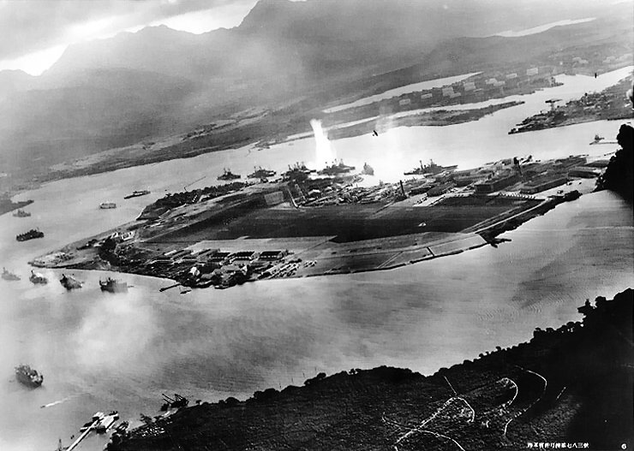
Aerial View of Pearl Harbor at the beginning of the attack

Slide 91
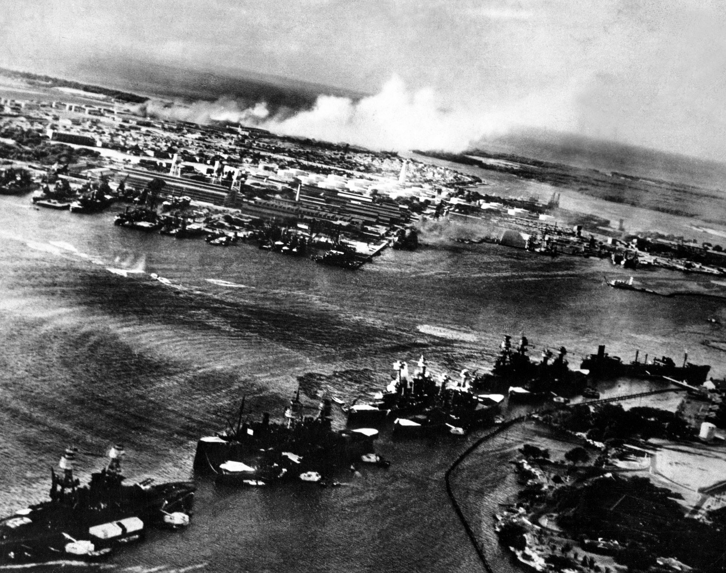
Japanese aerial photo view of the bombing of Pearl Harbor

Slide 92
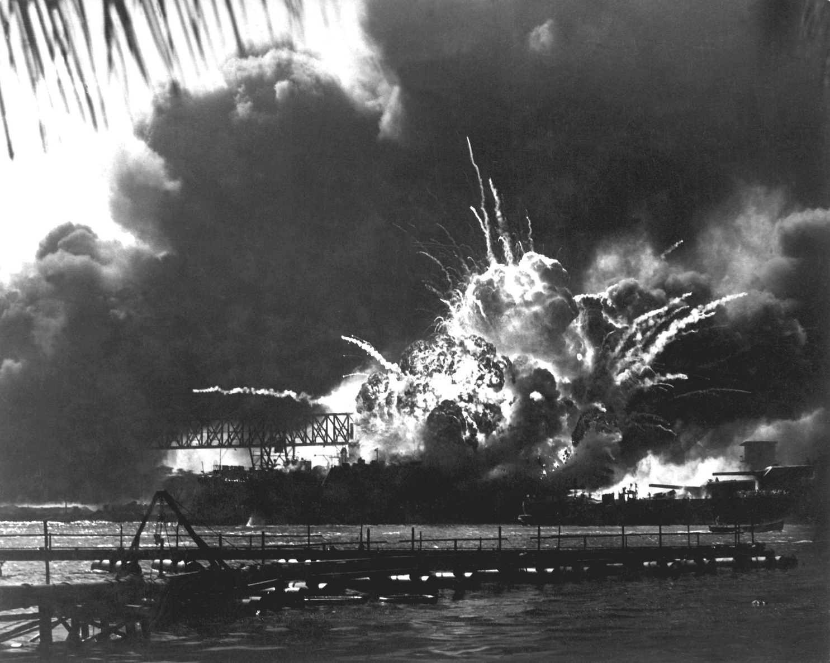
USS Shaw exploding at Pearl Harbor

Slide 93
One Major Effect of Pearl Harbor
Led Adolf Hitler to declare war on the United States on 11 December 1941
This was Hitler’s second major mistake of 1941 – both of which combined to eventually doom the Third Reich
Why did Hitler do it?
  Hitler believed that after defeating the Soviet Union, his next war would be with the United States
  The problem with defeating the United States (which meant invading the U.S.) was the U.S. Navy which had to be sunk before Germany could invade
  For this, Germany needed a blue-water Navy which would take time to construct
  Japan, however, had a blue water Navy & if the US Navy was sunk in the Pacific by Japan, it would make an eventual German invasion of the U.S. much easier
Notes:
Why Hitler Did It - By invading the Soviet Union, Hitler assumed and assured his associates that this would free Japan to move south, thus drawing the U.S. into the Pacific. Since he expected to defeat the Soviet Union quickly, he would first get America diverted to the Pacific and, after conquering the Soviet Union, be enabled to shift resources to naval construction to deal with the U.S. directly. In the interim, it made no sense to him to provoke the U.S. into open hostilities by incidents that would produce only a small increment in U-boat and surface raider sinkings. Hence, Hitler’s contradictory policy of restraining U-boat attack on American merchant shipping and naval vessels while simultaneously egging the Japanese on to attacking in Southeast Asia and promising that if Japan got involved in a war with the United States, then he would declare war on the U.S. Once Japan attacked the United States, Hitler had several reasons for declaring war. He did not want Japan to be overwhelmed by the American response. His patience in the face of America's undeclared war on German U-boats, and its aid to Britain and Russia, was running out. He seems also to have been strongly influenced by Rainbow Five, the secret plan for a two-ocean war, which had been leaked to the Chicago Tribune. It revealed that the United States did not expect to be able to fight in Europe until 18 months after war broke out, a time by which Hitler expected the war to be over.

Slide 94
Did Roosevelt Know Beforehand?
There have been several conspiracy theorist historians who claimed that Roosevelt knew of the Pearl Harbor attack beforehand and let it happen so as to get the U.S. into the war
There is no proof that Roosevelt knew beforehand and much evidence against it
  While American leaders knew the Japanese were going to attack, they did not know that Pearl Harbor would be an object of the attack
  Roosevelt was much more concerned about stopping Hitler than fighting Japan – A war with Japan would trap him in the wrong war
  Roosevelt could not have known that Hitler would declare war on the U.S.
Notes:
Roosevelt conspiracy - American historians have disputed for years the issue of whether Roosevelt 'knew': those who believed he did imply that he had sought and found in foreknowledge of Japanese 'infamy' the pretext he needed to draw the United States into the war on the side of Britain. It is an extension of the charge that there was a secret understanding between Roosevelt and Churchill, perhaps concluded at their August meeting in Placentia Bay, Newfoundland, to use Japanese perfidy as a means of overcoming American domestic resistance to involvement.
Cryptography - Although the American cryptanalysts had broken both the Japanese diplomatic cipher Purple and the naval cipher JN 25b, Purple was used only to transmit instructions from the Japanese Foreign Office to its diplomats abroad; in the nature of things, such instructions did not include details of war plans and, though their contents during the last months of peace aroused the suspicions of the American eavesdroppers, suspicion did not amount to proof. War plans, which would have supplied proof, were not entrusted to JN 25b. So stringent was Japanese radio security in the weeks before Pearl Harbor that all orders were distributed between Tokyo, fleet and army by courier, and the striking forces proceeded to their attack positions under strict radio silence.
Wrong war – In the aftermath of Pearl Harbor, there would have been little inclination on the part of Congress or the American people to gratuitously declare war on Germany absent any major German provocation. There would have much pressure to divert Lendlease supplies and military equipment from Russia and to some extent Britain to the support of American efforts in the Pacific. It was not Pearl Harbor, but Hitler’s declaration of war in response to Pearl Harbor that brought the U.S. into the war against Germany. Roosevelt could not have known that Hitler would declare war on the U.S. The Tripartite Pact between Germany, Italy, and Japan obligated Germany to go to war with the U.S. only if the U.S. attacked Japan, not the reverse.

Slide 95
News of the Attack
Most of the American public found out about the attack in bits and pieces over radio news broadcasts
Many found out when athletic and cultural events were interrupted by PA system announcements
At Griffith Stadium, where the Washington Redskins were playing the Philadelphia Eagles, a crowd of 27,000 remained in the dark even though the PA system began calling on various generals and admirals plus the Resident Commissioner of the Philippines to report to their offices
Notes:
Griffith Stadium Among those NOT asked to report to his office was Ensign John F. Kennedy. In the second half, the AP writer Pat O’Brien got a bulletin saying that accounts of the game should be kept to less than 150 words. When after the game, O/Brien voiced a loud objection, saying that this was a very exciting game, he was told “Japs just kicked off. At war now. Postscript. The Redskins won the game 20-14 thanks to two 4th quarter touchdown passes by Redskins quarterback Sammy Baugh.

