Slide 1
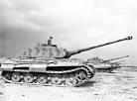
Part II Session2
How To Stop a Blitzkrieg.

Slide 2
What is a Blitzkrieg?
“The term Blitzkrieg gets used, often sloppily, to cover different though related things.
Literally― lightning war.
As such it could be applied to many campaigns (ex. The 16th Century campaigns of Frederick the Great; Israel’s 1967 fighting), although the word popularly rose to describe the so-called German way in warfare in 1939-1941.
Fast battle ground movements by armored and mechanized infantry units to take the enemy’s army off guard with advances, regroups, bypasses and advances again.
The ground assault backed by tactical air power (dive bombers and medium range bombers), gave it a new touch.*”
To conquer quickly, not obliterate, restrain your losses.
I would add― initial surprise
* Paul Kennedy

Slide 3
How many Blitzkriegs and attempts were there since 1939?
WW II―5
German invasion of the Low countries, Denmark, Norway and France, 1939-1940.
German invasion of Russia and counter- attacks, 1941-1942. But, ultimately the Russian pushed back to Berlin.
Japanese invasion of the Philippines, Malaya, Burma & DEIs.
German advances to El Alamein and counter attacks by the British, 1942. British out gunned Rommel, Germans had a long vulnerable supply line.
The German Battle of the Bulge attack, Dec 1944-Jan 1945, but with no airpower. Ultimately repulsed by US armor and clearing skies allowing Allied tactical air strikes.
Post WW II―3
The 1967 Israeli actions with Egypt, Syria and Jordan.
US and Allies in Gulf Wars I and II. Shock and awe.
Successful

Slide 4
Why the German WW II Blitzkrieg?
For starters, the impetus of the 1000 year Reich drove that they were destined to and had the right for Lebensraum.
Memory―To avoid the four years of static WW I trench warfare on the Western Front, 50 miles back and forth.
In 1939, England, France and Poland combined, fielded a larger army than Germany. Need to overcome this: Divide.
The battle had to be decisive and short:
Finite resources particularly fuel for an industrialized Army.
To take advantage of un-coordinated Allied actions.
The French were hunkered down in the Maginot line.
The British were working appeasement and were concerned with the Empire. It had aircraft and armor, but on its island.
If the US was concerned at all; it was still 4000 mile away and country was generally isolationist.

Slide 5
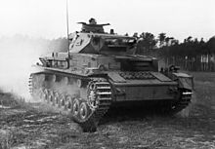
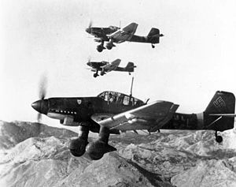
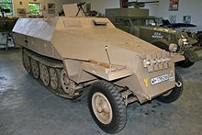
Panzer D IV Battle Tank
JU 87 Stuka Dive Bomber
German Blitzkrieg
Forces
German SdKfz [special ordnance
Vehicle] 251 half-track APC,
with mobile infantry
All equipped with tactical radios

Slide 6
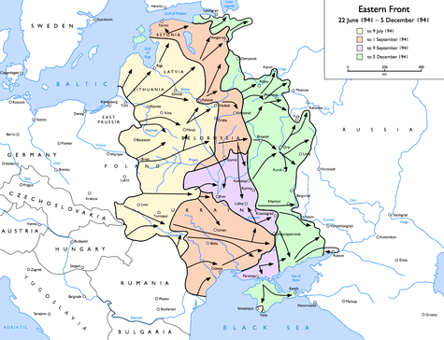
Blitzkrieg - Operation Barbarossa
Operation Barbarossa proved in the end to be a disaster for the Germans, and the Soviets were badly damaged. Although the Germans had failed to take Moscow outright, they held huge areas of the western Soviet Union, including the entire regions of present-day Belarus, Ukraine, and the Baltic states, plus parts of Russia proper west of Moscow. German forces had advanced 1,050 mi and maintained a north-south front of 1,900 mi. The Germans held up to 500,000 sq mi of territory with over 75 million people at the end of 1941, and went on to seize another 250,000 sq mi (before being forced to retreat after defeats at the Battle of Stalingrad (1942–43) and the Battle of Kursk (1943)
The eastern front at the time of the Battle of Moscow:
Initial Wehrmacht advance – to 21 June 9 July 1941
Subsequent advances – 10 July to 1 September 1941
Encirclement and battle of Kiev – 1 to 9 September 1941
Final Wehrmacht advance – to 5 December 1941

Slide 7
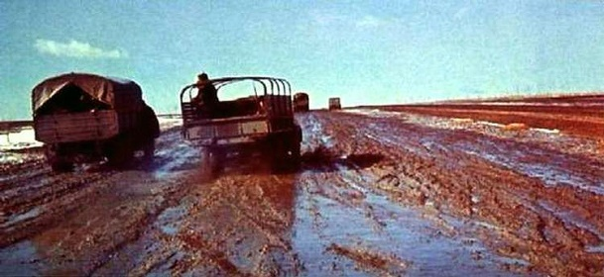
The German Blitzkrieg of Russia
Initially in 1941, in 6 months the Germans quickly pushed hundreds of miles deep to the gates of Moscow, with 1900 mile north/south front by the largest invasion army ever ― Blitzkrieg style.
Then there was a Russian winter, the coldest since 1812, and a long supply line. The Russians retreated with a scorched earth. Then the spring thaw and the unpaved Russian roads were a sea of mud – Rusputia.
Hitler believed that the war on Russia had to be a Vernichtungskrieg ― war of annihilation not to a surrender. So the war picked up again in 1942-1943.
But, the Russians had depth, a large population and industry east beyond the Urals, sufficient national food and fuel supplies.
They had more manpower [>2X Germany] and they began to stem the German armored assaults, reducing the core German forces and moving westward to regain their lands.

Slide 8
Blitzkrieg Falls Apart―1942-1943
The Germans were fighting a three front war.
They were shifting armor and air units between fronts, lessening the Blitzkrieg's impact.
Blitzkrieg: short intense action to an enemies defeat.
They were more than conquers:
― They shot and staved millions of Russian POWs.
― They pillaged the county sides that they had over-run.
― In the Ukraine, where they were originally greeted as liberators, through their heinous actions they turned the bulk of a 40 million strong Ukrainian population against them.

Slide 9
What Distributed Technologies Were Required to Counter Blitzkrieg?
A lot of Armor, thus factories and assembly lines.
Where did the modern tank come from?
US Army conversion to reliable diesels engines.
Army breaks the Navy’s hold of small diesel engines.
Armor unit mobile communications
− Germans made major use of VHF-FM radios.
Countermeasures.
Tires.
Fuel.

Slide 10
The Russian Tank and Anti-tank Armor

Slide 11
American Inventor J. Walter Christie The M1928 Design
1928, US Army was not interested.
Christie’s tank features speed and mobility
Army wanted tanks that primarily supported infantry
The British bought several Christie models and incorporated some of the design into their Cruiser Mark III.
The Soviets bought several in 1931, labeled as tractors, and shipped without guns.
The Christie design had:
Sloping sides to deflect shells
Inventive suspensions with both springs and torsion bars that aided in fast cross country travel over open stretches.

Slide 12
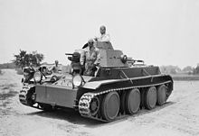
Christie never was able to sell any quantity of tanks.
He sold prototypes.
Above, 1936 version of the Christie Tank.

Slide 13
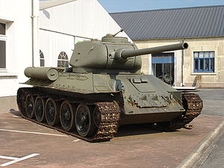
WW II Soviet T-34 Tank with many of Christie’s designs

Slide 14
The T-34 Tank In Many Ways Impressive, But With Lots of Flaws
The US Army evaluated the T-34 at Aberdeen in late 1942 and submitted an extensive report to the Russians.
They liked the sloping body
The easily used gun and aiming devices
The lightweight diesel engines
That it could climb and maneuver better than comparable US and British tanks
Detractions
Poor quality steel
Weak, under-designed treads
Lamentable air filters that resulted in engine failures
Terrible transmission, probably caused more losses than combat
Poor welding, leaked water, which shorted the electrical systems
Poor field radios, no crew communications
Commanders compartment was a horror and the controls often require a hammer to get them to move

Slide 15
So What Did the Russians Do in 1943?
They accepted the evaluation at face value.
But did nothing, just kept turning out quantity.
But, began to send some mod kits to repair facilities and did up-grades on a hit-or-miss basis.
Field cannibalized destroyed tanks for parts.
They seriously incorporated nine Aberdeen recommendations into the new model T-34-85.
After Kursk, they began to phase in the new model, the T-34-85.

Slide 16
Counters to the Tank
The British, Russians and Germans used mine fields. They didn’t have to destroy the tank, just damage its tread.
Against the last German Blitzkrieg attack at Kursk, the Russians placed 2400 anti-tank mines/mile and 2600 anti-personnel mines per/mile sometimes 15 miles deep.
Russians used artillery and mortars housed in prefabricated and portable concrete pill boxes.

Slide 17
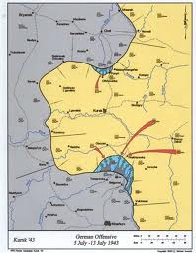
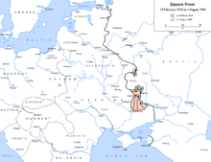

Slide 18
Three Interesting Russian Advantages
1. The Russians historically had and moved large armies and crossed large rivers. Their army had far greater emphasis on engineer units than did the Germans.
They used many pre-fabricated pontoon bridges that were disassembled and used elsewhere.
2. The Russians used a large deception [Maskirivia] organizations. [Discussion in the next section]
These [1 and 2] had a well developed mid-level management and command structure.
3. (Non technical) A large network of partisans.
Early German mistreatment of non-Russian Slavic populations in the western Soviet Union (Baltic, White Russian, Ukrainian) came back to haunt them.
Those still loyal of Communist Government.

Slide 19
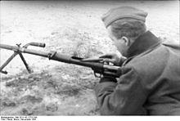
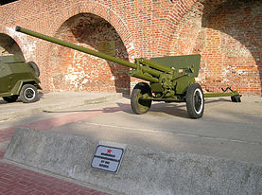
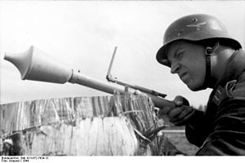
The Anti-Tank Gun
All sides developed Anti-Tank guns.
The Russian Degtyaryov PTRD-4, single shot, simple and produced in vast quantities.
The more modern Russian 57mm ZiS2
German Panzerfaust, single,
preloaded shell

Slide 20
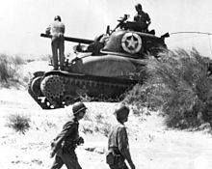
Knudsen-Returns
In 1939 US Army has a total of 200 M-2 light tanks.
August 1940 – Knudsen convinced the Army to contract with Chrysler to build tanks (M-3 first for the British and later M-4).
Knudsen contacted noted industrial designer Albert Kahn to start designing a new modern assemble line tank plant for Chrysler near Chicago.
Lend-Lease Soviet M-3 Lee
Tanks at Kursk
M-4 Sherman Tank, Sicily, 1943

Slide 21
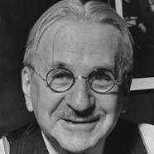
Albert Kahn
One of the most prolific architects in American history, Albert Kahn designed well over 1,000 buildings in his lifetime.
By WW II, Kahn's 600-staff industrial design operation was involved in making Detroit an important center of America's Arsenal of Democracy.
Worked with Sorensen in the Ford River Rouge complex
Ford’s B-24 factory

Slide 22
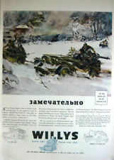
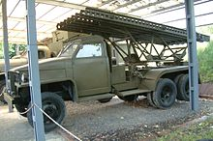
The Lend – Lease Studebaker Trucks and the Willys Jeeps
The Soviets built 665,000 Soviet trucks in WW II or 58 % needed. US provided 470,000.
The US provided the rest through lend-lease.
The US trucks were significantly more robust, more reliable, thus were often used to move ammunition and rockets.

Slide 23
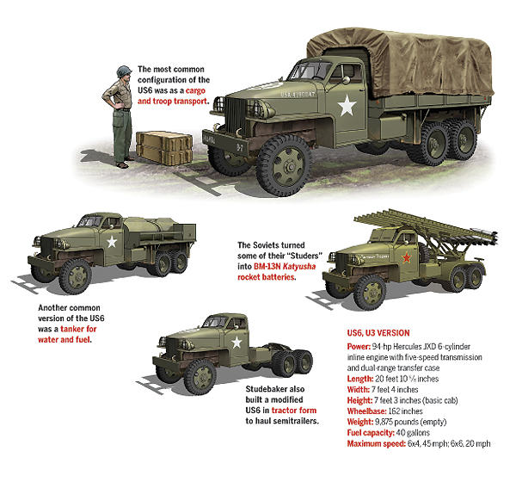

Slide 24
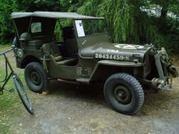
The American Love Affair with the Auto
The depression notwithstanding millions of Americans GIs have experience fixing autos, trucks and farm equipment.
GIs kept our fleets running and improvised.
Tanks modified with bulldozer blades from scrap.
This national technical competence was a work around for hurried and often inadequate training.
The Allies’ troops less mechanically experienced.
Normandy: Improvised tank blades and
“Salad Forks” to penetrate the Hedgerows

Slide 25
The Eastern Front and the North Atlantic
On examination many similarities.
Both covered vast areas.
Neither the British in the Atlantic nor the Russians on the Eastern front gave up the fight in spite of heavy early losses.
Both Fronts spanned three years and countered the intent of Blitzkrieg's theory of a short war.
Both Fronts were eventually won by a combinations of new inventions, better management/more intelligent command and grim battles– no silver bullets.
The Casablanca conference ruled out a negotiated armistice – demanded unconditional surrender.

Slide 26
An Army Runs On:
Food
Tires
Fuel

Slide 27
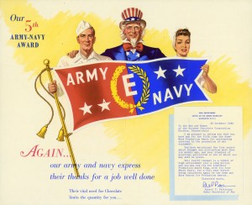
Billions manufactured
You have heard of the
K Ration, meet the
Hershey’s U.S. Army
D Field Ration
The Hershey U.S. ARMY FIELD RATION D was a highly concentrated food intended for emergency use. One ration consists of three chocolate bars sized to fit in the soldiers’ pockets. Hershey was the first to product this ration. This was for the GI on the front with no other source of food. It provided a day’s supplies of calories, vitamins and stimulants, but packaged to taste like blah oatmeal, so it would not be eaten as candy.
The 10 IN 1 RATION-supplied sufficient food for ten soldiers and withstands all climatic conditions. Chocolate bars of the Ration D type are included.
Hershey’s TROPICAL CHOCOLATE- in bar form, designed to withstand the effects of extreme heat. High in food energy value. “Our entire output is scheduled for shipment overseas through the Army, Navy, Marine Corps and Red Cross.”

Slide 28
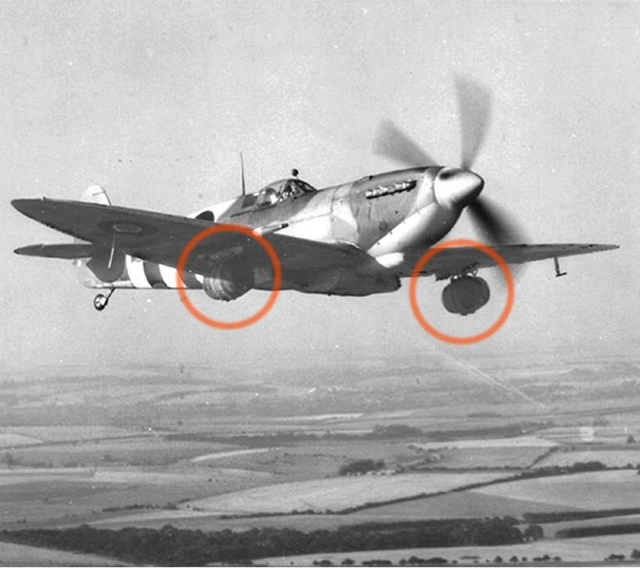
13 June 1944: An English brewery donates a sizable amount of fresh beer
for the troops fighting in Normandy and a unique delivery method is created,
Strapping kegs to the under wings of Spitfires being shipped to forward airfields.
Flying at 12 000 feet chills the brew to perfection

Slide 29
US Rubber Reserve Company (USRRC)
In 1940 most rubber products used natural rubber and 90% of it was imported from SE Asia remaining 10% from South America and Africa.
Processed rubber doesn’t recycle readily.
The Administration formed the US Rubber Reserve Company to: (1) conserve natural rubber and (2) expand synthetic rubber production.

Slide 30
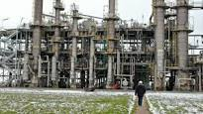
Synthetic Rubber Production Complex
The US, Germany and Russia generally used the same manufacturing processes using hydrocarbon based raw materials in chemical factories.

Slide 31
US Synthetic Rubber
B.F. Goodrich Company scientist Waldo Semon developed a new and cheaper version of synthetic rubber known as Ameripol in 1940. Ameripol made synthetic rubber production much more cost effective, helping to meet the country's needs during World War II.
Building on Ameripol the Government launched a major (and largely secret) effort to improve synthetic rubber production.
A large team of chemists from many institutions were involved. The rubber designated GRS (Government Rubber Styrene), a copolymer of butadiene and styrene, was the basis for U.S. synthetic rubber production during World War II.
From 1942 on, US synthetic rubber production expanded greatly once Japan conquered nearly all the world's limited supplies of natural rubber in SEA.
Rubber was required for tires and a vast array of other war products.
By 1944, 50 US factories were pouring out a volume of the material twice that of the world's natural rubber production before the beginning of the war.

Slide 32
http://www.nationalww2museum.org/learn/education/for-students/ww2-history/at-a-glance/rubber.pdf

Slide 33
German Synthetic Rubber
Germany had no ready access to natural rubber, but had an advanced chemical industry. By 1935, German chemists synthesized the first of a series of synthetic rubbers known as Buna rubbers using coal as a basic component.
These plant were prime AAF/RAF targets.
Operation Pointblank bombing targeted the 12 major Synthetic Plants, including:
Schkopau plant (50K tons/year)
Hüls synthetic rubber plant near Recklinghausen (30K tons/year)
Kölnische Gummifäden Fabrik, tire and tube plant at Deutz on the east bank of the Rhine.
The Ferrara, Italy, synthetic rubber factory was bombed August 23, 1944.
Ludwigshafen/ Oppau (15K tons/year,)
Hanover/ Limmer (reclamation, 20K tons/year,)
Leverkusen (5K tons/year,).
A synthetic rubber plant at Auschwitz in Nazi-occupied Poland, was under construction in March 1944. Sabotaged by slave labors and never went on line.

Slide 34
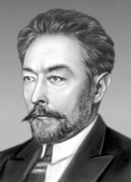
Russian Synthetic Rubber
In the Soviet Union, production of polybutadiene, used a 1910 process developed by Russian Chemist, Dr. P.Lebedev. The industrialization process was begun in 1932–33, using potatoes and limestone as raw materials.
The Soviet Union had no ready access to natural rubber which was controlled by the British.
Thus, by necessity in 1940 the Soviet Union had the largest synthetic rubber industry in the world, producing more than 50,000 tons per year. This increased to as much as 100,000 tons per year during the war.

Slide 35
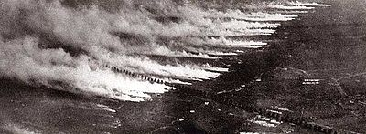
Poison Gas– the Weapon that Wasn’t
WW I. Chemical warfare was a major component of the first global war and first total war of the 20th century. The killing capacity of gas, however, was limited – only four percent of combat deaths were caused by gas.
Gas was unlike most other weapons of the period because eventually it was possible to develop effective countermeasures, such as gas masks.
In the later stages of the war, as the use of gas increased, its overall effectiveness diminished.
Post WW I Geneva convention against using but not against producing gas.
WW II. Britain planned to use mustard gas on the landing beaches in the event of an invasion in 1940. The US considered using gas to support the planned invasion of Japan. [American Heritage (August/September 1985) P.36 "Why We Didn't Use Poison Gas in World War II."]
Both sides had chemical weapons but the general fear of retaliation prevented them from being used. Both sides equipped the troops with better gas masks

Slide 36
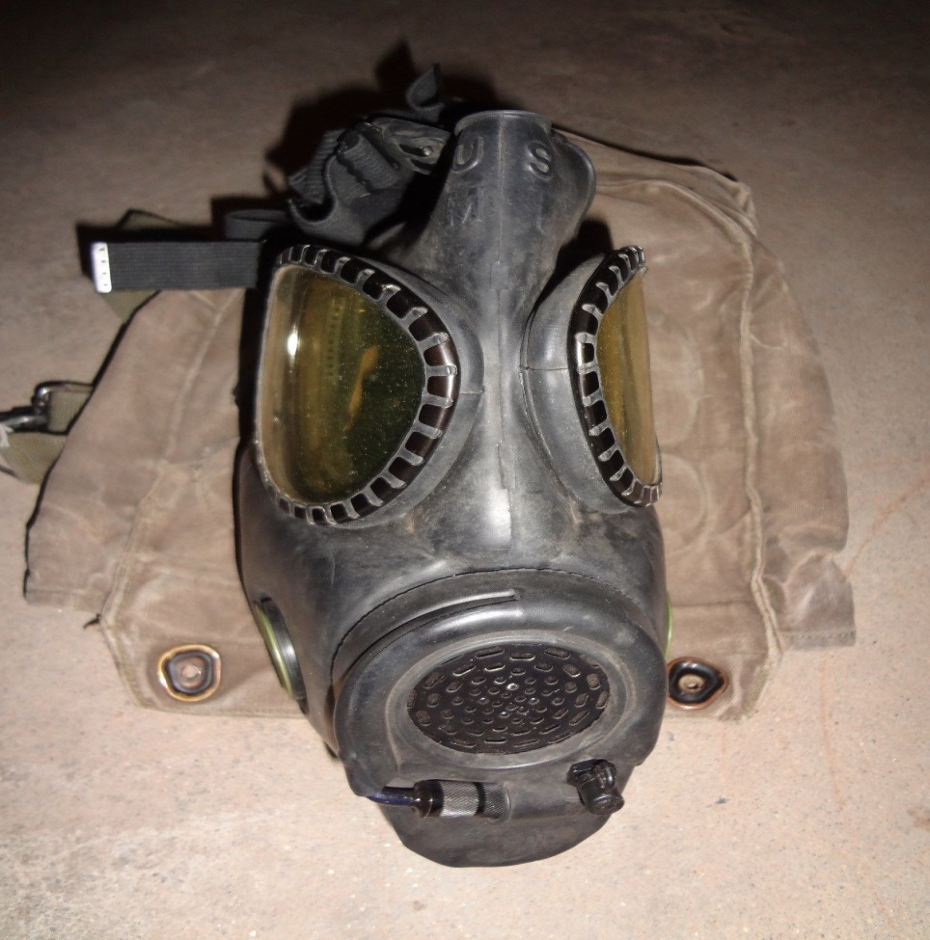
The WW II Modern Gas Mask
The gas mask that people in the USA are familiar with was developed in 1944 by the US Army Chemical Warfare Service.
It was made of plastic and rubber-like material that greatly reduced the weight and bulk compared to WW I gasmasks and fitted the user's face more snugly and comfortably.
The main improvement was replacing the separate filter canister connected with a hose by a filter canister screwed on the side of the gas mask, that could be replaced easily.
Also, it had replaceable plastic lenses, much helping vision

Slide 37
Soviet/German Air Strength
By 1944 the Germans had moved all but 500 aircraft from the Russian front to face tens of thousands of Soviet aircraft.
Stalin continually complained that the Allies were not doing enough to relieve pressure by the Germans. The Allies’ 1944-1945 combined land and air campaigns provided some relief.

Slide 38
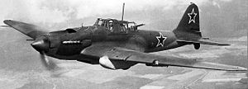
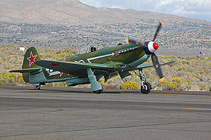
Prominent Russian Aircraft
Ilyushin IL-2/10 Shturmovik)
Ground attack aircraft
42.330 built
Yakovlev Yak-9 Fighter
16,769 built
In addition to the 150K or so Soviet built MiG, Yak, Ilyushin and other
aircraft, the Soviet Union received [Lend-lease] or impounded.
P-39 5007 P-63 2421 P-40 XXXX Hurricane 2962
P-51 IMP P-47 196 Spitfire 1331 B-24 IMP
A-20 2008 B-25 662 B-29 30 IMP

Slide 39
Battlefield Communications Blitzkrieg uses surprise and rapid movements, communications can work as a counter veiling force

Slide 40
In the Ranks–Frontline Communications Handie-Talkie®/Walkie-Talkie
The Motorola SCR-300 "Walkie-Talkie" The first US backpacked radio transmitter /receiverto be widely used, created by an engineering team in 1940 at the Galvin Manufacturing Company (fore-runner of Motorola).
The team consisted of Dan Noble, who conceived of the design using VHF-FM, Henryk Magnuski who was the principal RF engineer, Marion Bond, Lloyd Morris, and Bill Vogel.
Later Motorola also produced the hand-held UHF-AM SCR-536 radio "Handie-Talkie".
The terms are often confused today, but the original Walkie-Talkie referred to the back mounted model, while the Handie-Talkie was the device which could be held entirely in the hand, 5.5 pounds and a 1 mile range.
Both devices ran on vacuum tubes and used high voltage dry cell batteries. Handie-Talkie became a trademark™ of Motorola, Inc. on May 22, 1951.

Slide 41
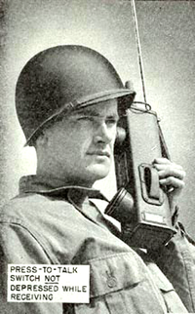
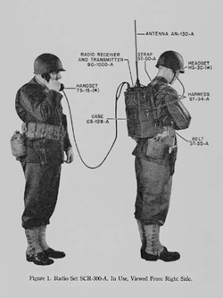
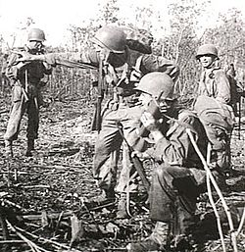
Noemfoor, Dutch New Guinea, July 1944. A US soldier (foreground) uses a walkie-talkie during the Battle of Noemfoor. (Photographer: Allan F. Anderson.)
SCR-536 “Handie -Talkie"
SCR-300-A “Walkie-Talkie
Motorola engineer, Donald Mitchell, recognized the strategic value of portable communications after he observed a National Guard training exercise and saw how radios installed in vehicles were abandoned in the mud and confusion of battle.
He returned to the company convinced that military communications had to follow man to the greatest degree possible and immediately began to engineer a radio that could be carried in the hand.

Slide 42
Conclusion
Blitzkrieg ultimately did not work.
It initially worked on small, weak countries
France had other considerations
But, the British, Russians and US didn’t stop fighting.
Ultimately, the Germans experienced a defeat even worse WW I.
The Japanese also had initial success, but in the end had to “Endure the Unendurable” the occupation of their Home Islands.

