Slide 1
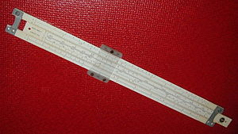
Engineers (and Managers) of Victory© The Problem Solvers Who Turned the Tide in the Second World War Part II

Slide 2
Engineers (and Managers) of Victory© Sessions
Fall term
Sessions 1, 2 & 3: The Marshaling and Focusing of US Manufacturing. Knudsen and Kaiser
Session 4: How to Get the Convoys Safely across the Atlantic.
------------------------------------------------------------------------
Winter term
Session 5: How to Win Command of the Air.
Session 6: How to stop a Blitzkrieg.
Session 7: How to Seize an Enemy-held Shore.
Session 8: Overcoming the Tyranny of Distance in the Pacific.

Slide 3
Who/What Will We Be Discussing?
Some giants of industry
Some notable scientists, both US and British
Many unknown and unsung engineers and managers who solved a crucial problem or worked a dilemma at the right time and right place.
Occasionally referencing German advances that had to be countered. Nothing was static.
Discussing more often their products than who.

Slide 4
Linkage
There are a four sessions for presentation purposes.
But, as you will see as we progress, many of the management techniques and technologies are common in the various WW II campaigns.
Just enough history to put the technology in context.

Slide 5
Timeline Highlights
1931-1941 Japanese military operations in China eventually leading to increasing US/Japanese tensions and US embargo.
1930-1940 An explosion of technologies.
August 1939 Albert Einstein’s letter to the President on U²³⁵ nuclear potential. Manhattan project initiated.
September 1939 Germany invades Poland, the WW II European Theater begins.
1939 – 1943 Atlantic Convoys/U-boat sea war.
May 1940 US War-time industrialization initiated.
September 1940 Peacetime US draft initiated.
November 1940/March 1941, President Roosevelt re-elected to 3rd term. Lend – Lease initiated.

Slide 6
Timeline Highlights, continued
June 1941 Germany invades Russia. Hitler directs that U-boats avoid US shipping.
December 7, 1941 Pearl Harbor.
December 11, Germany declares War on the US.
November, 1942 Allies invade French North Africa.
January 7, 1943 Casablanca Conference.
Rapid invention, innovation and immediate application.
June 6, 1944 Normandy Invasion.
April 1945, B-29 flights to Japan from the Marianas begin in-mass. US Navy surrounds Japan.
May 8, 1945 Germany surrenders
August 7/9 1945, 2 atomic bombs dropped on Japan.
August 14, 1945 Japan surrenders.

Slide 7
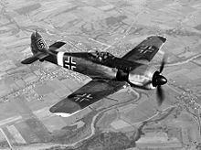
Part II Session 1 How To Win Command of the Air

Slide 8
Prequel – Command of the Air
First military aircraft 1909. First Air Combat 1911. Command of the Air is a mid-20th century transformation.
There was air warfare [mostly observation] at the WWI fronts, but it did not effect the ultimate outcome.
Germans implement Strategic Bombing of London with 54 Zeppelins raids and Gotha bomber raids [1915-1918].
Because of WWI stalemate, both the Allies [to a degree] and the Axis powers leaped at the battlefield aviation revolution to avoid a future stalemates.
1920s Paper studies, 1930s fledgling bombers,1940 combat
“With Command of the Air over the battle fields or sea lanes, victory was workable, but without it, there was only stalemate or ultimate defeat.”

Slide 9
Lessons of the 1930s/Early 1940s
The French Air force, the largest in the world in 1930 was allowed to decay because of the economy.
When WW II started in 1939/1940, the French would not let British bombers fly from French fields.
The RAF held most of their fighters back in England during the May 1940 European mainland fighting.
By May 1941 RAF bombers only flew at night, somewhat concealed, but with greatly diminished bombing accuracy.
Pre-Pearl Harbor only England and Russia, had Air Forces comparable in numbers to the Germans [6 months]. Actions not coordinated.

Slide 10
Profound Change
With the defeat of France in 1940 and the withdrawal of Britain: the greatest Western military powers – “The Traditional Principles of European warfare were rendered obsolete.”
From discussions of Germany’s initial victories, in both this Command of the Air and the next Blitzkrieg session; it would appear that Hitler’s investment in aircraft had given Germany an unbeatable weapon. But …

Slide 11
Changing Nature of Command of the Air
WW II
The US and British Commonwealth had both tactical and strategic airpower
The Soviets only had tactical airpower
The Germans had predominantly tactical airpower and later rockets
The Italians and Japanese only had tactical airpower.
Post WW II – Dominance does not always equate to success
Chinese Nationalist and Communist civil war– none
Korea ― US dominance once the F-86 is deployed. MIG Alley
Vietnam ― US dominance
Iran/Iraq War 1980-1988 ― Stalemate
Israeli/Arab states ― Israeli dominance
UK/Argentina 1982 ― Stalemate
Gulf Wars ― US dominance
Afghanistan ― US dominance
____________________________________________
The Cold War: US and the Soviet Union had nuclear stalemate

Slide 12
WW II Command of the Air

Slide 13
How To Win Command of the Air – WW II Allies Chronological Perspective
Protect England – The Battle of Britain
Early radar and RAF command and control centers
Early defensive aircrafts
Allies extend air cover over invasion beaches
Allies project Airpower over the Axis nations and conquered area
Strategic Air Doctrine
Long range navigation, particularly at night
Intelligence, radio intercepts and decryption
Long range aerial protection [fighters protect the bombers]

Slide 14
British Survival ― Critical Management of Limited Resources
RAF’s decentralized, but networked, command and control centers skillfully managed limited resources.
The British were flying over home turf and had multiple landing fields for damaged aircraft or wounded crews.
The British could wait for the Germans to come, husbanding fuel and available air Crews.
By the BoB [ July 1940 forward ] the British were building more aircraft than the Germans.
German aircrafts had short operational ranges and much British industry was beyond that range.
Damaged German aircraft had to limp back to the Channel or France for the crews to survive.

Slide 15
Very Early Radars and Command and Control Centers Roll Out
Dr. Henry Tizard head of 1936 RAF Scientific Committee.
First Radar Masts went up in 1936 and Dr. Tizard was able to convince the RAF that the Radars and the C&C centers had to be actively tested: the RAF Biggen Hill exercise. Result: Just too many unknowns.
So, the operational tests initially scheduled for several weeks ran almost continually till WW II, as the C&C system was continually technically upgraded and operational procedures were continually refined.
The RAF warded off the small German raids between Sept 1939 and July 1940 and refined their AD system against a real threat.

Slide 16
Hat, EE 606

Slide 17
EE 306, Antennas
Speed of light = Frequency x Wavelength
Speed of light is a constant
3×10⁸ m/s
Antenna size
What come to mind when we think of a RADAR antenna?
EE 306: The key to size is the operating frequency. In early
systems low frequencies were used to keep the equipment from
melting, but the price is a larger antenna.
The 10 CM cavity magnetron – British break through. Much
higher operation frequencies with low temperatures,
hence smaller antennas.
This is not an early British RADAR antenna!

Slide 18
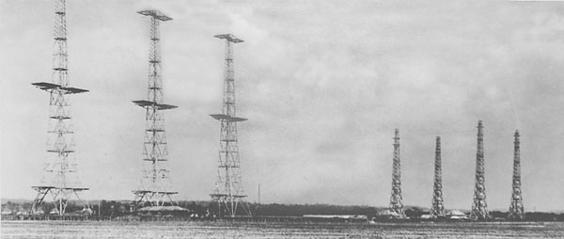
This is an early British Radar Antenna
240 feet
300 feet
Receiver
Transmitter
Chain Home Antennas in Perspective

Slide 19
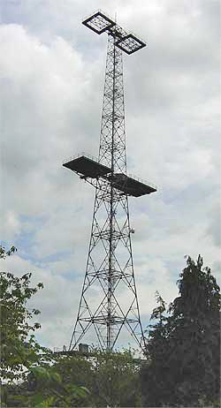
Early RAF RADAR (Chain Home) was a simple system.
The broadcast side was formed from two 300-ft tall steel towers strung with a series of antennas between them.
The receive side was a second set of 240-ft tall wooden towers, with a series of crossed antennas at various heights up to 215 ft.
Most stations had more than one set of each antenna, tuned to operate at different frequencies.
They were vulnerable!

Slide 20
Early Radar VCR
Towers
Bomber clips

Slide 21
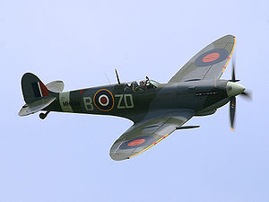
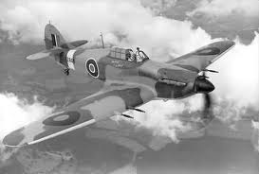
Hurricanes and Spitfires in Action
Supermarine Spitfires and Hawker Hurricanes, the workhorse of the air battle, were flown by extraordinarily young pilots who fought with tenacity and courage.
Both aircrafts are displayed at the Smithsonian.
Both from the same MOD RFP, one a defensive tackle in a dust-up, the other a gymnast.

Slide 22
Strategic German Errors
Failed to fully realize the importance of the frail radar towers.
Did not target industrial sites, as many were in the English midlands too far for the twin engine German bombers.
No strategic target set concentration/focus, direction was all over the place.
Hitler continually meddled.
Goering tried everything, first the RAF, then London.
When bomber losses mounted, Goering forced the Me-109s to stay with the bombers and gave up much of their war fighting capabilities.

Slide 23
Battle of Britain Video
15 September 1940
RAF C&C Sector operations room

Slide 24
Battle of Britain Numbers
The RAF with its RADAR and control centers held and the German Luftwaffe was driven back.
The RAF lost 440 aircraft and a quarter of its pilots in the month of August 1940 alone. Ultimately lost 1081 aircraft and 441 pilots killed and 903 wounded.
Germans lost 1652 aircraft with approximately 3200 air crews total killed, wounded or missing.
During the BoB months the English built 2200 new aircraft to 950 by the Germans.

Slide 25
Blackett’s Anti-Aircraft Tasking
In Sept 1940 Dr. Blackett was assigned to the Army’s Anti-aircraft command.
The British knew the Home Chain was vulnerable and constructed a number of smaller portable cavity magnetron units.
Smaller RADARs had just been delivered to the AA batteries but no one had figured out how to automate the RADARSs and early “computers” to provide the proper bearing and attitude of the guns. “System” Gun siting modifications were finally made.
There then ensued an exercise in OR implementation, the grouping of scattered guns into a small number of large batteries. Even though there were holes, the radar could “see” aircraft at night for the first time.
The 20,000 shell required to hit one aircraft dropped to 4,000 shells.

Slide 26
US/UK Technical Collaboration Prior to Pearl Harbor
As WW II got underway in 1939/1940, the British realized that American weapons development and manufacturing capabilities were vital to their survival.
Although the US was not yet a direct participant in the war, Churchill directed that UK technology secrets be shared in exchange for the 50 US WW I Destroyers.
Churchill believed that these were the tipping point.
In the summer of 1940, the Tizard Mission brought these secrets to the United States. The cavity magnetron was included, and almost immediately the MIT Radiation Laboratory was established to develop and productize miniaturized microwave radars using this 10cm cavity magnetron.

Slide 27
Hat, NSA

Slide 28
US/UK Technical Collaboration Prior to Pearl Harbor, Con’t.
The Neutral US sent an Army/Navy team to England, lead by General George B. Short, a Senior Staff aide to General Marshal.
The British provided additional research.
US Team’s #2, Admiral Robert Ghormley asked “Did the British have any data on Japanese fortifications in the WW I Japanese controlled Mandated Pacific Islands?” He was shortly provided with a massive Admiralty report.
Gen. Short then initiated the joint exchange of cryptographic research that continues to this day.
Nick Hopkins and Ian Traynor The Guardian, 9 January 2014
The US provided a machine designed to break the Japanese Purple code and received Enigma data in return.

Slide 29
Centimeter WL RADAR One of the Major WW II Technologies That Extends to Today
Seeing through the clouds and beyond
Radar technology, the ability to used radio waves to detect distant objects was very primitive in 1940, but became highly developed in a few years at sites like MIT’s Radiation Laboratory.
Dr. Alfred Lee Loomis, founder and initially underwrote
Radar made “surprise attack” virtually obsolete and vastly enlarged the arena of modern warfare.
Today’s radars can track incoming aircraft/missiles, and direct defense at them.

Slide 30
Quick Evolution of the Bomber
At the end of WW I, the bomber and particularly the concept of Strategic Bombardment was a only a theory.
The 1920s showed only minor advancement.
The late 1930s showed the first practical bombers in Europe, in the US and in Japan. But, US B-17/B-24/B-29s had range.
Early WWII bombers were slow, vulnerable and lacked range.
But, at the outset of WW II the Germans enjoyed significant practical advantages against weak adversaries.
The German bomber supported the astonishing defeat of France in May 1940.
The eclipse of what had been one of Western Europe’s greatest military nations for the past three centuries.
In the minds of many this totally confirmed this impression: “Traditional principles of warfare were rendered obsolete!”

Slide 31
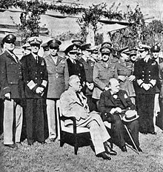
President Roosevelt and Prime Minister Churchill at January 1943 Casablanca Conference.
Plan the Invasion of Europe and issue the “Casablanca Declaration.”
Its most historically provocative statement of purpose: “Unconditional Surrender.”

Slide 32
First the Germans and Then the Allies
In order to launch a Seaborne invasion you had to control the sky: Invade England or Invade France.
Bombing campaign had three components.
Geography
Targeting
Men and their weapons… The pilots and their planes
Two German campaign: July 1940 - May 1941, V1/V2 1944-1945.
— A consequence of the early end of German daytime bombing in May of 1941 was the lack of aerial reconnaissance of the Normandy invasion build up.
Conversely, the Allied air Campaign: Was continuous from February 1942-April 1945.

Slide 33
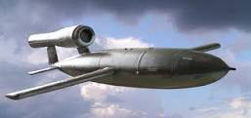
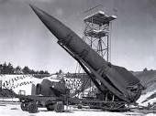
German Air Campaign: Two/Three(?) Phases
Battle of Britain
From Sept 1939 – May 1940, sporadic over-flights by the Germans
Active Air Campaign — June 1940 – Sept 1940
Night Bombing [The Blitz] from Oct 1940 to May 1941. Units withdrawn from France for Russian Invasion.
June 1941 - Aug 1944/April 1945
− Quiescent, no day light air intelligence of the Normandy build-up
June 1944 - March 1945
June – October 1944, V-1s
August 1944 - March 1945, V-2 attacks on London and Antwerp

Slide 34
Dr. Blackett’s Actions in Aviation
March 1941, Blackett is appointed the head of RAF Costal Command’s Operational Research Section.
Function of the human eye―Recommends changing CC aircraft camouflage colors, doubles U-boat sightings/flying hour.
Blackett was the sole dissenter on a British plan to unilaterality develop an A-bomb. Seeks collaboration with the US in July 1941.
Blackett moves to the Admiralty as head of OR
Opposes US/UK strategic bombing in Germany, as ineffective. Recommends long range bomber equipped with airborne radars be used to protect the convoys.

Slide 35
Allied Bombing Campaign The Rolls reversed
1942-1943 There were conflicting requirements and issues:
The slow 8th AF bomber build up in England
The balance of Strategic Bombing and convoy protection
Proving critical mass of air power for Strategic Bombing
The drain of the Pacific campaign
British/Allied Bombing from early 1941 till late 1943 was very ineffective.
British quickly driven from day-light bombing
Northwestern European weather is poor at best
US doctrine was daylight precision bombing by heavily armed bombers in a tight protective formations — The bomber would always get through!

Slide 36
Trying to Win Command the sky
March 1943
US: Schweinfurt (Ball Bearings), Regensburg (FW-190 factory)
British: Nuremburg
Losses were such that it appeared that the air effort was going backward.
Fighter performance developments by all sides exceeded bomber formation’s ability to defend themselves.

Slide 37
Technical Issues
Technical Issues
Accurate continental weather forecasting.
Continual improvement in the science of meteorology.
Particularly for the RAF, how do you navigate at night?
The Gee, OBOE, LORAN [MIT Rad Lab] like systems.
RADAR equipped Mosquito pathfinder aircraft.
How do you jam improving German RADAR system?
Aluminum chaff clouds
How accurate is your photo reconnaissance?
Improving cameras, lens and more stable photo processing. Long range aircraft going further
More and more photo recon flights $−$ just more data!

Slide 38
But, Now the Germans Were Flying Over Their Country
A build up of C&C centers that directed RADAR controlled flack batteries and launched fighters.
But, a 5X larger area and never as comprehensive as RAF
But roles reversed, the Germans now had short ranges to fly matching their aircraft’s short capabilities and many landing fields.
Night fighters, Heinkel He 219, a relatively sophisticated design, it possessed a variety of innovations, including an advanced VHF-band intercept RADAR.
But, until the arrival of the long range P-51 Mustang, the US bombers flew alone on large portions of their flights, both in and more significantly back.

Slide 39
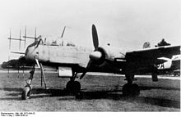
Heinkel He 219 Owl, Operational 1943, 300 Built

Slide 40
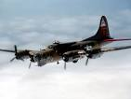
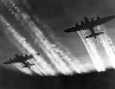
Memphis Belle-May 1943 Film Clip
Most of the Belle’s flights were against French costal targets,
the last and 25th was against Wilhelmshaven.

Slide 41
Operation Chastise―Dam Busters
An attack on German Ruhr Valley dams on 16–17 May 1943 by RAF No. 617 Squadron using a specially developed “Bouncing bomb" invented and perfected by Barnes Wallis.
Effect: The Möhne and Edersee Dams were breached, causing catastrophic flooding of the Ruhr valley and of villages in the Eder valley, while the Sorpe dam sustained only minor damage.
Two hydroelectric power-plants were destroyed and several more were damaged.
Factories and mines were also either flooded, damaged or destroyed.
An estimated 1,600 people drowned [many were Soviet POWs].
The damage was mitigated by rapid repairs by the Germans, with production returning to normal in September.

Slide 42
Dam Busters-Tennis Anyone?
Special bomb: Wallis's initial idea was to drop a 20,000 # bomb from about 40,000 ft. This idea was part of the earthquake bomb concept. However, at that time no bomber aircraft was capable of flying at that altitude with such a heavy payload.
A much smaller explosive charge would suffice,
If it could be detonated directly against the dam wall below the surface of the water,
but the major German reservoir dams were protected by heavy torpedo nets to prevent such an attack.
Wallis's breakthrough design: A drum-shaped bomb — essentially a specially designed, heavy depth charge — spinning backwards at over 500 rpm.
Dropped at a sufficiently low altitude at the correct speed, would skip for a significant distance over the surface of the water in a series of bounces before reaching the dam wall.
Its residual spin would run the bomb down the front side of the dam to its underwater base. Using a hydrostatic fuse, an accurate drop could bypass the dam's defenses and enable the bomb to explode against the dam.

Slide 43
Two Operational Technical Issues
The first ―determine when the aircraft was at optimum distance from its target. Both the Möhne and Eder Dams had towers at each end.
Solution: Trigonometry-A special targeting device with two prongs with a length of string tied in a loop and pulled back centrally to a fixed point in the manner of a sling shot. Then lining up with the towers and making the same angle with the two towers indicated the correct distance from the dam, and when to release the bomb.
The second ―was the aircraft's altitude, as the barometric altimeters then in use lacked sufficient accuracy. Two spotlights were mounted at angles, one under the aircraft's nose and the other under the fuselage, so that at the correct height their light beams would converge on the surface of the water.

Slide 44
http://en.wikipedia.org/wiki/Operation_Chastise

Slide 45
The Fabled Path of the P-51
In Spring 1940, the RAF [eager to take up President Roosevelt's invitation to use American factories and aeronautical expertise] challenged North American Aviation to design a fighter to a set of specs in 120 days; if it wanted a contract.
117 frantic days later, the design team led by Edgar Schmued rolled out the first prototype.
France had just fallen. Britain, standing alone against Hitler, hurriedly ordered 620 planes.
After Lend-Lease passed Congress in 1941, the US purchased the planes and gave them to Britain.

Slide 46
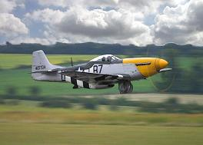
P-51 with Invasion Stripes

Slide 47
But What of the P-51’s Parentage?
The P-51 had an American mother (North American Aviation) and an English father (Initial British orders for the craft in 1940). As the British say, it was “Born above the sheets.”
The somewhat anti-British US Air Production Board had its own fighter priorities: P-38s, P-39/63s, P-40s and P-47s.
The first P-51s were delivered to England in early 1942, with Allison engines. It was intended to be a low altitude ground support fighter.

Slide 48
What did this mean?
The P-51 did not progress through the standard Army Air Corp engineering, procurement and testing program.
No US Army sponsor.
No US Army logistics tail, no maintenance and pilot training
There were other US aircraft for low altitude ground support/attack.
The US had other interests and priorities.

Slide 49
Sheer Luck!
Rolls-Royce chief test Pilot Ronnie Harker is called to a British airbase in 1942 to see newly delivered P-51s.
Flies one, is very impressed [it is far more than a ground attack fighter, but has high altitude limitations, because of the engine] and when back and examines the engine compartment realized that the Rolls Royce Merlin 61 [high altitude performance] will fit with only the slightest bracket changes.
Modified, P-51 now out-climbs the Spitfire at 20% fewer engine revs to fighter combat altitudes.
P-51 was far more fuel efficient and has significantly more fuel capacity than the Spitfire.
With external, dropable, fuel tanks the P-51 can fly with B-17s from England to the Polish Boarder and back and has enough fuel to fight off German fighters.

Slide 50
• Significant P-51 Operational Improvement was attained with the more powerful Rolls-Royce engine in spite of weighing 245 #s more. 2% GC Δ • With simple brackets, the Merlin fit in the P-51’s engine compartment.
Specification | Allison V1610 | Rolls-Royce Merlin
Length | 85.81 in | 88.70 in
Width | 29.28 in | 30.80 in
Height | 37.65 in | 40.00 in
Weight | 1395 lbs. | 1640 lbs.

Slide 51
Allison vs Merlin There were a lot of Variables
Merlin
More complex with internal superchargers
1710 HP at 3000 rpm
RR version more complex to build, English Ford and US Packard versions reduced parts count and assembly labor
shorter maintenance intervals
Allison
– External common AAC turbo-superchargers
– 1600 HP at 3000 rpm
– Many parts inter-changeable within US AAC fleet and PT boats
– Longer maintenance intervals

Slide 52
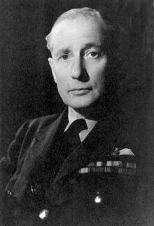
Who Pulled This Off? Air Marshall Wilfred Freeman
Production genius in the Air Ministry
Pushed RAF production in the late 1930s
Now responsible for allocating Rolls-Royce Merlin engines including the supply now coming from the Packard factory in Detroit.
Sponsor of the twin engine Mosquito–believed by some as the most versatile aircraft of WW II.

Slide 53
What next?
The British equip 5 P-51s with advanced Merlin 61 engines. Two are sent to General Karl Spaatz, 8th AF commander, for AAC testing.
Air Marshall Freeman, when shown the modified P-51 and convinced of its superb flying characteristics ordered first 250, then 500 of them converted with Merlin 61s.
Working with his high-level contacts serving with both Churchill and Roosevelt and knowing the inability of the British aircraft factories to build any more aircraft; he lobbied the US to expand North American’s production.
With serendipity, the AAC now with Packard Merlin 61 vastly expands P-51 production and incorporates the now named Mustang into the AAC.

Slide 54
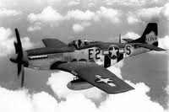
The long range P-51 arrives on the scene
Serendipity: An early British requirement, superb aeronautical design, high
octane gas, the Roles-Royce Merlin engine and external fuel drop tanks

Slide 55
WW II Paper Drop Tanks
A little known use of paper during WW II was in the manufacture of fuel drop tanks used by the 8th Air Force.
The British devised a system using laminated cardboard, varnish and glued paper that would hold 108 gallons of fuel – good for one mission!
Cheaper than aluminum, Germans could not reuse.
The following photo and captions tells the story.

Slide 56
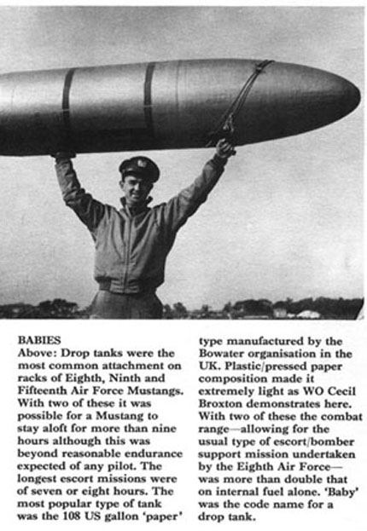

Slide 57
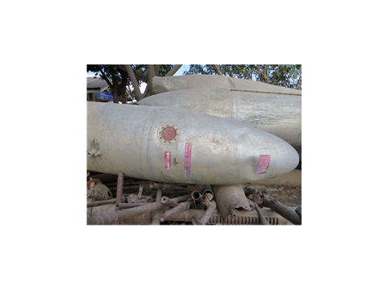

Slide 58
Ingenuity: Vietnamese lopped the top third, squared of the back,
got Chinese outboard motors, smoothed out the sides and
Reconstructed very good small boats.

Slide 59
Trivial Pursuit
15,100 P-51s [all models] were produced.
P-51D specs: 440 MPH, six 50 caliber machine guns.
Straight and level flight at escort altitude:
P-51 64 gal/hour, two drop tanks carry 3.4 extra hours
P-38 144 gal/hour
P-47 140 gal/hour
P-51 with close attention to fuel, with drop tanks, could stay in the air about 9 hours.
On D-day 11,500 allied aircraft participated, including 3700 fighter patrols.

Slide 60
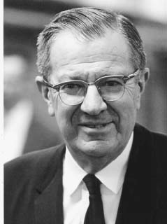
Dr. Frederick Terman
During World War II, Terman directed a staff of more than 850 at the Radio Research Laboratory at Harvard University.
This organization was the source of Allied jammers to block enemy radar, tunable receivers to detect radar signals, and aluminum strips (“chaff”) to produce spurious reflections on enemy radar receivers.
These countermeasures significantly reduced the effectiveness of radar-directed anti-aircraft fire.
Terman’s career was mostly at Stanford and he is credited with Inventing “Silicon Valley” by encouraging students to form their own companies. Including Litton and Hewlett - Packard

Slide 61
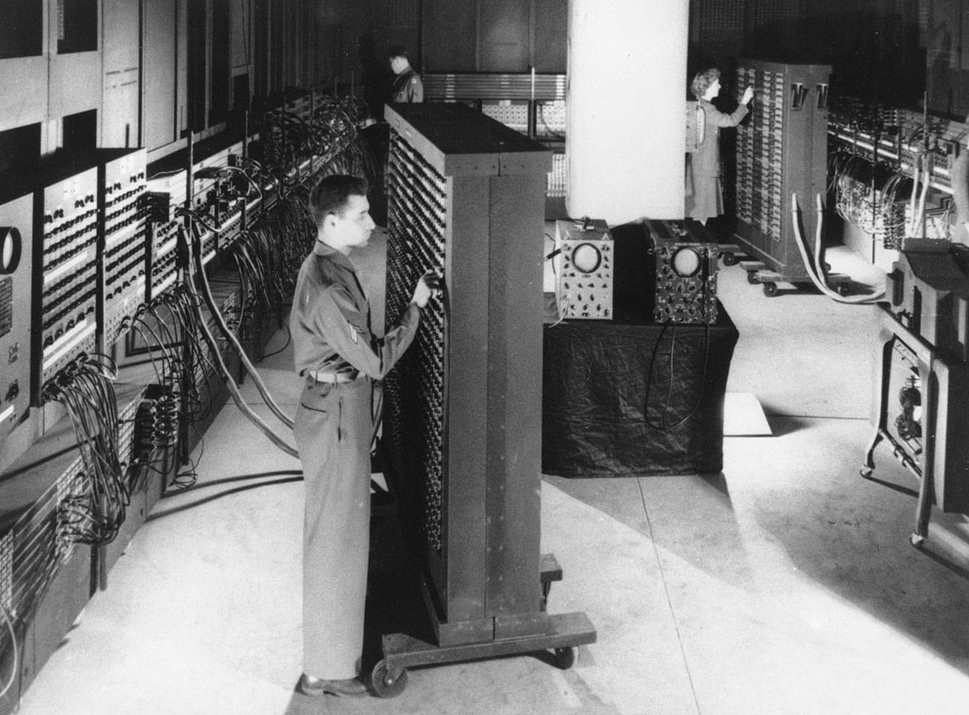
This 1946 photograph shows ENIAC (Electronic Numerical Integrator and Computer), the first general purpose electronic computer - a 30-ton machine housed at the University of Pennsylvania. Developed in secret starting in 1943, ENIAC was designed to calculate artillery firing tables for the United States Army's Ballistic Research Laboratory.
The completed machine was announced to the public on February 14, 1946. The inventors of ENIAC promoted the spread of the new technologies through a series of influential lectures on the construction of electronic digital computers at the University of Pennsylvania in 1946, known as the Moore School Lectures. (AP Photo)

Slide 62
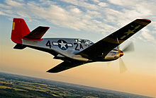
Destroying the Luftwaffe
in early 1944, 8th AF CO General James Doolittle permitted the fighters to stop flying in formation with the bombers and instead attack the Luftwaffe wherever it could be found.
The Mustang groups were sent in well before the bombers in a "fighter sweep," intercepting German fighters while they were forming up.
With this policy change, between June – October 1944 the Luftwaffe lost 13,000 fighter pilots and aircrew members, and the Allies were able to establish air superiority.
As Doolittle later noted, "Adolf Galland said that the day we [US] took our fighters off the bombers and put them against the German fighters, that is, went from defensive to offensive, Germany lost the air war.“
Tuskegee airman stayed with their bombers.
By 1944 the US and England just had far more airplanes.

Slide 63
VHS Operation Point blank

Slide 64
The Strategic Air Doctrine-1
Both the RAF and the US Army Air Corps espoused that strategic bombing could accomplish victory by destroying the enemies' military and war industries and collapsing the moral of the enemies’ citizens. This was based in part on Admiral Alfred Thayer Mahan’s writings on the negative impact of naval blockades on civilian activities.
The RAF, beginning in 1939/1940 with twin engine bombers, had marginal success and then only by flying at night.
Since the 1920s the US AAC was chaffing to prove that Strategic Bombardment would result in short wars.
The US 8th AF began arriving in England Feb 1942.

Slide 65
The Strategic Air Doctrine-2
The USAAC was experiencing explosive growth.
But; the AAC Generals didn’t want the bomber units spread out and taken from the initial attacks on Germany and particularly didn’t want their B-24s modified for ASW.
The first 8th AF crews were undertrained; their bombers were still a work in progress; bases were still being built; organizations were shaking out
Supplies and fuel came over by ship.
The British wanted revenge for their bombed cities and the US press and officials clambered for action.
The US in particular and the British, less so, needed targets to shake out their combat units.

Slide 66
The Strategic Air Doctrine-3
Partial Solution: Target the German U-boat pens on the French west Coast and their coming and going in the bay of Biscay.
The U-boat problem was severe.
The issue ultimately taken to Churchill and Roosevelt.
Direction: The convoys had to be protected, both to keep England supported and to bring over the millions of US and Canadian forces and all their supplies for the invasions of Italy and France.

Slide 67
The Strategic Air Doctrine-4
U-Boat pens proved to be indestructible to even direct hits and most US and British bombs missed their targets.
But with more VLR aircraft with vastly improved radars and intelligence from a steadily improving cryptanalysis; U-boats in the bay of Biscay were under continual attack both day and night.
From late 1943 till 1945 Strategic bombing of the German heartland continued unabated.
Germany faced a combination of aircraft/skilled pilots losses, fuel shortages, growing allied numbers

Slide 68
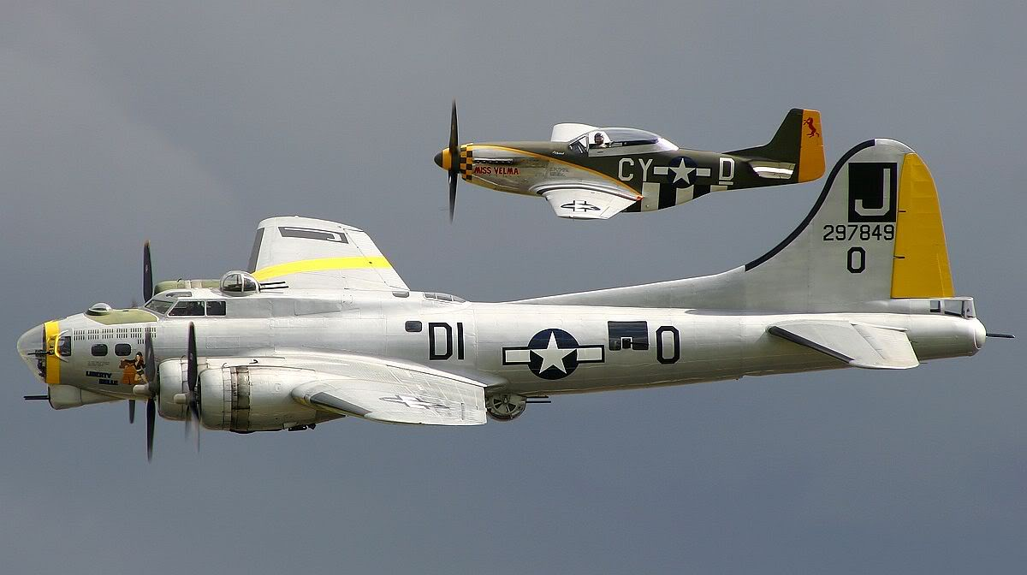

Slide 69
Continual German Fuel Shortfall
Prior to the war Germany was dependant on Rumanian and US oil [ESSO Caribbean sources], after the invasion of Poland the Germans went to the SE Polish oil fields but were thwarted by the quick 1939 Russian partition invasion.
A major impetus of the June 1941 German invasion of Russia was to seize the Baku/Caspian Sea oil fields; Ukrainian food, iron ore and coal.
Until driven back by the Russians in 1944/1945 the Germans exploited the Rumanian and Polish fields and Lithuania oil tar sands. And …

Slide 70
The Impact of Fuel on the War
The Germans were compelled early to go to synthetic oil derived from coal regardless of its inefficiencies. Synthetic plants were placed in SE Germany, Austria, even Poland away from the 8th AF, but then came the 15th AF flying north from Italy.
Italy had exhausted its limited oil fields by 1941 and was dependent on Rumanian and synthetic oil.
The US had unlimited fuel for all allied needs and had developed higher octane fuels which enhanced aircraft performance.
Russia supplied its fuel needs from secured Baku/ Caspian fields.

Slide 71
German Synthetic Fuel Production
March 1944 185,000 tons
May 1944 56,000 tons
July 1944 17,000 tons
February 1945 1,000 tons
Synthetic fuel plants were concentrated in SE Germany and were targeted by the strategic bomber force accompanied by the P-51s.
After Normandy P-51s were in France with shorter escort routes and more time to attack .

Slide 72
Notable Quotes
Gen. Doolittle in his memories quoted Hermann Goering saying "The day I saw fighters flying with bombers over Berlin, I knew the war was lost."
Mustang ace Brig. Gen. Thomas “Tommy” Hayes said that the Merlin-powered P-51 “had the three qualities you need most if you were going to escort bombers to Berlin: [1] range, [2] range and [3] range.”
German Field Marshall Wilhelm Keitel “Normandy invasion succeeded because of our inability to bring up reserves at the proper time, as enemy bomber and fighters made it impossible to throw additional division into the field.”

Slide 73
So, Did Command of the Air and Strategic Bombing Win the War in Europe?
Opinions vary!
It was not the short war projected by Strategic Bombing advocates!
There was no knock-out blow, the WWI style drawn-out land battle continued on three fronts.
The German civilian population did not break and force an end of the war.
Strategic Bombing was vast, but inaccurate.
1942-1943 at best was a Allied build-up and holding action.
1944-1945 constantly attacked industries and transportation.
As 85% of German forces were directed against Russia.
But, the US/UK air actions [1943-1945] drew the Luftwaffe from the Ostfeldung

Slide 74
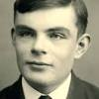
Footnote
Dr. Alan Turing – Receives Royal Pardon
(CNN) -- British WW II code-breaker, who was later subjected to chemical castration for homosexual activity, has received a royal pardon nearly 60 years after he committed suicide.
Turing was best known for developing the Bombe, a code-breaking machine that deciphered messages encoded by German machines. His work is considered by many to have helped change the course of the war and save thousands of lives.
The German Enigma encrypted messages that Turing cracked at the British government's code-breaking headquarters in Bletchley Park provided the Allies with crucial information.
Turing is considered a mathematical genius and later developed the Turing machine, which is considered to have formed the basis of modern computing.
"Dr. Turing deserves to be remembered and recognized for his fantastic contribution to the war effort and his legacy to science," British Justice Secretary Chris Grayling stated. "A pardon from the Queen is a fitting tribute to an exceptional man." The pardon, under the Royal Prerogative of Mercy, came into effect Dec 24, 2013.

Slide 75
Addition to History of Aviation WWI Session
Zeppelin Terror Attack
In the early days of World War I, Germany, determined to bring its British enemies to their knees, launched a new kind of terror campaign: bombing civilians from the sky. But the aircraft delivering the lethal payloads weren’t planes. They were Zeppelins, enormous...
www.PBS.org/WGBH/nova

