Slide 1
America Between the World Wars
Class 1
William A. Reader
E-mail: williamreader40@gmail.com

Slide 2
Why Is This Important?
The era between America’s entry into World War I and America’s entry into World War II is an important era – much that defines our modern world and modern America had its roots in this era
Many of you had parents and/or grandparents who came of age and lived through this era
Understanding the world they lived in will help us understand them
Notes:
Many of the consumer products, technologies, and social innovations that characterize life in modern America had their origins or development in the 1920s and 1930s.

Slide 3
Some Innovations that Originated Between WWI and WWII - 1
Hertz Rent-a-Car | Aerosol cans | Ballpoint pens
Daylight Saving Time | Academy Awards (Oscars) | Electronic computer
American Legion | Radar | Electron microscope
United Parcel Service | Scotch tape | Superman
Thompson sub-machine gun | Macy’s Thanksgiving Day Parade | Birdseye Frozen foods
National Football League | Drive-in movies | Bugs Bunny
Radio Broadcasting | Time & Newsweek | Chanel #5
Color & Sound Motion Pictures | Xerox copies | Loudspeakers
Band-Aids | Gallop Poll | Walt Disney cartoons
Television | Paperback books | “The Big Bang Theory”
35mm cameras | Nylon | Radio astronomy
Monopoly | Canned beer | FM radio
Notes:
Thus, much of what characterized life in 20th and 21st Century America had its origins in the period between the end of World War I and the beginning of World War II

Slide 4
Some Innovations that Originated Between WWI and WWII - 2
Good Humor Ice Cream Bar | Alka Seltzer | Sliced bread
Chanel No. 5 | Monopoly board game | Chlorofluorocarbons
Fast Food Chain Restaurants – White Castle | Colonial Williamsburg | Fluorescent lamps
Bureau of the Budget (predecessor of OMB) | Tomb of the Unknown Soldier | NBC & CBS
Reader’s Digest | Electric guitar | Waring blender
35mm Camera | Teflon | Instant coffee
Book-of-the-Month Club | LSD | Helicopter
Schick electric razor | Freeze-drying | Kleenex
Blondie & Dagwood | Batman | Desk-model Stapler
Jet engine | Life magazine | Pap Tests

Slide 5
What We Will Cover Today
Impacts of World War I and the Treaty of Versailles
Economic, Social & Political Effects
Financial
Agricultural
Industrial
Political
Other
Impacts of the Russian Revolution
The Influenza Pandemic
Immigration Restriction
Woodrow Wilson’s Four Great Mistakes
Begin discussion of Prohibition

Slide 6
Effects of World War I
You can’t understand the 1920s and 1930s without understand the impact of WWI
Most of what happened in the 20th century had its roots in WWI and the resulting peace treaties
The Russian Revolution
The Great Depression
World War II
The Cold War
Vietnam
The Arab-Israeli Wars
The two U.S. wars with Iraq
Notes:
World War I cast a giant shadow over the whole of the 20th century, and especially over the 1920s and 1930s. The events depicted on this slide all had their roots in World War I and the peace treaties that resulted from the war.

Slide 7
The Russian Revolution -1
The war placed a major strain on the Russian economy
Decline in civilian production
Rampant inflation, especially in the cities
Inadequate railroad infrastructure
The Ottoman Empire cut Russia off from the Western Allies
Prevented the Allies from shipping supplies to Russia
Led to the ill-fated Dardanelles campaign
Made Kamal Ataturk and unmade Winston Churchill
Fostered a sense of Turkish, Australian, and New Zealand identity
Notes:
Decline of production. Mass conscription of peasants, agricultural laborers, and urban workers led to a decline in civilian production, especially agricultural production. With fewer available farm laborers, large landowners could not afford to hire farm workers so that grain-producing land went out of production. Peasant families, with many of their male members in military service and unable to buy high-priced civilian goods, reverted to subsistence farming.
Inadequate railroads. Russia is a land of vast spaces. The cities where industry was concentrated were far from the major grain growing areas of the Ukraine, the oil-producing fields of Baku and Azerbaijan, and the coal fields of the Donets Basin. Both the cities and commodity-producing areas were in turn far from the front. The result was that the railroads could not meet the simultaneous demands of both the Army and the urban populations.

Slide 8
The Russian Revolution - 2
Decline of the Russian economy led to the “February” Revolution
The failures of the Provisional Government led to the “October” Bolshevik coup
Intermediate result: Russian Civil War
End Result: A Communist Russia
Notes:
Impacts of the Decline of the Russian Economy. The decline of the Russian economy was reflected in both food/fuel shortages and rampant inflation in the cities. These shortages were aggravated by the especially cold winter of 1916-17. It was the protest of women, marching on International Women’s Day, that precipitated the “February” Revolution when urban workers and Petrograd garrison soldiers joined the Revolution and the Russian army refused to fire on the crowds.
Bolshevik coup. The inability of the Provisional Government to solve or even effectively deal with the economic problems that precipitated the February Revolution and the government’s inability to win or end the war precipitated the Bolshevik coup.
Civil War. The Bolshevik coup in turn led to civil war. Motivated by anti-communism, by a desire to keep Allied war supplies at Vladivostok , Murmansk, and Archangel out of German hands, and by a hope of keeping Russia engaged on the Eastern Front, the Allies intervened on the side of the “Whites” The intervention, however, was not of a scale sufficient to defeat the Bolsheviks, but was enough to leave the Soviets with a deep suspicion of the West and a paranoid fear that the capitalist world was out to get them.

Slide 9
Effects of a Communist Russia
Split the World Socialist movement into a Communist wing and a Democratic Socialist wing.
Founding of the American Communist Party as a response to the events in Russia
The Communist Revolution in Russia and the Founding of the American Communist Party Led to:
The “Red Scare” in the U.S. &
A fear of Communist revolution among both political elites and the political Right in Europe
Notes:
Split between Socialists & Communists -The Split was over: 1) Party organization: Elitist revolutionary party vs Mass-movement party & 2) How to Achieve power: Violent revolution vs Democratic election. In Germany, this split was to have tragic results since it led the German Communists to see the German Socialists (and not the Nazis) as their primary enemy.
Fear of Revolution – The triumph of the Communists in Russia and the possibility of their possible accession to power elsewhere in Europe heightened the fears of political-economic-social elites and the paranoia of the political Right. By focusing fears upon communism, it blinded people to the dangers and radicalism of the Fascists and Nazis. It led many conservatives into the illusion that “the enemy of my enemy [the Communists] is my friend.”

Slide 10
Impact of the US Involvement in WWI
US involvement in WWI had impacts in many different areas
Financial
Agricultural
Industrial
Political
Other

Slide 11
Financial Impact of WWI - 1
Sizable increase in the national debt
Led to postwar policies of cutting federal govt expenditures
Income Tax becomes the dominant mode of taxation
Mass marketing of war bonds as both an investment and as a means of showing one’s patriotism
Made a large proportion of the American public bondholders
Notes:
National debt – The national debt rose from $1.2 billion in 1916 to $25 billion in 1920. As a result, interest payments on the post-war debt exceeded 40% of revenues. This led to strong pressure to reduce expenditures.
Taxation - WWI had raised the issue of how to pay for it – massive borrowing and/or high taxes
Wilson & McAdoo favored extending the income tax to the middle classes. Looking back on the Civil War, they wanted to avoid the large-scale inflation of that war
1917 War Revenue Act raised the top income bracket tax rate from 15% to 67%, with the tax beginning at an income level of $1,000 for individuals and $2,000 for couples.
It also imposed a very high excess profits tax
Made 5 million more Americans subject to income taxes. About 15% of American households were now subject to the income tax.
Bonds - Since taxes only covered a third of the war costs, there was a massive effort to sell war bonds. Unlike the Civil War where bonds were marketed as an investment (bonds were known as 7-30s & 5-20s), now they were marketed as a means of showing one’s patriotism, with small-town insurance agents, Wall Street bankers, Boy Scouts, and prominent celebrities all urged to donate their services to bond drives.
Bonds were marketed in low denominations, and banks were encouraged to lend money to bank customers so they could buy bonds
To make the bonds financially appealing, McAdoo made the interest on the bonds exempt from all income taxes.
This appealed to middle- and working-class buyers. Over 13 million people bought $50 bonds and 6 million bought $100 bonds. Roughly half of all American families bought war bonds
The Treasury also sold Thrift Certificates with 5-yr maturities in denominations from $5 to $1,000 and 25-cent Thrift Stamps which could be pasted in books and, when 20 stamps had been accumulated, exchanged for Thrift Certificates

Slide 12
Financial Impact of WWI - 2
Generated a high-degree of inflation
CPI doubled between 1915 and 1920
Led the Federal Reserve to raise the discount rate from 4% to 7%
The resulting recession was a major factor in the defeat of the Democrats in the 1920 Election
Other factors were the abrupt cancellation of war contracts and the process of demobilization
Notes:
Federal Reserve – During World War I, the Federal Reserve kept interest rates at 4 percent to facilitate Federal Government borrowing. To curb inflation (The CPI doubled between 1915 and 1920), the Fed between November 1919 and May 1920 raised the interest rate to 7 percent and kept it there for a year. The result was a decline in the GNP by 10% and an increase in the unemployment rate from 4% to 12%.
Cancellation of contracts – On Armistice Day, the long-distance phone lines were tied up by War and Navy Department personnel cancelling war contracts and war production orders.
Demobilization – Discharged veterans were given only $60, a new suit of clothes, and a railroad ticket to their home town. Nothing was done to either help them find jobs or to deal with the psychological aftereffects of battlefield trauma. Any psychological support needed by the veterans was provided by fellow members of the American Legion, the Veterans of Foreign Wars, and other veteran’s organizations.

Slide 13
Agricultural Impact of WWI - 1
European food production declined as agricultural manpower was drafted into military service
Led U.S. farmers to vastly expand agricultural production
Farmers took on mortgages to purchase land and to mechanize agricultural production
Mechanization and chemical fertilizers led to a vast increase in productivity
Notes:
Increased war-time production – To encourage production, Food Administrator Herbert Hoover set the price of wheat at $2.20 a bushel. As a result, farmers increased wheat acreage by 40% and wheat output by almost 50%.
Mechanization - Mechanization led to the replacement of farm horses by tractors and autos. 1/3rd of the crop land in 1900 was devoted to producing fodder for the nation’s 20,400,000 horses in the U.S, -- 17 million used for pulling plows and wagons in rural areas and 3.4 million for urban transport in cities -- and mules. As the auto and the tractor replaced draft animals, more and more agricultural land was turned over to producing food for humans.

Slide 14
Agricultural Impact of WWI - 2
A Depressed agricultural economy in the 1920s due to:
Post-war return of European agriculture to normal levels of production
The increased productivity and expanded output of American agriculture which led to:
Crop surpluses,
Low farm prices
Farmer agitation for measures that would restore parity
Notes:
European agricultural output had declined considerably during the war because of the drafting of peasants and farm laborers into military service. Also, nitrates that had started being used for fertilizer were given over to the production of munitions and explosives. To take up the slack, not only American but also Australian, Canadian, and Argentinian agricultural output increased. As European agriculture returned to normal levels of production, the result was a world surplus of agricultural commodity production. Since the demand for agricultural products is relatively inelastic, the result was a steep decline in prices worldwide.

Slide 15
Industrial Impact of WWI - 1
Created a big demand for munitions, steel, motor vehicles, communications equipment, and ships
Turned DuPont into a chemical-industrial giant
Created a planned economy run largely by big business interests via the Federal Government’s War Industries Board (WIB)
WIB had over 60 commodity divisions relating to specific industries that:
Were largely staffed by people from the industry
Were interwoven with the supply departments of the Army, Navy, other Federal agencies, and even the Allies
Notes:
The war created a big demand for munitions, steel, motor & horse-drawn vehicles, communications equipment, railroad equipment, and ships
Until 1914, the largest contract that Bethlehem Steel had ever signed was for $10 million. In November 1914, Bethlehem Steel received a contract from the Royal Navy for guns, shells, and ships totaling $135 million.
E.I. Dupont was transformed from a large gunpowder company into a chemical-industrial giant, supplying the Allies with 40% of their munitions
WWI created within the US what economist Murray Rothbard called ‘war collectivism’ – a planned economy run largely by big business interests through the instrumentality of the federal government. It involved the cartelization of the economy under the aegis of government with prices and wages raised, production fixed, and military and other government contracts channeled into the hands of favored corporate producers.
Liberal intellectuals saw this as a way of transcending the weaknesses and social conflicts that they saw in the two major alternatives of laissez-faire capitalism and Marxian socialism.
Big business was very enthusiastic about the extensive planning and economic mobilization that American participation in WWI would bring. Industrial preparedness had won the support of the Chamber of Commerce and the great bulk of American industry.
In 1916, Wilson had established the governmental Council of National Defense (CND), with an Advisory Commission of private industrialists to prepare the American economy for war. Wilson saw the Council as especially valuable since it opened up a new and direct channel of communication and cooperation between business and scientific men and all departments of the Government. He saw the personnel of the Advisory Commission as marking ‘the entrance of the nonpartisan engineer and professional man into American governmental affairs.’
The head of the Advisory Commission was Walter S. Gifford (chief statistician of AT&T), Daniel Willard (President, Baltimore & Ohio RR), Bernard M. Baruch (Wall Street financier), Howard E. Coffin (VP of Hudson Motor Co), Julius Rosenwald (President, Sears, Roebuck & Co); Samuel Gompers (President, American Federation of Labor), one scientist, and one leading surgeon.
The Advisory Commission designed the system for purchasing war supplies, with each branch of industry forming a committee to organize the sale of their products to the govt and the prices to be paid for these products.
Willard was put in charge of dealing with the railroads, Coffin with munitions and manufacturing, Baruch with raw materials and minerals, Rosenwald with supplies, and Gompers with labor.
Because war mobilization was proceeding slowly, the US Chamber of Commerce urged Congress that the director of the CND ‘should be given power and authority in the economic field analogous to that of the chief of state in the military field.’ In July 1917, the raw materials, munitions, and supplies departments were brought together under a new War Industries Board (WIB)

Slide 16
Industrial Impact of WWI - 2
WIB Conservation Division standardized a whole host of products in terms of size, color, versions, and variety
E.g. Sizes, colors, & varieties of clothing; the shaping and sizes of drill bits & screw threads
Prior to WWI, each company and industry had determined its own standards
250 types of plow models
755 types of drills
Notes:
War-time standardization – To save strategic materials and make production more efficient, Bernard Baruch, head of the War Industries Board, ordered drastic standardization. The number of styles of pocketknives was reduced from 6,000 to 144 and the number of colors of typewriter ribbons was reduced from 150 to 5.

Slide 17
Industrial Impact of WWI – 3
WIB Price-Fixing Committee was responsible for:
Setting prices to control inflation
Guaranteeing a ‘fair profit’ to the producers in order to stabilize the market
Notes:
Often this involved ‘cost-plus’ contracts
Big Business liked this because it stabilized prices, ironed out market fluctuations, and gave industry representatives a major role in setting prices
Harry A. Wheeler, president of the US Chamber of Commerce, wrote that war ‘is giving business the foundation for the kind of cooperative effort that alone can make the U.S. economically efficient.’

Slide 18
Industrial Impact of WWI - 4
The Food Administration
Headed by Herbert Hoover
Persuaded Americans to eat fish and vegetables in place of wheat and meat
Promoted “wheatless’ and ‘meatless’ days
Popularized spaghetti (pasta with tomato sauce) as both a meat strecher and as a dish for meatless days
Standardized food sizes & portions
Standardized the size of bread loaves
Notes:
The Food Administration was given full authority over food, enforced by a series of licenses issued to all divisions of the food industry along with conditions that had to be met to keep the license
Hoover mobilized a vast network of citizen volunteers to help the bureaucracy enforce its decrees by stigmatizing decree violators as unpatriotic.
Price controls were imposed on the basis of ‘a reasonable margin of profit’ over costs and sold on the basis of fighting inflation.
Rebates or discounts to particular customers were prohibited
Standardized the size of bread loaves
During World War I, American diets started to change under the impact of three factors:
1. Food Administration attempts to get people to eat more perishable fruits and vegetables so that the U.S. could ship staples and preserved food to Europe
2. Army mess food whose cooking manuals stressed the idea of balanced meals that included potatoes, fruits, and vegetables as well as meat or chicken.
3. The cachet that Italian pasta dishes with tomato sauce -- especially spaghetti -- acquired due to both the fact that Italy was an ally and the Food Administration’s promotion of the dish since red sauce served as an excellent meat stretcher. This helped move spaghetti and other Italian dishes out of the “Little Italy’s” into the American middle class mainstream. i.e. Spaghetti became an American middle class food as well as an Italian food.
Before World War I, eating a lot was thought to be sensible, and being plump was regarded as a sign of good health as well as prosperity. Early nutritionists suggested that an adult male ought to consume 3,000 to 3,500 calories each day. Faced with an army and allies to feed as well as a reduced agricultural labor force, the U.S. government in 1917 began telling people they could remain healthy if they ate less as long as they consumed the proper pro­teins, carbohydrates, minerals, and vitamins. Claims that fewer calories sufficed for working adults were reinforced by rationing programs and campaigns for voluntary "wheatless" and "meatless" meals each day and entire days each week. During and after U.S. participation in the European war, a fundamental shift began tak­ing place in American eating habits, especially among the middle and upper classes. Southern and immigrant soldiers who had been exposed to much more varied meals while in the military con­tributed to the change as well. By the end of the 1920s Americans were better fed yet consumed 5 percent fewer calories per capita than they had on the eve of the war, a very significant overall de­cline during a period of general prosperity.

Slide 19
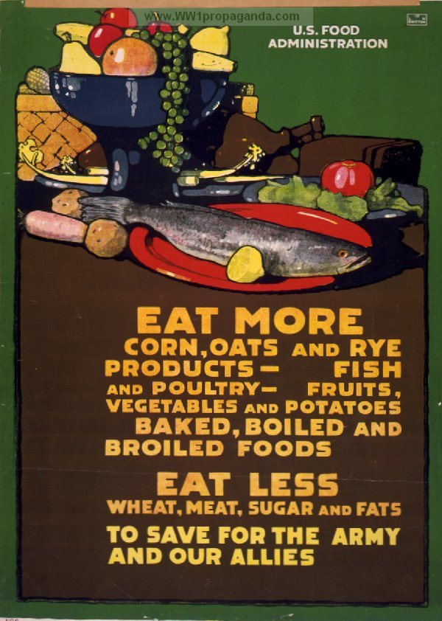
Food Administration Poster

Slide 20
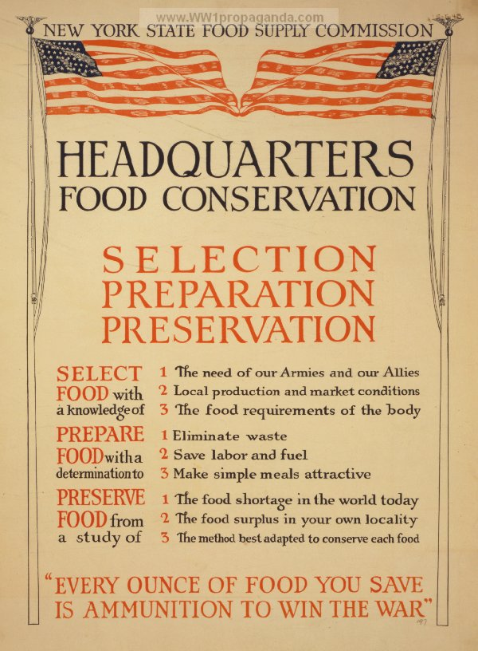
Food Administration Poster

Slide 21
Industrial Impact of WWI – 5
Provided a model
For big business, a model of what could be achieved by national coordination and cartelization
For liberal intellectuals, a model that was
An alternative to both laissez-faire capitalism and Soviet communism
A way of transcending the weaknesses and social conflicts of both of the above
For the FDR Administration, a model for many New Deal agencies and programs
Notes:
For big business, the wartime economy was a model of what could be achieved by national coordination and cartelization in stabilizing production, prices, and profits; and which abolished much competitive diversity in the name of standardization.
This paved the way for promoting the cooperative association of business trade groups by Secretary of Commerce Herbert Hoover in the 1920s
As Secretary of Commerce, Herbert Hoover supported the creation of buyers’ cartels in several industries (ie. Coffee & rubber), restrictions on oil production, and cartelization of the textile industry. He also continued to impose standardization, abolishing or simplifying about a thousand industrial products.
Provided a model for Roosevelt’s NRA and AAA.
Led people such as Bernard Baruch and George N. Peck (President of the Moline Plow Company) to support federal farm price supports through federally-organized farm cartels that would ensure parity – culminated in the AAA and the current federal farm price support system
Led people such as Gerard Swope (President of General Electric) to propose a revived form of ‘war collectivism’ in what eventually became the NRA.
Many NRA officials were veterans of war mobilization in WWI and of the WIB and its various sections
John Hancock – head of the WIB naval industrial program
Leo Wolman – head of production-statistics of the WIB
GEN Clarence C. Williams – Chief of Ordnance in charge of Army war purchasing
Isador Lubin
WWI experience provided the inspiration of many New Deal agencies and programs
This included such agencies as the NRA and AAA
During WWI, the Emergency Fleet Corporation and the United States Housing Corporation were established to provide housing for war workers. This provided a precedent for both federal housing programs and ‘planned communities.’

Slide 22
Political Impact of WWI - 1
Wilson created the Committee on Public Information headed by George Creel (CPI) to create the war spirit necessary to fight the war
Led to an upsurge of anti-German hysteria
Based on propaganda demonizing everything German
Pioneered in the use of media celebrities to propagandize and sell war bonds
Erosion of civil liberties
Suppression of anti-war groups
Suppression of the American Socialist Party
Notes:
As the U.S. entered World War I, Wilson had plausible reasons to worry about domestic opposition. Elected to a second term on the slogan “He Kept Us Out of War,” Wilson faced the challenge of converting much of the public from a belief in neutrality that he had encouraged. There were 8,000,000 Americans who looked to Germany as their nation of origin, and much of the German-language press had been sympathetic to the Central Powers. Elements on the left, including the Socialist Party, called on workers to oppose the war effort. Consequently, Wilson named Progressive journalist George Creel to direct the Committee on Public Information, the federal office Wilson established by executive order to manage public opinion and propagandize the war effort. In the huge propaganda effort that followed, Creel enlisted academics and journalists to compose pamphlets, articles, speeches, and other material vilifying Germany and justifying the war as the great crusade for democracy, using every channel of communication, including public speeches, motion pictures, posters, civic organizations, and the press. In addition, the Wilson Administration turned to censorship.
The purpose of the Creel Committee was to create the ‘war spirit’ necessary to fight and win World War I. It led to a demonization of everything German:
Teaching the German language was forbidden
Dachshunds became ‘liberty dogs’ and sauerkraut became ‘liberty cabbage’
War bond posters screamed ‘Stop the Hun’
A broadway play, entitled The Kaiser: The Beast of Berlin portrayed the kaiser as gloating over slaughtered Belgian civilians and torpedoed American ships
A popular film, My Four Years in Germany, depicted the kaiser as a paranoid with the IQ of a 6-year old. The German General Staff was introduced with a series of superimposed images comparing each man to an animal.
Eric von Stroheim made an acting career portraying the prototypical monstrous German officer who murdered people and children for the fun of it in several movies
Once war was declared, German-Americans became the victims of American prejudices. Although previously highly respected, they were now suspected of espionage and sabotage. The German language was banned from the schools, German books were burned, Beethoven and Wagner were dropped from orchestral programs, and with patriotic zeal, sauerkraut was transformed into "liberty cabbage." In Baltimore, German Street became Redwood Street and the waiters at the city's leading German restaurant were rumored to be spies. Writers with Germanic-sounding names, among them Henry Mencken and Theodore Dreiser, were harassed. Super-patriotic vigilante groups such as the American Protective League and the National Security League rounded up supposed "slackers," pacifists, and conscientious objectors, with official approval.
During World War 1, the persecution of Germans in American society was so pronounced that Germans were forced to abandon their language and customs, at least in public. German books were burned outside numerous libraries, while Beethoven was banned from symphonic repertories. The atmosphere was such that Germans hid the fact they were German and changed their own names-Schmitz to Smith, and so forth. For its part, the public renamed almost every German street and landmark and even altered menus, so that sauerkraut became Liberty Cabbage, and so on.
Suppression of the Socialists - Unlike European Socialist and Labor parties (which supported their country’s war effort), the American Socialist party opposed U.S. entrance into World War I and mobilization for war. The result was the jailing of its leaders and the suppression (through denial of mailing privileges) of all of its publications.

Slide 23
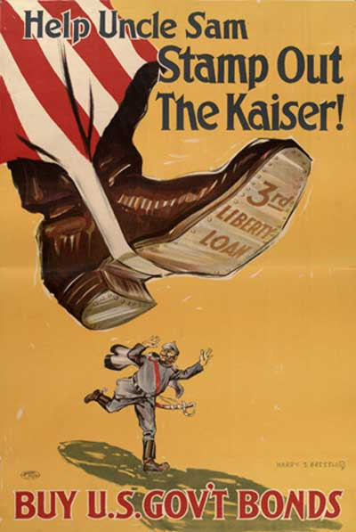
Savings Bond Ad

Slide 24
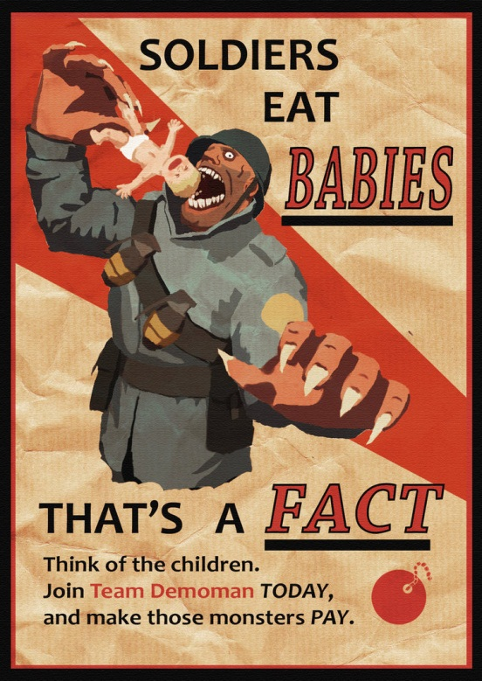
Anti-German Propaganda Poster

Slide 25
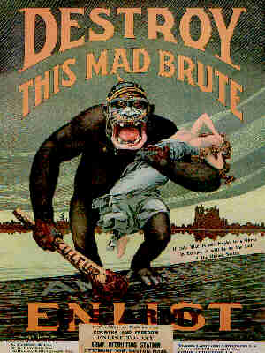
Anti-German Enlistment Poster

Slide 26
Political Impact of WWI - 2
Made possible the enactment of Prohibition
Supporters of Prohibition exploited the belief that drink impeded industrial productivity and soldierly fighting ability
The Anti-Saloon League successfully linked liquor to disloyalty and beer-drinking with sympathy to the kaiser and his Huns
Led to the Post-war “Red scare”
The Russian Revolution and the founding of the American Communist Party led to a fear that revolution could happen here
This fear was intensified by the “100% Americanism” promoted by the war and the Creel Committee
Notes:
Enactment of Prohibition – While Prohibition owed its enactment to World War I, Prohibition had an interesting history and some very significant consequences, which I will discuss in more detail later.
100% Americanism - “As [Seymour] Lipset correctly states Americanism is an ism in the same way that communism was. While other nations have a sense of themselves derived from a common history—one cannot become un-English or Swedish, for example—being an American is regarded as an ideological or religious commitment and is not a matter of birth. Hence, those who reject American values are "un-American" by definition. "Americans" writes Lipset, are Utopian moralists who press hard to institutionalize virtue, to destroy evil people, and eliminate wicked institutions and practices. A majority even tell pollsters that God is the moral guiding force of American democracy. They tend to view social and political dramas as morality plays, as battles between God and the Devil, so that compromise is virtually unthinkable.”

Slide 27
Political Impact of WWI – 3
Anti-German hysteria (and the Red Scare) in turn led to:
A stress on 100% Americanism
Immigration Restriction
Immigration Act of 1917
Emergency Quota Act of 1921
Immigration Act of 1924 (National Origins Act)
Notes:
The ideology of (and stress on) 100% Americanism was characterized by elements of racism, nativism, and a rejection of Europe. It was a melange of the following beliefs: that the United States of America was the best nation in the world; that the roots of American progress lay in acceptance of, and conformity to, the Anglo-Saxon Protestant norms of the American middle class; that immigration (particularly of political radicals, and racially-ethnically inferior groups) should be severely limited and that immigrants should learn English and abandon their Old World culture; anti-radicalism (especially fear of communism); extreme dislike of anything German; racism; and isolationism.
The combination of anti-German hysteria, anti-communism, and 100% Americanism led to immigration restriction and the end of era marked by the motto on the Statue of Liberty.

Slide 28
Immigration Restriction Acts
Immigration Act of 1917
Barred entry to immigrants from most of Asia
Barred many categories of “undesirables”
Barred immigrants age 16 and above who were illiterate
Immigration Act of 1921
Limited the annual number of immigrants from each country to 3% of the number of persons from that country living in the U.S. in 1910
Notes:
Asian Barred Zone – The Act barred entry to Asians living in an area south of the 50th parallel of latitude North, east of the 50th and west of the 110th meridians of longitude East. It also barred entry to Pacific and Indian Islanders living in an area north of the 10th parallel South, south of the 20th parallel North, east of the 50th and west of the 160th meridians of longitude East. Thus, it effectively barred the immigration of Middle Eastern Arabs and Turks, Iranians, Indians, Chinese, Vietnamese, Burmese, Thais, Chinese, and Indonesians.
Undesirables – idiots, criminals, alcoholics, epileptics, “insane persons,” beggars, persons “mentally or physically defective,” polygamists, and anarchists.

Slide 29
Immigration Restriction Acts -2
Asian Exclusion Act of 1924
Barred immigration from an Asia-Pacific triangle from Japan, China, Korea, India, and Southeast Asia
Barred immigration of any persons ineligible for naturalization
Non-whites were not deemed eligible for naturalization
Provoked an official diplomatic protest from Japan
Notes:
The Japanese diplomatic note to Secretary of State Charles Evans Hughes said that the Act of 1924 “establishes the rule that the admissibility of aliens to the United States rests not upon individual merits or qualifications but upon the division of race to which applicants belong. In particular, it appears that such racial distinction in the act is directed essentially against Japanese, since persons of other Asiatic races are excluded under separate enactments of prior dates…”

Slide 30
Immigration Restriction Acts -3
National Origins Act of 1924
Temporarily limited the annual number of immigrants
After July 1, 1927 (later postponed to July 1, 1929)
Imposed a total annual quota of 150,000 with the annual quota for any country or nationality being proportional to their proportion of the U.S. population in 1920
Gave non-quota status to wives and unmarried children of U.S. citizens and natives of Western Hemisphere countries
Notes:
National Origins - Initially, the Act limited the number of persons from each country to 2% of the number of persons from that country living in the U.S. in 1890 until the Census calculated the proportion of the U.S. population in 1920 that originated from each country and nationality group and applied that proportion to the total immigration quota of 150,000.

Slide 31
Other Impacts of WWI -1
Airplane
Gave Hollywood dominance in the motion picture industry
Consumer products
Safety razors
Wrist watches
Kotex
Cigarettes
Notes:
Safety razor - The safety razor and disposable double-edged blade had been patented by King Gillette in 1901, but did not come into common use until the U.S. Army issued safety razors to the troops. The straight razor received another blow when Colonel Jacob Schick patented the electric shaver in 1924.
Wrist watch - Wristwatches replaced the pocket watch during the war since they were much more user-friendly in a battlefield situation
Kotex - Previously, scientist Ernst Mahler (who also later developed Kleenex) had developed a cotton substitute made of wood cellulose for Kimberly-Clark company that was used to make bandages during the war. Learning Red Cross nurses had pressed these bandages into service as sanitary napkins, the developed a new product, called Kotex, which was put on the market in 1921.
“Even more sensitive a subject than deodorant, menstrual pads appeared and became a success in the 1920s. Before the invention of Kotex, women used cotton cloths or rags, which they washed and reused. During the First World War, a Wisconsin company called Cellucotton made bandages from wood fibre for use in the army hospitals in France, and the nurses began using these "cellucotton" bandages as disposable sanitary pads. Once the war was over, the company renamed them Kotex (short for "cotton-like texture") and hired a Chicago advertising agency to market this awkward product. (p250} [Ashenburg_The Dirt on Clean]
“Bizarrely, its first ad showed two wounded soldiers with an attendant nurse, and two other soldiers in the background. Accepted by the Ladies' Home Journal but never printed, the ad was recalled by the agency, which had second thoughts about spotlighting men in connection with such an unmentionable female function. But the product's wartime origin—perhaps some sense that if it was good enough for heroic soldiers, it would serve for a woman's monthly inconvenience—was apparently too compelling to forgo entirely. The next attempt, which was published in the Journal in 1921 and is pictured here, shows a wounded veteran seen from the back in his wheelchair in a garden, attended by a nurse and another woman. A third woman sits behind them on the grass. The copy fills in the "romantic background" of this "wonderful absorbent," which is now manufactured by machinery that makes and seals it completely without contact from human hands. The sanitary pads became so successful that the company changed its name from Cellucotton to Kotex. (p250}[Ashenburg_The Dirt on Clean]
Cigarette smoking - While rapid urbanization, changing gender roles, and clever advertising played major roles in turning adult Americans into cigarette smokers, the widespread use by soldiers during World War I also played a major role.

Slide 32
Other Impacts of WWI – 2
Spread Jazz from New Orleans to the cities of the North
Created New Standards of What Was Considered to be Attractive
From full-bodied to slim
From Gibson Girl to Flapper
Created the Conditions for the Great Influenza Pandemic of 1917-1919
Notes:
JAZZ “The closing in November 1917 of Storyville, the wide-open New Orleans red-light district, to protect the health and morals of the U.S. Navy's sailors, added a vibrant new force to the culture of Northern cities—jazz music. Many of the military bands that saw service in the war with Spain had broken up in New Orleans following the conflict, and some musicians left their instruments in pawn shops where they fell into the hands of eager and talented young blacks. Nondescript little bands began beating out lively, improvised tunes, a mixture of African rhythms, black folk chants, and syncopation. (p49} [Miller_New World Coming]
“Jazz bands played in honky-tonks, dives, and dance halls such as Funky Butt Hall and the Come Clean Dance Hall. Musicians gathered after work, usually around 3 A.M., at a place called the Frenchman's. "It was only a back room, but it was where all the greatest pianists frequented," recalled Jelly Roll Morton, the first real master of the jazz form, who created a syn­thesis of blues and ragtime. "The millionaires would come to listen to their favorite piano players.... People came from all over the country and most time you couldn't get in." The drugstore across the street sold cocaine; newsboys peddled three marijuana cigarettes for a dime. (p49} [Miller_New World Coming]
“Jazz, near jazz, and semi-jazz was also being played beyond the Crescent City. Itinerant black piano men crisscrossed the South and West, offering various styles: ragtime, fast western, overhand bass, barrelhouse, and sock. Syncopated music was also featured by minstrel and vaudeville troupes, and there were numerous guitar pickers like Leadbelly and Blind Lemon Jefferson who earned an erratic living singing and playing blues and dance tunes. St. Louis, Kansas City, and Memphis also had their own distinctive styles of jazz and blues. (p49} [Miller_New World Coming]
New Standards of Attractiveness World War I dietary changes inaugurated nothing short of a revolution in standards of attractiveness and attempts to achieve it. In the late nineteenth century, when getting enough to eat regularly was often still a challenge and the understanding of nutrition was limited, being stout was regarded as a sign of health, success, and beauty. Actress Lillian Russell, widely regarded as the Great American Beauty of the 1880s, tipped the scales at 200 pounds. Late-nineteenth-century clothing had tended to emphasis or even help to create a plump figure. Both men's and women's clothing had featured layers of heavy fabrics, padded shoulders, and a loose fit. Women's dresses, normally with flared and pleated ankle-length skirts, made fuller by being worn over petticoats, used yards of cloth. As more young women began working outside the home in the cities of the 18905, simpler styles—tailored suits or long, dark skirts (without petticoats) and white blouses or "shirtwaists"— became common. Just before World War I, fitness rather than girth emerged as the standard for male attractiveness. The somewhat more slender (though still robust) silhouette of the Gibson Girl, named for the popular magazine drawings of Charles Dana Gibson, took hold as the female counterpart. The war, however, prompted tremendous change in thought and fashion. Wartime shortages of both food and fabric stirred government conservation efforts. The administration of Woodrow Wilson sought to educate people on the advantages of eating less and, consequently, weighing and wearing less. Good nutrition was reflected in erect posture, healthy-looking skin, and shiny hair. These characteristics, rather than plumpness, became signs of beauty, not to men­tion patriotism. Likewise, more simple clothing with fewer layers, single- instead of double-breasted suits, and shorter skirts saved fab­ric and aided the war effort. After the war ended, the slender image of the "flapper" girl and the soldier "doughboy" continued to be idealized as the epitome of attractiveness. (p121}
Women's clothing styles in the postwar era, at least those favored by younger women, were the most notable symbol of the new fash­ion. Flapper-style dresses used light fabrics that hung straight from the shoulders and gathered low on the hips rather than at the waist. This style sought to deemphasize both the bust and the hips in order to create a slim profile. Corsets disappeared almost altogether, and !! multi-layer petticoats gave way to single-layer slips, or just "knick­ers," under skirts. Hemlines, which had only during the war risen from ankle to mid-calf, rose to the knee and beyond as the 1920s proceeded. Exposed lower legs acquired further emphasis from sheer silk stockings. (p121&124}

Slide 33
The Influenza Pandemic - 1
Started on a pig farm in Haskell County Kansas
Two events led to the virus becoming a pandemic:
Annual Iowa Cedar Rapids Swine Show in September 1917, and
Large-scale induction of Iowa & Kansas farm boys at Fort Funston
First wave in the spring and summer of 1918
Unlike most flu, which have U-shaped death graphs, this flu had a W-shaped graph
Notes:
The epidemic of 1918 or one of its viral strains probably started on a pig farm in Iowa. After the annual Iowa Cedar Rapids Swine Show in September 1917, a mysterious ailment gripped its pigs. !! As the prize-winners returned to their barns, millions of hogs fell ill and thousands died. Pig farmers, who also got sick, said they had never seen anything like it.
People suffering from influenza shed virus for usually no more than seven days after infection and often even less. After that, though they still may cough and sneeze, they will not spread the disease. As sparsely populated and isolated as Haskell County was, the virus infecting the county might well have died there and failed to spread to the outside world. That would be so except for one thing: this was wartime. What happened was the farm boys inducted into the army at Camp Funston, part of the Fort Riley military reservation, carried the infection from Haskell County to the Camp (aided by civilians from Haskell who visited their soldier-relatives at the camp).
Camp Funston had an average 56,000 soldiers, and had literally been thrown together in a few weeks in 1917. It was overcrowded and, in the record cold winter of 1917-18, was inadequately heated. The result was that the men huddled closely around the stoves in the barracks. On March 4, 1918, a private at Funston reported ill on sick call with the flu. Within two weeks, 1,100 were sick enough to be admitted to the hospital and thousands more needed treatment at infirmaries scattered around the base. 237 of the hospitalized men developed pneumonia, but only 38 died. Meanwhile, Funston fed a constant stream of men to other American bases and to Europe.
The first wave of the 1918 pandemic engulfed Americans with tell-tale headaches and fevers during the spring and summer of that year. The only portent was the number of young people dying from pneumonia. Most flu epidemics have U-shaped death graphs. The young and the old, exhausted by the flu if they don’t succumb immediately, eventually lose their ability to fight off bacterial infections like pneumonia and die. But in the summer of 1918, the death graph resembled a W. Many more young adults than usual seemed to be getting the flu followed by pneumonia. Doctors didn’t recognize the trend until the fall.

Slide 34
The Influenza Pandemic – 2
Flu spread from Camp Funston to other Army training camps and to Europe thanks to crowded barracks, sealed troop ships, and the fetid trenches of the Western Front
Called “Spanish Flu” since neutral Spain did not censor news accounts of the flu
Second (and most lethal) wave first appeared in September 1918 at Camp Devens MA
Notes:
Doctors didn’t recognize the W-mortality trend until the fall. By then, American troops had already introduced the flu to war-weary Europe. !! Germans called it the ‘Blitz Katarrh,’ English the ‘Flanders Grippe,’ and Americans called it the ‘Spanish Flu’ since Spain, a neutral power, didn’t censor its news during the war and flu, which eventually killed half a million Spaniards, was making headlines in Spain.

Slide 35
The Influenza Pandemic – 3
Second wave virus singled out 20- and 30-year olds
By the end of October 1918, 1 in 5 U.S. soldiers had been infected
Virus provoked a hyper immune response which flooded the lungs with fluid
This allowed secondary bacterial infections (most commonly pneumonia) to deliver the fatal blow

Slide 36
The Influenza Pandemic - 4
An estimated 50 million people died of the flu
This included 550,000 Americans
Roughly half who died were people in their 20s and 30s
May have killed as many as 8%-10% of the people in the 20s-30s age group
In many American cities, over half the population was infected
Notes:
Mortality Characteristics - in the 1918 pandemic, roughly half of those who died were young men and women in their twenties and thirties. As many as 8%-10% of all young adults then living may have been killed by the virus
Impact of the Pandemic - Police and fire departments barely functioned; schools, libraries, theaters, churches, and pool halls were closed. Doctors and nurses perished in large numbers. The draft was suspended, troop ships were idled. There were swamped hospitals, overflowing morgues, mass graves, and corpses in homes beside the sick and dying. Every effort to prevent infection failed. People wore gauze face masks, in many cities required by law. They wiped telephones with alcohol and avoided shaking hands.

Slide 37
The Influenza Pandemic – 5
WWI contributed to the Flu Pandemic in several ways:
Providing an initial funnel of infection at Fort Funston
Creating population movements of both refugees from areas of fighting and rural workers to areas of war-time employment in cities
Creating a malnourished population in Europe
By channeling more and more doctors and nurses into military-related medicine, it caused a deterioration of civilian medical care
Notes:
Population movements – World War I created refugees who fled the fighting. It also led large numbers of rural (and other) workers to areas of war-time and war industry employment. Such movements were often accompanied by a decline in living standards which created the conditions under which an epidemic could flourish.
Malnourished population in Europe – In Germany, meat rations in1918 were down to 12% of 1913 per capita consumption. In 1918, the wheat and potato harvests in Germany were only 57% and 56% of their 1913 output. In Austria-Hungary and Russia, the situation was even worse.
Channeling of medical personnel - With four million Americans under arms and William C. Gorgas planning for 300,000 hospital beds, the military suctioned more and more nurses and physicians into cantonments, aboard ships, and to France until it extracted nearly all the best young physicians. Medical care for civilians deteriorated rapidly since the doctors who remained in civilian life were largely those over 45 years of age, the vast majority of whom had been trained in the old ways of medicine. The shortage of nurses would prove even more serious.

Slide 38
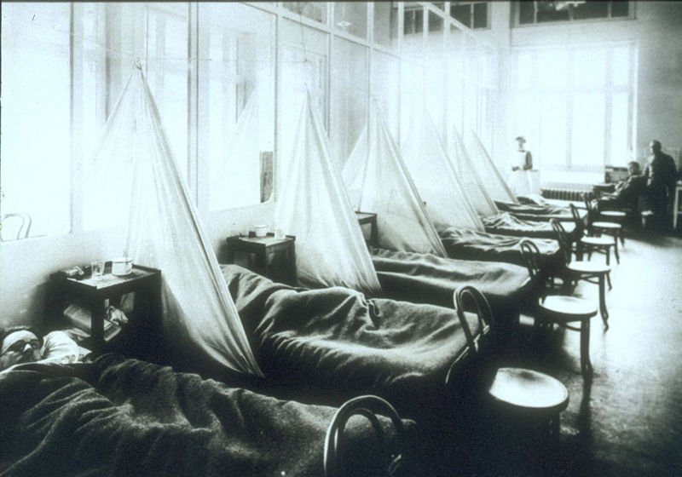
Camp Hospital

Slide 39
Other Impacts of WWI – 3
Created a potential market for ham and broadcast radio
Large number of wartime radio operators
American Legion and other veterans organizations
Tomb of the unknown soldier
Armistice Day (November 11th) as a national holiday
Later renamed Veterans’ Day

Slide 40
Four Key Wilson Decisions - 1
The decision to turn the Paris peace negotiations into an extended summit
Kept Wilson out of touch with what was going on in the U.S.
Led Wilson to ignore the problems of war-related inflation and postwar demobilization
This was to have deep implications for the Democrats in the 1920 election
Notes:
No Planning for Demobilization - “Preoccupied with the making of the peace, Wilson had made no plans for demobilization. Without warning, without preparation, the nation stumbled leaderless into a turbulent conversion to peacetime. The first day after the Armistice, Washington residents found it almost impossible to place long-distance telephone calls because the lines were jammed by offi­cials canceling $4 billion in government contracts. Nine million workers were almost immediately thrown out of work. Some four million service­men were released into an already chaotic labor market with $60 each and a railway ticket home—and without any program for integrating them into civilian life
Inflation - “Raging inflation wiped out the modest gains in wages won during the war. By late 1919, the purchasing power of the dollar was less than half what it was in 1913. For the average family, it was a disaster. The price of bread, butter, and bacon doubled and potatoes had quadrupled in price. Clothing cost twice as much. Professional and salaried workers, including police­men, clerical workers, and government employees, were worse off than at any time since the Civil War. Semiskilled workers earned less than $2,000 !! a year; unskilled laborers less than the $1,500 generally accepted as the poverty line for a family of five.
Labor Unrest - “American labor entered the postwar period with high expectations. The unions had, with government encouragement, launched successful wartime organizing drives, with membership totaling about five million, almost a fifth of the labor force, and they anticipated further gains. Labor had shown its patriotism during the war by limiting strikes, but once the fighting was over all restraints were thrown off. Job insecurity, layoffs, and miserable working conditions—made worse by employers who thought labor needed disciplining and used the return of peace to take back bene­fits they had been forced to concede—made strife inevitable. A majority of workers put in a forty-eight-hour week and retirement was almost non­existent. In good times, they worked feverishly to lay aside something against the inevitable layoffs. Few employers and no state provided any form of unemployment insurance against the day when the production line shut down or the furnaces were banked. Samuel Gompers, the con­servative head of the AFL, opposed unemployment compensation on the grounds that it was Socialistic and therefore un-American.
“Embittered by decades of government intervention on behalf of employers, Gompers argued that labor should shun government assistance and depend upon its own resources to wring concessions from employers. Unfortunately, labor had few such resources. Four million workers walked picket lines during 1919. Copper miners in Butte, Montana; New England telephone operators; textile workers in Passaic, New Jersey, and Lawrence, Massachusetts; New York City building trades workers and railway shop­men—all went on strike. Most of these walkouts ended in failure and strengthened the will of the corporate establishment to resist labor's demands.
“The year began with a strike by 35,000 Seattle shipyard workers seeking higher wages and shorter hours. Seattle was the center of the militant labor tradition of the Pacific Northwest, and the Central Labor Council, which represented all organized labor in the area, broke from the usual tactics of American unions and called a general strike that shut down the entire city. James Duncan, the leader of the Labor Council, had ties to the IWW, and the Wobblies were blamed for the general strike. Although the strikers saw to it that essential services were uninterrupted and there was no violence, the Seattle newspapers and Mayor Ole Hanson claimed the walkout was the harbinger of a Communist takeover of America. Newspapers across the country followed the same line.
“Some 1,500 federal troops were sent into Seattle at Hanson's request, and the mayor, who rode about the city in a flag-draped car, warned union leaders that unless they immediately called off the strike, he would use the soldiers to crush it. At the same time, Gompers and the top leadership of the AFL came out against the general strike, which they denounced as a weapon of European class warfare. All AFL unions were ordered to cease supporting the shipyard workers, and without their backing, the strike sputtered to an end. Ole Hanson claimed credit for a victory over the Bol­sheviks, although the hostility of the AFL leadership to the general strike was the true cause of its collapse. Hanson resigned as mayor to tour the country giving hair-raising lectures on the dangers of the Red Peril—which proved far more lucrative than his elected job.}
“The crushing of the Seattle strike set the pattern for 1919. Business, industrial, and banking leaders claimed radicalism, not wages or working conditions, was the real issue in most labor disputes. They bankrolled super-patriotic groups that whipped up public anxiety about the Bolshevik menace whenever a strike loomed, and unions were branded "sovietism in disguise." These campaigns were eminently successful, as the public was convinced that organized labor owed its allegiance to an alien creed. Politi­cians quickly climbed on the bandwagon and the press found the fight against radicalism a circulation-building substitute for wartime sensationalism.
“In September 1919, about three quarters of the poorly paid, miserably treated Boston police force, with greater desperation than hope, went on strike for recognition of a union affiliated with the AFL and improvements in pay and working conditions. They worked a twelve-hour shift for about $23 a week and had to furnish their own uniforms. Mayor Andrew J. Peters urged Governor Calvin Coolidge to call out the National Guard to main­tain order. The cautious Coolidge passed the buck back to the mayor, con­tending he lacked power to intervene in city affairs. (p42}
“Unlike Seattle, which had remained calm during the general strike, Boston exploded into violence. Three people were killed and shops were looted as efforts by veterans, college students, and businessmen to police the streets were ineffective. From his Western swing in support of the League of Nations, President Wilson denounced the strike as "a crime against civilization" and the strikers—mostly good Irish Catholics—were called "Bolsheviks" and "deserters.”
Mayor Peters finally ordered out local Guard units and order was !! restored, although the strike went on. Unexpectedly, on the third day of the walkout, Coolidge took it upon himself to order additional state troops into Boston. Realizing that they had made a serious error, the strikers voted to return to work, but Coolidge would not have it. The entire police force was fired and replaced. Samuel Gompers urged Coolidge to reconsider, but the governor refused in ringing tones: "There is no right to strike against the public safety, by anybody, anywhere, anytime." Anxious Americans hailed Coolidge's words and even though he had played only a minor role in end­ing the Boston police strike, he became a figure of national importance.

Slide 41
Four Key Wilson Decisions – 2
2. The decision to accept a flawed treaty in order to win foreign acceptance of the League of Nations
Treaty contained provisions and omissions that
Were politically unpalatable to the U.S. Senate
Were to cause future trouble
3. The refusal to accept any changes or reservations in the Treaty to win Republican support
Notes:
The provisions and omissions that were to cause difficulty in the Senate and in the U.S. public were
Giving Shantung to Japan
Article 10
Separate seats in the League for the British dominions
Failure to provide for Irish independence
The provisions that were to cause future trouble were
Reparations
“War Guilt” clause
Creation of small, weak states in Eastern Europe that had sizable minority populations and whose governments lacked legitimacy
Danzig & the Polish Corridor on the one hand and a Polish boundary 150 miles east of the Curzon line with a Polish state with large Ukrainian and Byelorussian minorities meant that neither Russia nor Germany supported the new status quo in Eastern Europe. This was to pave the way for future German and Soviet aggression in eastern Europe

Slide 42
Four Key Wilson Decisions - 3
4. The Decision not to resign the Presidency after his stroke
Led to the U.S. being governed by Wilson’s wife
This meant that the problems of postwar inflation, demobilization, and recession were totally ignored
Let the Lodge Republicans dominate the debate over ratification of the Versailles Treaty
This sapped support for the Treaty and led to its eventual defeat
Notes:
In the words of historian Thomas Fleming The Illusion of Victory. America in World War I,”If [Mrs Wilson, Admiral Grayson, and Joseph Tumulty] had announced that Woodrow Wilson had sacrificed his health and strength in pursuit of his unreserved commitment to the League of Nations, and handed over the presidency to Vice President Marshall, Senator Henry Cabot Lodge's carefully constructed plan to either defeat the treaty or make it a "Republicanized" document with his reservations would have been swept away in a burst of national sympathy for the fallen president. When Wilson collapsed aboard his train after the Pueblo speech, the New York Times had hailed him as a sacrificial hero:"The figure that will stand out in the memory of the Western people is that of a man burning with a restrained passion for a great purpose, for the accomplish­ment of which he would gladly lay down his life." It is not hard to imagine how powerfully an honest statement about the president's cerebral throm­bosis would have affected the Senate—-and the American people. “Instead, Edith Wilson's decision that it was her patriotic duty as well as her loving responsibility to keep him in the White House until he recovered his strength created a web of lies and political ineptitude that inflicted mortal wounds on the Treaty of Versailles, the League of Nations, and America's entire experience in World War I.

Slide 43
Impact of the Treaty of Versailles
Led to great resentment in Germany
Signing the Versailles “diktat” weakened the Weimar Republic, giving the German Right (and the Nazis) a tool with which to attack the Republic
Created instability in Eastern Europe
Created weak and unstable states
Strengthened Germany strategically
Constituted a peace settlement that neither Germany nor Soviet Russia supported
Notes:
Weak & unstable states – The Wilsonian concept of national self-determination was problematic when applied to eastern Europe since different nationalities were geographically co-mingled – with differentiations reflected primarily in religion, prevailing language, rural-urban residence, and socio-economic class. Thus, for example, in many areas incorporated into Poland, the landlords were German and the peasants and agricultural laborers were Polish while the residents of the towns were predominantly German and Jewish. Since the principle of nationality was the dominant criteria (and with Poland, access to the Baltic Sea as well) used to create the new states of eastern Europe, the boundaries often made little economic sense and left substantial and often resentful minority populations within their borders.
Strengthened Germany strategically – Pre-World War I Germany had two major European powers on its eastern borders – Russia & Austria-Hungary. Post-war Germany had relatively weak states on its eastern border – Poland, Lithuania, Czechoslovakia, and Austria.
Russia, Germany & Versailles – Soviet Russia never signed the Treaty of Versailles and often denounced it. Germany signed it under duress and continually sought its revision – peacefully under the Weimar Republic and by force under the Nazis.

Slide 44
Impact of Failed Ratification
Greatly weakened the League of Nations
Fostered a sense of disillusionment
With World War I and its results
With U.S. participation in the war
With U.S. engagement with the world
This in turn fostered a spirit of isolationism that was reflected in restrictive immigration laws, high tariffs, and the Neutrality Acts of the 1930s
Notes:
Whether ratification of the Treaty and U.S. joining of the League of Nations would have made the League sufficiently powerful enough to deter Japanese, Italian, and German aggression is problematical and very debatable, what is certain, however, is that U.S. failure to join greatly weakened the League and made it a very ineffectual instrument in deterring aggression.

Slide 45
The Impact of High Tariffs
Harding and Coolidge Administrations followed a policy of:
Mimimalist government
Lowering taxes
Paying down the National Debt
Support of high tariffs
High tariffs
Reduced European access to the U.S. market
Made Europe dependent on U.S. bank loans to pay war debts, reparations, and buy U.S. goods
Notes:
Lowering taxes – During the Harding-Coolidge administrations, the top marginal income tax rate of 77% during World War I was reduced in stages to a top marginal rate of 20% while the income level at which the top marginal rate took effect was raised. As a result, tax reductions disproportionately favored the wealthy although many millions were removed from the Federal income tax roles. Thus, in 1929, only 4 million households out of roughly 30 million households paid any Federal Income tax.
National debt – During the Harding-Coolidge administration, the national debt declined from $25.95 billion in 1920 to $18.51 billion in 1927 and $16.19 billion in 1930.
Fordney-McCumber Tariff of 1922 – Raised ad valorem rates on dutiable goods to 38.5% and 14% overall.

