Slide 1
Getting from here to there and back – The impact of a few transportation innovations on history
Class 1
William A. Reader
E-mail: wreader@cox.net

Slide 2
Introduction
Many things cause historical change
  Among the most potent and far-reaching causes of change are the development of new modes of communication and transportation
  Changes in communication and transportation networks produce cultural, economic, social, political, and military revolutions
  This class will focus on the impact of transportation innovations
Notes:
The idea was that the phenomena that transform culture are caused by changes in communication and transportation systems and methods was formulated by Harold Innis and Marshall McLuhan. Their idea was that changes in communication and transportation networks produce cultural revolutions. (p319) [Cantor_AmericanCentury]

Slide 3
What the Course Will Cover
Transportation innovations that have made travel and the shipment of goods faster, cheaper, or less onerous have had a great impact on history
Course will focus on the following:
  Domesticated Horse & Camel
  Ocean-going sailing ship & steam-powered ship
  Railroad
  Automobile
  Airplane
Notes:
Innovations which have made travel and the shipment of goods cheaper, faster, and less onerous have had a great impact on history. This course will look at the impact of a few of these transportation innovations – the domesticated horse, the camel, the ocean-going ship, the steamship, the railroad, the automobile, and the airplane and see how each affected history and previously existing modes of transportation.

Slide 4
What We Will Cover Today
The Horse and its Impacts
  Early Man Before the Horse
  Domesticating Plants & Animals
    Issues involved in domesticating animals
  Domesticating the Horse
  Notes About the Horse
  Outline of the effects of the Horse upon Society
    Social
    Cultural
    Economic

Slide 5
What We Will Cover Today
The military and political role of the horse
  The changing role of the horse in warfare
  Significant wars involving the horse and some of the historical consequences of those wars
  What if the horse had never been domesticated or had become extinct
  The horse and the origin of motion pictures

Slide 6
The Impact of the Horse
William A. Reader
E-mail: wreader@cox.net

Slide 7
Hunter-Gatherers
For most of his existence, man lived as a hunter-gatherer
Despite their living in harsh physical environments, they initially had plenty to eat
  Food supplies were abundant because food gatherers have an extraordinary knowledge of the plant and animal life in their home territory
But as a result of both climate change and population increase, this Garden of Eden life didn’t last
Notes:
Hunter-gatherers - Humans first emerged around 140,000-270,000 years ago. The first agricultural communities emerged only around 12,000 years ago. Except for the dog, the first animals were domesticated 10,000 years ago.

Slide 8
Hunter-Gatherers - 2
As hunter-gatherer band population increased, or the ability of the environment to support the existing population decreased, hunter-gatherers had two options:
  Expand into previously unoccupied territory
    This led to the great pre-historic migrations that took place in the last ten thousand years
      From Siberia across the Bering Strait into North and then South America, from Southeast Asia to Australia, and from East Asia to Polynesia
  Domesticate plants and become farmers
  Domesticate animals and become herders
Notes:
Farmers vs Herders - The domestication of animals and the development of breeding and herding led to the emergence of the nomadic barbarian cultures adapted to the steppe lands. The steppe lands were marginal for agriculture but ideal for herding. Conversely, the river valleys of Eurasia – the Nile, Tigris-Euphrates, Indus, and Yellow – were ideal for agriculture. Thus, the Agricultural Revolution branched into two lines of development that set the pattern of history from the Agricultural Revolution up to the beginnings of the modern era.

Slide 9
Consequences of Plant & Animal Domestication
Domestication of plants and animals produced food surpluses. These divided humans into three major groups
  Those who became farmers
  Those who became pastoral nomads
  Those who remained hunter-gatherers
The interaction between these groups led to:
  Farmers displacing hunter-gatherers onto ever more marginal land
  Trade and later conflict between pastoral nomads and farmers
Notes:
Farmers, Nomads & Hunter-Gatherers - With the rise of agriculture, two separate paths toward food production resulted: one from gathering to cereal gardening to plow agriculture; the other from hunting to herding and pastoral nomadism. As a result, humans were divided into three major groups -- those who became farmers, those who became pastoral nomads, and those who remained foragers.
Farmers vs Hunter-Gatherers - This division created a permanent tension between the two types of subsistence with very different needs. “The farmer needed to close off land, kill or drive away virtually all animals living on it, chop down or burn almost all plants growing on it, and keep other humans off it. The hunter-gatherers needed free access to large tracts of land filled with many kinds of plants and animals, all of whom had free and easy access to bodies of water such as rivers, ponds, and lakes.” One consequence of this conflict was on land where agriculture could be practiced, the much more populous farmers replaced the hunter-gatherers, forcing the latter into areas such as the desert (Kalahari & the Australian outback), high mountains (New Guinea), Arctic tundra, and the Amazonian rain forest. The same thing happened when European farmers encountered American Indian gatherers.
Farmers vs Pastoral Nomads – Initially, there was little contact between farmers and pastoral nomads since agricultural and grazing lands were normally separated. In overlapping areas, such as areas where forest met steppe or at oases, nomads would trade animal products for agricultural and craft products. Once the horse was domesticated and the nomads became highly mobile, the existence of crop surpluses provided incentive for pastoral nomads to war upon farmers to seize their agricultural surpluses to feed their livestock (and themselves) and also gain access to water and grazing land. In 19th century America, the conflict between farmers and nomads led to “wars” on the Great Plains between Indians and farmers on the one hand and cattlemen and farmers on the other.

Slide 10
A Note on Animals
Animals fall into three categories as far as human use is concerned
  Food animals – the animals are either eaten or produce milk or eggs that are eaten or both
  By-product animals – the animals’ skin, fleece, fur, or bones are used to produce clothes, footwear, tools, or other implements
  Transport animals – the animal is used to tote a load on its back, pull a cart or wagon, or carry a human rider
Domestication made animals available to humans when needed. However, domestication was not easy
Notes:
Food animals – Domesticated food animals included the goat (goats’ milk), cow, pig, sheep (lamb & mutton), chicken, and turkey. Initially, the dog and the horse were also food animals. Many wild animals – such as deer, bison, and elk – were also hunted for food.
By-product animals – Many animals – both domesticated and wild – were exploited for their by-products such as leather, wool, and fur.
Transport animals – Transport animals had to be either domesticated or, in the case of Asian elephants, tamed. While potentially domesticable, Asian elephants were normally captured in the wild and then tamed since it was less costly to capture and tame them than to raise them from infancy to adulthood – a process which took roughly 15 years (and a lot of feed)

Slide 11
Domestication of Animals
Of the world’s 148 wild, herbivorous mammals that weigh over 100 lbs, only 14 have ever been domesticated
  8000 BC – goat, sheep, pig
  6000 BC – cow
  4000 BC – horse, donkey, water buffalo
  3500 BC – llama, alpaca
  2500 BC – Bactrian camel, Arabian camel
Notes:
14 Domesticated Animals - The ‘Minor Nine’ were important only in limited areas of the globe -- the Arabian camel (domesticated c2500 BC), the Bactrian camel (domesticated c2500 BC), the llama/alpaca (two distinct breeds of the same species, domesticated c3500 BC), donkey (domesticated c4000 BC), water buffalo (domesticated c4000 BC), reindeer, yak, banteng (Bali cattle), and gaur (Mithan). The ‘Major Five’ became important and widespread all over the globe -- the cow (domesticated c6000 BC), sheep (domesticated c8000 BC), pig (domesticated c8000 BC), goat (domesticated c8000 BC), and horse (domesticated c4000 BC)

Slide 12
Why Only 14 of 148? - 1
Six reasons why animals fail domestication
  Diet – some animals are fussy eaters – koalas & pandas
  Slow maturation rate – some animals take too long to grow to adult size - gorillas & Asian elephants
  Resistance to captive breeding - vicunas
  Too Nasty – prone to attack humans – zebras, African buffalo, hippos, rhinos
  Tendency to panic when put in an enclosure - deer
Notes:
There are at least six reasons why many animals failed domestication.
1. Diet. Many animals like koalas and pandas are too finicky in their plant preferences.
2. Growth Rate. To be worth keeping, domesticates must grow quickly to adult size. This eliminates gorillas and elephants who take 15 years to reach adulthood. Modern Asians who want work elephants find it much more cost effective to capture elephants in the wild and then tame them rather than raise them from birth.
3. Problems with Captive Breeding. Some animals do not like to breed in captivity or breed under the watchful eyes of others. These include cheetas and vicunas (an Andean wild camel prized for its very fine wool).
4. Nasty Disposition. Tendencies to kill or attack humans have disqualified many otherwise ideal candidates for domestication. These include grizzly bears, African buffalo, hippopatamuses, onagers, zebras, elk, and African antelope.
5. Tendency to Panic. Some species are programmed for flight if they see a threat. A nervous species put into an enclosure is likely to panic and suffer injury or death trying to escape. These include deer, antelope, and gazelles.

Slide 13
Why Only 14 of 148? - 2
Six reasons why animals fail domestication
6. Social Structure inappropriate for domestication
    For animals to be domesticated, they must
      Live in a herd or pack so that they are tolerant of each other
      Have an established hierarchy so they follow a dominant leader and will accept humans as a pack leader
      Live in overlapping home ranges rather than mutually exclusive territories
Notes:
6. Social Structure. “Almost all species of domesticated large mammals prove to be ones whose wild ancestors shared three social characteristics: they live in herds; they maintain a well-developed dominance hierarchy among herd members; and the herds occupy overlapping home ranges rather than mutually exclusive territories.”
These social herd animals are tolerant of each other so they can be bunched up. Since they follow a dominant leader and will imprint on humans as that leader, they can readily be driven by shepherds or dogs. They do well when penned in crowded conditions because they are accustomed to living in densely-packed groups in the wild
In contrast, members of most solitary territorial animal species cannot be herded. They do not tolerate each other, they do not imprint on humans, and they are not instinctively submissive.” Cats and ferrets are the sole territorial species to be domesticated, and they were domesticated because the motive for doing so was to keep them as solitary hunters or pets and not to herd them into large groups to be raised for food

Slide 14
Implications
Only a few transport animals were ever domesticated
  These animals existed only in Eurasia and North Africa
Only a slightly larger number of food animals were domesticated
Many large animals which because of their size and strength would have made ideal transport and war animals were never domesticated
All these factors were to have immense historical consequences
Notes:
Large animals that would have made ideal transport or war animals if they could have been domesticated were the African elephant, the rhinoceros, the tapir, and the zebra.

Slide 15
Food Animals
The domestication of food animals (who often shared living quarters with their owners):
  Created a class of nomadic shepherds who raised herds of such animals and moved with them from grazing area to grazing area
  Led to the use of these animals for both their meat and their byproducts
    Leather products and woolen garments
  Led to new foods in the form of storable milk products such as yogurt and cheese
  Led to the emergence of a whole host of new diseases
    Animal diseases evolved to infect humans
Notes:
The first animal to be domesticated was the dog. Next came the food animals – goats, sheep, pigs, and cattle. Last to be domesticated were the transport animals – the donkey, ox, and finally the horse and camel.
Animal-human diseases - Every infectious or epidemic disease known among humans has a close animal counterpart. Humans share fifty diseases with cattle, forty-six with sheep and goats, forty-two with pigs, thirty-five with horses, and twenty-six with poultry.” Thus, measles is closely related to both distemper in dogs and rinderpest in cattle; smallpox to cowpox in cattle; and human influenza to influenzas in both ducks and pigs

Slide 16
Domestication of the Horse
The horse was first domesticated c4000 BC in the area of the Russian steppe where the Dneiper and Don Rivers flow into the Black Sea
  It is a region of the Eurasian steppe where steppe and forest areas met
Domestication occurred in stages
  Farmers and herders initially hunted the horse for food by driving them into corrals
  They soon realized that horses could be tamed and used as pack animals
  They also realized that horses could also pull carts and be ridden
Notes:
Most scholars think that the horse was first exploited primarily for its meat and milk, and secondarily as a pack animal. Only much later did people actually ride horses as steeds. In hunting wild horses, human groups typically utilized cooperative drives, driving the animals into a trap or corral. With this method, corralled animals were often too numerous to immediately kill and consume. As a consequence, some horses may have been held in the stockade or alternatively hobbled and allowed to feed as meat on the hoof to be dispatched later when needed.
Why There? - There is a growing body of archaeological evidence and theory that the transition from a long, loose association between species to full domestication is most likely to occur in marginal areas, outside the principal range of the animal species and far from the center of the local human culture. Stock tending in the long run allowed for a civilization that could support a much higher-density human population than did hunting and gathering. But that was only in the very long run. Agriculture did not increase wealth, longevity, leisure time, or health for average people until the Industrial Revo­lution. Raising animals in captiv­ity was something that people living on the fringes of ancient society, in the most resource-poor areas, struggling to main­tain a standard of life that eluded them as game grew scarce, as forests were cut down, as soils were exhausted, did in desperation. Likewise, it was in the remote, resource-poor reaches of an animal's natural range that it was most likely to be forced into intimate contact with humans. Herds that could no longer make a living in the familiar niche that millions of years of evolution had adapted them to exploit began to seek out a new niche, one that exploited the grain fields and garbage dumps of human habitations. This niche may also have exploited the natural care-giving instincts of humans toward animals that exhibit -what animal behaviorists call care-soliciting behavior. In many parts of the world even today, free-roaming popula­tions of feral dogs thrive around villages, not because they serve any useful purpose, but because they are so successful at deflecting human aggression with cringing, submissive behav­ior that brings out our soft side. As far as horses and men were concerned, the region north of the Black Sea seven millenniums ago was precisely such a fringe area. From about 7,100 to 6,600 years ago, the human population there focused its attention on the forest-steppe, an intermediate zone some 200 kilometers wide between the dense forest and the open steppe. The broken forest provided a perfect habitat for abundant game. The rich, loess soils that underlay the forests supported fertile crops. Cattle and other livestock were raised. But as the human population grew, local pressures mounted. The forests were cleared for grain fields and pasture. The forest game dwindled. At archaeological sites in the region dating from 6,600 to 6,100 years ago, bones of boar, deer, and aurochs become much scarcer. And in their place begin to appear vast numbers of bones of horses.

Slide 17
Notes About the Horse
The horse evolved in North America
It crossed over to Eurasia during the Ice Ages when a land bridge connected Siberia and Alaska
  At the same time the ancestors of the American Indians crossed over from Eurasia
It became extinct in the Americas roughly 9,000 to 10,000 years ago
Notes:
Beringerian Land Bridge - The Ice Ages of the Pleistocene caused sea levels to drop by as much as several hundred feet, more than enough to create a land bridge – called Beringia - between Asia and Alaska over what is now the Bering Strait. This land bridge allowed plant and animal species to move between the eastern and western hemispheres – the most notable of which was the movement of human beings from Siberia into the New World and the movement of camels and horses in the opposite direction from North America to Eurasia and later Africa
Extinct in North America - At the end of the Pleistocene, the large mammals that had evolved to exploit the open tundra and grasslands started vanishing at an astonishing rate. In North America, the end of the Ice Age saw the total extinction of 35 genera of megafauna – mammoths, mastodons, stagmoose, giant elk, saber-toothed tigers, and equines. Whether horses (and camels) became prey to large saber-toothed cats, lost their forage as a result of climatic oscillation, were the victims of epidemics, or were killed off by the depredations of prehistoric man is still in dispute. By 10,000 years ago, the horses of North America were gone. No depiction of horses appears in any known pre-Columbian art of the New World. ... The horse would not return to North America until January 2, 1494, when Columbus brought 24 stallions and 10 mares to Hispaniola.

Slide 18
Notes About the Horse -2
Horses were difficult to domesticate because
  They could easily outrun a man
  If cornered, they will fight
  They are difficult to sneak up on or surprise
    They have a 357-degree field of vision with only two small blind spots
    They have excellent night vision, but limited binocular and stereoscopic vision
    They need only four hours of sleep per day which they obtain in 15-20 minute segments
      They normally sleep standing

Slide 19
Notes About the Horse -3
Despite the difficulties, horses were domesticated because
  They were herd animals with a dominance hierarchy and a tendency to form long-lasting bonds with other horses and with humans
  They exhibited neoteny – the tendency to retain juvenile traits into adulthood
    This allowed horses to view many types of work as a ‘work-game’
  They lacked horns and antlers
    This made them easier to capture and to train
Notes:
Horse social structure – Horses show a strong fundamental instinct — under a wide variety of circumstances—to form long-lasting attachments to specific individuals. This basic instinct toward bonding with other individuals is the glue that holds harems — the fundamental social structure of the horse — together. Both mares and stallions will select their mates, a mutual attraction that gives the harem its long-term stability. Horses removed from a herd will also readily form attachments to surrogates, including their human owners or even a barn cat. It is this instinct that humans draw upon in establishing their relationship with domesticated horses.
Neoteny - Neoteny, the retention into adulthood of juvenile traits (such as inquisitiveness, adaptability, docility, playfulness, and care-soliciting behavior) is a common feature of both the behavior and physical appearance of domesticated species. The veterinarian and horse authority Andrew Fraser has suggested that some residual inclination toward play is activated in adult domestic horses in many sports. The movement, group activity, or variety of pace and environment involved in racing, jumping, dressage, hunting, and even driving in harness with other horses may be accepted by horses in part as ‘analogs’ to natural play. Training and learning may explain why a horse can be made to perform these tasks, but seem inadequate to explain the undeniable enthusiasm that many horse show for these pursuits. Fraser says that it might make sense to think of these more as ‘work-games’ from the horse’s point of view.

Slide 20
Notes About the Horse - 4
Despite the difficulties, horses were domesticated because - 2
  They were herbivores that could live on the grass of the Eurasian steppes
    Thrived on grasses a cow would starve on
  They possessed a diastema or gap in the teeth that permitted effective placement of a bridle and bit
  They could move through snow, scrape it away to feed and break through ice-covered waterholes to drink
    This allowed other animals to forage in snow-covered areas
Notes:
Thrived on poor grass - Unlike many large grazing animals, horses break down the otherwise indigestible cellulose of stems and leaves in a digestive organ known as the cecum. While ruminants such as sheep and cattle have to rest for hours after eating, the hoofed herbivores that possess a cecal digestive system (horses, tapirs, and rhinos) can eat and run. The horse’s cecum is not as efficient in extracting energy from food as the cow’s four stomachs but it allows the horse to eat the lowest-protein, highest-fiber roughage. This allows horses to survive on vegetation unable to support ruminants. Thus, horses can respond to a poor-quality diet by eating more.
Diastema - the horse possesses a diastema, or gap between the front incisors and the rear grinders. Control of the horse by man would have proved far more difficult without this anatomical convenience, which allowed the effective placement of bridle and bit.
Cold weather adaptability - It is possible, though, that cold-weather adaptability to steppe winters may have been the motivating factor in the exploitation of the horse as a low-maintenance food source. The high gait of the horse allows it to move through snows that paralyze sheep. With its tough hoofs, the horse scrapes away snow in order to feed and breaks through ice-covered waterholes in order to drink; this clearing away of snow allows other animals to forage. Compared to ruminants, horsemeat is low in saturated and high in polyunsaturated fats and is also high in amino acids, minerals, and vitamins. It is significant that steppe folk beliefs commonly attribute unusual medicinal and nutritional properties to horse products.

Slide 21
Notes About Horses -5
A horse can carry about 200 lbs on its back
When properly harnessed, a horse can pull loads of 10-15 horsepower for short periods
  On a travois, it can pull 300 lbs (4 times that of a large dog)
  With a wagon on a good road, it can pull 4,000 lbs
  On a railway, it can pull 14,000 lbs
  Along a canal towpath, it can pull up to 60,000 lbs
Notes:
Horsepower - One horsepower was first defined by James Watt, the inventor of the steam engine, as the amount of work required to pull a weight of 150 lbs out of a hole 220 feet deep (sometimes described as 33,000 foot-pounds) in one minute. A horse, when properly harnessed, can pull overloads of ten to fifteen times that for short periods, with pairs of horses developing over 30 horsepower
Travois - a vehicle used by Plains Indians consisting of two trailing poles serving as shafts and bearing a platform or net for the load

Slide 22
Notes About Horses - 6
Horses move naturally with 4 basic gaits:
  Walk -- 4.0 mph
  Trot – 8.1 to 12.0 mph
  Canter – 12.0 to 15.0 mph
  Gallop – 25.0 to 30.0 mph
    In a racing gallop, the record is 55 mph
While a human porter could carry 50 lbs over 20 miles in a day, a horse could carry or pull a much greater load over a greater distance

Slide 23
Notes About the Horse - 7
While relatively low maintenance, horses eat and drink a lot
  Horses need to eat about 2%-2.5% of their body weight each day
  Horses need to drink 10-12 gallons of water a day
This meant that horses needed a physical environment with plenty of grass or grain and plenty of water
Notes:
For an average size thousand pound horse, that is about 20 lbs per day. Rustling up food is a fulltime job for a horse.

Slide 24
Effects of the Horse - 1
Once the horse was domesticated, it found many uses and had many major impacts
The pulling power of the horse:
  Led to the invention of the wheel
    Horse and wheel gave rise to the 2-wheeled cart, the war chariot, and later the 4-wheeled wagon, carriage, and stagecoach
  Led to the development of the stick and later the moldboard plow
  Facilitated the long-distance movement of people and cargo

Slide 25
Effects of the Horse - 2
The mobility of the horse
  Allowed the nomads of the Eurasian steppe to raid, conquer, and trade with the civilizations that arose in the Middle East, India, and China
    This led to Eurasian civilization being beset by recurring nomad invasions
  Created the equestrian empires that led to
    Thousands of miles of roads
    Unitary language and writing systems
    Standardized coinage, weights, and measures
Notes:
Cavalry and char­iot conquests culminated in the first far-flung equestrian empires that effectively absorbed earlier nuclear states, the Persian in the west stretching from India to the Mediterranean, the Qin in the east encom­passing the whole of China. Astonishingly, introduction of advanced horse technologies to these two regions, separated by vast distances, triggered identical parallel developments at opposite ends of Asia. In both empires thousands of kilometers of roads were constructed for horse transport; a unitary language and writing system were imposed; and coinage, weights, and measures were standardized across the realm. Burgeoning overland trade consequently spurred maritime commerce. In China canals were built to transport foreign commodities from south­ern ports deep into the interior. In the west a canal, wide enough for two ships to pass, was dug between the Red Sea and the Nile to link trade from the Indus to the Mediterranean.

Slide 26
Effects of the Horse - 3
The speed and power of the horse:
  Along with related innovations served to revolutionize warfare
  Led to innovations designed to neutralize the horse (and horse-related innovations) on the battlefield
  The result was an arms technology race in which a horse-related innovation or new tactic on offense led to defensive innovations designed to counter the offensive innovation or tactic
Notes:
The chariot – a two-wheeled cart carrying a driver and a bow-and-arrow shooter (and sometimes a person with a shield to ward off enemy spears and arrows) – revolutionized early warfare. The horse and chariot allowed warriors to shoot arrows at their enemy, avoid enemy pursuit, and chase after a fleeing enemy. The saddle allowed for a mounted warrior who could shoot arrows or throw javelins on terrain not suitable for chariots or other wheeled vehicles. The stirrup allowed a mounted lance-armed warrior to charge an enemy with the full power of the horse to devastating effect. To counter charging horses, the Greeks devised the phalanx – a mass rectangular heavy infantry formation – armed with pikes and sarissas – 13’ to 21’ long spears which could be used to impale charging horses.

Slide 27
Effects of the Horse - 4
The beauty of the horse served to inspire many great works of art and memorialize military heroes
  The Panathenaic procession of horses-and-riders and horse-drawn vehicles on the Parthenon frieze
  Roman triumphal arches
  Equestrian statues of military heroes from Roman emperors to Civil War generals
  Paintings of horses by famous artists
Notes:
In the words of Catherine Johns Horses. History, Myth, Art, “The beauty of horses has delighted artists at all times and places. Artists who have illustrated historical and mythological events, or who have had the task of portraying and glorifying powerful patrons, have needed, for purely practical reasons, to study horses and to learn to depict them with skill and accuracy, but many have also enjoyed and studied them as a favorite subject in their own right.” Horses appear in art across the ages. Representations of horses are not only to be found in what have traditionally been called the fine arts, painting and sculpture: horse imagery has also been used to decorate objects of use and adornment, not only because of the animals' symbolism, but simply because they are so pleasing to the human eye. Horse-shaped or horse-adorned objects have been made in stone and metal, ceramic and glass, wood, bone, ivory and textiles; they are part of the visual and decorative repertoire of most human cultures

Slide 28
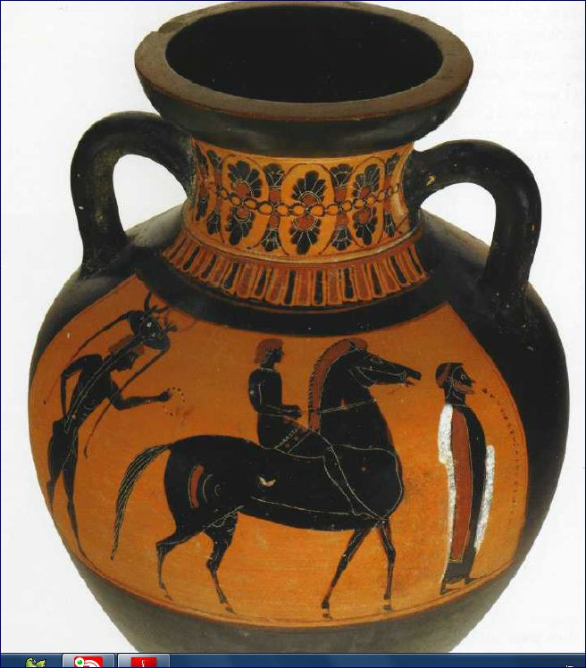
Greek Amphora

Slide 29
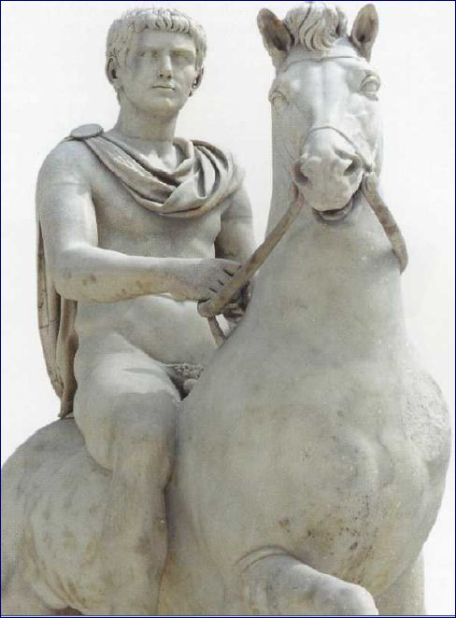
Roman Sculpture

Slide 30
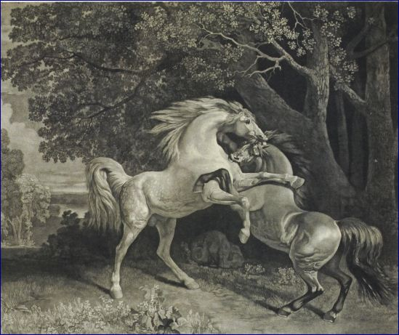
George Stubbs
Notes:
George Stubbs – “Fighting Stallions,” 1788

Slide 31
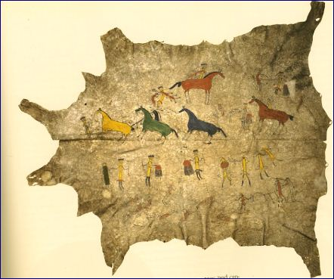
Amerindian Buffalo Hide Painting

Slide 32
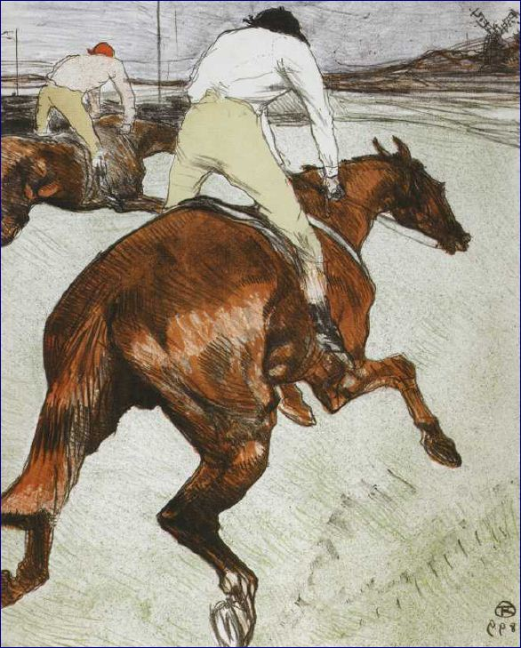
Toulouse-Lautrec
Notes:
Toulouse-Lautrec “The Jockey,” 1899

Slide 33
Effects of the Horse - 5
The overall prowess of the horse (and its rider) inspired many myths and legends
  The Centaur (half man, half horse)
    Became the Zodiac symbol for Sagittarius
  The Pegasus (flying horse)
    Became the logo for Mobil Oil and Tri-Star Pictures
  The Unicorn
    Mythologization of the rhinoceros and the aurach
  The Buddha and Kanthaka
  Mohammed and Al Burak
  The Four Horsemen of the Apocalypse
Notes:
Centaur - While Greece lacked the vast grasslands and great horse herds of the Persians, Greek myth and ritual contained much equestrian imagery. In early antiquity, peoples south of the steppes viewed the mounted steppe warrior astride his fleet steed with amazement, imagining a fabulous creature, half human, half ani­mal. The centaur's form varied. It might be represented by a fully human forebody combined with the hind legs of a horse. Alternatively, the forelegs might also be equine, in which case the centaur often was winged. In the thirteenth century bc, an Assyrian cylinder seal depicted a winged centaur with the torso of a bearded man hunting gazelles with a dog in front. The winged archer-centaur with a scorpion's tail of course later became the zodiac symbol for Sagittarius
Pegasus - The Greek Pegasus remains for most of us the very archetype of the flying horse. He was the son of Poseidon and of the Gorgon Medusa; with a blow of his hoof he brought into being the sacred spring Hippocrene, and he carried the thunderbolt of Zeus. The idea of a flying horse is, however, far older and more widespread than its focus in Graeco-Roman culture. A depiction of a horse with huge, feathered wings can look wonderfully plausible, and the idea of flight is no more than an extension of the qualities of speed and grace that are already associated with the species. Winged horses remain popular fantasies, not only in art and literature but also in commerce and advertising.
Unicorn - a mythical animal generally depicted with the body and head of a horse, the hind legs of a stag, the tail of a lion, and a single horn in the middle of the forehead. . Unicorns are mentioned not only in Classical literature but also in Biblical sources, as though they were an actual living species rather than an imaginary one. The qilin, or Chinese unicorn, has the body of a deer, the tail of an ox, the hoofs of a horse and a single 'horn' of flesh: it is a gentle, beneficent creature whose appearance foretells the birth of a ruler. More familiar in the West is the medieval, heraldic unicorn — a lightly built white horse, usually with cloven hoofs and a goat-like beard, and with a long, straight, spiralling horn emerging from the centre of the forehead. In medieval times this animal carried a range of symbolism that included purity, chastity and virginity
Buddha - The Buddha was carried on his travels, from the moment that he left his princely home, by his horse Kanthaka, no mere beast of burden but a rational individual whose personal thoughts and feelings are recorded in the sacred texts.
Mohammed - Horses feature frequently in the tales and traditions of Islam, as might be expected amongst conquering peoples who took pride in the possession of one of the most beautiful breeds of horse, the Arab. The Prophet Mohammed himself allegedly ascended to heaven in the year AD 621 on the back of the winged horse Al Burak, who was brought to him by the archangel Gabriel
Four Horsemen of the Apocalypse – Revelation 6:2-8 describes the four horses – the white horse of conquest, the red horse of war, the black horse of famine, and the pale green horse of death.

Slide 34
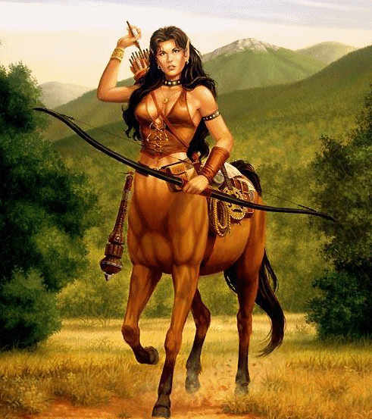
Centaur

Slide 35
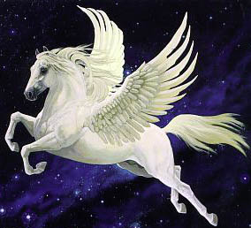
Pegasus

Slide 36
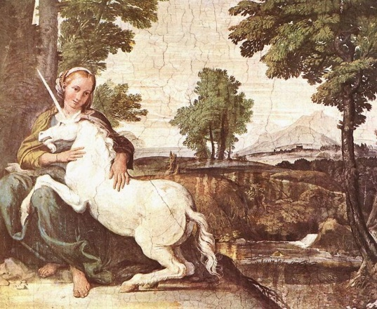
Unicorn
Notes:
From a painting by Domenico Zampieri in 1602 in the Palazzo Farnese, Rome.

Slide 37
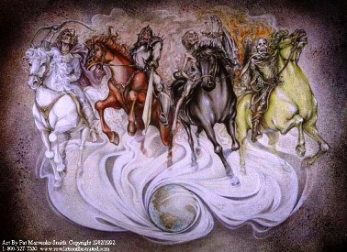
Four Horsemen of the Apocalypse

Slide 38
Economic Effects of the Horse - 1
Owning horses required major land resources
  In the land scarce environment of Western Europe and China, only relatively wealthy people could afford to own horses
    In eras when military power depended on owning horses and having specialized training, it meant that military and political power was monopolized by a relatively small elite
      In the centralized empires of Eurasia, it meant a form of monarchical despotism
      In decentralized areas like Medieval Western Europe and Japan, it meant feudalism
Notes:
While the horse was a low maintenance animal in terms of care, it was high maintenance in terms of feed. The British archaeologist Stuart Piggott estimates that feeding a pair of chariot horses in prehistoric Britain would have required the entire annual crop from 10 acres of barley. The arrival of the chariot in China in the 12th century BC led directly to the importation and planting of an entirely new crop, alfalfa, to provide needed fodder for the horses. Finally, the building and maintaining of the chariots !! themselves placed huge demands on the services of wood, leather, and metal workers and wheelwrights

Slide 39
Economic Effects of the Horse - 2
The Horse required a substantial infrastructure
  Land dedicated toward growing oats, barley, alfalfa, or grass
  An employment infrastructure of trainers; grooms; stable hands; makers of carts, wagons, chariots & carriages; saddle makers; blacksmiths & farriers; carpenter builders of stables and way station facilities; and veterinarians

Slide 40
Socio-Cultural Effects of the Horse
Gave rise to such sports as thoroughbred horse racing, harness horse racing, polo, horse shoes, dressage, rodeo, and fox hunting
Gave rise to such entertainment events as horse shows, parades, circuses, and horse riding
Led men to give up dresses in favor of trousers
  It was much easier to ride a horse wearing trousers than wearing a tunic
Notes:
Trousers replace dresses - Besides forming the prototype for all types of civilized cavalry, the nomads made major changes in the life-style of Europeans. The nomad’s pants with belts & buckle proved much better suited to a horse riding life-style than did European tunics (a loose-fitting garment, sleeved or sleeveless, extending to the knees and worn by men and women especially in ancient Greece and Rome) or Middle Eastern caftans (a full-length garment with elbow-length or long sleeves, worn chiefly in eastern Mediterranean countries). Eventually, the trousers and belts of the nomads became the universal standard for male wear throughout Europe even though women retained the older tunics
First appearance of trousers - Trousers first enter recorded history in the 6th century BCE, with the appearance of horse-riding Iranian peoples. At this time, not only the Persians, but also allied Oriental and Central Asian peoples such as the Bactrians, Armenians, Scythians, Xiongnu, Huns, and later the Mongols. are known to have worn them. The Egyptians, Greeks, and Romans, however, disdained trousers in favor of tunics and draped clothes such as togas. The impact of the colder climates of northern Europe and the greater utility of trousers when it came to riding horses led the Medieval European upper classes to wear trousers. The tendency of lower class males to imitate higher ones in turn led the lower classes to largely adopt the wearing of trousers, usually wearing them under tunics of varying length. Eventually, tunics for men gave way to both underwear and trousers. Women, who rarely rode horses (as distinct from carriages), continued to wear tunics or dresses.

Slide 41
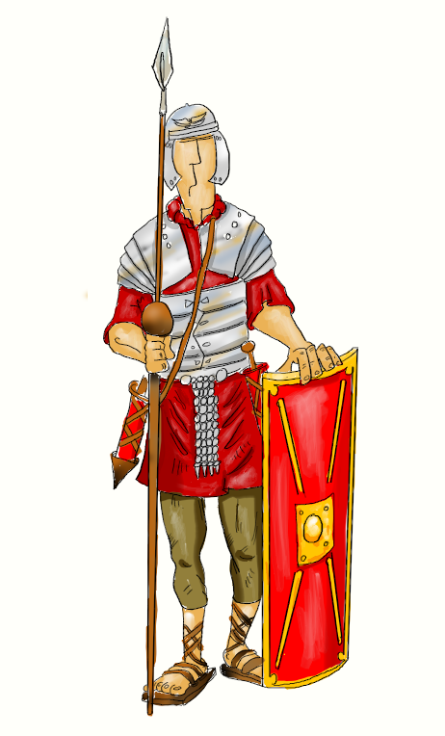
Roman Soldier in Tunic

Slide 42

Indian Tunic
Notes:
On ceremonial and formal occasions (like weddings), Indian men wear tunics and Indian women wear saris. Indian tunics are now normally worn with either trousers or pajama pants.

Slide 43
Nomads and the Horse
Given the voracious appetite of their horses and herds, the nomads of the steppes had to move in an annual circuit of hundreds of kilometers to find pasture
When climate and ecology conditions changed, nomad tribes had to range further afield
  This brought them into conflict with other nomad tribes, leading to cascading displacements
In the resulting wars, military use of the horse evolved through several different eras
Notes:
If the climate on the steppe changed, as it often did, water holes dried up and grass decreased. Consequently, nomad tribes had to range further and further afield in order to find water and grass. This brought tribes into contact and conflict with each other. As a result, one or more of the parties to a resource conflict either was forced out or decided to move out of their traditional grazing range. This in turn brought the migrating tribe into contact and conflict with other nomad tribes. The result was a cascading displacement which resulted in nomad tribes living near civilized agricultural areas deciding to invade those areas.

Slide 44
The Horse in War
Use of the horse in warfare went through several eras
  War chariots
  Mounted horsemen with bows-and-arrows
  Mounted knights with shields and lances, swords, or battle axes
  Medieval armored knights with chain mail or protective armor and lances and swords
  Mounted cavalry as firearms make the mounted knight in armor obsolete
Notes:
War chariots – The horse-drawn war chariot that had 2 or 3 riders, one of whom drove the horse with the second firing arrows at the enemy and the third shielding the other two from the spears and arrows of the enemy. These innovations were generally adopted by the agricultural civilizations and often improved upon. While chariots had proved initially devastating, they could be countered by the arrows shot and spears thrown by infantry. Chariots on a battlefield often suffered from collisions with enemy chariots and sideswipe collisions with friendly chariots. Also, chariots did not work well on hilly, swampy, or uneven ground. As a result, the chariots were relegated to the role of troop carriers to the battlefield with the warriors then riding into battle on mounted horses, although the Persians made use of chariots with scythes attached to the wheel for attack purposes
Mounted horsemen with bows-and-arrows – These horsemen generally had light protective leather armor along with swords and bows-and-arrows. Typically, they would shoot arrows or hurl javelins at enemy infantry and then pull back, then sallying forth to pursue fleeing enemy soldiers
Mounted knights – With the invention of the high-back saddle, the iron horseshoe, and the stirrup, it became possible for the mounted warrior to have both hands free. While the Parthians and Sarmatians rode in full armor with heavy lances without stirrups, there was always the danger that the rider might be toppled by his own blow. The stirrup averted this problem by allowing the rider to grip the lance in a crouched position, with the lance held in the right hand and braced under the arm, whereas previously the lance had been held loosely. With this firmer grip, the equestrian warrior was able to attack an adversary with the full force of the charging horse instead of merely the strength of one arm. Meanwhile, the saddle with a raised and reinforced back prevented the rider from being impelled backward.
Armored knights – To protect themselves from enemy arrows or swords, knights started wearing chain mail and later suits of armor. This added to the weight of the knight, requiring that he ride horses specially bred for the purpose of carrying him – the destrier. With lance, sword, and armor, destrier-charging knights could overwhelm both infantry and enemy mounted cavalry.

Slide 45
Historically Significant Wars involving the Horse
Persian conquest of Southwest Asia and Qin conquest of China
Alexander’s Conquest of Persia
Arab conquest of Southwest Asia, Central Asia, North Africa, and Spain
Carolingian conquest of Western Europe and the rise of Feudalism
The Mongol Empire
The Era of Firearms
  The Amerindian Horse Cultures of the Great Plains and the Indian Wars of the American West

Slide 46
Creation of Persian & Chinese Empires
Persian conquest of Southwest Asia
  Steppe nomads using horse-riding cavalry created the Persian-Mede empire in Southwest Asia
    Led to the Persian conquest of Babylon and the return of many Jews from Babylon to Judea
    Led to the establishment of Aramaic with its consonantal script as the lingua franca of the empire
    Brought into Judaism certain Zoroastrian beliefs that were to have major impacts
Qin conquest of China
  Steppe nomads using chariots created the Qin empire of China
    Ended the “Warring States” period
    Created a unified China for the first time
    Paved the way for the Han Dynasty
Notes:
Creation of Chinese & Persian Empires - Through selective breeding, the Iranian-speaking Medes produced a larger horse fully capable of carrying an armed warrior with combat weapons. Cavalry and char­iot conquests culminated in the first far-flung equestrian empires that effectively absorbed earlier nuclear states, the Achaemenid in the west stretching from India to the Mediterranean, the Qin in the east encom­passing the whole of China. Astonishingly, introduction of advanced horse technologies to these two regions, separated by vast distances, triggered identical parallel developments at opposite ends of Asia. In both empires thousands of kilometers of roads were constructed for horse transport; a unitary language and writing system were imposed; and coinage, weights, and measures were standardized across the realm. Burgeoning overland trade consequently spurred maritime commerce. In China canals were built to transport foreign commodities from south­ern ports deep into the interior. In the west a canal, wide enough for two ships to pass, was dug between the Red Sea and the Nile to link trade from the Indus to the Mediterranean
Zoroastrian influences - These included the concept of the seven days of genesis, the concept of the devil, the concept of angels and demons, the concepts of heaven and hell, the prophecy of the coming of a messianic savior, the idea of a virgin birth, and the concept of a last day of judgment. Like Judaism, Zoroastrianism combined spiritual vision with a strict code of behavior observing purity laws. These concepts were to shape the religious beliefs and practices of Pharisaic Judaism, Christianity, the various Gnostic faiths, and Islam.

Slide 47
Alexander’s Conquest of Persia
In the 4th century, Macedonia conquered the Greek city-states and went on under Alexander the Great to conquer Persia
  Philip of Macedon combined cavalry with the Greek phalanx to create a military juggernaut
  Alexander brought with him a staff of scholars to study and report on the lands they traversed
    Led to the cross-fertilization of Greek, Babylonian, Persian, Egyptian, and Indian knowledge
      Two eventual outcomes were the Library of Alexandria and the Indian development of the concept of the zero
      Alexander and his successors encouraged Greek settlement of Southwest Asia and Egypt
Notes:
During the fourth century bc, the Greek city-states came under the hegemony of Macedonia, which extended from the lower Danube to the Aegean and from the Adriatic to the Black Sea. Philip (lover of horses) and his son were the first Greeks to make consistent and extensive use of cavalry, introduc­ing on the battlefield far-reaching reforms that placed their army at the forefront of military technology. The Macedonian cavalry known as "the King's Companions" was trained to fight in tight formation. Consolidating Macedonian control of the Greeks in the League of Corinth, Philip prepared to invade the Persian empire in order to liberate the Greek cities of Asia Minor. After Philip’s death, Alexander in 334 bc led his army, some 30,000 infantry strong with 5,000 cavalry, from Thrace across the Hellespont.
Greek military tactics – The Greek phalanx was a tight heavy multiple-line infantry formation armed with swords and sarissas – 13’ to 21’ foot pikes that rested on the shoulders of 4 men in a line and was used to impale enemy infantry, horses, and chariots. While the phalanx was charging, Macedonian cavalry charges would concentrate on a set spot in the enemy line, break through, and batter the enemy back onto the anvil of the charging phalanx. This coordination between horsemen and infantry was an entirely new development in the history of Western warfare and was designed to make numbers superfluous. Against this combination, Persian chariots and light infantry were greatly overmatched.
Library – Ptolemy was one of Alexander’s generals and after Alexander’s death assumed control of Egypt. His appreciation of the contribution of the scholars led to his founding the famed Museum/Library of Alexandria which functioned as both a collecting library and a research institute. In the Museum, writers, astronomers, physicians, botanists, and mathematicians conducted research and experiments. The Library housed their great works and translations of the masterpieces of Babylonian, Jewish, and Egyptian learning. One major endeavor of Ptolemy was to persuade the Jewish chief priest to send 70 Jewish scholars to Alexandria to translate the Hebrew scriptures into Greek – the result of which was the Greek Septuagint Bible. As time went on, the Greek-speaking Jews of Alexandria and areas outside Palestine accepted into their scripture texts of non-Hebraic origin. When the canon of the Hebrew bible was finalized in the 1st century AD, it did not incorporate Greek texts included in the Septuagint. Later on, the Septuagint with the New Testament added was translated into Latin – the Vulgate. Come the Protestant Reformation, the Protestants rejected the Vulgate in favor of the Hebrew Bible and Greek New Testament as translated into vernacular from the oldest Hebrew and Greek texts while the Catholics relied upon vernacular translations from the Vulgate. As a result, Catholic and Protestant bibles differ.
Zero - After 600 bc the Babylo­nians regularly employed wedge-shaped marks in their sexagesimal numbering system (1 to 60) as placeholders when tallying numbers, so that 120 was denoted as 2=60 and 180 as 3=60. For this = function, the Greeks had substituted the lowercase omicron - a hollow circle. Stimulated by this Greco-Babylonian system of annotation transmitted during the Alexandrine invasion, Indian mathematicians by the fifth century ad would advance to develop the revolutionary construct of the zero in a base 10 system. It might be noted that the Babylonians also invented the binary system of numbering, using short and long wedge marks as the equivalent of our 1s and 0s.
Greek settlement - As thou­sands of Greeks settled across Asia, temples, gymnasia, theaters, and hippodromes were built to accommodate the colonists. Thus, Greek philosophy, science, literature, art, law, and sports impacted Asia

Slide 48
The Carolingians & Feudalism
As a result of the battle of Tours (732), Charles Martel decided that he needed a significant cavalry force
  This led to the development of feudalism as a means of supporting and equipping a professional cavalry force
With mounted cavalry, the Franks under Charlemagne were able to combat the Muslims in Provence and conquer much of present day Germany, creating the Carolingian Empire
  With the destrier and chain mail/body armor, the armored knight came into his own

Slide 49
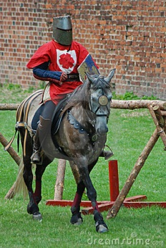
Medieval Knight

Slide 50
Impact of the Horse Collar
Another invention that revolutionized Medieval Europe was the horse collar and breast strap
  These replaced the throat and girth harness which pressed against the horse’s windpipe and jugular vein causing the horse to lose 80% of its efficiency
  The horse collar rested on the horse’s shoulders and the breast strap, eliminating the earlier restriction on the horse’s air and oxygen supply
The horse collar enabled Europeans to replace oxen with horses
  Peasants now could plow land much faster with much less effort and time
  Merchants, traders, and peasants could also use the horse to pull 4-wheel wagons with heavy loads
Notes:
Invention of the horse collar - The horse collar was developed by the Scandinavians. By the 9th century AD – on the evidence of burial sites and travelers’ accounts – the collar was in general use with horses there for plowing the land, where the power required is much greater than in pulling a light cart or chariot. The Greeks and Romans used a throat and girth harness in which the straps were wound around the belly and neck of the horse. The neck strap simultaneously pressed on the jugular vein and the windpipe, causing the horse to lose 80% of its efficiency. The collar harness which rested on the horse’s shoulders and the breast strap (which rested against the horse’s chest) eliminated the earlier harness’ restriction on the horse’s air and oxygen supply and enabled the horse to assume a major economic role in both agriculture and the hauling of wagons
Effects of the horse collar - With a collar harness and horseshoes, a horse could plow 30 to 50 percent faster than an ox (except in heavy, wet soils). This advan­tage accounted for the spread of horses as draft animals, and by the twelfth century ce, European agricultural production was dependent on horses. What draft animals offered was a time-saving measure. With a hoe, 100 hours of work are required to ready one hectare (2.471 acres) of land for planting grain. But with an ox pulling a simple wooden plow, the same task can be completed in 30 hours. With a horse, the same task could be completed in 15 to 20 hours. In essence, the draft animal s "discretionary time" was diverted to our use. Once evolved, this horse-harness led to the development of wagons with pivoted front axles and brakes. The four-wheel wagon capable of hauling heavy loads was a common feature by the middle of the thirteenth century. The effects on town were extraordinary. Peasants began to live in cities while going each day to their fields.

Slide 51
The Mongol Empire - 1
The Mongol armies consisted of light and heavy cavalry
  The light cavalry was equipped with bows-and-arrows, sword or battle axe, javelins, and a leather-covered wicker shield
  The heavy cavalry wore iron helmets, leather body armor with rings or scales of iron and carried a shield, bows-and-arrows, scimitar, and lance
  During battle, a screen of light cavalry unleashed a volley of arrows, moving to the rear to allow the heavy cavalry to advance in a massed charge
Notes:
From the Jin area of western China, the Mongols conscripted local siege experts into their armies and adopted Jin weapons and techniques: ballista, catapult, trebuchet, and battering rams. [The ballista was a mechanical device that shot large arrows capable of damaging structures as well as individuals; the catapult hurled stones and flaming liquids; and the trebuchet, powered by the drop of a heavy counterweight, threw objects faster than the torsion catapult] !! The firelance, a bamboo tube of gunpowder, was the also implemented as a flame thrower to spread fire and to terrorize troops and horses.

Slide 52
The Mongol Empire - 2
The Mongols conquered Russia, invaded the Middle East and sacked Baghdad, reached as far as Breslau and Budapest in Europe, and conquered China
  The peace and order introduced by the Mongols fostered trade along the Silk Road
The Mongols introduced several Chinese technological innovations to Europe
  Paper currency
  Block printing technology
  Gunpowder
  Cast iron/steel
Notes:
Sack of Baghdad – The sack of Baghdad in 1258 destroyed the Abbasid caliphate and also the center of Islamic learning in the Middle East. Most of the inhabitants were killed, and the irrigation infrastructure was largely destroyed or allowed to silt up. In the words of historian Steven Dutch, “The Mongol destruction of Baghdad was a psychological blow from which Islam never recovered. Already Islam was turning inward, becoming more suspicious of conflicts between faith and reason and more conservative. With the sack of Baghdad, the intellectual flowering of Islam was snuffed out.”
Long-distance trade - After a region was subjugated, Genghis put every effort into rebuild­ing cities and reestablishing the economy. Nomads everywhere loved trade, and merchants were encouraged to resume their commercial activities under the protection of the Mongol army. Everything was done to promote vigorous international traffic as companies of traders received capital and enjoyed many rights and privileges along the routes across Eurasia. Roads were patrolled by the army, armed guards accom­panied the caravans, bandits were apprehended, and oases protected against nomad raids. Post stations were constructed at regular intervals on main routes and stocked with food, supplies, and horses. Upon presenting passports, official travelers received refreshment and remounts to continue their journey. To further strengthen and better integrate his newly won empire, Genghis Khan introduced a land tax and customs dues. He granted freedom of worship to all religions, Buddhist, Christian, Muslim, or Jewish, thereby cultivating the good­will of the clergy in all denominations, who in turn would preach loy­alty and political support for Mongol rule. With this patronage, the Mongols harnessed the clerics' spiritual power and communication network for the benefit of the empire.
Paper currency - Unlike the Chinese, who viewed traders with dis­dain, the Mongols energetically cultivated relations with foreigners, seeing international trade as a means to generate great wealth. Much of the overland trade was organized by ortogh (merchant associations), which were given preferential treatment when raising capital to finance risky ventures. Their trade was profitable to the Yuan government, for all merchants on reaching China were required to exchange precious metals for paper currency. Printed currency was a long-established institution in China, 10 million paper notes per annum having been issued by the Song in the twelfth century. Money printed on paper made from mulberry bark was quickly adopted by the Mongols. Backed by either silk or precious metals, in Khubilai's reign it became a universal currency, readily accepted throughout the Yuan realm as legal tender. Together, the issue of paper money and safe transit of goods overland furnished new impetus for trade, with the result that the ancient routes from northern China through Central Asia to the Middle East bustled with traffic.
Printing - Chinese priority in printing is well documented, and under the Mon­gols printed paper currency was introduced into Iran. In terms of histor­ical development, the sixth century ad saw the invention of xylography, by which a written sheet of paper was applied to a wood block coated with rice paste. By the eleventh century early experimentation with movable type, earthenware and wood, took place in China, cul­minating in the thirteenth-century development of bronze metal type in Korea. However, due to the impracticality of working with thou­sands of oriental characters, little headway was made with movable type in the East. But wood-block printing was commonplace, and the Uighurs were mainly responsible for introducing their Mongol over­lords to the medium of print. Under the Yuan, the Imperial Library !! Directorate, established in 1273, printed as many as 1,000 copies of a book, and by the beginning of the fourteenth century several million calendrical pamphlets were produced per annum. No one knows for certain how printing technology reached the West. Rather surprisingly, Islam seems not to have been the intermediary agent. Because there were innumerable Christian embassies through Tabriz to China follow­ing Mongol expansion, the transmission of printing technology from China across Iran to Europe appears likely. As for Europe, in the wake of Mongol expansion, xylography was first evi­denced in 1259 in Poland, in 1283 in Hungary, and later in Germany, its method identical to that of the Chinese. The early fifteenth century, however, ushered in important European advances in metallographic impression by medieval craft guilds. Metal founders experimenting with soft bronze or brass dies, engraved with letters of the alphabet, produced a lead typeface, far more durable than the woodblock and capable of rapid replication. But the final step in the development of typographic print was engineered in the Rhineland c 1450 by Johannes Gutenberg. Type pieces were arranged letter by letter on a grooved composing strip to make a complete line. The lines of type composing a page were then locked into a frame and linked for the printing press. Delivering sharp, consistently figured impressions and printing on both sides of the page, by 1475 Gutenberg's invention had achieved the major functions that were to characterize western printing for the next four centuries
Gunpowder - there was a long history of gunpowder in China, whose alluvial soils were strongly impregnated with saltpeter, such that a simple fire might accidentally trigger an explosion. In the ninth century, Chinese gunpowder consisted of a mixture of saltpeter, sulfur, and charcoal in the approximate proportions of 75:14:10 and therefore differed from the petroleum-based "Greek fire" used against the Arabs in 673 during the siege of Constantinople. On contact with flame, gunpowder exploded, releasing superheated gas that propelled a projectile over distance against a target. As is well known, gunpowder in China was first used harmlessly in the manufacture of pyrotechnics for ceremonial display. But the wars in the north against the Qidan and Jurchen during the Song period prompted significant innovation in the field of explo­sives and incendiaries, transforming the catapult into a gun. By 1232, gunpowder was utilized in grenades, bombs, and rockets. Defending Luoyang against the Mongols, the Qidan employed the chen tien lei thunder bomb, "an iron vessel filled with gunpowder and discharged from a catapult by the igniting of the powder" (Saunders 2001:197), which successfully pierced the metal armor of the besiegers. In 1259 gunpowder was exploded in a fire-lance huoquiang, "a bamboo tube which discharged a cluster of pellets at a distance of 230 m" The Mongols, always quick to learn from their ene­mies, under Subedei promptly adopted the thunder bomb and carried it west in their second invasion of Europe, where it is claimed a primi­tive cannon was deployed against the Hungarians at the battle of Sajo. Before the Mongol expansion, gunpowder was unknown in the west; during the Crusades there was no trace of its use by either Christian or Muslim. Yet, by the fourteenth century, firearms were widely employed in both Asia and Europe. Again the evidence sug­gests probable transmission of the technology by Mongols westward from China.
Cast iron/steel - Another important innovation, the mass production of cast-iron implements, was achieved in China by the third century bc. Because of their superior furnace technology, reaching peak efficiency during the Han dynasty, the Chinese commanded extremely high temperatures in their blast furnaces. This, combined with the use of giant bellows and the massive burning of carbon fuel, rendered a liquid iron-carbon alloy that flowed freely from the slag at about 1150°C; steel was then produced by reducing the carbon content of the liquid iron. Prior to the mid-second millennium ad, steel and cast-iron blast furnaces were nonexistent in Europe. Manuscript evidence indicates that cast-iron blast furnace technology arrived in the Rhine Valley in 1380, followed during the next 200 years by several pro­cesses long established in steel production in China; in the west by the fifteenth century waterwheels were used to power large bellows. Again, while independent invention cannot conclusively be ruled out, there is ample evidence to suggest that as a result of the Mongol sweep of Eura­sia, cluster diffusion of several technologies occurred, in which perhaps the most significant - printing, gunpowder, and cast-iron/steel technol­ogy - reached the Rhineland from eastern Asia in the fourteenth and fifteenth centuries. Just as earlier in the diffusion of silk, stirrups, and paper, once again the horse was the instrument of transmission. Technologically, these latest advances bridged the gap between the medieval and modern eras.

Slide 53
The Mongol Empire - 3
Two unintended consequences of the Mongol conquests eventually undid the Mongol Empire
  Mongol horsemen brought back the bubonic plague from Burma and Yunan which decimated the populations of the steppes, Europe, the Middle East, and China
  The gunpowder which the Mongols brought to Europe led to the development of firearms which could overwhelm the nomad archers of the steppes
Notes:
The first was the introduction of the plague bacillus which Mongol horsemen had brought back from their campaigns in Yunan and Burma, where it was endemic in the local rodent population.⁴⁷ Once established in the steppes, the bacillus decimated the population. For two centuries after 1326 (when the Black Death hit Europe), there was rapid depopulation and even the abandonment of some of the best pasture land in Eurasia. However, by the time some form of immunity had been established and the steppes population began to recover, the Mongols were faced with the second conse­quence of their previous expansion, the diffusion of military technology, par­ticularly gunpowder from China to the West. The steppes nomads found that the firearms developed in Europe by about 1550, and rapidly diffused to the other sedentary civilizations, could now counter nomad archers on the bat­tlefield. The nomads' military superiority was finally eroded. By the eigh­teenth century the diffusion of gunpowder weaponry led to the final eclipse of steppes peoples' military power,and the progressive encroachment of the Chinese and Russian empires into their grasslands

Slide 54
Firearms and the Horse
The invention of firearms made the knight obsolete since bullets could penetrate the knight’s armor
Despite the coming of firearms, warrior elites on horseback with their stress on individual hand-to-hand combat resisted acceptance of the longbow and gun since it threatened their elite status
  Thus cavalry charges persisted into the wars of the 19th century and even into World War I
Notes:
Demise of the knight - The longbow & arrow, and then the gun, with their killing action at a distance, rendered the knight obsolete. In addition, guns and bows were both cheap and easy to use, in contrast to the traditional knight who trained for war from boyhood. The result was that the Medieval knight gave way to the modern horse cavalryman, who like the infantry used firearms.
Knightly resistance to the gun – Barbara Ehrenreich in Blood Rites notes, “The point of war is to win, but elite warriors have another aim, too, which is to preserve their status as an elite. For long periods of time, these aims may be completely consistent, since members of hereditary warrior elites are likely to be the best trained and best suited to command. In times of technological change, though, the elite’s status consciousness often takes the form of a deep and fatal conservatism, a tendency to cling to favored weapons and methods well into their obsolescence. Thus, the traditional cavalry charge with lance persisted long after firearms became widely available, with cavalrymen in various cultures continuing to prefer close combat to the deadly but cowardly distance that crossbows, longbows, and guns introduced.
Cavalry charges - In 1866 in the Austro-Prussian War, 56,000 cavalrymen armed with lance and saber went up against guns and rifles, and a few years later during the Franco-German War, 96,000 men rode into the field similarly armed in the last massed charge in military history. Mounted soldiers were still used during the First World War—the Russians had over 200,000 available. It is tempting to say that cavalry made no difference in that war, but that wouldn't be true. A single division of German cavalry delayed the Russian army long enough to give Germany the victory at Tannenberg; and the British General Allenby used cavalry—supported by air power—effectively in Palestine against the Turkish army at the battle of Megiddo, one of the last battles with cavalry (and provid­ing a befitting bookend to that earlier battle of Megiddo in 1469 BCE, the first fight with chariots of which we have a written record.

Slide 55
Firearms and the Horse - 2
Despite elite warrior resistance, the horse cavalry’s role by the 19th century became that of:
  scouting,
  screening of infantry movements,
  raiding enemy supply lines,
  transport of supplies and soldiers to the battlefield,
  transport of artillery pieces, and f
  foraging
Battles of cavalry units, such as the Civil War battle of Brandy Station, were between men on horseback armed with rifles and pistols.
Notes:
One Civil War innovation involving the horse was the ambulance to remove the wounded from the battlefield and bring them to a field hospital for treatment. Ambulances were 4-wheeled two-horse wagons with five men assigned to each ambulance – one as a driver and four as stretcher bearers. By the end of the Civil War, Union cavalry were armed with breech-loading Spencer repeating rifles that neither Confederate cavalry nor Union and Confederate infantry had. With these weapons, Union cavalry were able to overwhelm Confederate cavalry units towards the end of the war.

Slide 56
Firearms and the Horse - 3
Paradoxically, the large conscript armies of the 20th century required large numbers of horses simply to meet the massive logistical demands for supplies and ammunition.
  In World War I, every army depended on horses to move supplies from railheads to the front
  In World War II, the German and the Russian armies both relied on horses for their logistics
Notes:
Horses and World War I – World War I involved huge numbers of horses, which, like men, were conscripted. Every belligerent depended on them, as well as on mules and other beasts of burden. Before the Great War, the small British army had 25,000 horses but by the middle of 1917 the great new mass British armies had 591,000 horses, 213,000 mules, 47,000 camels and 11,000 oxen. In late 1917 there were 368,000 British horses and 82,000 British mules on the Western Front alone, hugely outnumbering British motor vehicles. This was not a question of a deluded commitment to cavalry. Only one-third of the British horses on the Western Front were for riding (and only some of these were in cavalry units) - the great majority transported the vast quantities of materiel required in modern war, particularly from the railheads to the front. The vast American armies pouring into Europe in 1918 equipped each of their very large infantry divisions with 2,000 draught horses, another 2,000 riding horses and no fewer than 2,700 mules: one horse or mule for every four men.
Horses and World War II – In 1939, the German Army had 590,000 horses, with each infantry division assigned 5,000 horses. For the invasion of the Soviet Union, 625,000 horses were assembled. At the beginning of 1945, the Wehrmacht still had 1,200,000 horses. An estimated 1,500,000 horses were killed in the war.

Slide 57
Firearms and the Horse - 4
In the 21st century, the horse still has had a role in war
  In the Sudan, the Arab Janjaweed fighters use horses in their wars in Darfur, western Sudan, and Eastern Chad
  In Afghanistan, U.S. Special Operations Command (SOCOM) used horses in the northern mountains of Afghanistan

Slide 58
The Horse Cultures of the Plains Indians - 1
The horse played a major role in the Spanish conquest of the Aztec and Inca empires
With the discovery of the silver mines at Zacatecas, Spanish rule and horses spread to north central Mexico
By the early 1600s, Spanish rule and horses had spread to the Pueblo settlements of the American Southwest.
  In 1680, the Pueblos revolted
    Led to the escape of thousands of Spanish horses
Notes:
By 1550 there were 10,000 horses in the lush grazing lands around Queretaro. Coronado's expedition of 1540 pen­etrated as far east as present-day Kansas. Onate led another expedition to the American Southwest in 1598 bringing along, in the tradition of the Castilian hacienda, thousands of sheep, cattle, and donkeys and 300 horses. Under the Spanish yoke, the Pueblos learned how to saddle, break, bridle, and ride the new beast. Soon the more mobile Apaches of the nearby mesas utilized the horse in hunting, and thus the technology of riding was transmitted to North America. But in 1680 the Pueblos revolted and drove the Spaniards out of the Southwest until 1690. In those 10 years, thousands of Spanish horses escaped from the upper Rio Grande valley into the surround­ing mountains and plains. This dispersal formed the nucleus of the great mustang herds that forever changed the history of the American West.

Slide 59
The Horse Cultures of the Plains Indians - 2
Before the horse, the North American prairie had few human inhabitants
  The tough sod without a steel plow discouraged farming
  The buffalo and other plains animals were too fast to provide a dependable food source
The horse’s speed and mobility enabled hunters to single out a specific animal and kill it at close range with a bow-and-arrow
  The Comanches of Texas were the first to use the horse to hunt buffalo.
Notes:
Human habitation on the Great Plains - As on the Eurasian steppes, before the horse the prairie had few human inhabitants because the tough sod discouraged farming and the plains animals were too fleet to provide a dependable food source. What inhabitants there were lived in the river valleys that traversed the Great Plains. As pedestrians, forest and riverine agricultural tribes on the fringes of the Great Plains had seasonally hunted buffalo by surrounding and stampeding a herd into traps or over cliffs.
Impact of the horse – The horse could gallop faster than the swiftest buffalo. The horse's speed and mobility enabled the skilled hunter to single out a specific animal, ride alongside, kill at close range with bow and arrow, and move on to the next, in no time obtaining a surfeit of meat. The chase was superior to the earlier surround in that it required a fraction of the time and effort and was far more productive
Spread of the horse on the plains - By 1705 the Comanche, mounted Shoshonean bands of nomadic hunter-gatherers, had emigrated onto the rich buffalo plains of Texas. Raiding the New Mexico horse lode, they also bred horses successfully, attaining herds of thousands of animals. By 1720, many more tribes - Sioux, Arapaho, Dakota, Crow, Blackfoot - deployed the horse in hunting buffalo herds on the Great Plains well to the north of the Platte River.

Slide 60
The Horse Cultures of the Plains Indians - 3
The horse impacted the Amerindians in ways other than that of hunting buffalo
  Made travel across the Plains easier
  Led many tribes to relocate to the Great Plains
  As buffalo-hunting tribes increased in number and size, intertribal wars became common
    In the Southwest, the Comanche won out over their Apache rivals, forcing them westward where they amalgamated with the Pueblo to become the Navaho
Notes:
Travel - The adoption of the horse was advantageous in other respects. To move across the prairies, the nomadic hunters needed to transport household impedimenta. Traditionally the dog travois had been used in transportation, but now the horse travois carried heavier loads farther and faster. A horse could pack 90 kg on its back or haul 135 kg on travois in one day, four times the load of a heavily burdened dog, twice as far. Tipis of 40 buffalo skins could now be transported, replacing the earlier six-skin lodge and allowing much larger aggrega­tions of people to operate on the plains.
Tribal in-migration - During the eighteenth century the rich new possibilities of the mounted life on the Great Plains attracted newcomers and competitors. From the Rockies to the northwest emigrated the Kiowa, a Uto-Aztecan people; the Comanche, a Shoshonean-speaking people. From the east in the upper Mississippi Valley came a succession of Siouan-speaking peoples: the Assiniboine and the seven Lakota (or Dakota) Sioux tribes.
Tribal wars - As powerful buffalo-hunting tribes increased in size, conflicts over hunting grounds arose. An entire Plains cultural complex emerged as intertribal wars were engendered and perpetuated by daring feats of horse raiding, counting coup, and scalping; captives were enslaved to perform domestic tasks or to be ransomed back. These wars were aggravated by the guns and ammunition that French traders and trappers had traded to the Indians in exchange for furs and buffalo skins. In addition, several Algonquian-speaking peoples, including the Blackfoot, Plains Cree, Gros Ventre, Arapaho, and Cheyenne, moved westward from homelands at the headwaters of the Mississippi or in the southern reaches of the Hudson Bay watershed. In sum, most of the Indian peoples we now associate with the Great Plains were relative newcomers who arrived during the eighteenth century
Navaho - Reeling from Comanche raids, Apache bands headed westward across the Rio Grande into western New Mexico. Many westering Apache refugees found a more secure haven in the canyons of northwest New Mexico. Along their way west, they raided the Pueblo, taking horses, sheep, cattle, and captives. Pueblo influence led the western bands to adopt weaving, pottery-making, and the herding of domestic animals, especially sheep. Having become a composite people, they syncretized new ceremonies and religious concepts by adapting Pueblo traditions to their own. As they became distinctive from the other Apaches, these composite and increasingly prosperous western bands became known to toe Hispanics as the Apache de Navihu, which soon became shortened Navajo.

Slide 61
The Horse Cultures of the Plains Indians - 4
The horse and the warrior culture that it engendered enabled the Plains Indians to resist Euro-American settlement of the Great Plains
  The result was a series of Indian wars that lasted through much of the 19th century
  These wars ended only when the Amerindian food base – the buffalo – was destroyed
Notes:
Amerindian resistance – The Plains Indians, like their Eastern cousins, had been decimated by European-origin and African-origin diseases. Unlike the eastern Indians, several generations had elapsed between their first contacts with Europeans and European diseases and their encounter with large numbers of EuroAmerican settlers. Fed by the buffalo, the Plains Indians had ample time to rebuild their tribal numbers. As American pioneers from the Atlantic states fanned out west onto the prairies equipped with the same covered wagons, cultigens, and domesticated animals with which Indo-Europeans six millennia earlier had expanded across the Eurasian steppes, they faced Amerindi­ans very different from the ones encountered at the beginning of the six­teenth century by Cortes and Pizarro. The pioneers met tribes, no longer pedestrian, who strongly resented foreign invasion of their prime hunt­ing territories and energetically resisted settler advance. The mounted Amerindian of the Plains was a formidable adversary. He had adopted the Spanish bridle and saddle, albeit a lighter rig. Both cottonwood frame saddles and leather pads stuffed with deer hair or grass, from which bentwood stirrups were suspended, were utilized. Unencum­bered, the tough, wiry mustang easily outraced eastern military horses, especially over short distances. A Plains innovation was a thong slipped around the horse's neck from which the agile rider hung over the far side of the horse, shielding himself from enemy arrows and bullets. The Amerindians never advanced in solid line; instead, a mass of "swirling, breaking, dissolving" riders, they thundered across the prairie unleashing a rain of arrows. Against such a charge, massed musketry or cannon was of limited usefulness.
Destruction of the buffalo – When the 19th century began, there were an estimated 60 million buffalo on the Plains. By 1900, barely a thousand were left.

Slide 62
If the Horse Had Never Been Domesticated
The impact of the horse can be illustrated by comparing the Old World which had the horse to the New World which didn’t
  In the Old World, agriculture, metallurgy, and alluvial civilizations all preceded horse domestication. All of these also arose in the New World
  With the horse, the Old World saw the emergence of the nomad horse cultures of the steppes. Without the horse, the prairies remained undeveloped and largely uninhabited.
Notes:
In that the domesticated horse had influ­enced Old World cultures for nearly 6,000 years before it reached the Americas, it is almost as if there existed on the planet two experiments in human civilization - one horsed, the other horseless. It might there­fore be instructive to compare the two hemispheres at time of contact in terms of the effects of horse presence and absence on the development of human culture.
In the Old World, agriculture, metallurgy, and circumscribed alluvial civilization all preceded horse domestication. All three developments occurred indigenously in the New World, although a little later than in the Old.

Slide 63
If the Horse Had Never Been Domesticated - 2
Horses by their load carrying capability and speed
  Promoted trade in commodities and products that could not be easily carried by human porter of llamas
    After their equestrian conquests, both Persian and Chinese rulers embarked on extensive road and canal construction to promote trade. There was no such construction in the Americas
    The Silk Road, especially under the Mongols, promoted extensive trade between China, the Middle East, and Europe. There was no equivalent Silk Road in the Americas, only intermittent sea contacts between MesoAmerica and South America
  Fostered the dissemination of ideas and inventions to a much greater degree than existed in the Americas
Notes:
That the horseless New World was less characterized by intensive, long-distance communica­tion and trade meant ideas and inventions diffused less effectively than in the horse-powered Old World. Amerindian religions, whose great ceremonial temples were centers of sacred pilgrimage, were regionally delimited. As is well known, the Inka empire had no system of writing; for its imperial accounting it depended instead on the ingenious knotted quipu. But this computing device was never utilized in Mesoamerica. Conversely, neither were the writing systems of Mesoamerica ever intro­duced into South America. This contrasts markedly with the adoption of writing in the Old World, where following his conquests, Darius I !! established Aramaic with its consonantal script as the official lingua franca of his equestrian empire, thus fusing the heterogeneous popu­lation into a unified culture and spawning in nearby Arabia and India related advanced writing systems eventually used in those great civ­ilizations. Later equestrians acted similarly. Alexander introduced the Greek alphabet to the Indo-European languages of the Silk Road. Illit­erate Genghis Khan, immediately recognizing the value of writing, had Uighur script adapted to Turkish and Mongol over his far-flung empire. Another invention, every bit as important as writing, was the Mayan zero, which predated the Hindu zero by 500 years. The Mayan zero was not merely a placeholder representing an empty space but had a specific value, a fixed place on the number line. Because the Mayan calendar was created at a time when the zero had already been conceptualized, it was superior to Old World calendars. Yet whereas Old World horses swiftly sped the Hindu zero east and west across Eurasia, the Mayan zero did not extend beyond Mesoamerica and Central America. Neither did the Mesoamerican wheel! Mexico had the wheel and Peru the pack animal, but never the twain did meet.

Slide 64
If the Horse Had Never Been Domesticated - 3
In the Old World, trade and idea dissemination promoted the growth of metallurgy. In the New World, metallurgical advances around the Great Lakes did not reach MesoAmerica or the Inca domains
In the Old World, the horse enhanced military capabilities, fostered technological innovation, and permitted the creation of empires. In the New World, empires were limited by logistic inadequacies and Aztec-Incan armies were technologically inferior to their Spanish enemies
Notes:
Metallurgy comparisons -In New World metallurgy, native copper was first worked around the Great Lakes and pedestrian traded c 4000 bc in North America. But unlike on the Eurasian steppes, where horsepower prospected new deposits, transported metals, and disseminated new metalworking techniques, there were no horses in North America whereby copper working diffused southward. Only millennia later, c 1500 bc, was metallurgy independently invented in Peru. Interest­ingly, the mobility of llama herding and transport might have aided in locating minerals in the Andes and spreading metallurgy south to Chile and Argentina and north to Colombia. But in the absence of high-speed communication, it was only c ad 650, again millennia later, that met­allurgy of nonferrous metals reached Mesoamerica through maritime contacts. While Amerindian metallurgists in the two nuclear areas pro­duced great artistic masterpieces in gold and silver, there was little or no industrial communication and interstimulation between centers. Iron, although used as flux, was not indigenously manufactured in the New World. Thus the Spaniards' Toledo steel, the product of centuries-long international experimentation afforded by horse communication and transport, was met only by wooden Aztec swords set with obsidian blades and copper arrowheads and in the Andes bronze mace heads and spearpoints
Differences in military capabilities - The total lack of pack or draft animals also had clear politi­cal consequences for Mesoamerica, where transportation was severely restricted in terms of both load and distance. Such constraints had seri­ous repercussions for war. It has been calculated that it was not logistically possible for Mexica armies to transport supplies for more than an eight-day round trip, obviously limiting the distance military forces could advance overland and engage in offensives. Troop movement was further hampered by the absence of formal roads,¹ compelling sol­diers to travel along the narrow dirt tracks of pedestrian traders or, in order to achieve some degree of simultaneity, to strike out across country, further complicating maneuvers. Supplies could be augmented by demanding support from subordinate towns en route, but this further slowed down the pace, stripping away any ele­ment of tactical surprise. Compared to the 110-km-per-day advance of Mongol equestrian armies, Mexica progress was painfully slow. As a consequence, the Mexica never achieved the territo­rial empire of Persia or Rome. Mexica expanded instead as a hegemonic empire, vanquishing cities, exacting tribute, and terrorizing tributaries into continued submission by its fearsome program of human sacrifice. Like Teotihuacan before them, the Mexica never ruled unchallenged over a unified region.

Slide 65
If the Horse Had Never Been Domesticated - 4
Without the horse:
  Old World civilizations would have remained isolated in their alluvial valleys
  The Central Asian steppe would have remain undeveloped and largely uninhabited
  The empires of Persia, Alexander, Rome, and Genghis Khan would never have been created
  The great inventions of steel, paper, printing, gunpowder, and the zero might well have never been diffused across Eurasia

Slide 66
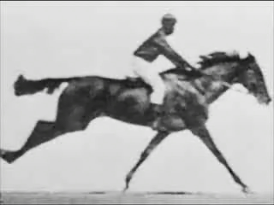
Muybridge Horse Photographs
Notes:
A final impact of the horse was its impact on the development of motion pictures. One issue of controversy among horsemen and scientists was whether, during a gallop, there was a time when the horse had all four of its feet off the ground. In 1872, Eadweard J. Muybridge, an English photographer who spent much of his life in the United States, was asked by Leland Stanford, former governor of CA and a race horse owner, was asked to study the question. Muybridge set up multiple parallel cameras to photograph the horse as it galloped past, with each camera being triggered by the tripping of a thread as the horse passed in front of the camera. The images were copied in the form of silhouettes onto a disc and viewed in a machine called a Zoopraxiscope which showed the horse in motion and proved that there was a point at which all four of the horse’s hooves were off the ground. Thus, the Zoopraxiscope was in fact an intermediate stage towards motion pictures or cinematography. In February 1888, Muybridge visited Thomas Edison’s lab in West Orange NJ, stimulating Edison’s interest in inventing a camera capable of filming motion pictures.

