Slide 1
Aging Life Care™ Planning
Guide to Senior Housing
Options
presented by
Heidi L. Garvis, CMC® Certified Care Manager
Aging Life Care™ Professional

Slide 2
Why Plan Ahead?

Slide 3
Three Housing Options Available to Seniors Who Need Care
Live in your own home with home care
Live in a senior community
Live in a family member’s home and receive care from a family member

Slide 4
“I don’t want to go live with those old people!”

Slide 5
Retirement and Independent Housing

Slide 6
Continuing Care Retirement Communities (CCRC)
More than one level of care
Entry fee may or may not be refundable
Resort type amenities & services included
Housing size: From studios up to cottages
Fees vary, waitlists vary
CCRC’s may also be called “Life Plan” Communities

Slide 7
LifeCare or Fee-for-Service
What is LifeCare?
Contract offered by SOME CCRC’s
Provides MORE care at a initial IL monthly rate.
Buy-in or entry fee is non-refundable.
What is Fee-for-Service?
Rental style: Fee-for-service.
Pay more as more care is needed- Buy-in entry fees are usually 90% refundable.

Slide 8
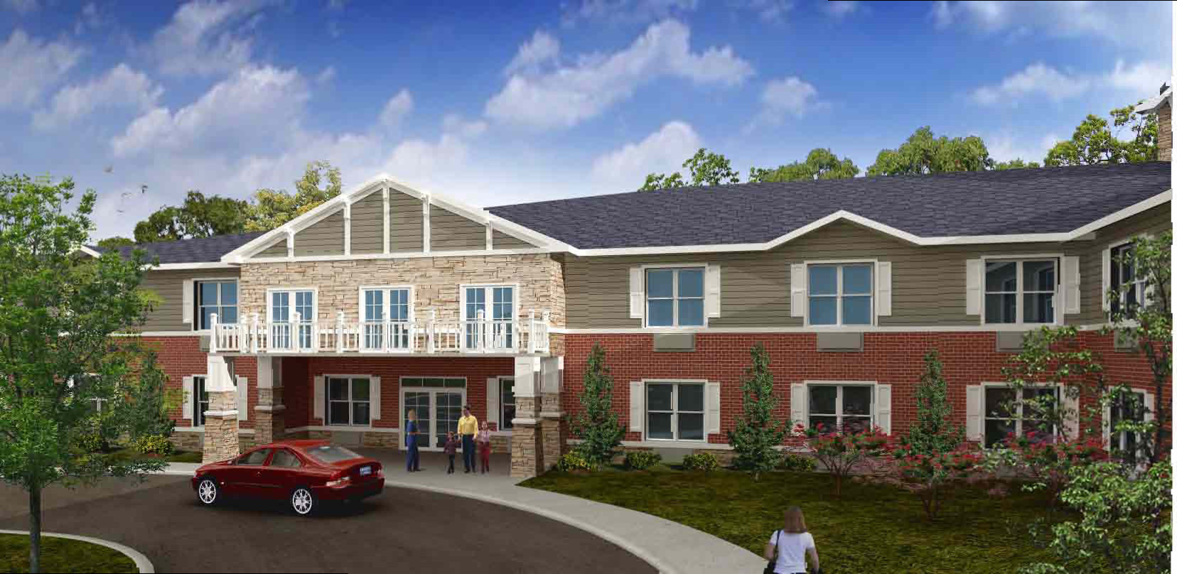
Assisted Living, Memory and Skilled Nursing

Slide 9
Assisted Living and Memory Care
Asst w/ Activities of daily living (ADLs)
3 meals, housekeeping, transportation, activities, Apt. setting
Licensed, state inspections
Memory Care is specialty care that includes a higher staff to resident ratio, special programming, secured building and safe outdoor area.
What about a small residential AL?

Slide 10
Skilled Nursing and Rehabilitation
Long Term and Short-term care
Long term – Highest Level of Care
Medicaid
Short-term Rehab
Usually covered by Medicare Part A

Slide 11
The Costs
Independent Liv Apt. $3-5,000/mo +
Assisted Living $6-9,000/mo +
Skilled Nursing and Rehabilitation $10,000/mo+
Good to Know…
Always include your current home living expenses and then care costs to compare options.

Slide 12
Some Misconceptions..
I can go into a CCRC when I need AL
Medicare pays for long-term care
Living at home with home care is less expensive than AL

Slide 13
Searching Tools…
Guide To Retirement Living: SOURCE BOOK
800-394-9990
www.retirement-living.com
Virginia Dept. of Social Services (ALFs)
www.dss.state.va.us/facility/search/
www. Medicare.gov
“Nursing Home Compare” for skilled nursing facilities

Slide 14
What’s Your Plan?
Heidi Garvis, CMC® and Debbie Aggen, RN, CMC®
571-488-9396
www.caringconsiderations.com
Aging Life Care™ Planning
Senior Housing Search
Care Management

