Slide 1
Federal Debt, Spending and Taxes 2018
Jim Cantwell, Instructor
jcantwell@cox.net
April/May 2018

Slide 2
Deficit (2018)
Outlays $4.142 Trillion
Revenues $3.338Trillion
Deficit $804 Billion
Source: CBO Actual

Slide 3
Where the 2018 Federal Dollar Spent Comes From:
3.338 ÷ 4.142 = .81
$1 spent = 81¢ revenue + 19¢ borrowed
Source: CBO Actual

Slide 6
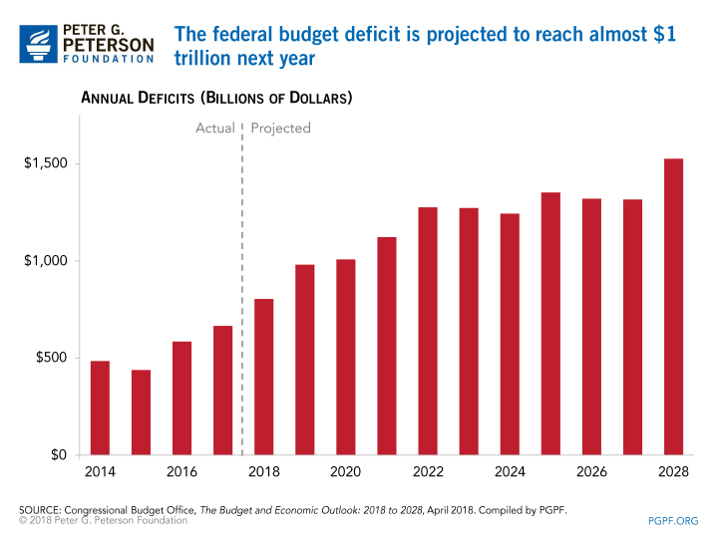

Slide 7
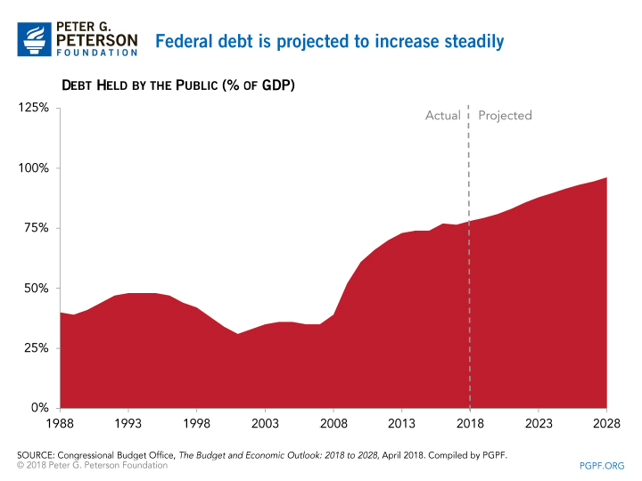

Slide 8
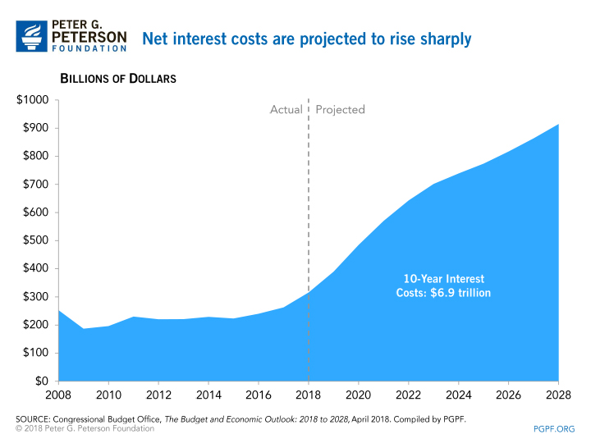

Slide 9
CBO Baseline Projections 2002-2011
January 2001 projection: $5.6 Trillion Surplus over next 10 years.
Actual: $6.1 Trillion cumulative deficit.
Total change: $11.7 Trillion.

Slide 10
Explanation of $11.7 Trillion Change over 10 years ($ Trillions)
What happened after the January 2001 Estimation of $5.6 Total Surplus?
Changes to Outlay Projections: 2) Changes to Revenue Projections:
$2.948 Discretionary (Legislative) - $2.808 Legislative Changes
$1.392 Mandatory (Legislative) - $3.339 Economic
$1.375 Net Interest (Legislative) - $6.1 Total Revenue Change
- $.112 Economic and Technical
$5.602 Total Outlay Changes
Total Impact on 2001 Projected Surplus = - $11.7
Actual Cumulative Surplus or Deficit (-) = - $6.1

Slide 11
Federal Revenues and Outlays, 2018 (in $billions)
Source: CBO Estimate

Slide 12
Mandatory Outlays, 2018 (in $ Billions; Total = 2,546)
Source: CBO Estimate

Slide 13
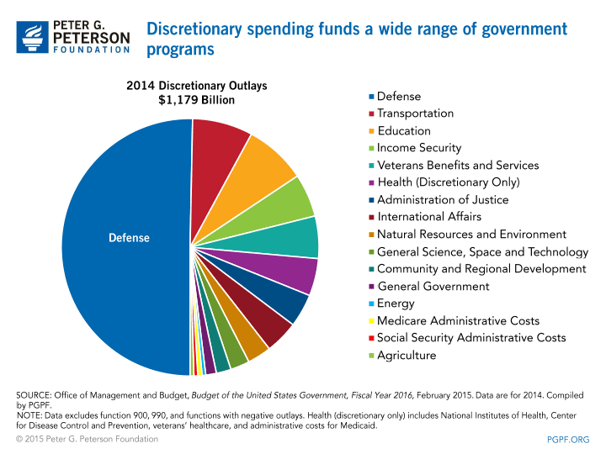

Slide 14
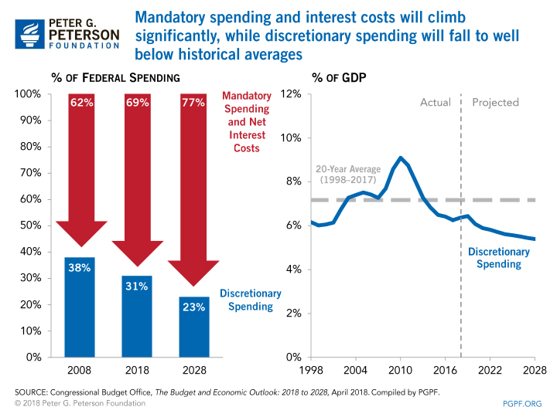

Slide 15
“When you borrow a lot of money to create a false prosperity, you import the future into the present. “ Michael Lewis, Boomerang.
The U.S. government has to come to terms with the painful fact that the good old days when it could just borrow its way out of messes of its own making are finally gone.” Xinhua, Chinese news agency

Slide 16
He said to the nation of Israel: “For the Lord your God will bless you just as He promised you; you shall lend to many nations, but you shall not borrow; you shall reign over many nations , but they shall not reign over you.” (Deuteronomy 15:6) “The borrower is the servant of the lender.” (Proverbs 22:7)

Slide 17
Federal Debt, Spending and Taxes 2018
Jim Cantwell, Instructor
jcantwell@cox.net
April 30, 2018

Slide 18
SIGNIFICANT CONSEQUENCES OF HIGH AND RISING DEBT
…WHEN INTEREST RATES RETURN TO MORE TYPICAL, HIGHER LEVELS, FEDERAL SPENDING ON INTEREST PAYMENTS WILL INCREASE SUBSTANTIALLY.
…ECONOMIC GROWTH WILL BE REDUCED.
…LAWMAKERS WILL HAVE LESS FLEXIBILITY TO USE TAX AND SPENDING POLICIES TO RESPOND TO UNEXPECTED CHALLENGES.
…THE LIKELIHOOD OF A FISCAL CRISIS IN THE UNITED STATES WILL INCREASE.
…THE BURDEN OF THE DEBT IS SHIFTED TO FUTURE GENERATIONS.
…FEDERAL SPENDING ON OTHER PROGRAMS LIMITED.

Slide 20
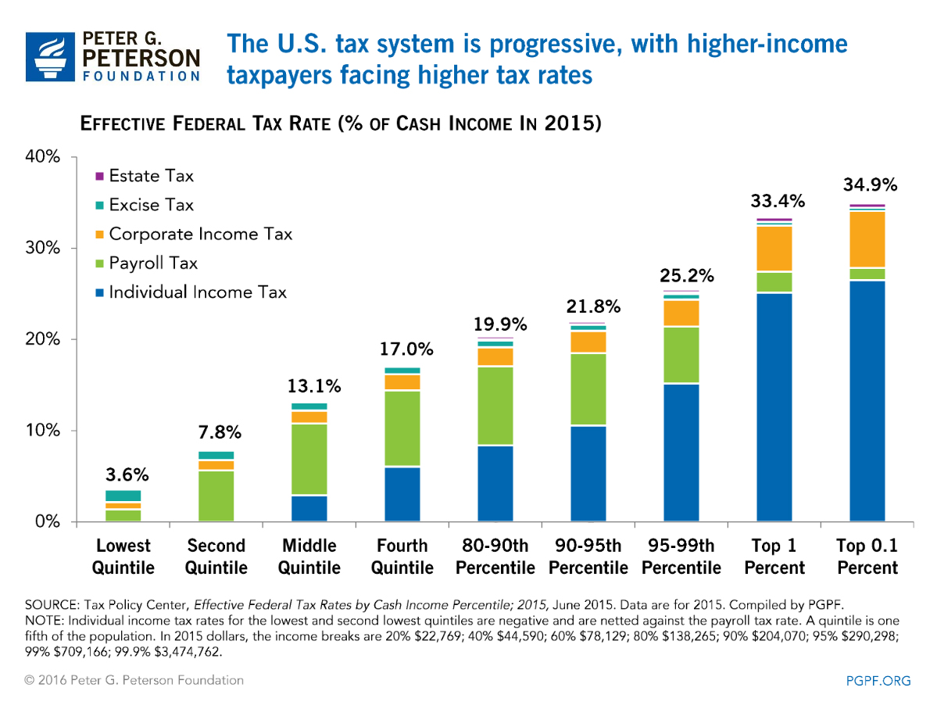

Slide 26
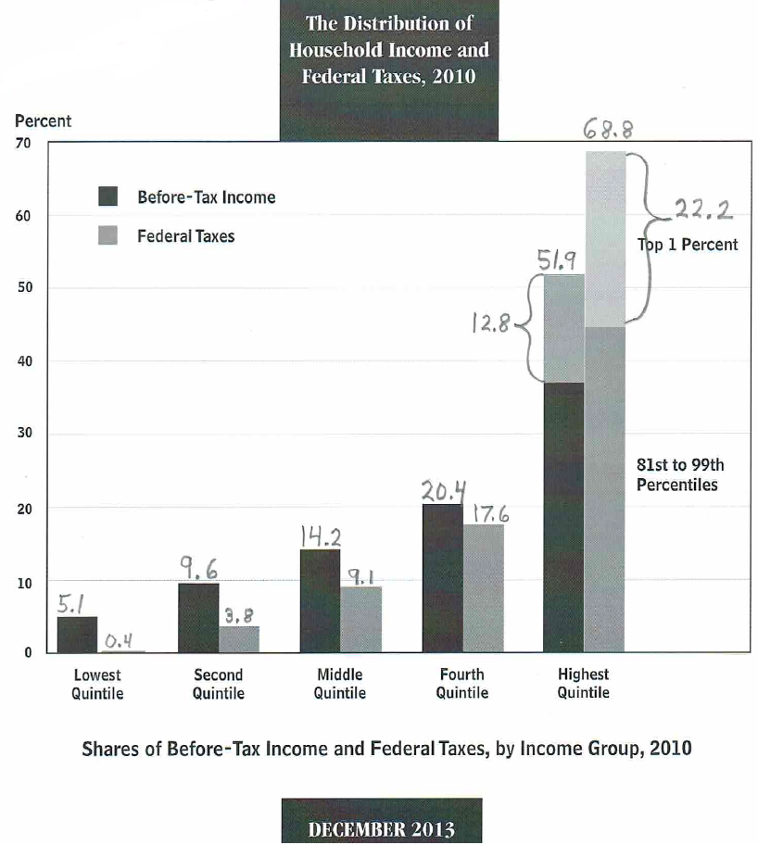

Slide 27
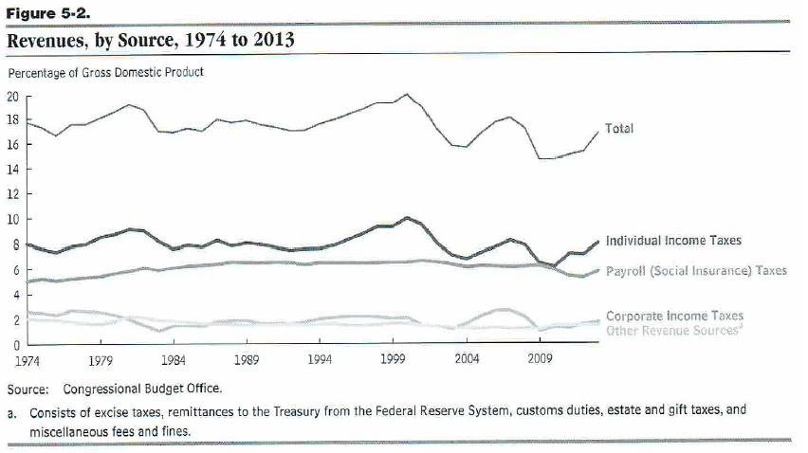

Slide 28
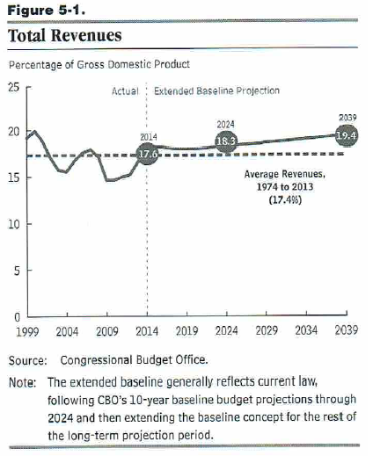

Slide 29
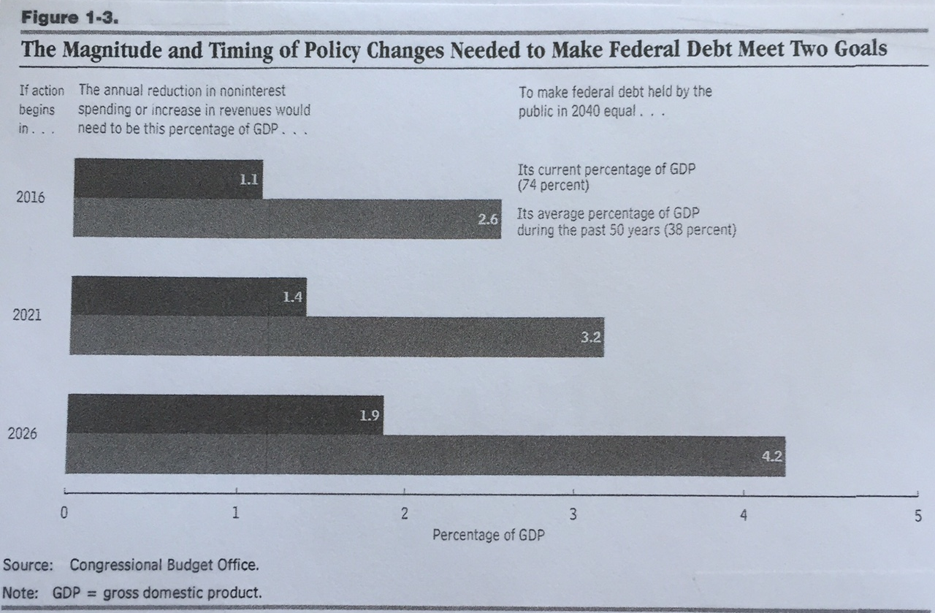

Slide 30
Who Holds the $14.3 Trillion Publicly-Held Debt?
Domestic Investors (8.3 Trillion, or 58%)
Federal Reserve (20%)
Individual Investors (10%)
Mutual Funds (9%)
Other Investors (19%)
Foreign Investors (6.0 Trillion, or 42%)
Japan (8%)
China (8%)
Other Countries (26%)

Slide 31
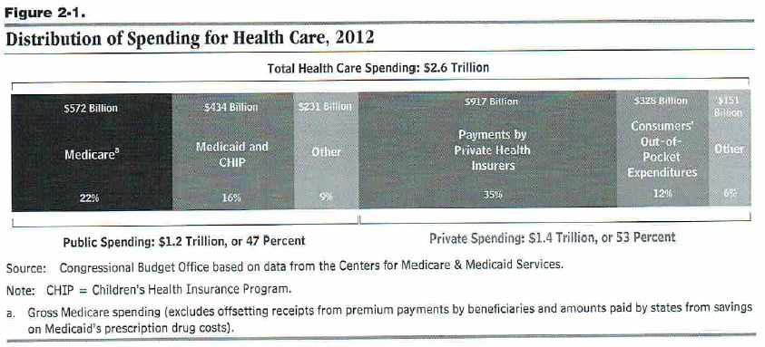

Slide 32
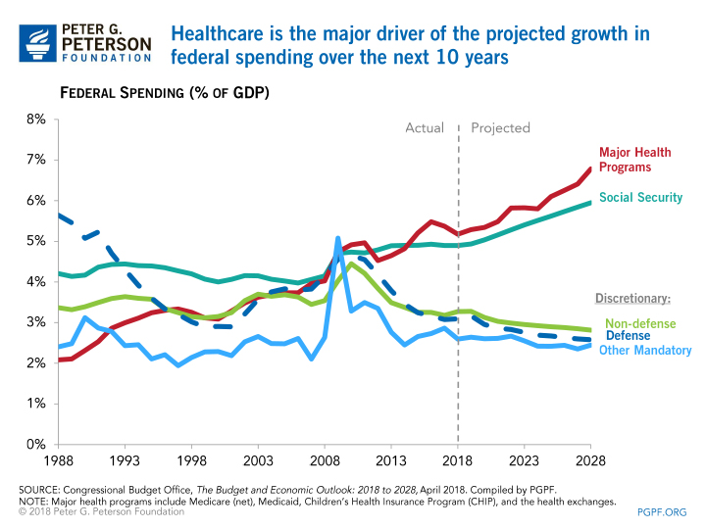

Slide 33
Federal Debt, Spending and Taxes 2018
Jim Cantwell, Instructor
jcantwell@cox.net
May 7, 2018

Slide 34
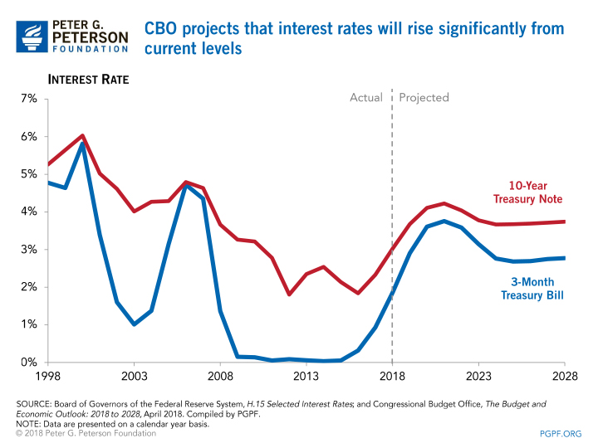

Slide 38
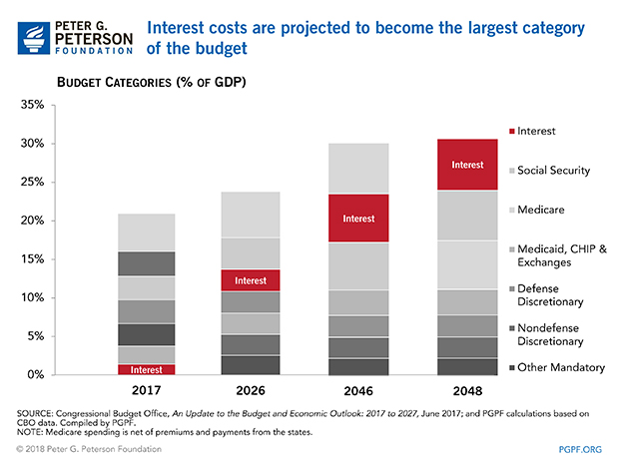

Slide 40
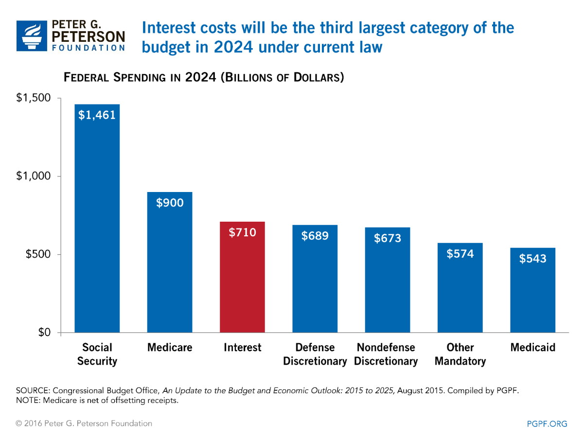

Slide 42
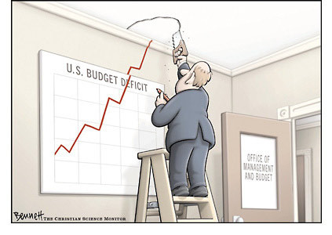

Slide 49
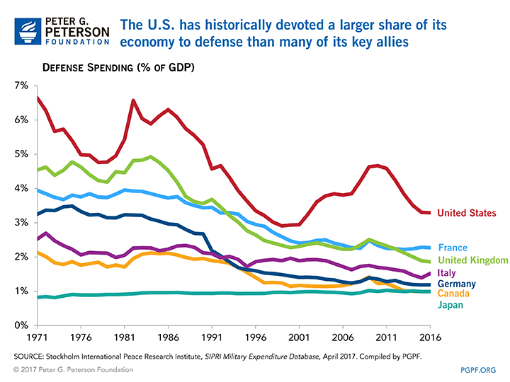

Slide 51
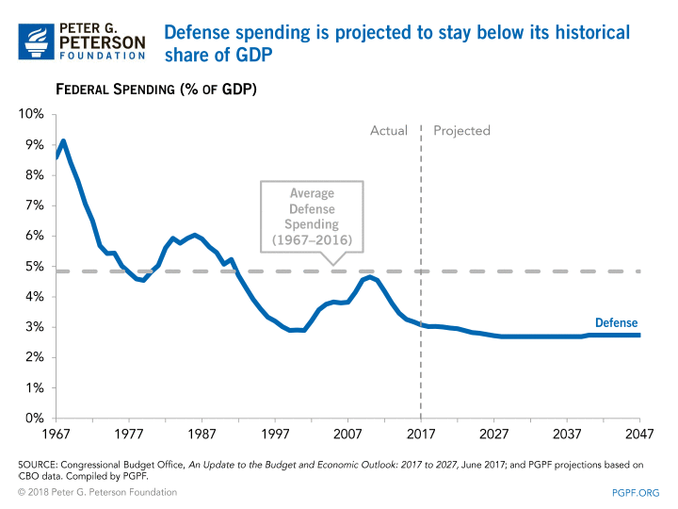

Slide 52
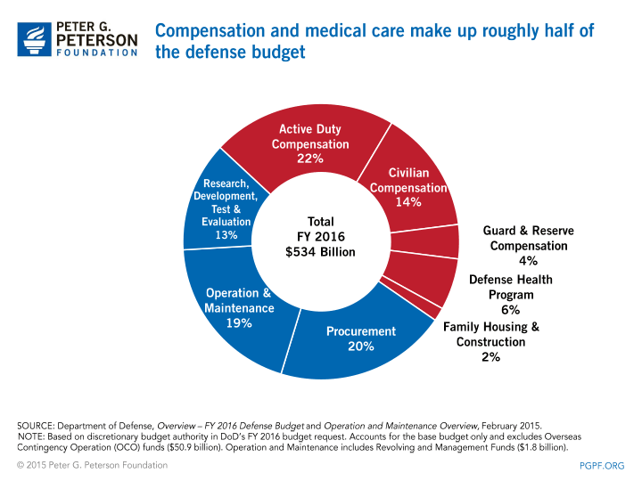

Slide 53
Quotes
“The fiscal path we are on today is simply not sustainable. These deficits that we are incurring on an annual basis are like a cancer, and they are truly going to destroy this country from within unless we have the common sense to do something about it. We face the most predictable economic crisis in history.” Erskin Bowles, who was Bill Clinton’s Chief of Staff and later co-chairman of an Obama-appointed commission of the debt.

Slide 54
Quotes
“We’re driving seventy miles an hour toward a cliff. And when we reach that cliff will be determined by events over which we have very little control. The path we’re on can’t go on for fifteen years. Whether it can go on for two, three, four years, I have no idea.” Robert Reischauer, former CBO Director.

Slide 55
Federal Debt, Spending and Taxes 2018
Jim Cantwell, Instructor
jcantwell@cox.net
May 14, 2018

Slide 56
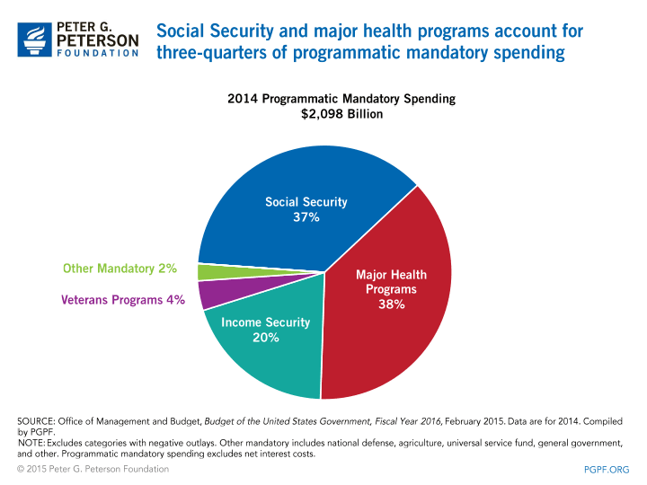

Slide 57
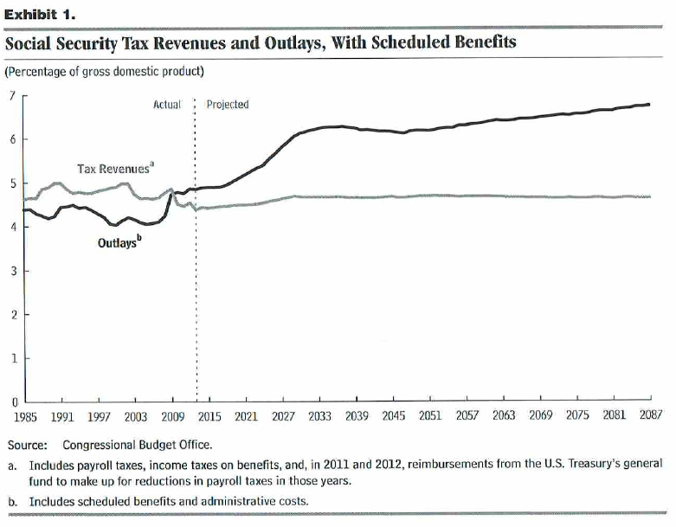

Slide 58
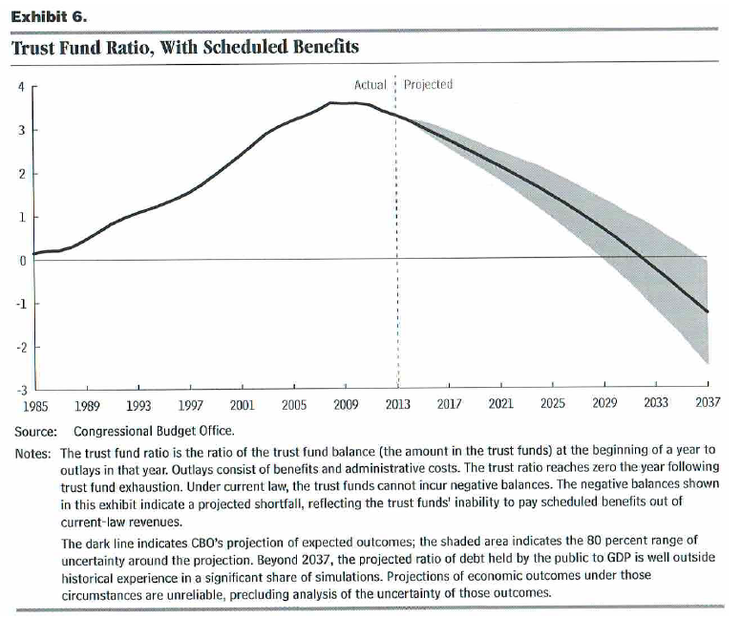

Slide 59
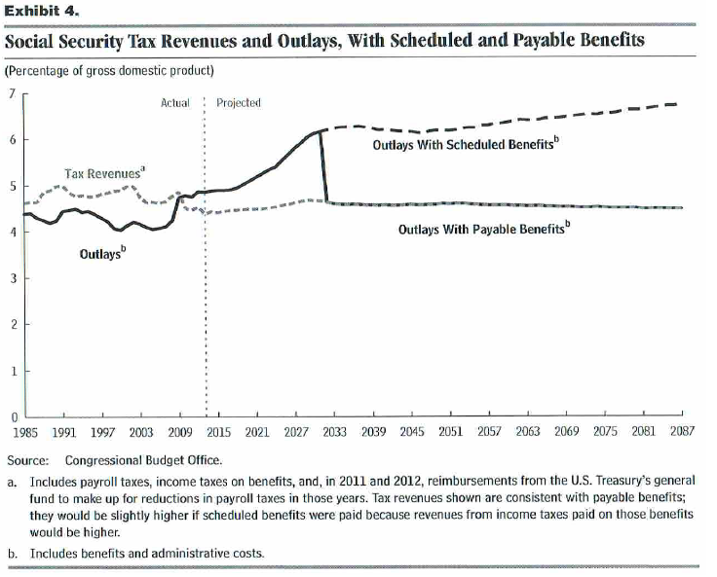

Slide 60
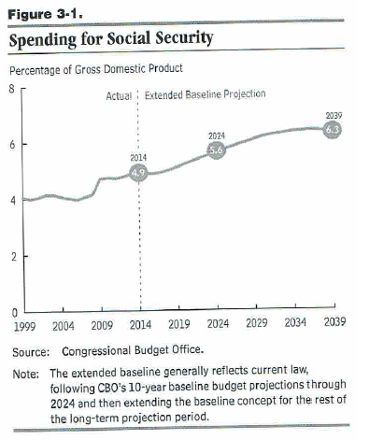

Slide 62
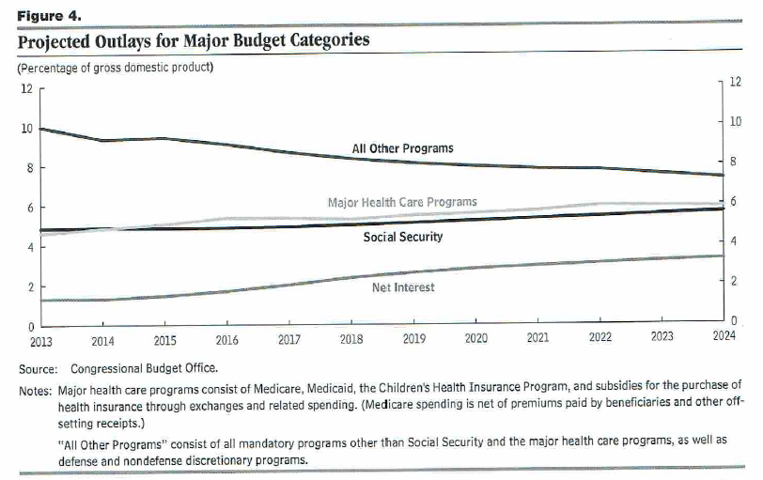

Slide 63
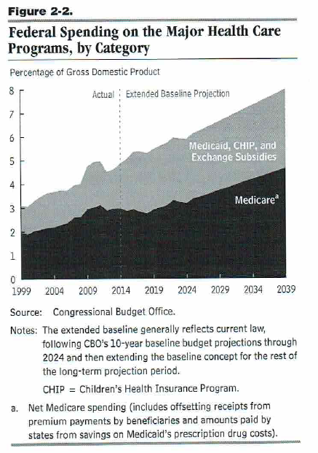

Slide 65
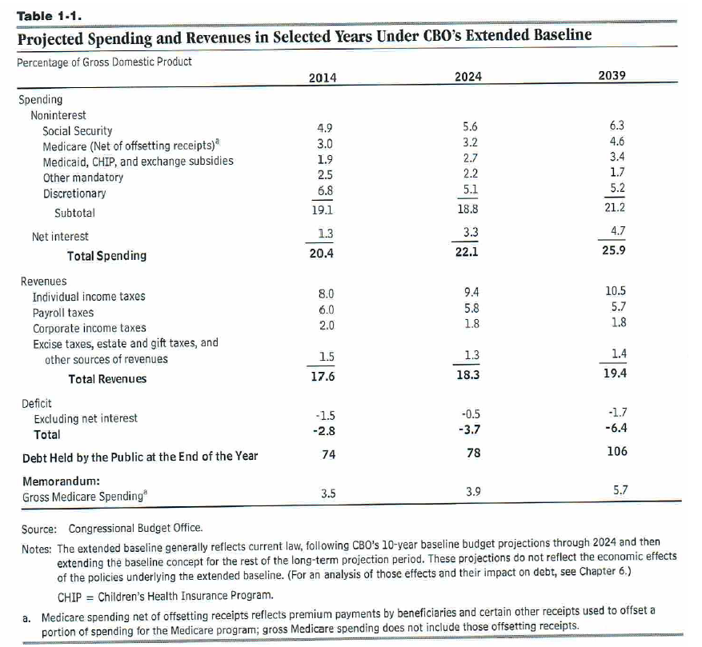

Slide 67
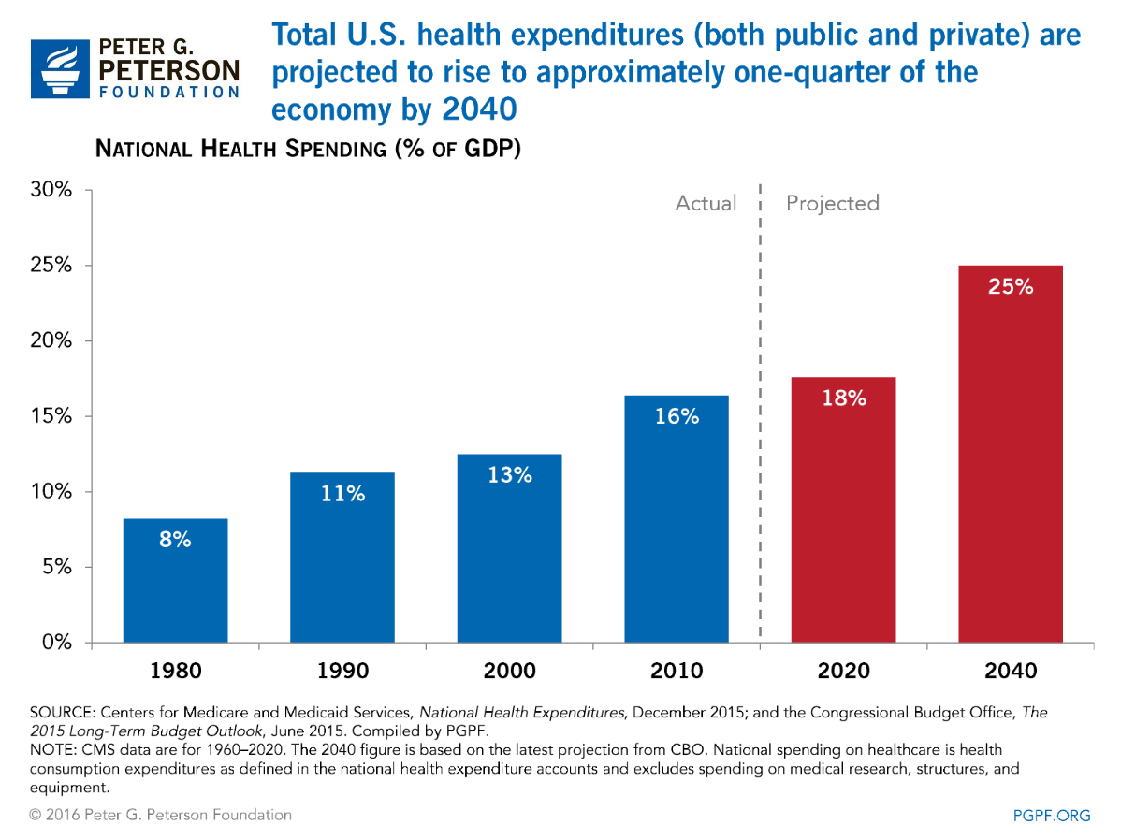

Slide 69
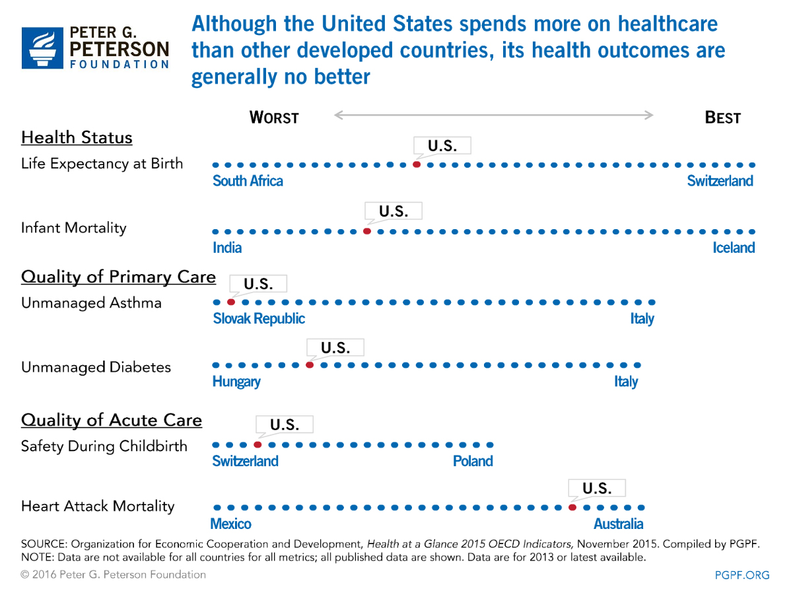

Slide 70
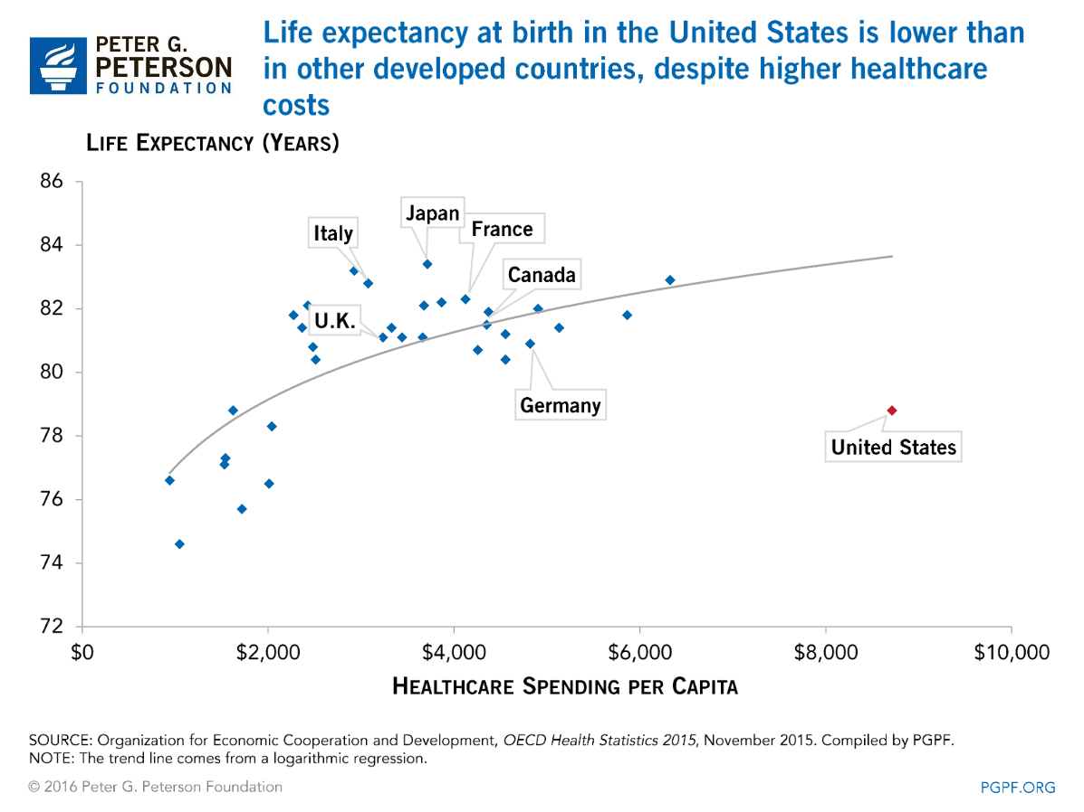

Slide 73
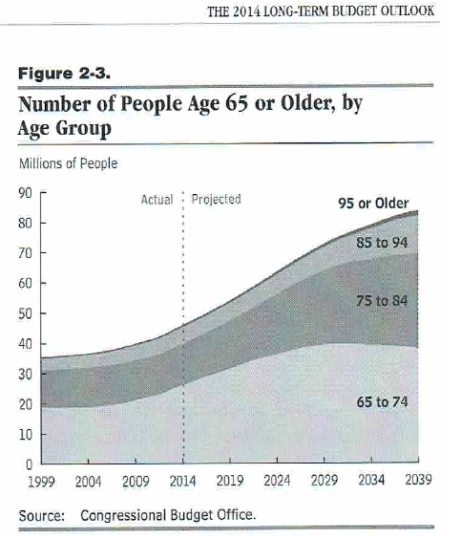

Slide 74
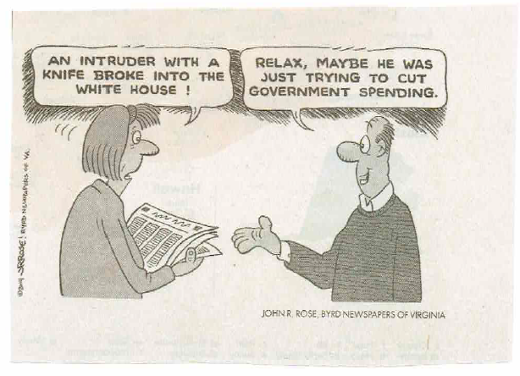

Slide 75
Summary: Federal Deficits and Debt (April 2018)
In April 2018, CBO projected 2018 federal spending of $4.142 trillion (or 20.8 percent of GDP) and revenues of $3.338 trillion (or 16.6 percent of GDP) for a deficit of $804 billion. While the annual deficit has declined over the last several years, debt held by the public has increased, doubling since 2008 to $12.77 trillion in 2014, or 74 percent of GDP, and 14.43 trillion in 2017, or 76.5 percent of GDP.

Slide 76
Summary: Federal Deficits and Debt (April 2018)
Federal spending on the elderly, especially Social Security, Medicare and Medicaid, account for a large and growing proportion of federal spending.
CBO states that outlays for Social Security totaled $939 billion (or 4.9 percent of GDP) in fiscal year 2017, accounting for nearly 23 percent of all federal spending. In 2010, and since, annual outlays for the program have exceeded annual revenues excluding interest credited to the trust funds.

Slide 77
Summary: Federal Deficits and Debt (April 2018)
As a percent of GDP, CBO projects that under current law spending on budget items other than Social Security, Medicare, Medicaid, and net interest will decline from 10.2 percent currently to 8.7 percent in 2028.

Slide 78
Summary: Federal Deficits and Debt (April 2018)
For 2017, CBO reports federal spending for Medicare (net of offsetting receipts), Medicaid, and CHIP plus health care exchange subsidies accounted for 5.5 percent of GDP, with Medicare alone accounting for 3.7 percent, rising to 5.1 percent by 2028.
Interest on the debt is expected to rise very rapidly as interest rates return to more normal levels. As a percent of GDP, CBO projects net interest will rise from 1.4 percent currently to 5.5 percent in 2028.

Slide 79
Summary: Federal Deficits and Debt (April 2018)
As a percent of GDP, Federal revenues include individual income taxes (8.0 percent), social insurance taxes (6.0 percent), corporate income taxes (2.0 percent) and other taxes (1.5 percent) in 2014. The federal tax system is progressive. In 2010, the top 20 percent received 51.9 of before-tax income, and paid 68.8 percent of federal taxes. The top one percent received 12.8 percent of before-tax income and paid 22.2 percent of federal taxes. The lowest 20 percent received 5.1 percent of before-tax income and paid 0.4 percent of federal taxes.

