Slide 1
Tax Preparation Simplified
John Higgins
Today: Virginia Taxes and Record Keeping

Slide 2
Today’s Tax Topics
1. Virginia Tax Law
2. Organizing your tax records

Slide 3
Virginia Taxes
They are complicated!
Little help is available
So many people pay too much
Why?
Because they are unaware of:
Allowable subtractions/deductions
Available credits
How to maximize the spouse tax adjustment

Slide 4
Who Needs to File in Virginia
Every Virginia resident whose Virginia adjusted gross income (VAGI) is at or above the minimum threshold must file
Single - VAGI is $11,950 or more
MFJ - VAGI is $23,900 or more
MFS - VAGI is $11,950 or more
Complete Form 760, Lines 1 through 9, to determine VAGI

Slide 5
What’s New in Virginia
Not much this year – see 760 Instructions
No more credit for local/state political contributions
Allowed a $2000 Deduction for contributions to an ABLE account (unlimited if age 70+)
Additional arcane tax credits for food crop donations and R&D expenses

Slide 6
Common Virginia Tax Forms
760 is the basic VA tax return
Schedule ADJ
Any Additions, Subtractions, and Deductions not directly entered on 760
Schedule CR is for credits
Generally pretty obscure special credits
See instructions
Schedule VAC is to allocate refund to Virginia College Savings account and other voluntary contributions listed in 760 instructions
760C is for underpayment penalties if applicable
Total withholding less than 90% of tax due
760 ES is for making estimated tax payments

Slide 7
Virginia Overview
FEDERAL ADJUSTED GROSS INCOME (AGI)
+ ADDITIONS
- SUBTRACTIONS
= VIRGINIA AGI
- DEDUCTIONS
- EXEMPTIONS
=VIRGINIA TAXABLE INCOME
x TAX TABLES
= TAX
- SPOUSE TAX ADJUSTMENT
- CREDITS
- TAX ALREADY PAID
= TAX OWED/REFUND

Slide 8
Fixed date conformity
What is that??
Virginia “conforms” to the Internal Revenue Code with some exceptions
That conformance is renewed annually by the Legislature effective through Dec 31 of the tax year – the “fixed date”
If you have income that falls in the exceptions, you have to add adjust your Va taxable income accordingly.
Examples include bonus depreciation, certain types of NOL, high-yield discount notes, and some business debt cancellation

Slide 9
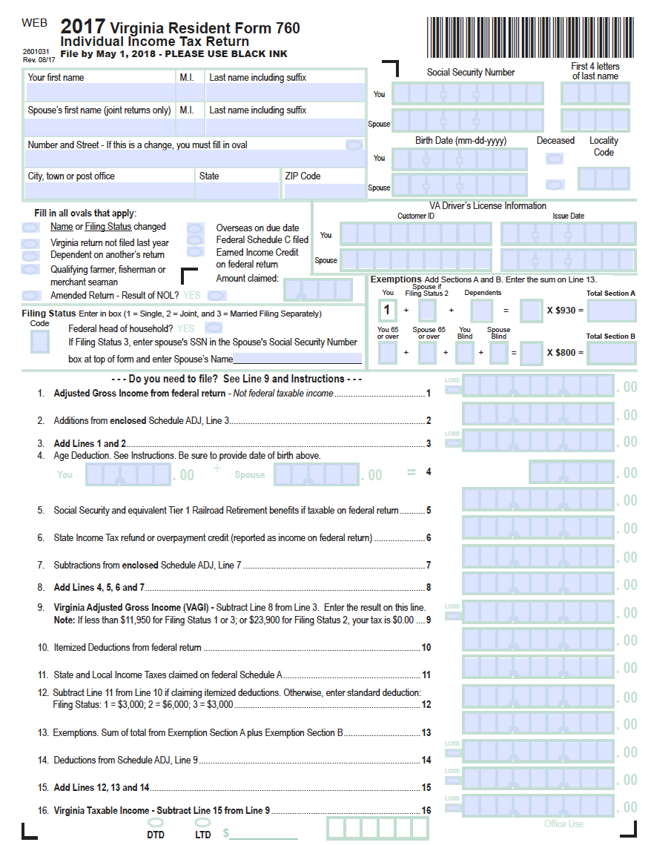
BIO DATA
PERSONAL & DEPENDENT EXEMPTIONS
FEDERAL AGI
ADDITIONS & SUBTRACTIONS
VIRGINIA AGI
DEDUCTIONS & EXEMPTIONS
VIRGINIA TAXABLE INCOME

Slide 10
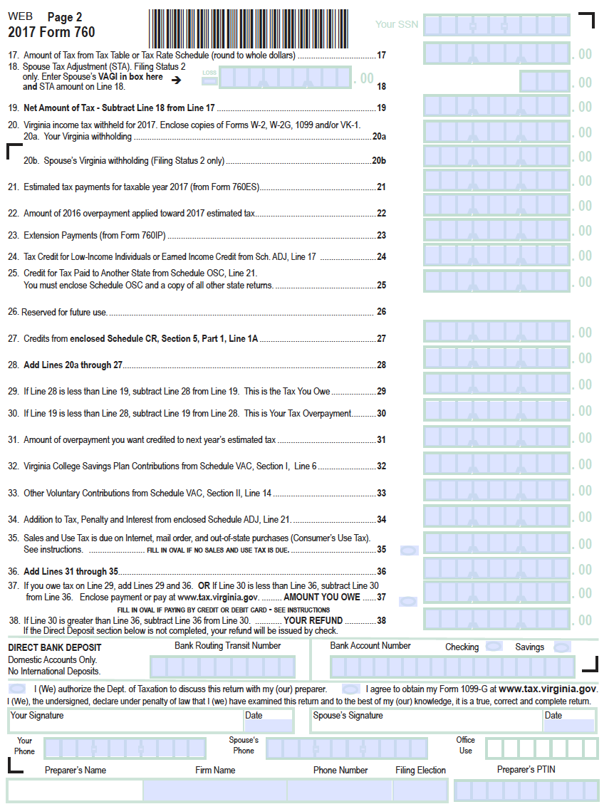
TAX INCLUDING STA
PAYMENTS
CREDITS
VOLUNTARY CONTRIBUTIONS
CONSUMER”S USE TAX
TAX OWED OR REFUND

Slide 11
Va Additions to Fed AGI
760 Line 1 is Federal AGI (1040 Line 37)
760 Line 2 is Additions from Schedule ADJ Line 3
E.g., Schedule ADJ Code 10 Interest on obligations of other states not taxed federally but taxable in Virginia

Slide 12
Va AGE Deduction and Subtractions from Federal AGI
760 Line 4 is the Age Deduction – use worksheet
As much as $12,000 for taxpayers 65 or older
Can be limited if Income minus SS benefits > $75,000
760 Line 5 subtracts SSI and RRB that was taxed on 1040 Line 20b – not taxed in Va
760 Line 6 subtracts the federally taxed state refund amount on 1040 Line 10
760 Line 7 is the total subtractions from Schedule ADJ Line 7 (see next slide)
760 Line 9 is your Virginia AGI (VAGI)

Slide 13
760 line 7 = Schedule ADJ Line 7
Schedule ADJ Line 4 is income from obligations of the US not taxed in Va (e.g., US Savings Bond Interest )
Schedule ADJ Line 5 is disability income reported as wages on 1040 (e.g., 1099-R Distribution Code 3)
If over 65 can deduct up to $20,000 if Age Deduction not taken
Schedule ADJ Line 6 is other subtraction codes from the instructions. Common ones include:
Code 20 – Capital Gains on Va obligations (taxed by IRS, not Va)
Code 22 – RR retirement benefits (Pensions)
Code 24 – VA Lottery winnings less than $600 (Not a deduction or “floor” - $600 or more is fully taxable)
Code 34 – Certain distributions from College Savings plan (not used for education due to death, disability, or availability of scholarship funds)
Code 37 – Unemployment Benefits (taxed by IRS, not Va)

Slide 14
Calculating the Virginia Taxable Income
760 Line 9 is Virginia AGI
760 Line 10 is Federal Itemized Deductions
760 Line 11 and 12 add back the Federal “State Income Tax Deduction” or adds the Virginia Standard Deduction if not itemizing
760 Line 13 has the total personal and dependent exemptions from top of 760 page 1
760 Line 14 totals the Deductions from Schedule ADJ Line 9 (see next slide)
760 Line 15 is the Virginia Taxable Income

Slide 15
Schedule ADJ Deductions Line 9
Typical Deduction Codes on Schedule ADJ Line 8 that are totaled to Schedule ADJ Line 9
Code 101 – Child/Dependent Care (total expense, not just Federal Credit on 1040 Line 49)
Code 104 – Virginia College Savings Plan contributions (Up to $4000 except unlimited if over age 70)
Code 106 – Long Term Care Insurance Premiums, if not deducted on Fed Sch A Medical
Code 109 – Sales tax on energy efficient appliances
Code 111 – Charitable Miles ($0.18/mile in Va/$0.14 IRS)
Code 114 – Funeral, Medical, and/or Dental Insurance Premiums (for certain low income taxpayers age 66 or older)

Slide 16
Calculating Tax Owed or Refunded
760 Page 2 calculates the tax on Va Taxable Income and applies payments, credits, and voluntary contributions to arrive at your final refund or tax bill
Some credits are worth examining
760 Line 18 is the Spouse Tax Adjustment (STA) (see next slide)
760 Line 24 is Va equivalent of Federal EIC
760 Line 26 is credit for political contributions
One half the contribution up to $50 (MFJ)/$25 (all others) for state offices
760 line 27 is credits from Schedule CR
Various obscure credits. See instructions
760 Page 2 Line 36 is the Consumer’s Use Tax
Tax on internet and out-of-state purchases

Slide 17
Spouse Tax Adjustment (STA)
VA only has one tax table for everyone
STA corrects for MFJ taxpayers paying more than if they filed single
Maximum adjustment is $259
Can shift joint income (interest, dividends, etc.) and expenses between spouses to get maximum STA
Strategy is to get one spouse close to, but under, $17K

Slide 18
Effect of Spouse Tax Adjustment
Spouse
5.75%
$17,000
5%
Taxpayer
Taxpayer
Spouse
$5000
$3000
3%
2%
Before
After

Slide 19
To Conclude Virginia Taxes
Virginia Tax Laws are complicated
You can reduce your Virginia taxes by:
Not missing Subtractions and Deductions
Optimizing the Spouse Tax Adjustment
Taking advantage of Credits
Final Caution – Penalty threshold is low ($150)
QUESTIONS OR COMMENTS ON VIRGINIA TAXES?

Slide 20
Organization of Your Tax Records
The Proverbial Shoebox
or
Is There a Better Way?

Slide 21
Three Types of Records
Essential for filing
Required by the IRS
Desirable for filing
Needed to maximize deductions & credits
Retention Documents
May be required in the long term

Slide 22
Essential Filing Documents
IRS NUMBERED INCOME FORMS
W-2 Wages
W-2G Gambling Winnings
1099’s
Interest 1099-INT & 1099-OID
Dividends 1099-DIV
Sale of Stock 1099-B, Broker Statements
Sale of Home 1099-S
Retirement Income 1099-R, RRB-1099 & SSA-1099
Unemployment/Refund 1099-G
Cancellation of Debt 1099-A, 1099-C
Odds & Ends 1099-MISC
1095-A Affordable Care Act
K-1’s Partnerships and Trusts

Slide 23
About These Forms
They vary in size and design
Don’t be confused
They contain information other than income
Don’t overlook anything
They have been sent to the IRS
Don’t ignore anything

Slide 24
Other Filing Essentials
Un-numbered forms or records
Interest paid or received from individuals
Seller-financed home sale
Alimony received
Self Employment Income
Prizes and Awards

Slide 25
Desirable (to your benefit) for Filing
Adjustments to Income
Alimony paid
IRA contributions
Student Loan Interest
Itemized Deductions (Schedule A)
Medical expenses
Real Estate Taxes
VA Taxes paid
Mortgage interest (Form 1098)
Charitable contributions (Form 1098C for cars)
Other allowable expenses
Virginia Subtractions & Deductions

Slide 26
Retention Documents
Why retain?
To help with next year’s return
To reduce next year’s taxes e.g. loss carryovers
You may want to amend a past return
You may be audited!!
You need to know the basis for future asset sales
Sentimental value!
How long?
“For as long as they are important for federal tax law”
(IRS Publication 17)

Slide 27
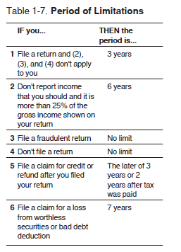
Period of limitations from Pub 17

Slide 28
Asset Basis Records
BASIS is your investment in an asset
Needed to figure your gain or loss when you sell
Complications
Time: May be many years between purchase and sale
Splits: Must be accounted for
Reinvested dividends: should be included
Homes:
Records of improvements
Postponed pre-1997 gains reduce basis
KEEP THESE RECORDS FOREVER!

Slide 29
Statute of Limitations
3 YEARS from date of filing - “in general”
6 YEARS - if income under-reported by over 25%
FOREVER - if a return is false or fraudulent
YOUR CHOICE!
At least retain a copy of your return and all supporting documents for 3 years

Slide 30
Organizing Your Records
It’s a personal thing
Throw out the shoebox (not the contents)
Sort
Distinguish between tax and other financial documents e.g. bank statements
Use your computer (if you are comfortable)
MS Excel/Mac Numbers spreadsheet or free alternatives
Or use file folders

Slide 31
Suggestions
A folder for the new tax year
Notes from prior year
Estimated Tax coupons & payments
Prior year carryovers e.g. unused capital losses
Infrequent receipts e.g. real estate tax, car tax
January stuff - W-2’s, 1099’s, etc.
Charitable contributions
Envelope for current year receipts
Diary entry for charitable mileage
Medical records
Separate doctors, dentists, insurance premiums and co-pays, prescriptions, glasses, mileage

Slide 32
Suggestions (cont’d)
A folder for each Home: (closing documents, cost of improvements, and associated dates)
Folders for Stocks, Bonds, or Funds:
Original purchase date and cost
For Stocks:
Details of splits or additional stock received
Dates and number of shares sold
For Mutual Funds:
Current year monthly statements
At year end keep December statement, destroy the rest
Use fund’s average cost basis

Slide 33
Finally…
After filing, keep in that year’s tax folder
A copy of return (all forms)
Copies of all Income forms (W-2’s, 1099’s, etc)
All other supporting documents
After 3 years
Move essentials to basement
Shred the rest
Ensure your spouse knows where all your tax documents are

