Slide 1
OLLI Lecture March 22, 2016 What Can Presidents Actually Do For the Economy?©
Authored and Presented by Gerald A. Hanweck, Sr. Professor of Finance School of Business George Mason University Fairfax, VA ghanweck@gmu.edu

Slide 2
What Can Presidents Actually Do For the Economy?
Introduction Some of the promises and claims that presidential hopefuls and former presidents claim they can and have done for the U.S. economy 1. Added jobs 2. Reduced inflation 3. Improved infrastructure 4. Safer living through use of the military in wars or cold-wars 5. Ended cold and hot wars 6. Fairer financial markets through regulation or deregulation 7. Free trade through trade agreements that improved U.S. employment and living standards 8. Saved the economy 9. Others

Slide 3
What Can Presidents Actually Do For the Economy?
Presidential Terms of Office Ronald Reagan 1981 -1989 George H.W. Bush 1989 -1993 William J. Clinton 1993- 2001 George W. Bush 2001- 2009 Barak H. Obama 2009- 2017
NBER Business Cycles
Peak to Trough
1973-12-01 to 1975-03-01
1980-02-01 to 1980-07-01
1981-08-01 to 1981-11-01
1990-08-01 to 1991-03-01
2001-04-01 to 2001-11-01
2008-01-01 to 2009-06-01

Slide 4
What Can Presidents Actually Do For the Economy?
A review of the economic events under various presidents since Ronald Reagan took office in 1981 1. What has happened with GDP from 1978 to the present by Presidential term 2. Compare Actual to Potential GDP by Presidential term 3. Key events with energy prices (WTI crude oil prices) 4. Rate of inflation for Personal Consumption Expenses 5. Manufacturing Employment 6. Total Nonfarm Payroll and Construction Employment 7. Housing Prices and 30-year Fixed Rate Mortgage 8. Net Domestic Fixed Investment and Net Nonresidential Investment 9. Federal Government Expenditures, Defense Expenditures & Surplus & Deficit 10. Interest rates & PCE – Fed Funds rate, mortgage rates 10-year Treasury Bond Rate

Slide 5
What Can Presidents Actually Do For the Economy?
Historical Review of the Data By Presidential Term 1. GDP vs Potential GDP 2. GDP and the Price of Oil WTI Price 3. Rate of Growth of GDP 4. Manufacturing Employment 5. Nonfarm Payroll Employment: Total, Private Industries, Construction 6. Housing Prices and 30-year Fixed Rate Mortgage 7. Interest Rates and Monetary Policy

Slide 6
What Can Presidents Actually Do For the Economy? Narrative
Reagan Administration’s Economic Policies (“Reaganomics”): Deregulation and Reduced Government 1. Inherited High inflation (“stagflation” and back-to-back recessions (1980, and 1981) and 10% unemployment rate. 2. Administered DIDMCA (Depository Institutions and Monetary Control Act of 1980) which deregulated interest banks could charge on deposits (6 year phase-out of Regulation Q) and began major banking deregulation culminating in Gramm- Leach-Bliley Act in 1999 which largely repealed Glass-Steagall. 2. Economic Recovery Tax Act of 1981:Tax cuts for 70% to 28% for top bracket and 48% to 34% for corporate tax rate Tax Equity and Fiscal Responsibility Act of 1982 (repealed some of ERTA 1981) Tax Reform Act of 1986 (lowered tax rates for individuals from 50% to 28% and corporations) 3. Garn-St Germain Depository Institutions Act of 1982 lowered capital standards for thrifts by instituting regulatory capital standards (counting “goodwill” as capital) and MMDAs and Super Now accounts. This helped to fuel the S&L Crisis which ended in 1989. Competitive Equality Act of 1987 (recapitalize thrifts). 4. Instituted substantial budget cuts in 1985 with cooperation of Congress 5. Increased defense spending as a way to achieved an end to the Cold War 6. Considerably expanded the national debt through deficit financing of tax cuts 7. A long economic expansion began under the Reagan Administration that lasted until 1991

Slide 7
What Can Presidents Actually Do For the Economy? Narrative
George H. W. Bush Administration’s Economic Policies (1989-1993) 1. Began the administration with the S&L Crisis is full swing 2. 1989 Financial Institutions Reform Recovery and Enforcement Act (FIRREA) Limited thrifts’ investment in nonresidential real estate Ordered thrift divestiture of junk bonds Created Resolution Trust Corporation (RTC) to resolve failed and failing thrifts 3. 1991 Federal Deposit Insurance Corporation Improvement Act (FDICIA) Prompt Corrective Action – mandatory bank interventions by regulators Risk-based deposit insurance premiums Limited use of too-big-to-fail bailouts Extended Federal regulation of foreign bank branches in U.S. 4. August 2, 1990 (to February 28, 1991), began and completed the Gulf War, Desert Storm and Desert Shield, with invasion of Iraq and defense of Kuwait, Saudi Arabia and Israel, accompanied by a military coalition of 34 countries and a buildup costing U.S. $25 billion.

Slide 8
What Can Presidents Actually Do For the Economy? Narrative
Clinton Administration’s Economic Policies (1993-2001) The administration began in the midst of a recovery from the 1990-91 recession and was ended in recession after the Dot-Com boom had ended in January 2001. The economy was clearly driven by the developments in information technology of the Internet and communications of the time. 1. Omnibus Budget Reconciliation Act of 1993 Cut taxes on low income taxpayers and raised taxes on the wealthiest 1.2 percent of taxpayers. 2. North American Free Trade Agreement, January 1994 3. Illegal Immigration Reform and Immigrant Responsibility Act (IIRIRA) September 30, 1996 Reducing legal immigration from 800,000 to 550,000 per year 4. Clinton authorized the use of U.S. Armed Forces in a NATO bombing campaign against Yugoslavia in 1999, named Operation Allied Force to stop ethnic cleansing and genocide by Serbia. 5. Riegle-Neal Interstate Banking and Branching Efficiency Act 1994 Allowed bank holding companies to acquire banks in other than their home state and to convert these starting in 1997 into branches of a single interstate bank (also newly chartered branches in other states) 6. Financial Services Modernization Act (Gramm-Leach-Bliley Act) 1999 which repealed a good part of Glass-Steagall.

Slide 9
What Can Presidents Actually Do For the Economy? Narrative
George W. Bush Administration’s Economic Policies (2001-2009) The Administration began in the midst of the 1991 recession. On September 11, 2001 2 hijacked aircraft flew into the Twin Towers in New York City several blocks from Wall Street and the New York Stock Exchange. That set in motion the retaliation for this attack. Another stuck the Pentagon and another crashed in Pennsylvania. 1.Taxes Economic Growth and Tax Reconciliation Act of 2001 Jobs and Growth Tax Relief Reconciliation Act of 2003 Increased tax deductions for married couples, eliminate the estate tax and reduced marginal tax rates. These cuts were intended to increase jobs. Neither were made permanent and likely increased the deficit. 2. No Child Left Behind Act in 2002 substantially increased Federal Government spending for educaion 3. Federal spending increased because of the wars in Iraq and Afghanistan and the Global War on Terrorism and the Federal Budget deficit increased as well. This spending was following a long reduction in defense spending during the Clinton Administration. 4. A housing price bubble began in 2004 ending in 2007 and with the start of the Great Recession at the end of the Bush Administration’s term in 2008. 5. To avoid worsening the financial crisis the Economic Stimulus Act of 2008 created lump sum tax rebates to avoid recession and the Troubled Asset Relief Program and the Emergency Stabilization Act were passed in 2008.

Slide 10
What Can Presidents Actually Do For the Economy? Narrative
Barak Obama Administration’s Economic Policies (2009-2017) 1. Economic Stabilization Act of 2009 $900 billion for “shovel ready projects.” About $600 billion spent to date. 2.2010 Wall Street Reform and Consumer Protection Act
a. Creates the Financial Services Oversight Council that would look out for systemic risks at large Fls.
b. Gives the government power to break up Fls that provide a systemic risk to the financial system.
c. Creates the Consumer Financial Protection Agency to regulate products such as credit cards and mortgages.
d. Allows Congress to order the Government Accountability Office to audit Federal Reserve activities.
e. Gives shareholders the right to a nonbinding proxy vote on corporate pay packages.
f. Requires some over-the-counter derivatives be traded through clearinghouses to provide transparency of the value of trades.

Slide 11
What Can Presidents Actually Do For the Economy? Narrative
Monetary Policy during the various presidential administrations
Federal Reserve Chairman:
Paul Volcker
Alan Greenspan Ben Bernanke Janet Yellen
The Fed and FOMC are independent of the President and are creations of Congress.
The Federal Reserve Banks are independent corporations overseen by the Board of Governors of the Federal Reserve System
What did monetary policy contribute in each presidential administration era?

Slide 12
What Can Presidents Actually Do For the Economy? Conclusion
Presidents can inspire, but can’t do much to contribute to economic growth, stabilization or development without dramatic and directed efforts. In this regard the Reagan Administration stands out.

Slide 13
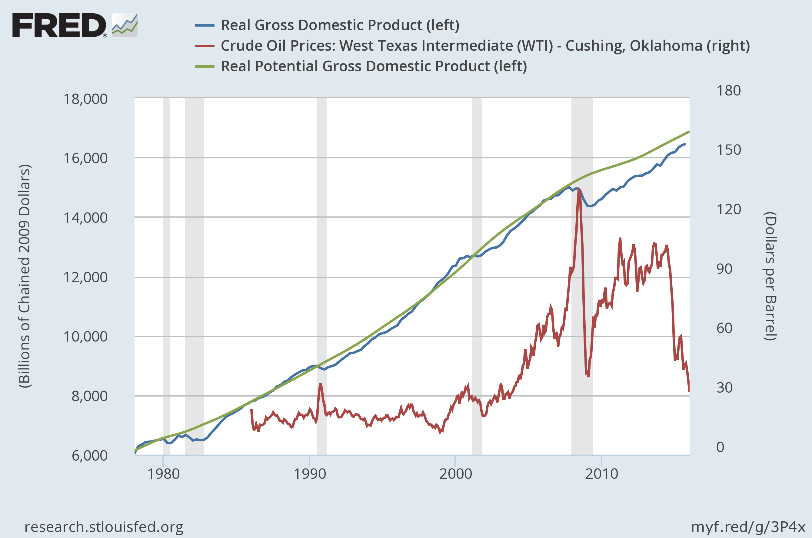
B. Obama 2009-2016
G.W. Bush
2001-2008
Clinton
1993-2000
2005 Q3
G.H.W. Bush
1989-1992
1998 Q2
Reagan 1980-88
Notes:
Real Gross Domestic Product BEA Account Code: A191RX1 Real gross domestic product is the inflation adjusted value of the goods and services produced by labor and property located in the United States. For more information see the Guide to the National Income and Product Accounts of the United States (NIPA) - (http://www.bea.gov/national/pdf/nipaguid.pdf) Source: US. Bureau of Economic Analysis Release: Gross Domestic Product Crude Oil Prices: West Texas Intermediate (WTI) - Cushing, Oklahoma Definitions, Sources and Explanatory Notes: http://www.eia.doe.gov/dnav/pet/TblDefs/pet_pri_spt_tbldef2.asp Source: US. Energy Information Administration Release: Spot Prices Real Potential Gross Domestic Product Real potential GDP is the CBO’s estimate of the output the economy would produce with a high rate of use of its capital and labor resources. The data is adjusted to remove the effects of inflation. Source: US. Congressional Budget Office Release: Budget and Economic Outlook

Slide 14
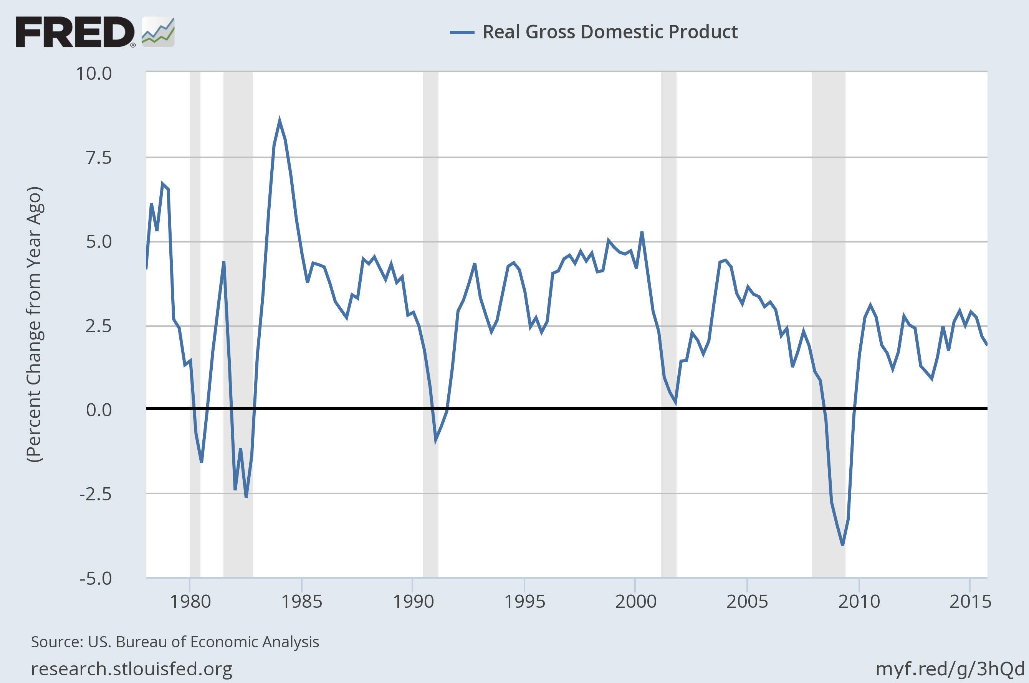
Real Gross Domestic Product Percentage Change From a Y/Y
(Y/Y, %)
Reagan 1980-88
G.H.W. Bush
1989-1992
Clinton
1993-2000
G.W. Bush
2001-2008
B. Obama 2009-2016
Notes:
BEA Account Code: A191RX1 Real gross domestic product is the inflation adjusted value of the goods and services produced by labor and property located in the United States. For more information see the Guide to the National Income and Product Accounts of the United States (NIPA) - (http://www.bea.gov/national/pdf/nipaguid.pdf) Source: US. Bureau of Economic Analysis Release: Gross Domestic Product Growth Rate Calculations | US recession dates

Slide 15
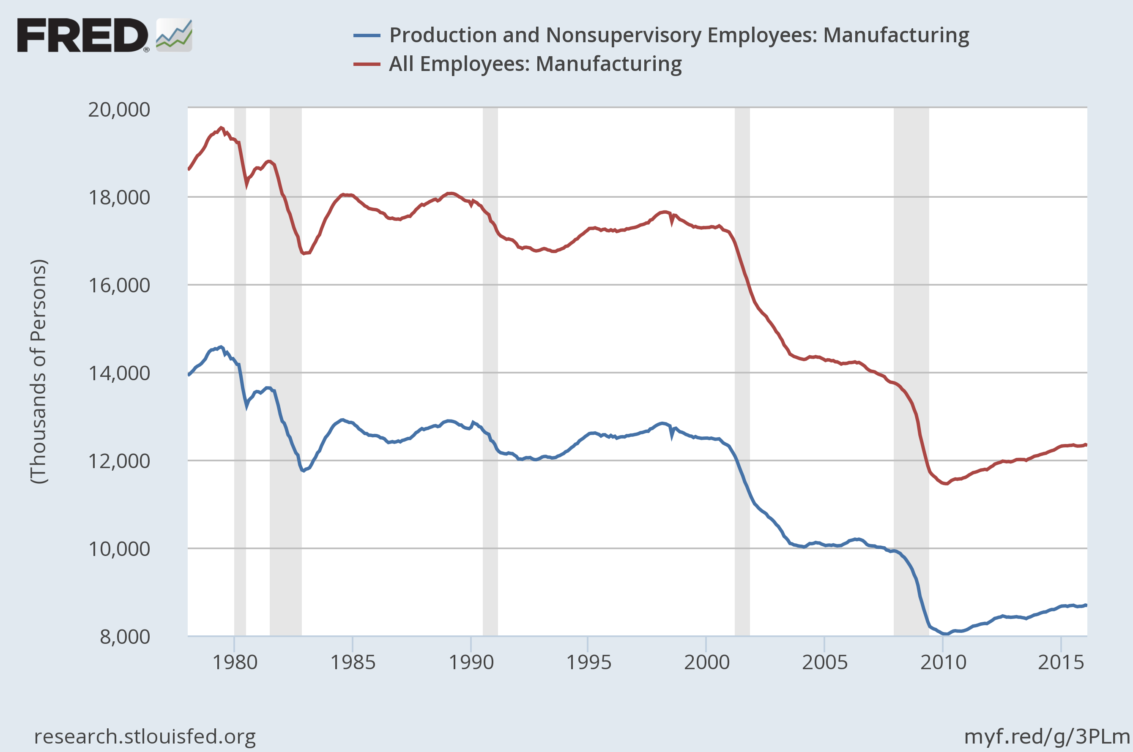
Manufacturing Employment: (M01 1978-M02 2016)
Reagan 1980-88
G.W. Bush
2001-2008
G.H.W. Bush
1989-1992
Clinton
1993-2000
B. Obama 2009-2016
Notes:
Production and Nonsupervisory Employees: Manufacturing Production and related employees include working supervisors and all nonsupervisory employees (including group leaders and trainees) engaged in fabricating, processing, assembling, inspecting, receiving, storing, handling, packing, warehousing, shipping, trucking, hauling, maintenance, repair, janitorial, guard services, product development, auxiliary production for plant's own use (for example, power plant), recordkeeping, and other services closely associated with the above production operations.#Nonsupervisory employees include those individuals in private, service-providing industries who are not above the working-supervisor level. This group includes individuals such as office and clerical workers, repairers, salespersons, operators, drivers, physicians, lawyers, accountants, nurses, social workers, research aides, teachers, drafters, photographers, beauticians, musicians, restaurant workers, custodial workers, attendants, line installers and repairers, laborers, janitors, guards, and other employees at similar occupational levels whose services are closely associated with those of the employees listed.The series comes from the 'Current Employment Statistics (Establishment Survey)'The source code is: CES3000000006 Source: US. Bureau of Labor Statistics Release: Employment Situation All Employees: Manufacturing The series comes from the 'Current Employment Statistics (Establishment Survey)'The source code is: CES3000000001 Source: US. Bureau of Labor Statistics Release: Employment Situation

Slide 16
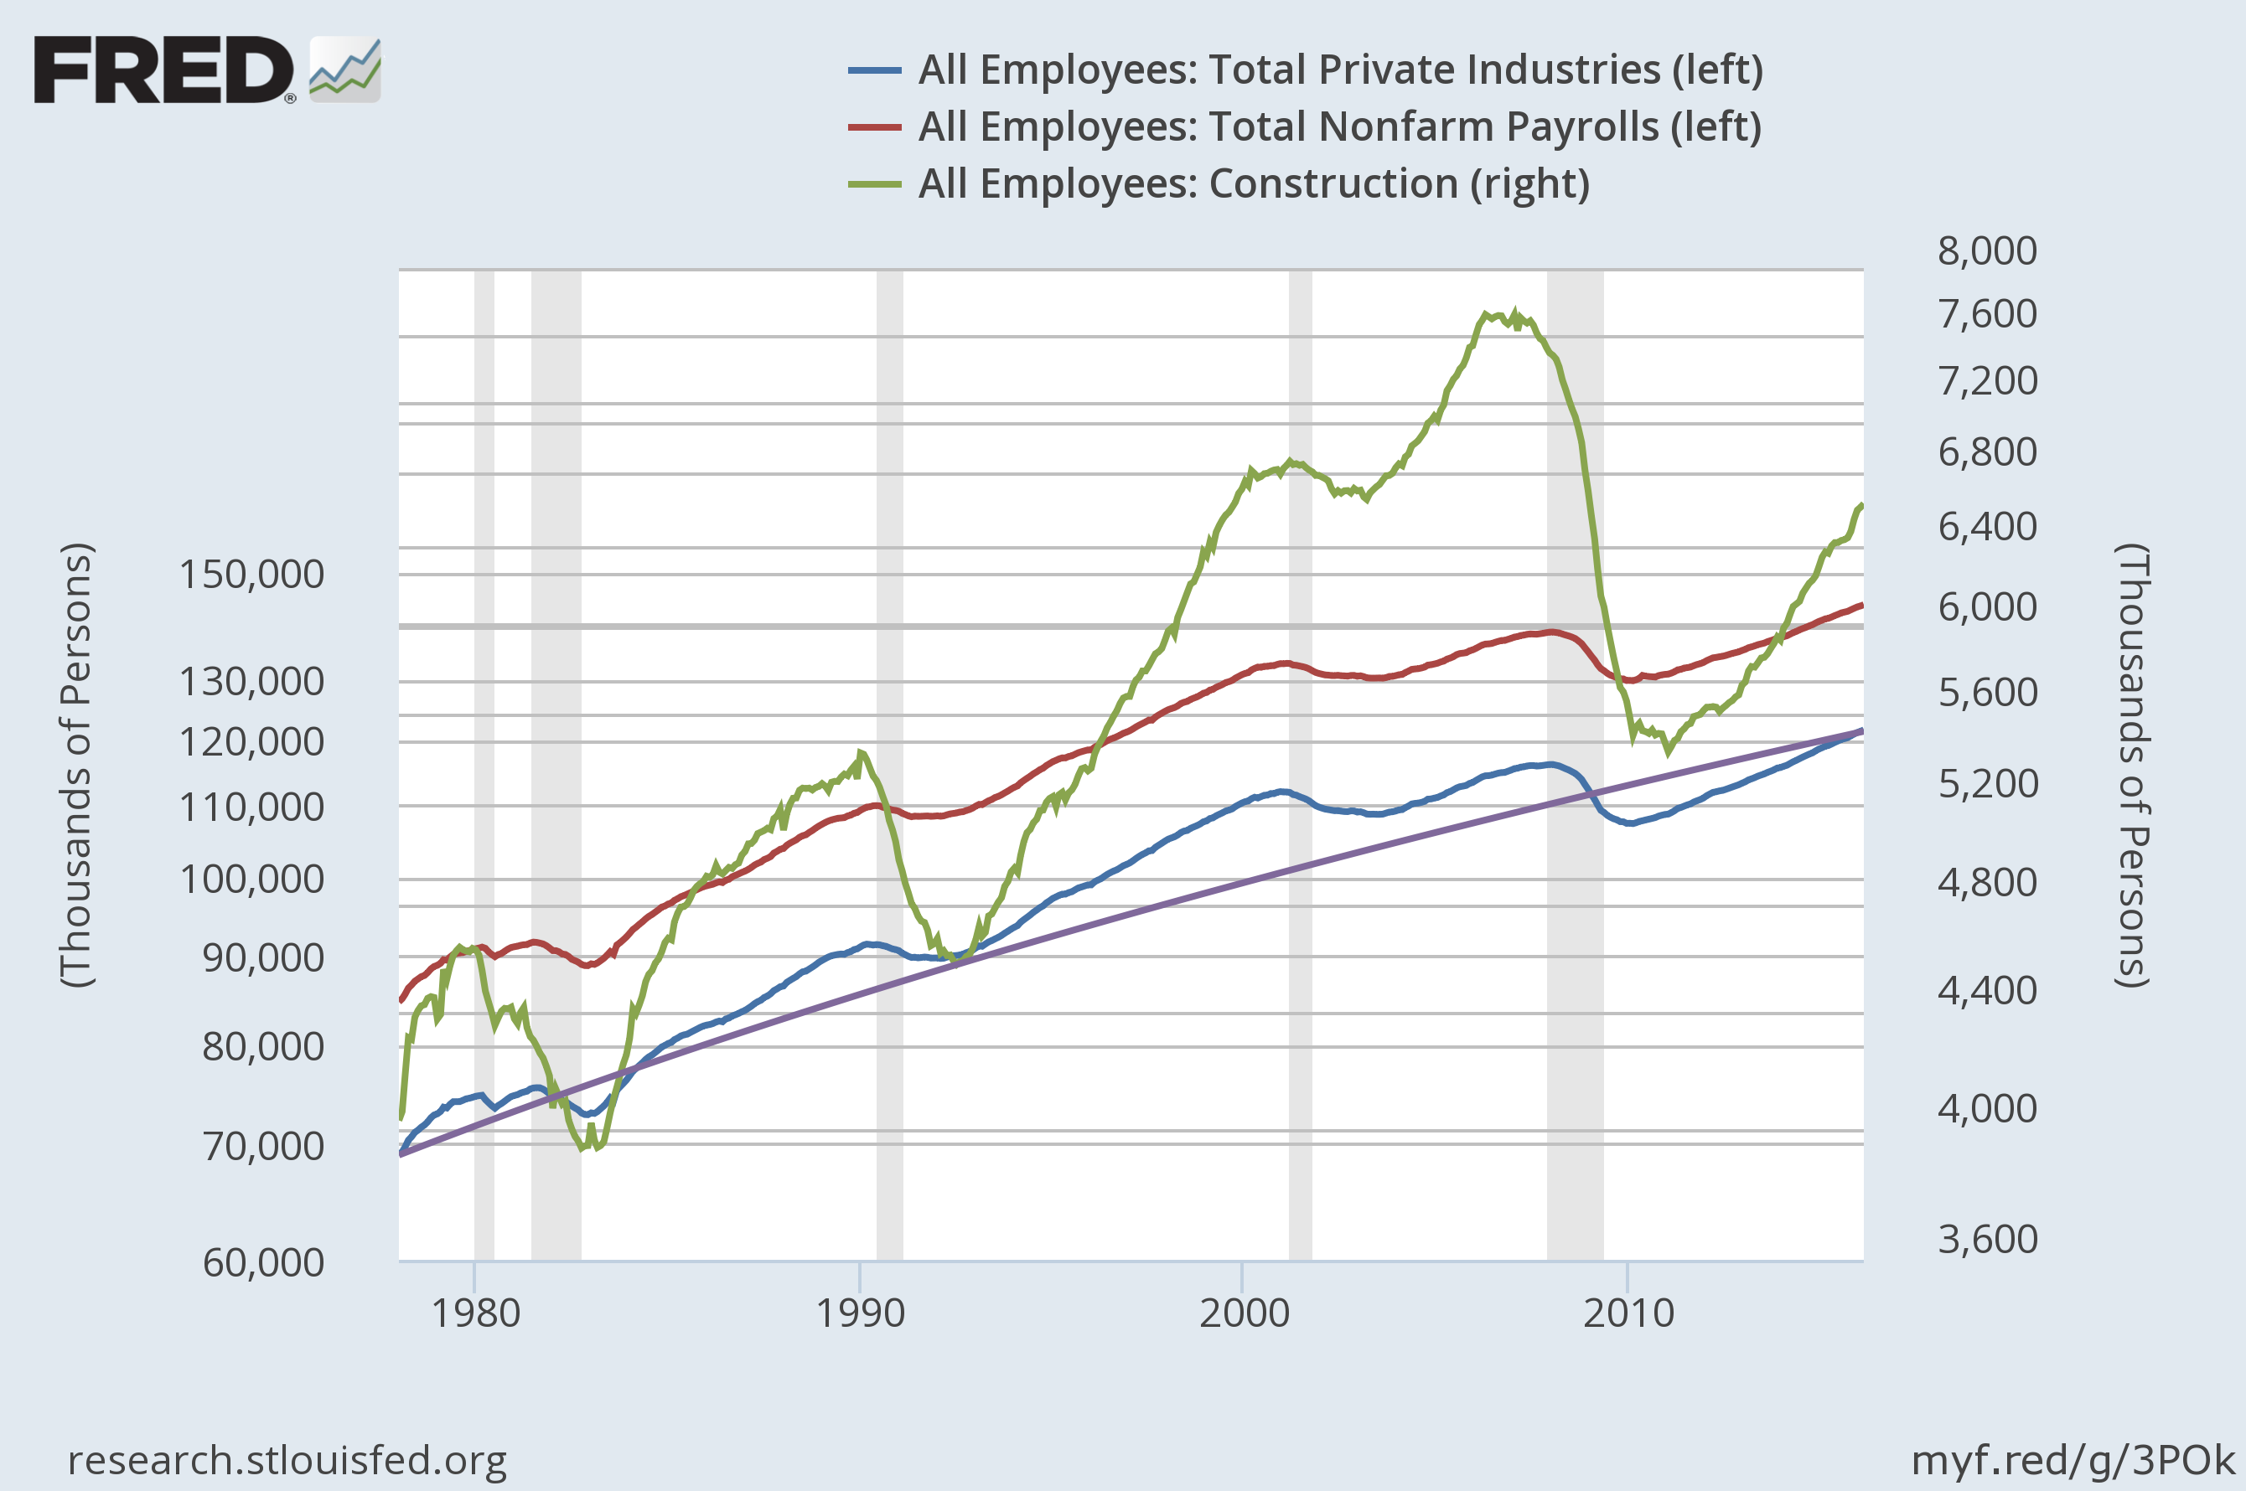
Nonfarm Employment Logarithmic Scales
Clinton
1993-2000
B. Obama 2009-2016
G.H.W. Bush
1989-1992
Reagan 1980-88
G.W. Bush
2001-2008
Notes:
All Employees: Total Private Industries The series comes from the 'Current Employment Statistics (Establishment Survey)'The source code is: CES0500000001 Source: US. Bureau of Labor Statistics Release: Employment Situation All Employees: Total Nonfarm Payrolls All Employees: Total Nonfarm, commonly known as Total Nonfarm Payroll, is a measure of the number of U.S. workers in the economy that excludes proprietors, private household employees, unpaid volunteers, farm employees, and the unincorporated self-employed. This measure accounts for approximately 80 percent of the workers who contribute to Gross Domestic Product (GDP). This measure provides useful insights into the current economic situation because it can represent the number of jobs added or lost in an economy. Increases in employment might indicate that businesses are hiring which might also suggest that businesses are growing. Additionally, those who are newly employed have increased their personal incomes, which means (all else constant) their disposable incomes have also increased, thus fostering further economic expansion. Generally, the U.S. labor force and levels of employment and unemployment are subject to fluctuations due to seasonal changes in weather, major holidays, and the opening and closing of schools. The Bureau of Labor Statistics (BLS) adjusts the data to offset the seasonal effects to show non-seasonal changes: for example, women's participation in the labor force; or a general decline in the number of employees, a possible indication of a downturn in the economy. To closely examine seasonal and non-seasonal changes, the BLS releases two monthly statistical measures: the seasonally adjusted All Employees: Total Nonfarm (PAYEMS) and All Employees: Total Nonfarm (PAYNSA), which is not seasonally adjusted. The series comes from the 'Current Employment Statistics (Establishment Survey)' The source code is: CES0000000001 Source: US. Bureau of Labor Statistics Release: Employment Situation All Employees: Construction Construction employees in the construction sector include: Working supervisors, qualified craft workers, mechanics, apprentices, helpers, laborers, and so forth, engaged in new work, alterations, demolition, repair, maintenance, and the like, whether working at the site of construction or in shops or yards at jobs (such as precutting and preassembling) ordinarily performed by members of the construction trades.The series comes from the 'Current Employment Statistics (Establishment Survey)'The source code is: CES2000000001 Source: US. Bureau of Labor Statistics Release: Employment Situation

Slide 17
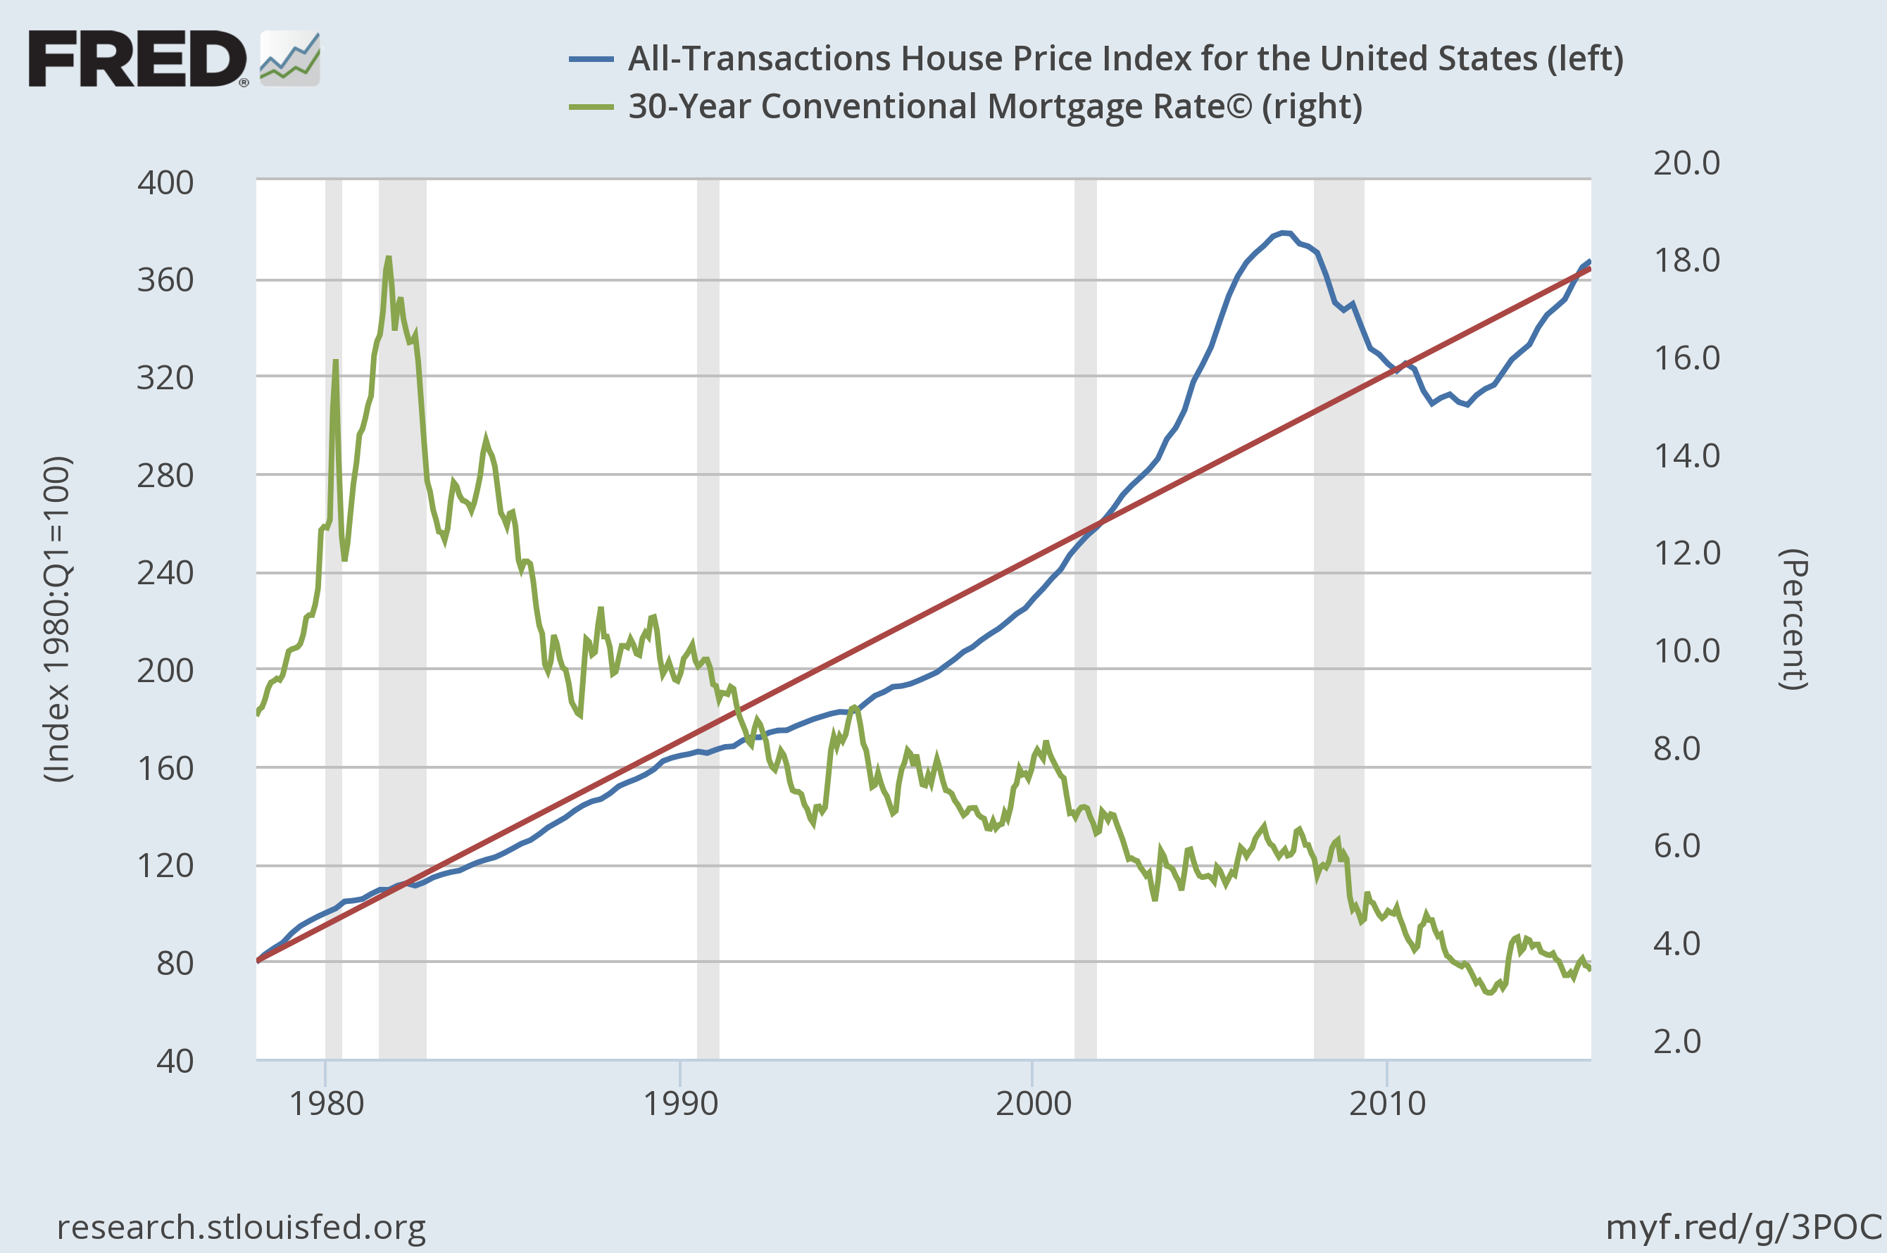
House Price Index and 30-year Mortgage Rate (Index value and %; Q1 1978 to Q4 2015)
Reagan 1980-88
Clinton
1993-2000
B. Obama 2009-2016
G.H.W. Bush
1989-1992
G.W. Bush
2001-2008
Notes:
All-Transactions House Price Index for the United States Estimated using sales prices and appraisal data. Source: US. Federal Housing Finance Agency Release: House Price Index 30-Year Conventional Mortgage Rate© Contract interest rates on commitments for fixed-rate first mortgages. Source: Primary Mortgage Market Survey data provided by Freddie Mac. Copyright, 2014, Freddie Mac. Reprinted with permission. Source: Board of Governors of the Federal Reserve System (US) Release: H.15 Selected Interest Rates

Slide 18
Federal Government Consumption Expenditures and National Defense Contribution to GDP
Reagan 1980-88
G.W. Bush
2001-2008
G.H.W. Bush
1989-1992
Clinton
1993-2000
B. Obama 2009-2017

Slide 19
Real Nonresidential Fixed Investment and by Domestic Business
Reagan 1980-88
G.H.W. Bush
1989-1992
G.W. Bush
2001-2008
B. Obama 2009-2016
Clinton
1993-2000

Slide 20
Interest Rates and Personal Consumption Expenditure Inflation: (1978- 2016)
Reagan 1980-88
G.H.W. Bush
1989-1992
Clinton
1993-2000
G.W. Bush
2001-2008
B. Obama 2009-2016

Slide 21
Interest Rates and Personal Consumption Expenditure Inflation: (1978- 2016)
Reagan 1980-88
G.H.W. Bush
1989-1992
Clinton
1993-2000
G.W. Bush
2001-2008
B. Obama 2009-2016

Slide 22
The End
Thank you

