Slide 1
The History of Protest Music Class 4: Current issues and songs
Jim Dunphy
dunphyjj@aol.com

Slide 2
More recent songs
Address a multitude of issues
Anti war and civil rights remain issues
However, other issues have come to the fore
Police/minority relations
Hunger
International conflicts
Free expression

Slide 3
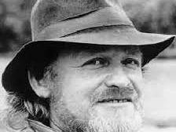
Eric Bogle
b. September 23, 1944

Slide 4
Eric Bogle
Born in Scotland, and after dropping out of school at age 16, worked in a variety of trades
Moved to Australia at age 25
Was involved in a number of bands, and settled in the folk scene in Canberra, Australia’s capital
Many of his songs deal with war and conflict, including “the Troubles” in Northern Ireland

Slide 5
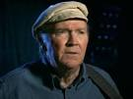
Liam Clancy
September 2, 1935 – December 4, 2009

Slide 6
Liam Clancy
Was part of the Clancy Brothers group (with brothers Paddy and Tom) with Tommy Makem
Famous for traditional and Irish rebel songs
The group was one of the most popular during the folk revival of the early 1960’s
Had a number one hit in 1976 with “And the Band Played Waltzing Matilda”
Liam was the last surviving member of the group.

Slide 7
And the Band Played Waltzing Matilda
https://www.youtube.com/watch?v=NA961ER34Co

Slide 8
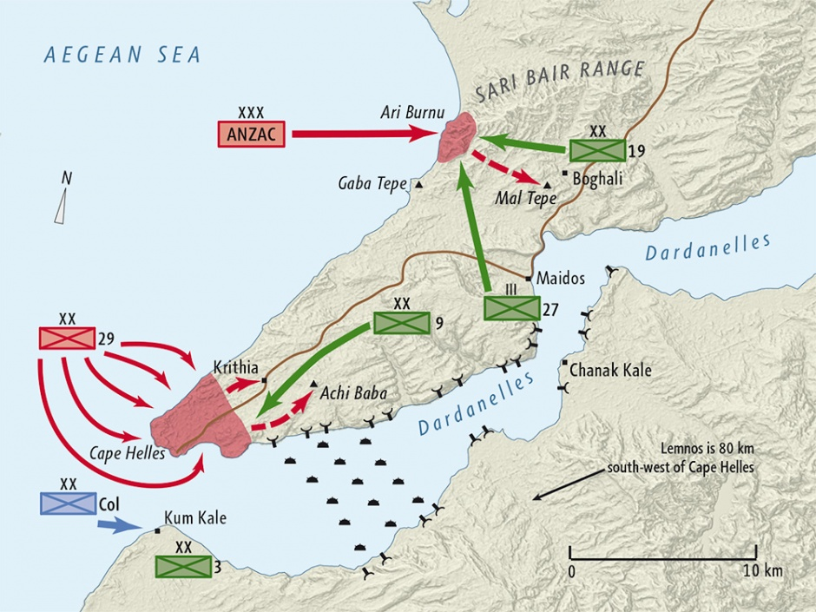
And the Band Played Waltzing Matilda
Churchill wanted to open a new front
Idea was to force the Dardanelles open from the Mediterranean to the Black Sea

Slide 9
And the Band Played Waltzing Matilda
A naval attempt to force the Straits failed
No plans were made for a land invasion, but after the naval failure, that was the only option
The ANZAC landed unprepared on April 25, 1915
This date is still celebrated in Australia and New Zealand as ANZAC Day

Slide 10
And the Band Played Waltzing Matilda
The Turkish forces were well dug in
After months of fruitless attempts to root them out, the troops were withdrawn in January 1916
Many Australians and New Zealanders still believe their troops were squandered by British leaders

Slide 11
And the Band Played Waltzing Matilda
Australian casualties – 8,700 killed, 19,400 wounded
NZ casualties – 2,700 killed, 4,700 wounded
WWI Australia population – 4.9 million, NZ – 1.1 million
With US population of 323 million, equivalents would be:
Australia deaths – 573,500
NZ deaths – 792,800
US deaths in all 20th century wars – 615,600

Slide 12
And the Band Played Waltzing Matilda
Bogle sang the song first in a competition, and after he finished there was dead silence and then thunderous applause
Sung every April 25 at ANZAC Day celebrations
Was voted one of the top 30 Australian songs of the 20th Century

Slide 13
And the Band Played Waltzing Matilda
Song uses as its theme the unofficial anthem of Australia “Waltzing Matilda”
Contrast between the proud sendoff and the forgotten return
When the old man is watching the parade, he is asking the same question as Country Joe did “what are we fighting for?”
And, like Country Joe, the narrator states “I ask myself the same question.”

Slide 14
And the Band Played Waltzing Matilda
In a 2009 interview, Bogle said
“I wrote it as an oblique comment on the Vietnam War which was in full swing… but while boys from Australia were dying there, people had hardly any idea where Vietnam was.”
“Gallipoli was a lot closer to the Australian ethos – every school kid knew the story, so I set the song there.”

Slide 15
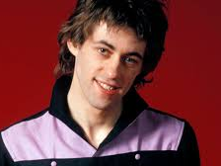
Bob Geldof
B. October 5,1951

Slide 16
Bob Geldof
Born in Ireland, and worked in a number of trades
Moved to Canada, where among other things, hosted a children’s TV program
Returned to Ireland in 1975 and formed the Boomtown Rats, a punk group
Had a number of hits with that group

Slide 17
Bob Geldof
Called out a group of nuns on a TV program, bringing an end to the Boomtown Rats
Started a solo career in 1986
Played in the Amnesty International event, The Secret Policeman’s Other Ball
Led to Band Aid and Live Aid

Slide 18
Bob Geldof
Since Geldof was born in the Republic of Ireland, he was awarded an Honorary Knight of the British Empire
He is thus entitled to add KBE after his name
But cannot officially be called “Sir”
Not prevented him from the unofficial name of “Sir Bob”

Slide 19
Do They Know it’s Christmas?
https://www.youtube.com/watch?v=1AcD7hho9fs

Slide 20
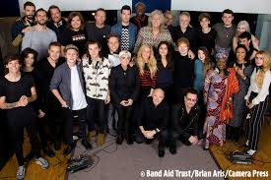
Band Aid
In 1984, Geldof founded Band Aid in response to the hunger crisis in Ethiopia
The song “Do They Know It’s Christmas” was the biggest selling single in UK history
Raised over 8 Million pounds for hunger relief

Slide 21
Band Aid
The 1984 version included:
Bono and Adam Clayton (U2)
Phil Collins
Boy George
George Michael
Simon leBon and other members of Duran Duran
Members of Bananarama
Robert “Kool” Bell and members of Kool and the Gang

Slide 22
Live Aid
Geldof concluded that one of the reasons for the famine in Africa was crushing debt
He organized Live Aid in 1985, with simultaneous concerts in London at Wembley Stadium and Philadelphia at JFK Stadium
Phil Colling played in both, taking the Concorde between the two events
The two concerts were said to have raised almost 50 million pounds

Slide 23
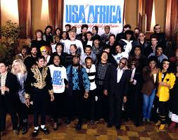
Served as an inspiration for
USA for Africa
Farm Aid

Slide 24
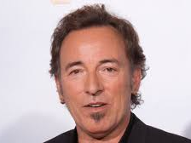
Bruce Springsteen
b. September 23, 1949

Slide 25
Bruce Springsteen
Grew up in Freehold NJ
Poor student, briefly attended Ocean County Community College
Was called for induction in 1965, but was 4F as a result of a concussion
Formed first band in 1965, and in a subsequent 1969 band, worked with many future members of the E Street Band

Slide 26
Bruce Springsteen
Signed a contract with Columbia Records in 1972, and first two albums received critical acclaim did not sell well
Third album, Born to Run, was one of the best selling and most influential albums in history
Became one of the best selling artists, with legendary live shows.

Slide 27
Bruce Springsteen
Considered Elvis Presley, Roy Orbison and Pete Seeger as influences
Released, in 2006, Seeger Sessions, an album of 13 songs either written or popularized by Pete Seeger
Spoke for the common man, who had been overlooked by society.

Slide 28
Bruce Springsteen
As noted, his song, Born in the USA, is the story of a Vietnam vet who comes home to a failing community.
Used (before Springsteen stopped it) by the Reagan campaign as a warm up song.

Slide 29
American Skin (41 shots)
https://www.youtube.com/watch?v=aQMqWAiWPMs

Slide 30
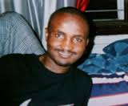
American Skin
In February 1999, NYPD were searching for a serial rapist
They approached Amadou Diallo, who allegedly ran for his building entrance.
When he reached for his pocket, he was shot 41 times, 19 hitting him

Slide 31
American Skin
It turned out that he was reaching for his wallet, and was not the rapist.
The police involved were found not guilty, but the city settled with the family for $3 million
American Skin was written as a reaction to the incident

Slide 32
American Skin
It was never released as a single or on a studio album, but is only available in a live version as a concert album
Police organizations sharply criticized the song
American Skin was written as a reaction to the incident

Slide 33
American Skin
Springsteen later wrote that the song, while critical, tried to be balanced
The first verse is from the policeman’s perspective
Received an award from the NAACP for the song

Slide 34
From Cop Killer to Katrina to Black Lives Matter
Recent protest music from the black community has turned more hostile, based on the failure to receive complete equality
The optimistic music of the civil rights era has changed to cynicism and pessimism

Slide 35
From Cop Killer to Katrina to Black Lives Matter
For many of these artists, they had to establish their career before they could turn political
For example, both Beyonce and Kendrik Lamar had multiple hit records before “Formation” and “To Pimp a Butterfly”

Slide 36
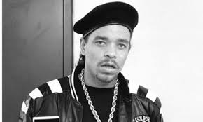
Cop Killer
Cop Killer was released in 1992, by the rap group Body Count
The lyrics were by lead singer Ice T and music by the group’s lead guitarist Ernie C.
The record was a middling seller until it came under criticism by many police organizations and others, including VP Dan Quayle

Slide 37
Cop Killer
In the introduction to the song, Ice T sets out all of the abuses he claims police have done, and sets up the rest of the song as justifiable.
The grieving of police families is no different from the grieving of families of those killed by the police

Slide 38
Cop Killer
After public protests and complaints from stockholders, Warner Brothers withdrew the record, and it has never been released.
Ice T later noted that he was playing a character, and if you believe him to be a cop killer, then you must believe that David Bowie is an astronaut

Slide 39
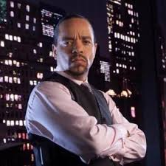
Cop Killer
Ironically, Ice T is probably best known now as Detective Finn Tutola in the long running TV series, Law and Order: Special Victims Unit

Slide 40
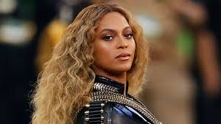
Formation
Formation is the most explicitly political song of Beyonce’s career
Debuted when she guest starred in Coldplay’s 2016 Super Bowl halftime show

Slide 41
Formation
https://www.youtube.com/watch?v=WDZJPJV__bQ

Slide 42
Formation
Images in the video harken back to Katrina, which many blacks think that the federal government did not provide sufficient assistance because the affected population was poor and black
Also show images of a slave south, although with black images as the master class

Slide 43
Formation
In an aside, Beyonce talks about her “Jackson Five nose” making reference to Michael Jackson’s nose before multiple plastic surgeries
Images of police cars going under water have been interpreted as anti police.
Beyonce later said “anyone who perceives my message as anti-police is completely mistaken…. But let's be clear: I am against police brutality and injustice. Those are two separate things.”

Slide 44
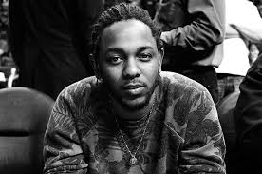
Kendrick Lamar
Lamar’s album, To Pimp a Butterfly, touches on many of the themes noted:
Police brutality and killings
Imprisonment
After affects of slavery
Oppression of blacks, particularly young men

Slide 45
To Pimp a Butterfly
The lead song from this album, Alright, has been called “a modern black national anthem.”
In the video for this song, the singer is first seen lying on the ground, surrounded by police.
In a flashback, he is shown being shot by the police.
His spirit is then shown as flying over his hometown of Oakland, showing the depressed area and both the hope and despair of the black inhabitants.

Slide 46
To Pimp a Butterfly
The song makes frequent use of the N word, particularly in the chorus, where it is said, “n, we goin’ be alright.”
Reflecting on the death of blacks by police, he cries out “And we hate Popo, wanna kill us dead in the street for sure”
The singer’s spirit is shown on a lamppost after seeing all of his town and is shot and killed by the police, silencing his voice

Slide 47
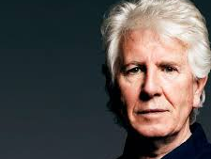
Graham Nash
b. February 2, 1942

Slide 48
Graham Nash
Born away from his hometown because of evacuation during the Blitz
First was a member of the Hollies, a band later inducted in the Rock and Roll Hall of Fame
Left the band in 1969 to form Crosby, Still and Nash (and later and Young)

Slide 49
Graham Nash
After the initial breakup of CSNY, paired up with Crosby, reunited with Hollies and reunited with CSNY
Always was the most political of the group, and continued in recent CSNY tours
Is an accomplished photographer
Is an officer of the Order of the British Empire for music and charitable works

Slide 50
Almost Gone (The Ballad of Bradley Manning)
https://www.youtube.com/watch?v=ywFTvC3JUKY

Slide 51
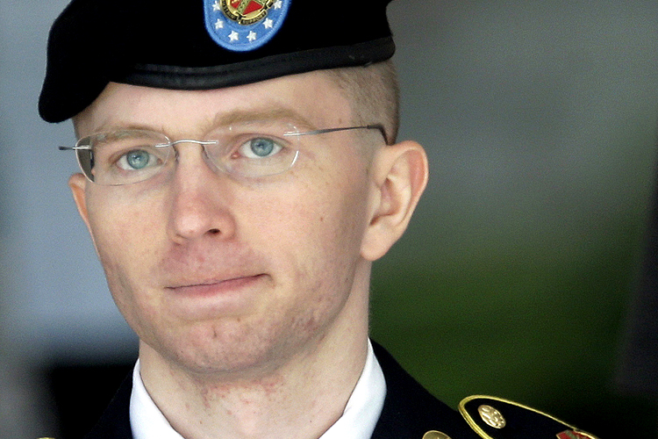
Almost Gone
Bradley Manning released about 750,000 documents to Wikileaks
Was arrested and charged under the Espionage Act
At Court Martial, was found guilty and sentenced to 35 years

Slide 52
Almost Gone
In prison, transitioned to female and now goes by the name Chelsea Manning
Just before the end of his term, President Obama commuted Manning’s sentence
However, he did not pardon or exonerate Manning.

Slide 53
Almost Gone
Written by Nash and James Raymond, the son of David Crosby
Nash stated he considered Manning a hero
“making public…true number and causes of civilian casualties in Iraq…human rights abuses by US funded contractors…role spying and bribery plays in international diplomacy.”
Nash further criticized President Obama for stating that Manning “had broken the law,” which precluded a fair trial

Slide 54
Almost Gone
The title comes from a statement by Manning’s lawyer, who, when asked about Manning’s mental state, said it was “almost gone.”
Nash argues in the song that what Manning did was “tell the truth” and that he “did his duty to his country first.”
You can tell from the video that this song is not always popular when done live

Slide 55
Other songs
USA for Africa We are the World
U2 In the Name of Love
Green Day American Idiot

Slide 56
Bonus Track
In 2003, Christopher Guest wrote, directed and starred in A Mighty Wind, a homage to the folk revival
The plot was a memorial concert to one of the key producers of the folk revival
Three groups were involved – all of them based on folk revival bands
2013’s Inside Llewyn Davis was a more serious look at the folk revival

Slide 57
Bonus Track
The New Main Street Singers – The New Christy Minstrels
The Folksmen – The Kingston Trio, The Limelighters
Mitch and Mickey – Ian and Sylvia, Richard and Mimi Farina
And now, with all three groups, the finale of the concert – A Mighty Wind!

