Slide 1
The Lincoln Assassination: Facts, Fiction and Frankly Craziness Class 4: The Lincoln Assassination in Culture
Jim Dunphy
dunphyjj@aol.com

Slide 2
This class
Books – fiction and non fiction
Movies/TV shows
Comic books (?)

Slide 3
Books
Make sure you picked up the bibliography available as a handout

Slide 4
Books – fiction

Slide 5
Hanging Mary
Fictional account of Mary Surratt, told through the eyes of a fictional boarder
Come away with the idea that the Surratt boarding house was the HQ of the plot, but Mary’s guilt is a little more problematic
If there is a villain in the piece, it is her son John for abandoning her.

Slide 6
The Impeachment of Abraham Lincoln
“What if” book in which Lincoln survives the assassination attempt
His “let ‘em up easy” philosophy comes into conflict with the Radical Republicans (in a way like Andrew Johnson’s)
As a result, he ends up being impeached, and the result is….
(I guess you’ll have to read the book)

Slide 7
Henry and Clara
Story of MAJ Rathbone and Clara Harris through their childhood and married life, with emphasis on the events of April 14
Mallon makes the case that Rathbone was suffering from a 19th century version of PTSD, both from the war and the assassination
To a large extent, their lives were “stranger than fiction” so the novel reads like a novel, even when true

Slide 8
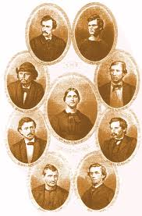
Books – non fiction

Slide 9
Manhunt
Probably the best single volume on the assassination
While mainly concerned with the escape and pursuit, does go into the assassination itself.
Very easy read – as compared to other books which tend to be academic

Slide 10
The Lincoln Assassination Encyclopedia
The one book to have next to you while you are reading any of the other assassination books
Copiously illustrated, all of the major (and a lot of the minor) characters in the story are here
Only drawback – very limited before and after information about the people discussed
Of course, if there were, the book might have reach a thousand pages.

Slide 11
Lincoln Murder Conspiracies
Effectively debunks all of the nonsense we discussed in Class 3, particularly the Stanton conspiracy
Well organized and an easy read
Although over 30 years old, remains the final word on the subject

Slide 12
American Brutus
Kauffman is one of the leading scholars of the assassination (and who I met while he was leading a Surratt Society Booth escape tour)
Not many new revelations in this book, but deep in color and background
Kauffman sees Booth as a master manipulator – which does not exonerate the other conspirators

Slide 13
Fortune’s Fool
Alford is a Professor of History at NVCC
His biography is probably the last word on a person who only lived to be 26
In depth review of his acting career, which often gets short shrift in studies of the assassination
Winner and finalist for a number of book awards

Slide 14
The Assassin’s Accomplice
Used as the basis for the movie The Conspirator (more about that later)
Looks at the assassination through the lens of Mary Surratt
Conclusion is that Mary Surratt was actively involved in the plot
But it is less definitive that she deserved execution

Slide 15
Alias Paine
Ownsbey has created, in the absence of any other biography, what will probably be the last word on Lewis Powell
While she does have a good deal of documentation, she does have to resort to conjecture on someone who, but for his part in the assassination, would have been long forgotten about.

Slide 16
His Name is Still Mudd
Edward Steers, one of the foremost Lincoln assassination writers (see below) clearly refutes the “innocent doctor” theory

Slide 17
His Name is Still Mudd
Steers concludes that Mudd
Knew Booth and was involved in the kidnap plot
Could not have failed to recognize him on the night of April 14-15
While might not have known of the assassination at that time, clearly did before Booth left and then lied to authorities to give Booth a head start
Thus, Steers finds that Mudd’s conviction was appropriate.

Slide 18
Chasing Lincoln’s Killer
Young adult version of Manhunt
Good first book on the Lincoln Assassination for tweens

Slide 19
The Day Lincoln Was Shot
By far the oldest book on the list – originally published in 1955
Bishop was a newspaper reporter, and literally goes hour by hour on April 14, 1865
More what and when than how and why.

Slide 20
Blood on the Moon
Steers, along with Swanson and Kauffman, are probably the leading contemporary writers on the Lincoln assassination
Written before Manhunt and American Brutus, debunks some of the more out there conspiracy theories.
Good on Mudd and the Confederate activity in MD

Slide 21
Come Retribution
This volume revives the Confederate grand conspiracy
It does prove that Booth was working with the Confederate Secret Service in Canada on the kidnap plot
While there were interactions after the kidnap plot collapsed, the connection between the Confederates and the assassination still falls in the not proven category.

Slide 22
Backstage at the Lincoln Assassination
An excellent introduction to the general world of theater in the mid 19th century and the events at Ford’s
All of the principal characters – Keene, Hawk, Spangler are here, along with the Ford brothers and countless others
One finishes the book with an excellent understanding of how theater worked, and why Booth plotted the assassination for a theater.

Slide 23
The Lincoln Assassination Riddle
A series of essays about different aspects of the assassination, manhunt and trial
Presupposes a basic knowledge of the assassination
Most of the materials on the limitations of the defendants to testify in their trial came from here.

Slide 24
Assassination Vacation
Last of the legitimate books – put here for a reason
Plot is the author (along with her sister and nephew) visit sites from, among others, the Lincoln, Garfield, McKinley and Kennedy assassinations
If you were going to bring one Lincoln assassination book to the beach, this would be the one
Vowell has written a number of other books about American History which are all recommended.

Slide 25
The Lincoln Conspiracy
The last book in this presentation and in actual historical usefulness
As noted in Class 3, tried to revive the Stanton theory, only to put a final stake in its heart
Useful reading only to show what bad history looks like.

Slide 26
For the digitally inclined
In this day and age, books are not the only source of information
There are a gazillion websites out there with information about the Lincoln Assassination
Let’s look at the best of the best

Slide 27
Boothie Barn
Run by a local husband/wife team
Dave Taylor is a local elementary school teacher and tour guide
His wife Kate is a docent at the Mudd House (where they had their reception!)
Can be reached at boothiebarn.com

Slide 28
Roger J Norton
There are two site Norton runs – the first is a more traditional historical research one
There is a general Lincoln and one specifically on the assassination
Reached at http://rogerjnorton.com/Lincoln.html

Slide 29
Roger J Norton
The second is a discussion forum
Again, there are general Lincoln forums and one specifically on the assassination
Reached at http://rogerjnorton.com/LincolnDiscussionSymposium/forum-5.html

Slide 30
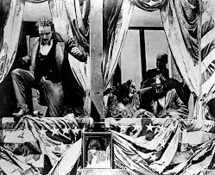
Movies/TV

Slide 31
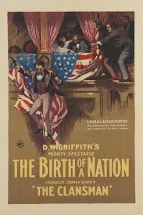
Birth of a Nation (1915)
One of the earliest depiction of the assassination in film
Check out how Booth is portrayed
Typical of silent movies, the scenery chewing is astonishing
Of course, Birth is better known for its virulent racism than for its portrayal of the assassination

Slide 32
Birth of a Nation – Assassination
https://www.youtube.com/watch?v=JOe_s-zoMkE

Slide 33
Birth of a Nation (1915)
Not surprisingly, given Griffith’s background in theater, the action on stage is historically accurate
Lord Dundreary is correctly portrayed with his whiskers
The action on stage is correct – Asa Trenchard saying…..

Slide 34
The Conspirator (2010)
We will be showing two extended scenes from this movie
First, the assassination
Second, the hanging of the conspirators
These scenes, helped by among others, the Surratt Society, are probably the most realistic and historically accurate examples of the events .

Slide 35
The Conspirator – The Assassination
https://www.youtube.com/watch?v=VI-k593OFtM

Slide 36
The Conspirator – The Executions
https://www.youtube.com/watch?v=wDJuv0x1wEo

Slide 37
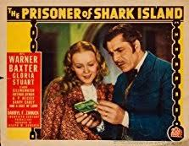
Dr. Mudd Movies – Shark Island
There are also a number of movies on Dr. Mudd, all of which are sympathetic (and I would argue wrong) on the history
The first was the 1936 film The Prisoner of Shark Island, starring Warner Baxter as Dr. Mudd
Not surprising the slant of the movie, since it was based on The Life of Dr. Mudd, by Nettie Mudd Monroe, the Dr.’s daughter

Slide 38
Dr. Mudd Movies – Shark Island
Starring Warner Baxter and Dr. Mudd and Gloria Stuart as his wife (what 1997 role would she be most remembered for?)
The title card, to the tune of “Maryland, My Maryland” stated
As a nation we must acknowledge the injustice visited on one of the most unselfish and courageous men in American history
And signed by George Radcliffe, US Senator from MD

Slide 39
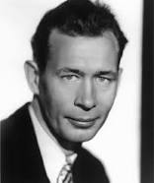
Dr. Mudd Movies – Shark Island
The origin of the movie was when Darryl Zanuck read an article about the restoration of Ft. Jefferson, and asked writer Nunnally Johnson (r) if there was a picture there
Johnson read Lloyd Lewis’ Myths after Lincoln, and fixed on the Dr. Mudd story

Slide 40
Dr. Mudd Movies – Shark Island
Johnson would later state:
It was 50/50 whether Mudd was innocent or guilty, so I went with innocent
Speaking as a screenwriter, and not a historian!

Slide 41
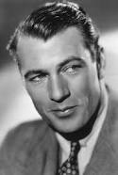
Dr. Mudd Movies – Shark Island
In 1938, two years after the movie came out, it was turned into a radio play
Starring Gary Cooper as Dr. Mudd and Fay Wray (yes, that Fay Wray) as Mrs. Mudd

Slide 42
Dr. Mudd Movies – Shark Island
Since it was live radio, mistakes could not be corrected
So when Coop referred to Booth as Lincoln’s “assistant” not “assassin” that is what the radio audience heard.

Slide 43
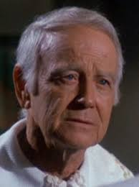
Dr. Mudd Movies – Laramie
In 1962, on the TV program Laramie, Dr. Mudd made another appearance
Played by Lew Ayres, the plot was Dr. Mudd moves west to start a new life (nope) and ends up treating a ranchers son, amputating an arm to save his life (nope again)

Slide 44
Dr. Mudd Movies – Laramie
In a coincidence only possible in TV, the father is the Union officer who arrested Mudd
He and his cronies are about to hang Mudd when the good guys arrive
The saved Mudd plans to move on to SF (nope, nope and nope!)

Slide 45
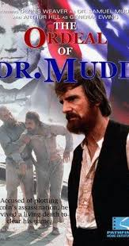
Dr. Mudd Movies
40+ years later, in 1980, Dennis Weaver starred in The Ordeal of Dr. Mudd (and you can guess from the title the slant of the movie)
The plot is that Dr. Mudd was only a simple country doctor doing his duty to an unknown patient, and was then railroaded into prison
The title card states “What you are about to see is a true story.”
NOT!

Slide 46
Television

Slide 47
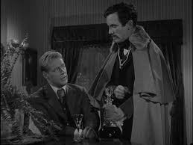
Twilight Zone – Season 2 Back There
Peter Corrigan, a college professor, gets into a discussion about whether events could be changed if time travel were possible
He soon finds himself in DC on April 14, 1865
Trying to warn people of the attempt on Lincoln’s life, he is arrested as a drunk
He is bailed out by a Mr. Wellington, who as he leaves Corrigan, drops a handkerchief with the initials JWB
And then…….

Slide 48
Twilight Zone – Season 2 Back There
After his time travel, where then does Professor Corrigan (aka Russell Johnson) travel?

Slide 49
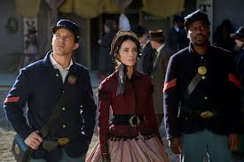
Timeless – Season 1 The Assassination of Abraham Lincoln
The time travelers return to April 1865 to find the bad guy
Only to find the bad guy has teamed up with John Wilkes Booth
They can’t stop the assassination – but do they change history anyhow?

Slide 50
Comics

Slide 51
Comics
Comics have provided both a illustrated version of the assassination
And a fantastical version with superheroes from both DC and Marvel involved with the assassination
So we have facts, fiction and (very much) frankly craziness

Slide 52
Graphic Library – The Assassination of Abraham Lincoln

Slide 53
A Treasury of Victorian Murder– The Murder of Abraham Lincoln

Slide 54
With Malice Towards One Detailed graphic novel

Slide 55
Treasure Chest of Fun and Fact – JFK/Lincoln parallels

Slide 56
Treasure Chest of Fun and Fact –
This was a magazine that was put out by the Catholic Bishops of America
In a later issue, they told the story of the Catholic Dr. Mudd
Any guesses as to their take on Dr. Mudd’s guilt or innocence?

Slide 57
Biography of JW Booth – obviously leading up to the assassination

Slide 58
To Transition
First, as we enter the world of fiction, HORROR!

Slide 59
The why of the assassination – JW Booth born with a crimson claw!

Slide 60
And now….
We leave the realm of facts (well, at least mostly facts) and end up in the realm of SUPERHEROES!

Slide 61
How Lincoln won the Battle of Gettysburg

Slide 62
Jimmy Olsen goes back in time and sleeps through the assassination

Slide 63
Superman saves Lincoln (but only in a parallel universe!)

Slide 64
Superman tries again!

Slide 65
An actor (playing the wrong role) goes back in time

Slide 66
The Flash finds out Lincoln has been assassinated (in 2971)

Slide 67
Scalphunter prevents the assassination – and thwarts Stanton!

Slide 68
Well, maybe the assassination was justified
https://www.youtube.com/watch?v=o4-KfGVsx_8

Slide 69
And as the grand finale – Batman (with an assist from Lincoln himself) thwart Booth
https://www.youtube.com/watch?v=bUjG1HSSaGI

Slide 70
Don’t forget!
Save the date: May 10, 2019
OLLI Lincoln Assassination Field Trip
Head to
Ford’s Theater
House where Lincoln died/Center for Education and Leadership
Lunch at Lincoln’s favorite burger joint, the Hard Rock café

